Slide 1
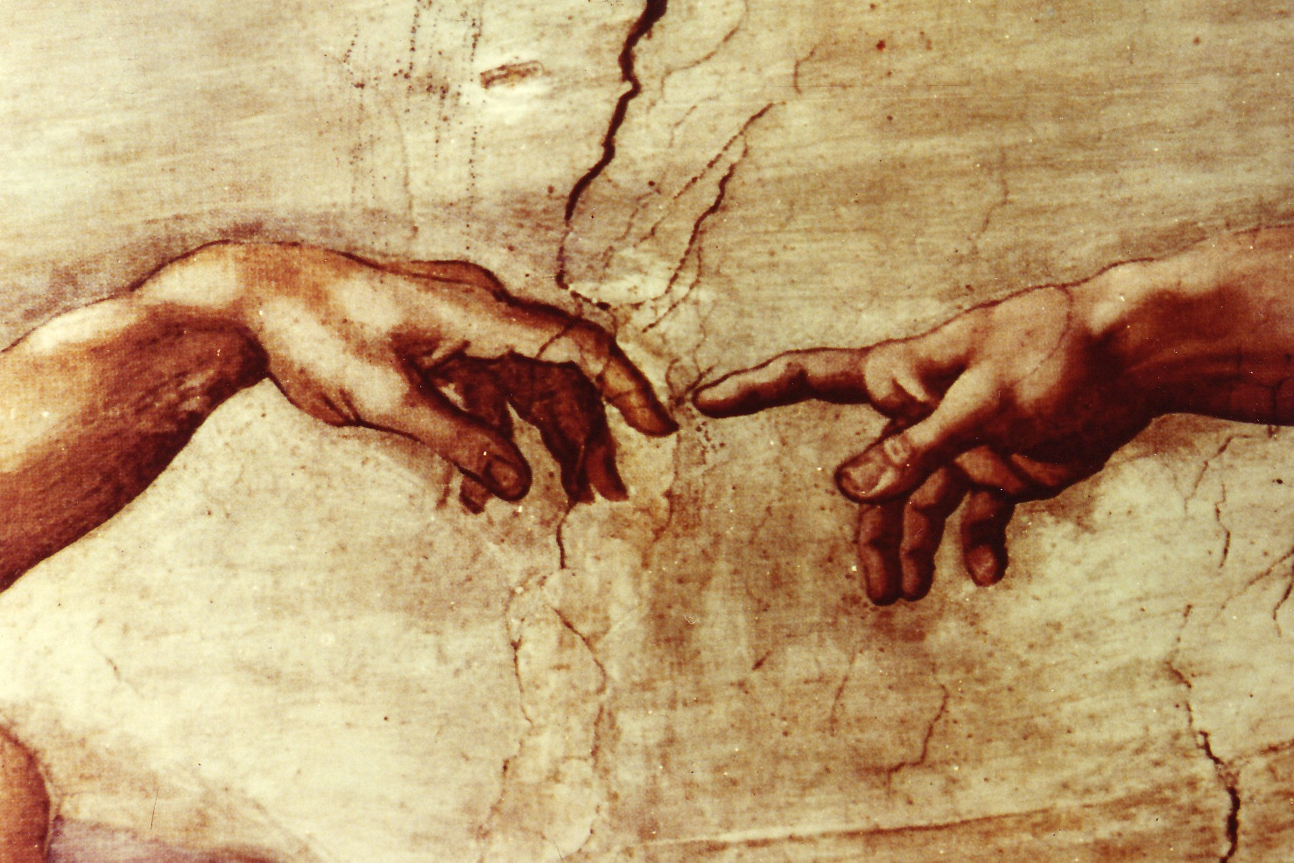

Slide 2
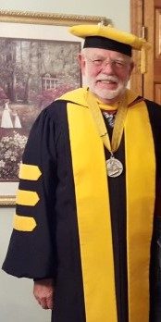
Don Harvey Madison
1945 - 2022

Slide 3
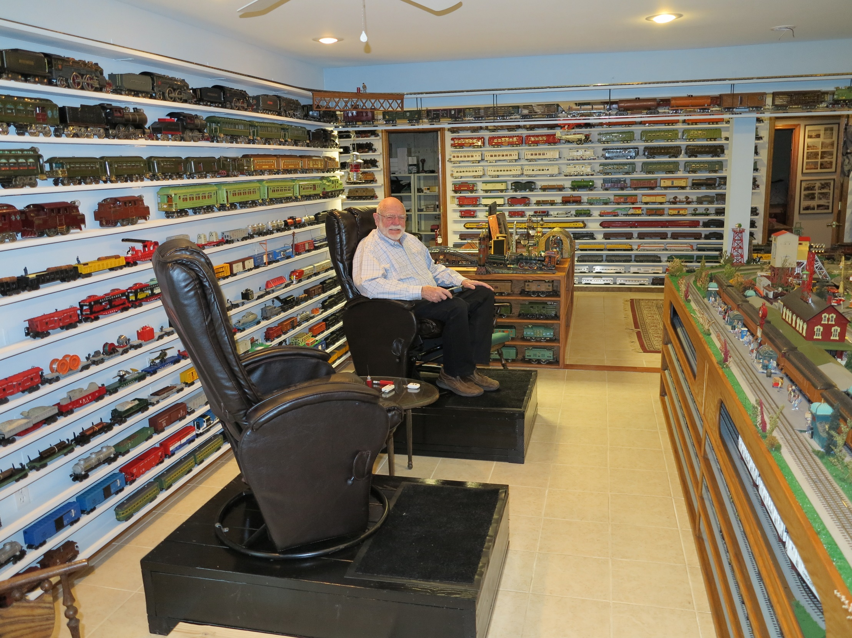
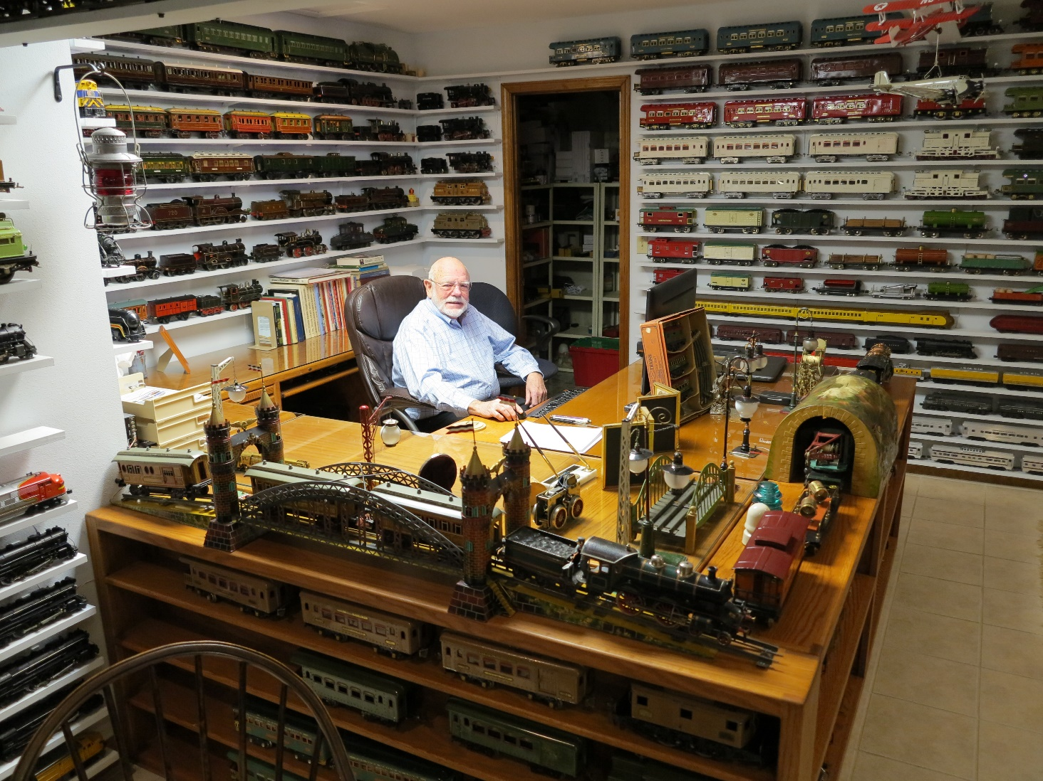
Madison Final

Slide 4


Slide 5
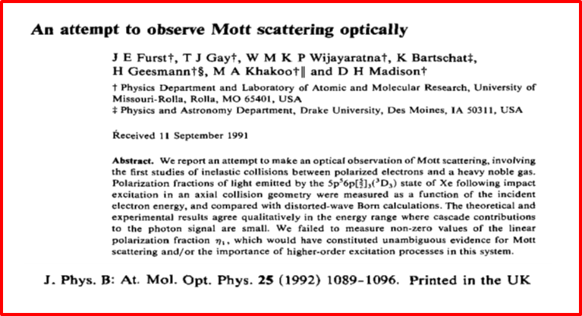
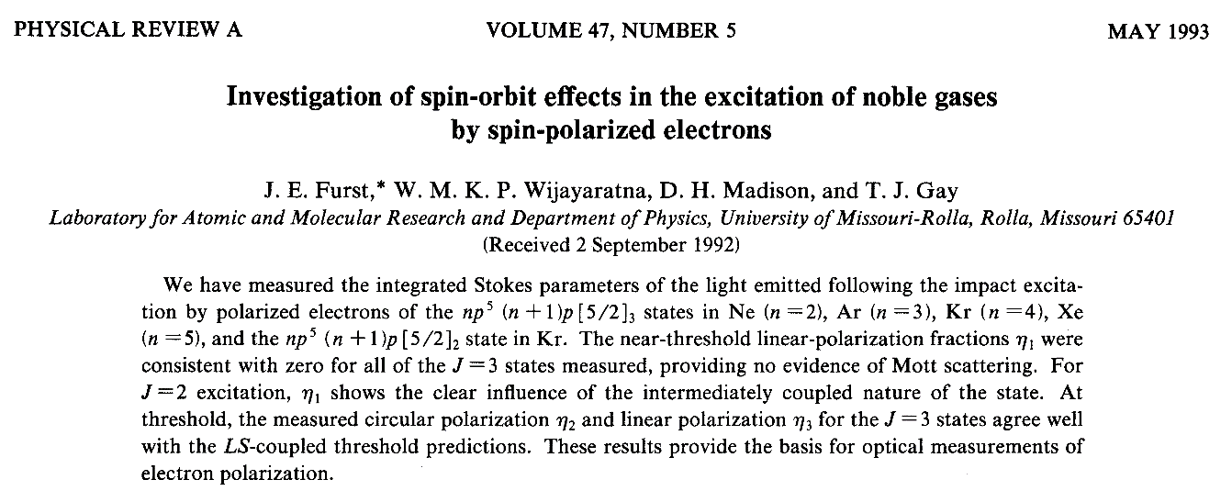

Slide 6


Chiral Electron – Chiral Molecule Collision Dynamics and a Search for Chiral Asymmetry in Secondary Electron Emission from Cysteine
Timothy Gay, Karl Ahrendsen
University of Nebraska – Lincoln
Ken Trantham
University of Nebraska – Kearney
Dale Tupa
LANL

Slide 7
The problem of biological homochirality and the Vester-Ulbricht Hypothesis

Slide 8
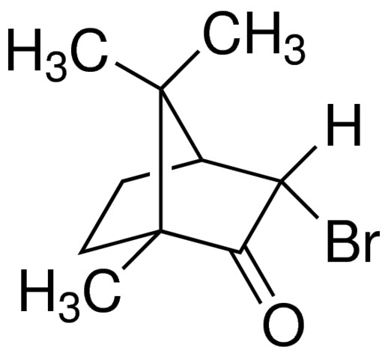
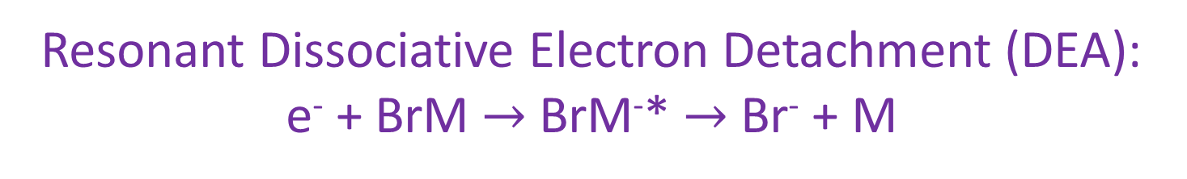
Bromocamphor
“chiral center”
Resonant Dissociative Electron Detachment (DEA):
e⁻ + BrM $→$ BrM⁻* $→$ Br⁻ + M

Slide 9
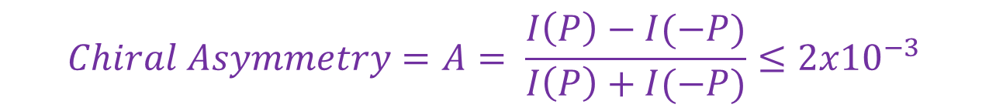
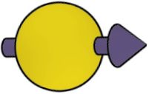
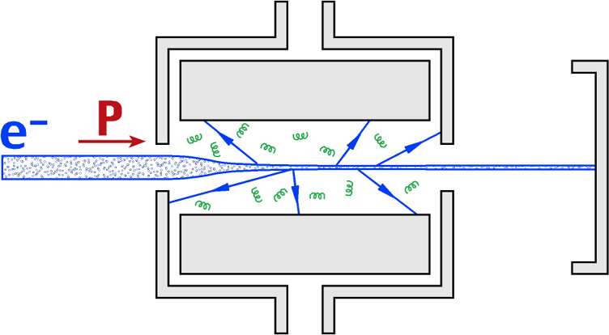
Electron Circular Dichroism in DEA
P_{e}
I(P)
$$Chiral Asymmetry=A= \frac{I\left(P\right)−I(−P)}{I\left(P\right)+I(−P)}≤{2x10}^{−3}$$
Dreiling et al.; PRL 113, 118103 (2014); PRL 116, 093201 (2016); JPBL 21, 21T01 (2018

Slide 10
Electron Circular Dichroism in Transmission
P_{e}
I(P)
Transmission Asymmetry:

Slide 11
Possible Dynamics of DEA Asymmetry
Our results are permitted by symmetry, but what are the dynamics responsible?
Three different models for the enhancement of DEA resonance formation:
Mott/plural scattering (~Z²)
Spin-other-orbit coupling (Z⁰; optical rotation)
“Helicity-density” dynamics (~Z²)
Theoretical challenge: what is the exponent for Z for a given collision channel?

Slide 12
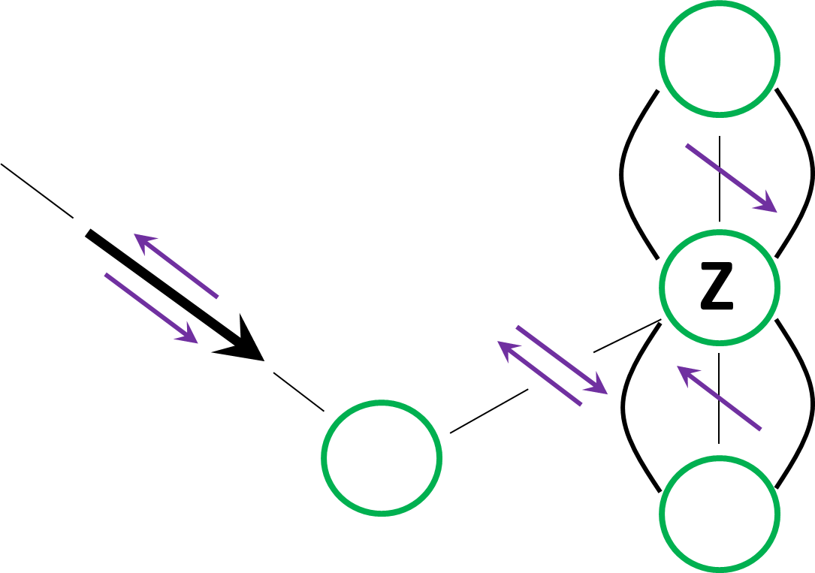
Mott Scattering
Achiral molecule
J. Kessler, J. Phys. B 15, L101 (1982).
R.A. Hegstrom, Nature 297, 643 (1982).
Notes:
Even though we are averaging over an isotropic orientation of chiral molecules, the distribution is not symmetric. For achiral molecules, it would be symmetric, and the lower atom would be there. But for chiral molecules, on average, it is not there.

Slide 13
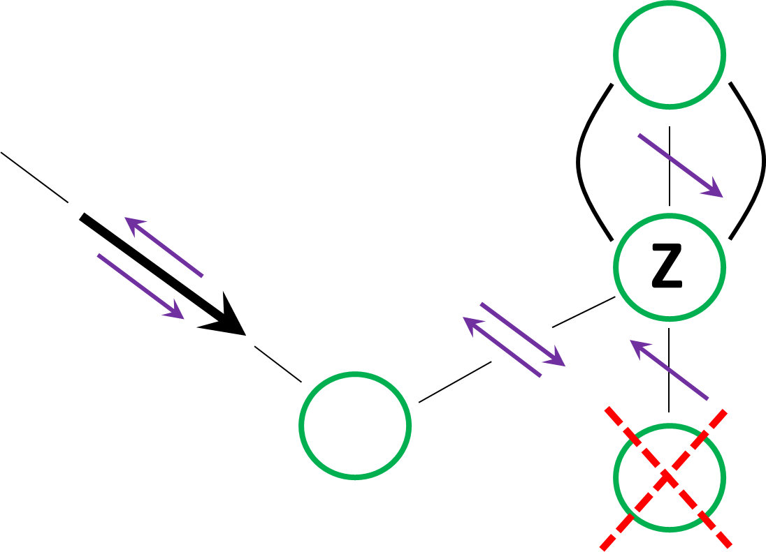
Mott Scattering II
Chiral molecule
DEA resonance
İ Asymmetric Mott scattering doesn’t average to zero!
Notes:
Even though we are averaging over an isotropic orientation of chiral molecules, the distribution is not symmetric. For achiral molecules, it would be symmetric, and the lower atom would be there. But for chiral molecules, on average, it is not there.

Slide 14
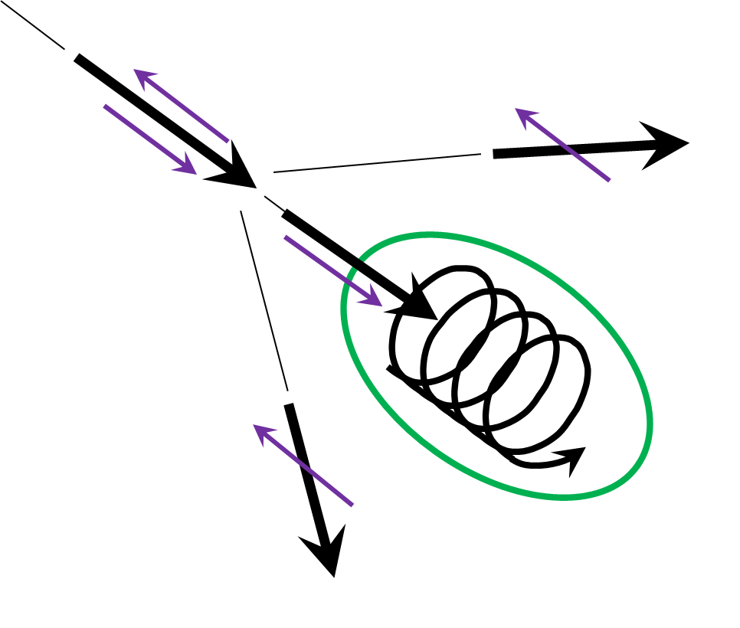
Spin-other-orbit coupling
D.W. Walker, J. Phys. B 15, L289-L292 (1982).
T.J. Gay, in Advances in Atomic, Molecular, and Optical Physics, 57, 157–247 (Academic, 2009).
Notes:
In a chiral molecule, state-to-state magnetic- and electric-dipole transition amplitudes induced by the electromagnetic pulse of a passing electron can interfere constructively, producing a transient magnetic moment along the beam axis independent of electron polarization. This will have a different effect on incident electrons of opposite spin due to the spin-other-orbit interaction, resulting in ECD asymmetries

Slide 15
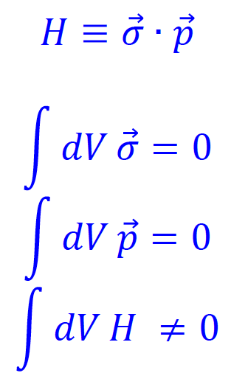
HELICITY DENSITY
Chiral stereochemistry → Chiral Electrons

Slide 16
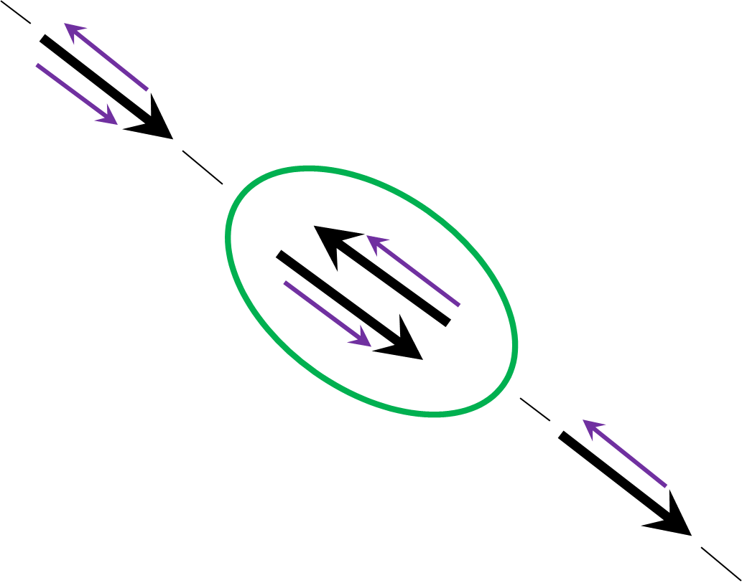
“Helicity-density” dynamics
Temporary negative molecular ion state leading to DEA produced by “counter-propagating” incident and target electrons
V.A. Onishchuk, Sov. Phys. JETP 55, 412 (1982).
T.J. Gay, M. E. Johnston, K.W. Trantham, and G.A. Gallup, in Selected Topics in Electron Physics (Plenum, New York, 1996).
A.D. Scheer, G.A. Gallup and T.J. Gay, J. Phys. B 39, 2169 (2006).

Slide 17
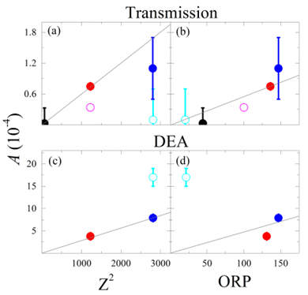
Everything we know so far for the halocamphors…
camphor
3-bromocamphor
3-iodocamphor
3,9-bromocamphor
10-iodocamphor
J.M. Dreiling et al. JPB 51, 21LY01 (2018); Ruivo and Varella, Phys. Chem. Chem. Phys.,2021, 23, 17616

Slide 18
Problems
Organic molecules poison GaAs photocathodes
Halocamphors are chiral, but not relevant biologically
Polarized cosmic beta rays didn’t interact with gaseous targets

Slide 19
Rb Spin Filter
SOURCE
DIFFERENTIAL PUMPING & TRANSPORT OPTICS
TARGET & POLARIMETER

Slide 20
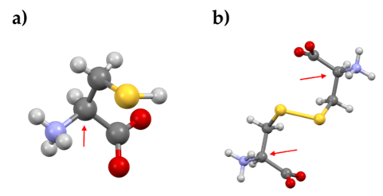
Amino Acids: Cysteine (a) and Cystine (b)

Slide 21
Optically-Pumped Rb Spin-Transfer Cell

Slide 22
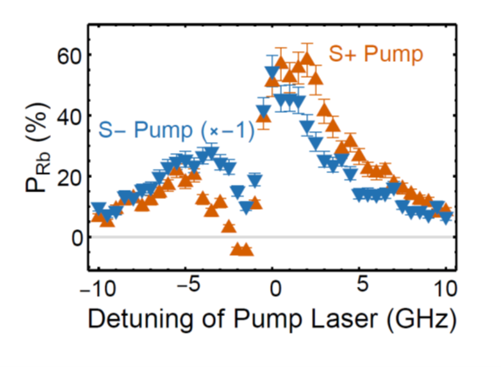
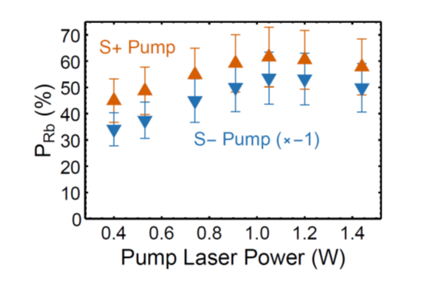
Wavelength Dependence of Rb Polaization
Rb Polarization Saturation

Slide 23
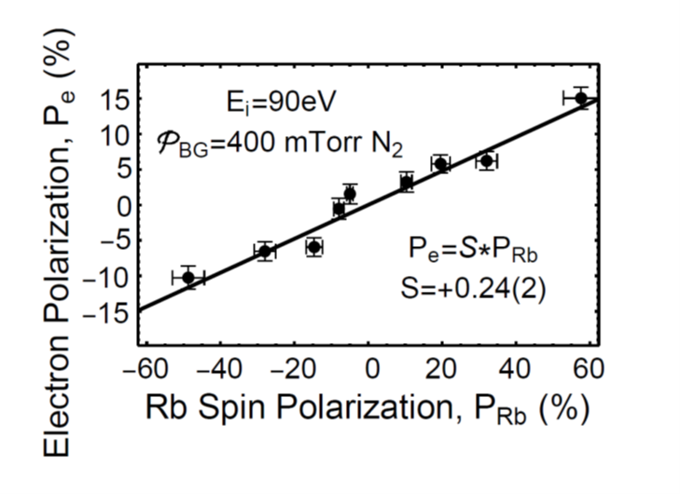
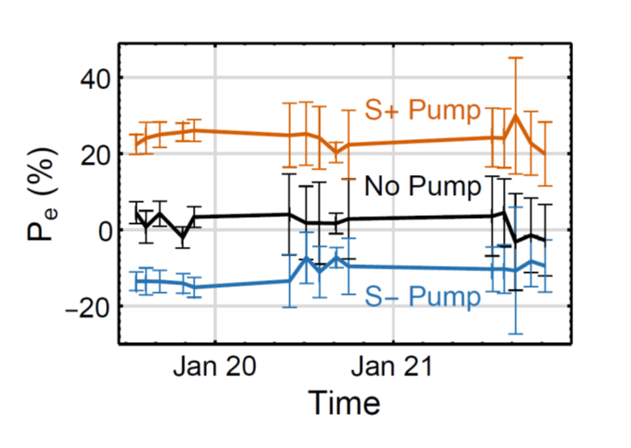
Performance Parameters of the Rb Spin Filter
Spin transfer efficiency
Spin stability over time
P_{e} = 23%
I_{out} > 4 μA
Polarization Figure of Merit – 200 nA
∆E ≈ 1-3 eV
Quasi-turn-key operation

Slide 24
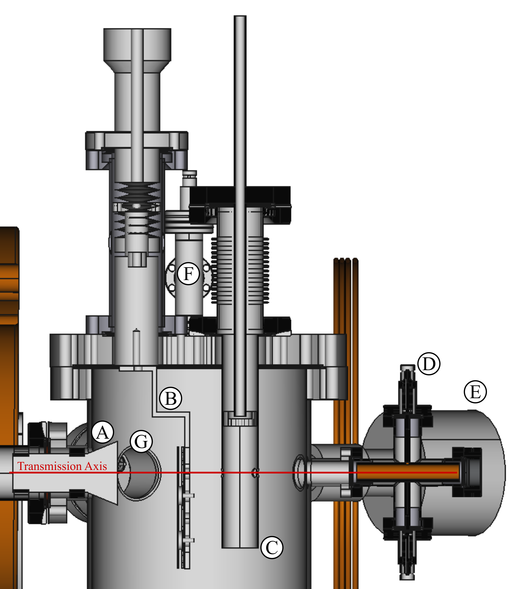
Solid cysteine target cell and He electron polarimeter
A – trochoidal beam deflector
B – cysteine targets
C - He electron polarimeter target cell
D – Faraday cup
E – He optical polarimeter

Slide 25
Problems
(Polarized cosmic beta rays didn’t interact with gaseous targets)
Energy width of electron beam is wide (2-3 eV)
Solution
Investigate kinetic secondary electron emission

Slide 26

Kinetic Secondary Electron Emission
$$γ=1$$

Slide 27
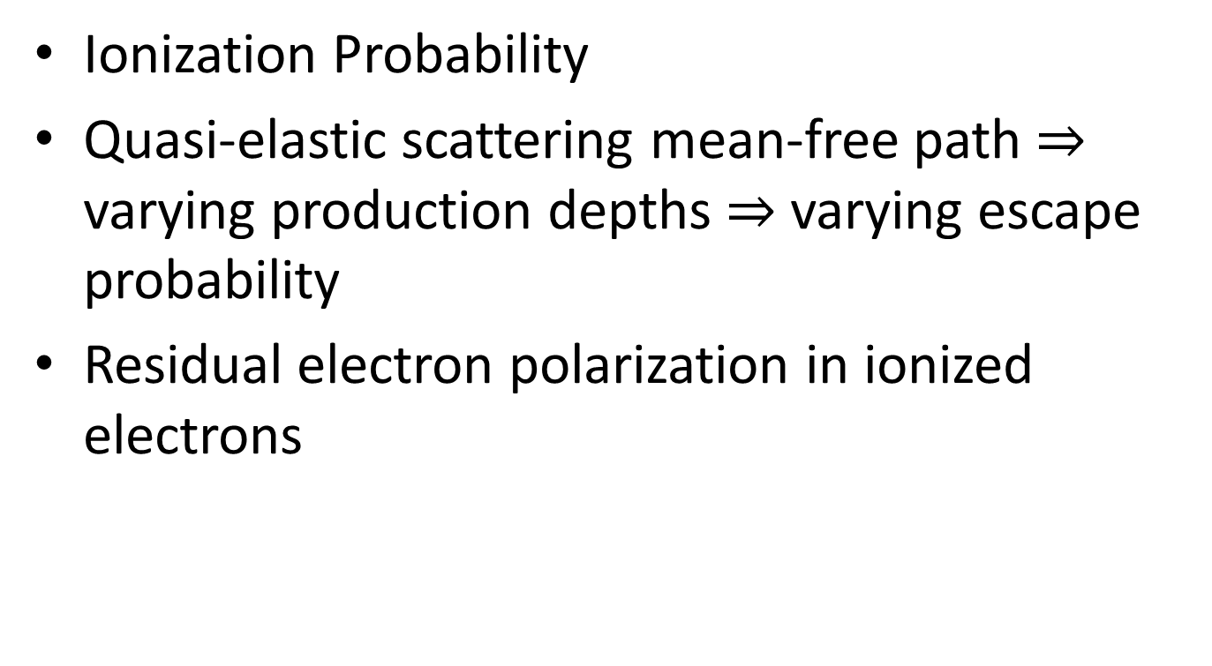
Chiral Dependence of Secondary Electron Emission
Ionization Probability
Quasi-elastic scattering mean-free path $⇒$ varying production depths $⇒$ varying escape probability
Residual electron polarization in ionized electrons

Slide 28
Kinetic Secondary Electron Emission
MgO
Cysteine

Slide 29
4 Data-Taking Formats
Pumping laser on resonance; -9 V on target; TRUE ASYMMETRY
Pumping laser on resonance; +54 V on target; FALSE ASYMMETRY
Pumping laser off resonance; -9 V on target; FALSE ASYMMETRY
Pumping laser off resonance; + 54 V on target; FALSE ASYMMETRY

Slide 30
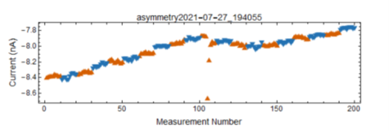
“Raw” Data
Day-to-Day Final Data; A_{voltage} = A_{on}-A_{off}

Slide 31
Final Results
A_{SEE} < 10⁻³ for cysteine at 140 eV
A_{DEA} ranges from 1 x 10⁻⁴ – 2 x 10⁻³ for the halocamphors
NB – Lowest Z exhibiting chiral effects to date: Br (Z = 35)
K. Ahrendsen et alia, JCP in press

Slide 32
Seleno-Cysteine (a) and Seleno-Cystine (b) Z = 34
Pretend these are Orange

Slide 33
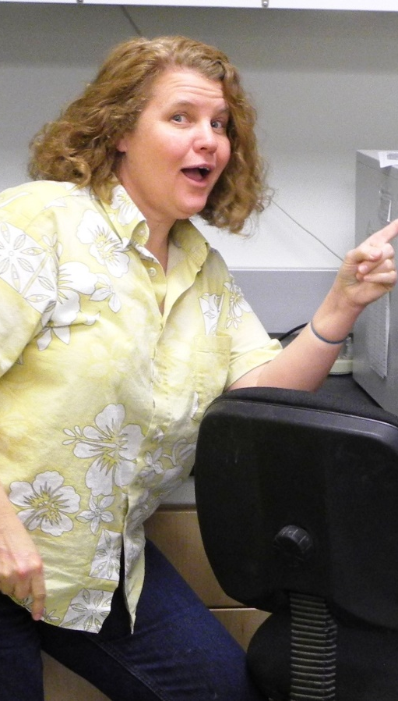
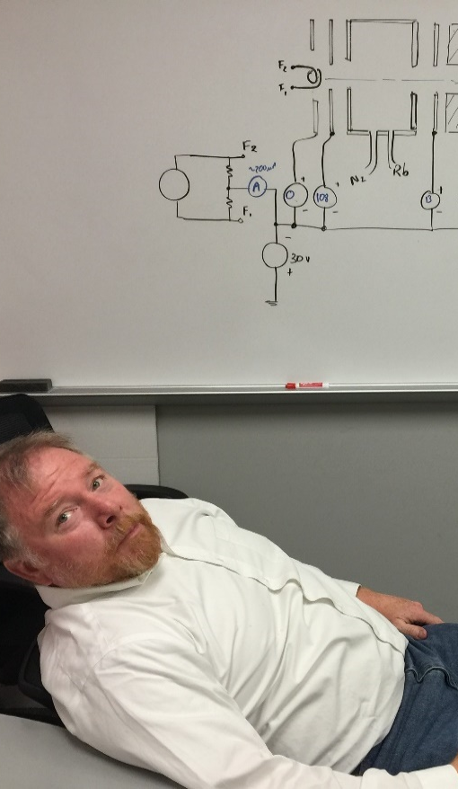

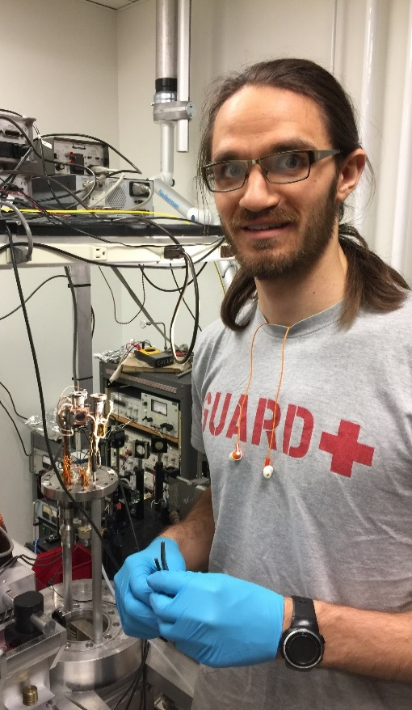
Co-Perpetrators
Karl Ahrendsen; former grad student; Smith College
Dale Tupa; Los Alamos National Lab
Ken Trantham; former grad student; UNK
Joan Dreiling; former grad student; Quantinuum

Slide 34
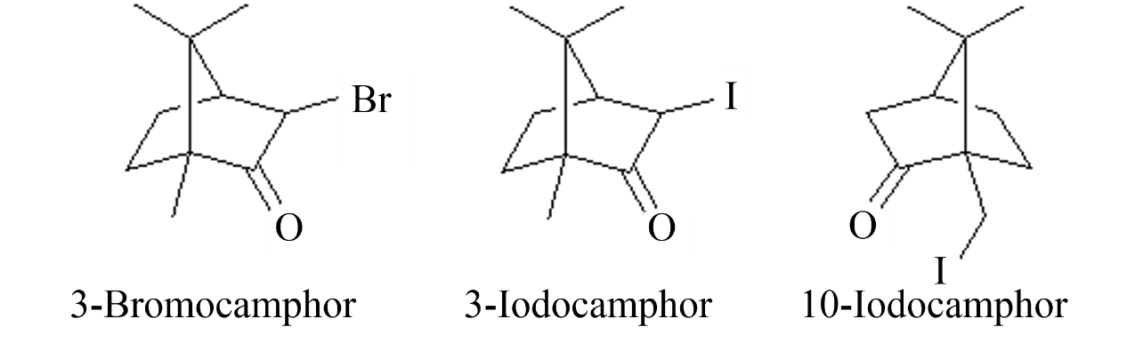
Investigate collisional dynamics
Theories explaining asymmetry disagree on dependence on Z
Vary Z
Bromocamphor, Z_{Br} = 35
Iodocamphor, Z_{I} = 53
Vary location of highest Z
3-Iodocamphor
10-Iodocamphor

Slide 35
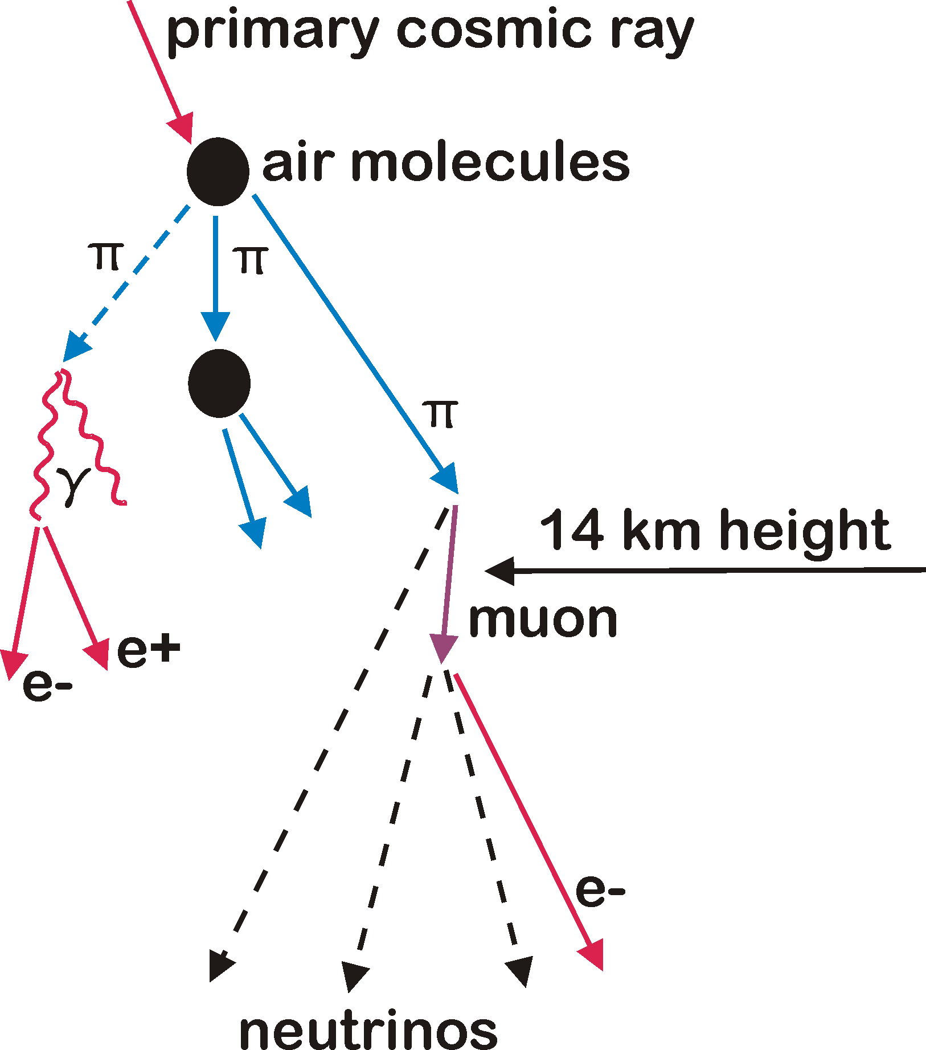
Cosmic Rays
…e.g., a 2J proton…

Slide 38
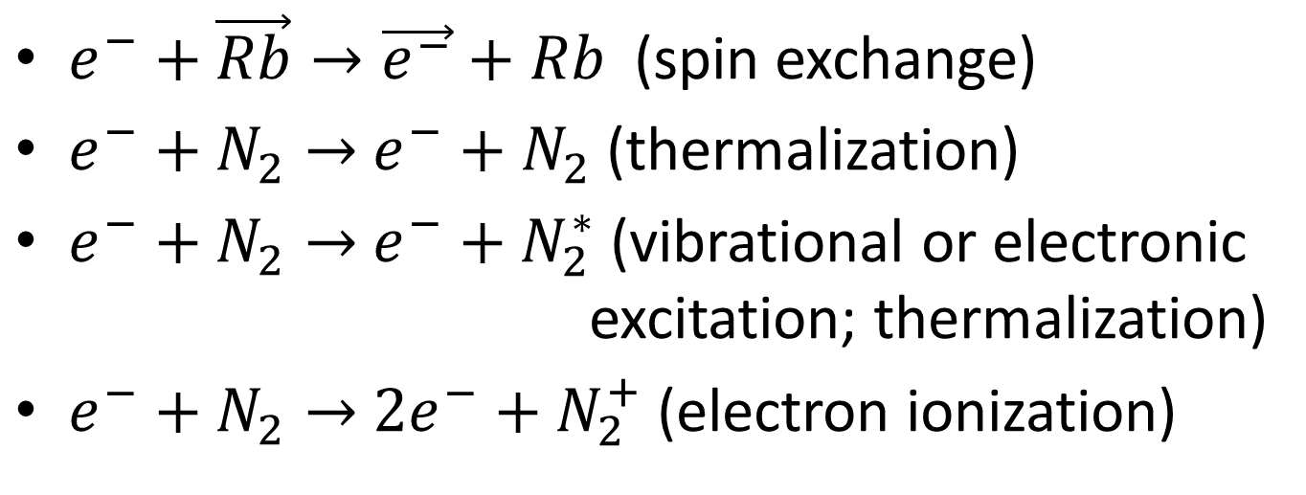
Important Rb Spin Filter Collision Channels
$e^{−}+\vec{Rb}→\vec{e^{−}}+Rb$ (spin exchange)
$e^{−}+N_{2}→$ $e^{−}+N_{2}$ (thermalization)
$e^{−}+N_{2}→$ $e^{−}+$ $N_{2}^{∗}$ (vibrational or electronic excitation; thermalization)
$e^{−}+N_{2}→$ ${2e}^{−}+$ $N_{2}^{+}$ (electron ionization)

