Slide 1

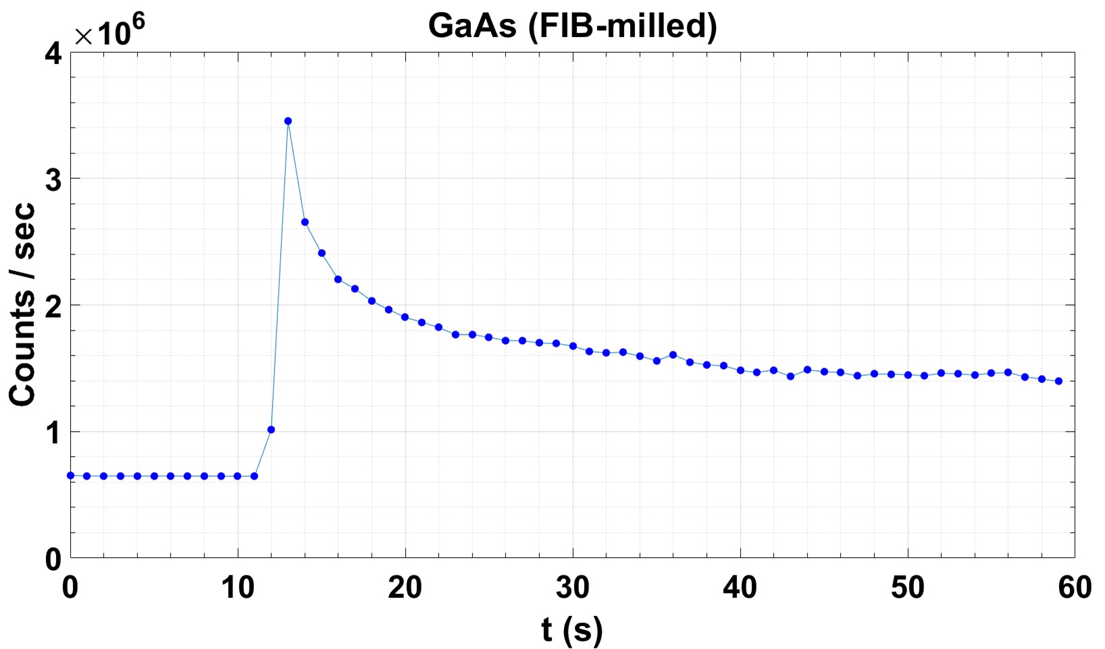
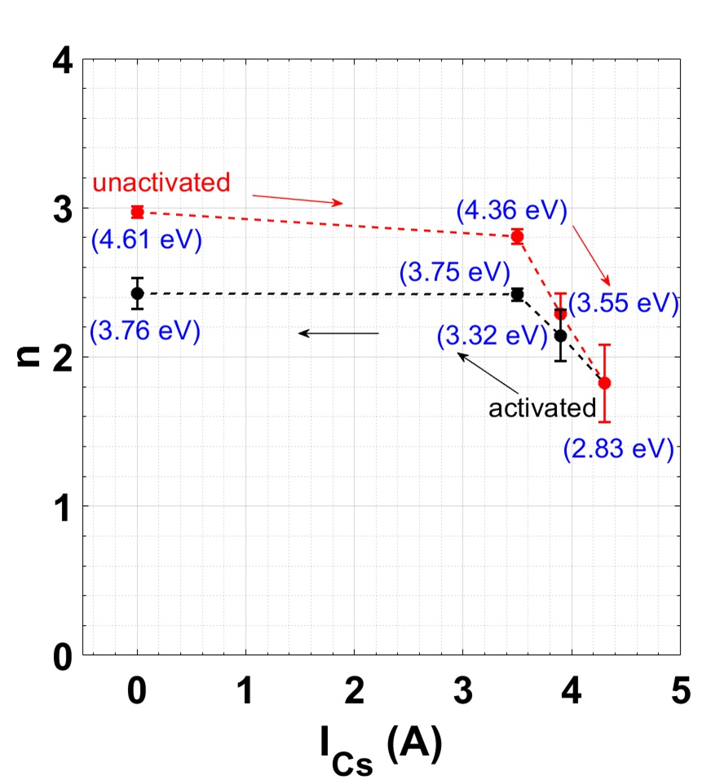
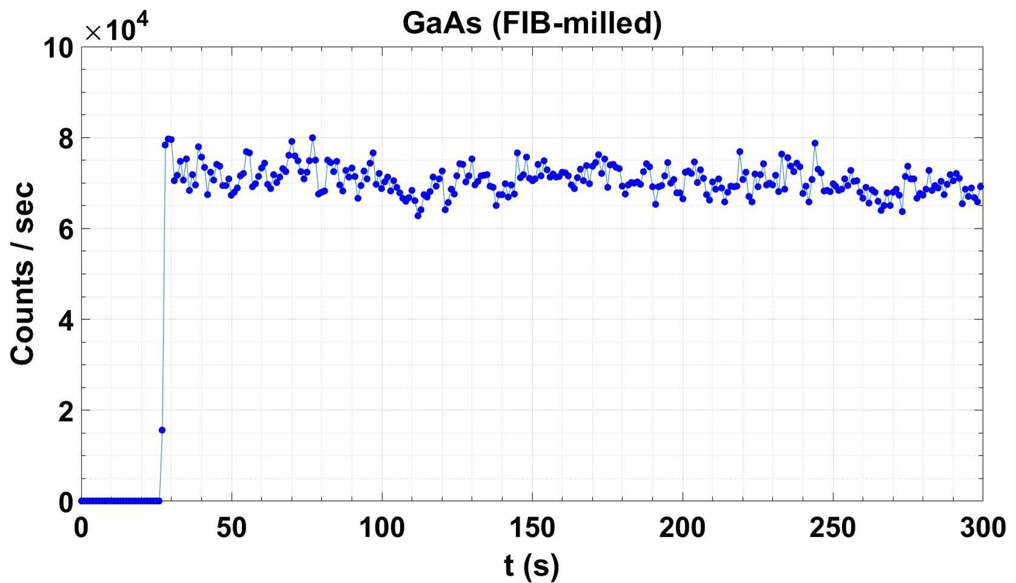
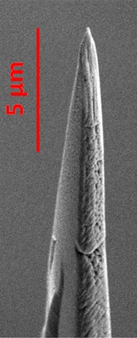
Focused-ion-beam-milled GaAs nanotip: A semiconducting ultrafast photoemission electron source
Sam Keramati^{1,*}, William Newman¹, Herman Batelaan¹, T. J. Gay¹
¹Department of Physics and Astronomy, University of Nebraska-Lincoln, USA
Fig.1 SEM image of a cleaved GaAs shard
Fig.3 Multiphoton photoemission order varies with the cesiator current
Fig.4 Count rate stability
Activated
laser blocked
10 μm
laser unblocked
Cleaved GaAs tips contain several sharp (nano)structures which may photoemit under fs laser illumination. We seek to achieve well-defined GaAs nanostructures as ultrafast spin-polarized free electron sources [1-2].
Deactivated
Fig.2 Focused ion beam (FIB) milled GaAs tip
A nanotip is carved out in a 3D Ga⁺ ion milling process (FEI Helios 660). The geometrical apex radius of curvature is 70 nm.
Femtosecond photoemission properties of this tip are presented.
We also demonstrate workfunction lowering using a cesium dispenser in the proximity of this tip.
laser blocked
Photoemission order n decreases as the deposition rate of Cs on the GaAs tip increases (red data). Ti:Sa oscillator at 90 MHz, <100 fs, 800nm (1.55 eV), <10 GW/cm². V_{tip} = -100 V. Workfunction = 4.1 eV.
Activation by Cs decreases the workfunction of GaAs. The total multiphoton energies are shown in parentheses. Large lowered values of up to -1.78 eV for moderate currents are thus demonstrated. Increase in emission current is consistently observed from <2 e/pulse for unactivated tip to up to 8 e/pulse. The tip remains activated (black data).
laser unblocked
The photoemission count rate as well as the emission current off the tip show a transient behavior for the activated tip for the first several seconds after unblocking the laser. We attribute this to fs laser ablation of the deposited Cs layer.
Deactivating the tip by leaving it in the same fs laser focal spot for 6 hours at I_{Cs} = 0 A leaves no Cs for ablation, hence steady photoemission.
S. Keramati, W. Newman, and T. J. Gay acknowledge support by NSF under the Award Number PHY-2110358. H. Batelaan acknowledges support by NSF under the award number PHY-1912504.
*Present address (S.K.): Departments of Physics and Chemistry, University of Toronto, Canada. Email: sam.keramati@utoronto.ca
References
[1] E. Brunkow, et al., "Femtosecond-laser-induced spin-polarized electron emission from a GaAs tip", Appl. Phys. Lett. 114, 073502 (2019).
[2] T.J.Gay, et al., U.S. Patent 1011337, "Fast Spin-Polarized Electron Source.”

