Slide 1

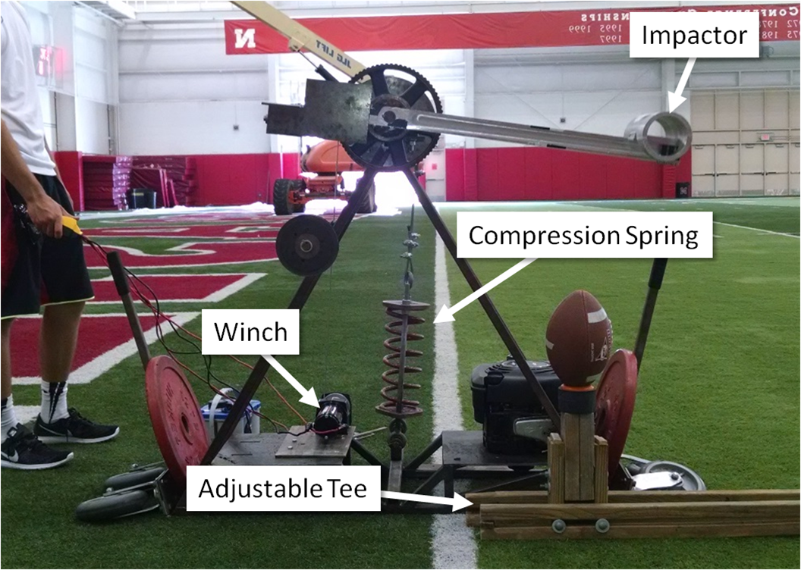
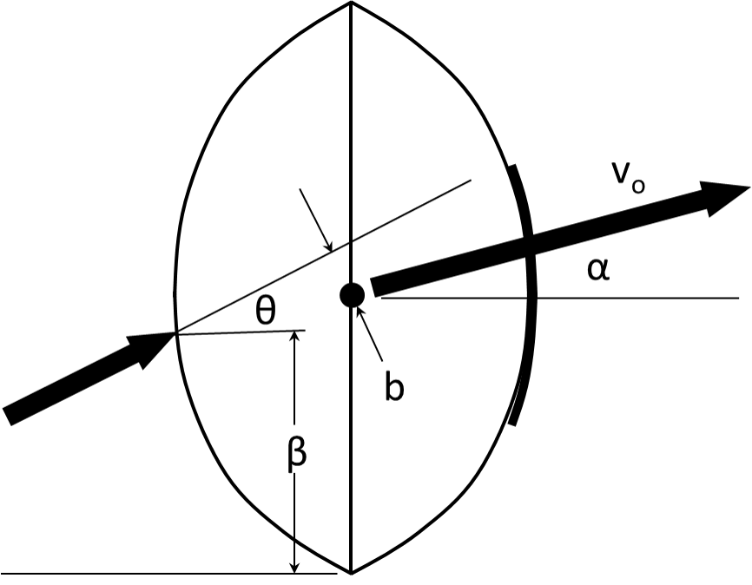

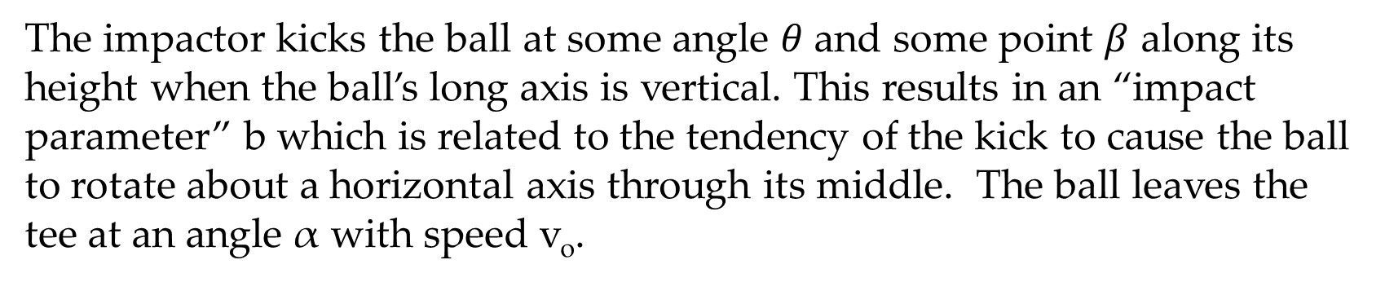
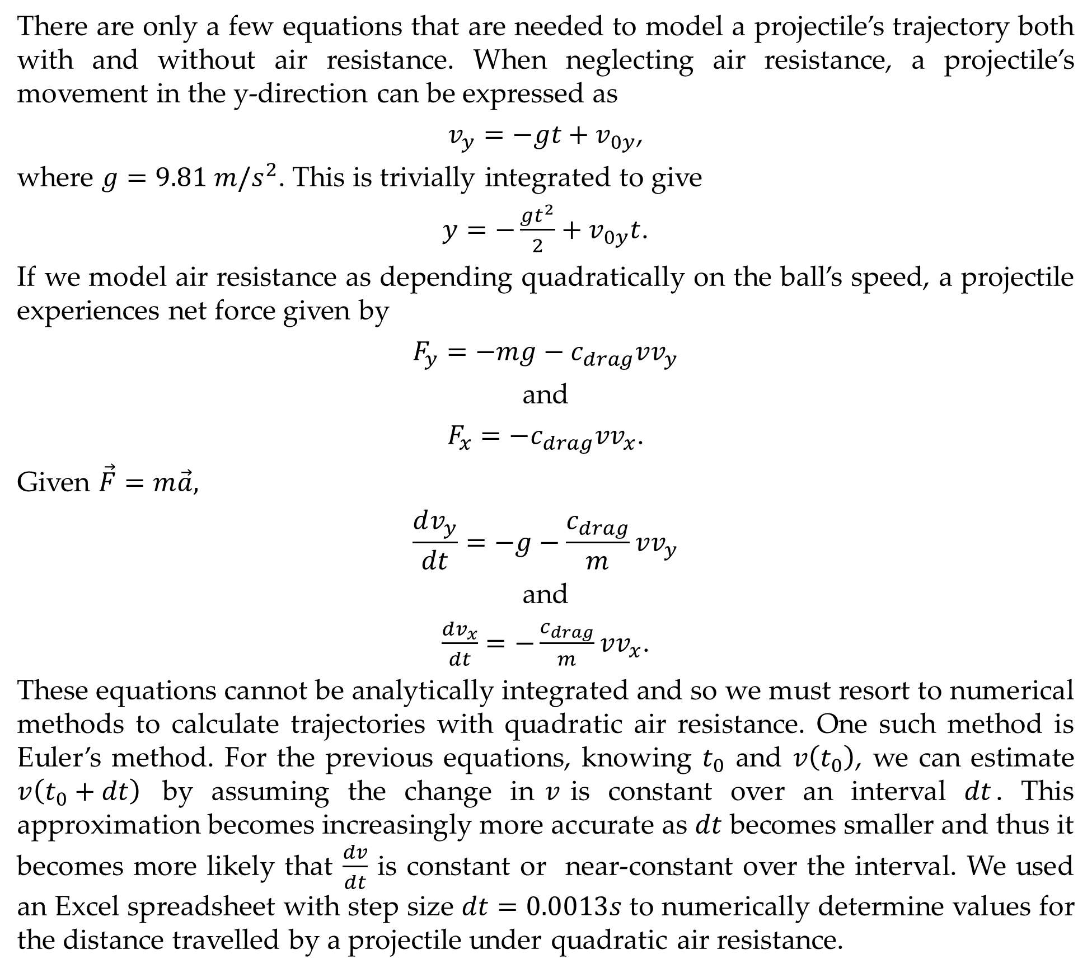
Football Trajectories and Air Resistance
Jesse Y. Lin¹, Chase M. Pfeifer^{2,3,4}, Judith M. Burnfield^{3,4}, Timothy J. Gay⁵
¹Lincoln East High School; ²University of Nebraska-Lincoln Dept. of Mechanical Engineering & Materials Engineering, ³Nebraska Athletic Performance Lab; ⁴Madonna Rehabilitation Hospital Institute for Rehabilitation Science and Engineering; ⁵University of Nebraska-Lincoln Dept. of Physics & Astronomy
Introduction
Trajectory Physics
Results
This research studies the effect of different football kicking geometries on the flight trajectory of the ball. We used a mechanical kicker (Fig.1) to systematically study the effect of the kick angle θ (see Fig.2) and the position of the impact, β, on the ball’s flight. A computer program to simulate the ball’s flight was written as well, giving us the ability to study the role of air drag.
There are only a few equations that are needed to model a projectile’s trajectory both with and without air resistance. When neglecting air resistance, a projectile’s movement in the y-direction can be expressed as
$v_{y}=−gt+v_{0y}$,
where $g=9.81 m/s^{2}$. This is trivially integrated to give
$y=−\frac{gt^{2}}{2}+v_{0y}t$.
If we model air resistance as depending quadratically on the ball’s speed, a projectile experiences net force given by
$$F_{y}=−mg−c_{drag}vv_{y}$$
and
$F_{x}=−c_{drag}vv_{x}$.
Given $\vec{F}=m\vec{a},$
$$\frac{dv_{y}}{dt}=−g−\frac{c_{drag}}{m}vv_{y}$$
and
$\frac{dv_{x}}{dt}=−\frac{c_{drag}}{m}vv_{x}$.
These equations cannot be analytically integrated and so we must resort to numerical methods to calculate trajectories with quadratic air resistance. One such method is Euler’s method. For the previous equations, knowing $t_{0}$ and $v\left(t_{0}\right)$, we can estimate $v\left(t_{0}+dt\right)$ by assuming the change in$v$is constant over an interval $dt$. This approximation becomes increasingly more accurate as $dt$ becomes smaller and thus it becomes more likely that $\frac{dv}{dt}$ is constant or near-constant over the interval. We used an Excel spreadsheet with step size $dt=0.0013s$ to numerically determine values for the distance travelled by a projectile under quadratic air resistance.
The Mechanical Kicker
Data for this experiment was gathered with the kicking device in Figure 1 and 3D motion capture equipment, adjusted for various launch conditions and kicking geometries.
Figure 4. Range as it varies with the kick height $β$.
Figure 5. Range as it varies with the kick angle $θ$.
Figure 4. Drag coefficient/mass as it varies with the impact parameter.
Results from data collection show a maximum range for intermediate values of beta. This trend could have resulted from the fact that intermediate values of beta result in the impactor kicking the ball normal to its surface with less energy changed into rotation. We can also conclude that the kick angle has little to no effect on the range of the football. Using our program to calculate drag coefficients for each launch condition, we can also see a weak upwards trend in the drag coefficient as the impact parameter increases.
Figure 1. Photograph of the kicking device. The impactor delivers the force to the ball.
The impactor kicks the ball at some angle $θ$and some point $β$ along its height when the ball’s long axis is vertical. This results in an “impact parameter” b which is related to the tendency of the kick to cause the ball to rotate about a horizontal axis through its middle. The ball leaves the tee at an angle α with speed v_{o}.
Acknowledgments
Research facilities and 3D motion capture equipment provided by the Nebraska Athletic Performance Lab. 2D video equipment provided by the University of Nebraska-Lincoln Department of Mechanical & Materials Engineering. This work was supported in part by NSF GRANT PHY-1505794.
Figure 3. Sample graph using data calculated in Microsoft Excel illustrating the effect of quadratic air resistance on a projectile. Range of each projectile is indicated to the right of the curve.
Figure 2. Schematic illustrating the various kicking parameters. The force vector of the impactor on the ball is indicated by the arrow at the left; the initial velocity vector is shown at the right.

