Slide 1
Deep Learning In The Enterprise
Challenges and Opportunities
Thomas Cleberg
Application Solution Architect
Enterprise Data Lake Platform and Services

Slide 2
Agenda
Introduction
Considerations for using deep learning in a risk-adverse corporate environment
Use Case Example

Slide 3
Introduction
Large (Fortune 500) Life, Health and Special Lines Mutual Insurance company
Growing technology adoption in the areas of data acquisition and use in a large number of areas- including machine learning and artificial intelligence.

Slide 4
Introduction
Insurance is heavily regulated
HIPAA
PII
State DOI
Underwriting
Actuarial Standard
Many of these regulatory bodies require transparency in decisionmaking.

Slide 5
Introduction
What kinds of models do you think auditors like?

Slide 6
Introduction
Deep learning has a place even in such a heavily regulated environment.
Responsibly choosing the application of these models for problems that can’t be solved by more transparent methods is a crucial step.

Slide 7
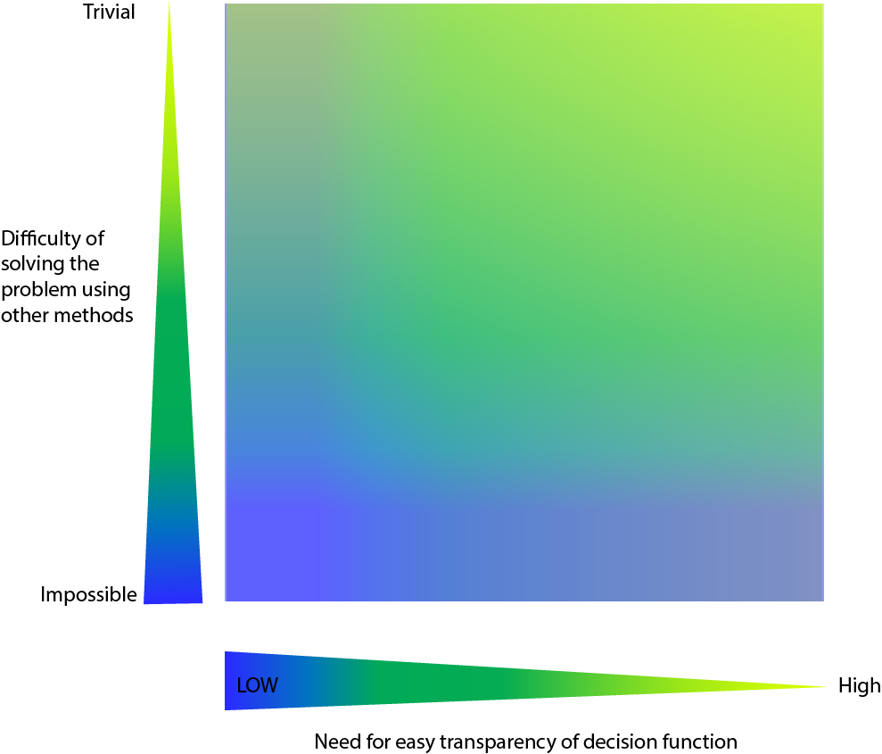
Should we use a deep learning approach for this problem?

Slide 8
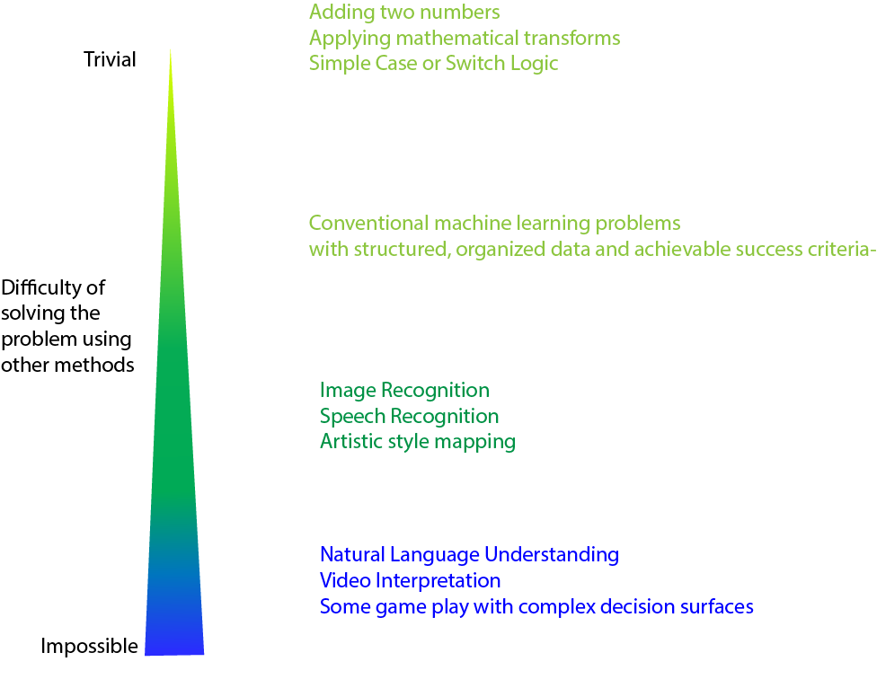

Slide 10
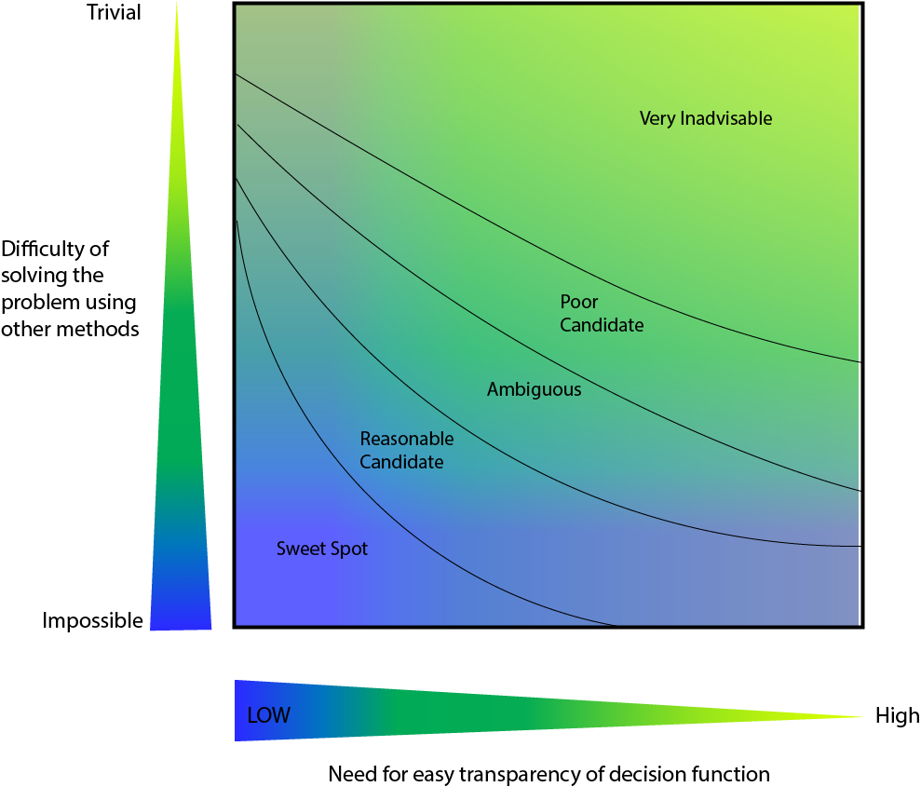

Slide 11
Use Case - Question
Can we predict the department that a course is delivered by based on its title?

Slide 12
Resources
Large volumes of hand-typed class descriptions are received.
We have access to ~40 Million hand-scored examples(!)
Record contents:
University Name
Course Name
Course Enrollment
Median time spent studying for the course

Slide 13
The Departments
English
History
Physics
Business
Visual Art
Architecture
Comp-Sci
Math

Slide 14
Cost Function Considerations
The cost of the system misclassifying between the departments is not equal. For example, classifying a Math class as a CS class is much less costly than classifying it as an English class.

Slide 15
The Data
Based on this data, an employee has to decide what department the course belongs in.
Unfortunately, the data is frequently incomplete. It’s always non-standardized and messy.
University Name: U. of Linclon
Course Name: Fields- Cecil or Flanders?
Course Enrollment:
Median Studying Time: 200 Hours

Slide 16
System Requirements
Because it’s impossible to guess what data might come in, the solution must be robust to input error, and it must also generalize to data that includes words and phrases that are not represented in the training data.

Slide 17
Analogous Situation
Despite these challenges, we need a system that can correctly classify these records as often as human observers do (~90 % of the time) and without increasing the cost as we want to remove the reliance on human intervention from the process.

Slide 18
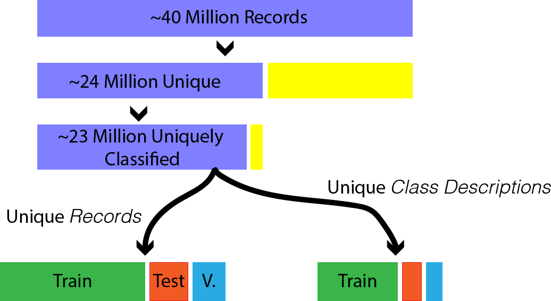
Sampling

Slide 19
Initial Modeling - Baseline
Multiclass Logistic Regression
SVM
Random Forest
Neural Network
On Course Enrollment,
Median Studying Time,
and n-grams through
n=3 for words in University
Name and Course Name.

Slide 20
Initial Modeling - Baseline
These models struggled to reach 75% accuracy- well below the required level of performance.
Furthermore,
Unable to generalize to words that had never been encountered in training
Not robust to even very common mis-spelling, typos.

Slide 21
Analogy
Analogy is an important part of this problem.
$Nice ≅Amiable≅Kind$
The general semantic areas are very informative of which department the class belongs in, for example, when:
$Writing ≅Composition≅$ Scribbling

Slide 22
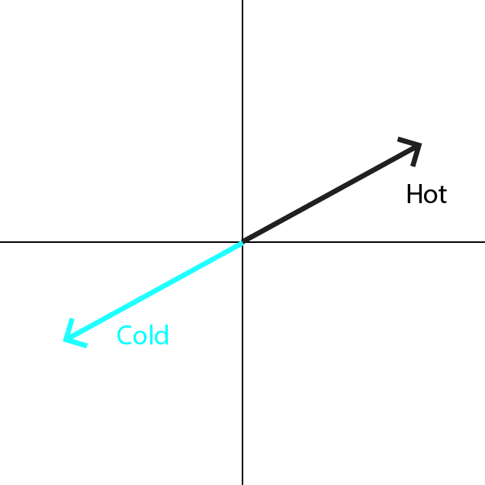
Why is this difficult? Humans can do it pretty easily. (ctd.)
Computers lack this analogy reference, so we have to create it for them.

Slide 23
Word Vectors
One structure that can assist with this analogical reasoning is the Word Vector.
King

Slide 24
Word Vectors
Like an Autoencoder, a word vector approach seeks to express the semantic content of words along many dimensions of meaning.
Simply, they do so by modeling the contexts in which words appear- which words appear near others, and which never do.

Slide 25
Word Vectors
Stanford’s GloVe Vectors are generated via a weighted least squares regression on co-occurences of words within a context window.

Slide 26
Word Vectors
Google’s Word2Vec specifically uses an Autoencoder framework to produce word vectors.

Slide 27
Word2Vec
Facebook’s FastText extends this approach by additionally producing vector representations for character combinations within words.

Slide 28
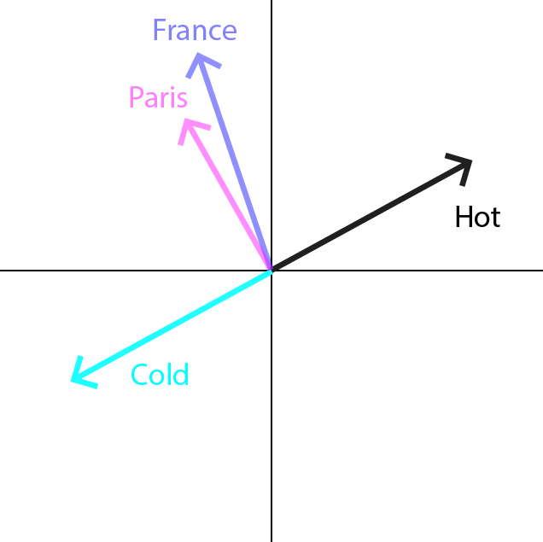
Word Vectors
We tested many pre-trained sets of word vectors for effectiveness on the problem and chose a 300-dimensional set of GloVe vectors trained on 6 Billion tokens of the Gigaword dataset and Wikipedia.
These vectors have a 400,000 word vocabulary.

Slide 29
Word Vectors
In our model, these vectors were used to initialize a shared embedding layer for both the Course and University name.
Then, separate LSTM layers were used to process the sequence of words within those fields.

Slide 30
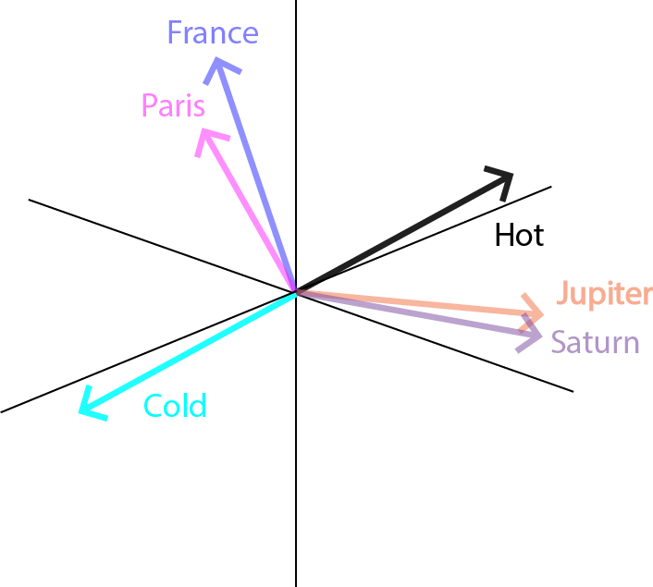
Word Vectors
These values allow the model to reason with analogy beyond the words used in the training data.
$$Mutual+Omaha≅Trust$$
$$New+York+City≅NY≅NYC≅Manhattan$$
$$Bartender−Drinks+Flower≅Florist$$

Slide 31
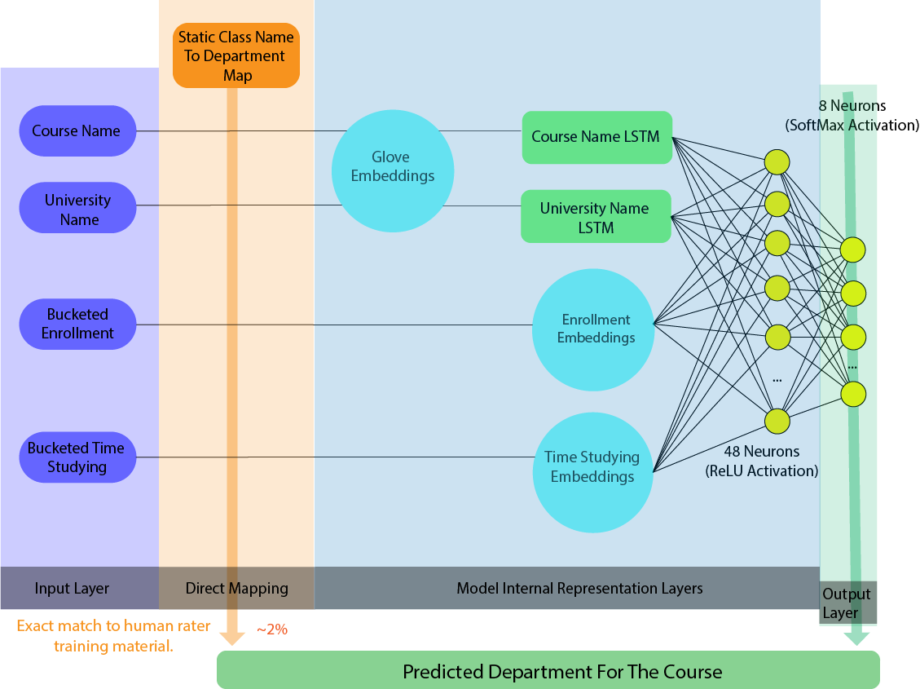
Final Model Architecture

Slide 32
Prior State
Prior to model development:
Department identification was a manual, human process
Return time of scoring was a relatively long process- it had to pass through a human workflow.
Full automation of processes that relied on department identification was therefore not possible.

Slide 33
Current State
After model training and implementation:
Model scoring is very fast and automated - 0.15s for a set of 10 records.
Available as a REST service to be used as part of automated group quoting.
Scoring system use distributed almost immediately to users via Excel application by the system requestor- more sophisticated consumption methods followed quickly.

Slide 34
Training-To-Consumption Tooling
Model Training
Client Applications
Produces
Model Object
Is Consumed
By
Is Used By
REST Service

Slide 35
Model Lifecycle Maintenance
To maintain business interests, we defined:
Who is the “Owner” of the model?
Who has the motivation to get the model fixed if it’s broken?
What are the responsibilities of a model owner?
What are the responsibilities of a team building a model for a model owner?
What is the responsibility of the team building the model for ongoing maintenance needs?
How often does it need to be re-evaluated and/or re-trained?
What service levels are acceptable for response of the model rest service?
How are these service levels measured and established?

Slide 36
Thank You!
Questions?

