Slide 1

Deep Learning at Hudl
Ben Cook

Slide 2


Outline
Why DL?
Projects
Lessons Learned

Slide 3

Why deep learning?

Slide 4
At Hudl, deep learning solves real problems and leverages our data

Slide 5

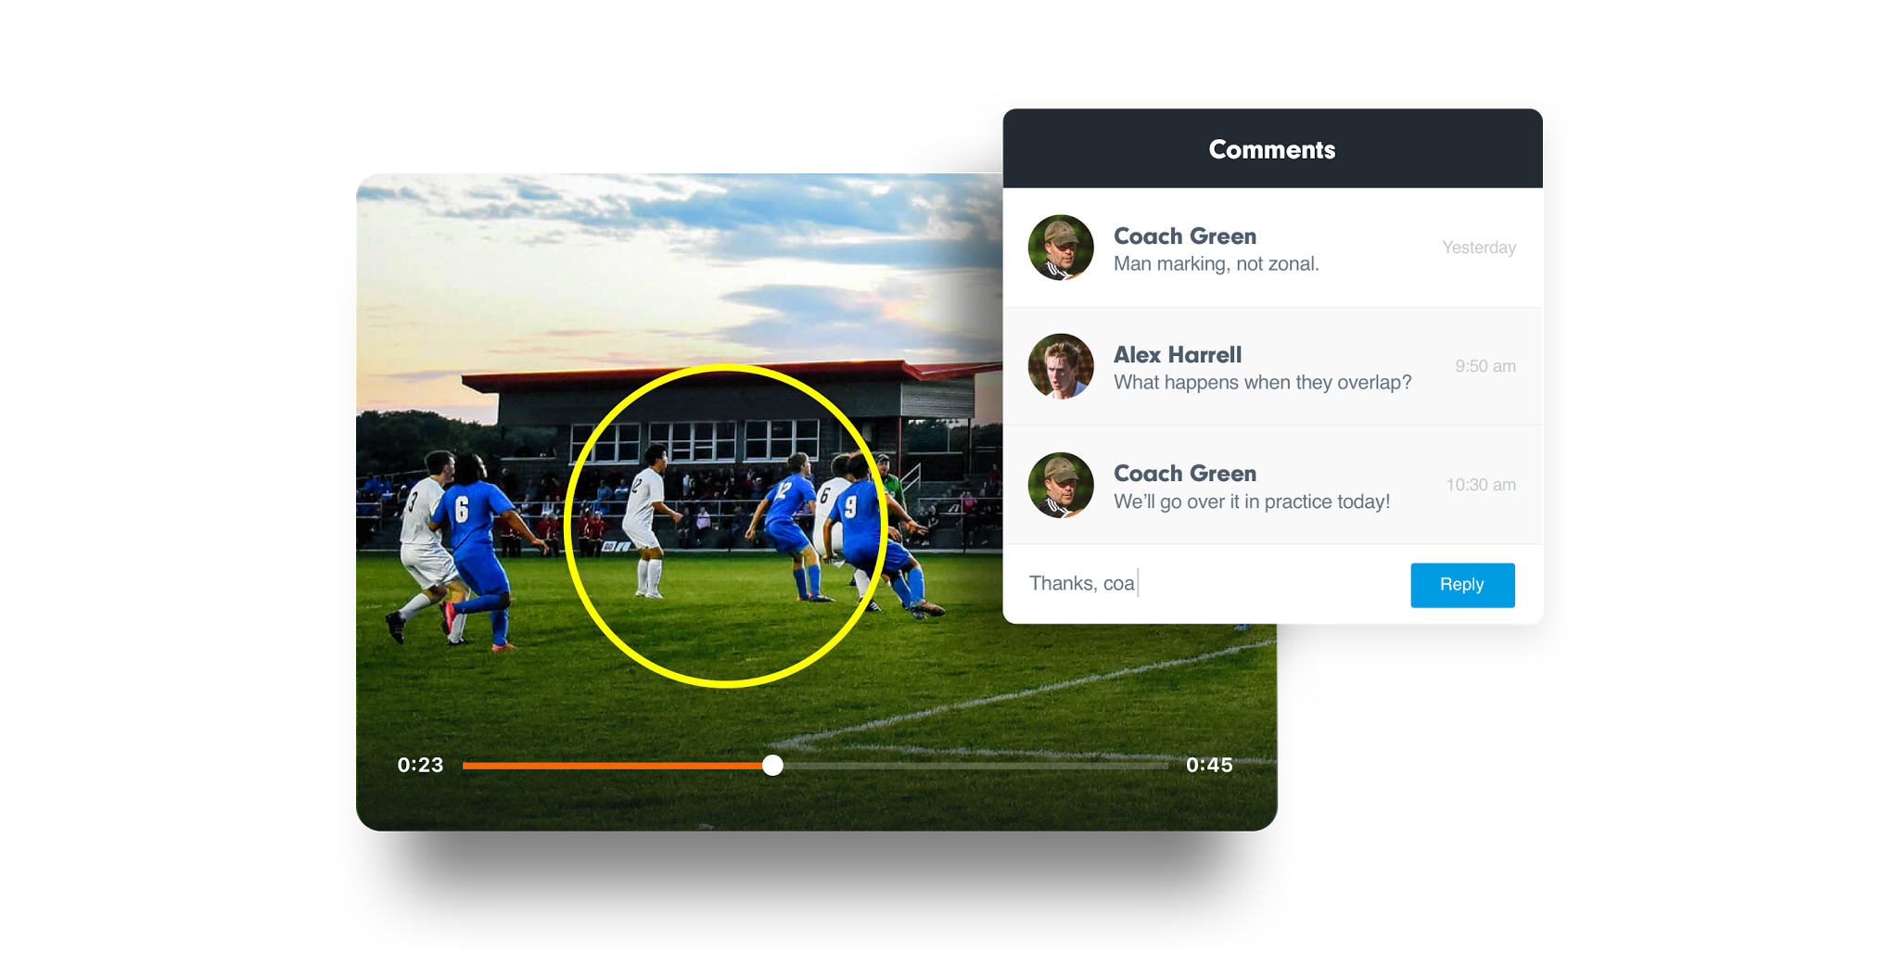
Bring lessons
to life
Help your team see
exactly what needs to improve. Allow players to critique their own performance, or provide personalized feedback by sharing comments and drawings.

Slide 6
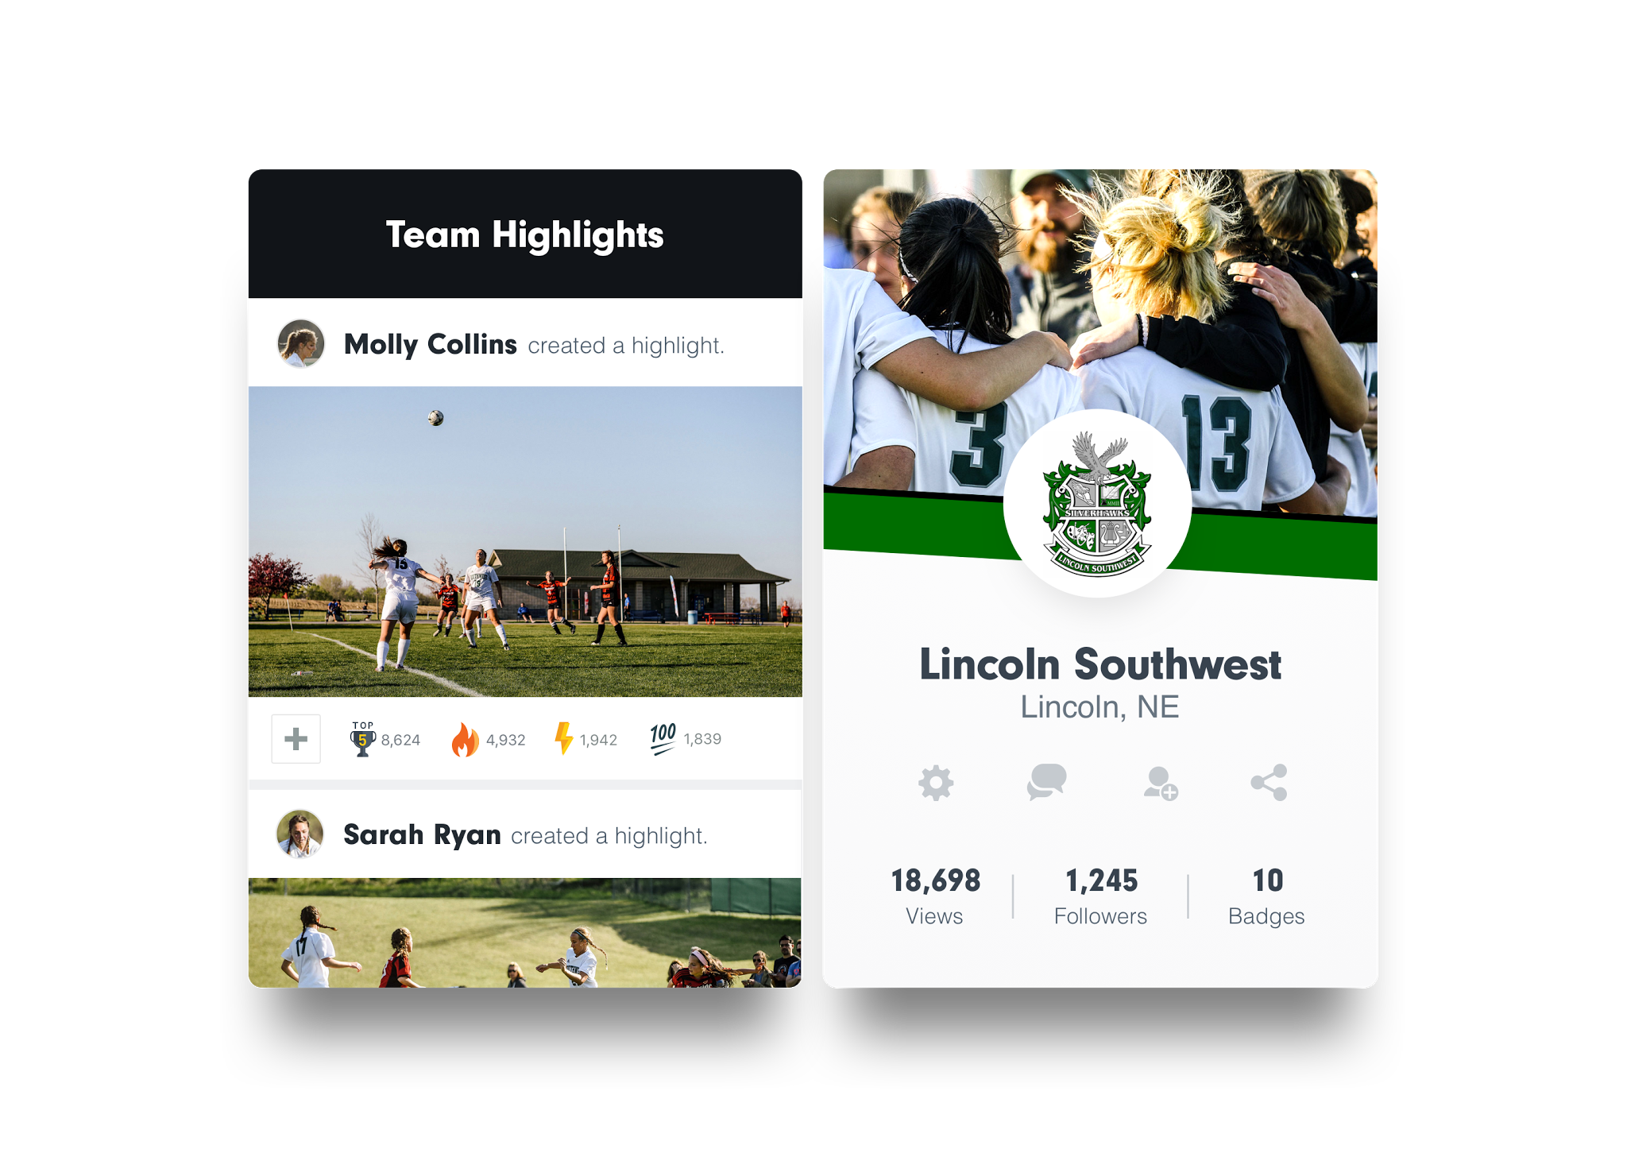
Highlights
on demand
Help athletes stand out with the tools to create and share custom highlights with family, friends and recruiters.

Slide 7

Hudl has lots of data
24.5 PB video
271MM labeled American football clips
376K labeled basketball games
26MM highlights

Slide 8
Projects

Slide 9
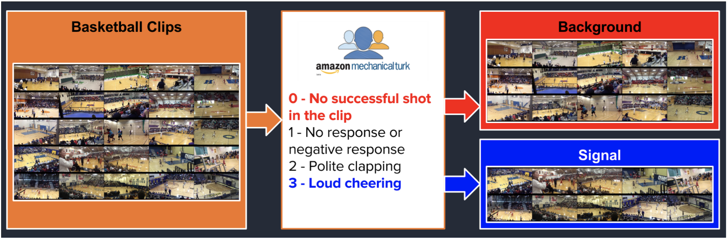
Project Sona

Slide 10
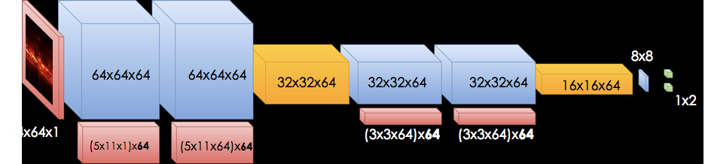
Project Sona

Slide 11
Project Sona in Production
SQS
Hudl.com
ECS

Slide 12
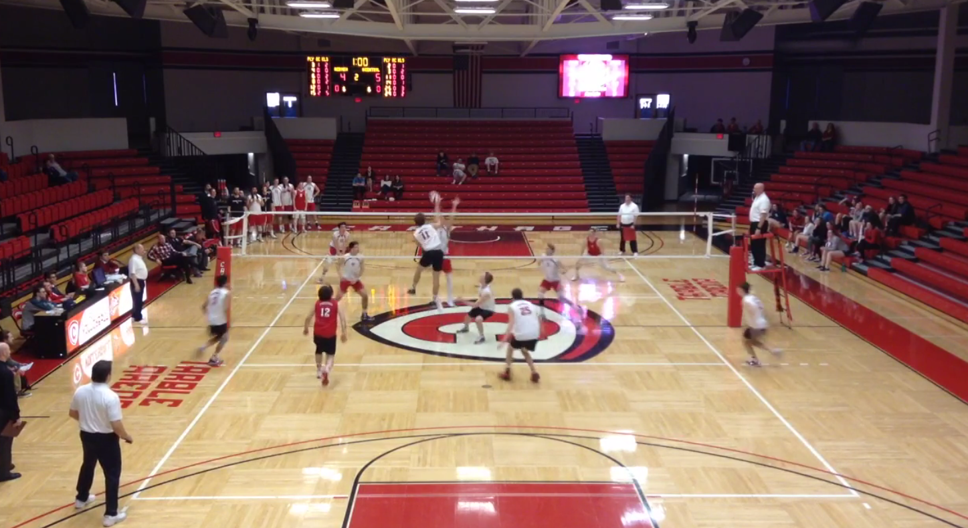
Volleyball Serve Detection

Slide 13
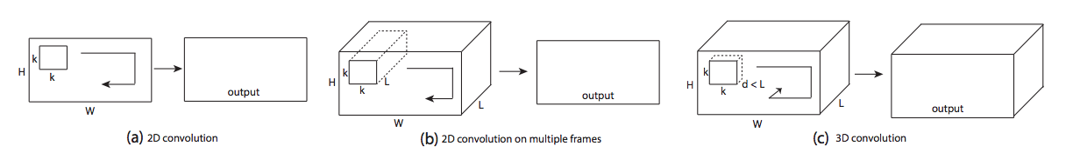
Volleyball Serve Detection
D. Tran, L. Bourdev, R. Fergus, L. Torresani, and M. Paluri. Learning spatiotemporal features with 3D convolutional networks. In Proc. ICCV, 2015.

Slide 14
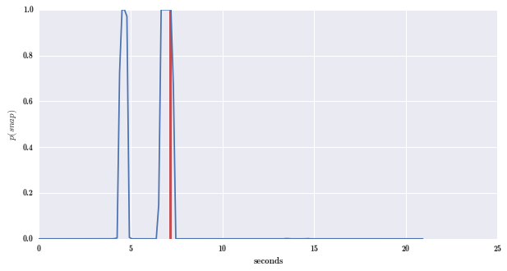
Volleyball Serve Detection
D. Tran, L. Bourdev, R. Fergus, L. Torresani, and M. Paluri. Learning spatiotemporal features with 3D convolutional networks. In Proc. ICCV, 2015.

Slide 15

Volleyball Serve Detection in Production

Slide 16
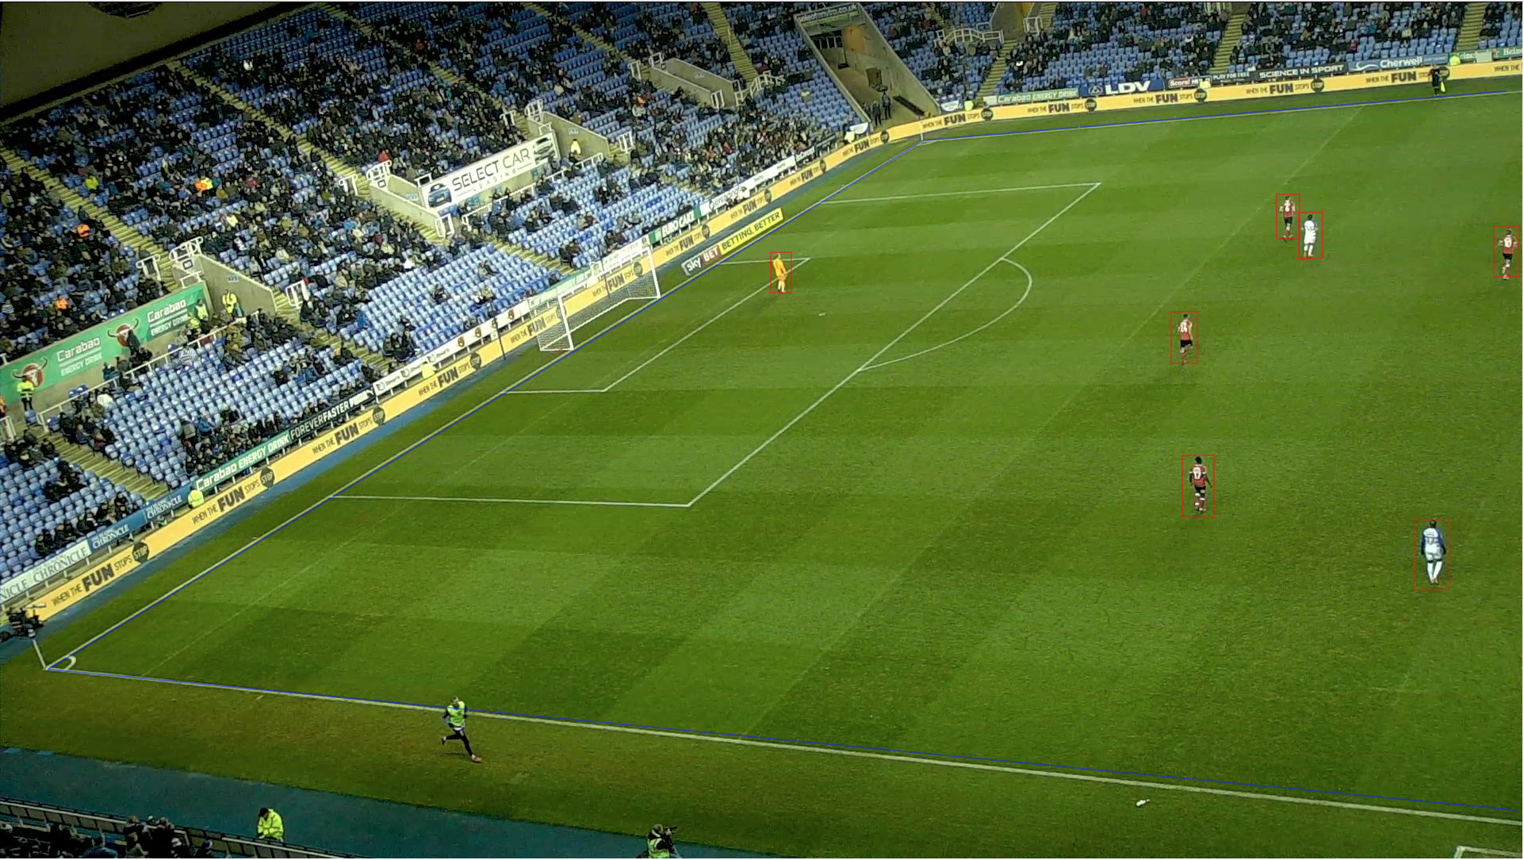
Object Detection

Slide 17
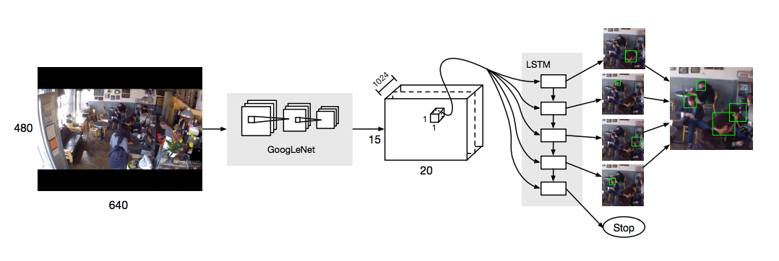
Object Detection
R. Stewart and M. Andriluka. End-to-end people detection in crowded scenes. arXiv preprint arXiv:1506.04878, 2015.

Slide 18
Object Detection in Production
Auto Uploader
Batch
Correction
Hudl.com

Slide 19
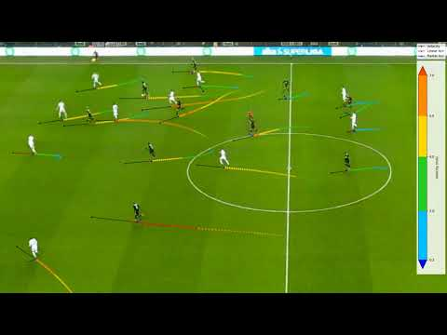
Object Detection in Production

Slide 20
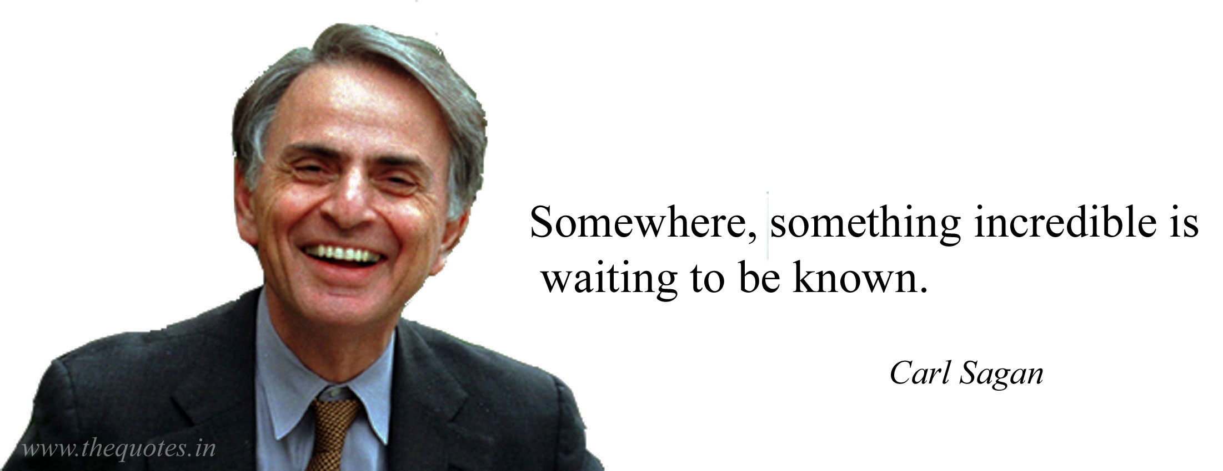
Project SAGAN

Slide 21
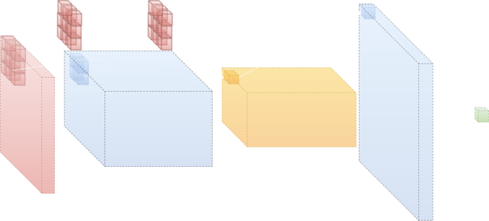

The Discriminator
An machine optimized classification network whose sole purpose is to identify real inputs.
f(image) → (class)
f(image) → (class)

Slide 22
The Generative Adversary
An machine optimized adversary whose sole purpose is to defeat classification networks by generating realistic but forged inputs.
f(noise) → (image)

Slide 23
Observed Inputs
(Real & Forged)
Class Already Known
Random Noise
Discriminator Results
④
②
①
③
f(image) → (class)
f(noise) → (image)
∞
②
④
f(image) → [ real || forgery ]
f(noise) → [ forgery ]
Unobserved Images
Real || Forgary
Random Noise
Convincing Forgary

Slide 24
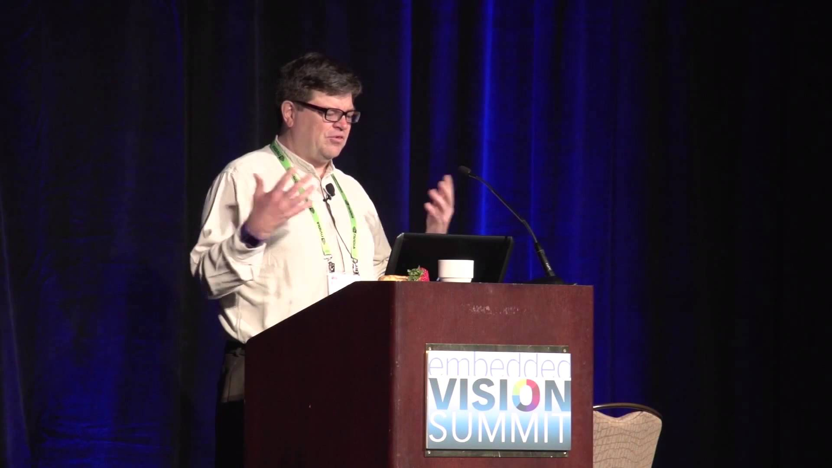


Generative Adversarial Networks is the most interesting idea in the last ten years in machine learning
Yann LeCun
Director
Facebook AI Research

Slide 25

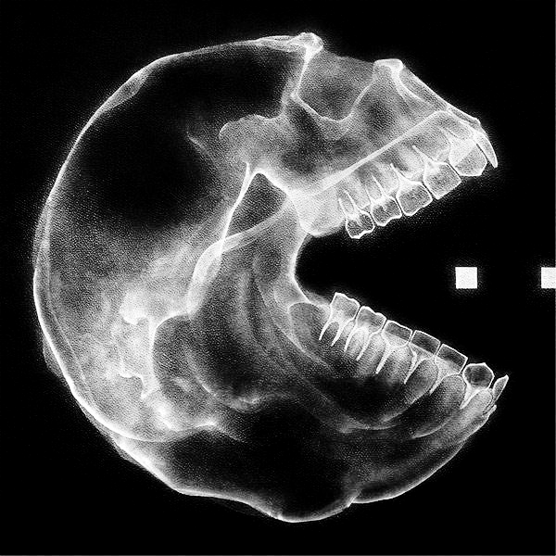
POC:
Hunt Ms. Pac-man

Slide 26
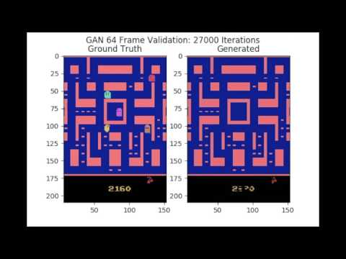

Slide 27
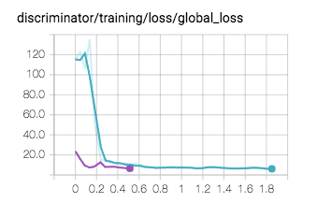
These two networks are trained on the following output:
  X – x position
  Y – y position
  C – confidence
They both converge quickly…
The GAN Transfer is significantly more efficient than the Random Init
Random Initialization
GAN Transfer Initialization

Slide 28
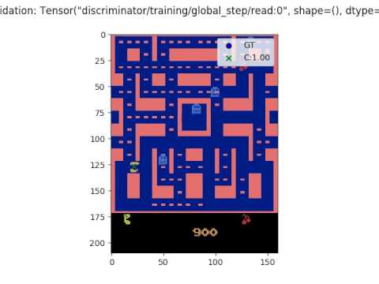

Slide 29
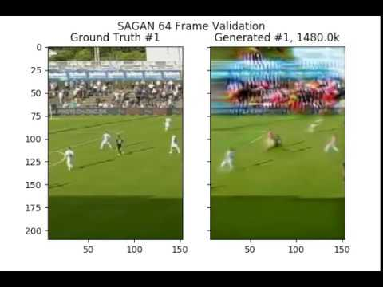

Slide 30

Project SAGAN in Production

Slide 31
Lessons Learned

Slide 32
Lessons Learned
A good model isn't good enough
Don't implement from scratch
Data is king

Slide 33

Get in touch.
Ben Cook
Research Director
ben.cook@hudl.com
@jbencook

