Slide 1
CSCE 488/489 Fall 2009/Spring 2010 Projects
Mehmet Can Vuran
Assistant Professor
107 Schorr
University of Nebraska – Lincoln
Lincoln, NE 68588-0115
mcvuran@cse.unl.edu
www.cse.unl.edu/~mcvuran

Slide 2
Computer Engineering Senior Design Projects
Stonehenge - Wireless Monitor Controller System
Erin Bartholomew, Paul Bauer, Nate Lowry, Sabina Manandhar
New Sneakers - Jarvis Home Automation Platform
Nick Ebert, Tim Echtenkamp, Ray Page, Matt Rosno
Under Pressure – Fire Fighting Robot
Anne Neilsen, Justin Popek, Lyle Shearer

Slide 3
Computer Engineering Senior Design Projects
Wireless Monitor Controller System

Slide 4
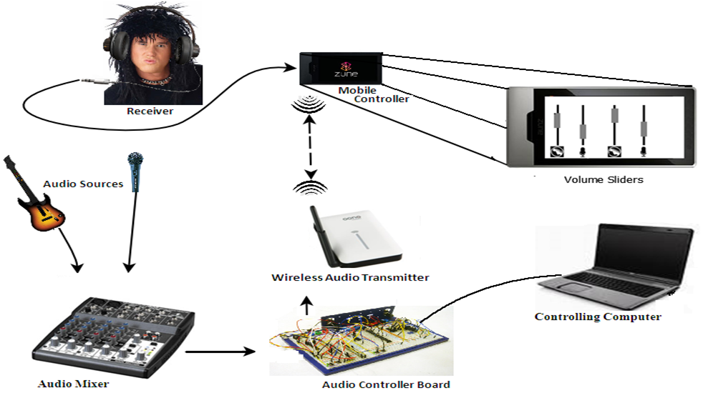
Wireless Monitor Controller System

Slide 5
Motivation
To create a way to more discretely and conveniently control audio levels for playback monitors.
Wireless Monitor Controller that includes a mobile web interface for volume control
Components:
Audio Mixer
Audio Controller Board
Controlling Computer
Wireless Audio Transmitter
Mobile Controllers
Headphones/Receiver

Slide 6
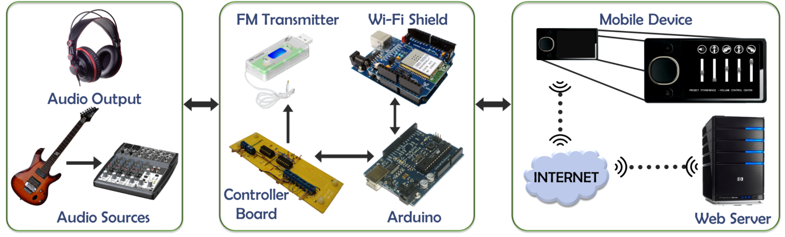
Final Schematic

Slide 7
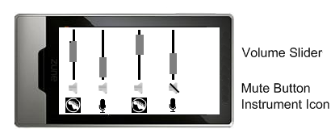
Implementation
Mobile Controller: internet enabled cell phone or other wireless device
Web interface in HTML and JavaScript

Slide 8
Computer Engineering Senior Design Projects
Jarvis Home Automation Platform

Slide 9
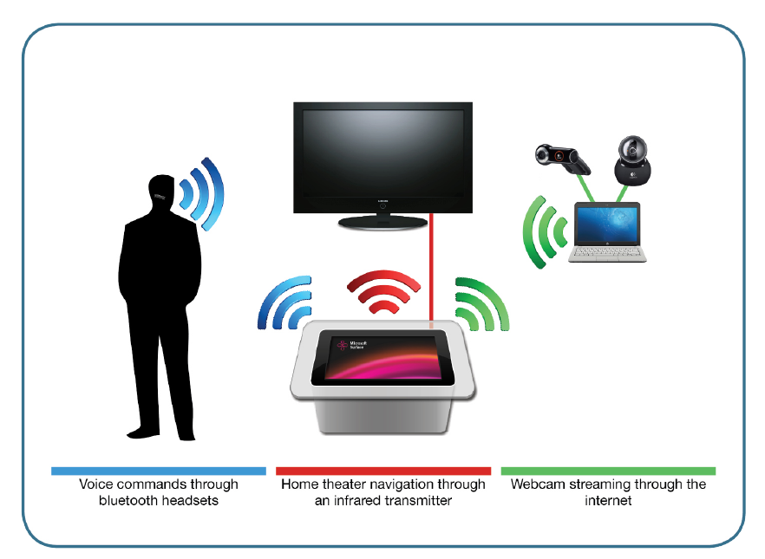
Jarvis Home Automation Platform

Slide 10
Jarvis Home Automation Platform
Next-generation “butler”
Provide homeowners with user-defined information
Concise
Accurate
Unobtrusive
Goal: Make life easier through home and information automation
Check locks, lights, and garage doors
Check the weather without sitting down at a desk
Remind users about daily tasks and events
Provide users access to shared items such as grocery lists and music libraries

Slide 11
Project Goals
Primary Goals
Digital media library – Front-end for a digital media library
Surveillance cameras – Display live video from networked security cameras
Stretch Goals
TV – Control a TV
Time of the day logic – Based on the time of day, systems base responses vary
Miracle Goals
Voice recognition – Recognize different users and respond differently
Home energy consumption – Track/visualize/alert energy consumption of various appliances
Heating and Air Controller – Optimize HVAC usage

Slide 12
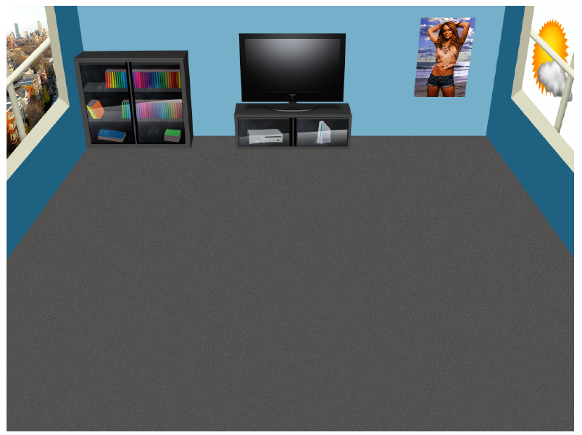
Jarvis Home Automation Platform

Slide 13
Computer Engineering Senior Design Projects
Fire Fighting Robot

Slide 14
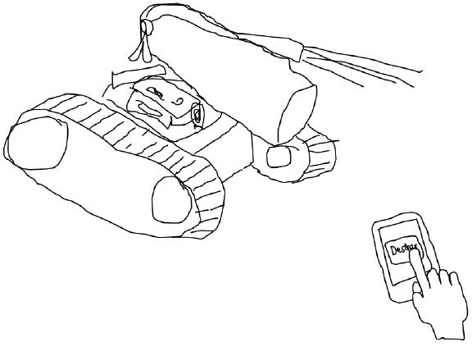
Artist’s Conception

Slide 15
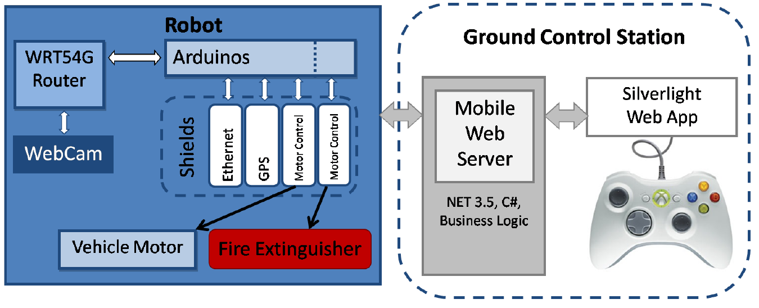
Engineers’ Conception

Slide 16
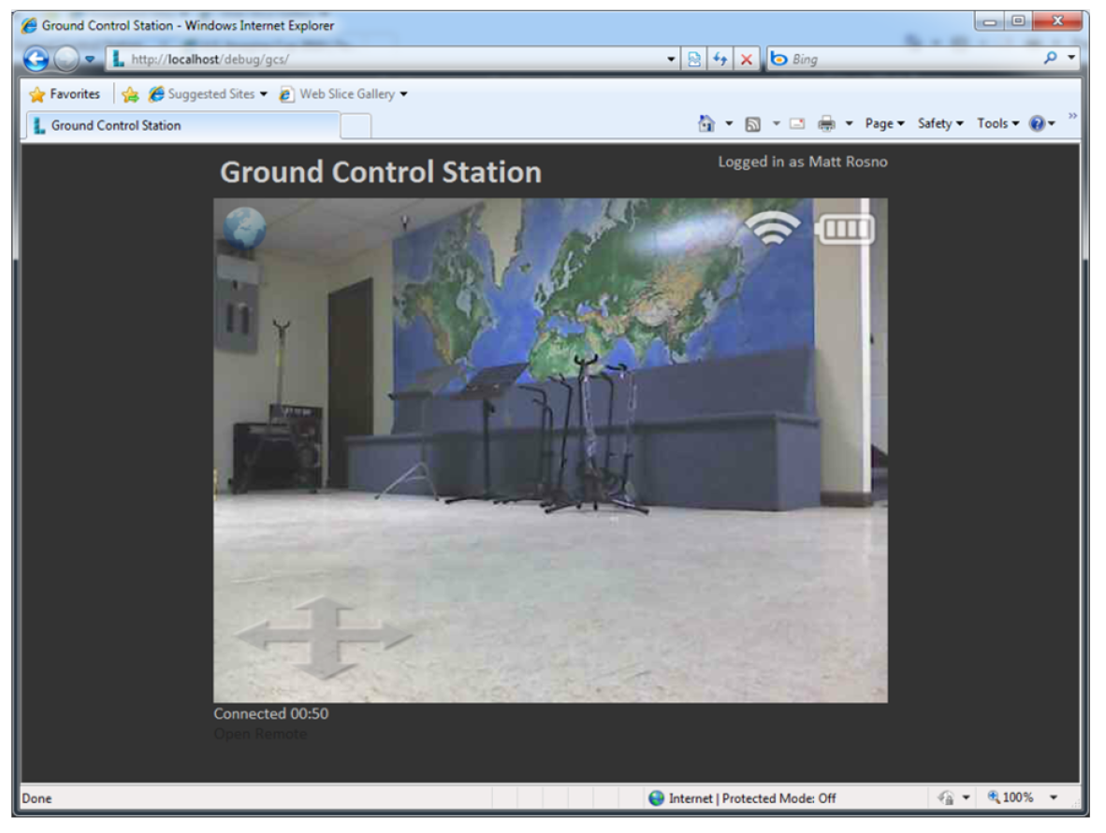
Engineers’ Conception

Slide 17
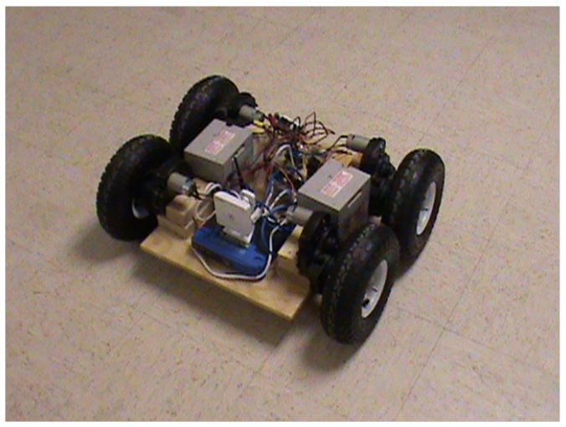
Engineers’ Conception

Slide 18
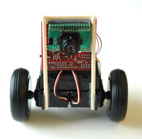
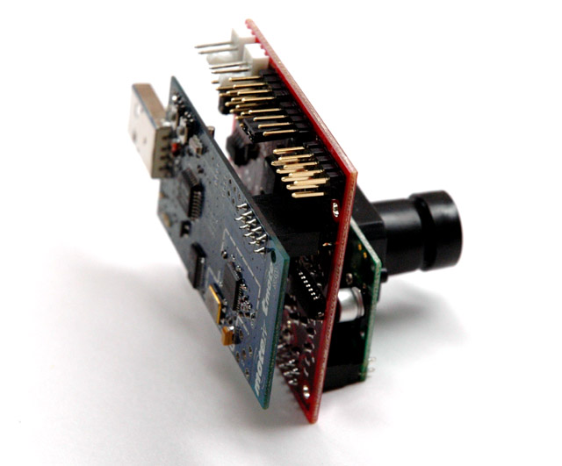
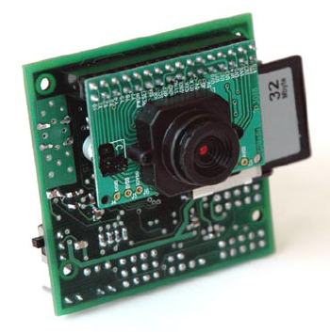
Wireless Multimedia Sensor Networks
Video and audio streams, still images, and scalar sensor data

Slide 19
Sensor Networks & Embedded Systems Course Projects
2007-2010
19

Slide 20


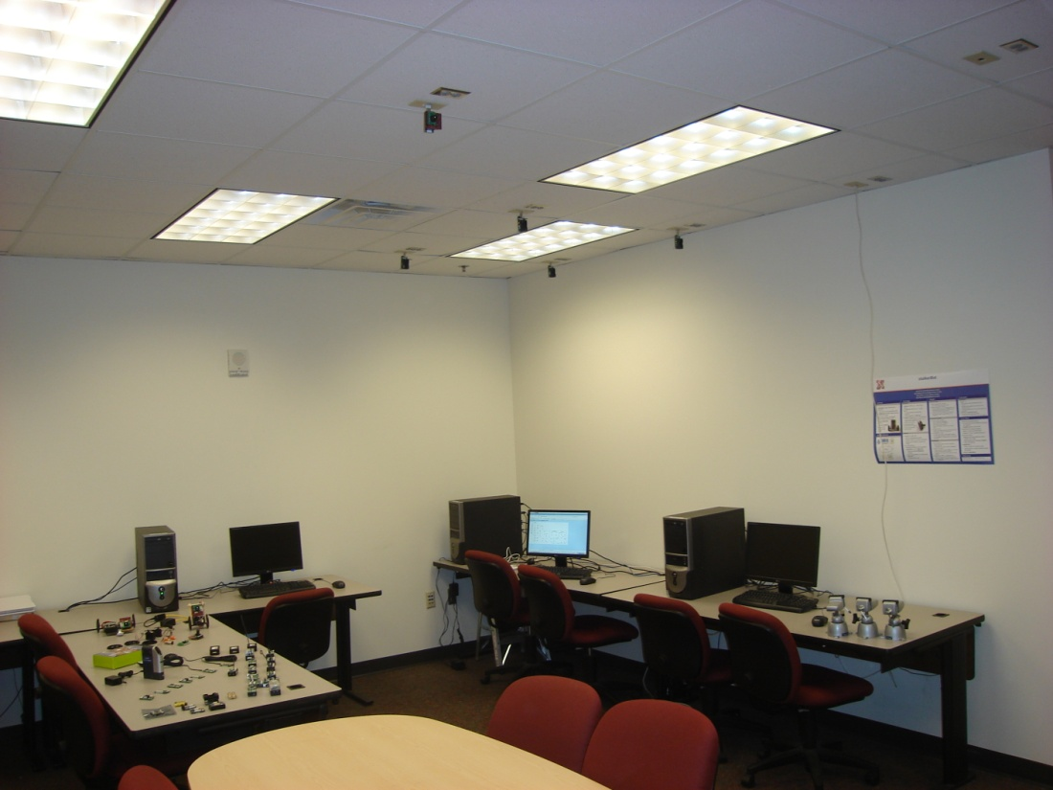
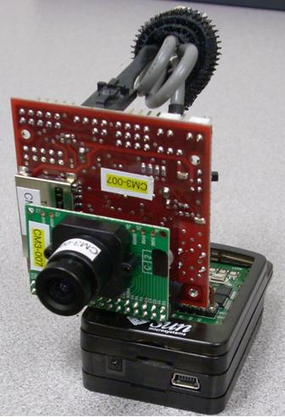
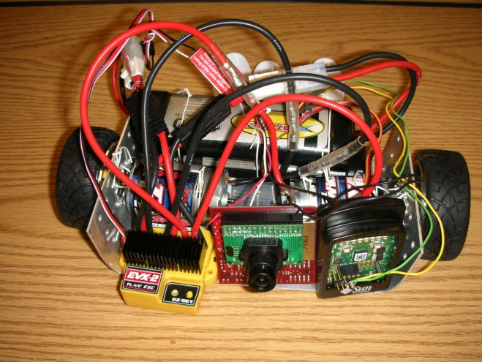
Wireless Multimedia Sensor Node

Slide 21
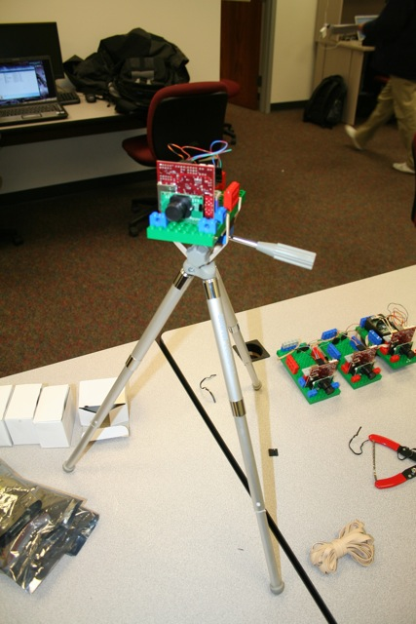
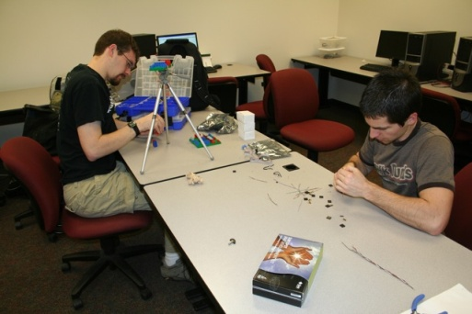
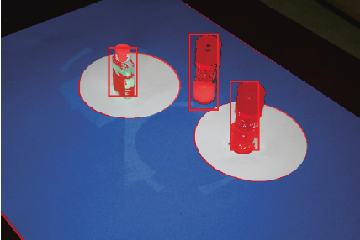
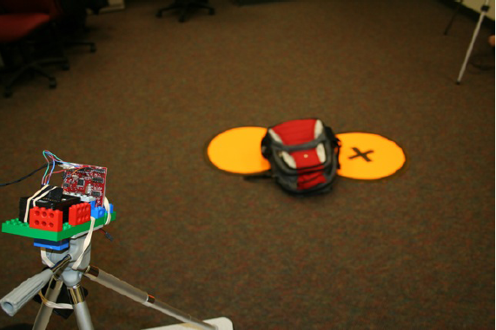
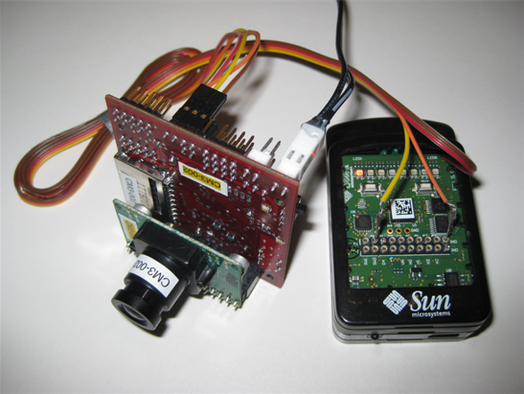
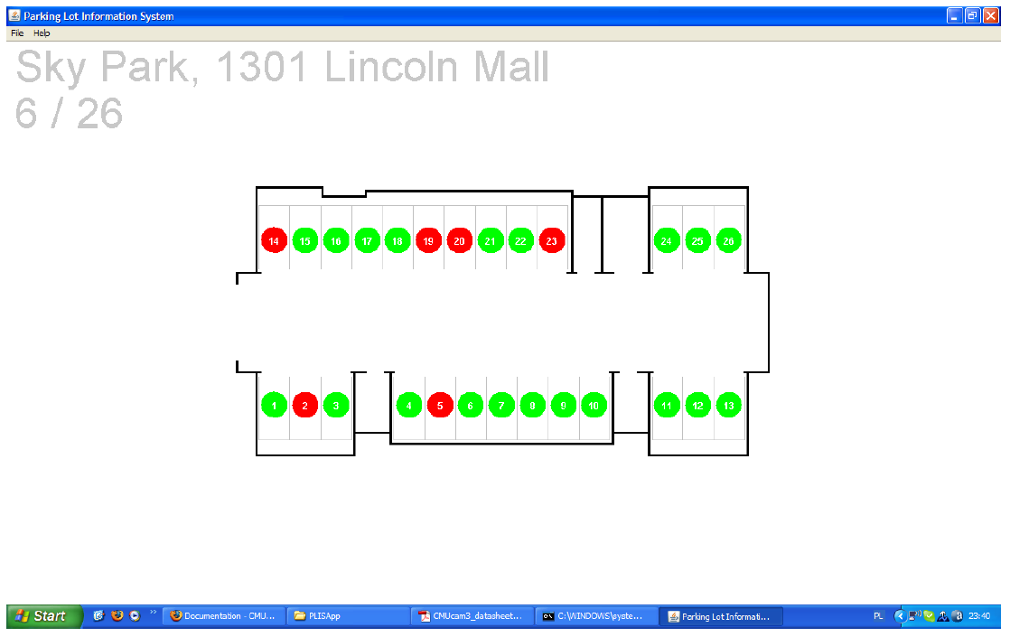
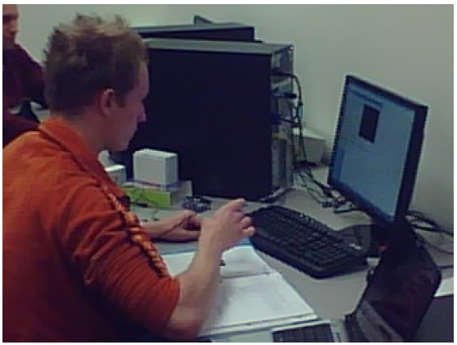
3D Environment Modeling with WSNs
Parking Lot Information System

Slide 22


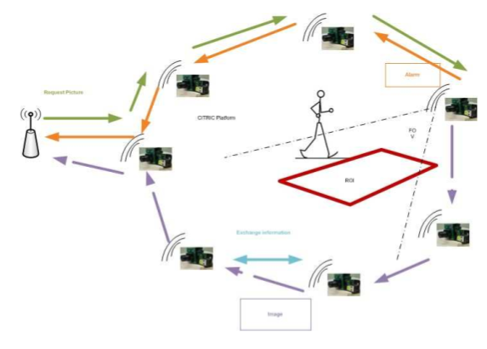
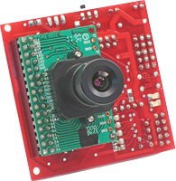
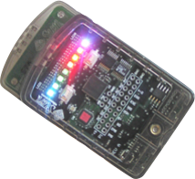
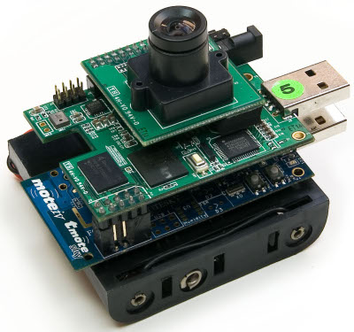
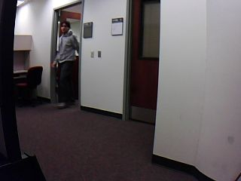
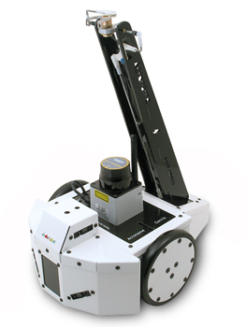
Testing and Surveillance using Sensor Networks

Slide 23
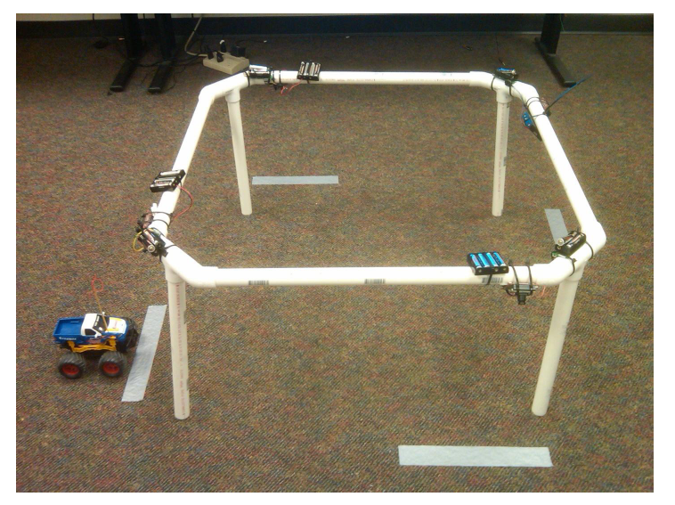
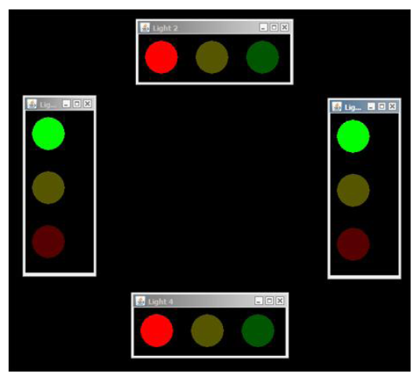
Traffic Control using Sensor Networks

Slide 24

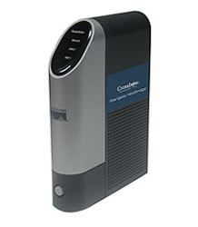
Interconnecting WSNs with Internet
WLAN
WSN
WSN

Slide 25
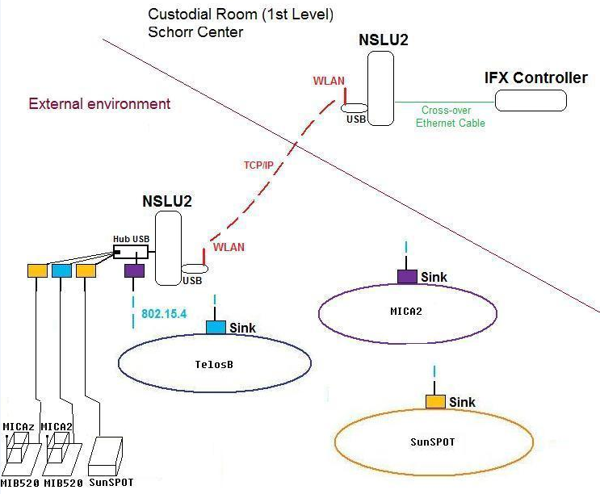
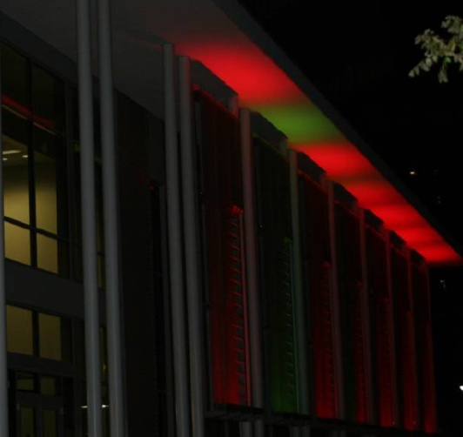
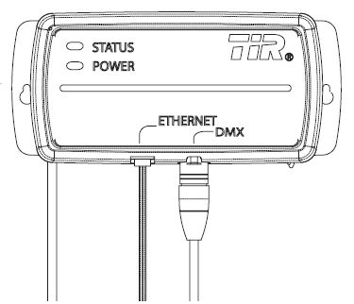
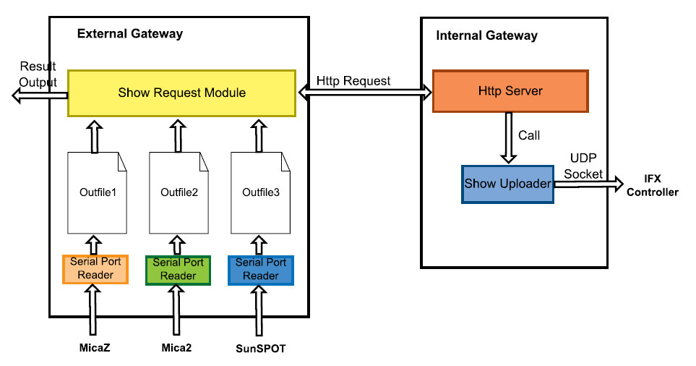
Distributed Building Light Control

Slide 26
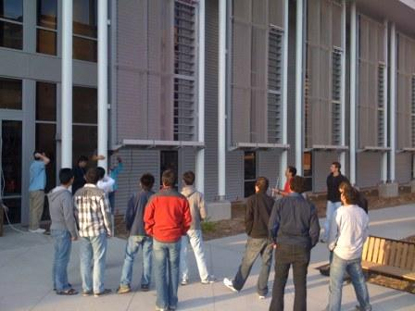
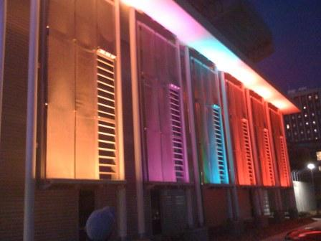
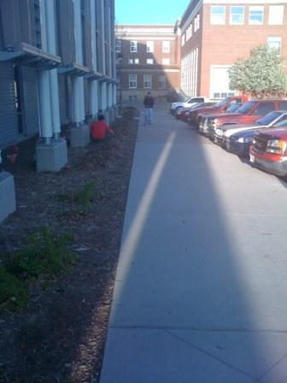
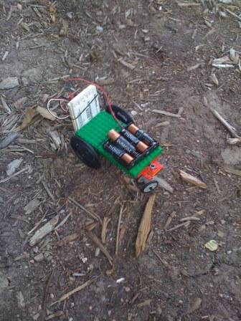
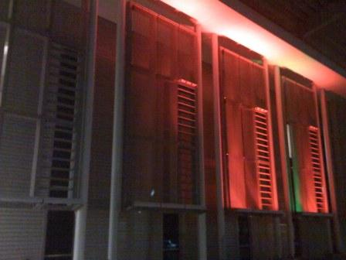
Distributed Building Light Control

Slide 27
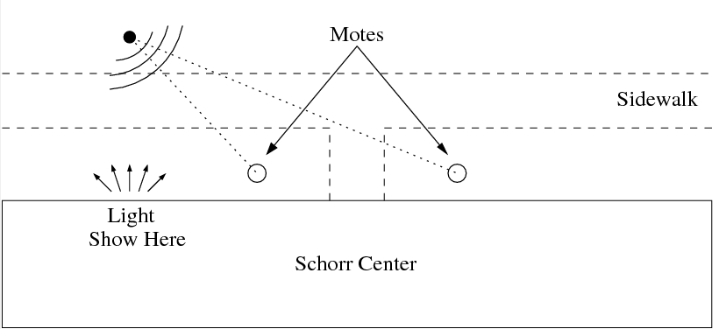
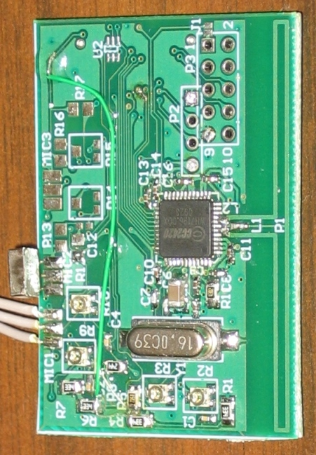
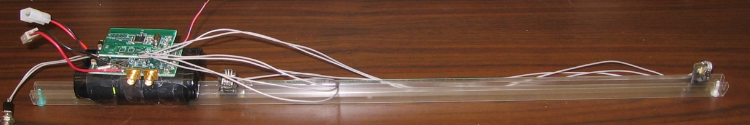
Distributed Clap/Sniper Detection

Slide 28
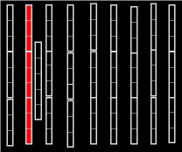
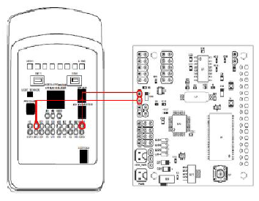
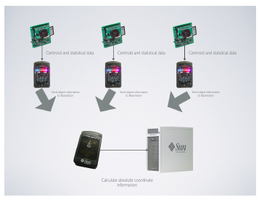
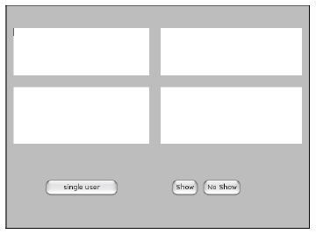
Distributed Building Light Control:
Motion Trackers
Video Surveillance

Slide 29
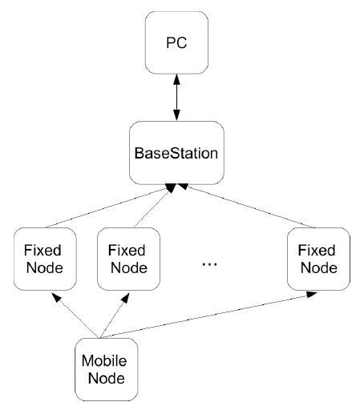
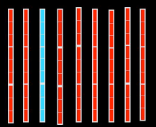
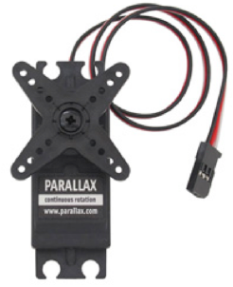
Distributed Building Light Control:
Tracker
Vehicle tracking

Slide 30
Wireless Sensor Networks

Slide 31





Wireless Underground Sensor Networks
A New Frontier
Tiny computers capable of wireless communication
On-board sensing capabilities (soil moisture, temperature, salinity, etc…)
Communication through soil
Networks for the Earth in the Earth
A. R. Silva and M. C. Vuran, ``Communication with Aboveground Devices in Wireless Underground Sensor Networks: An Empirical Study, ’’ in Proc. IEEE ICC '10, Cape Town, South Africa, May 2010.
A. R. Silva and M. C. Vuran, “Empirical Analysis of Underground-to-underground Communication in Wireless Underground
Sensor Networks,” in Proc. IEEE DCOSS ‘09, Marina Del Rey, CA, June 2009.
I. F. Akyildiz, Z. Sun, and M. C. Vuran, “Signal Propagation Techniques for Wireless Underground Communication Networks," Physical Communication Journal (Elsevier), vol. 2, no. 3, pp. 167-183, Sept. 2009.

Slide 32


Potential Applications of WUSNs
Sports field
irrigation
Precision
agriculture

Slide 33

Agricultural Networks
Monitoring nodes
Infrastructure nodes
Infrastructure and Management Network
Monitoring central
Mobile sinks
UG2UG Link
UG2AG Link
AG2UG Link
Topsoil Region
Subsoil Region
Monitoring Network
Real-time information about soil and crop conditions
Inter-connection of heterogeneous machinery with the management network
Complete autonomy on the field

Slide 34


Slide 35

Extremely Efficient Irrigation Systems using Wireless Underground Sensor Networks

Slide 36




Experiment Setup
The new antenna scheme is adopted.
Two scenarios: with and without corn crop (280cm-height).
Burial depth: 40cm.
Two soil moisture levels: VWC 16.6% and 22.7%.

Slide 37



New Project

Slide 38



Monitoring Environment Behavior
Combining Sensor Networks with Advanced Monitoring techniques
Save Whooping Crane from Extinction

