Slide 1




Consensus-based Mining of API Preconditions in Big Code
Hoan Nguyen
Robert Dyer
Tien N. Nguyen
Hridesh Rajan

Slide 2
API Preconditions
Constraints on the receiver and parameters that
must hold right before calling the API
start >= 0
start <= end
end <= length()
java.lang.String.substring(int start, int end)

Slide 3
API Preconditions
Must hold to guarantee the method behaves as expected
Otherwise → Bug

Slide 4
A bug with String.substring(int, int) in project MSS Code Factory
while (...) {
start++;
if (start >= lenMacro)
break;
ch = macro.substring(start, 1);
}
Notes:
MSS Code Factory revision 2464

Slide 5
A bug with String.substring(int, int) in project MSS Code Factory
while (...) {
start++;
if (start >= lenMacro)
break;
ch = macro.substring(start, 1);
}
StringIndexOutOfBoundsException when start > 1

Slide 6
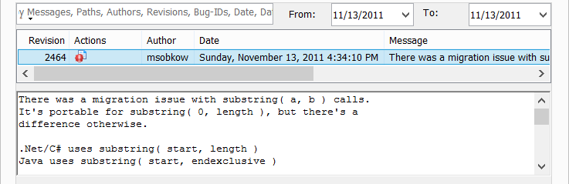
A bug with String.substring(int, int) in project MSS Code Factory
while (...) {
start++;
if (start >= lenMacro)
break;
ch = macro.substring(start, 1);
}
StringIndexOutOfBoundsException when start > 1

Slide 7
A bug with String.substring(int, int) in project MSS Code Factory
while (...) {
start++;
if (start >= lenMacro)
break;
ch = macro.substring(start, 1);
}

Slide 8
A precondition-related bug fix in project MSS Code Factory
while (...) {
start++;
if (start >= lenMacro)
break;
ch = macro.substring(start, 1);
}
fix bug
macro.substring(start, start + 1)

Slide 9
Study on the precondition-related bug fixing
Data collection
SourceForge projects: 3,413
Revisions: ~2M
Fixing revisions: ~370,000
Method
Analyzing code changes in each revision
Using heuristics to identify candidate fixing changes that added precondition(s)
Verifying candidates manually

Slide 10
Study on the precondition-related bug fixing
Result
Candidates:
3,130 (0.85%) fixing revisions
4,399 call sites
Manually verify a sample of 100 call sites
80 are actually related to missing preconditions

Slide 11
Use of Preconditions
Writing code conforming to the specifications
Automated program verification
Runtime assertion checking
Extended static checking
Bug detection
Automatic test case generation

Slide 12
Challenges
Manually specifying the specifications is time-consuming
Not many APIs are released with specified specifications
Mining Specifications Automatically

Slide 13
Prior Work
Focuses on single projects
This Work
Uses consensus across large number of projects to separate API-specific preconditions (wheat) from project-specific constraints (chaff)

Slide 14
Precondition Mining – Key Ideas
Preconditions can be mined from guard conditions at the call sites of the code using the APIs
Preconditions mined from multiple projects in a large-scale code corpus can be used to filter out chaff

Slide 15
Preconditions can be mined from guard conditions at the call sites of the code using the APIs
Key Ideas
Preconditions mined from multiple projects in a large-scale code corpus can be used to filter out chaff
C2
C2
C2
C1
C3
C1
C3
C1
C3
api()
api()
api()

Slide 16
Preconditions can be mined from guard conditions at the call sites of the code using the APIs
Key Ideas
Preconditions mined from multiple projects in a large-scale code corpus can be used to filter out chaff
C2
C2
C2
C1
C3
C1
C3
C1
C3
api()
api()
api()
C2
C2
C2
C1
C3
C1
C3
C1
C3
api()
api()
api()
C2
C2
C2
C1
C3
C1
C3
C1
C3
api()
api()
api()

Slide 17
Preconditions can be mined from guard conditions at the call sites of the code using the APIs
Key Ideas
Preconditions mined from multiple projects in a large-scale code corpus can be used to filter out chaff
C2
C2
C2
C1
C3
C1
C3
C1
C3
C2
api()
C2
api()
C2
api()
C2
C1
C3
C1
C3
C1
C3
C1
C3
api()
C2
api()
C2
api()
C2
api()
C1
C3
C1
C3
C1
C3
C2
api()
C2
api()
C2
api()
C2
C1
C3
C1
C3
C1
C3
C1
C3
api()
api()
C2
api()
C2
api()
C2
C1
C3
C1
C3
C1
C3
C2
api()
C2
api()
C2
api()
C2
C1
C3
C1
C3
C1
C3
C1
C3
api()
api()
api()
api()

Slide 18
Preconditions can be mined from guard conditions at the call sites of the code using the APIs
Key Ideas
Preconditions mined from multiple projects in a large-scale code corpus can be used to filter out chaff
C2
C2
C2
C2
C2
C2
C2
C1
C3
C1
C3
C1
C3
C1
C3
C1
C3
C1
C3
C1
C3
api()
C2
api()
api()
api()
api()
C2
api()
api()
C2
C2
C2
C2
C2
C1
C3
C1
C3
C1
C3
C1
C3
C1
C3
C1
C3
C1
C3
C2
api()
C2
C2
C2
C2
api()
api()
C2
api()
api()
api()
api()
C2
C1
C3
C1
C3
C1
C3
C1
C3
C1
C3
C1
C3
C1
C3
api()
api()
api()
api()
api()
api()
C2
api()
C2
C2
C2
C2
C2
C2
C1
C3
C1
C3
C1
C3
C1
C3
C1
C3
C1
C3
C1
C3
api()
api()
C2
api()
api()
api()
C2
api()
C2
api()
C2
C2
C2
C2
C1
C3
C1
C3
C1
C3
C1
C3
C1
C3
C1
C3
C1
C3
api()
api()
api()
api()
api()
C2
api()
C2
C2
api()
C2
C2
C2
C2
C1
C3
C1
C3
C1
C3
C1
C3
C1
C3
C1
C3
C1
C3
api()
api()
api()
api()
api()
api()
api()

Slide 19
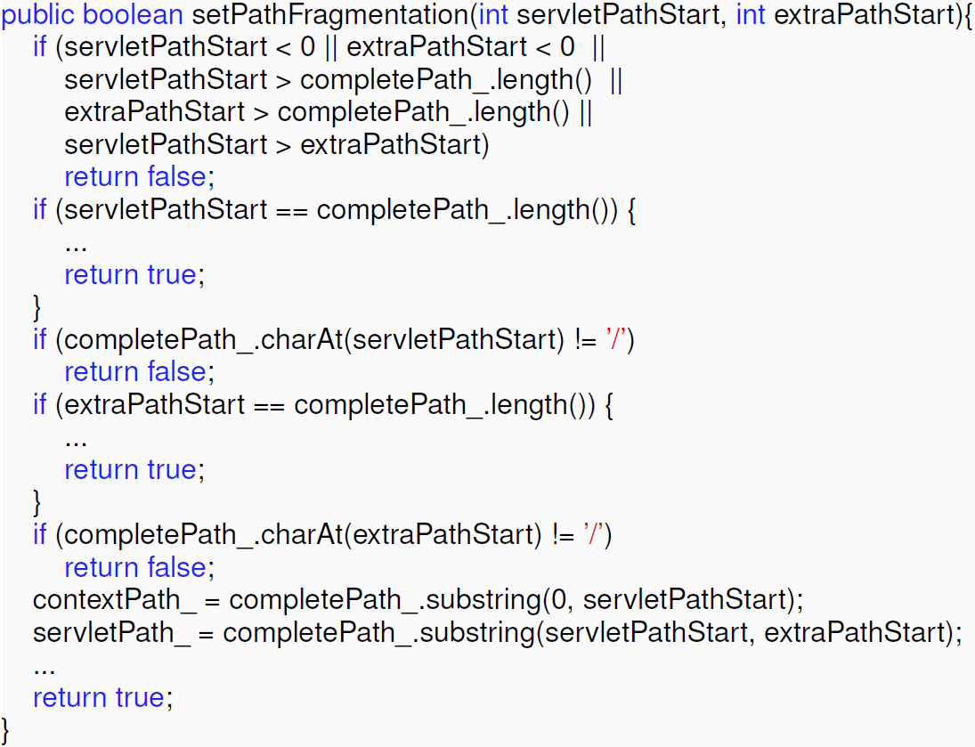
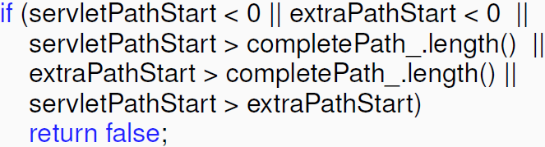
Preconditions can be mined from guard conditions at the call sites of the code using the APIs
servletPathStart >= 0
extraPathStart >= 0
servletPathStart <= completePath_.length()
extraPathStart <= completePath_.length()
servletPathStart <= extraPathStart
completePath_.substring(servletPathStart, extraPathStart)
Client code of API String.substring(int,int) in project SeMoA at revision 1929

Slide 20

Project-specific guard conditions will be filtered
completePath_.charAt(servletPathStart) == ‘/’
completePath_.charAt(extraPathStart) == ‘/’
completePath_.substring(servletPathStart, extraPathStart)

Slide 21
Consensus-based Precondition Mining
Conditions
0 <= start
start <= end
end <= length
contains(‘@’)
Client method
M₁
Extract
and
Normalize
Conditions
Build CFG
api(...)
Conditions
...
0 <= start
start <= end
end <= length
contains(‘@’)
0 = start
start <= end
end <= length
starts(‘/’)
Extract
and
Normalize
Conditions
Infer
Filter
and
Rank
Preconditions
Client method
M_{i}
Build CFG
api(...)
0 <= start
start <= end
end <= length
...
0 < start
start <= end
end <= length
ends(‘\n’)
Extract
and
Normalize
Conditions
Client method
M_{N}
Build CFG
api(...)

Slide 22
Precondition Mining
class String
...
substring (int, int)
...
Entry
true
start > end
Exit
false
client method
true
c1
false
Build CFG
do_true
do_false
string.substring (start, end)
Exit

Slide 23
Precondition Mining
substring (int, int): {start <= end}
Entry
true
start > end
Exit
false
client method
true
c1
false
Build CFG
control-dependent
do_true
do_false
string.substring (start, end)
Exit

Slide 24
Precondition Mining
substring (int, int): {start <= end}
Entry
true
start > end
Exit
false
client method
true
c1
false
Build CFG
do_true
do_false
string.substring (start, end)
Exit

Slide 25
Precondition Mining
substring (int, int): {start <= end}
Entry
true
start > end
Exit
false
client method
true
c1
false
Build CFG
do_true
do_false
string.substring (start, end)
Exit

Slide 26
Precondition Mining
substring (int, int): {start <= end}
Entry
Abstract
true
start > end
substring (int, int): {arg0 <= arg1}
Exit
false
client method
true
c1
false
Build CFG
do_true
do_false
string.substring (start, end)
Exit

Slide 27
Precondition Mining
arg0 < arg1
arg1 > arg0
arg0 – arg1 < 0
arg1 – arg0 > 0

Slide 28
Precondition Mining
Normalize
arg0 < arg1
arg1 > arg0
arg0 < arg1
arg0 – arg1 < 0
arg1 – arg0 > 0

Slide 29
Precondition Mining
Normalize
arg0 < arg1
arg1 > arg0
arg0 < arg1
arg0 – arg1 < 0
arg1 – arg0 > 0
arg0 – arg1 == 0
arg0 == arg1
arg0 == arg1

Slide 30
Precondition Mining
Normalize
Infer
arg0 < arg1
arg1 > arg0
arg0 < arg1
arg0 – arg1 < 0
arg1 – arg0 > 0
arg0 <= arg1
arg0 – arg1 == 0
arg0 == arg1
arg0 == arg1

Slide 31
Precondition Mining
Normalize
Infer
Filter and Rank
arg0 < arg1
arg1 > arg0
arg0 < arg1
arg0 – arg1 < 0
confidence > σ
arg1 – arg0 > 0
arg0 <= arg1
arg0 <= arg1
arg0 – arg1 == 0
arg0 == arg1
arg0 == arg1

Slide 32

Precondition Mining
Normalize
Infer
Filter and Rank
arg0 < arg1
arg1 > arg0
arg0 < arg1
arg0 – arg1 < 0
confidence > σ
arg1 – arg0 > 0
arg0 <= arg1
arg0 <= arg1
arg0 – arg1 == 0
arg0 == arg1
arg0 == arg1
confidence < σ
arg0 <= 12
arg0 <= 12
arg0 <= 12

Slide 33
Tool Implementation
Eclipse plugin

Slide 34
Datasets
 | SourceForge | Apache
Projects | 3,413 | 146
Total source files | 497,453 | 132,951
Total classes | 600,274 | 173,120
Total methods | 4,735,151 | 1,243,911
Total SLOCs | 92,495,410 | 25,117,837
Total used JDK classes | 806 (63%) | 918 (72%)
Total used JDK methods | 7,592 (63%) | 6,109 (55%)
Total method calls | 22,308,251 | 5,544,437
Total JDK method calls | 5,588,487 | 1,271,210

Slide 35
Datasets
 | SourceForge | Apache
Projects | 3,413 | 146
Total source files | 497,453 | 132,951
Total classes | 600,274 | 173,120
Total methods | 4,735,151 | 1,243,911
Total SLOCs | 92,495,410 | 25,117,837
Total used JDK classes | 806 (63%) | 918 (72%)
Total used JDK methods | 7,592 (63%) | 6,109 (55%)
Total method calls | 22,308,251 | 5,544,437
Total JDK method calls | 5,588,487 | 1,271,210
Almost 120 millions lines of source code

Slide 36
Datasets
 | SourceForge | Apache
Projects | 3,413 | 146
Total source files | 497,453 | 132,951
Total classes | 600,274 | 173,120
Total methods | 4,735,151 | 1,243,911
Total SLOCs | 92,495,410 | 25,117,837
Total used JDK classes | 806 (63%) | 918 (72%)
Total used JDK methods | 7,592 (63%) | 6,109 (55%)
Total method calls | 22,308,251 | 5,544,437
Total JDK method calls | 5,588,487 | 1,271,210
Not all JDK APIs are used in SourceForge and Apache

Slide 37
Datasets
 | SourceForge | Apache
Projects | 3,413 | 146
Total source files | 497,453 | 132,951
Total classes | 600,274 | 173,120
Total methods | 4,735,151 | 1,243,911
Total SLOCs | 92,495,410 | 25,117,837
Total used JDK classes | 806 (63%) | 918 (72%)
Total used JDK methods | 7,592 (63%) | 6,109 (55%)
Total method calls | 22,308,251 | 5,544,437
Total JDK method calls | 5,588,487 | 1,271,210
More than 20% method calls are to JDK APIs

Slide 38
Evaluation – Accuracy
Building ground-truth
Extracting preconditions from published formal specifications for JDK APIs on JML website
Data collection
/*@ public normal_behavior
@ requires 0 <= beginIndex
@ && beginIndex <= endIndex
@ && endIndex <= length();
@ …
/*@ public behavior
@ …
@ signals (NoSuchElementException) isEmpty();
@*/

Slide 39
Building ground-truth
Number of methods: 797
Number of preconditions: 1155

Slide 40
Evaluation – Accuracy
Metrics
Precision
Recall
Data collection

Slide 41
Running Time for Mining Preconditions of 797 JDK APIs
 | SLOCs | Client methods | Time
SourceForge | 92M | 4.7M | 17h35m
Apache | 25M | 1.2M | 34m

Slide 42
Types of Incorrectly-mined Preconditions
Type 1. The mined preconditions are stronger than specified
java.util.List.add(Object obj): obj != null
Type 2. The mined preconditions are project-specific, but common
java.lang.Math.min(double a, double b): a > 0, b > 0
Type 3. The mined preconditions are incorrect due to error in analysis
java.lang.StringBuffer.ensureCapacity(int capacity): capacity <= 0
Dataset | Total | Stronger | Specific | Analysis Error
SourceForge | 173 | 118 | 53 | 2
Apache | 187 | 121 | 65 | 1
Both | 195 | 129 | 66 | 0
Developers sometimes check stronger preconditions than specified

Slide 43
Types of Missing Preconditions
Type 1. Private
Preconditions involve private element(s) of classes
Type 2. No call
Methods are never called
Type 3. No occur
Preconditions are never checked
Type 4. Low frequency
Preconditions are checked with low confidence
 | Private | No call | No occur | Low confidence
SF | 4% | 4% | 9% | 3%
Apache | 5% | 5% | 12% | 3%
Both | 5% | 2% | 10% | 4%

Slide 44
Accuracy over Preconditions
 | Precision | Recall
SourceForge | 84% | 79%
Apache | 82% | 75%
Both | 83% | 80%

Slide 45
Newly Found Preconditions
5 preconditions are newly found for the JDK API methods that has already had JML specifications
Method | Precondition
String. getChars(int,int,char[],int) | arg3 >= 0
StringBuffer.append(char[]) | arg0 != null
BitSet.flip(int, int) | arg0 <= arg1
BitSet.set(int, int) | arg0 <= arg1
BitSet.set(int, int, boolean) | arg0 <= arg1

Slide 46
Accuracy by size
SourceForge
Apache

Slide 47
Evaluation – Usefulness
Suggesting preconditions for writing formal specification
Web-based survey

Slide 48
Suggesting Preconditions for Writing Formal Specifications
Class | Method | Suggest | Accept
StringBuffer | delete(int,int) | 3 | Y
 | replace(int,int,String) | 2 | Y*
 | setLength(int) | 1 | Y
 | subSequence(int,int) | 3 | Y
 | substring(int,int) | 3 | Y
LinkedList | add(int,Object) | 2 | Y
 | addAll(int,Collection) | 3 | Y
 | get(int) | 2 | Y
 | listIterator(int) | 2 | Y
 | remove(int) | 2 | Y
 | set(int,Object) | 2 | Y
2 classes | 11 methods | 25
miss

Slide 49
Conclusions
Mining API preconditions from large code corpus
120 million SLOCs on SourceForge and Apache
Tool implementation: Eclipse plugin
High accuracy
Recall: 75–80% and Precision: 82–84%
Useful for helping write specifications
All suggestions are accepted by specification writer

Slide 50
Contact
Hoan Nguyen
hoan@iastate.edu

Slide 51
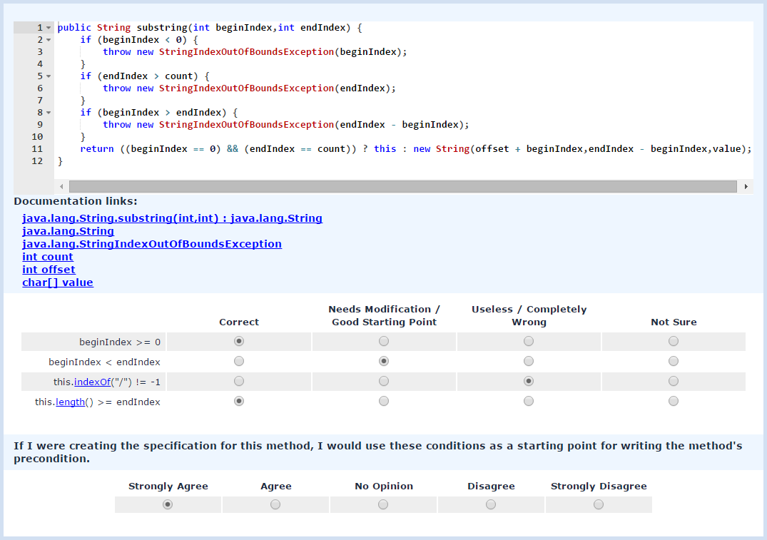
Web-based Survey http://boa.cs.iastate.edu/jml/
API method
Notes:
Participants were shown one method at a time and its mined precondition(s)
Participants rated the correctness of each precondition
Correct
Good starting point
Incorrect
Participants rated the usefulness of mined precondition(s) for each method
Strongly Agree, Agree, Disagree and Strongly Disagree

Slide 52
Web-based Survey http://boa.cs.iastate.edu/jml/
Documentation links
Notes:
Participants were shown one method at a time and its mined precondition(s)
Participants rated the correctness of each precondition
Correct
Good starting point
Incorrect
Participants rated the usefulness of mined precondition(s) for each method
Strongly Agree, Agree, Disagree and Strongly Disagree

Slide 53
Web-based Survey http://boa.cs.iastate.edu/jml/
Mined preconditions
Notes:
Participants were shown one method at a time and its mined precondition(s)
Participants rated the correctness of each precondition
Correct
Good starting point
Incorrect
Participants rated the usefulness of mined precondition(s) for each method
Strongly Agree, Agree, Disagree and Strongly Disagree

Slide 54
Web-based Survey http://boa.cs.iastate.edu/jml/
Rating on correctness
Notes:
Participants were shown one method at a time and its mined precondition(s)
Participants rated the correctness of each precondition
Correct
Good starting point
Incorrect
Participants rated the usefulness of mined precondition(s) for each method
Strongly Agree, Agree, Disagree and Strongly Disagree

Slide 55
Web-based Survey http://boa.cs.iastate.edu/jml/
Rating on correctness
Rating on usefulness
Notes:
Participants were shown one method at a time and its mined precondition(s)
Participants rated the correctness of each precondition
Correct
Good starting point
Incorrect
Participants rated the usefulness of mined precondition(s) for each method
Strongly Agree, Agree, Disagree and Strongly Disagree

Slide 56
Web-based Survey http://boa.cs.iastate.edu/jml/

Slide 57
Web-based Survey http://boa.cs.iastate.edu/jml/

