Slide 1

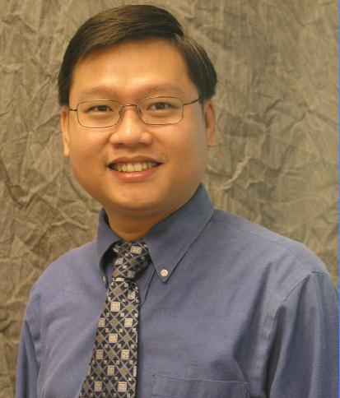


Demonstrating Programming Language Feature Mining using Boa
Robert Dyer
Hridesh Rajan
Tien N. Nguyen
Hoan Anh Nguyen
These research activities supported in part by the US National Science Foundation (NSF) grants CNS-15-13263, CNS-15-12947, CCF-15-18897, CCF-15-18776, CCF-14-23370, CCF-13-49153, CCF-13-20578, TWC-12-23828, CCF-11-17937, CCF-10-17334, and CCF-10-18600.

Slide 2
Today’s talk is about Mining Software Repositories at an Ultra-large-scale

Slide 3
What do I mean by software repository?

Slide 4










Slide 5
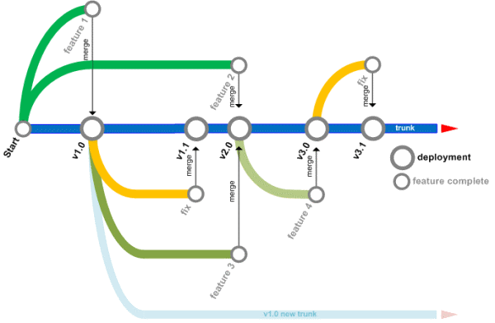




What features do they have?

Slide 6
What do I mean by mining software repositories (MSR)?

Slide 7

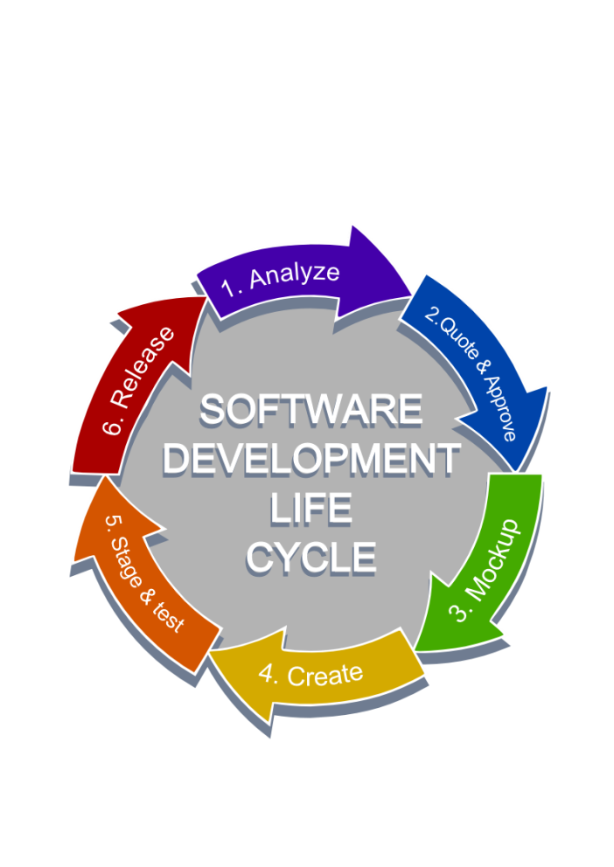



Slide 8
What are some examples of software repository mining?

Slide 9
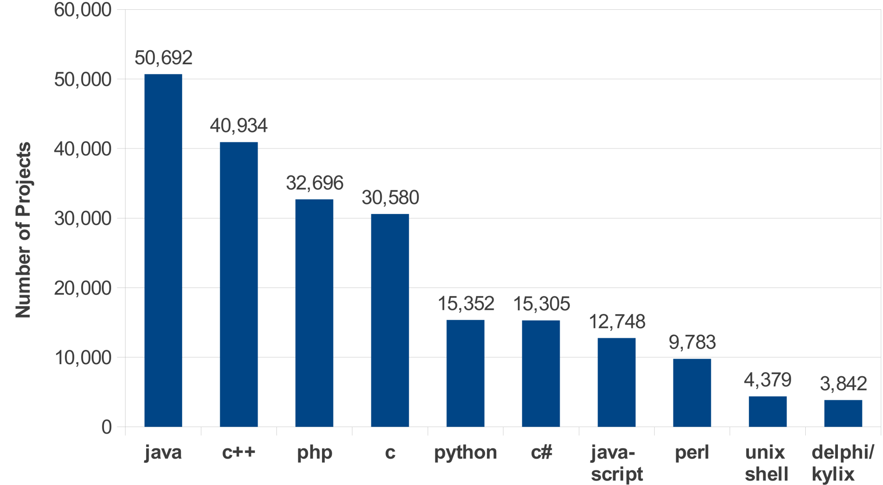
What is the most used programming language?

Slide 10
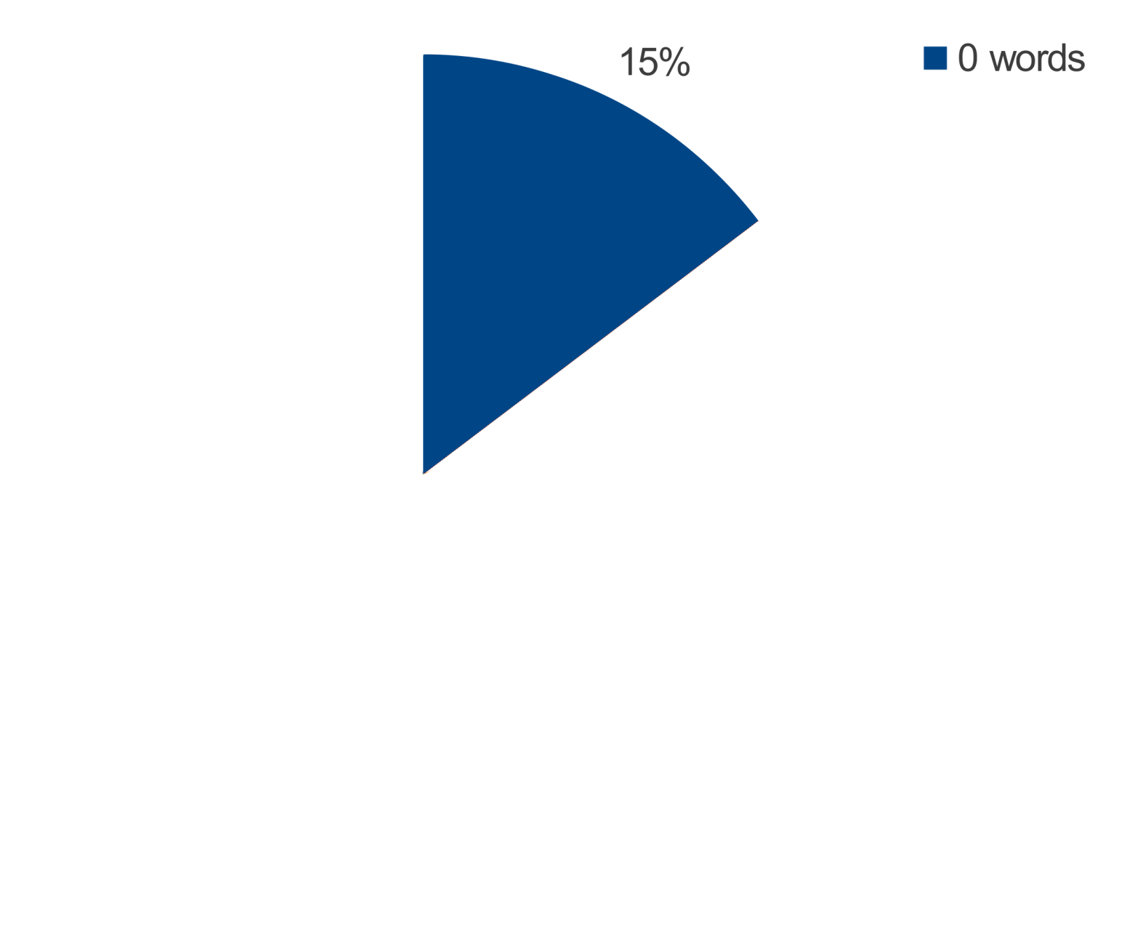
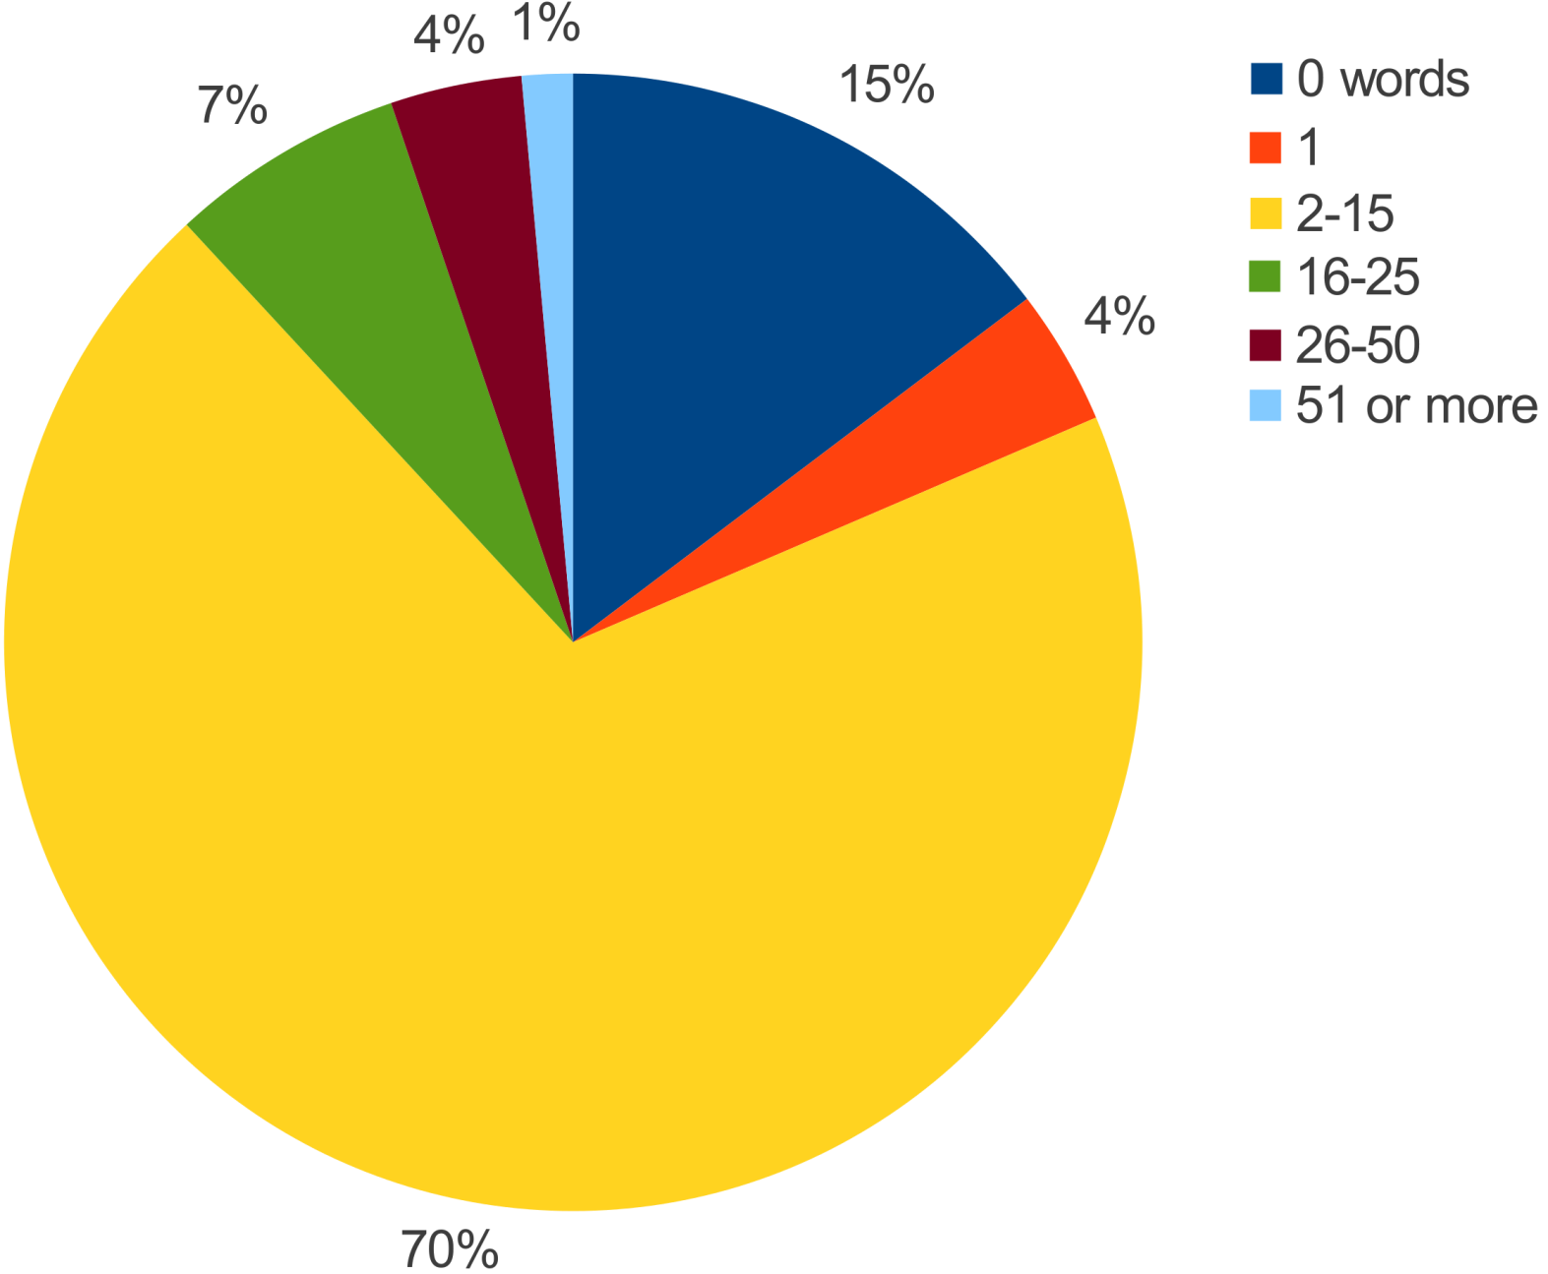
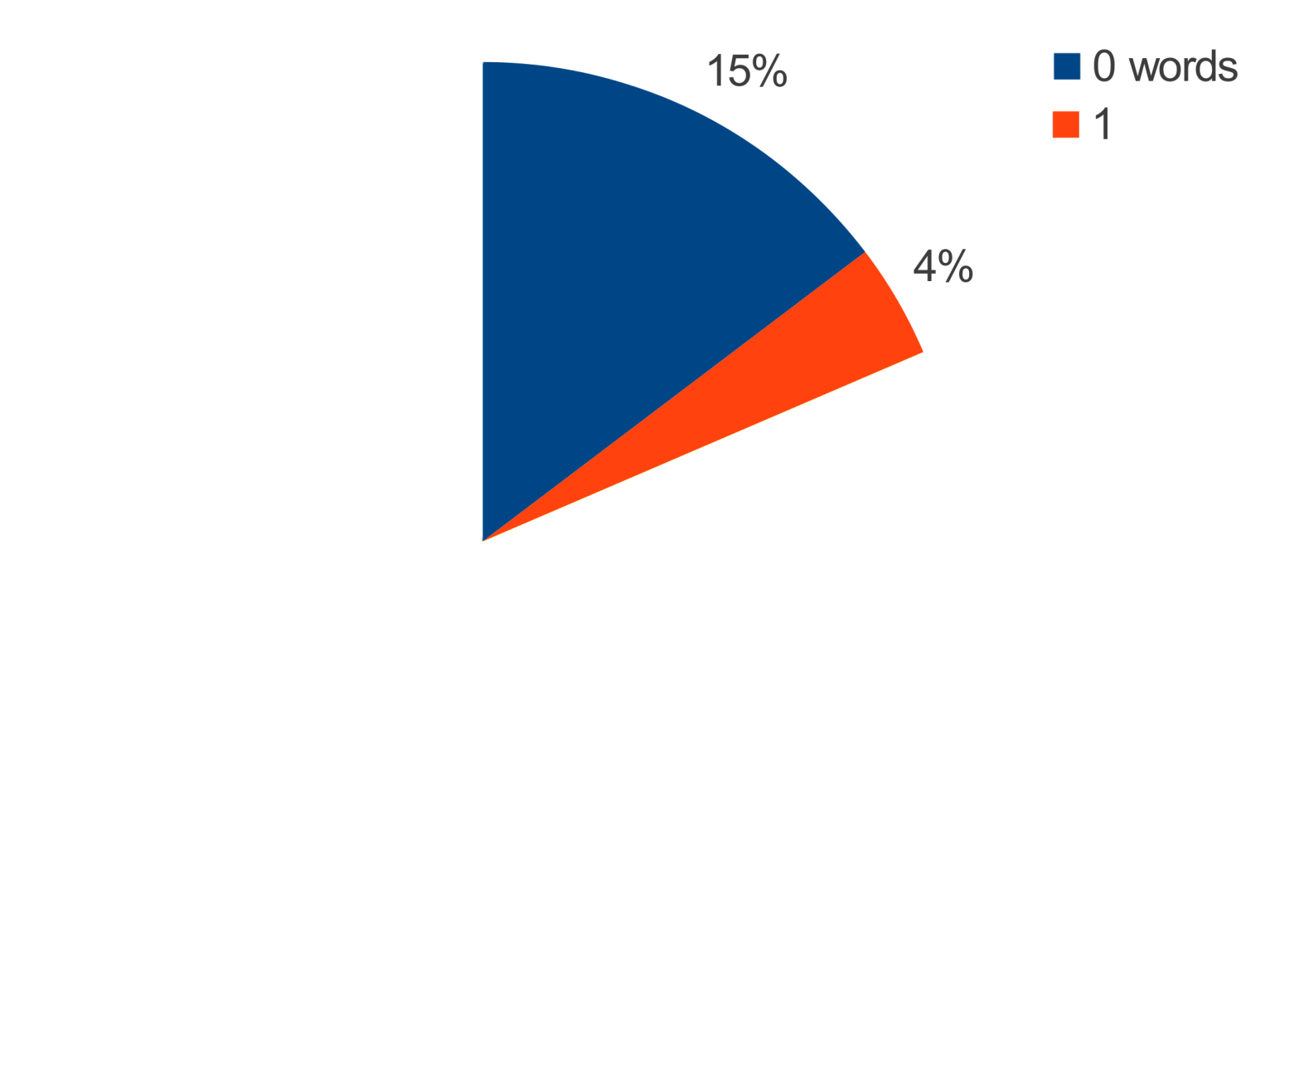
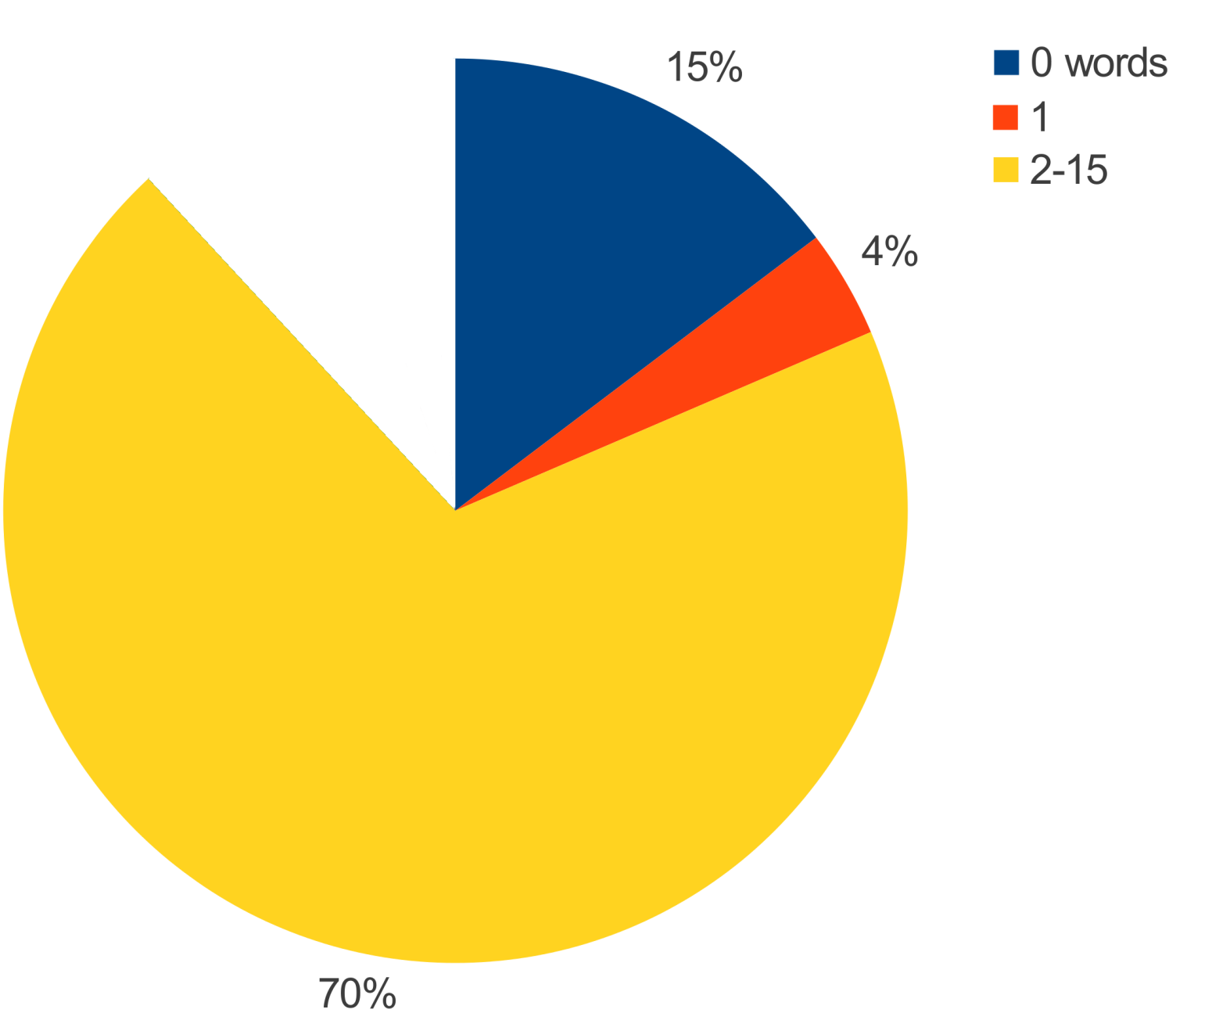
How many words are in commit messages?
Words[] = update, 30715
Words[] = cleanup, 19073
Words[] = updated, 18737
Words[] = refactoring, 11981
Words[] = fix, 11705
Words[] = test, 9428
Words[] = typo, 9288
Words[] = updates, 7746
Words[] = javadoc, 6893
Words[] = bugfix, 6295

Slide 11
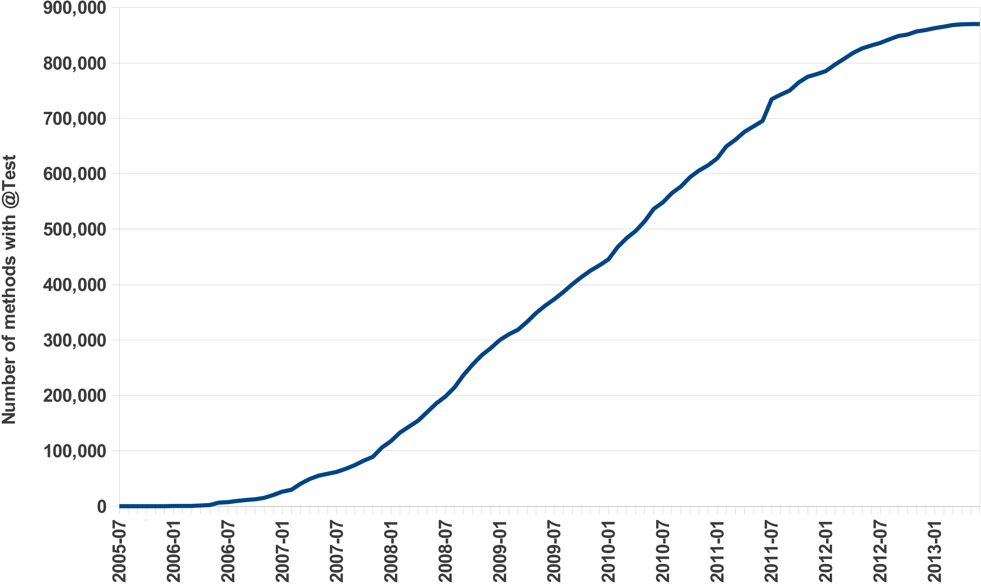
How has unit testing been adopted over time?
JUnit 4 release

Slide 12
What makes this ultra-large-scale mining?

Slide 13
Previous examples queried...
Projects | 699,331
Code Repositories | 494,158
Revisions | 15,063,073
Unique Files | 69,863,970
File Snapshots | 147,074,540
AST Nodes | 18,651,043,23
Over 250GB of pre-processed data
from SourceForge

Slide 14
Most recent dataset (Sep 2015)
Projects | 7,830,023
Code Repositories | 380,125
Revisions | 23,229,406
Unique Files | 146,398,339
File Snapshots | 484,947,086
AST Nodes | 71,810,106,868
Over 270GB of pre-processed data
from GitHub (focusing on Java projects)

Slide 15
What am I interested in?

Slide 16
Language Studies
What languages do
programmers choose?
[Meyerovich&Rabkin SPLASH'13]
Reflection
[Livshits et al. APLAS'05]
[Callaú et al. MSR'11]
Object-oriented Features
[Tempero et al. ECOOP'08]
[Muschevici et al. OOPSLA'08]
[Tempero ASWEC'09]
[Grechanik et al. ESEM'10]
[Gorschek et al. ICSE'10]
Generics
[Basit et al. SEKE'05]
[Parnin et al. MSR'11]
[Hoppe&Hanenberg SPLASH'13]
JavaScript / eval
[Yue&Wang WWW'09]
[Richards et al. PLDI'10]
[Ratanaworabhan et al. WEBAPPS'10]
[Richards et al. ECOOP'11]

Slide 17
Finding use of assert
Requires use of a parser (e.g. JDT)
Requires knowledge of several APIs
SF.net / GitHub API
SVNkit/JGit/etc
Must be manually parallelized

Slide 18
Finding use of assert
ASSERTS: output sum of int;
visit(input, visitor {
before node: CodeRepository -> {
snapshot := getsnapshot(node, "SOURCE_JAVA_JLS");
foreach (i: int; def(snapshot[i]))
visit(snapshot[i]);
stop;
}
before node: Statement ->
if (node.kind == StatementKind.ASSERT)
ASSERTS << 1;
});
Only 12 lines of code
Automatically parallelized
No external libraries
Analyzes 18 billion AST nodes in minutes

Slide 19


Boa
[TOSEM] (to appear)
[ICSE'14]
[GPCE'13]
[ICSE'13]
http://boa.cs.iastate.edu/

Slide 20
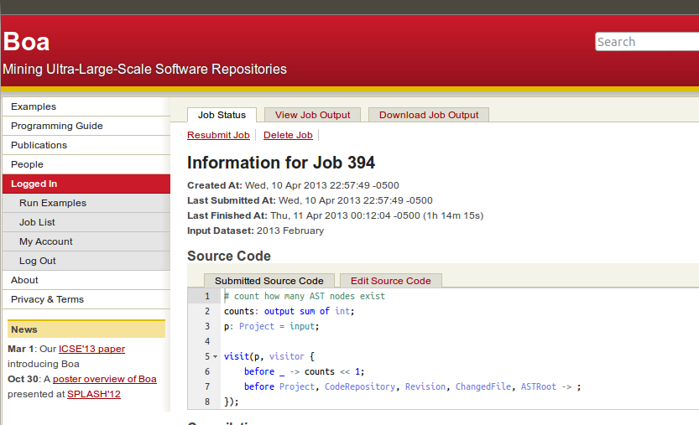




Boa's Architecture
Query result
returned
via web
Boa's Data Infrastructure
User submits
query
Replicate
and Transform
Compiled into
Hadoop program
Stored on
cluster
Deployed and
executed on cluster
cache
Boa's Computing Infrastructure

Slide 21
Automatic Parallelization
ASSERTS: output sum of int;
visit(input, visitor {
before node: CodeRepository -> {
snapshot := getsnapshot(node, "SOURCE_JAVA_JLS");
foreach (i: int; def(snapshot[i]))
visit(snapshot[i]);
stop;
}
before node: Statement ->
if (node.kind == StatementKind.ASSERT)
ASSERTS << 1;
});
Output variables with built in aggregator functions:
sum, mean, top(k), bottom(k), set, collection, etc
Compiler generates Hadoop MapReduce code

Slide 22
Abstracting MSR with Types
ASSERTS: output sum of int;
visit(input, visitor {
before node: CodeRepository -> {
snapshot := getsnapshot(node, "SOURCE_JAVA_JLS");
foreach (i: int; def(snapshot[i]))
visit(snapshot[i]);
stop;
}
before node: Statement ->
if (node.kind == StatementKind.ASSERT)
ASSERTS << 1;
});
Custom domain-specific types for mining software repositories
5 base types and 9 types for source code
No need to understand multiple data formats or APIs

Slide 23
Abstracting MSR with Types
Project
1
*
CodeRepository
1
*
Revision
1
1..*
ChangedFile
1
0..1
ASTRoot

Slide 24
Abstracting MSR with Types
ASTRoot
1
1..*
Namespace
1
*
1
1
Declaration
1
*
*
*
Method
Variable
Type
1
*
1
Statement
*
Expression

Slide 25
Challenge: How can we make mining source code easier?
Answer: Declarative Visitors

Slide 26
Easing Source Code Mining with Visitors
id := visitor {
before T -> statement;
after T -> statement;
};
visit(node, id);

Slide 27
Easing Source Code Mining with Visitors
id := visitor {
before id : T1 -> statement;
before T2, T3 -> statement;
before _ -> statement;
};

Slide 28
Easing Source Code Mining with Visitors
ASTRoot
ASTRoot
Namespace
Namespace
Declaration
Declaration
Method
Method
Variable
Variable
Type
Type
Statement
Statement
Expression
Expression

Slide 29
Easing Source Code Mining with Visitors
ASTRoot
before n: Declaration -> {
}
before n: Declaration -> {
foreach (i: int; n.fields[i])
visit(n.fields[i]);
}
before n: Declaration -> {
foreach (i: int; n.fields[i])
visit(n.fields[i]);
stop; }
Namespace
Declaration
Method
Variable
Type
Statement
Expression

Slide 30
Let’s revisit the assert use example.

Slide 31
Finding use of assert
ASSERTS: output sum of int;

Slide 32
Finding use of assert
ASSERTS: output sum of int;
visit(input, visitor {
});

Slide 33
Finding use of assert
ASSERTS: output sum of int;
visit(input, visitor {
before node: Statement ->
});

Slide 34
Finding use of assert
ASSERTS: output sum of int;
visit(input, visitor {
before node: Statement ->
if (node.kind == StatementKind.ASSERT)
});

Slide 35
Finding use of assert
ASSERTS: output sum of int;
visit(input, visitor {
before node: Statement ->
if (node.kind == StatementKind.ASSERT)
ASSERTS << 1;
});

Slide 36
Finding use of assert
ASSERTS: output sum of int;
visit(input, visitor {
before node: CodeRepository -> {
snapshot := getsnapshot(node, "SOURCE_JAVA_JLS");
foreach (i: int; def(snapshot[i]))
visit(snapshot[i]);
stop;
}
before node: Statement ->
if (node.kind == StatementKind.ASSERT)
ASSERTS << 1;
});

Slide 37
Let’s see that query in action!

Slide 38
Dataset
Processes
Assert = 538372
input = project₁
Boa Program
Assert << 1;
Output
Assert << 1;
input = project₂
Boa Program
input = project₃
Boa Program
Assert
1
1
1
.
.
.
.
.
.
1
1
1
1
input = project_{n}
Boa Program
ASSERTS: output sum of int;
visit(input, visitor {
before node: CodeRepository -> {
snapshot := getsnapshot(node, "SOURCE_JAVA_JLS");
foreach (i: int; def(snapshot[i]))
visit(snapshot[i]);
stop;
}
before node: Statement ->
if (node.kind == StatementKind.ASSERT)
ASSERTS << 1;
});

Slide 39
Back to our feature study…

Slide 40
What is our study about?
How have new Java language features
been adopted over time?
Assume Java
Corpus of 30k+ projects
Over 10 years of history
Study 18 new features from 3 language editions

Slide 41
Research Questions
RQ2: How frequently is each feature used?
RQ4: Could features have been used more?
RQ5: Was old code converted to use new features?

Slide 42
Research Question 2
How frequently was each
language feature used?

Slide 43
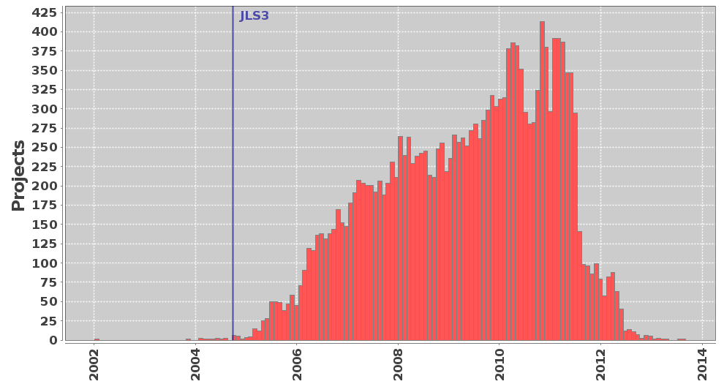
Project Histogram: Annotation Use

Slide 44
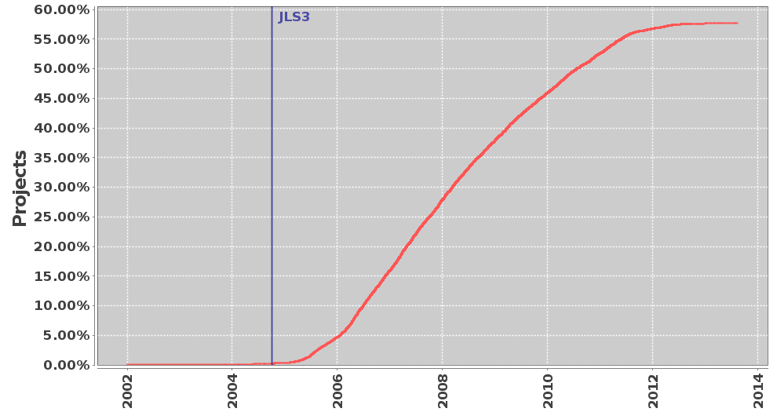
Project Density: Annotation Use

Slide 45
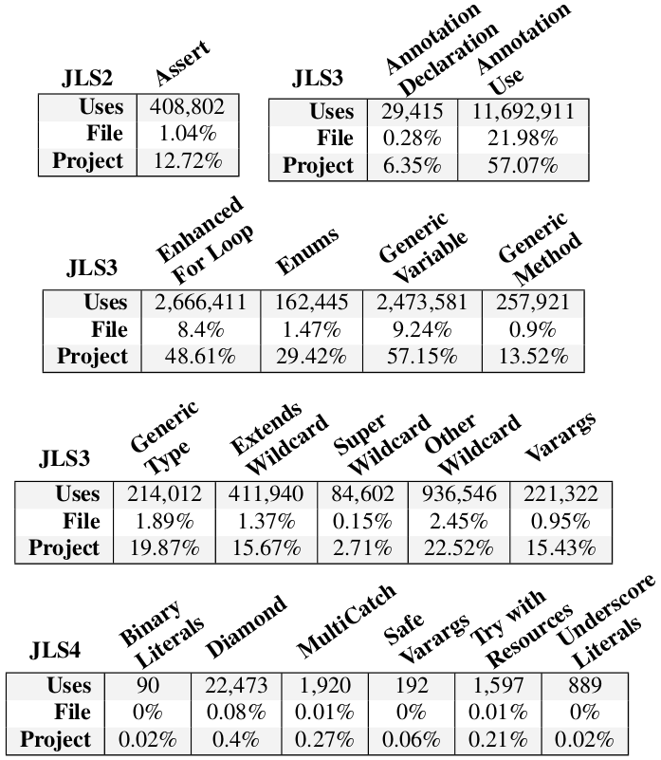
Some features popular

Slide 46
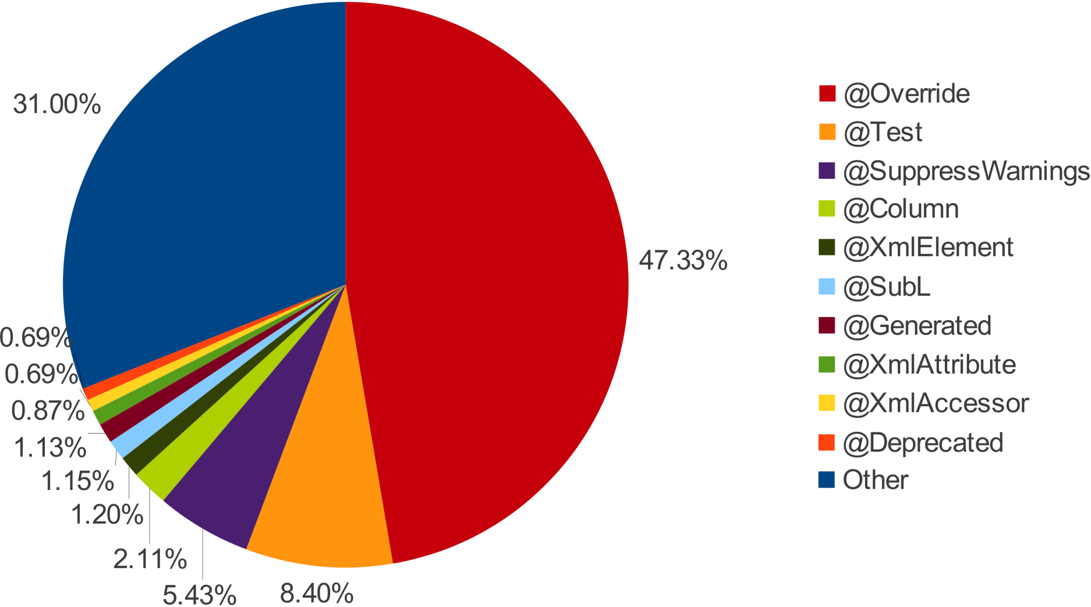
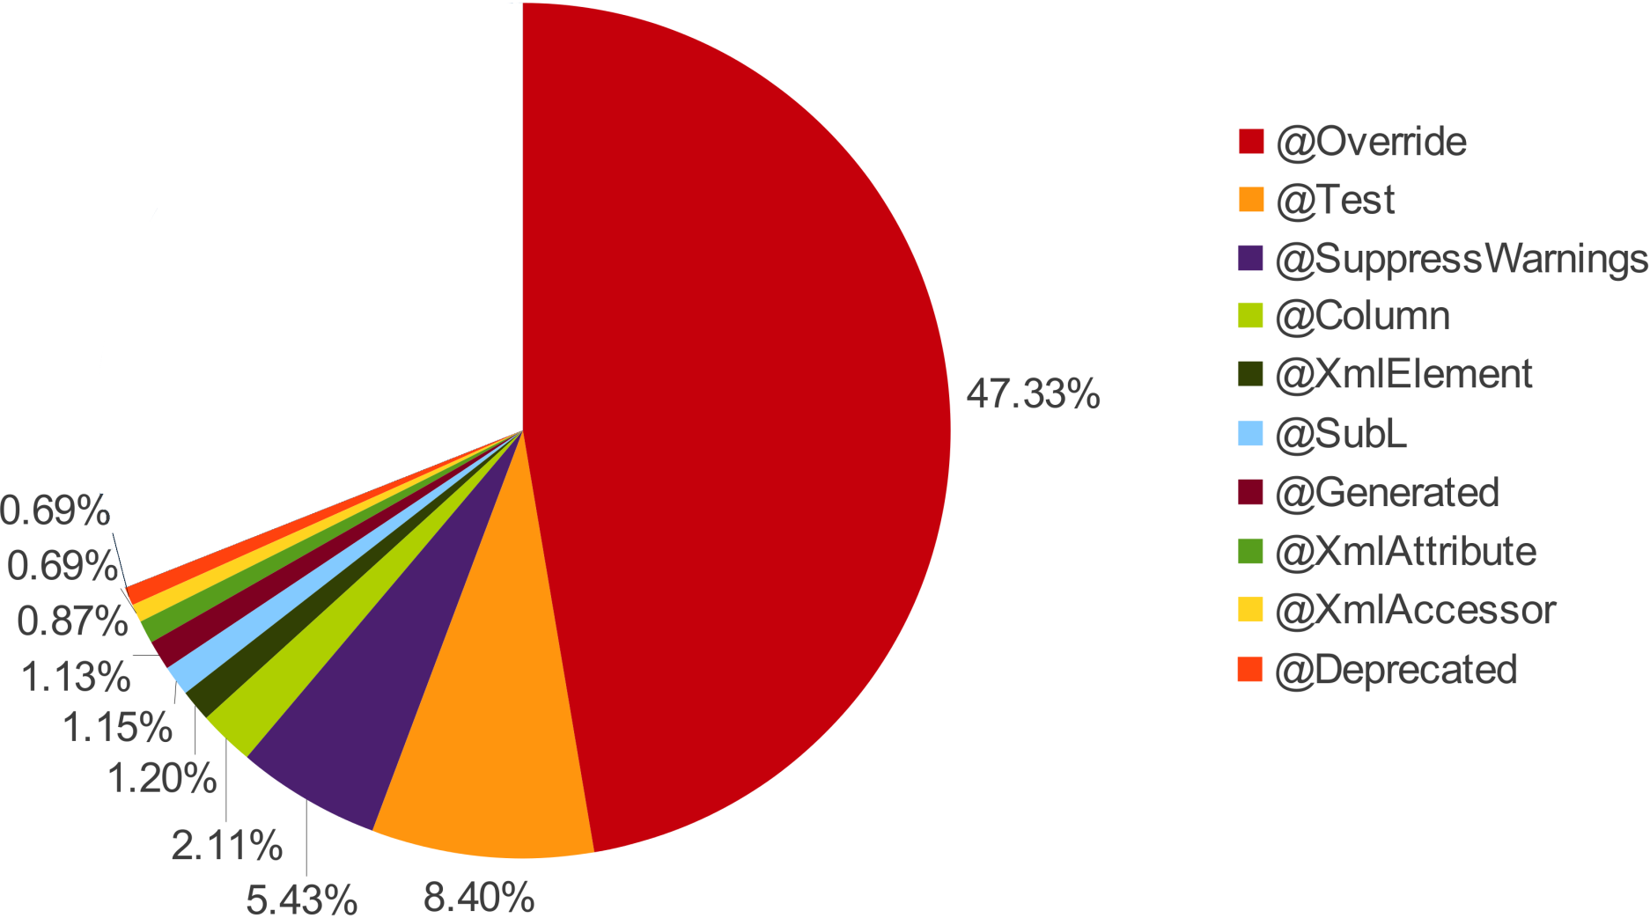
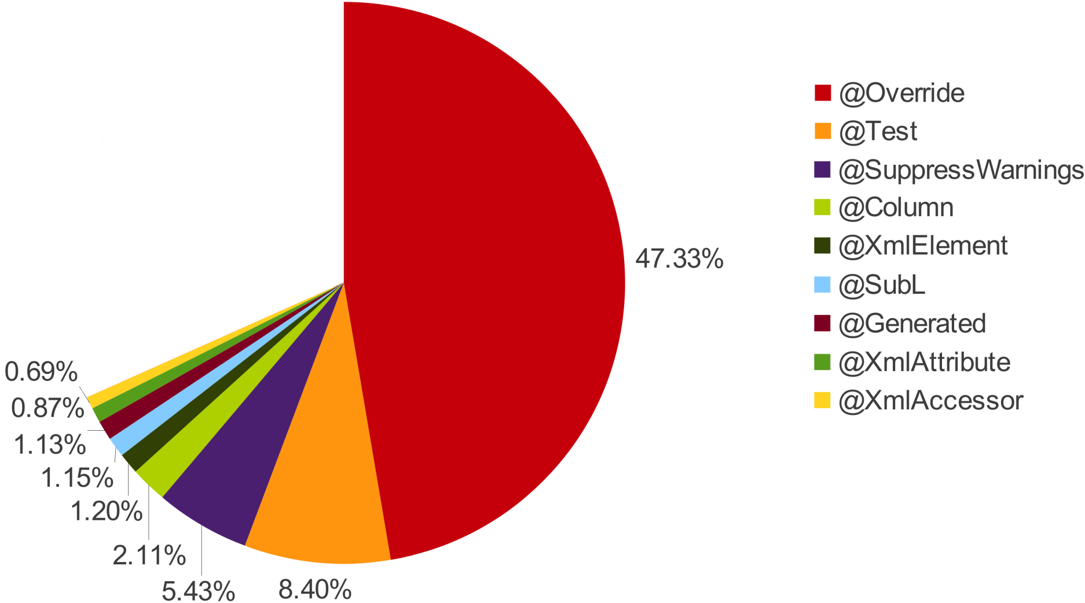
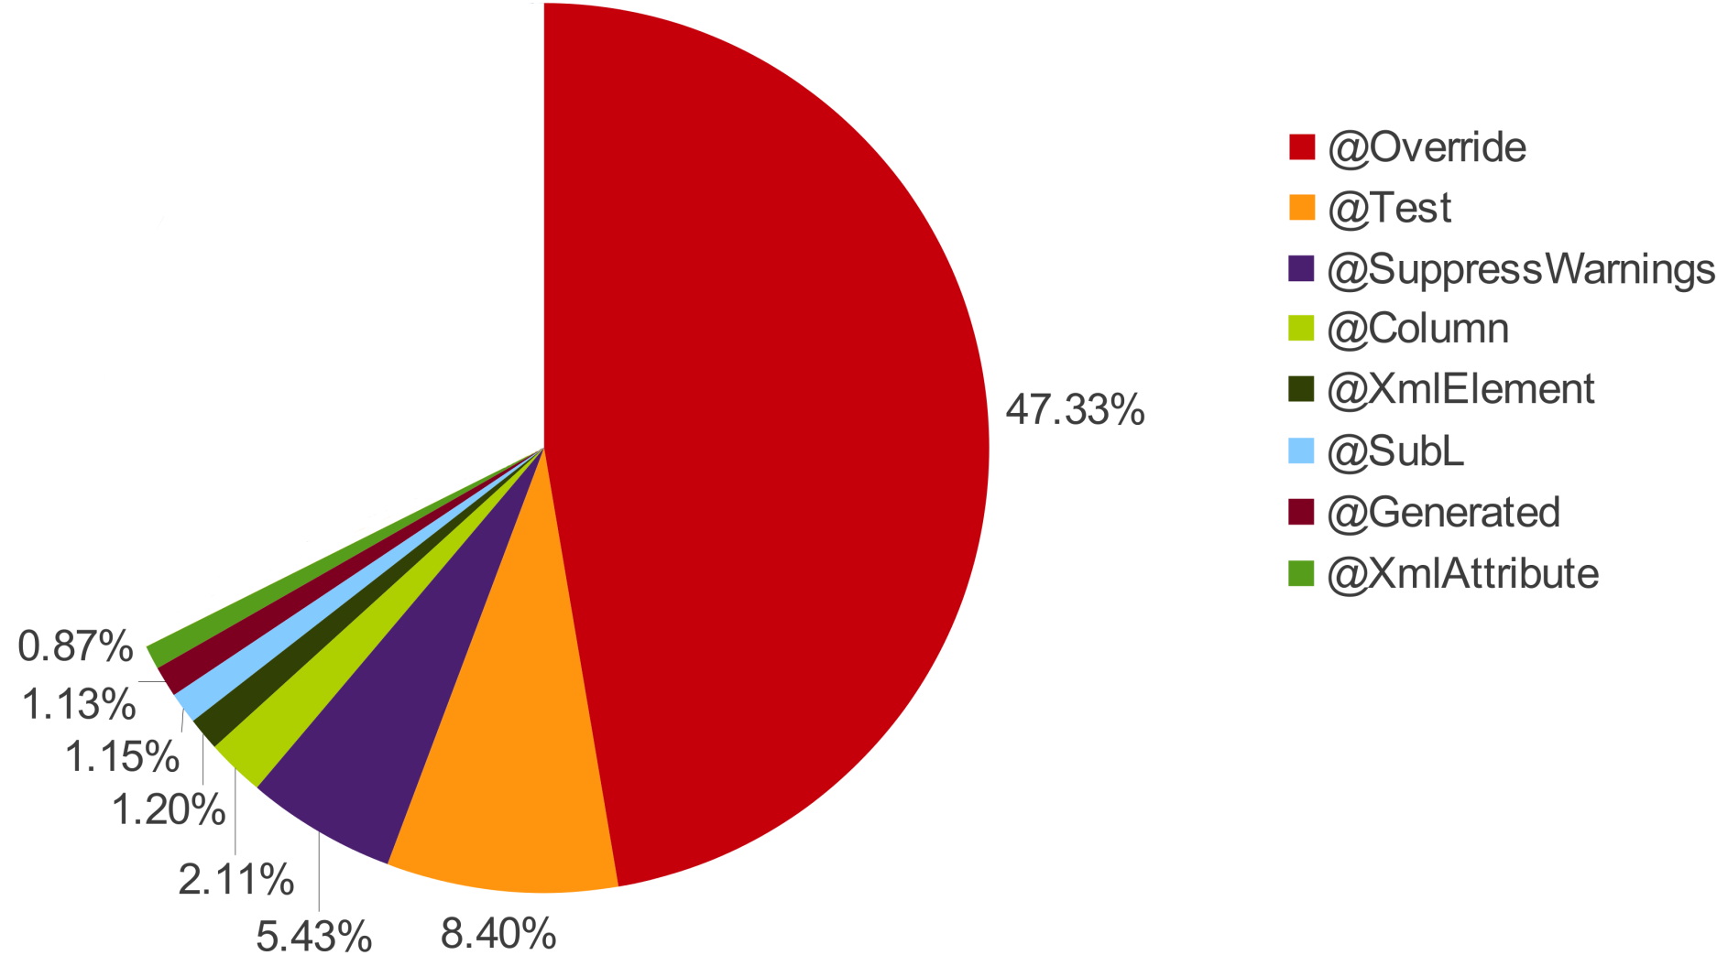
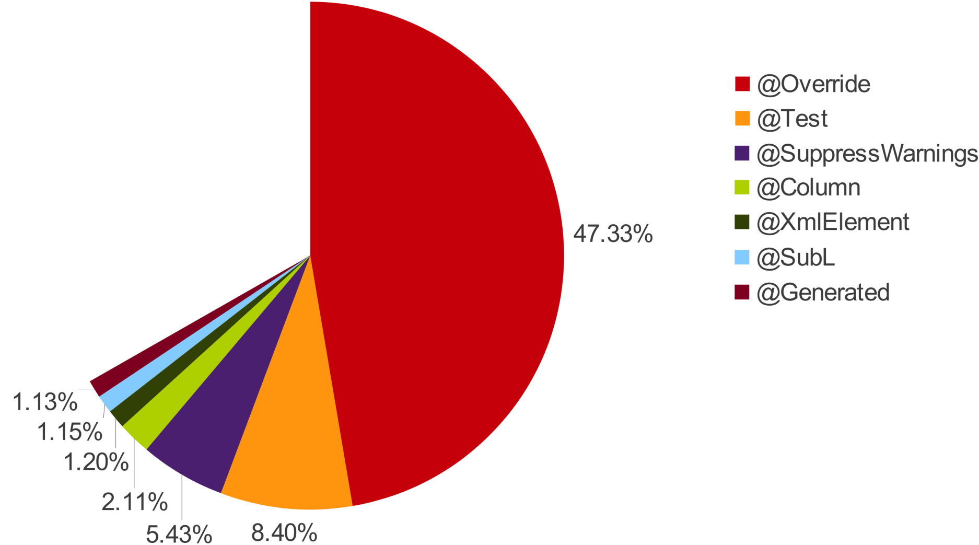
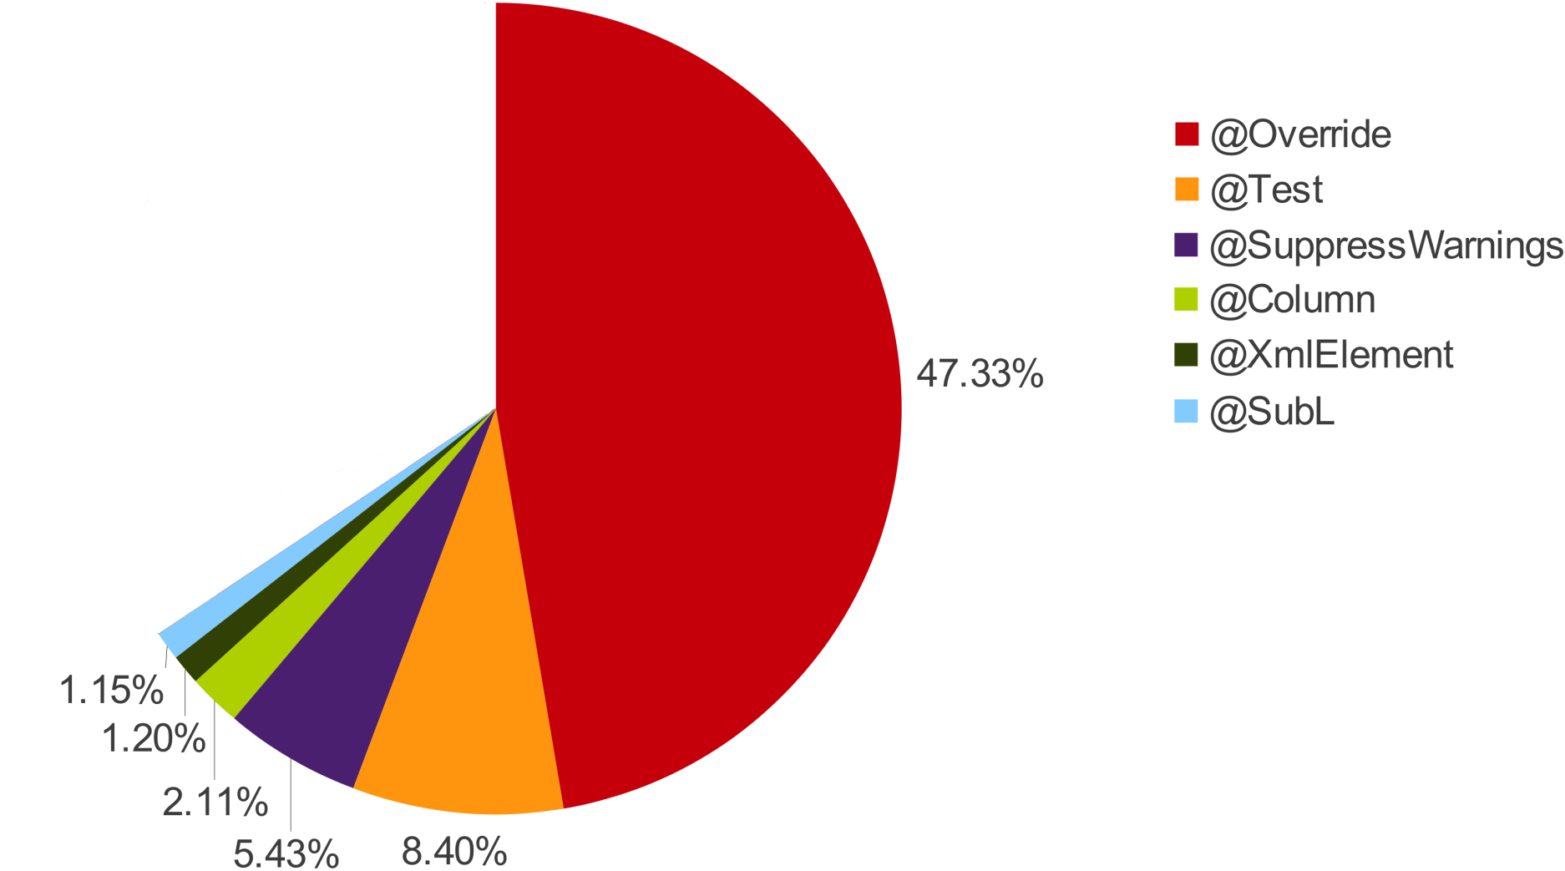
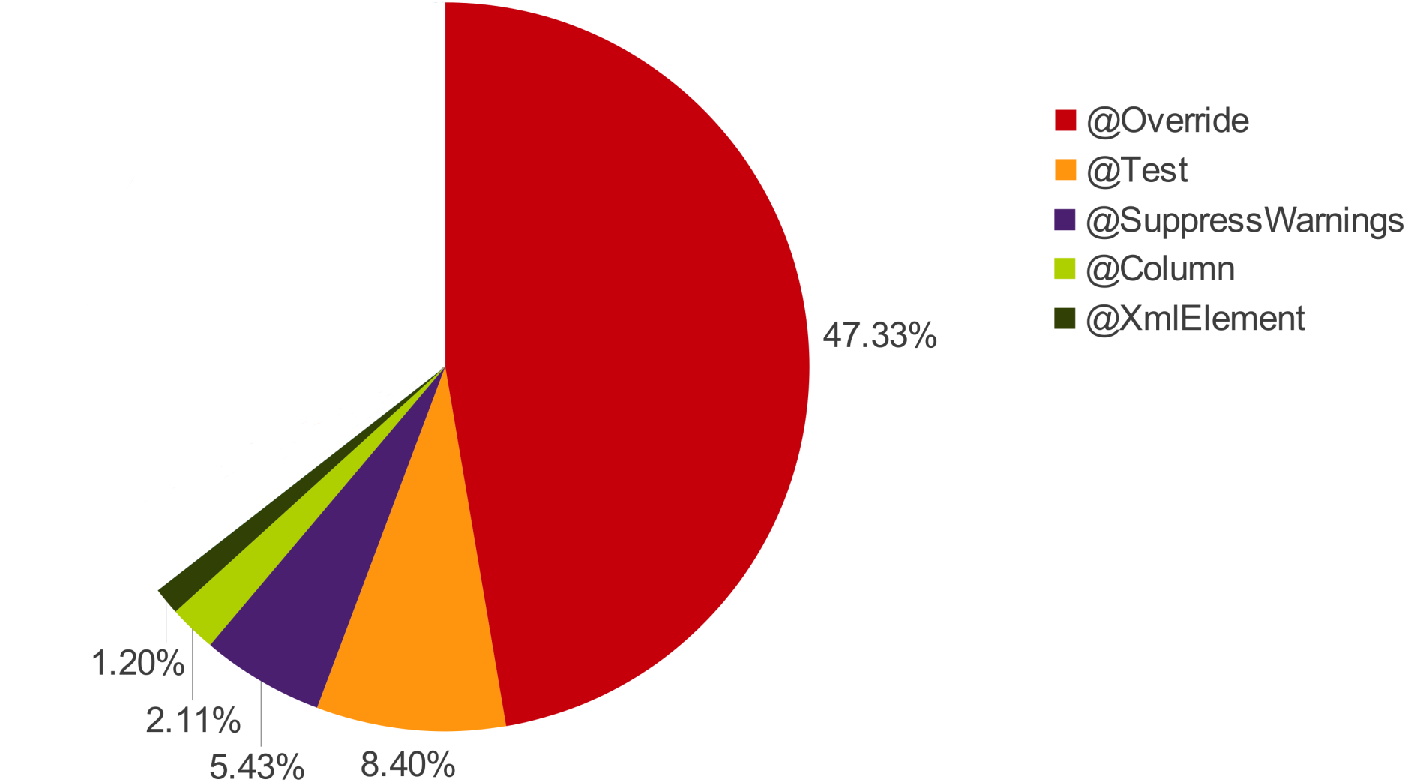

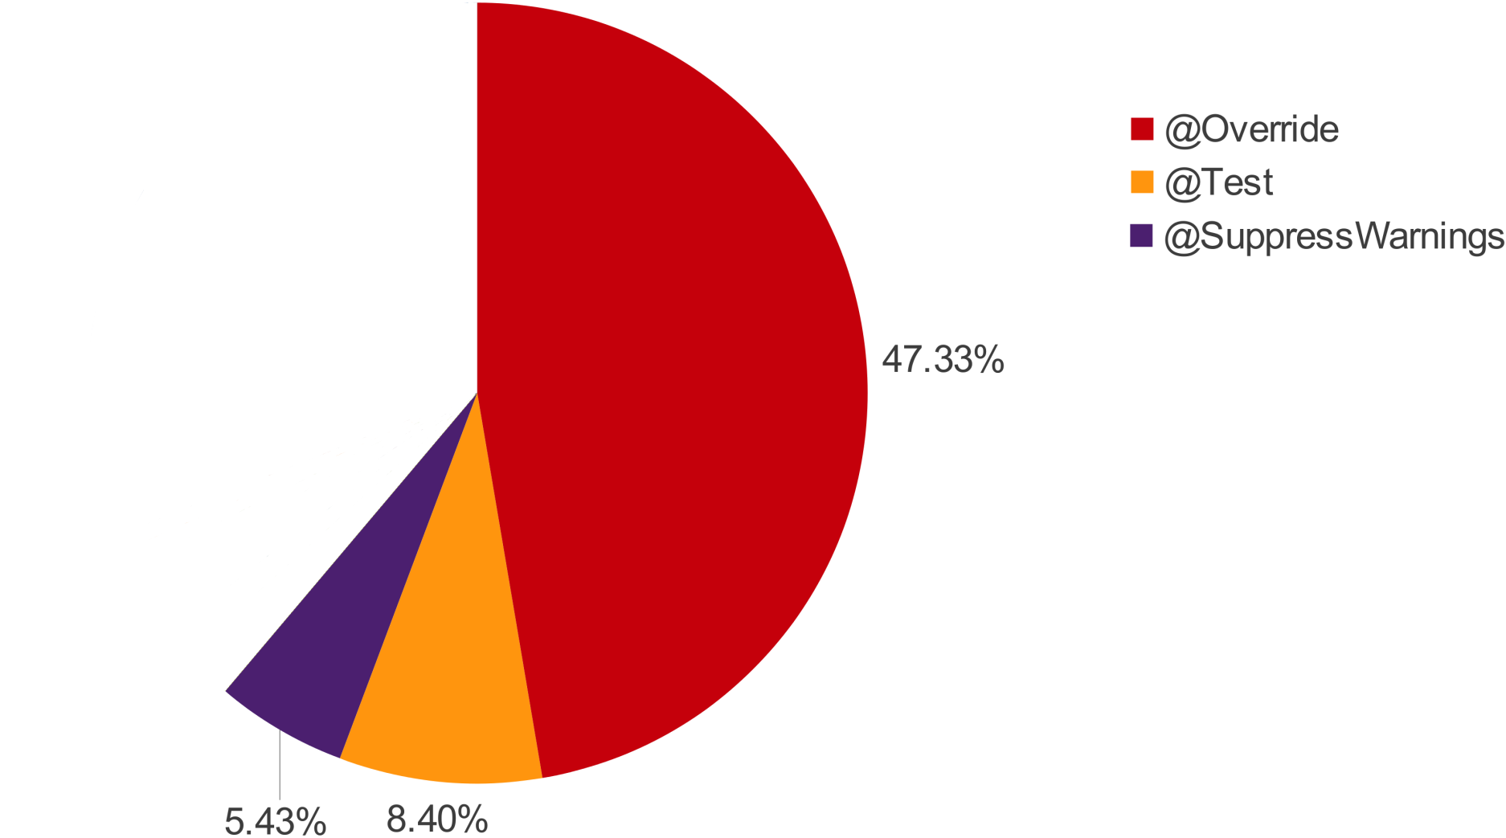
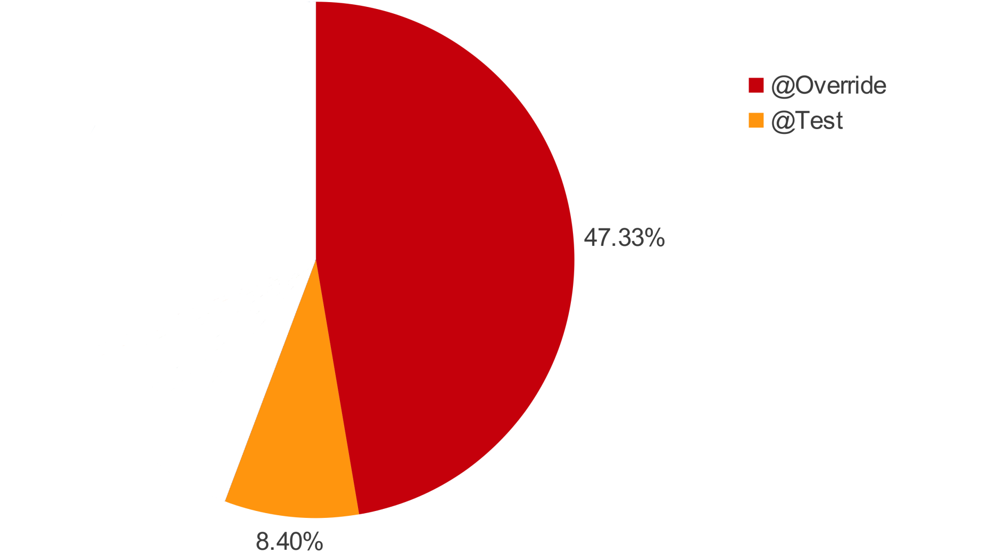
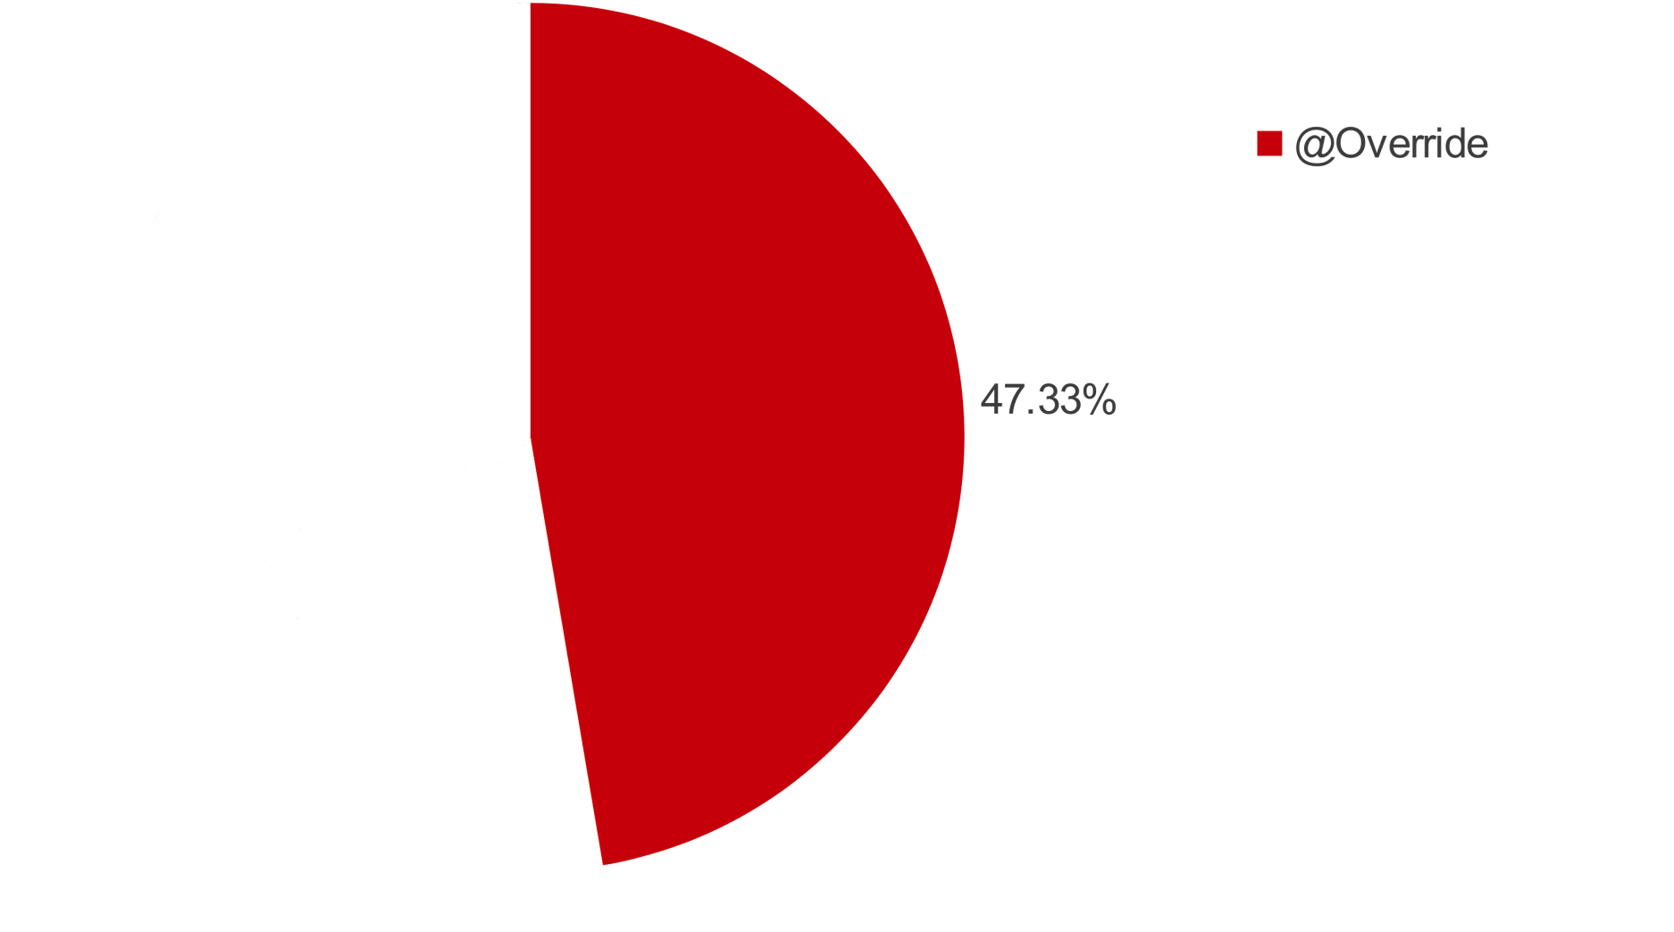
Some features popular. Why?

Slide 47
Some features popular. Why?
List
ArrayList
Map
HashMap
Set
Collection
Vector
Class
Iterator
HashSet
(confirms [Parnin et al. MSR'11])

Slide 48
Research Question 4
Could features have been used more?

Slide 49
Opportunity: Assert
Find methods that throw IllegalArgumentException.
void m(..) {
if (cond) throw new IllegalArgumentException();
...
}
Simpler
void m(..) {
assert cond;
...
}
Machine-checkable
Easily disabled for production

Slide 50
Opportunity: Binary Literals
Find where literal 1 is shifted left.
int x = 1 << 5;
short[] phases = {
0x7,
0xE,
0xD,
0xB
};
short[] phases = {
0b0111,
0b1110,
0b1101,
0b1011
};

Slide 51
Opportunity: Underscore Literals
Find integers with 7 or more digits and no underscores.
int x = 1000000;
int x = 1_000_000;

Slide 52
Opportunity: Diamond
Instantiation of generics not using diamond.
List<String> l = new ArrayList<String>();
List<String> l = new ArrayList<>();

Slide 53
Opportunity: MultiCatch
A try with multiple, identical catch blocks.
try { .. }
catch (T1 e) { b1 }
catch (T2 e) { b1 }
try { .. }
catch (T1 | T2 e) { b1 }

Slide 54
Opportunity: Try w/ Resources
Try statements calling close() in the finally block.
try {
.. } finally {
var.close();
}
try (var = ..) { ..
}

Slide 55
Millions of opportunities!
 | Assert | Varargs | Binary Literals | Diamond | MultiCatch | Try w/ Resources | Underscore Literals
Old | 89K | 612K | 56K | 3.3M | 341K | 489K | 5.3M
New | 291K | 1.6M | 5K | 414K | 24K | 33K | 507K

Slide 56
Millions of opportunities!
Actual Uses
 | Assert | Varargs | Binary Literals | Diamond | MultiCatch | Try w/ Resources | Underscore Literals
Projects | 12.72% | 15.43% | 0.02% | 0.4% | 0.27% | 0.21% | 0.02%
Potential Uses
Projects | 18.18% | 88.78% | 5.9% | 59.08% | 49.75% | 37.27% | 51.15%

Slide 57
Research Question 5
Was old code converted to use new features?

Slide 58
Detecting Conversions
File.java
(Revision N)
File.java
(Revision N+1)
uses_{N}
potential_{N}
uses_{N+1}
potential_{N+1}
uses_{N} < uses_{N+1}
potential_{N} > potential_{N+1}

Slide 59
Detected lots of conversions!
 | Assert | Varargs | Diamond | MultiCatch | Try w/ Resources | Underscore Literals
Count | 180 | 2.1K | 8.5K | 162 | 154 | 2
Files | 105 | 1.6K | 3.8K | 125 | 99 | 1
Projects | 37 | 488 | 72 | 23 | 17 | 1
manual, systematic sampling confirms
2602 conversions
13 not conversions

Slide 60
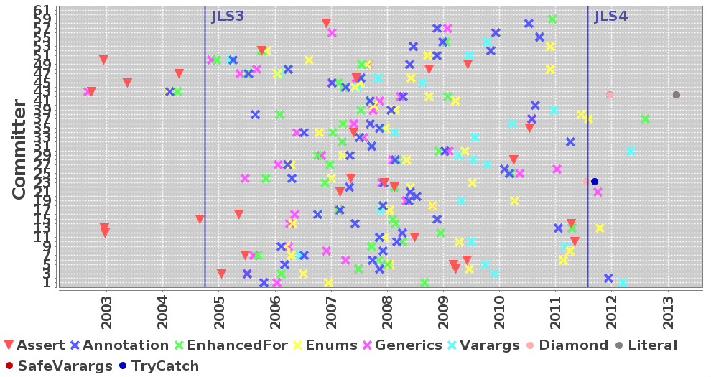
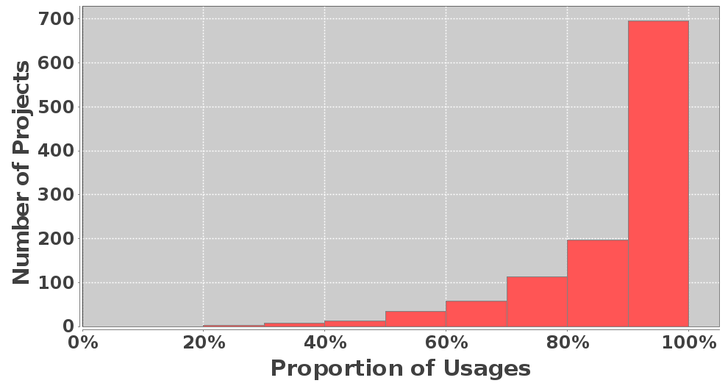
Feature adoption by individuals
Similar usage patterns
 | Assert | Varargs | Diamond | MultiCatch | Try w/ Resources | Underscore Literals
Count | 180 | 2.1K | 8.5K | 162 | 154 | 2
Files | 105 | 1.6K | 3.8K | 125 | 99 | 1
Projects | 37 | 488 | 72 | 23 | 17 | 1
To summarize...
Old code converted to use new features
 | Assert | Varargs | Binary Literals | Diamond | MultiCatch | Try w/ Resources | Underscore Literals
Old | 89K | 612K | 56K | 3.3M | 341K | 489K | 5.3M
New | 291K | 1.6M | 5K | 414K | 24K | 33K | 507K
All | 380K | 2.2M | 61K | 3.7M | 365K | 522K | 5.8M
Files | 1.39% | 12.74% | 0.11% | 12.25% | 2.28% | 1.85% | 5.86%
Projects | 18.18% | 88.78% | 5.9% | 59.08% | 49.75% | 37.27% | 51.15%
Only few features
see high use
Despite (missed) potential for use

Slide 61
Summary
Ultra-large-scale language feature studies
pose several challenges
Boa provides abstractions to address
these challenges
Ultra-large-scale dataset with millions of projects
Automatically parallelizes queries
Domain-specific language, types, and functions
to make mining software repositories easier

Slide 62
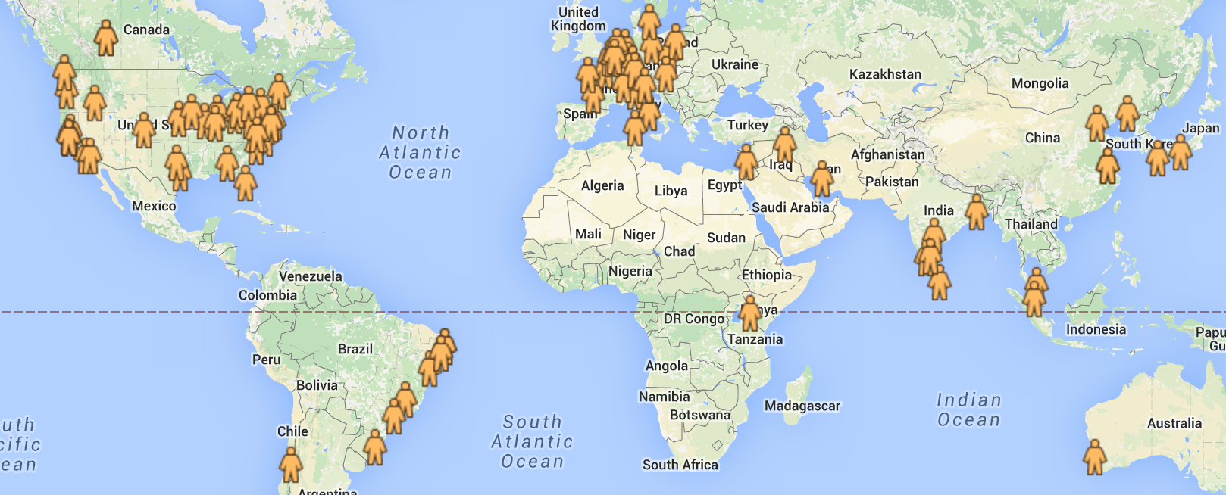
Boa's Global Impact
370+ users from over 20 countries!
http://boa.cs.iastate.edu/

Slide 63

Participate in the MSR 2016 Mining Challenge
deadline: Feb 19
http://2016.msrconf.org/#/challenge

