Slide 1


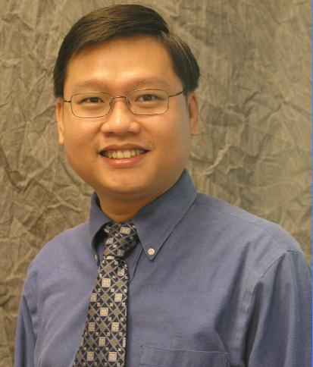

Efficiently Mining Source Code with Boa
Robert Dyer
Hridesh Rajan
Hoan Anh Nguyen
Tien N. Nguyen
The research activities described in this talk were supported in part by the US National Science Foundation (NSF) grants CCF-13-49153, CCF-13-20578, TWC-12-23828, CCF-11-17937, CCF-10-17334, and CCF-10-18600.

Slide 2
What do I mean by software repository?

Slide 3










Slide 4
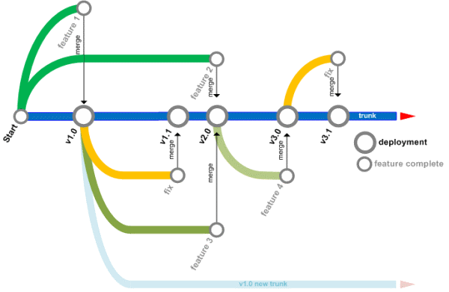




What features do they have?

Slide 5
What do I mean by mining software repositories (MSR)?

Slide 6

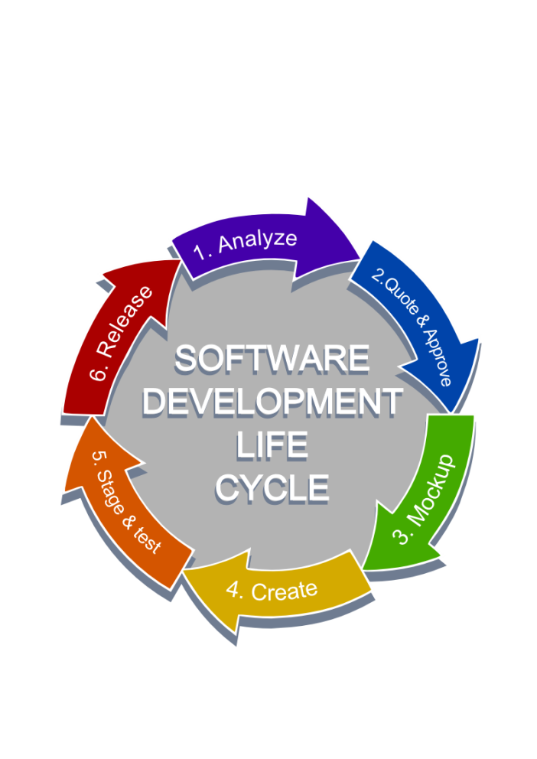



Slide 7
What are some examples of software repository mining?

Slide 8
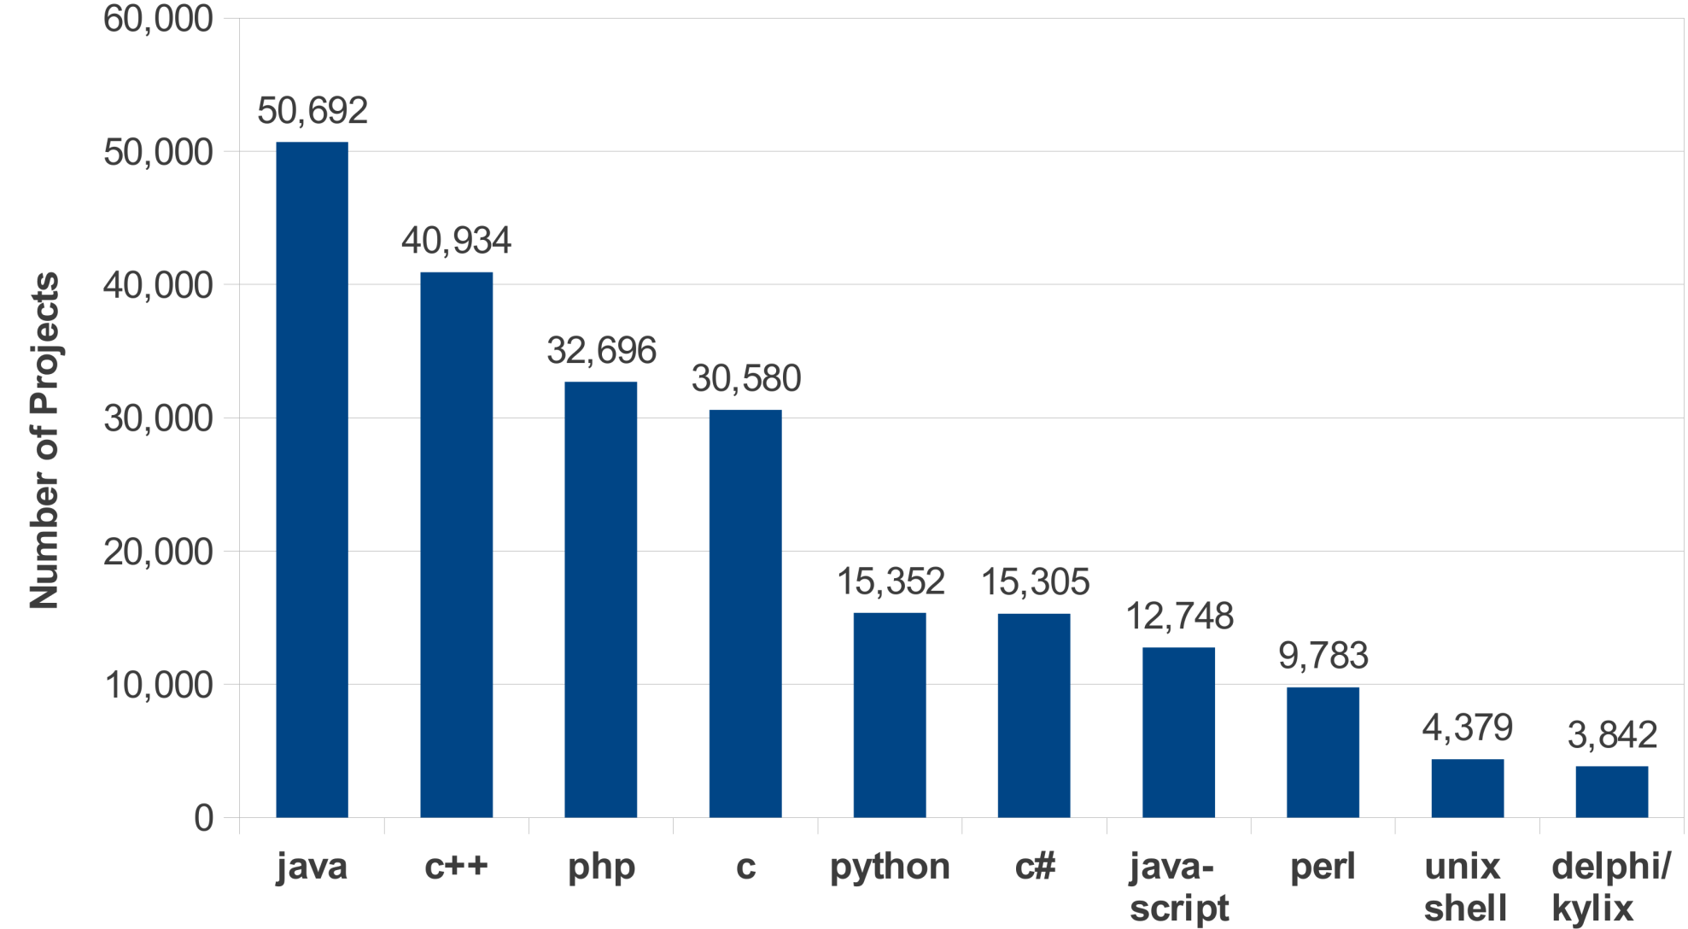
What is the most used programming language?

Slide 9
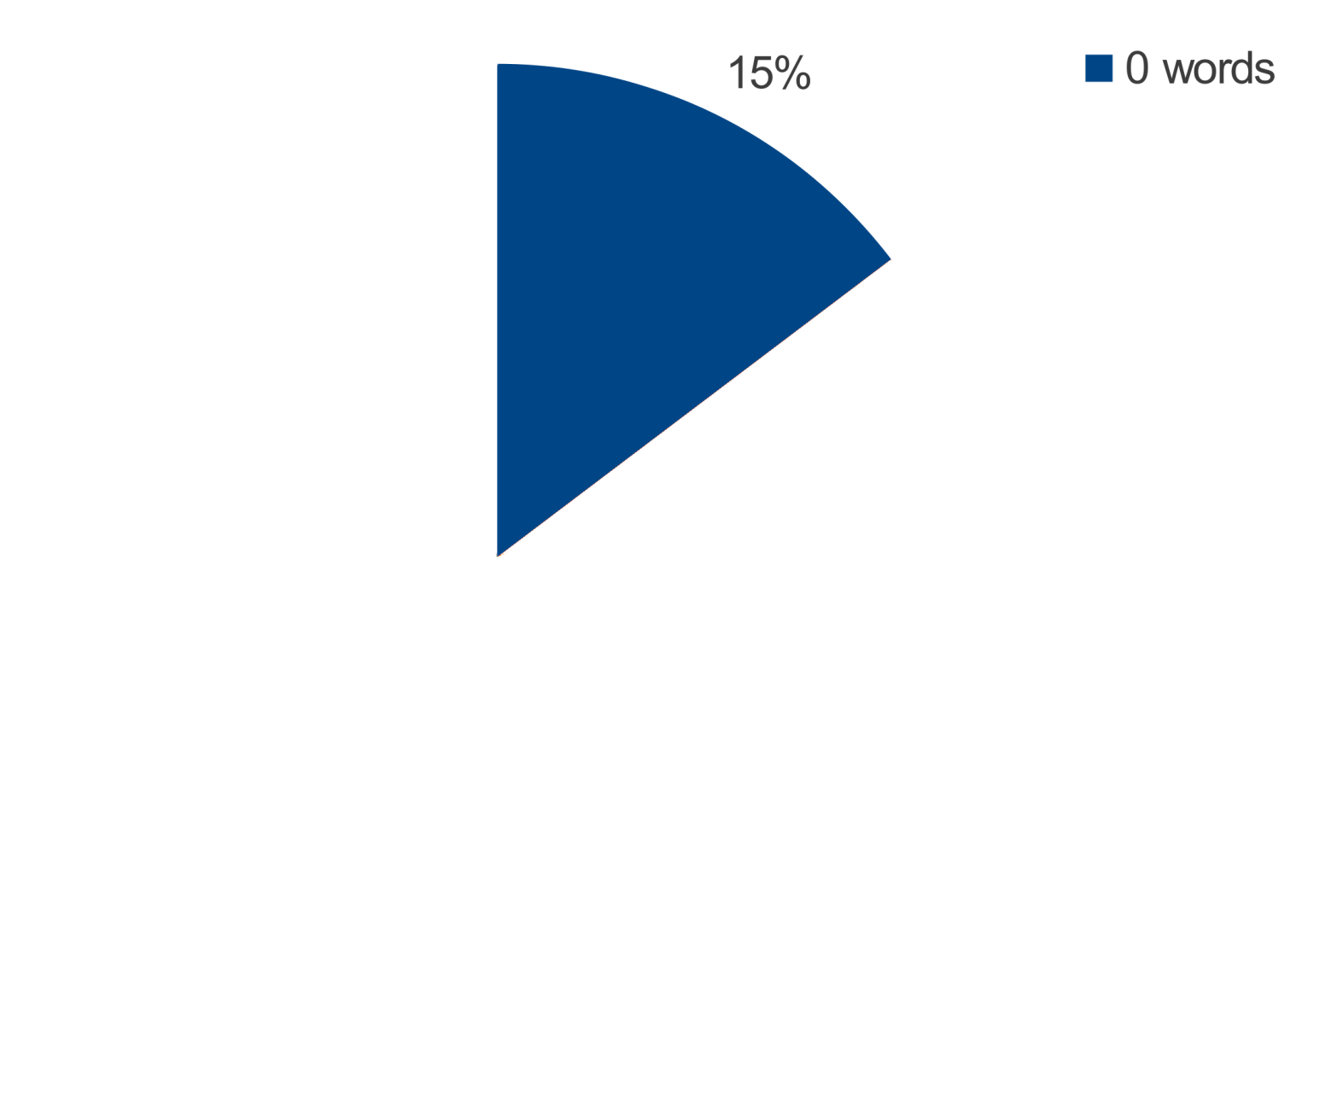
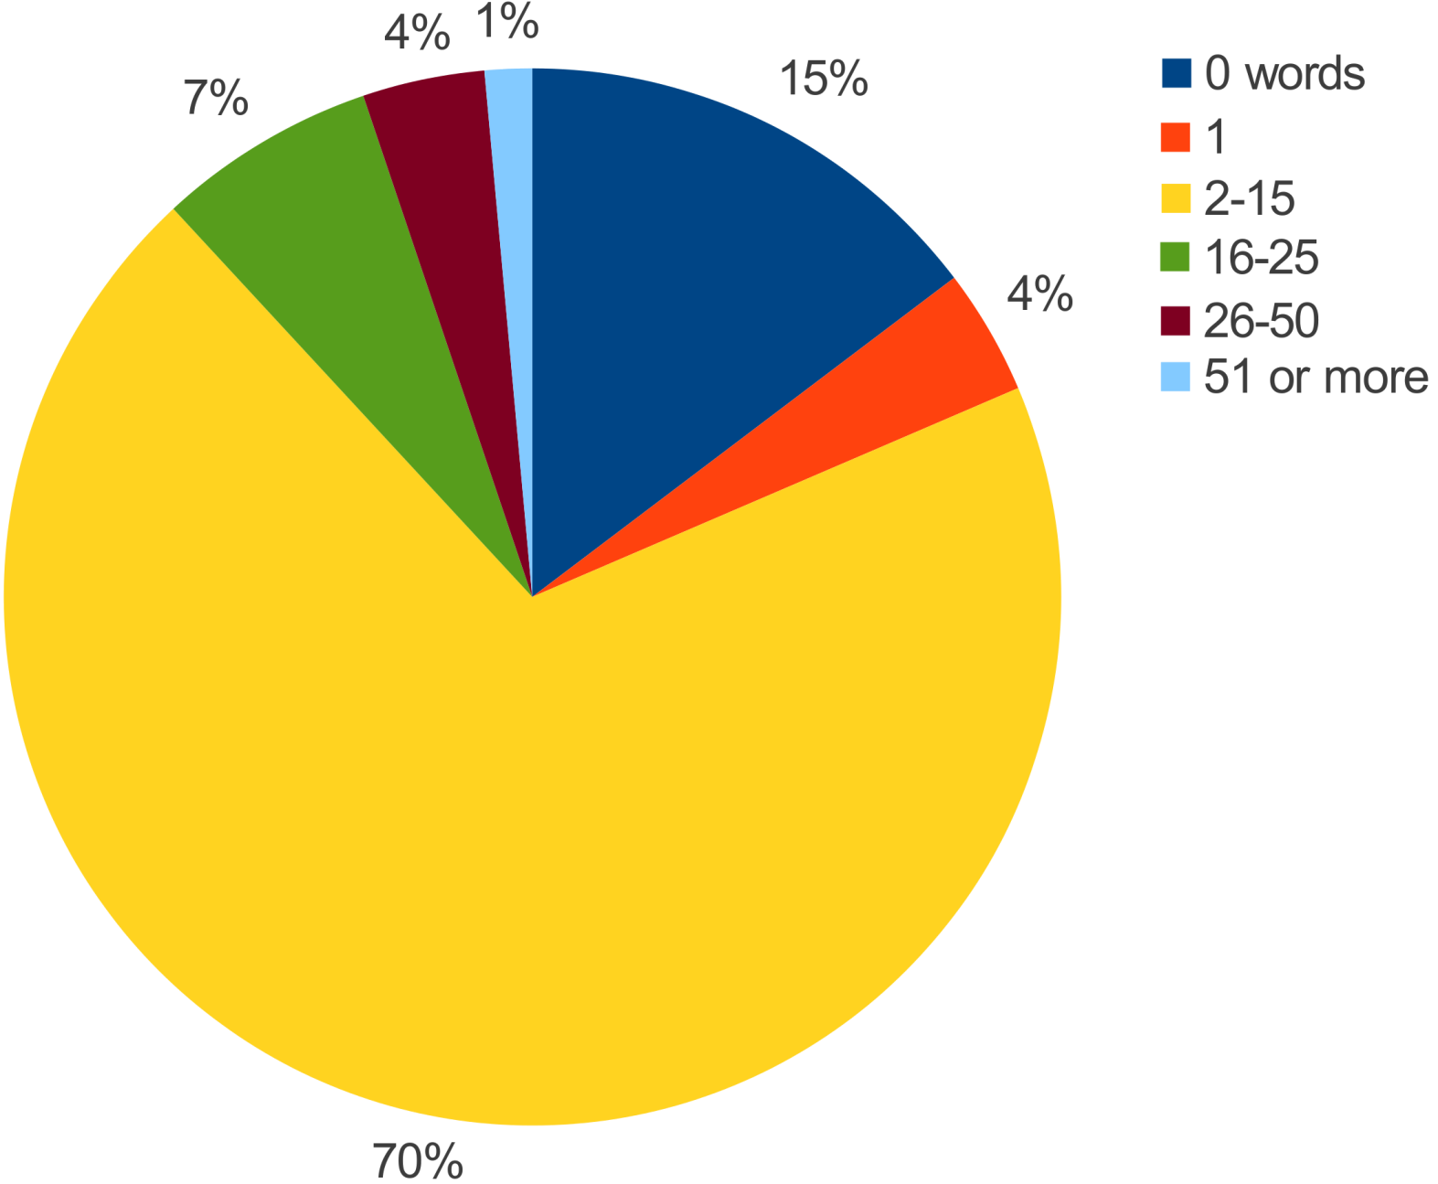
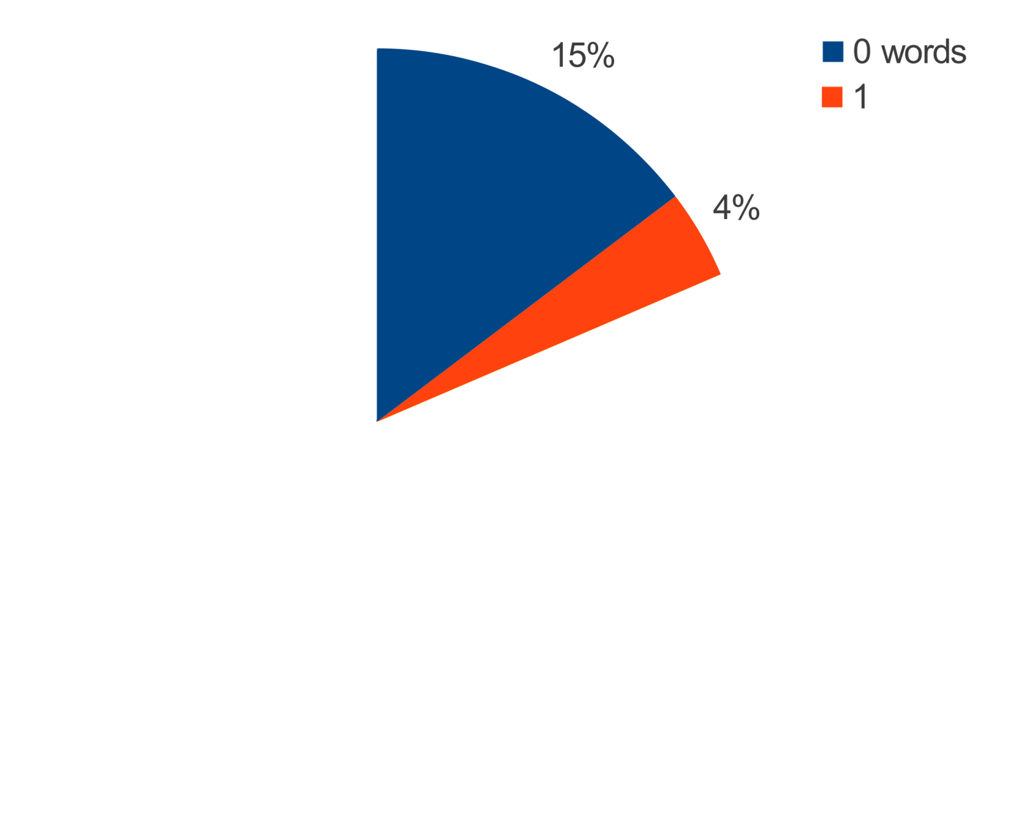
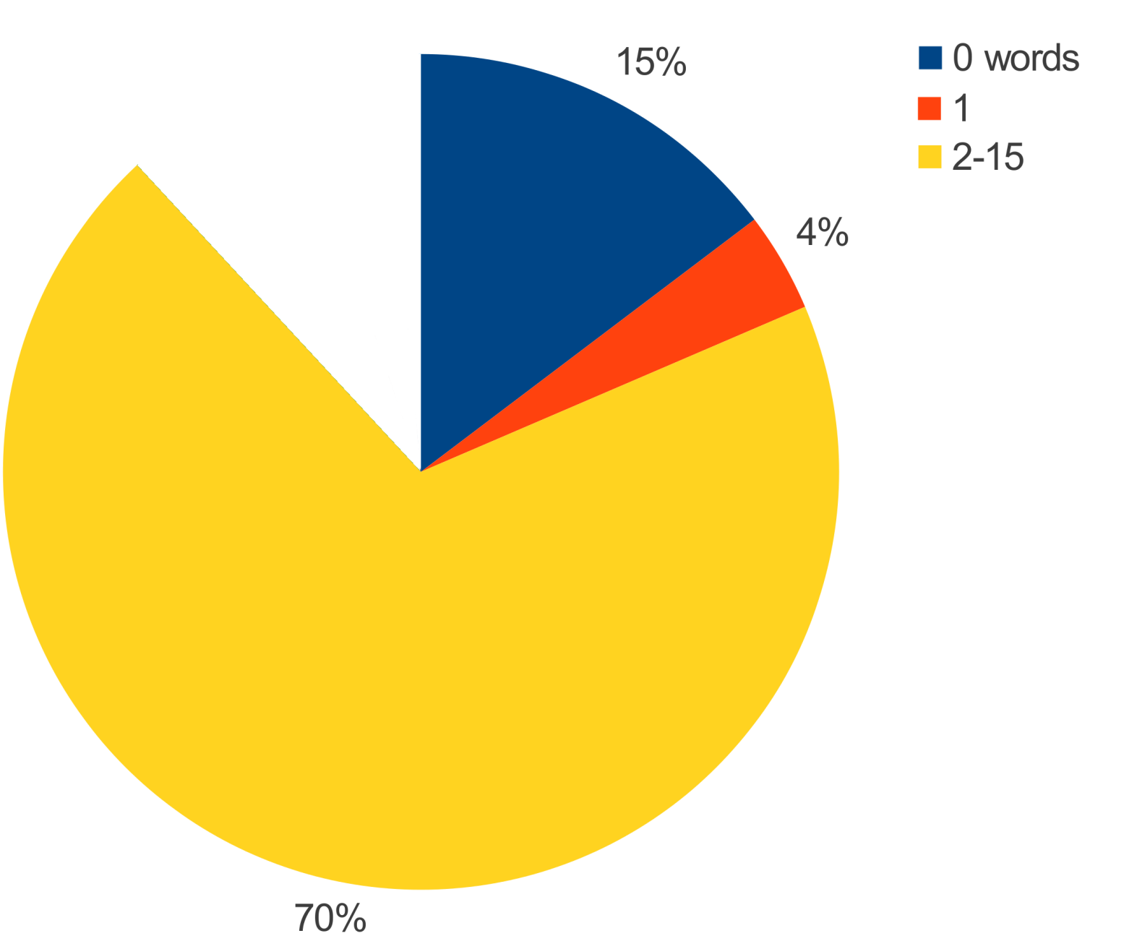
How many words are in commit messages?
Words[] = update, 30715
Words[] = cleanup, 19073
Words[] = updated, 18737
Words[] = refactoring, 11981
Words[] = fix, 11705
Words[] = test, 9428
Words[] = typo, 9288
Words[] = updates, 7746
Words[] = javadoc, 6893
Words[] = bugfix, 6295

Slide 10
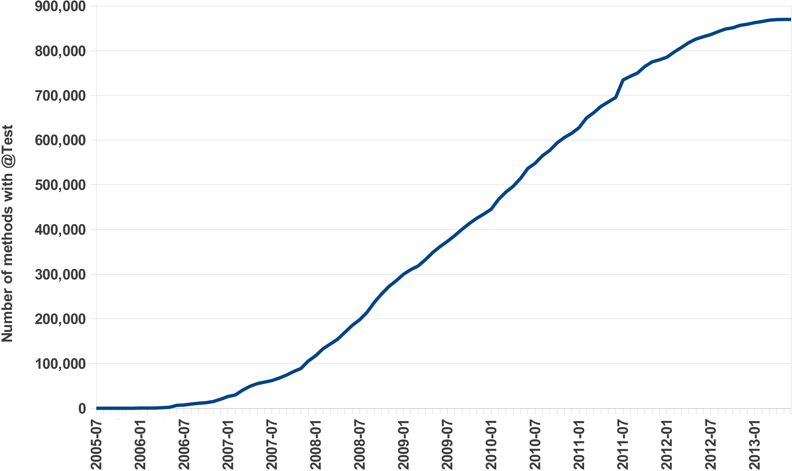
How has unit testing evolved over time?
JUnit 4 release

Slide 11
What makes this ultra-large-scale mining?

Slide 12
Previous examples queried...
Projects | 699,331
Code Repositories | 494,158
Revisions | 15,063,073
Unique Files | 69,863,970
File Snapshots | 147,074,540
AST Nodes | 18,651,043,23
Over 250GB of pre-processed data

Slide 13
What does bringing BIGDATA to the masses mean?

Slide 14
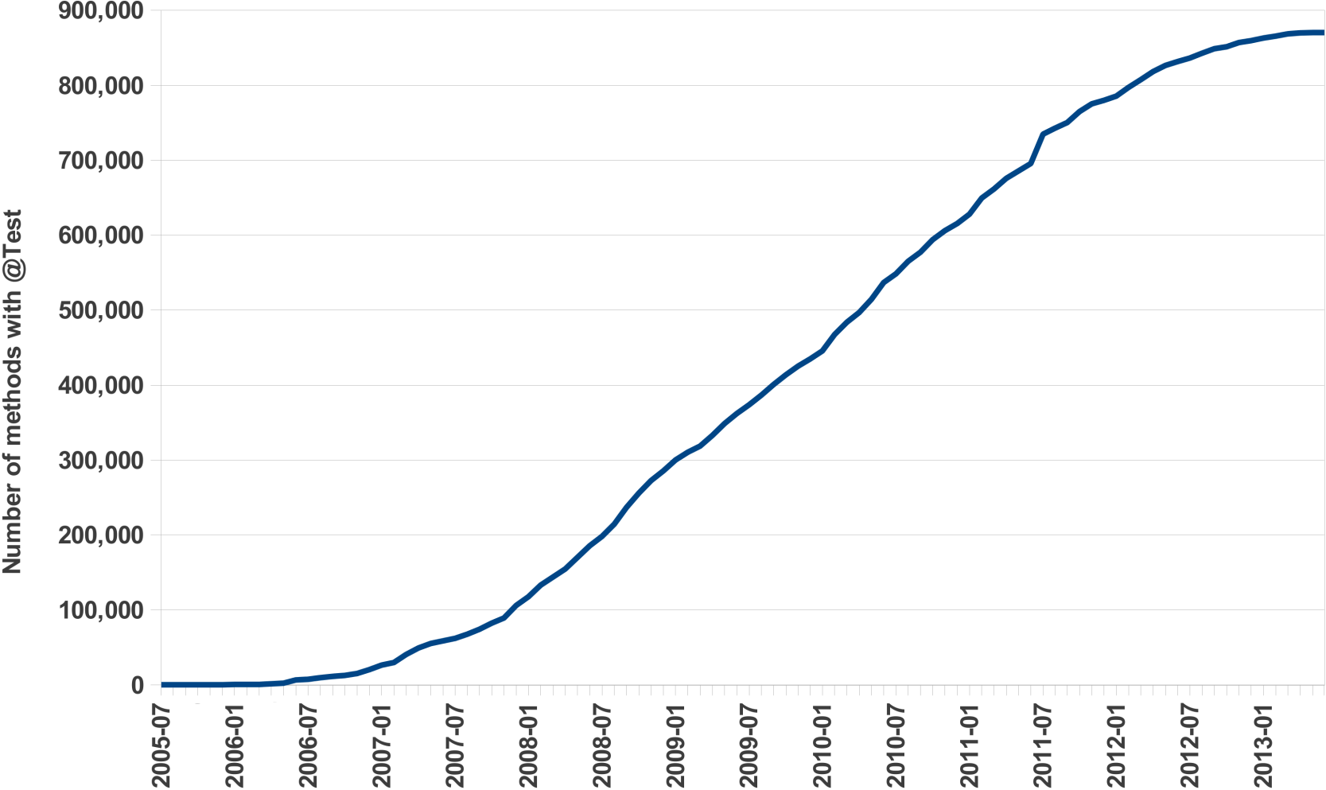
How has unit testing evolved over time?
How can we solve this task?

Slide 15
mine project
metadata
Results
foreach
yes
Has
repository?
Method has
@Test?
yes
mine
revisions
mine
sources
Access
repository
Find all
source files
Find all
methods

Slide 16
mine project
metadata
Results
foreach
yes
Has
repository?
Challenge: Volume
Method has
@Test?
yes
mine
revisions
mine
sources
Access
repository
Find all
source files
Find all
methods

Slide 17
Challenge: Volume
Projects | 699,331
Code Repositories | 494,158
Revisions | 15,063,073
Unique Files | 69,863,970
File Snapshots | 147,074,540
AST Nodes | 18,651,043,23
How do you:
  Find such a large dataset? Transform the data for analysis?
  Access this data? Efficiently analyze the data?
  Store the data?

Slide 18
mine project
metadata
Results
foreach
yes
Has
repository?
Challenge: Velocity
Method has
@Test?
yes
mine
revisions
mine
sources
Access
repository
Find all
source files
Find all
methods

Slide 19
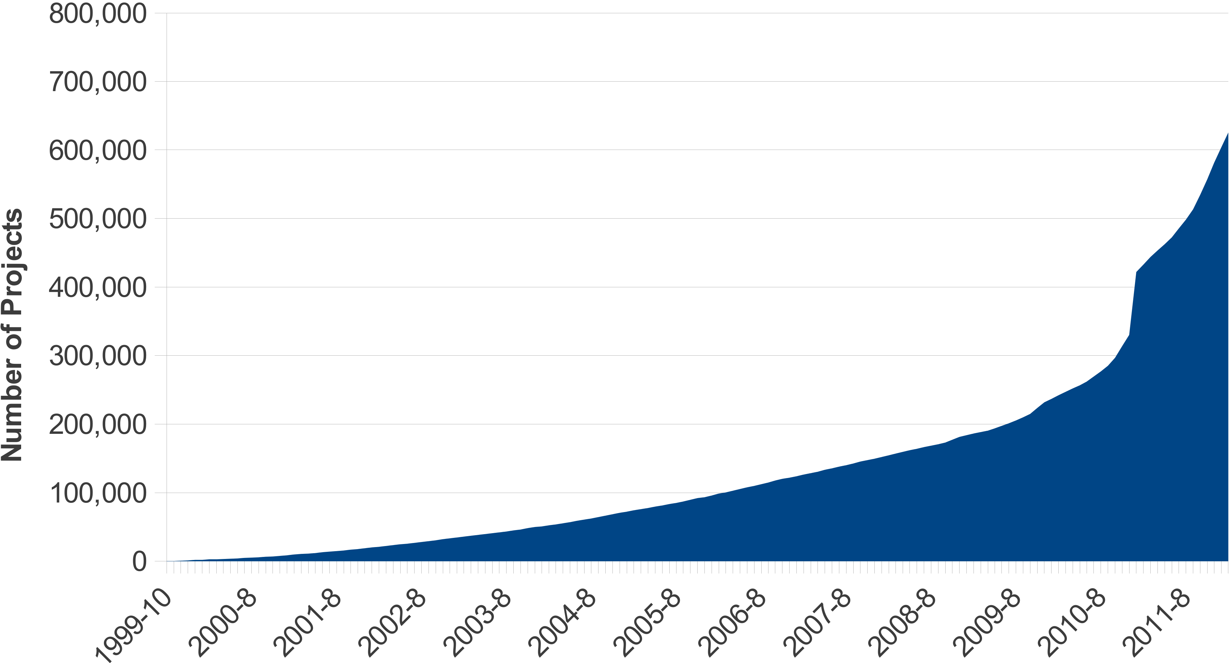
Challenge: Velocity

Slide 20
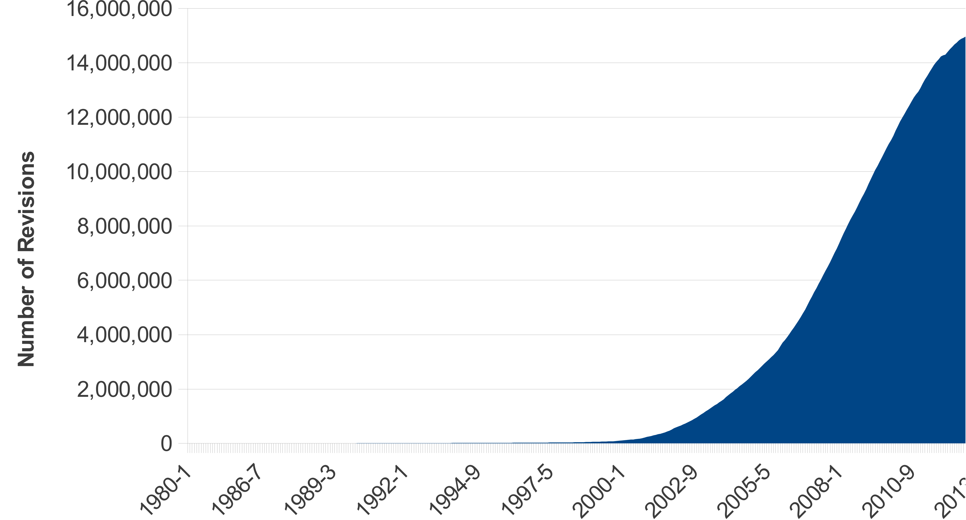
Challenge: Velocity

Slide 21
mine project
metadata
Results
foreach
yes
Has
repository?
Challenge: Variety
Method has
@Test?
yes
mine
revisions
mine
sources
Access
repository
Find all
source files
Find all
methods

Slide 22






Challenge: Variety

Slide 23
Ultra-large-scale Software Repository Mining
The Boa Experience
[ICSE'14]
[ICSE'13]
[GPCE'13]
[SPLASH'13 SRC]
[TOSEM] (under review)

Slide 24
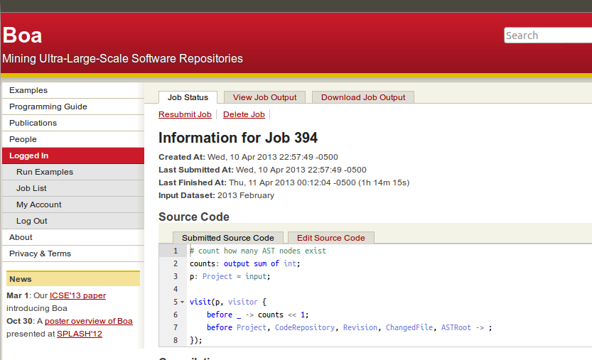



Boa's Architecture
Query result
returned
via web
Boa's Data Infrastructure
User submits
query
Replicate
and Transform
Compiled into
Hadoop program
Stored on
cluster
Deployed and
executed on cluster
cache
Boa's Computing Infrastructure

Slide 25
mine project
metadata
Results
foreach
yes
Challenge: Volume
Method has
@Test?
Has
repository?
Challenge: Velocity
Challenge: Variety
yes
mine
revisions
mine
sources
Access
repository
Find all
source files
Find all
methods

Slide 26
A better solution...
Tests: output sum[timestamp] of int;
cur_time:timestamp;
visit(input, visitor {
before n: Revision -> cur_time = n.commit_date;
before n: Modifier ->
if (n.kind == ModifierKind.ANNOTATION &&
match(`^(org\.junit\.)?Test$`,
n.annotation_name))
Tests[cur_time] << 1;
});
Only 10 lines of code
Automatically parallelized
No external libraries
Analyzes 18 billion AST nodes in minutes

Slide 27
How has unit testing evolved over time?
Tests: output sum[timestamp] of int;

Slide 28
How has unit testing evolved over time?
Tests: output sum[timestamp] of int;
visit(input, visitor {
});

Slide 29
How has unit testing evolved over time?
Tests: output sum[timestamp] of int;
visit(input, visitor {
before n: Modifier ->
});

Slide 30
How has unit testing evolved over time?
Tests: output sum[timestamp] of int;
visit(input, visitor {
before n: Modifier ->
if (n.kind == ModifierKind.ANNOTATION &&
});

Slide 31
How has unit testing evolved over time?
Tests: output sum[timestamp] of int;
visit(input, visitor {
before n: Modifier ->
if (n.kind == ModifierKind.ANNOTATION &&
match(`^(org\.junit\.)?Test$`,
n.annotation_name))
});

Slide 32
How has unit testing evolved over time?
Tests: output sum[timestamp] of int;
visit(input, visitor {
before n: Modifier ->
if (n.kind == ModifierKind.ANNOTATION &&
match(`^(org\.junit\.)?Test$`,
n.annotation_name))
Tests[cur_time] << 1;
});

Slide 33
How has unit testing evolved over time?
Tests: output sum[timestamp] of int;
cur_time:timestamp;
visit(input, visitor {
before n: Revision -> cur_time = n.commit_date;
before n: Modifier ->
if (n.kind == ModifierKind.ANNOTATION &&
match(`^(org\.junit\.)?Test$`,
n.annotation_name))
Tests[cur_time] << 1;
});

Slide 34
Dataset
Tests[631152000] = 5
Tests[631154020] = 12
Tests[631161103] = 14
Tests[631172392] = 18
.
.
.
Output
input = project₁
Boa Program
Tests[631152000] << 1;
Tests[631154020] << 1;
input = project₂
Boa Program
input = project₃
Boa Program
Tests
631152000, 1
631152000, 1
631154020, 1
.
.
.
.
.
.
631152000, 1
631154020, 1
631154020, 1
631161103, 1
input = project_{n}
Boa Program
Tests: output sum[timestamp] of int;
cur_time:timestamp;
visit(input, visitor {
before n: Revision -> cur_time = n.commit_date;
before n: Modifier ->
if (n.kind == ModifierKind.ANNOTATION &&
match(`^(org\.junit\.)?Test$`,
n.annotation_name))
Tests[cur_time] << 1;
});
Tests: output sum[timestamp] of int;
cur_time:timestamp;
visit(input, visitor {
before n: Revision -> cur_time = n.commit_date;
before n: Modifier ->
if (n.kind == ModifierKind.ANNOTATION &&
match(`^(org\.junit\.)?Test$`,
n.annotation_name))
Tests[cur_time] << 1;
});
Tests: output sum[timestamp] of int;
cur_time:timestamp;
visit(input, visitor {
before n: Revision -> cur_time = n.commit_date;
before n: Modifier ->
if (n.kind == ModifierKind.ANNOTATION &&
match(`^(org\.junit\.)?Test$`,
n.annotation_name))
Tests[cur_time] << 1;
});
Tests: output sum[timestamp] of int;
cur_time:timestamp;
visit(input, visitor {
before n: Revision -> cur_time = n.commit_date;
before n: Modifier ->
if (n.kind == ModifierKind.ANNOTATION &&
match(`^(org\.junit\.)?Test$`,
n.annotation_name))
Tests[cur_time] << 1;
});
Tests: output sum[timestamp] of int;
cur_time:timestamp;
visit(input, visitor {
before n: Revision -> cur_time = n.commit_date;
before n: Modifier ->
if (n.kind == ModifierKind.ANNOTATION &&
match(`^(org\.junit\.)?Test$`,
n.annotation_name))
Tests[cur_time] << 1;
});

Slide 35
Automatic Parallelization
Tests: output sum[timestamp] of int;
cur_time:timestamp;
visit(input, visitor {
before n: Revision -> cur_time = n.commit_date;
before n: Modifier ->
if (n.kind == ModifierKind.ANNOTATION &&
match(`^(org\.junit\.)?Test$`,
n.annotation_name))
Tests[cur_time] << 1;
});
Output variables with built in aggregator functions:
sum, mean, top(k), bottom(k), set, collection, etc
Compiler generates Hadoop MapReduce code

Slide 36
Abstracting MSR with Types
Tests: output sum[timestamp] of int;
cur_time:timestamp;
visit(input, visitor {
before n: Revision -> cur_time = n.commit_date;
before n: Modifier ->
if (n.kind == ModifierKind.ANNOTATION &&
match(`^(org\.junit\.)?Test$`,
n.annotation_name))
Tests[cur_time] << 1;
});
Custom domain-specific types for mining software repositories
5 base types and 9 types for source code
No need to understand multiple data formats or APIs

Slide 37
Abstracting MSR with Types
Project
1
*
CodeRepository
1
*
Revision
1
1..*
ChangedFile
1
0..1
ASTRoot

Slide 38
Abstracting MSR with Types
ASTRoot
1
1..*
Namespace
1
*
1
1
Declaration
1
*
*
*
Method
Variable
Type
1
*
1
Statement
*
Expression

Slide 39
Challenge: How can we make mining source code easier?
Answer: Declarative Visitors

Slide 40
Background: Visitor Pattern
Rectangle
DrawVisitor
Rectangle
draw(Graphics g)
scale(int x, int y)
visit(Rectangle r)
visit(Circle c)
visit(Triangle t)
accept(Visitor v)
Circle
ScaleVisitor
Circle
draw(Graphics g)
scale(int x, int y)
visit(Rectangle r)
visit(Circle c)
visit(Triangle t)
accept(Visitor v)
Triangle
Triangle
draw(Graphics g)
scale(int x, int y)
accept(Visitor v)

Slide 41
Easing Source Code Mining with Visitors
id := visitor {
before T -> statement;
after T -> statement;
};
visit(node, id);

Slide 42
Easing Source Code Mining with Visitors
id := visitor {
before id : T1 -> statement;
before T2, T3 -> statement;
before _ -> statement;
};

Slide 43
Easing Source Code Mining with Visitors
ASTRoot
ASTRoot
Namespace
Namespace
Declaration
Declaration
Method
Method
Variable
Variable
Type
Type
Statement
Statement
Expression
Expression

Slide 44
Easing Source Code Mining with Visitors
ASTRoot
before n: Declaration -> {
}
before n: Declaration -> {
foreach (i: int; n.fields[i])
visit(n.fields[i]);
}
before n: Declaration -> {
foreach (i: int; n.fields[i])
visit(n.fields[i]);
stop;
}
Namespace
Declaration
Method
Variable
Type
Statement
Expression

Slide 45
Let's see it in action!
http://boa.cs.iastate.edu/boa/

Slide 46
Summary
Ultra-large-scale software repository mining
poses several challenges
Boa provides abstractions to address
these challenges
Ultra-large-scale dataset with almost 700k projects
Automatically parallelizes queries
Domain-specific language, types, and functions
to make mining software repositories easier

Slide 47
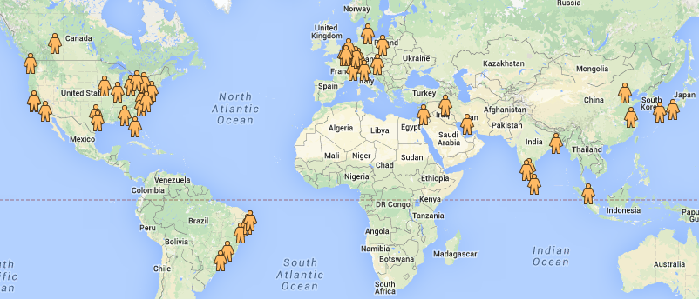
Boa's Global Impact
90+ users from over 20 countries!

Slide 48
Thank you!
http://boa.cs.iastate.edu/

