Slide 1
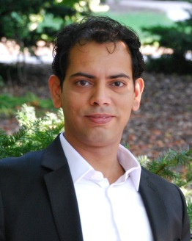
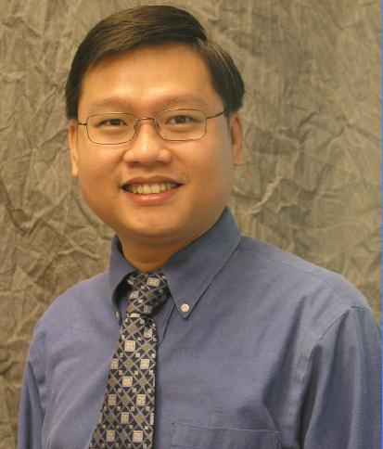
Mining Billions of AST Nodes to Study Actual and Potential Usage of Java Language Features
Robert Dyer
Hridesh Rajan
Hoan Anh Nguyen
Tien N. Nguyen
The research activities described in this talk were supported in part by the US National Science Foundation (NSF) grants CCF-13-49153, CCF-13-20578, TWC-12-23828, CCF-11-17937, CCF-10-17334, and CCF-10-18600.

Slide 2
Previous Language Studies
What languages do
programmers choose?
[Meyerovich&Rabkin SPLASH'13]
Reflection
[Livshits et al. APLAS'05]
[Callaú et al. MSR'11]
Object-oriented Features
[Tempero et al. ECOOP'08]
[Muschevici et al. OOPSLA'08]
[Tempero ASWEC'09]
[Grechanik et al. ESEM'10]
[Gorschek et al. ICSE'10]
Generics
[Basit et al. SEKE'05]
[Parnin et al. MSR'11]
[Hoppe&Hanenberg SPLASH'13]
JavaScript / eval
[Yue&Wang WWW'09]
[Richards et al. PLDI'10]
[Ratanaworabhan et al. WEBAPPS'10]
[Richards et al. ECOOP'11]

Slide 3
What is this study about?
How have new Java language features
been adopted over time?
Assume Java
Corpus of 30k+ projects
Over 10 years of history
Study 18 new features from 3 language editions

Slide 4
Research Questions
RQ1: Are language features used before release?
RQ2: How frequently is each feature used?
RQ3: How did committers/teams adopt features?
RQ4: Could features have been used more?
RQ5: Was old code converted to use new features?

Slide 5
How is Java's language defined?
Java Language Specifications (JLS)

Slide 6
Java Language Specifications (JLS)
JLS2 | Java 1.4 | May 2002
JLS3 | Java 5 | September 2004
JLS4 | Java 7 | July 2011
JLS5 | Java 8 | March 2014

Slide 7
JLS2: New Language Features
Assert
assert i > 0;
assert n != null;

Slide 8
JLS3: New Language Features
Annotation Declaration
Annotation Use
Enums
@interface Test {}
@Test void m()
enum E { N1, ..}
Enhanced-For Loop
Varargs
Generic Types
for (T v : items)
...
void m(T... arg){
interface List<T> {}
Generic Variables
Generic Methods
Generic Wildcards
List<T> l;
Map<K,V> m;
<T> void m(T a){
Class<?> c;
Class<? extends E> c;
Class<? super S> c;

Slide 9
JLS4: New Language Features
Diamond
Multi-catch
Map<K, V> m = new HashMap<>();
try { .. }
catch (E1 | E2 e) { .. }
Underscore Literals
int MILLION = 1_000_000;
int MASK = 0xFF_FF_00;
Try with Resources
try (File f = new ..) {
Binary Literals
int ONE = 0b001;
int TWO = 0b010;
int FOUR = 0b100;
Safe Varargs
@SafeVarargs
static <T> List<T> asList(T... elems) {

Slide 10
Study Tools and Dataset
Dataset
Processes
Assert[631152000] = 5
Assert[631154020] = 12
Assert[631161103] = 14
Assert[631172392] = 18
.
.
.
input = project₁
Boa Program
Assert[631152000] << 1;
Output
Assert[631154020] << 1;
input = project₂
Boa Program
Boa
[ICSE'13]
input = project₃
Boa Program
Assert
631152000, 1
631152000, 1
631154020, 1
.
.
.
.
.
.
631152000, 1
631154020, 1
631154020, 1
631161103, 1
input = project_{n}
Boa Program
http://boa.cs.iastate.edu/java-features/

Slide 11
Study Dataset
Projects | 31,432
Revisions | 4,298,309
Java Files | 9,093,216
Java File Snapshots | 28,747,948
AST Nodes | 18,323,905,323

Slide 12
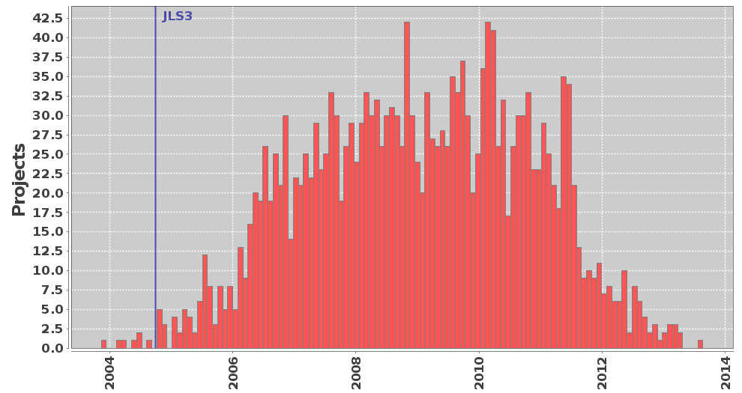
Research Question 1
Are language features used
before release?
Yes!

Slide 13
Research Question 2
How frequently was each
language feature used?

Slide 14
Project Histogram: Annotation Use

Slide 15
Project Density: Annotation Use

Slide 16
Some features popular

Slide 17
Some features popular. Why?

Slide 18
Some features popular. Why?
List
ArrayList
Map
HashMap
Set
Collection
Vector
Class
Iterator
HashSet
(confirms [Parnin et al. MSR'11])

Slide 19
Research Question 3
How did committers adopt features?
Adoption by individuals, not teams
(confirms [Parnin et al. MSR'11])

Slide 20
Research Question 4
Could features have been used more?

Slide 21
Opportunity: Assert
Find methods that throw IllegalArgumentException.
void m(..) {
if (cond) throw new IllegalArgumentException();
...
}
Simpler
void m(..) {
assert cond;
...
}
Machine-checkable
Easily disabled for production

Slide 22
Opportunity: Varargs
Find methods that take arrays as last argument.
void m(a1, a2, T[] a3) {
m(.., .., new T[] {t₁, t₂, ..}) {
void m(a1, a2, T... a3) {
m(.., .., t₁, t₂, ..) {

Slide 23
Opportunity: Binary Literals
Find where literal 1 is shifted left.
int x = 1 << 5;
short[] phases = {
0x7,
0xE,
0xD,
0xB
};
short[] phases = {
0b0111,
0b1110,
0b1101,
0b1011
};

Slide 24
Opportunity: Underscore Literals
Find integers with 7 or more digits and no underscores.
int x = 1000000;
int x = 1_000_000;

Slide 25
Opportunity: Diamond
Instantiation of generics not using diamond.
List<String> l = new ArrayList<String>();
List<String> l = new ArrayList<>();

Slide 26
Opportunity: MultiCatch
A try with multiple, identical catch blocks.
try { .. }
catch (T1 e) { b1 }
catch (T2 e) { b1 }
try { .. }
catch (T1 | T2 e) { b1 }

Slide 27
Opportunity: Try w/ Resources
Try statements calling close() in the finally block.
try {
.. } finally {
var.close();
}
try (var = ..) { ..
}

Slide 28
Millions of opportunities!
 | Assert | Varargs | Binary Literals | Diamond | MultiCatch | Try w/ Resources | Underscore Literals
Old | 89K | 612K | 56K | 3.3M | 341K | 489K | 5.3M
New | 291K | 1.6M | 5K | 414K | 24K | 33K | 507K

Slide 29
Millions of opportunities!
Actual Uses
 | Assert | Varargs | Binary Literals | Diamond | MultiCatch | Try w/ Resources | Underscore Literals
Projects | 12.72% | 15.43% | 0.02% | 0.4% | 0.27% | 0.21% | 0.02%
Potential Uses
Projects | 18.18% | 88.78% | 5.9% | 59.08% | 49.75% | 37.27% | 51.15%

Slide 30
Impact: Potential for bugs
BufferedReader br = ...;
String s = br.readLine();
br.close();
throw new IOException();
try (BufferedReader br = ...;) {
String s = br.readLine();
}

Slide 31
Impact: Potential for bugs
Mine for methods that:
1. declare they throw IOException
2. do not catch IOException in body
3. contain a call to close()
public void close()
throws IOException {
f.close();
}
193,768 instances
sampling shows 50% accuracy
try {
...
} finally {
f1.close();
f2.close();
}
try {
sock.close();
rec.close();
} catch (Exception e) { }

Slide 32
Research Question 5
Was old code converted to use new features?

Slide 33
Detecting Conversions
File.java
(Revision N)
File.java
(Revision N+1)
uses_{N}
potential_{N}
uses_{N+1}
potential_{N+1}
uses_{N} < uses_{N+1}
potential_{N} > potential_{N+1}

Slide 34
Detected lots of conversions!
 | Assert | Varargs | Diamond | MultiCatch | Try w/ Resources | Underscore Literals
Count | 180 | 2.1K | 8.5K | 162 | 154 | 2
Files | 105 | 1.6K | 3.8K | 125 | 99 | 1
Projects | 37 | 488 | 72 | 23 | 17 | 1
manual, systematic sampling confirms
2602 conversions
13 not conversions

Slide 35
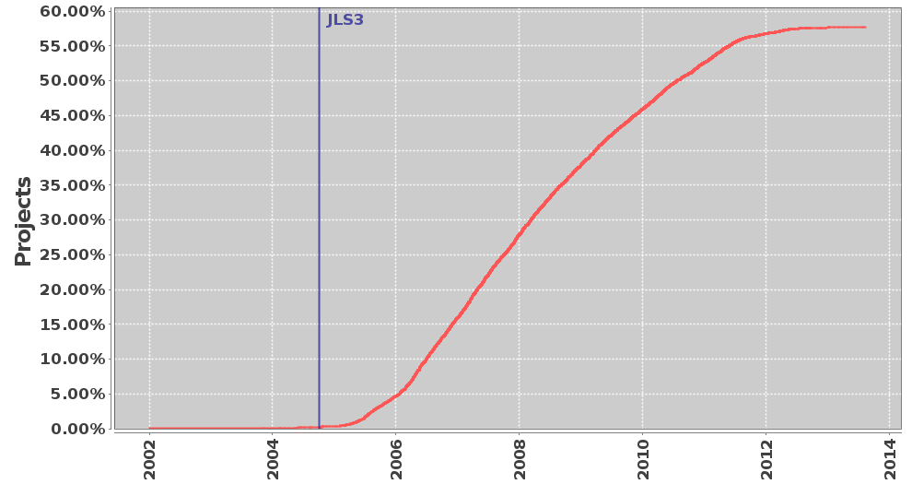
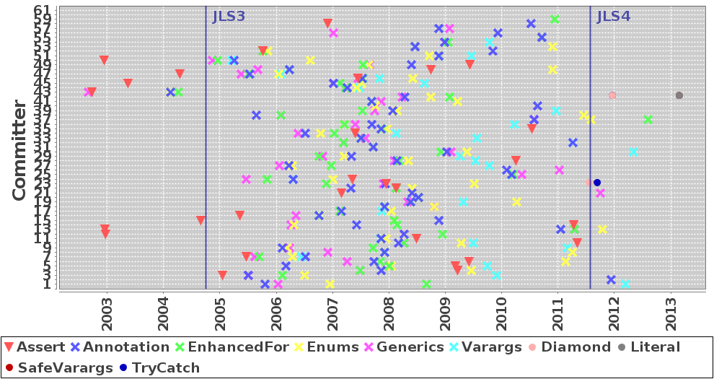
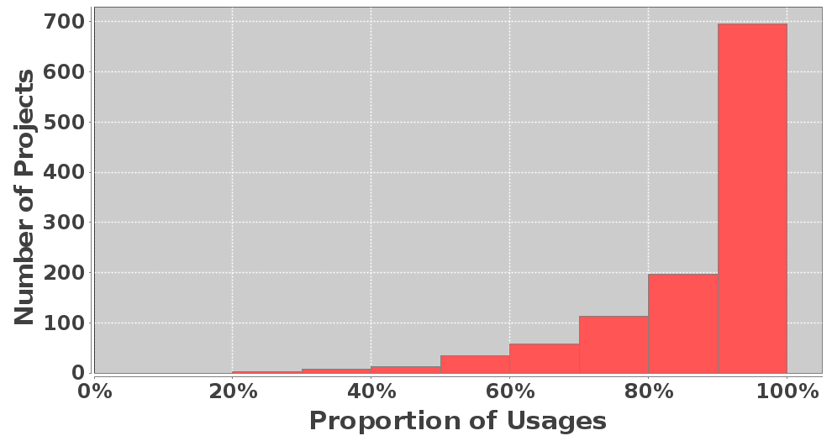
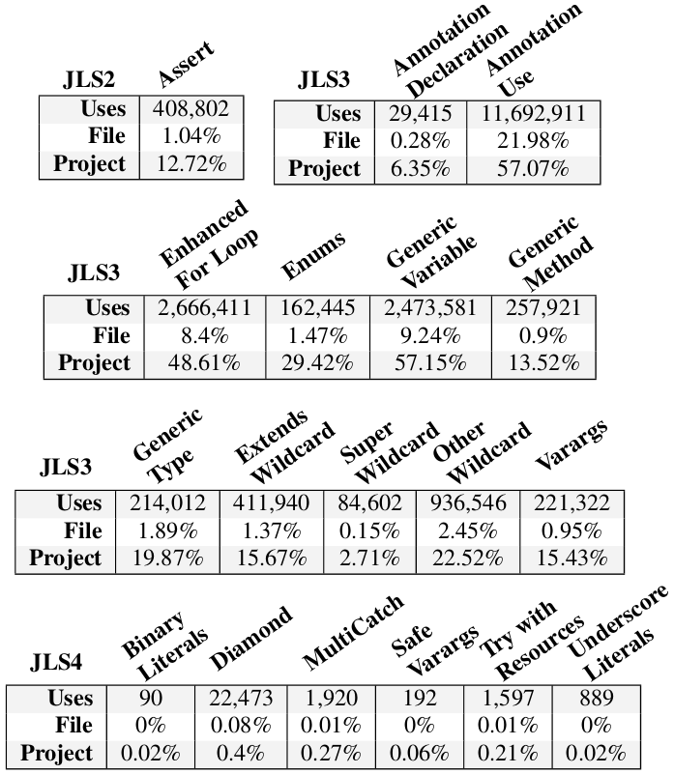
Feature adoption by individuals
Similar usage patterns
 | Assert | Varargs | Diamond | MultiCatch | Try w/ Resources | Underscore Literals
Count | 180 | 2.1K | 8.5K | 162 | 154 | 2
Files | 105 | 1.6K | 3.8K | 125 | 99 | 1
Projects | 37 | 488 | 72 | 23 | 17 | 1
To summarize...
Old code converted to use new features
 | Assert | Varargs | Binary Literals | Diamond | MultiCatch | Try w/ Resources | Underscore Literals
Old | 89K | 612K | 56K | 3.3M | 341K | 489K | 5.3M
New | 291K | 1.6M | 5K | 414K | 24K | 33K | 507K
All | 380K | 2.2M | 61K | 3.7M | 365K | 522K | 5.8M
Files | 1.39% | 12.74% | 0.11% | 12.25% | 2.28% | 1.85% | 5.86%
Projects | 18.18% | 88.78% | 5.9% | 59.08% | 49.75% | 37.27% | 51.15%
Only few features
see high use
Despite (missed) potential for use

Slide 36
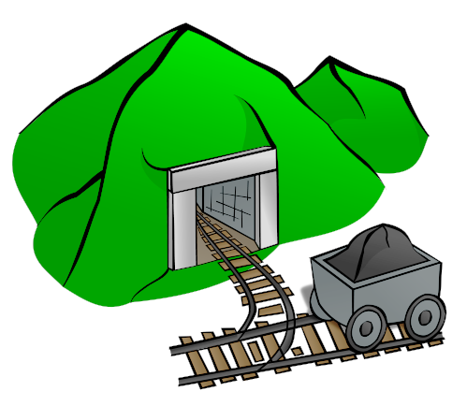
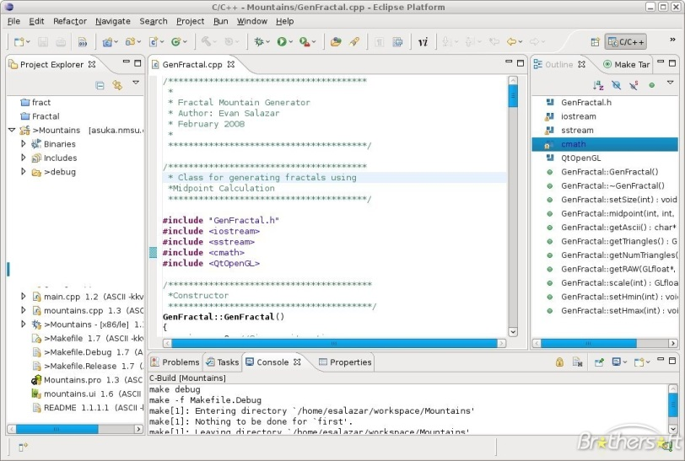
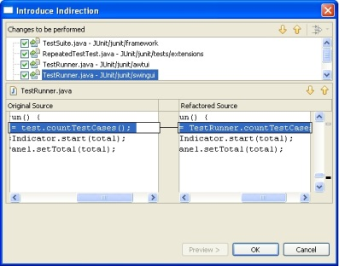
Call to action!

Slide 37
Thank you!
http://boa.cs.iastate.edu/java-features/

