Slide 1





Mining Preconditions of APIs in Large-Scale Code Corpus
Hoan Nguyen
Robert Dyer*
Tien N. Nguyen
Hridesh Rajan
*currently at the Bowling Green State University
Notes:
Good afternoon - Collaborative work with my colleague Tien, and our current and past students.
Let's begin with an overview.

Slide 2
Lack of API specifications is a critical SE problem
Specifications: Pre { Q } Post, i.e. behavioral specifications
Self-perpetuating cycle affecting high assurance systems: since APIs are not specified, lot harder and costlier to specify client code
Specification inference: given code auto-create specs
Existing work has focused on single project. Consequently, inference bounded by project-specific conditions
Big code: readily available, large # of projects (10³ – 10⁶)
Q: Will consensus across large number of projects help?
Goal: show feasibility, effectiveness for preconditions
Technique to infer preconditions, apply to a large chunk of JDK
Compare with expert-written preconditions from JML specs
High precision, identify missing and new preconditions
Notes:
This work is targeting the problem that commonly used API lack specifications.
- By specifications here we refer to behavioral specification: pre+post
- Since APIs lack specifications, its harder to write high assurance systems
Spec inference approach promise to solve this problem, but existing work has focussed on inferring project-specific specifications
An opportunity that has come is that large amount of code is now easily available.
Building on this opportunity, this work examines whether consensus across large number of projects can help improve specification inference.
We show feasibility of this direction, and its effectiveness for preconditions.

Slide 3

Reason, verify
void m(…) {//pre: ?
…
lib.api();
…
} //post: ?
void m(…) {//pre: P
…
lib.api(); //pre: ?
…
} //post: Q
Missing Spec
Our work
void m(…) {//pre:P?
…
lib.api(); //pre: ?
…
} //post:Q?
void m(…) {//pre: P
…
lib.api(); //pre: P’
…
} //post: Q
Notes:
Writing code conforming to the specifications
Automated program verification
Runtime assertion checking: jmlrac
Extended static checking: ESC/Java
Bug detection
Automatic test case generation

Slide 4
Preconditions: Constraints on receiver and parameters that
must be true right before calling the API
0 <= beginIndex
beginIndex <= endIndex
endIndex <= length();
public String substring(int beginIndex, int endIndex)
throws StringIndexOutOfBoundsException;
Challenges:
Manually specifying can be costly.
Not too many APIs are released with preconditions.

Slide 5
Can we mine preconditions automatically?

Slide 6
Related work: focuses on single projects
[Ernst et al. 99, Flanagan et al. 01, Weimer et al. 05, Wei et al. 11, Ramanathan et al. 07]
Notes:
Dynamic approaches
Ernst et al. [ICSE’99] detects program invariants via running test cases
Weimer et al. [TACAS’05] mine temporal specification from error handling paths
Wei et al. [ICSE’11] infer complex post-conditions from simple programmer-written ones
Static approaches
Several approaches mine the temporal specifications between method calls
Ramanathan et al. [PLDI’07] combine program analysis and data mining to infer preconditions

Slide 7
Challenge: separate project specific constraints (chaff) mixed with API specific preconditions (wheat)
Notes:
Dynamic approaches
Ernst et al. [ICSE’99] detects program invariants via running test cases
Weimer et al. [TACAS’05] mine temporal specification from error handling paths
Wei et al. [ICSE’11] infer complex post-conditions from simple programmer-written ones
Static approaches
Several approaches mine the temporal specifications between method calls
Ramanathan et al. [PLDI’07] combine program analysis and data mining to infer preconditions
----- Meeting Notes (11/18/14 12:10) -----
separate?

Slide 8
This work: use consensus across large number of projects to separate wheat from chaff
Notes:
Dynamic approaches
Ernst et al. [ICSE’99] detects program invariants via running test cases
Weimer et al. [TACAS’05] mine temporal specification from error handling paths
Wei et al. [ICSE’11] infer complex post-conditions from simple programmer-written ones
Static approaches
Several approaches mine the temporal specifications between method calls
Ramanathan et al. [PLDI’07] combine program analysis and data mining to infer preconditions

Slide 9
Preconditions can be mined from guarded conditions at the call sites of the code using the APIs
Key Ideas
Preconditions mined from multiple projects in a large-scale code corpus can be used to filter out chaff
Notes:
Dynamic approaches
Ernst et al. [ICSE’99] detects program invariants via running test cases
Weimer et al. [TACAS’05] mine temporal specification from error handling paths
Wei et al. [ICSE’11] infer complex post-conditions from simple programmer-written ones
Static approaches
Several approaches mine the temporal specifications between method calls
Ramanathan et al. [PLDI’07] combine program analysis and data mining to infer preconditions

Slide 10
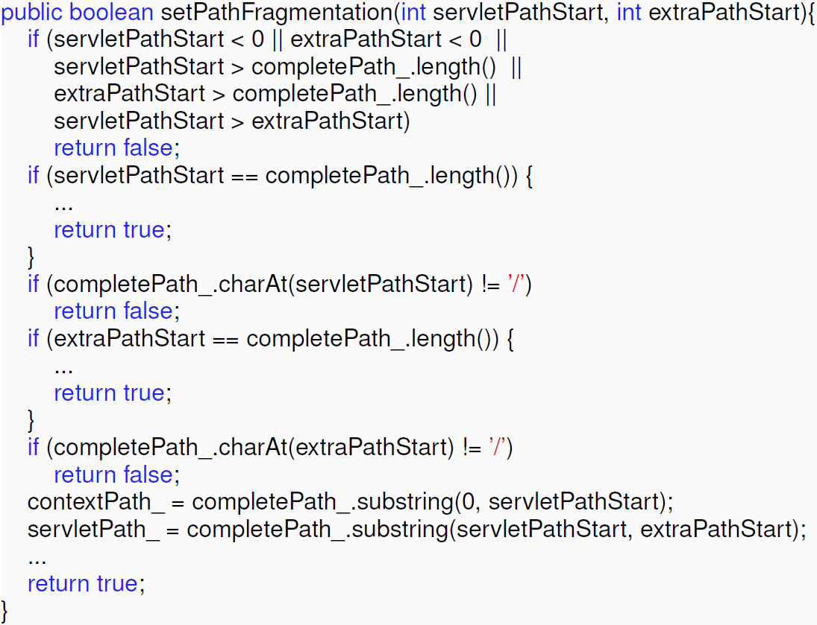
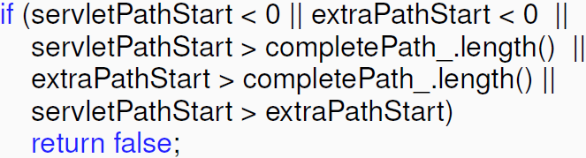
Preconditions can be mined from guarded conditions at the call sites of the code using the APIs
Key Ideas
Preconditions mined from multiple projects in a large-scale code corpus can be used to filter out chaff
servletPathStart >= 0
extraPathStart >= 0
servletPathStart <= completePath_.length()
extraPathStart <= completePath_.length()
servletPathStart <= extraPathStart
completePath_.substring(servletPathStart, extraPathStart)
Client code of API String.substring(int,int) in project SeMoA at revision 1929

Slide 11
Preconditions can be mined from guarded conditions at the call sites of the code using the APIs: a. extract, b. normalize
Key Ideas
Preconditions mined from multiple projects in a large-scale code corpus can be used to filter out chaff
class String
...
substring (int, int)
...
substring (int, int): {start <= end}
Entry
true
start > end
Exit
false
client method
true
c1
false
Build CFG
do_true
do_false
string.substring (start, end)
Exit
API call is control-dependent on exactly one branch of the condition
Notes:
Slide on extracting conditions

Slide 12
Preconditions can be mined from guarded conditions at the call sites of the code using the APIs: a. extract, b. normalize
Key Ideas
Preconditions mined from multiple projects in a large-scale code corpus can be used to filter out chaff
s < t
t > s
s – t < 0
t – s > 0
s – t == 0
s == t
s <= 12
Notes:
Slide on normalizing conditions

Slide 13
Preconditions can be mined from guarded conditions at the call sites of the code using the APIs: a. extract, b. normalize
Key Ideas
Preconditions mined from multiple projects in a large-scale code corpus can be used to filter out chaff
Normalize
s < t
t > s
s < t
s – t < 0
t – s > 0
s – t == 0
s == t
s <= 12

Slide 14
Preconditions can be mined from guarded conditions at the call sites of the code using the APIs: a. extract, b. normalize
Key Ideas
Preconditions mined from multiple projects in a large-scale code corpus can be used to filter out chaff
Normalize
s < t
t > s
s < t
s – t < 0
t – s > 0
s – t == 0
s == t
s == t
s <= 12

Slide 15

Preconditions can be mined from guarded conditions at the call sites of the code using the APIs
Key Ideas
Preconditions mined from multiple projects in a large-scale code corpus can be used to filter out chaff
completePath_.charAt(servletPathStart) == ‘/’
completePath_.charAt(extraPathStart) == ‘/’
completePath_.substring(servletPathStart, extraPathStart)

Slide 16
Preconditions can be mined from guarded conditions at the call sites of the code using the APIs
Key Ideas
Preconditions mined from multiple projects in a large-scale code corpus can be used to filter out chaff
C2
C2
C2
C1
C3
C1
C3
C1
C3
api()
api()
api()

Slide 17
Preconditions can be mined from guarded conditions at the call sites of the code using the APIs
Key Ideas
Preconditions mined from multiple projects in a large-scale code corpus can be used to filter out chaff
C2
C2
C2
C1
C3
C1
C3
C1
C3
api()
api()
api()
C2
C2
C2
C1
C3
C1
C3
C1
C3
api()
api()
api()
C2
C2
C2
C1
C3
C1
C3
C1
C3
api()
api()
api()

Slide 18
Preconditions can be mined from guarded conditions at the call sites of the code using the APIs
Key Ideas
Preconditions mined from multiple projects in a large-scale code corpus can be used to filter out chaff
C2
C2
C2
C1
C3
C1
C3
C1
C3
C2
api()
C2
api()
C2
api()
C2
C1
C3
C1
C3
C1
C3
C1
C3
api()
C2
api()
C2
api()
C2
api()
C1
C3
C1
C3
C1
C3
C2
api()
C2
api()
C2
api()
C2
C1
C3
C1
C3
C1
C3
C1
C3
api()
api()
C2
api()
C2
api()
C2
C1
C3
C1
C3
C1
C3
C2
api()
C2
api()
C2
api()
C2
C1
C3
C1
C3
C1
C3
C1
C3
api()
api()
api()
api()

Slide 19
Preconditions can be mined from guarded conditions at the call sites of the code using the APIs
Key Ideas
Preconditions mined from multiple projects in a large-scale code corpus can be used to filter out chaff
C2
C2
C2
C2
C2
C2
C2
C1
C3
C1
C3
C1
C3
C1
C3
C1
C3
C1
C3
C1
C3
api()
C2
api()
api()
api()
api()
C2
api()
api()
C2
C2
C2
C2
C2
C1
C3
C1
C3
C1
C3
C1
C3
C1
C3
C1
C3
C1
C3
C2
api()
C2
C2
C2
C2
api()
api()
C2
api()
api()
api()
api()
C2
C1
C3
C1
C3
C1
C3
C1
C3
C1
C3
C1
C3
C1
C3
api()
api()
api()
api()
api()
api()
C2
api()
C2
C2
C2
C2
C2
C2
C1
C3
C1
C3
C1
C3
C1
C3
C1
C3
C1
C3
C1
C3
api()
api()
C2
api()
api()
api()
C2
api()
C2
api()
C2
C2
C2
C2
C1
C3
C1
C3
C1
C3
C1
C3
C1
C3
C1
C3
C1
C3
api()
api()
api()
api()
api()
C2
api()
C2
C2
api()
C2
C2
C2
C2
C1
C3
C1
C3
C1
C3
C1
C3
C1
C3
C1
C3
C1
C3
api()
api()
api()
api()
api()
api()
api()

Slide 20
Preconditions can be mined from guarded conditions at the call sites of the code using the APIs
Key Ideas
Preconditions mined from multiple projects in a large-scale code corpus can be used to filter out chaff
C1
C2
C3
C2
C2
C1
C2
C3
C1
C2
C3
C1
C2
C3
C1
C2
C3
C1
C2
C3
C2
C2
C1
C2
C3
C1
C2
C3
C1
C2
C3
C1
C2
C3
C1
C3
C1
C3
C1
C3
C1
C3
api()
C2
api()
api()
api()
api()
C2
api()
C2
api()
api()
api()
api()
C2
api()
api()
C2
C2
C2
C2
C2
C2
api()
api()
C1
C3
C1
C3
C1
C3
C1
C3
C1
C3
C1
C3
C1
C3
C1
C3
C1
C3
C1
C2
C3
C1
C2
C3
C1
C2
C3
C1
C2
C3
C1
C3
C2
api()
C2
C2
C2
C2
api()
C2
C2
api()
C2
C2
C2
C2
api()
C1
api()
C3
C2
C1
api()
C3
C1
api()
C3
C1
api()
C3
C1
api()
C3
C1
C3
C1
api()
C3
C2
C1
api()
C3
C1
api()
C3
C1
api()
C3
C1
api()
C3
C1
C2
C3
C1
C3
C1
C3
api()
api()
api()
api()
api()
api()
C2
api()
api()
api()
api()
api()
api()
C2
api()
C2
C2
C2
C2
C2
C2
C2
api()
C1
C3
C1
C3
C1
C3
C1
C3
C1
C3
C1
C3
C1
C3
C1
C3
C1
C2
C3
C1
C2
C3
C1
C2
C3
C1
C2
C3
C1
C2
C3
C1
C3
api()
api()
api()
C2
api()
api()
api()
C2
api()
C2
api()
C2
C2
api()
C2
api()
api()
api()
C2
api()
C2
api()
C1
C3
C2
C2
C1
C3
C1
C3
C1
C3
C1
C3
C1
C3
C2
C2
C1
C3
C1
C3
C1
C2
C3
C1
C2
C3
C1
C3
C1
C3
C1
C3
C1
C3
api()
api()
api()
api()
api()
C2
api()
api()
api()
api()
api()
C2
api()
C2
C2
api()
C2
C2
C2
C2
C2
api()
C2
api()
C1
C3
C1
C3
C1
C3
C1
C3
C1
C3
C1
C3
C1
C3
C1
C3
C1
C3
C1
C2
C3
C1
C2
C3
C1
C2
C3
C1
C2
C3
C1
C3
C2
C2
C2
C2
C2
C2
C2
C2
C2
C2
api()
C2
C2
api()
C2
C2
api()
C1
C3
api()
api()
C1
api()
C3
C1
api()
api()
api()
api()
api()
api()
api()
api()
C1
C3
C1
C3
C3
C1
C3
C1
C3
C1
C3
C1
C3
C1
C3
C1
C3
C1
C3
C1
C3
C1
C3
api()
C2
api()
api()
api()
api()
C2
api()
C2
api()
api()
api()
api()
C2
api()
api()
C2
C2
C2
C2
C2
C2
api()
api()
C1
C3
C1
C3
C1
C3
C1
C3
C1
C3
C1
C3
C1
C3
C1
C3
C1
C3
C1
C2
C3
C1
C2
C3
C1
C2
C3
C1
C2
C3
C1
C3
C2
api()
C2
C2
C2
C2
api()
C2
C2
api()
C2
C2
C2
C2
api()
C1
api()
C3
C2
C1
api()
C3
C1
api()
C3
C1
api()
C3
C1
api()
C3
C1
C3
C1
api()
C3
C2
C1
api()
C3
C1
api()
C3
C1
api()
C3
C1
api()
C3
C1
C2
C3
C1
C3
C1
C3
api()
api()
api()
api()
api()
api()
C2
api()
api()
api()
api()
api()
api()
C2
api()
C2
C2
C2
C2
C2
C2
C2
api()
C1
C3
C1
C3
C1
C3
C1
C3
C1
C3
C1
C3
C1
C3
C1
C3
C1
C2
C3
C1
C2
C3
C1
C2
C3
C1
C2
C3
C1
C2
C3
C1
C3
api()
api()
api()
C2
api()
api()
api()
C2
api()
C2
api()
C2
C2
api()
C2
api()
api()
api()
C2
api()
C2
api()
C1
C3
C2
C2
C1
C3
C1
C3
C1
C3
C1
C3
C1
C3
C2
C2
C1
C3
C1
C3
C1
C2
C3
C1
C2
C3
C1
C3
C1
C3
C1
C3
C1
C3
api()
api()
api()
api()
api()
C2
api()
api()
api()
api()
api()
C2
api()
C2
C2
api()
C2
C2
C2
C2
C2
api()
C2
api()
C1
C3
C1
C3
C1
C3
C1
C3
C1
C3
C1
C3
C1
C3
C1
C3
C1
C3
C1
C2
C3
C1
C2
C3
C1
C2
C3
C1
C2
C3
C1
C3
api()
api()
api()
api()
api()
api()
api()
api()
api()
api()
api()
api()
api()
api()

Slide 21
Preconditions can be mined from guarded conditions at the call sites of the code using the APIs
Key Ideas
Preconditions mined from multiple projects in a large-scale code corpus can be used to filter out chaff
Conditions
0 <= start
start <= end
end <= length
contains(‘@’)
Client method
M₁
api(...)
Extract
and
Normalize
Build CFG

Slide 22
Preconditions can be mined from guarded conditions at the call sites of the code using the APIs
Key Ideas
Preconditions mined from multiple projects in a large-scale code corpus can be used to filter out chaff: a. infer, b. filter and rank
Conditions
0 <= start
start <= end
end <= length
contains(‘@’)
Client method
M₁
api(...)
Extract
and
Normalize
Build CFG
Candidate
Preconditions
0 = start
start <= end
end <= length
starts(‘/’)
0 <= start
start <= end
end <= length
contains(‘@’)
Client method
M₂
Build CFG
api(...)
Extract
and
Normalize
Preconditions
Infer
Filter
and
Rank
0 <= start
start <= end
end <= length
...
0 < start
start <= end
end <= length
ends(‘\n’)
Client method
M_{N}
Build CFG
api(...)
Extract
and
Normalize

Slide 23
Preconditions can be mined from guarded conditions at the call sites of the code using the APIs
Key Ideas
Preconditions mined from multiple projects in a large-scale code corpus can be used to filter out chaff: a. infer, b. filter and rank
Normalize
Infer
s < t
t > s
s < t
s – t < 0
t – s > 0
s <= t
s – t == 0
s == t
s == t
s <= 12

Slide 24
Preconditions can be mined from guarded conditions at the call sites of the code using the APIs
Key Ideas
Preconditions mined from multiple projects in a large-scale code corpus can be used to filter out chaff: a. infer, b. filter and rank
Normalize
Infer
Filter and Rank
s < t
t > s
s < t
s – t < 0
confidence > σ
t – s > 0
s <= t
s <= t
s – t == 0
s == t
s == t
s <= 12
s <= 12
s <= 12
confidence < σ

Slide 25
How accurately do we mine preconditions?
Are mined preconditions useful?

Slide 26
Evaluation – Accuracy
Data collection
 | SourceForge | Apache
Projects | 3,413 | 146
Total source files | 497,453 | 132,951
Total classes | 600,274 | 173,120
Total methods | 4,735,151 | 1,243,911
Total SLOCs | 92,495,410 | 25,117,837
Total used JDK classes | 806 (63%) | 918 (72%)
Total used JDK methods | 7,592 (63%) | 6,109 (55%)
Total method calls | 22,308,251 | 5,544,437
Total JDK method calls | 5,588,487 | 1,271,210
Almost 120 millions SLOCs

Slide 27
Evaluation – Accuracy
Data collection
 | SourceForge | Apache
Projects | 3,413 | 146
Total source files | 497,453 | 132,951
Total classes | 600,274 | 173,120
Total methods | 4,735,151 | 1,243,911
Total SLOCs | 92,495,410 | 25,117,837
Total used JDK classes | 806 (63%) | 918 (72%)
Total used JDK methods | 7,592 (63%) | 6,109 (55%)
Total method calls | 22,308,251 | 5,544,437
Total JDK method calls | 5,588,487 | 1,271,210
63% (55%) JDK methods are used in SourceForge (Apache)

Slide 28
Evaluation – Accuracy
Data collection
 | SourceForge | Apache
Projects | 3,413 | 146
Total source files | 497,453 | 132,951
Total classes | 600,274 | 173,120
Total methods | 4,735,151 | 1,243,911
Total SLOCs | 92,495,410 | 25,117,837
Total used JDK classes | 806 (63%) | 918 (72%)
Total used JDK methods | 7,592 (63%) | 6,109 (55%)
Total method calls | 22,308,251 | 5,544,437
Total JDK method calls | 5,588,487 | 1,271,210
One-fourth of method calls are to JDK APIs

Slide 29

Evaluation – Accuracy
Data collection
Building ground-truth
Extracting preconditions from published formal specification for JDK APIs on JML website
797 Methods, 1155 preconditions
/*@ public normal_behavior
@ requires 0 <= beginIndex
@ && beginIndex <= endIndex
@ && endIndex <= length();
@ …
/*@ public behavior
@ …
@ signals (NoSuchElementException) isEmpty();
@*/
www.jmlspecs.org

Slide 30
Accuracy over Preconditions
 | Precision | Recall | Time
SourceForge | 84% | 79% | 17h35m
Apache | 82% | 75% | 34m
Both | 83% | 80% | 18h03m
~ 1 minute to come up with a precondition

Slide 31
Accuracy over Preconditions
 | Precision | Recall | Time
SourceForge | 84% | 79% | 17h35m
Apache | 82% | 75% | 34m
Both | 83% | 80% | 18h03m
5 preconditions are newly found for the JDK API methods that has already had JML specifications
Notes:
Details in paper.

Slide 32
Types of Incorrectly-mined Preconditions
Type 1. The mined preconditions are stronger than specified
java.util.List.add(Object obj): obj != null
Type 2. The mined preconditions are project-specific, but common
java.lang.Math.min(double a, double b): a > 0, b > 0
Type 3. The mined preconditions are incorrect due to error in analysis
java.lang.StringBuffer.ensureCapacity(int capacity): capacity <= 0
Dataset | Total | Stronger | Specific | Analysis Error
SourceForge | 173 | 118 | 53 | 2
Apache | 187 | 121 | 65 | 1
Both | 195 | 129 | 66 | 0
Developers sometimes check stronger preconditions than specified

Slide 33
Types of Missing Preconditions
Type 1. Private
Preconditions involve private element(s) of classes
Type 2. No call
APIs are never called
Type 3. No occur
Preconditions are never checked
Type 4. Low frequency
Preconditions are checked with low confidence
 | Private | No call | No occur | Low confidence
SourceForge | 4% | 4% | 9% | 3%
Apache | 5% | 5% | 12% | 3%
Both | 5% | 2% | 10% | 4%
Some preconditions are never checked due to the semantics of the client code

Slide 34
Accuracy by size
SourceForge
Apache

Slide 35
Class | Method | Suggest | Accept
StringBuffer | delete(int,int) | 3 | Y
 | replace(int,int,String) | 2 | Y*
 | setLength(int) | 1 | Y
 | subSequence(int,int) | 3 | Y
 | substring(int,int) | 3 | Y
LinkedList | add(int,Object) | 2 | Y
 | addAll(int,Collection) | 3 | Y
 | get(int) | 2 | Y
 | listIterator(int) | 2 | Y
 | remove(int) | 2 | Y
 | set(int,Object) | 2 | Y
2 classes | 11 methods | 25
Usefulness Evaluation
Can we help create new specifications?
Notes:
Chose 2 classes in JDK that had methods without specifications
Used mined preconditions to create preconditions for those methods in JML syntax
Sent to JML team

Slide 36
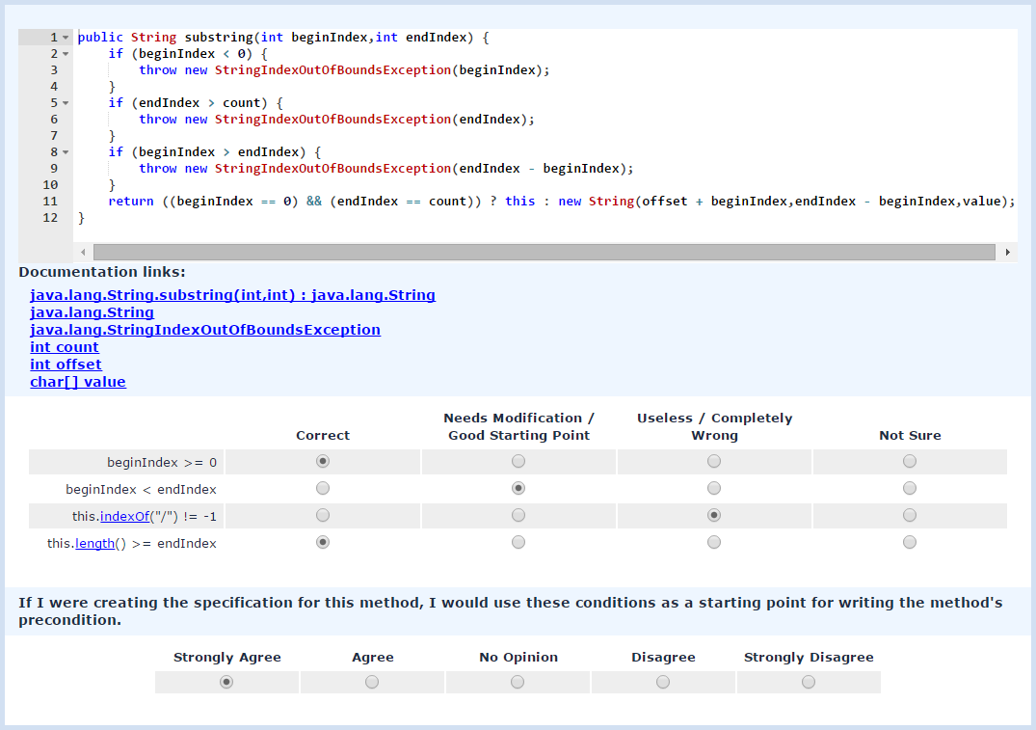
Usefulness Evaluation
Web-based Survey
http://boa.cs.iastate.edu/jml
Notes:
* 82% are rated as correct or good starting point
* 81% agree on the usefulness of the mined preconditions

Slide 37

Lack of API specifications, a critical hurdle for high assurance SE, can potentially be overcome by leveraging big code mining. We show feasibility for preconditions.
boa.cs.iastate.edu
Notes:
Mining API preconditions from large code corpus
120 million SLOCs on SourceForge and Apache
High accuracy
Recall: 75–80% and Precision: 82–84%
Found 5 missing preconditions
Useful for writing specifications
All suggestions are accepted by specification writer
81% of survey participants

Slide 39
A precondition-related bug in project MSS Code Factory
while (ch.equals(" ") || ch.equals("\t") || ch.equals("\n") ||
ch.equals("\f") || ch.equals("\r")) {
start++;
if (start >= lenMacro)
break;
ch = macro.substring(start, 1);
}
Notes:
MSS Code Factory revision 2464

Slide 40
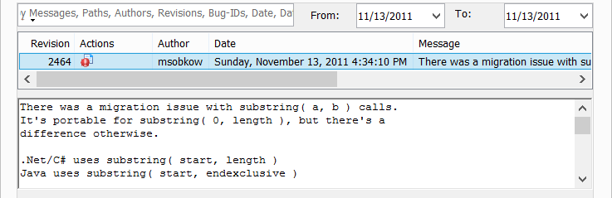
A precondition-related bug in project MSS Code Factory
while (ch.equals(" ") || ch.equals("\t") || ch.equals("\n") ||
ch.equals("\f") || ch.equals("\r")) {
start++;
if (start >= lenMacro)
break;
ch = macro.substring(start, 1);
}
StringIndexOutOfBoundsException when string macro is empty

Slide 41
A precondition-related bug fix in project MSS Code Factory
while (ch.equals(" ") || ch.equals("\t") || ch.equals("\n") ||
ch.equals("\f") || ch.equals("\r")) {
start++;
if (start >= lenMacro)
break;
ch = macro.substring(start, 1);
}
fix bug
macro.substring(start, start + 1)

Slide 42
Study on precondition-related bug fixing
Data collection
Projects: 3,413
Revisions: ~2M
Fixing revisions: ~370,000
Methodology
Comparing code before and after change
Identifying fixing changes that added precondition(s) for a JDK API → candidates
Verifying candidates manually

Slide 43
Study on the precondition-related bug fixing
Result
Candidates:
3,130 fixing revisions
4,399 API call sites
Manually verify a sample of 100 call sites
80 are actually related to missing preconditions
Null-pointer and Index-out-of-bounds exceptions are the most common

Slide 44
Related Precondition Mining Approaches
Dynamic approaches
Ernst et al. [ICSE’99] detects program invariants via running test cases
Weimer et al. [TACAS’05] mine temporal specification from error handling paths
Wei et al. [ICSE’11] infer complex post-conditions from simple programmer-written ones

Slide 45
Related Precondition Mining Approaches
Static approaches
Several approaches mine the temporal specifications between method calls
Ramanathan et al. [PLDI’07] combine program analysis and data mining to infer preconditions

Slide 46
Accuracy with added technical components
SourceForge
Apache

Slide 47
Conclusions
Mining API preconditions from large code corpus
120 million SLOCs on SourceForge and Apache
High accuracy
Recall: 75–80% and Precision: 82–84%
Found 5 missing preconditions
Useful for writing specifications
All suggestions are accepted by specification writer
81% of survey participants

Slide 48
Evaluation – Accuracy
Data collection
 | SourceForge | Apache
Projects | 3,413 | 146
Total source files | 497,453 | 132,951
Total classes | 600,274 | 173,120
Total methods | 4,735,151 | 1,243,911
Total SLOCs | 92,495,410 | 25,117,837
Total used JDK classes | 806 (63%) | 918 (72%)
Total used JDK methods | 7,592 (63%) | 6,109 (55%)
Total method calls | 22,308,251 | 5,544,437
Total JDK method calls | 5,588,487 | 1,271,210

Slide 49
Evaluation – Accuracy
Data collection
 | SourceForge | Apache
Projects | 3,413 | 146
Total source files | 497,453 | 132,951
Total classes | 600,274 | 173,120
Total methods | 4,735,151 | 1,243,911
Total SLOCs | 92,495,410 | 25,117,837
Total used JDK classes | 806 (63%) | 918 (72%)
Total used JDK methods | 7,592 (63%) | 6,109 (55%)
Total method calls | 22,308,251 | 5,544,437
Total JDK method calls | 5,588,487 | 1,271,210

Slide 50
Building ground-truth
Number of methods: 797
Number of preconditions: 1155

Slide 51
Evaluation – Accuracy
Data collection
Building ground-truth
Extracting preconditions from published formal specification for JDK APIs on JML website
Metrics
Precision
Recall

Slide 52
Newly Found Preconditions
5 preconditions are newly found for the JDK API methods that has already had JML specifications
Method | Precondition
String. getChars(int,int,char[],int) | arg3 >= 0
StringBuffer.append(char[]) | arg0 != null
BitSet.flip(int, int) | arg0 <= arg1
BitSet.set(int, int) | arg0 <= arg1
BitSet.set(int, int, boolean) | arg0 <= arg1

Slide 53
Types of Incorrectly-mined Preconditions
Type 1. The mined preconditions are stronger than specified
java.util.List.add(Object obj): obj != null
if (obj != null)
list.add(obj);

Slide 54
Types of Incorrectly-mined Preconditions
Type 1. The mined preconditions are stronger than specified
java.util.List.add(Object obj): obj != null
Type 2. The mined preconditions are project-specific
java.lang.Math.min(double a, double b): a > 0, b > 0
if (a > 0 && b > 0)
a = Math.min(a, b);

Slide 55
Types of Incorrectly-mined Preconditions
Type 1. The mined preconditions are stronger than specified
java.util.List.add(Object obj): obj != null
Type 2. The mined preconditions are project-specific
java.lang.Math.min(double a, double b): a > 0, b > 0
Type 3. The mined preconditions are incorrect due to error in analysis
java.lang.StringBuffer.ensureCapacity(int capacity): capacity <= 0
if (capacity <= 0) {
capacity = -capacity;
strBuf.ensureCapacity(capacity);
}

Slide 56
Evaluation – Usefulness
Suggesting preconditions for writing formal specification
Web-based survey

Slide 57
Suggesting Preconditions for Writing Formal Specification
Chose 2 classes in JDK that had methods without specifications
Used mined preconditions to create preconditions for those methods in JML syntax
Sent to JML team

Slide 58
Suggesting Preconditions for Writing Formal Specification
Class | Method | Suggest | Accept
StringBuffer | delete(int,int) | 3 | Y
 | replace(int,int,String) | 2 | Y*
 | setLength(int) | 1 | Y
 | subSequence(int,int) | 3 | Y
 | substring(int,int) | 3 | Y
LinkedList | add(int,Object) | 2 | Y
 | addAll(int,Collection) | 3 | Y
 | get(int) | 2 | Y
 | listIterator(int) | 2 | Y
 | remove(int) | 2 | Y
 | set(int,Object) | 2 | Y
2 classes | 11 methods | 25

Slide 59
Web-based Survey http://boa.cs.iastate.edu/jml/
API method
Notes:
Participants were shown one method at a time and its mined precondition(s)
Participants rated the correctness of each precondition
Correct
Good starting point
Incorrect
Participants rated the usefulness of mined precondition(s) for each method
Strongly Agree, Agree, Disagree and Strongly Disagree

Slide 60
Web-based Survey http://boa.cs.iastate.edu/jml/
Documentation links
Notes:
Participants were shown one method at a time and its mined precondition(s)
Participants rated the correctness of each precondition
Correct
Good starting point
Incorrect
Participants rated the usefulness of mined precondition(s) for each method
Strongly Agree, Agree, Disagree and Strongly Disagree

Slide 61
Web-based Survey http://boa.cs.iastate.edu/jml/
Mined preconditions
Notes:
Participants were shown one method at a time and its mined precondition(s)
Participants rated the correctness of each precondition
Correct
Good starting point
Incorrect
Participants rated the usefulness of mined precondition(s) for each method
Strongly Agree, Agree, Disagree and Strongly Disagree

Slide 62
Web-based Survey http://boa.cs.iastate.edu/jml/
Rating on correctness
Notes:
Participants were shown one method at a time and its mined precondition(s)
Participants rated the correctness of each precondition
Correct
Good starting point
Incorrect
Participants rated the usefulness of mined precondition(s) for each method
Strongly Agree, Agree, Disagree and Strongly Disagree

Slide 63
Web-based Survey http://boa.cs.iastate.edu/jml/
Rating on correctness
Rating on usefulness
Notes:
Participants were shown one method at a time and its mined precondition(s)
Participants rated the correctness of each precondition
Correct
Good starting point
Incorrect
Participants rated the usefulness of mined precondition(s) for each method
Strongly Agree, Agree, Disagree and Strongly Disagree

