Slide 1


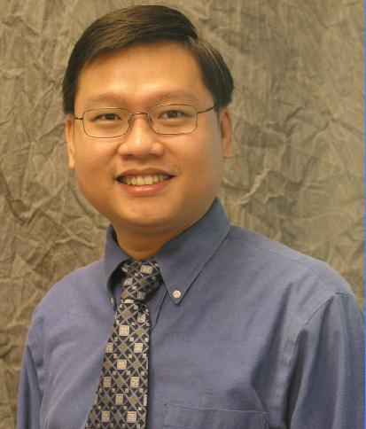



Program Analysis on
Thousands of Projects
Ganesha Upadhyaya
Hridesh Rajan
Tien N. Nguyen
Robert Dyer
These research activities supported in part by the US National Science Foundation (NSF) grants
CNS-15-13263, CNS-15-12947, CCF-15-18897, CCF-15-18776, CCF-14-23370, CCF-13-49153,
CCF-13-20578, TWC-12-23828, CCF-11-17937, CCF-10-17334, and CCF-10-18600.

Slide 2
Today’s tutorial is about
Mining Software Repositories and performing Program Analysis at an Ultra-large-scale

Slide 3
What do I mean by software repository?

Slide 4











Slide 5
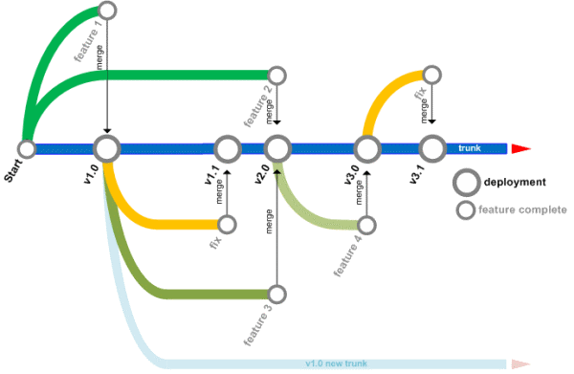




What features do they have?

Slide 6
What do I mean by mining software repositories (MSR)?

Slide 7

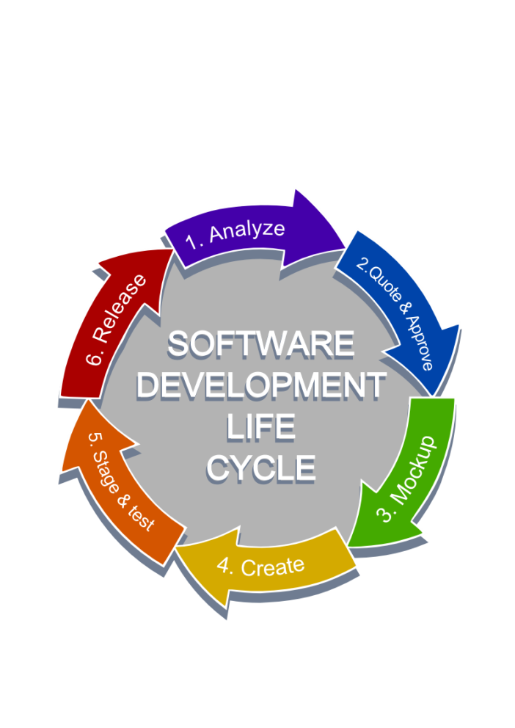



Slide 8
What are some examples of software repository mining?

Slide 9
What is the most used programming language?

Slide 10
What is the most used programming language?

Slide 11
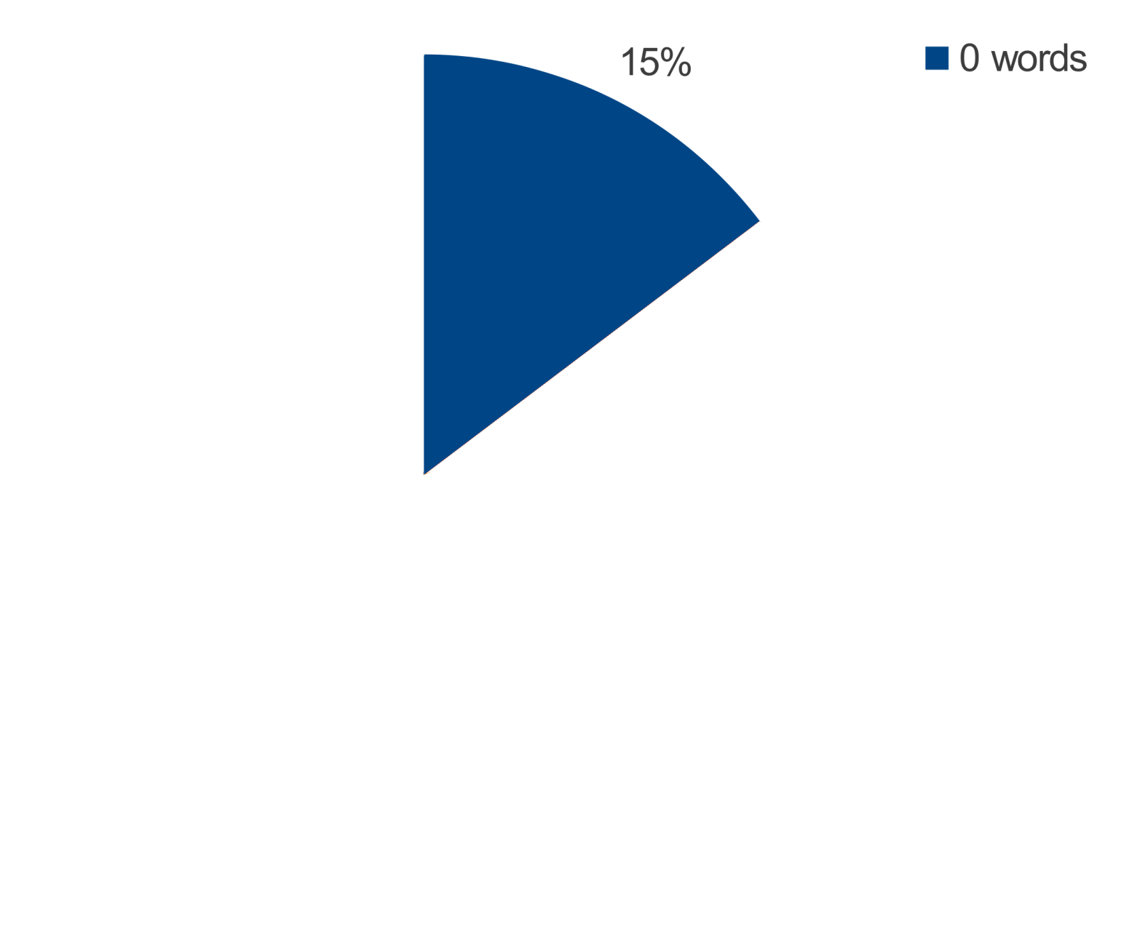
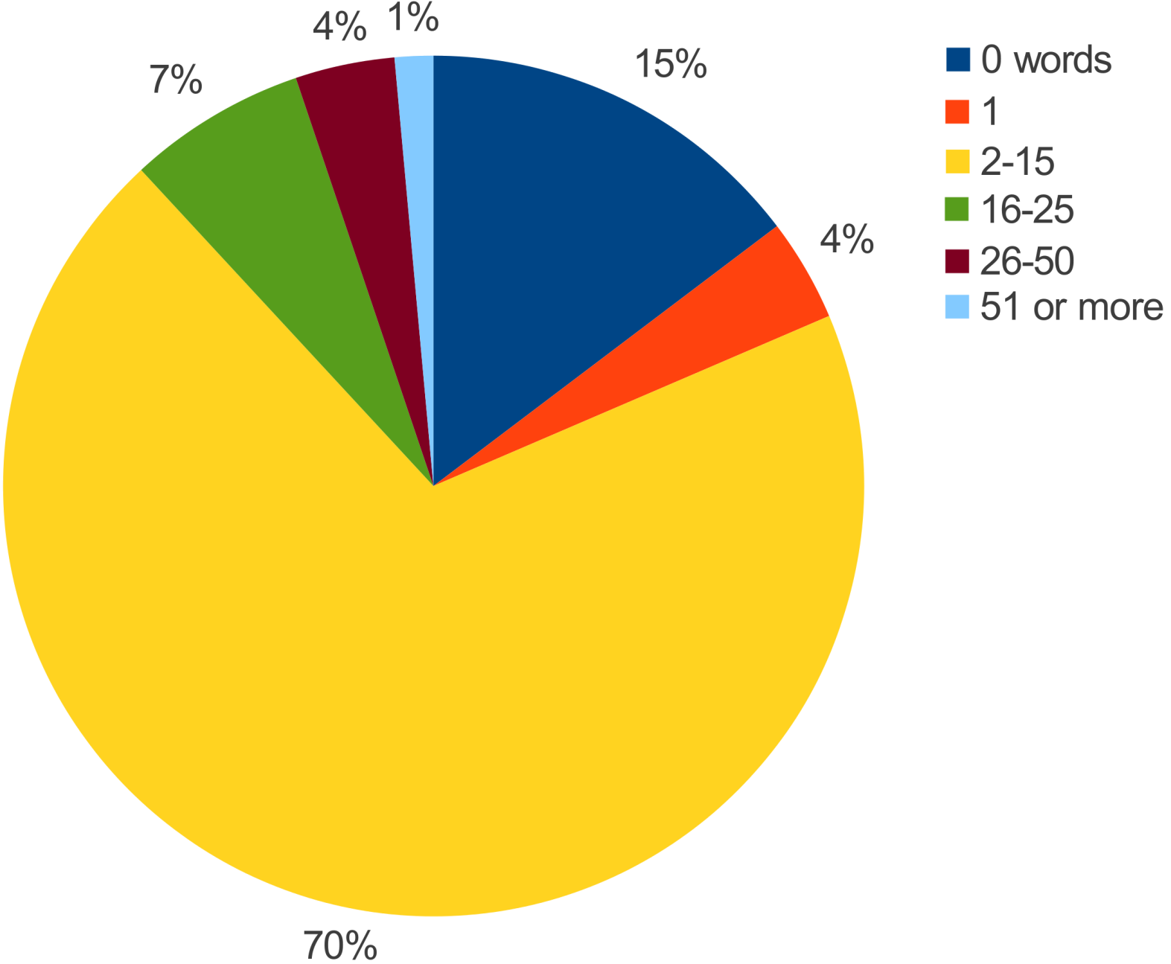
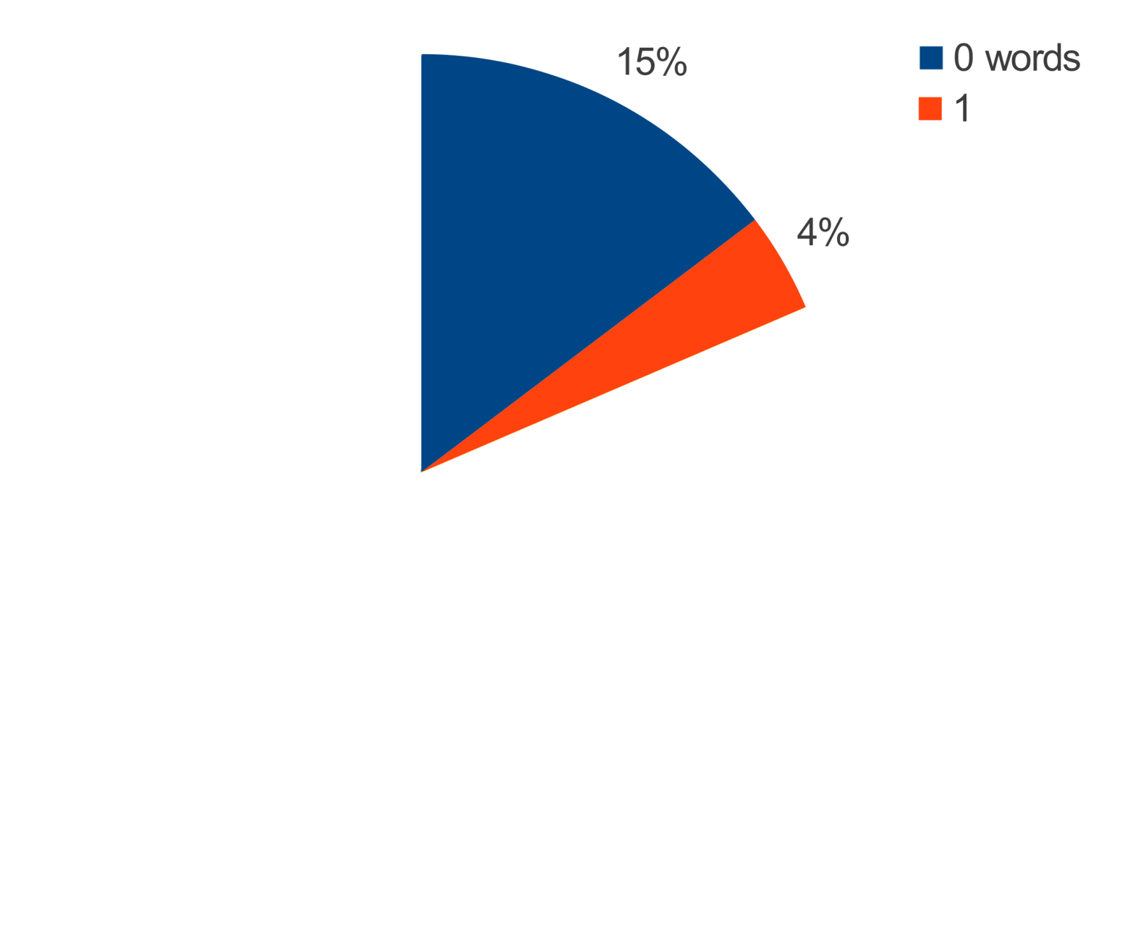
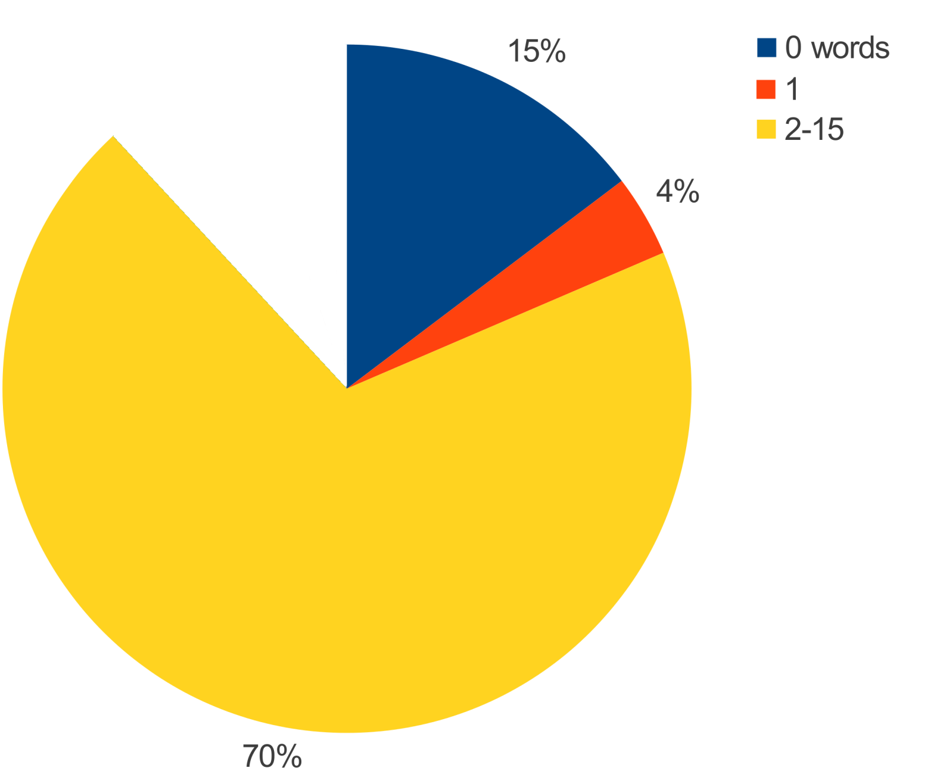
How many words are in commit messages?
Words[] = update, 30715
Words[] = cleanup, 19073
Words[] = updated, 18737
Words[] = refactoring, 11981
Words[] = fix, 11705
Words[] = test, 9428
Words[] = typo, 9288
Words[] = updates, 7746
Words[] = javadoc, 6893
Words[] = bugfix, 6295

Slide 12
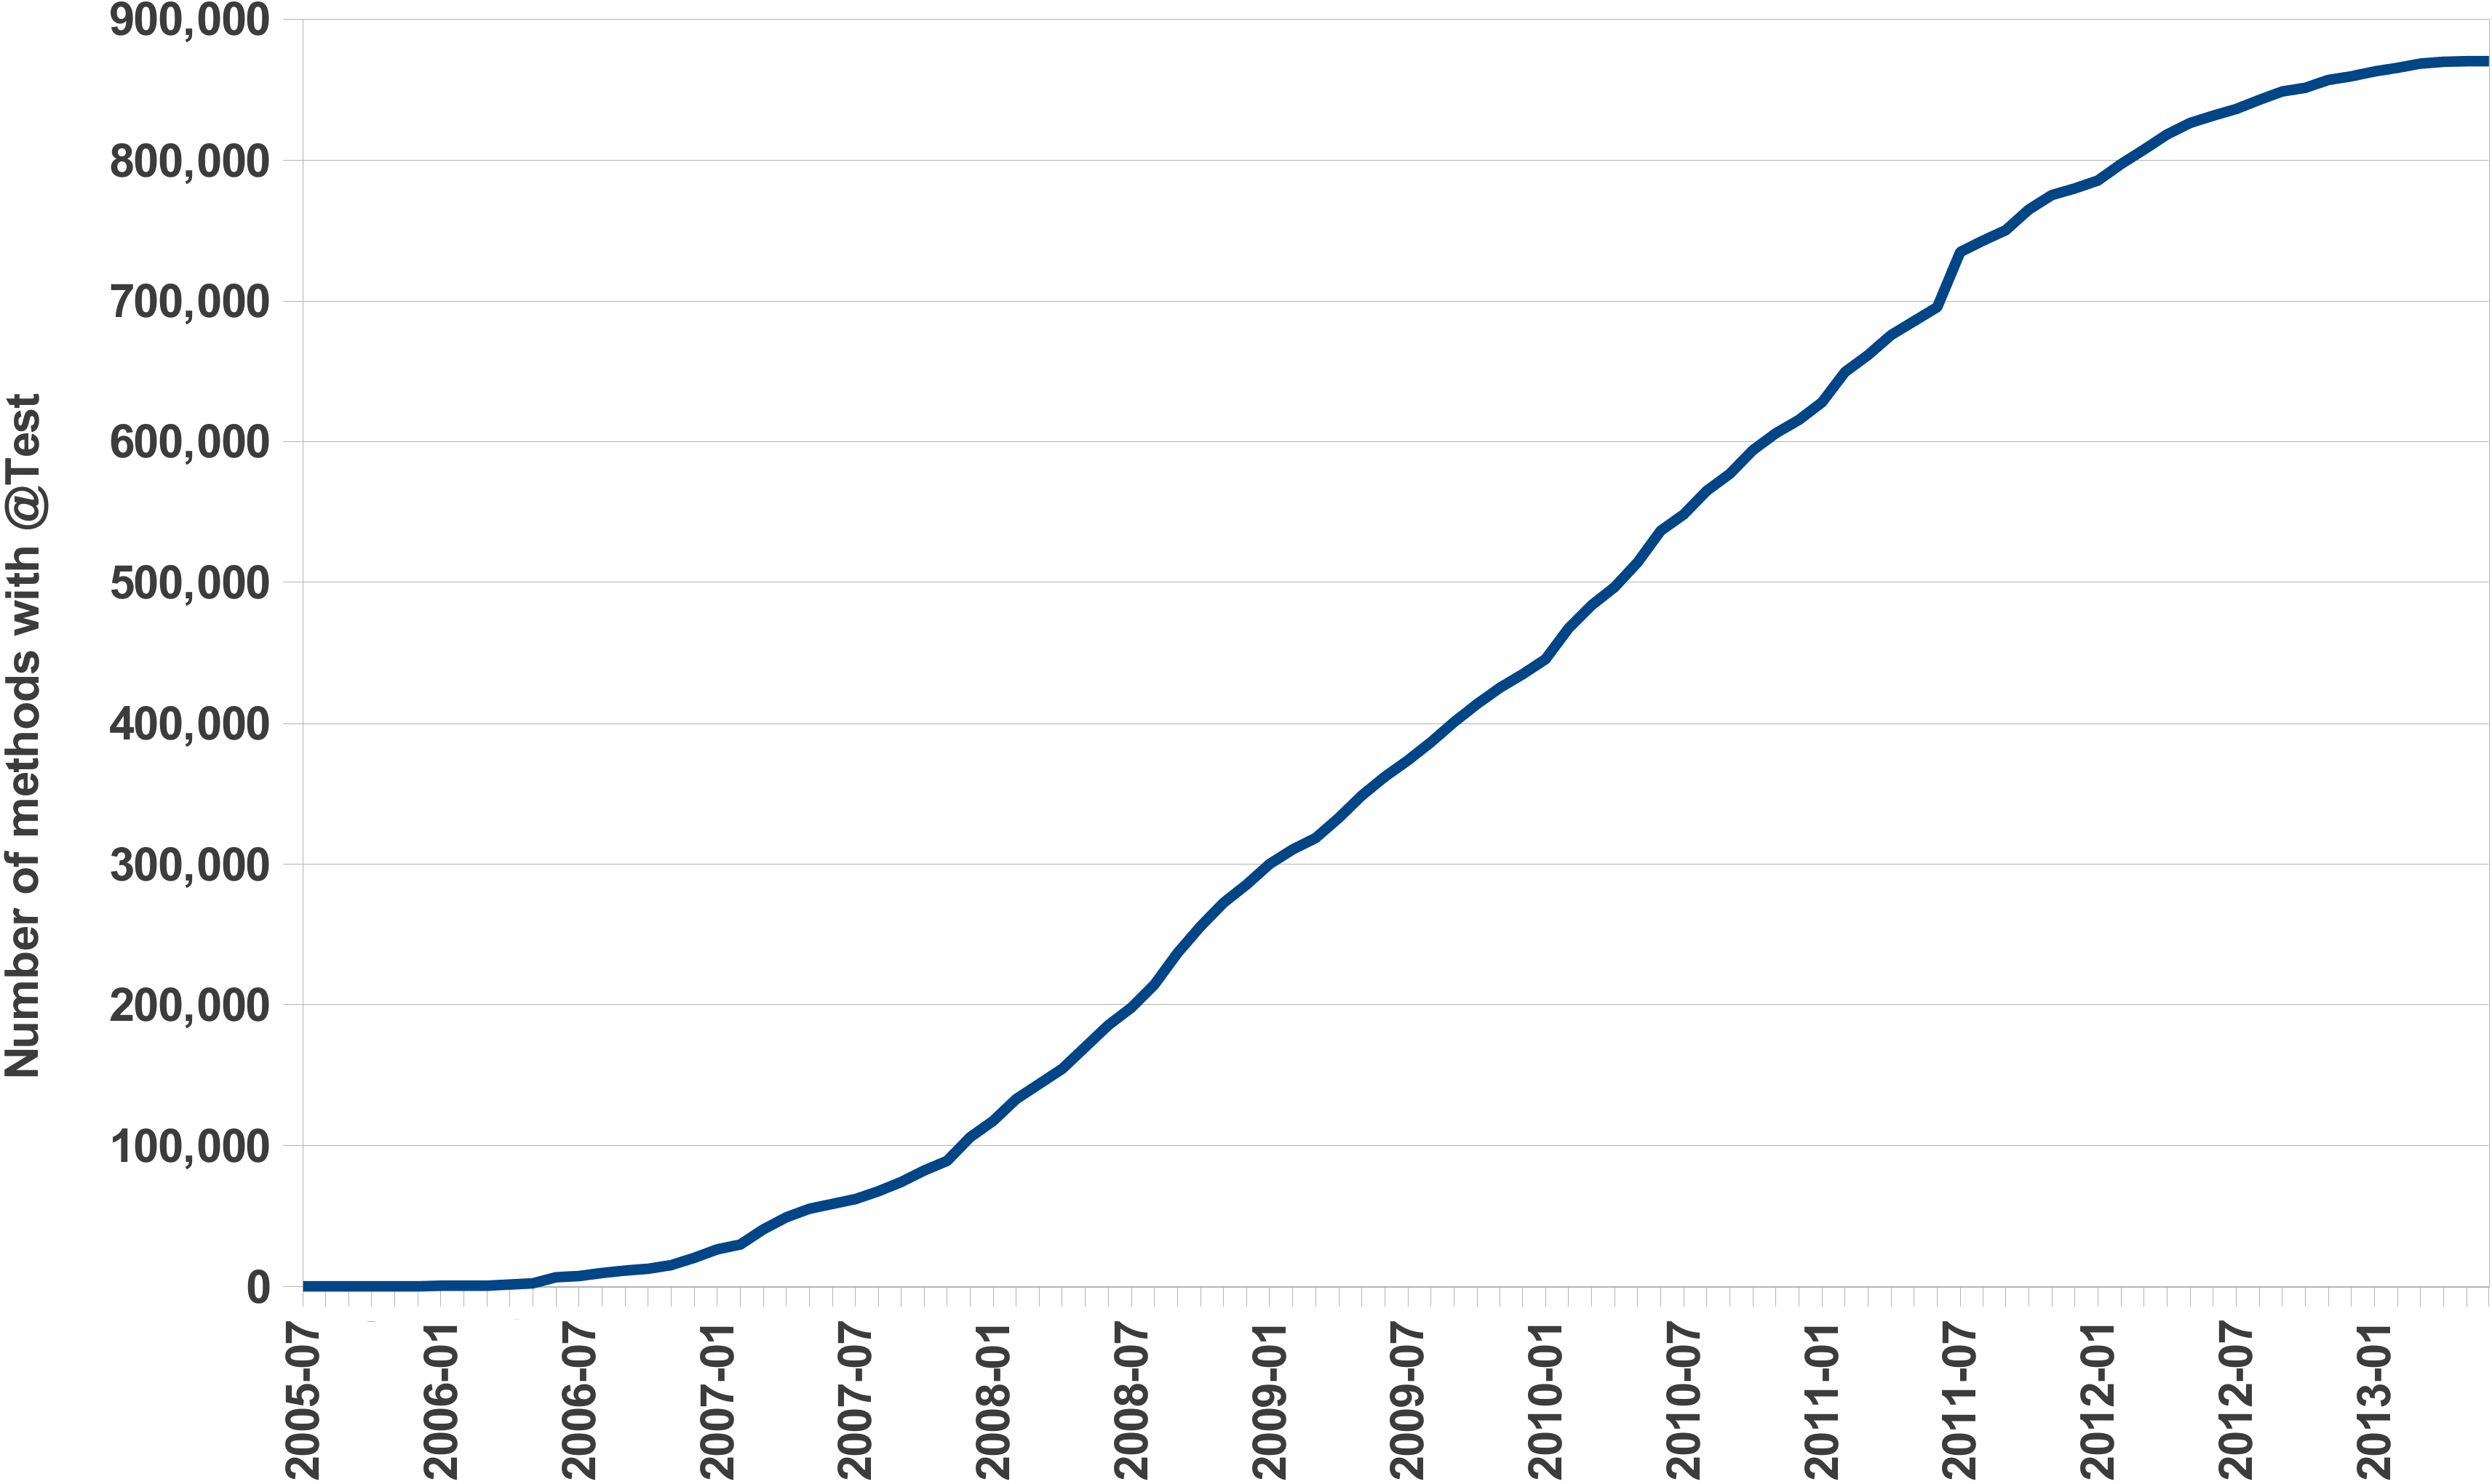
How has unit testing been adopted over time?
JUnit 4 release

Slide 13
What makes this ultra-large-scale mining?

Slide 14
Previous examples queried...
Projects | 699,331
Code Repositories | 494,158
Revisions | 15,063,073
Unique Files | 69,863,970
File Snapshots | 147,074,540
AST Nodes | 18,651,043,238
Over 250GB
of pre-processed, compressed data
from SourceForge

Slide 15
Previous examples queried...
Projects | 7,830,023
Code Repositories | 380,125
Revisions | 23,229,406
Unique Files | 146,398,339
File Snapshots | 484,947,086
AST Nodes | 71,810,106,868
Over 270GB
of pre-processed, compressed data
from GitHub

Slide 16
Let’s look at a real-world mining task!

Slide 17
Finding use of assert
Requires use of a parser (e.g. JDT)
Requires knowledge of several APIs
  SF.net / GitHub API
  SVNkit/JGit/etc
Must be manually parallelized

Slide 18
Finding use of assert
ASSERTS: output sum of int;
visit(input, visitor {
before node: CodeRepository -> {
snapshot := getsnapshot(node, "SOURCE_JAVA_JLS");
foreach (i: int; def(snapshot[i]))
visit(snapshot[i]);
stop;
}
before node: Statement ->
if (node.kind == StatementKind.ASSERT)
ASSERTS << 1;
});
Only 12 lines of code
Automatically parallelized
No external libraries
Analyzes 18 billion AST nodes in minutes

Slide 19


Boa
[TOSEM’15]
[ICSE’14]
[GPCE'13]
[ICSE'13]
http://boa.cs.iastate.edu/

Slide 20
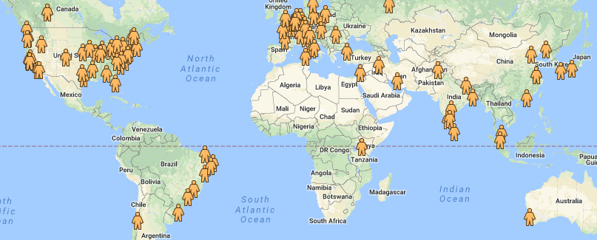
Boa's Global Impact
850+ users from 29 countries!
http://boa.cs.iastate.edu/

Slide 21
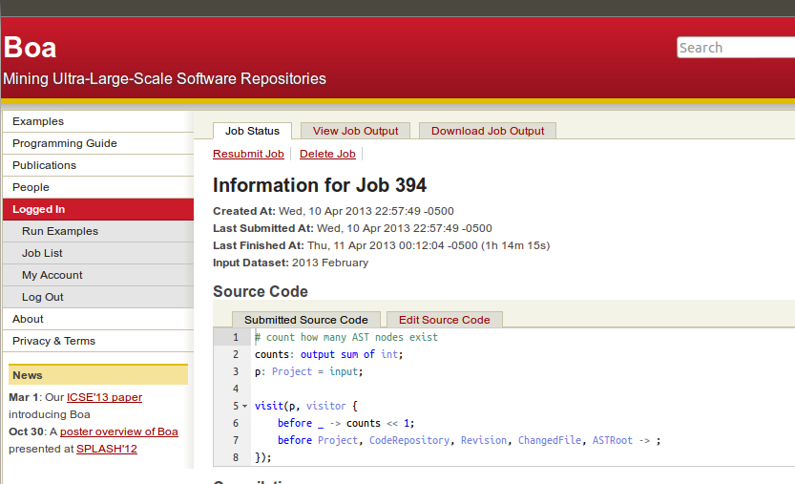




Boa's Architecture
Query result
returned
via web
Boa's Data Infrastructure
User submits
query
Replicate
and Transform
Compiled into
Hadoop program
Stored on
cluster
Deployed and
executed on cluster
cache
Boa's Computing Infrastructure

Slide 22
Automatic Parallelization
ASSERTS: output sum of int;
visit(input, visitor {
before node: CodeRepository -> {
snapshot := getsnapshot(node, "SOURCE_JAVA_JLS");
foreach (i: int; def(snapshot[i]))
visit(snapshot[i]);
stop;
}
before node: Statement ->
if (node.kind == StatementKind.ASSERT)
ASSERTS << 1;
});
Output variables with built in aggregator functions:
sum, mean, top(k), bottom(k), set, collection, etc
Compiler generates Hadoop MapReduce code

Slide 23
Abstracting MSR with Types
ASSERTS: output sum of int;
visit(input, visitor {
before node: CodeRepository -> {
snapshot := getsnapshot(node, "SOURCE_JAVA_JLS");
foreach (i: int; def(snapshot[i]))
visit(snapshot[i]);
stop;
}
before node: Statement ->
if (node.kind == StatementKind.ASSERT)
ASSERTS << 1;
});
Custom domain-specific types for mining software repositories
5 base types and 9 types for source code
No need to understand multiple data formats or APIs

Slide 24
Abstracting MSR with Types
Project
1
*
CodeRepository
1
*
Revision
1
1..*
ChangedFile
1
0..1
ASTRoot

Slide 25
Abstracting MSR with Types
ASTRoot
1
1..*
Namespace
1
*
1
1
Declaration
1
*
*
*
Method
Variable
Type
1
*
1
Statement
*
Expression

Slide 26
Challenge: How can we make mining source code easier?
Answer: Declarative Visitors

Slide 27
Easing Source Code Mining with Visitors
id := visitor {
before T -> statement;
after T -> statement;
};
visit(node, id);

Slide 28
Easing Source Code Mining with Visitors
id := visitor {
before id : T1 -> statement;
before T2, T3 -> statement;
before _ -> statement;
};

Slide 29
Easing Source Code Mining with Visitors
ASTRoot
ASTRoot
Namespace
Namespace
Declaration
Declaration
Method
Method
Variable
Variable
Type
Type
Statement
Statement
Expression
Expression

Slide 30
Easing Source Code Mining with Visitors
ASTRoot
before n: Declaration -> {
}
before n: Declaration -> {
foreach (i: int; n.fields[i])
visit(n.fields[i]);
}
before n: Declaration -> {
foreach (i: int; n.fields[i])
visit(n.fields[i]);
stop;
}
Namespace
Declaration
Method
Variable
Type
Statement
Expression

Slide 31
Let’s revisit the assert use example.

Slide 32
Finding use of assert
ASSERTS: output sum of int;

Slide 33
Finding use of assert
ASSERTS: output sum of int;
visit(input, visitor {
});

Slide 34
Finding use of assert
ASSERTS: output sum of int;
visit(input, visitor {
before node: Statement ->
});

Slide 35
Finding use of assert
ASSERTS: output sum of int;
visit(input, visitor {
before node: Statement ->
if (node.kind == StatementKind.ASSERT)
});

Slide 36
Finding use of assert
ASSERTS: output sum of int;
visit(input, visitor {
before node: Statement ->
if (node.kind == StatementKind.ASSERT)
ASSERTS << 1;
});

Slide 37
Finding use of assert
ASSERTS: output sum of int;
visit(input, visitor {
before node: CodeRepository -> {
snapshot := getsnapshot(node, "SOURCE_JAVA_JLS");
foreach (i: int; def(snapshot[i]))
visit(snapshot[i]);
stop;
}
before node: Statement ->
if (node.kind == StatementKind.ASSERT)
ASSERTS << 1;
});

Slide 38
Let’s see that query in action!
Username: ase17
Password: tutorial

Slide 39
Dataset
Processes
Assert = 538372
input = project₁
Boa Program
Assert << 1;
Output
Assert << 1;
input = project₂
Boa Program
input = project₃
Boa Program
Assert
1
1
1
.
.
.
.
.
.
1
1
1
1
input = project_{n}
Boa Program
ASSERTS: output sum of int;
visit(input, visitor {
before node: CodeRepository -> {
snapshot := getsnapshot(node, "SOURCE_JAVA_JLS");
foreach (i: int; def(snapshot[i]))
visit(snapshot[i]);
stop;
}
before node: Statement ->
if (node.kind == StatementKind.ASSERT)
ASSERTS << 1;
});

Slide 40
Another task: finding first time each file uses an annotation

Slide 41
First Uses of Annotation
visit(input, visitor {
});

Slide 42
First Uses of Annotation
visit(input, visitor {
before node: Modifier ->
if (node.kind == ModifierKind.ANNOTATION) {
}
});

Slide 43
First Uses of Annotation
visit(input, visitor {
before node: Modifier ->
if (node.kind == ModifierKind.ANNOTATION) {
cur_date := int(current(Revision).commit_date);
cur_file := current(ChangedFile).name;
}
});

Slide 44
First Uses of Annotation
times: map[string] of bool;
visit(input, visitor {
before node: CodeRepository -> clear(times);
before node: Modifier ->
if (node.kind == ModifierKind.ANNOTATION) {
cur_date := int(current(Revision).commit_date);
cur_file := current(ChangedFile).name;
if (!haskey(times, cur_file)) {
times[cur_file] = true;
}
}
});

Slide 45
First Uses of Annotation
AnnotFirstUse: output bottom(1)[string] of string weight int;
times: map[string] of bool;
visit(input, visitor {
before node: CodeRepository -> clear(times);
before node: Modifier ->
if (node.kind == ModifierKind.ANNOTATION) {
cur_date := int(current(Revision).commit_date);
cur_file := current(ChangedFile).name;
if (!haskey(times, cur_file)) {
times[cur_file] = true;
AnnotFirstUse[input.id] << cur_file weight cur_date;
}
}
});

Slide 46
Summary
Ultra-large-scale software repository mining
poses several challenges
Boa provides abstractions to address
these challenges
Ultra-large-scale dataset with millions of projects
Automatically parallelizes queries
Domain-specific language, types, and functions
to make mining software repositories easier

Slide 47
Break time!
Come back for more!

Slide 48


Program Analysis on
Thousands of Projects
Ganesha Upadhyaya
Iowa State
University
Hridesh Rajan
Iowa State University
Robert Dyer
Bowling Green State University
Tien N. Nguyen
University of Texas at Dallas
These research activities supported in part by the US National Science Foundation (NSF) grants CNS-15-13263, CNS-15-12947, CCF-15-18897, CCF-15-18776, CCF-14-23370, CCF-13-49153, CCF-13-20578, TWC-12-23828, CCF-11-17937, CCF-10-17334, and CCF-10-18600.

Slide 49
Outline
Motivation
Program analysis quick introduction
Program analysis in Boa
Language extension
Example and demo

Slide 50
Motivation
Program Analysis in Boa Today
  Abstract syntax tree (AST) level
    Analyzing project metadata
    Revision histories (or commits)
    Source code
      Classes (Declaration AST)
      Methods (Method AST)
      Statements (Statement AST)
      Expressions (Expression AST)

Slide 51
Motivation
Program Analysis in Boa Today
  Examples
    Churn rate of files in projects
      how often files are modified?
    How many fixing revisions added null checks?
    How certain Java language feature is used?
      Assert statements
    Computing source code metrics
      Number of attributes (NOA)
      Number of public methods (NPM)

Slide 52
Motivation
What is missing?
  Analyzing control flow between program statements
  Analyzing data flow

Slide 53
Motivation
Many interesting analyses require control and data flow information
  Finding resource leak
    A resource (File, Socket, etc) is properly closed after use on all program paths

Slide 54
Motivation
Many interesting analyses require control and data flow information
  Finding deadlock/data-race
    A lock acquired in the program is not released on all program paths

Slide 55
Motivation
Many interesting analyses require control and data flow information
  Finding loop invariant/code motion
    Can a loop statement be moved outside of loop?

Slide 56
Motivation
Many interesting analyses require control and data flow information
  API related
    API call sequence
      Which API methods are called often together?
        Iterator.next is called together with Iterator.hasNext

Slide 57
Motivation
Many interesting analyses require control and data flow information
  API related
    API usage mining
      How a certain API method must be used?
        FileInputStream.close must be enclosed in a finally{} block
FileInputStream is = …
try {
} catch () {
} finally {
is.close()
}

Slide 58
Motivation
Many interesting analyses require control and data flow information
  API related
    API precondition mining
      What are the conditions that must be checked before calling an API method?
        String.substring(begin, end), requires begin >= 0 and end < length of the string

Slide 59
Motivation
Bigger use cases
  Bug fix suggestions
  Programming pattern discovery
  Specification inference
  Code search

Slide 60
Program Analysis
What is program analysis?
  Analyzing programs
  Developing algorithms and tools for understanding certain program behavior
void foo(int n) {
int j = 0;
  while (n > 0) {
  if (j % 2 == 0)
  j++;
  else
  j--;
  n--;
  }
  assert “j is positive”
}
Result
====================
“j” is positive
“j” is negative
“j” can be anything
Program
Analysis
Tool
Is “j” positive?

Slide 61
Applications of Program Analysis
Finding bugs
  In the syntax, functionality, etc.
Security
  Does the program leak private user data?
Verification
  Does the program always behaves according to its specification?
Optimization
  Which variables should be kept in the register for faster memory access?
  Is it safe to execute loop iterations in parallel?

Slide 62
Two Flavors of Program Analysis
Static
  Analyzes source code artifacts
Dynamic
  Analyzes program while it is running
Trade off
  Static
    Reasons about all executions, but less precise
  Dynamic
    Limited to observed executions, but more precise

Slide 63
Static Program Analysis
Is about analyzing source code artifacts
  Source code text
  Intermediate representations
    Abstract syntax trees (ASTs)
    Control flow graphs (CFGs)
    Program dependence graphs (PDGs)
    Call graph (CGs)

Slide 64
Control and Data Flow Analysis
Performed over the Control Flow Graph (CFG) representation of the program
Control Flow Graph (CFG)
    A directed graph G = (N, E) with nodes representing program statements and edges representing the flow of control

Slide 65
Example CFG
0
START
void foo(int n) {
int j = 0;
  while (n > 0) {
  if (j % 2 == 0)
  j++;
  else
  j--;
  n--;
  }
  assert “j is positive”
}
1
int j = 0
2
n > 0
3
j % s == 0
4
j++
5
j++
6
n--
assert “j is positive”
7
END
8

Slide 66
Data Flow Analysis
Computing certain information at every node of the CFG
    For instance, Live variable analysis computes a set of live variables at each program statement
    A variable is live at a program point if it has some use after the program point

Slide 67
Data Flow Analysis
Essentials for describing a data flow analysis
  What information to compute?
  What are the initial values at nodes?
  Analysis direction?
    FORWARD or BACKWARD
  How to merge two or more values at join nodes?
    Intersection
    Union

Slide 68
Data Flow Analysis
Live variable analysis
  What information to compute?
    A set of variables
  What are the initial values at nodes?
    Empty set
  Analysis direction?
    BACKWARD
  How to merge two or more values at join nodes?
    Set union

Slide 69
Control and data flow analysis in Boa

Slide 70
Control/Data Flow Analysis in Boa
Core concept
  An analysis is a collection of traversals
  A traversal visits every node in the CFG in certain order

Slide 71
Control Flow Graph (CFG) in Boa
Accessing CFG of a method
visit(input, visitor {
before method: Method -> {
cfg := getcfg(method); # on-the-fly construction
}
});

Slide 72
Control Flow Graph (CFG) in Boa
Accessing CFG of a method
visit(input, visitor {
before method: Method -> {
cfg: CFG
cfg = getcfg(method);
}
});

Slide 73
Control Flow Graph (CFG) in Boa
Accessing CFG of a method
visit(input, visitor {
before method: Method -> {
cfg := getcfg(method);
cfgDotStr := dot(cfg);
}
});

Slide 74
Control Flow Graph (CFG) in Boa
Accessing CFG Nodes
t := traversal(n: CFGNode) {
nodeid := n.id;
if (def(n.stmt))
stmt := n.stmt;
}
  if (def(n.expr)) {
  expr := n.expr;
  }
foreach (j: int; def(n.predecessors[j])) {
# n.successors[j]
}
}

Slide 75
Language extension for program analysis support

Slide 76
Language Extension for Program Analysis Support
Traversal
    t1 is the traversal variable
    n is the node currently being visited
    body may contain any valid boa statement
    T is the type of the return value
t1 := traversal(n: CFGNode): T {
body
}

Slide 77
Language Extension for Program Analysis Support
Traverse
    g is the graph or CFG
    d is the traversal direction
      FORWARD or BACKWARD
    k is the traversal kind
    t is the traversal
    fp is the fixpoint function
traverse(g, d, k, t, fp)

Slide 78
Language Extension for Program Analysis Support
Traverse
    k is the traversal kind
traverse(g, d, k, t, fp)
Traversal Strategy | Description
DFS | Depth-first
POSTORDER | Post-order
REVERSEPOSTORDER | Reverse post-order
WORKLIST_POSTORDER | Worklist with post-order
WORKLIST_REVERSEPOSTORDER | Worklist with reverse post-order
ITERATIVE | Any order
Hybrid | When you are not sure

Slide 79
Language Extension for Program Analysis Support
Fixpoint
    fp is the name of the fixpoint function
    curr, prev are two values that are compared
    bool a fixpoint function must always return a boolean
    body may contain any valid boa statement
fp := fixp(curr, prev: T): bool {
body
}

Slide 80
Data Structures for Storing the Analysis Results
Basic types
    bool, float, int, string, time
Collections
    array of basic_type
    map[basic_type] of basic_type
    stack of basic_type
    set of basic_type
    enum type
    tuple type
type T1 = enum { A = “true”, B = “false” }
t1: T = T1.A
type t = { i: int, s: string, b: bool };
tup: t = { 5, “string”, false };
tup.f1 = “foo”; tup.b = true;

Slide 81
Basic Functions
add(C1, e)
addAll(C1, C2)
remove(C1, e)
removeAll(C1, C2)
C3 := union(C1, C2)
C3 := intersection(C1, C2)

Slide 82
Accessing Traversal Results
Using a special API
  getvalue(node)
    Get result of a node in the current traversal
  getvalue(node, myTraversal)
    Get result of a node in some other traversal

Slide 83
Example

Slide 84
Dominator Analysis
Compute a list of control flow dominators for every node in the CFG
  A control flow dominators of a node ‘n’ is a set of nodes that exists in every path from the START node to node ‘n’
Analysis
  Computes list of node ids
  Direction is FORWARD
  Initial values
    START = {}, all other nodes have list of all nodes as initial values
  Merge
    Set intersection

Slide 85
Dominator Analysis
0
{0}
1
{0, 1}
{0, 1, 2}
2
3
{0, 1, 3}
4
{0, 1, 2, 4}
5
{0, 1, 5}

Slide 86
Dominator Analysis
type T = set of string;
doms: map[string] of set of string;
dominators := traversal(node: CFGNode): T {
doms: set of string;
...
return doms;
}
collect := traversal(node: CFGNode) {
...
}
fp := fixp(curr, prev: T): bool {
…
}
visit(input, visitor {
before method: Method -> {
cfg := getcfg(method);
traverse(..., dominators, fp);
traverse(..., collect);
}
});

Slide 87
Dominator Analysis
type T = set of string;
doms: map[string] of set of string;
dominators := traversal(node: CFGNode): T {
doms: set of string;
...
return doms;
}
collect := traversal(node: CFGNode) {
...
}
fp := fixp(curr, prev: T): bool {
…
}
visit(p, visitor {
before method: Method -> {
cfg := getcfg(method);
traverse(..., dominators, fp);
traverse(..., collect);
}
});

Slide 88
Dominator Analysis
type T = set of string;
dominators := traversal(node: CFGNode): T {
doms: T;
...
return doms;
};

Slide 89
Dominator Analysis
dominators := traversal(node: CFGNode): T {
doms: T;
if (def(getvalue(node))) {
doms = getvalue(node);
} else {
if (node.id == 0) {
add(doms, string(id));
} else {
doms = allNodeIds;
}
}
return doms;
};
Initialization

Slide 90
Dominator Analysis
dominators := traversal(node: CFGNode): T {
doms: T;
if () {} else { if () {} else {} }
foreach (i:int; def(node.predecessors[i])) {
if (def(getvalue(node.predecessors[i]))) {
doms = intersect(doms, getvalue(node.predecessors[i]));
}
}
return doms;
};

Slide 91
Dominator Analysis
type T = set of string;
dominators := traversal(node: CFGNode): T {
doms: T;
if (def(getvalue(node))) {
doms = getvalue(node);
} else {
if (node.id == 0) {
add(doms, string(id));
} else {
doms = allNodeIds;
}
}
foreach(i:int; def(node.predecessors[i])) {
if (def(getvalue(node.predecessors[i])))
doms = intersect(doms, getvalue(node.predecessors[i]));
}
add(doms, string(id));
return doms;
};

Slide 92
Dominator Analysis
type T = set of string;
doms: map[string] of set of string;
dominators := traversal(node: CFGNode): T {
doms: set of string;
...
return doms;
}
collect := traversal(node: CFGNode) {
...
}
fp := fixp(curr, prev: T): bool {
…
}
visit(input, visitor {
before method: Method -> {
cfg := getcfg(method);
traverse(..., dominators, fp);
traverse(..., collect);
}
});

Slide 93
Dominator Analysis
type T = set of string;
doms: map[string] of set of string;
dominators := traversal(node: CFGNode): T {
doms: set of string;
...
return doms;
}
collect := traversal(node: CFGNode) {
...
}
fp := fixp(curr, prev: T): bool {
…
}
visit(p, visitor {
before method: Method -> {
cfg := getcfg(method);
traverse(..., dominators, fp);
traverse(..., collect);
}
});

Slide 94
Dominator Analysis
doms: map[string] of set of string;
collect := traversal(node: CFGNode) {
if (def(getvalue(node, dominators))) {
dom := getvalue(node, dominators);
doms[string(node.id)] = dom;
}
}

Slide 95
Dominator Analysis
type T = set of string;
doms: map[string] of set of string;
dominators := traversal(node: CFGNode): T {
doms: set of string;
...
return doms;
}
collect := traversal(node: CFGNode) {
...
}
fp := fixp(curr, prev: T): bool {
…
}
visit(p, visitor {
before method: Method -> {
cfg := getcfg(method);
traverse(..., dominators, fp);
traverse(..., collect);
}
});

Slide 96
Dominator Analysis
type T = set of string;
doms: map[string] of set of string;
dominators := traversal(node: CFGNode): T {
doms: set of string;
...
return doms;
}
collect := traversal(node: CFGNode) {
...
}
fp := fixp(curr, prev: T): bool {
…
}
visit(input, visitor {
before method: Method -> {
cfg := getcfg(method);
traverse(..., dominators, fp);
traverse(..., collect);
}
});

Slide 97
Dominator Analysis
type T = set of string;
doms: map[string] of set of string;
dominators := traversal(node: CFGNode): T {
doms: set of string;
...
return doms;
}
collect := traversal(node: CFGNode) {
...
}
fp := fixp(curr, prev: T): bool {
…
}
visit(p, visitor {
before method: Method -> {
cfg := getcfg(method);
traverse(..., dominators, fp);
traverse(..., collect);
}
});

Slide 98
Dominator Analysis
fp := fixp(curr, prev: T): bool {
return curr == prev;
};

Slide 99
Dominator Analysis
type T = set of string;
doms: map[string] of set of string;
dominators := traversal(node: CFGNode): T {
doms: set of string;
...
return doms;
}
collect := traversal(node: CFGNode) {
...
}
fp := fixp(curr, prev: T): bool {
…
}
visit(p, visitor {
before method: Method -> {
cfg := getcfg(method);
traverse(..., dominators, fp);
traverse(..., collect);
}
});

Slide 100
Dominator Analysis
type T = set of string;
doms: map[string] of set of string;
dominators := traversal(node: CFGNode): T {
doms: set of string;
...
return doms;
}
collect := traversal(node: CFGNode) {
...
}
fp := fixp(curr, prev: T): bool {
…
}
visit(input, visitor {
before method: Method -> {
cfg := getcfg(method);
traverse(..., dominators, fp);
traverse(..., collect);
}
});

Slide 101
Dominator Analysis
type T = set of string;
doms: map[string] of set of string;
dominators := traversal(node: CFGNode): T {
doms: set of string;
...
return doms;
}
collect := traversal(node: CFGNode) {
...
}
fp := fixp(curr, prev: T): bool {
…
}
visit(input, visitor {
before method: Method -> {
cfg := getcfg(method);
traverse(..., dominators, fp);
traverse(..., collect);
}
});

Slide 102
Dominator Analysis
visit(input, visitor {
before method: Method -> {
cfg := getcfg(method);
}
});

Slide 103
Dominator Analysis
allNodeIds: set of string;
visit(input, visitor {
before method: Method -> {
cfg := getcfg(method);
for (i := 0; i < len(cfg.nodes); i++) {
add(allNodeIds, string(i));
}
}
});

Slide 104
Dominator Analysis
visit(input, visitor {
before method: Method -> {
cfg := getcfg(method);
for (i := 0; i < len(cfg.nodes); i++) {
add(allNodeIds, string(i));
}
traverse(cfg, TraversalDirection.FORWARD, TraversalKind.REVERSEPOSTORDER, dominators, fp);
traverse(cfg, TraversalDirection.FORWARD, TraversalKind.ITERATIVE, collect);
}
});

Slide 105
Dominator Analysis
op: output collection[string] of string;
doms: map[string] of set of string;
visit(input, visitor {
before method: Method -> {
cfg := getcfg(method);
for (i := 0; i < len(cfg.nodes); i++) {
add(allNodeIds, string(i));
}
traverse(..., dominators, fp);
traverse(..., collect);
methodKey := format("%s!%s!%s", p.project_url, path, method.name);
op[methodKey] << format("%s", doms);
}
});

Slide 106
Dominator Analysis
visit(input, visitor {
before method: Method -> {
cfg := getcfg(method);
for (i := 0; i < len(cfg.nodes); i++) {
add(allNodeIds, string(i));
}
traverse(..., dominators, fp);
traverse(..., collect);
methodKey := ...; op[methodKey] << format("%s", doms);
clear(dominators); clear(collect);
clear(doms); clear(allNodeIds);
}
});

Slide 107
Dominator Analysis
visit(input, visitor {
before method: Method -> {
cfg := getcfg(method);
for (i := 0; i < len(cfg.nodes); i++) {
add(allNodeIds, string(i));
}
traverse(cfg, TraversalDirection.FORWARD, TraversalKind.REVERSEPOSTORDER, dominators, fp);
traverse(cfg, TraversalDirection.FORWARD,
TraversalKind.ITERATIVE, collect);
methodKey := ...; op[methodKey] << format("%s", doms);
clear(dominators); clear(collect);
clear(doms); clear(allNodeIds);
}
});

Slide 108
Dominator Analysis
type T = set of string;
doms: map[string] of set of string;
dominators := traversal(node: CFGNode): T {
doms: set of string;
...
return doms;
}
collect := traversal(node: CFGNode) {
...
}
fp := fixp(curr, prev: T): bool {
…
}
visit(input, visitor {
before method: Method -> {
cfg := getcfg(method);
traverse(..., dominators, fp);
traverse(..., collect);
}
});

Slide 109
Dominator Analysis
No loop CFG
doms = {0}
preds = {}
doms = {0}
0
0
doms = {0, 1, 2, 3, 4, 5}
preds = {0, 4}
doms = {0, 1}
1
1
2
3
doms = {0, 1, 2, 3, 4, 5}
preds = {1}
doms = {0, 1, 2}
2
4
doms = {0, 1, 2, 3, 4, 5}
preds = {1}
doms = {0, 1, 3}
5
3
Reverse post-order
0, 1, 2, 3, 4, 5
doms = {0, 1, 2, 3, 4, 5}
preds = {2, 3}
doms = {0, 1, 4}
doms = {0, 1, 2, 3, 4, 5}
preds = {4}
doms = {0, 1, 4, 5}
4
5

Slide 110
Dominator Analysis
CFG with loop
doms = {0}
preds = {}
doms = {0}
0
0
doms = {0, 1, 2, 3, 4, 5}
preds = {0, 4}
doms = {0, 1}
1
1
2
3
doms = {0, 1, 2, 3, 4, 5}
preds = {1}
doms = {0, 1, 2}
2
4
doms = {0, 1, 2, 3, 4, 5}
preds = {1}
doms = {0, 1, 3}
5
3
Reverse post-order
0, 1, 2, 3, 4, 1, 2, 3, 4, 5
doms = {0, 1, 2, 3, 4, 5}
preds = {2, 3}
doms = {0, 1, 4}
doms = {0, 1, 2, 3, 4, 5}
preds = {1}
doms = {0, 1, 5}
4
5

Slide 111
Dominator Analysis
type T = set of string;
doms: map[string] of set of string;
dominators := traversal(node: CFGNode): T {
doms: set of string;
...
return doms;
}
collect := traversal(node: CFGNode) {
...
}
fp := fixp(curr, prev: T): bool {
…
}
visit(p, visitor {
before method: Method -> {
cfg := getcfg(method);
traverse(..., dominators, fp);
traverse(..., collect);
}
});
demo

Slide 112
Other Examples
Data flow analysis in Compiler Optimization
  Live variables, Reaching definitions, Common sub-expression elimination, Deadcode
Resource usage analysis
  How Java resource related APIs are used?
  How Java locks are used?
API Mining
  Preconditions
  Call sequence
  Usage

Slide 113
Thank you!
Q & A

