Slide 1

Machine Learning Based Device Type Classification for IoT device Continuous and Re-Authentication
4/26/22
Kaustubh Gupta
Masters Thesis Defense
Academic Advisor – Dr. Nirnimesh Ghose
University of Nebraska – Lincoln
Committee Members – Dr. Byrav Ramamurthy and Dr. Lisong Xu
C O L L E G E O F E N G I N E E R I N G

Slide 2
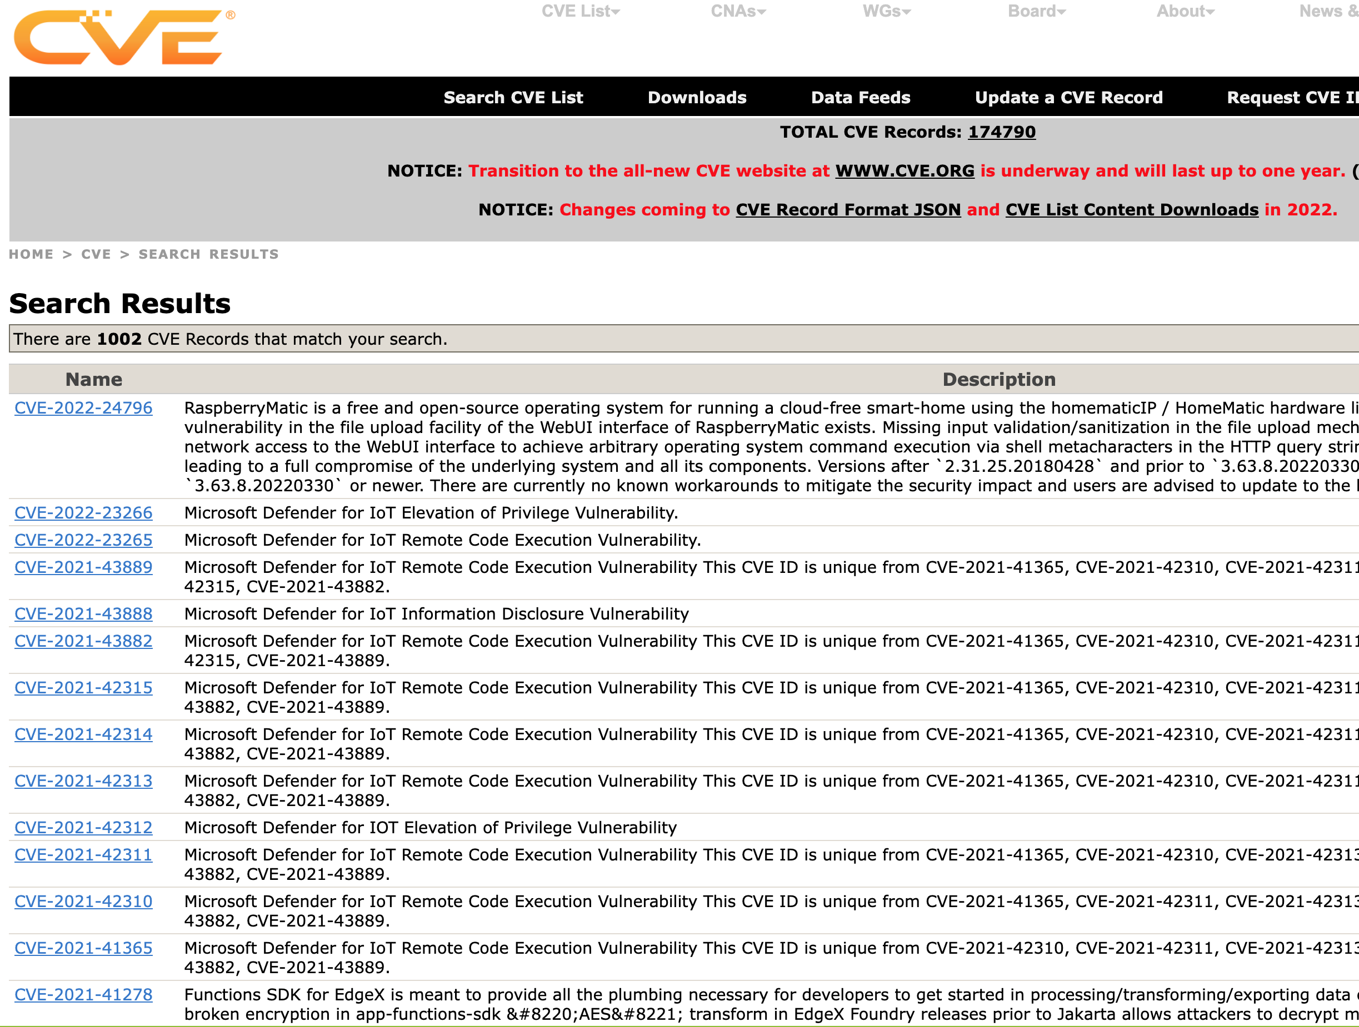
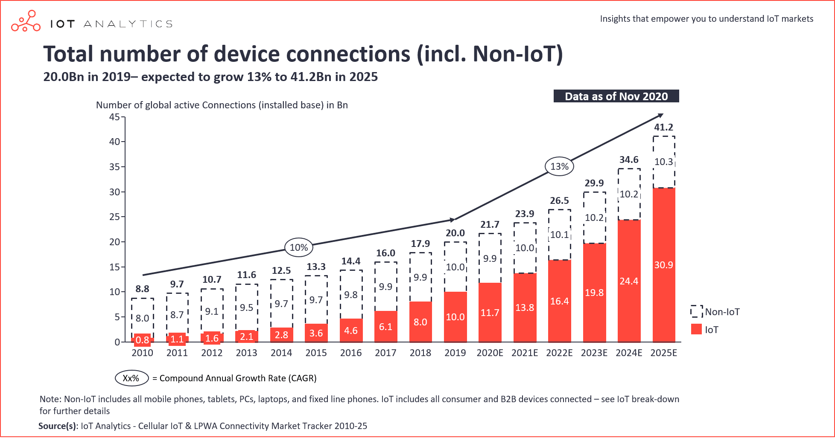
Introduction
4/26/22
Explosion in number of IoT Devices [1]
Security vulnerabilities of IoT devices [2]
[1] https://iot-analytics.com/state-of-the-iot-2020-12-billion-iot-connections-surpassing-non-iot-for-the-first-time/
[2] https://cve.mitre.org/cgi-bin/cvekey.cgi?keyword=IoT

Slide 3
Challenges
4/26/22
Many IoT devices today are manufactured by traditional home appliance manufacturers [1]
Using the vulnerabilities in IoT devices, an adversary can launch multiple attacks on other devices in the network [1]
Previous work does not provide a strict protocol for IoT authentication that is independent of vulnerable characteristics of the network or a protocol that does not rely significantly on the user input [1, 2]
Existing machine learning solutions do not classify the type of IoT device being authenticated, leaving the network vulnerable to actuating attacks carried out using vulnerable IoT devices [3]
There needs to be an efficient protocol that uses the least amount of time and memory for each authentication instance
[1] Miettinen, Markus, et al. "Iot sentinel: Automated device-type identification for security enforcement in iot." 2017 IEEE 37th International Conference on Distributed Computing Systems
(ICDCS). IEEE, 2017.
[2] Zhang, Jiansong, et al. "Proximity based IoT device authentication." IEEE INFOCOM 2017-IEEE Conference on Computer Communications. IEEE, 2017.
[3] Al-Garadi, Mohammed Ali, et al. "A survey of machine and deep learning methods for internet of things (IoT) security." IEEE Communications Surveys & Tutorials 22.3 (2020): 1646-1685.
3

Slide 4
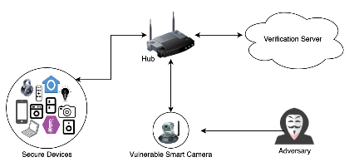
Contribution
4/26/22
We present the RADTEC (Re and continuous Authentication based on Device TypE Classification) protocol
The protocol leverages cross layer data (including network, data link, transport, and application,) and Machine Learning (ML) techniques to classify the type of device with an accuracy over 95%
Different types of machine learning classifiers were compared to best estimate the types of IoT device and to develop a stricter and more efficient method for authentication
4

Slide 5
Contribution
4/26/22
We present a device type-based re and continuous authentication protocol
We address the case where vulnerable IoT devices that can be compromised by an adversary and manipulated to:
Capture network traffic
Poison the network by uploading malicious packets and
Actuate a device to perform activities of some other type of device
Perform extensive experimentation by utilizing the available data for our ML-based device type classification technique to show the performance of various classifiers based on algorithms including:
Random Forest
K-Nearest Neighbors
Support Vector Machine
Gradient Boosting
Gaussian Naive Bayes
We also show that Random Forest Classifier is overall most accurate and efficient in performing accurate classifications
5

Slide 6
Related Work
4/26/22
Existing work includes machine learning-based techniques to differentiate several types of IoT devices from non-IoT devices or detect attacks while others include proximity-based solutions
Miettinen et al. [1] relies on MAC addresses to identify a new device trying to authenticate with the network, which can be spoofed
Bremler et al. [2] focus on distinguishing between IoT and Non-IoT (NoT) devices using ML, however, their classification model is only capable of classifying a device as IoT or not-IoT
Meidan et al. [3] whitelist devices that are classified as trustworthy by using machine learning, however, this could give a compromised whitelisted device unrestricted access to the network.
Al-Garadi et al. [4] present work that focuses mainly on detecting attacks by monitoring the behavior of the IoT device but does not extend machine learning classification techniques to differentiate between several types of IoT devices.
[1] Miettinen, Markus, et al. "Iot sentinel: Automated device-type identification for security enforcement in iot." 2017 IEEE 37th International Conference on Distributed Computing Systems (ICDCS). IEEE, 2017.
[2] Bremler-Barr, Anat, Haim Levy, and Zohar Yakhini. "Iot or not: Identifying iot devices in a short time scale." NOMS 2020-2020 IEEE/IFIP Network Operations and Management Symposium. IEEE, 2020.
[3] Meidan, Yair, et al. "Detection of unauthorized IoT devices using machine learning techniques." arXiv preprint arXiv:1709.04647 (2017).
[4] Al-Garadi, Mohammed Ali, et al. "A survey of machine and deep learning methods for internet of things (IoT) security." IEEE Communications Surveys & Tutorials 22.3 (2020): 1646-1685.
6

Slide 7
Related Work
4/26/22
Xiao et al. [5] present machine learning techniques to improve IoT systems spoofing resistance and detection, and to authenticate a device to protect data privacy
Identifying different attacks can end up utilizing many resources
The attack in real-life might differ from what the models are trained to identify
Liu et al. [6] propose ML-based classification to detect and identify legitimate and rogue IoT devices
It does not present a complete and formal authentication protocol that can incorporate the ML techniques presented in order to protect the network from certain attacks in real life
Finally, Zhang et al. [7] is a proximity-based solution requires a significant amount of work to be performed by the user
Furthermore, the authors only address initial authentication
7
[5] Xiao, Liang, et al. "IoT security techniques based on machine learning: How do IoT devices use AI to enhance security?." IEEE Signal Processing Magazine 35.5 (2018): 41-49.
[6] Liu, Yongxin, et al. "Machine Learning for the Detection and Identification of Internet of Things Devices: A Survey." IEEE Internet of Things Journal 9.1 (2021): 298-320.
[7] Zhang, Jiansong, et al. "Proximity based IoT device authentication." IEEE INFOCOM 2017-IEEE Conference on Computer Communications. IEEE, 2017.

Slide 8
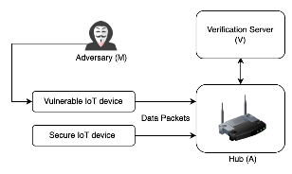
System Model
4/26/22
The main components of the system are:
Legitimate devices (D)
Hub (A)
Verification Server (V )
8

Slide 9
Adversary Model
4/26/22
The adversary (M) can utilize compromised knowledge to hijack a vulnerable device in the network as an attempt to:
Poison the network by injecting malicious packets
Capture network traffic to extract sensitive data
Actuate a device to perform activities of some other type of device
We assume that the adversary has no prior knowledge of the traffic pattern of any compromised device
9

Slide 10
Security Requirements
4/26/22
The security requirement of RADTEC is to authenticate devices based on the classification of the device type
Identifying IoT device type helps prevent device actuation attacks, for example the protocol can identify an IoT Camera as compromised if it is performing tasks that a Smart Lock would
Help identify attacks performed by an adversary’s IoT device present in the network to either capture traffic or inject malicious traffic into the network
The hub is responsible for the verification of the credentials input by the user and for the comparison of claimed and observed device types based on the traffic pattern
The hub and the verification server can be assumed to be a single entity as a secured gateway. The secured gateway performs:
Initial trust establishment
Policy-based network access
Continuous and re-authentication of devices
10

Slide 11
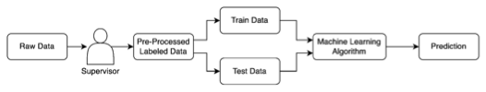
Machine Learning Models
4/26/22
Supervised learning algorithms implemented in this thesis include the Random Forest Classifier, K-Nearest Neighbors, Support Vector Machine Classifier, Gradient Boost Classifier, and Naive Bayes Classifier
Supervised Learning is a sub-category of machine learning where the learning of an algorithm is supervised which essentially means that the algorithm is taught by using examples
11

Slide 12
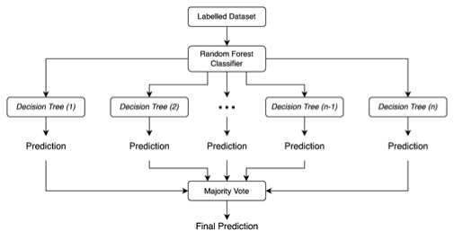
Machine Learning Models
4/26/22
Random Forest Classifier – It is based on a decision tree like structure at its core, and it can be categorized as an ensemble-based learning method used for making classifications
12

Slide 13
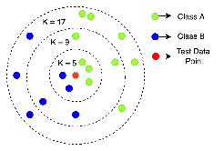
Machine Learning Models
4/26/22
K-Nearest Neighbor – It is a supervised machine learning algorithm, mostly used for solving classification problems. The algorithm works by estimating the test data point in a group, based on its nearest “K” number of neighbors
13

Slide 14
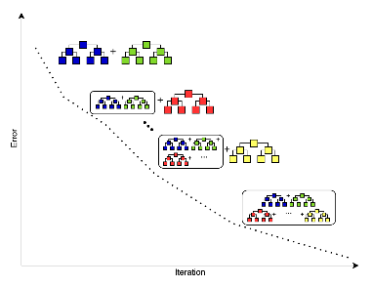
Machine Learning Models
4/26/22
Gradient Boosting Classifier – It is a supervised machine learning algorithm based on the ensemble technique, which means that it utilizes the predictions made by several different weak decision trees to give a strong final prediction
14

Slide 15
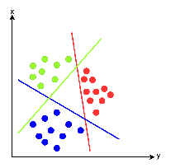
Machine Learning Models
4/26/22
Support Vector Machine – It performs classification by finding hyperplanes that would differentiate the multiple classes, and if a test data point can be placed within a certain hyperplane, it will share the same class with the data points in its neighborhood
15

Slide 16
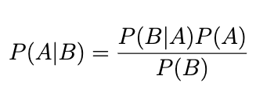
Machine Learning Models
4/26/22
Gaussian Naive Bayes – It is often used for classification jobs where the values of all features are continuous and distributed in a Gaussian distribution
The algorithm is called naive because it implies that the presence of any feature is completely independent of the existence of any other feature
It is based on the Bayes theorem which helps define the probability of the occurrence of hypothesis A after the data B, is already given by:
16

Slide 17
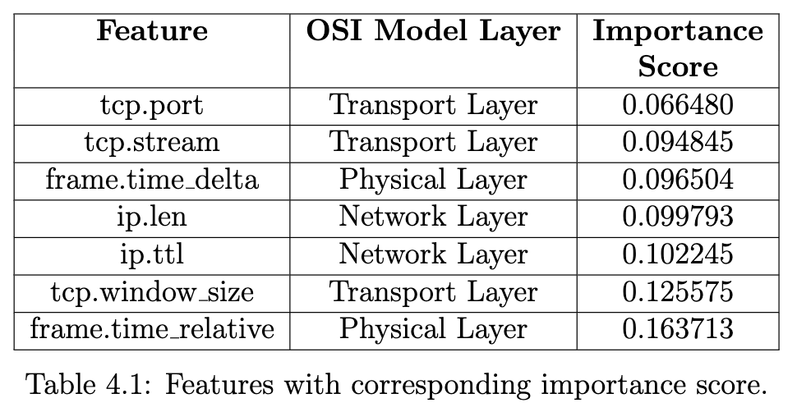
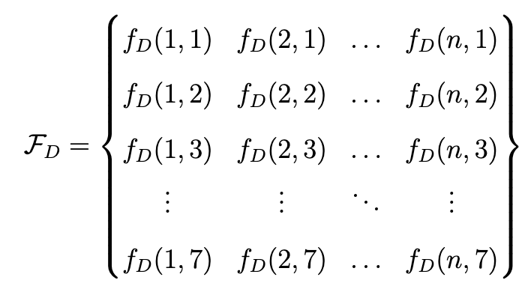
RADTEC
4/26/22
RADTEC - Re and continuous Authentication based on Device TypE Classification protocol,
Performs device type level classification based on traffic pattern/device fingerprint
Utilizes the device type to perform additional verification during the authentication process
Device Fingerprint Generation – The traffic from the legitimate device (D) is collected by the hub (A)
17

Slide 18
RADTEC – The Protocol
4/26/22
IoT Device (D)
Hub (A)
Verifier (V)
Initialization
Limited Access
Device Traffic
Capture Fingerprint
Fingerprint
Device Type Classification
Device Type
Device Type Verification
Full Access / Access Denied
Continuous & Re-Authentication
18

Slide 19
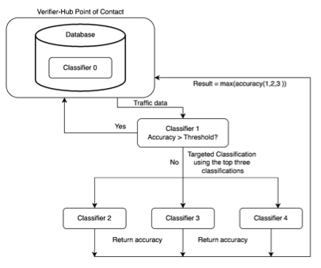
RADTEC – Verifier
4/26/22
19

Slide 20
Security Analysis – RADTEC
4/26/22
It can identify whether a device is known or unknown by using classification techniques, and if the device has been compromised
The protocol addresses scenarios where an adversary can:
Exploit a vulnerable device to inject malicious packets and therefore, poison the network
Use a vulnerable IoT device to extract sensitive data even if the network packets are encrypted
Compromise a vulnerable IoT device and actuate the activities that would typically be performed by a different type of device
RADTEC does so by keeping a constant track of changes in a device fingerprint and following the access policies defined within the hub
20

Slide 21
Security Analysis – Classification Technique
4/26/22
Adversary can easily spoof the MAC address of an already authenticated device and authenticate itself with the hub [1]
The only time we use the MAC address is to check if the device already exists in the database
The verifier will automatically be able to send confirmation to the hub that the MAC addresses match, but if the fingerprint does not match, so this device must be compromised
This is based on the idea that when a machine learning model is trained and tested on the same or at least similar dataset, it should provide predictions with the highest accuracy
Device is reclassified every time when it needs re-authentication irrespective of its previous authentication with the server
21
[1] Sheng, Yong, et al. "Detecting 802.11 MAC layer spoofing using received signal strength." IEEE INFOCOM 2008-The 27th Conference on Computer Communications. IEEE, 2008.

Slide 22
Discussion
4/26/22
We assume that there are three scenarios where a device needs to be authenticated when,
A new device is first introduced in the network
A previously authenticated device moves into and out of the network and requires re-authentication
A device that constantly remains inside the network requires continuous authentication
The protocol addresses all three scenarios by correlating a device MAC address to the ones previously stored in the database, and then providing authentication by using the classification techniques applied in this paper
If a vulnerable device is compromised by an adversary and the authentication credentials are stolen, it will generally be the case that the adversary does not know the type of the device
However, even if the adversary can identify the type of device, the adversary will not be able to perform any actions using the vulnerable device since the classification model will notice the change in device fingerprint, resulting in blocking the access given to the device
22

Slide 23
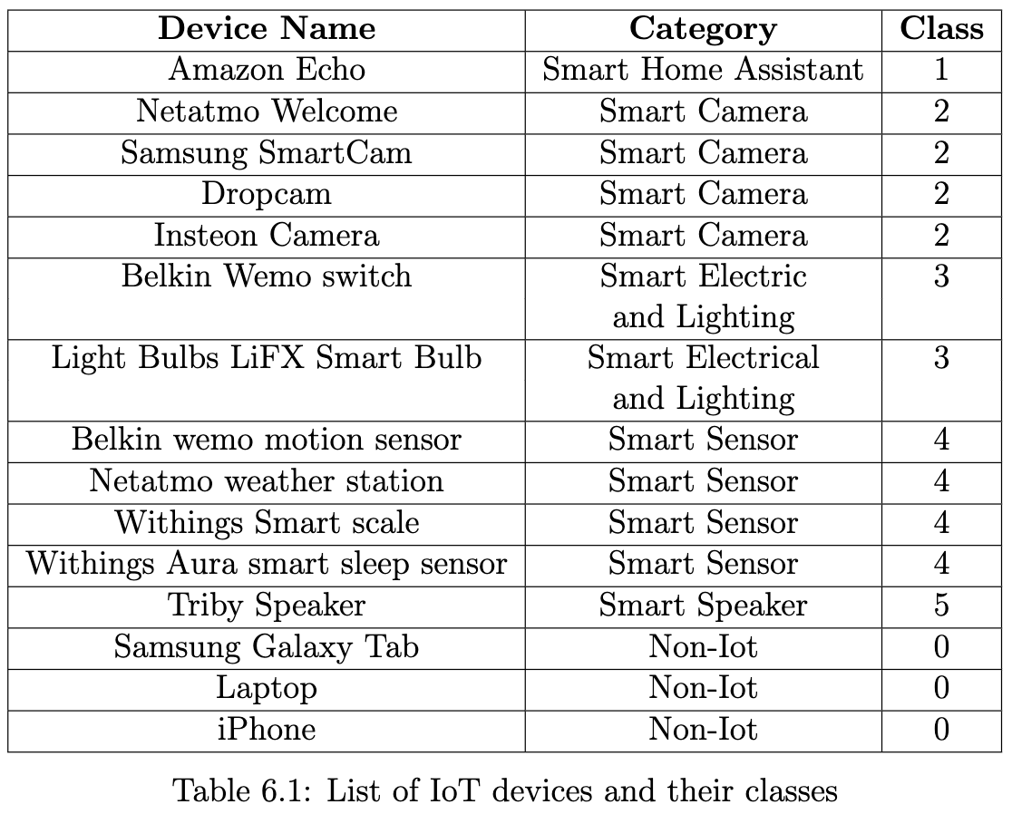
Implementation - Dataset
4/26/22
Implementation techniques used to classify IoT devices such as data preprocessing involving, data cleaning and splitting, standardizing features, numerical imputation, and feature engineering
We chose 15 devices as shown in Table 6.1 and obtained relevant information from packet capture files by extracting important features using tshark into a .csv file [1]
23
[1] Sivanathan, Arunan, et al. "Classifying IoT devices in smart environments using network traffic characteristics." IEEE Transactions on Mobile Computing 18.8 (2018): 1745-1759.

Slide 24
Implementation – Device Identification
4/26/22
The device identification process is done by utilizing the device fingerprint collected by the hub
The process for developing the ML model is scalable
New categories of IoT devices can simply be trained on the combined classifier and targeted classifiers by using device packet capture
Algorithm selection - Based on previous work and approaches, we use the following five classifiers:
Random Forest
K-Nearest Neighbors
Support Vector Machine
Gradient Boosting
Gaussian Naive Bayes
24

Slide 25
Implementation – Data Pre-Processing
4/26/22
Data Pre-processing
Data Cleaning and Splitting
Irrelevant data points were removed
Data was labelled and split into train and test data, 80% and 20% respectively
Standardizing Features
Features were standardized by subtracting the mean from the values and then scaling it to unit variance
Numerical Imputation
Missing values were imputed to the median values of each individual feature
25

Slide 26
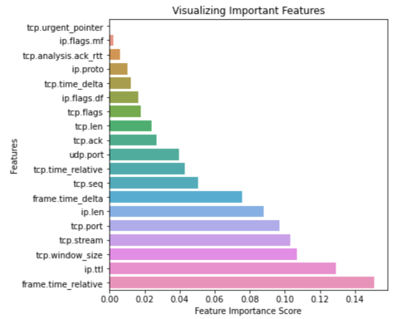
Implementation – Feature Engineering
4/26/22
Feature Engineering
We use a random forest search classifier to extract feature importance scores from the 19 features
A threshold of 0.05 was set for the importance score of features
All features with importance scores below the threshold were eliminated
Such features included tcp.urgent pointer, ip.flags.mf, tcp.analysis.ack rtt, ip.proto, tcp.time delta, ip.flags.df, tcp.flags, tcp.len, tcp.ack, udp.port, tcp.time relative, tcp.seq
26

Slide 27
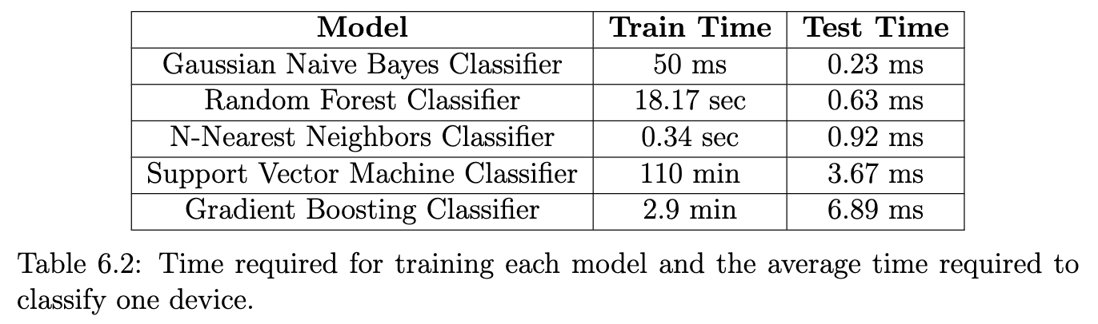
Implementation – Training & Testing
4/26/22
Training and Testing
Training was performed by fitting the model onto the data to make classifications
During testing, labels for test data were predicted by the trained models
Accuracy scores while performing testing were recorded
Time taken by the training process and the classification of a single device for each classifier was recorded (Table 6.2)
27

Slide 28
Results – F1 Score
4/26/22
The highest average F1 score for all classes was provided by the Random Forest Classifier (RFC)
RFC is near perfect for differentiating between an IoT and a non-IoT device
28

Slide 29
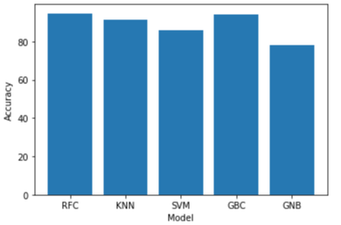
Results – Accuracy Score
4/26/22
After making the predictions, we established that the Random Forest Classifier (RFC) was the most accurate model for making the predictions with an accuracy of 95.2%
The second most accurate classifier was the Gradient Boost Classifier (GBC) with an accuracy of 94.8%
K-Nearest Neighbors Classifier (KNN) accuracy – 93.3%
Support Vector Machine Classifier (SVM) accuracy – 88.3%
Gaussian Naïve Bayes Classifier (NAB) accuracy – 76.8%
29

Slide 30
Conclusion
4/26/22
We proposed the RADTEC protocol as a solution to improve the security of IoT devices
Through machine learning and cryptographic techniques, RADTEC addresses the events in which an adversary can exploit a vulnerable device to:
Capture network traffic
Poison the network by injecting malicious packets
Actuate a device to perform activities of some other type of device
We used the Random Forest Classifier, Gradient Boost Classifier, K-Nearest Neighbors Classifier, Support Vector Machine Classifier and the Naive Bayes Classifier to identify the type of IoT device using cross-layer data
Random Forest Classifier was able to make the most accurate prediction with an accuracy score of 95.2% and the highest average F1 score
The time required to train the model and the average time taken to classify a single data point were recorded for all classifiers. Gaussian Naive Bayes Classifier was found to be the fastest classifier for training and testing
However, we would prefer to use the Random Forest Classifier, as it still required less time than most other models for training and testing and provided the most accurate results
30

Slide 31
Future Work
4/26/22
In our future work we plan to train classification models for several more types of IoT devices
We would further collect more data for each type of device to eliminate bias in our model, if any, to provide more accurate classifications for all the devices considered
In addition to the machine learning classifiers used in this thesis, we would perform device type level classification using several other types of classifiers
Finally, we would apply model fine-tuning techniques to improve the performance of our classifiers
Thank you!
31

