Slide 1
Spatial & Temporal Agnostic Deep-Learning based Radio Fingerprinting
MS Thesis Defense
Presented By:
Academic Advisor:
Dr. Nirnimesh Ghose
Committee Members:
Dr. Byrav Ramamurthy and
Dr. Lisong Xu
Fahmida Afrin
School of Computing, University of Nebraska-Lincoln
July 27th, 2023

Slide 2
Radio Fingerprinting
Physical layer authentication and identification of wireless devices based on their unique radio frequency (RF) signals.

Slide 3
Security
Radio fingerprinting is critical in the security and reliability of present and future wireless networks.

Slide 4
Hardware Manufacturing Variation
Hardware Imperfections:
I/Q imbalance,
non-linearity of digital-to-analog converters,
non-linearity of power amplification, etc.
These non-linearities in the manufacturing process, unique fingerprints emitted by individual devices can be used for authentication.

Slide 5
Challenges in RF fingerprinting
Factors that impact the accuracy of deep-learning model:
Indoor and outdoor environment complexities
Signal variability
Device and antenna differences,
Changing channel conditions, etc.
Different times of the day and locations have unique RF characteristics.
Spatial & Temporal variations can result in fast-changing wireless channels.

Slide 6
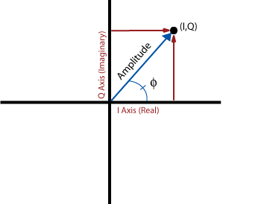
In-phase and Quadrature (I/Q) Signal
The signal can be represented:
s = I + Q j
By leveraging the power of complex numbers, we can enhance the model’s performance.
Where, Φ = Phase

Slide 7
Related Work
Previous works [1], [2], [3] extract RF signals, Most of the work used real and imaginary components separately resulting in losing information encoded in the signal's phase and amplitude.
The closest to our study, Haipeng L et al. [1] conducted research on enhancing deep-learning-based radio fingerprinting. They focused on improving robustness in cross-day scenarios but The approach considered real and imaginary parts of complex numbers separately.
[1] H. Li, K. Gupta, C. Wang, N. Ghose, and B. Wang. Radionet: Robust deep- learning based radio fingerprinting. In 2022 IEEE Conference on Communications and Network Security (CNS), pages 190–198. IEEE, 2022.
[2] J. Stankowicz, J. Robinson, J. M. Carmack, and S. Kuzdeba. Complex neural networks for radio frequency fingerprinting. In 2019 IEEE Western New York Image and Signal Processing Workshop (WNYISPW), pages 1–5. IEEE, 2019.
[3] Z. Liang, M. Tao, J. Xie, X. Yang, and L. Wang. A radio signal recognition approach based on complex-valued cnn and self-attention mechanism. IEEE Transactions on Cognitive Communications and Networking, 8(3):1358–1373, 2022.

Slide 8
Related Work
Chen et al. [4] demonstrated the superiority of complex-valued convolutional neural networks (CVNN) over real-valued networks across four diverse datasets, using only CReLU activation functions. Our approach investigates three different complex activation functions.
In our experiment, we utilized real-world datasets obtained from USRP, in contrast to Gopalakrishnan et al.’s [5] use of simulation datasets for evaluating CVNN on wireless protocol data.
Stankowicz et al. [6] investigated input/output representations and the treatment of complex values in fully connected neural networks. They highlighted the advantages of using complex-valued inputs and spectro-temporal representations.
[4] J. Chen, W.-K. Wong, B. Hamdaoui, A. Elmaghbub, K. Sivanesan, R. Dorrance, and L. L. Yang. An analysis of complex-valued cnns for rf data-driven wireless device classification. In ICC 2022-IEEE International Conference on Communications, pages 4318–4323. IEEE, 2022.
[5] S. Gopalakrishnan, M. Cekic, and U. Madhow. Robust wireless fingerprinting via complex-valued neural networks. In 2019 IEEE Global Communications Conference (GLOBECOM), pages 1–6. IEEE, 2019.
[6] J. Stankowicz, J. Robinson, J. M. Carmack, and S. Kuzdeba. Complex neural networks for radio frequency fingerprinting. In 2019 IEEE Western New York Image and Signal Processing Workshop (WNYISPW), pages 1–5. IEEE, 2019.

Slide 9
Contributions
We implemented a complex-valued convolutional neural network (CVNN) with different activation functions (Cart Leaky ReLU, Complex Cardioid, and CReLU) and integrated them with two transfer learning methods fine-tuning and triplet networks.
We collect data on a USRP B-205mini-i testbed with six transmitters and one receiver simultaneously in four locations. This includes three indoor environments in two separate buildings and one outdoor environment.
We further implemented a novel evaluation metric of “device ranking‘’, which tackles the variations in the accuracy to identify devices with certainty.
Finally, we provide results to attest to our hypothesis that CVNNs improve accuracy as compared to prior art [1]. Further, we compare the performance of transfer learning with fine-tuning and triplet networks.
[1] H. Li, K. Gupta, C. Wang, N. Ghose, and B. Wang, “Radionet: Robust deep-learning based radio fingerprinting,” in 2022 IEEE Conference on Communications and Network Security (CNS). IEEE, 2022, pp. 190–198.

Slide 10
Slicing windows
An example of slicing window method over M I/Q samples given trace length L and stride is 1.
Extract I/Q samples from RF signals and prepare I/Q traces for a classifier.
[1] H. Li, K. Gupta, C. Wang, N. Ghose, and B. Wang. Radionet: Robust deep- learning based radio fingerprinting. In 2022 IEEE Conference on Communications and Network Security (CNS), pages 190–198. IEEE, 2022. [ Source of Image]

Slide 11
Complex-Valued Convolutional Neural Network (CVNN)
We adopt library CVNN to work with complex values as CVNNs are barely supported by Tensorflow :
pip install cvnn
The library aims to provide complex-valued neural network layers.
It ensures that all other aspects of TensorFlow code remain unchanged.
The only distinction is the use of cvnn.layers instead of tf. keras.layers [7].
[7] J. A. Barrachina. Negu93/cvnn: Fixed max pooling 2d, Jan. 2021

Slide 12
Complex Activation Function
Cart Leaky ReLU:
Applies Leaky Rectified Linear Unit to both the real and imaginary parts of the input (x). Sensitive to the input phase rather than the input magnitude.
f(x) = (LeakyReLU(Re(x)), LeakyReLU(Im(x)))
Complex Cardioid:
The output magnitude is attenuated based on the input phase, while the output phase remains equal to the input phase.
f(x) = $\frac{1}{2}$ $(1+cos{(∠x))x}$
CReLU:
Preserves both positive and negative phase information. Apply ReLU after separating the negative and
positive part.
f(x) = (ReLU(x), ReLU(-x))

Slide 13
Transfer Learning
The reuse of a pre-trained model on a new problem.
knowledge of an already trained model is applied to a different but related problem.

Slide 14
Transfer Learning
Steps:
Pre-training: training a model on a source dataset, to learn general features.
Training: The knowledge acquired during pretraining is transferred to the target task.
Testing: model is evaluated on the test data from the target dataset.

Slide 15
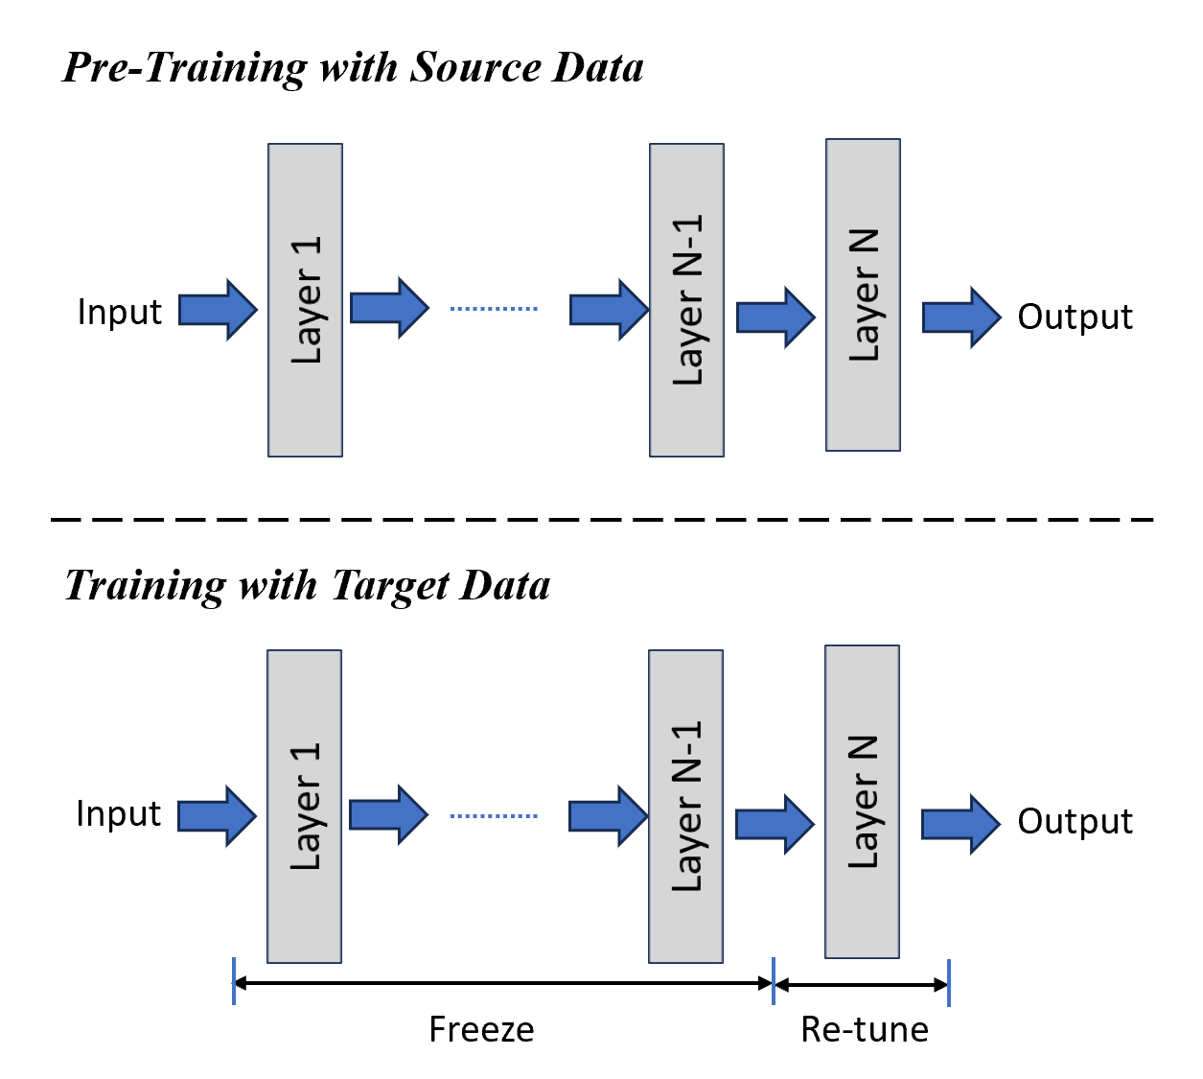
Fine-tuning
An approach to transfer learning in which the weights of a pre-trained model are trained on new data.

Slide 16
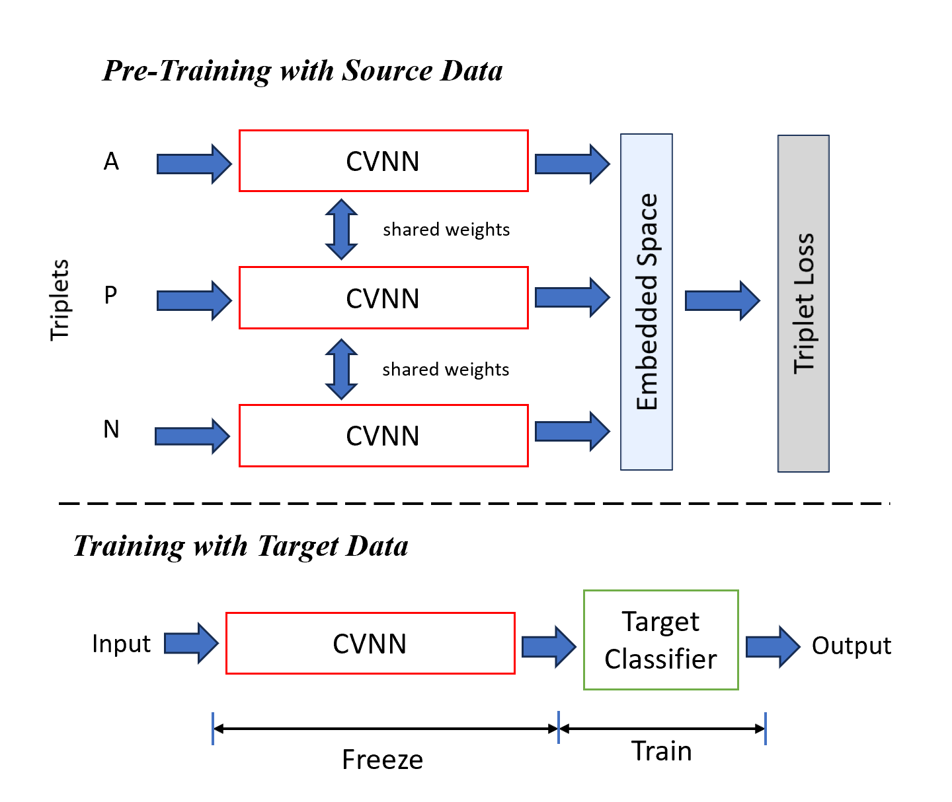
Triplet Network
One sub-network takes only anchor (A) samples as inputs.
The other two sub-networks are processing positive (P) and negative (N) inputs.
Training the network with a suitable loss function.

Slide 17
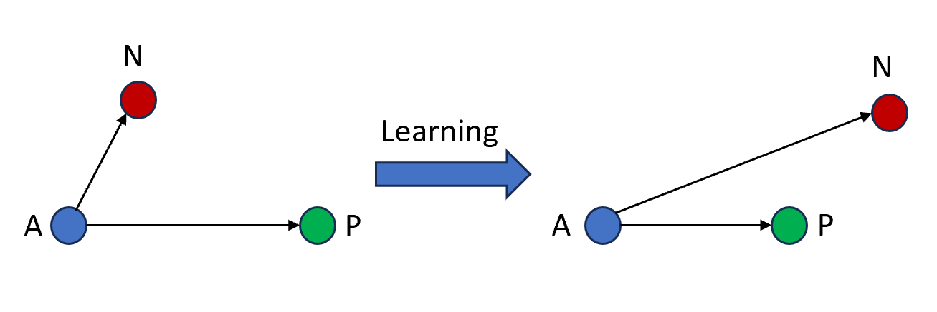
Triplet Network
Aims to distance between anchor and positive samples is minimized.
While the distance between anchor and negative samples is maximized.
The network learns to discriminate between samples of different classes or categories.

Slide 18
Evaluation Metric
Accuracy: Given N test traces, x traces are predicted correctly. Acc = x / N
Device Rank: aggregate scores of transmitters over N traces, sort the aggregated scores, report the rank of the correct transmitter
Why is the device rank better than accuracy?
Hardware imperfections are difficult to learn
Aggregated scores are more robust

Slide 19
Testbed
Seven USRPB205-mini-i devices are deployed, comprising one receiver and six transmitters.
Each USRP is equipped with a VERT2450 antenna.
The transmissions utilize IEEE 802.11 a/g and BPSK 1/2 modulation is employed.
The free and open-source GNU Radio code available is utilized [8].
Center frequency is 2.45 GHz, the bandwidth used is 2 MHz, and the sampling rate is set to 5 MS/S.
[8] Wime Project. (n.d.). Wime Project. https://www.wime-project.net/, Last Access: 07 July 2023, 07:58 PM

Slide 20
Datasets
All devices are stationary during data collection.
Total four locations data collected.
Transmitter and receiver are separated by approximately 2 feet.
Three transmissions are collected from each transmitter, each lasting for 30 seconds with a 15-second separation between transmissions.
Approximately 1.50 x 10^8 samples are gathered in each transmission, considering package loss.

Slide 21
Data Collection Map
On the map provided, Schorr Center UNL is denoted as Number 25.
we have gathered data from various sources, both inside and outside of the lab environment (locations 1, 2, and 4).
On the map, Number 35 represents the Library. we have collected data specifically from location 4 at this Library.

Slide 22
Experimental Focus
For neural network training, 1000 random I/Q traces are selected from each transmitter.
This selection results in a total of 6,000 I/Q traces for the entire dataset.
I/Q samples are gathered before, after the FFT, and after the WiFi Frame Equalizer on the receiver side.
However, the experiment utilizes only the after-FFT I/Q samples for analysis and evaluation.

Slide 23
Experimental Setting
Keras running on top of the TensorFlow is used to implement deep-learning architectures.
The code runs on Holland Computing Center [9] with a Tesla V100-PCIE-32GB GPU, which supports cuDNN version 8.6.0.
Data is split into three sets: 72% for training, 8% for validation, and 20% for testing.
[9] Holland Computing Center, https://hcc.unl.edu/, Last Access: 07 July 2023, 08:58 PM

Slide 24
Experimental Setting
RMSprop optimizer is used for training the models.
The learning rate is set to 0.1.
ComplexAverageCrossEntropy from the CVNN package is utilized as the loss function
Each model is trained for 100 epochs.
Early stopping is implemented with patience set at 10 epochs.

Slide 25
Architectures of Neural Networks
Three distinct activation functions- Cart Leaky ReLU, Complex Cardioid, and CReLU were tested.

Slide 26
Architecture of Fine-Tuning
Pre-training:
The CVNN model is initially trained using a source dataset before fine-tuning.
Hyperparameter Tuning:
In the training phase, hyperparameters of the pre-trained CVNN model are further optimized.

Slide 27
Architectures of Triplet Network
Parameters | Selected Value
Base Model | CVNN
Similarity Metrics | Cosine
Mining Strategy | Semi-Hard-Negative
Classifier | k-nearest neighbor
Optimizer | Adam
Batch Size | 128
Embedded Vectors Size | 64

Slide 28
Performance of Cart Leaky ReLU
 |  | Same-acc | Cross-acc
 |  |  |  | N=100 |  | N=200 |  | N=400 |  | N=800
S | T | CVNN | CVNN | FT | TN | FT | TN | FT | TN | FT | TN
1 | 288 | 99.97 ± 0.05 | 36.22 ± 5.45 | 85.74 ± 0.75 | 60.09 ±2.74 | 96.73 ± 0.30 | 56.48 ± 2.32 | 99.87 ± 0.03 | 57.84 ± 1.74 | 99.99 ± 0.00 | 68.05 ± 1.23
144 | 288 | 65.50 ± 5.08 | 30.13 ± 1.68 | 67.20 ±0.89 | 53.90± 0.08 | 73.12 ±1.67 | 59.87 ± 1.25 | 57.36 ± 2.30 | 41.25 ± 0.69 | 60.50 ± 2.12 | 48.16 ± 0.27
144 | 144 | 74.37 ± 2.75 | 38.74 ± 4.07 | 74.44 ± 2.14 | 53.87 ± 0.52 | 79.40 ± 1.13 | 55.54 ± 1.60 | 51.92 ± 1.63 | 44.70 ± 0.32 | 54.70 ± 1.67 | 54.33 ± 1.17
288 | 288 | 77.82 ± 2.70 | 43.42 ± 3.60 | 81.82 ± 1.50 | 54.75 ± 1.53 | 84.52 ± 1.26 | 44.52 ± 4.24 | 56.98 ± 0.87 | 54.81 ± 2.70 | 60.12 ± 1.10 | 66.88 ± 0.06
S =stride
T =trace length (t),
CVNN = base model,
FT = Fine-Tuning,
TN = Triplet Network,
N = # of traces per transmitter in target training data,
Same-acc = Same-Location Accuracy calculated for location 1.
Cross-acc = Cross-Location Accuracy calculated for location 4.

Slide 29
Performance of Complex Cardioid
 |  | same-acc | cross-acc
 |  |  |  | N=100 |  | N=200 |  | N=400 |  | N=800
S | T | CVNN | CVNN | FT | TN | FT | TN | FT | TN | FT | TN
1 | 288 | 99.87 ± 0.17 | 27.43 ± 8.39 | 78.52 ± 1.07 | 38.75 ± 10.6 | 90.72 ± 0.96 | 46.17 ± 2.66 | 98.65± 0.71 | 54.18 ± 4.10 | 99.97 ± 0.05 | 55.22 ± 0.41
144 | 288 | 60.88 ± 2.27 | 20.68 ± 4.48 | 53.24 ± 0.71 | 26.65 ± 1.21 | 54.38 ± 2.17 | 30.77 ± 0.09 | 67.15 ± 0.32 | 38.89 ± 2.20 | 78.47 ± 1.65 | 39.53 ± 0.28
144 | 144 | 50.73 ± 4.77 | 26.02 ± 4.51 | 49.74 ± 0.59 | 25.53 ± 7.54 | 50.39 ± 3.63 | 31.85 ± 0.55 | 67.16 ± 0.93 | 46.50 ± 4.76 | 78.72 ± 1.53 | 49.71 ± 0.35
288 | 288 | 58.73 ± 5.13 | 31.77 ± 6.05 | 51.18 ± 2.33 | 37.33 ± 3.63 | 54.71 ± 0.58 | 40.57 ± 0.05 | 76.55 ± 2.37 | 46.03 ± 8.14 | 79.38 ± 1.34 | 50.30 ± 0.24
S =stride
T =trace length (t),
CVNN = base model,
FT = Fine-Tuning,
TN = Triplet Network,
N = # of traces per transmitter in target training data,
Same-acc = Same-Location Accuracy calculated for location 1.
Cross-acc = Cross-Location Accuracy calculated for location 4.
Random Guess = 16.66%

Slide 30
Performance of CReLU
 |  | same-acc | cross-acc
 |  |  |  | N=100 |  | N=200 |  | N=400 |  | N=800
S | T | CVNN | CVNN | FT | TN | FT | TN | FT | TN | FT | TN
1 | 288 | 99.82 ±0.21 | 37.35 ±0.04 | 82.82 ± 2.20 | 43.22±0.96 | 92.91 ± 1.69 | 53.62±0.00 | 99.67 ± 0.15 | 43.93±0.15 | 99.99± 0.00 | 43.46±0.38
144 | 288 | 71.52 ± 2.12 | 29.05 ± 3.93 | 71.85 ± 3.70 | 36.79±4.86 | 91.64 ± 0.75 | 43.95±3.06 | 69.88 ± 0.08 | 48.04±1.41 | 69.00 ± 0.03 | 52.45±0.08
144 | 144 | 77.45 ± 1.98 | 39.14 ± 2.98 | 73.23 ± 1.32 | 43.85±0.85 | 86.89 ± 1.44 | 56.53±1.25 | 87.83 ± 2.47 | 55.04±0.59 | 87.62 ± 2.31 | 53.63±2.03
288 | 288 | 82.17 ± 2.79 | 44.18 ± 3.82 | 84.90 ± 2.80 | 63.03±4.69 | 87.77 ± 0.31 | 58.33±1.43 | 88.59 ± 0.60 | 66.63±2.02 | 89.27 ± 2.50 | 67.76±0.63
S =stride
T =trace length (t),
CVNN = base model,
FT = Fine-Tuning,
TN = Triplet Network,
N = # of traces per transmitter in target training data,
Same-acc = Same-Location Accuracy calculated for location 1.
Cross-acc = Cross-Location Accuracy calculated for location 4.
Random Guess = 16.66%

Slide 31
Observations of Tables
Except for S=1, which consistently provides the best results, higher values of the Stride (S) parameter generally show a positive correlation with accuracy.
Should choose strides so there are no overlaps across traces.
Increasing the value of N also leads to an improvement in accuracy.
There are a few exceptions in terms of accuracy trends mentioned above 3 points in specific cells.
CVNN base model excels with same-location data.
Performance is lower for cross-location data but still surpasses random guessing.
In the realm of Transfer Learning methods, Fine-Tuning (FT) outperforms Triplet Network (TN) in all three tables.
Among the three activation functions considered, CReLU exhibits better performance compared to the other two.

Slide 32
Performance of CReLU (Different Datasets)
 |  | same-acc | cross-acc
 |  |  |  | N=100 |  | N=200 |  | N=400 |  | N=800
S | T | CVNN | CVNN | FT | TN | FT | TN | FT | TN | FT | TN
1 | 288 | 99.85 ±0.16 | 26.56 ±9.99 | 82 .82 ±2.20 | 38.45 ± 0.44 | 92.91 ± 1.69 | 29.31 ± 0.30 | 99.67 ± 0.15 | 39.02±0.27 | 99.99 ± 0.00 | 97.67±0.08
144 | 288 | 81.78 ±3.61 | 26.83 ±4.26 | 54.60 ± 0.48 | 47.47 ± 0.40 | 66.41 ± 0.39 | 38.03 ± 0.58 | 57.20 ± 0.39 | 39.44 ± 0.31 | 56.63 ± 2.52 | 38.07 ± 0.53
144 | 144 | 80.90 ±1.32 | 25.09 ±1.82 | 53.23 ± 1.32 | 46.85 ± 0.10 | 66.89 ± 1.44 | 36.97 ±0.02 | 57.83 ± 2.47 | 39.45± 0.01 | 57.62 ± 2.31 | 39.95 ±0.02
288 | 288 | 85.88 ±1.89 | 28.44 ±2.15 | 54.90 ± 2.80 | 47.00 ± 0.14 | 67.77 ± 0.31 | 49.37±0.04 | 58.59 ± 0.60 | 49.41 ±0.04 | 69.27 ± 2.50 | 49.44±0.06
S =stride
T =trace length (t),
CVNN = base model,
FT = Fine-Tuning,
TN = Triplet Network,
N = # of traces per transmitter in target training data,
Same-acc = Same-Location Accuracy calculated for location 2.
Cross-acc = Cross-Location Accuracy calculated for location 3.
Random Guess = 16.66%

Slide 33
Compare with Previous Studies
 | Method | N=100 | N=200 | N=400 | N=800
Previous Method | FT | 46.45±0.71 | 49.98±0.53 | 52.56±1.12 | 55.17±0.11
 | ADA | 47.82±0.37 | 53.95±0.75 | 59.94±1.02 | 65.24±1.42
Our Method | FT | 61.73 ± 2.25 | 66.42 ± 1.02 | 71.01 ± 0.40 | 76.99 ± 2.18
 | TN | 65.08±0.33 | 65.50±0.16 | 65.95±0.58 | 66.05±0.17
N = # of traces per transmitter in target training data,
Comparison with previous studies [1] using HackRF-10 datasets. Here used data after Wifi Frame Equilizer and Random Guess 10%.
Our method, based on complex-valued Fine-tuning (FT), demonstrates significant improvement in cross-day accuracy and enhances cross-day accuracy from 55.17% to 76.99%.
Triplet Network (TN) exhibits slightly better performance than Adversarial Domain Adaptation (ADA), improving accuracy from 65.24% to 66.05%.
[1] H. Li, K. Gupta, C. Wang, N. Ghose, and B. Wang, “Radionet: Robust deep-learning based radio fingerprinting,” in 2022 IEEE Conference on Communications and Network Security (CNS). IEEE, 2022, pp. 190–198.

Slide 34
Device Rank
Device rank measures the classifier F's ability to authenticate a specific transmitter yj∗ using a subset of the test dataset Dyj∗ test.
The subset Dyj∗ test comprises n′ traces from the transmitter yj∗.
The goal is to rank the transmitter's aggregated score (si,k) concerning other transmitters' scores in the dataset Y.
A device rank of 1 over n′ traces suggests that classifier F ranks device yj∗ correctly
If the rank converges to 1 with a smaller number of traces, it indicates that the authentication is more effective since the correct rank is achieved sooner.

Slide 35
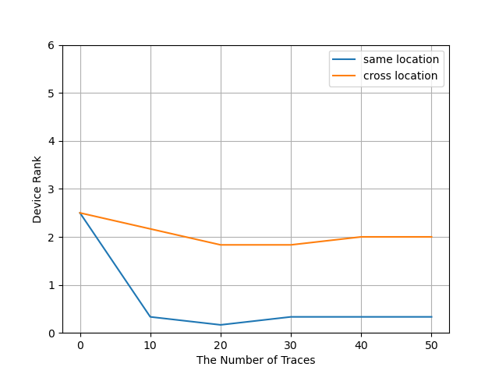
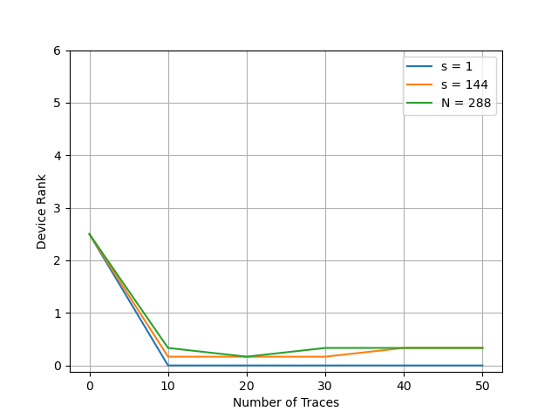
Device Rank
Device rank (frequency domain, usrpb205, CReLU, T= 288, S = 288, trainset: location 1 and test set: location 4) for cross-location.
Device rank (frequency domain, same-location, usrpb205, CReLU, T = 288, train and test set: location1 ) for different S.

Slide 36
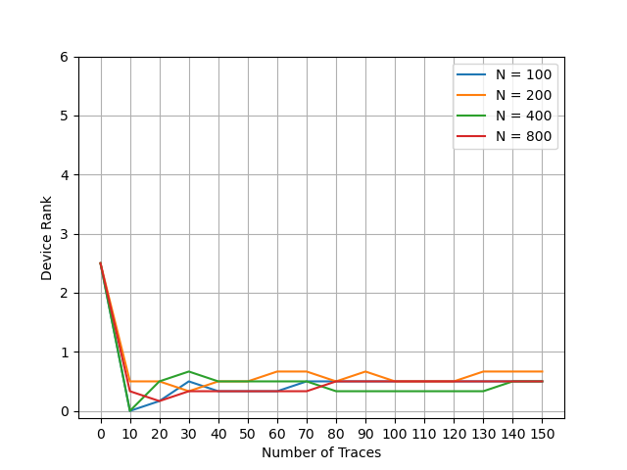
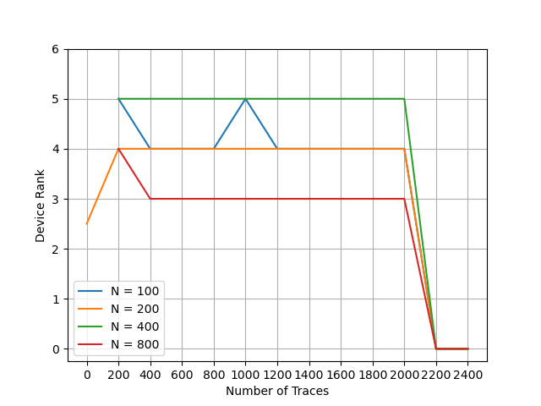
Device Rank
Device rank (Fine-tuning, cross-day, usrpb205, CReLU, T = 288, S = 288, data set: location 1 and test set: location 4) for different N.
Device rank (Triplet Network, cross-day, usrpb205, CReLU, T = 288, S = 288, data set: location 1 and test set: location 4) for different N.

Slide 37
Conclusion
Enhancing radio fingerprinting accuracy using complex-valued convolutional neural networks (CVNN).
Employed different complex activation functions, for different strides, and trace lengths.
Experiments conducted on four cross-location scenarios with neural networks applied to I/Q data in the frequency domain.
CReLU complex activation function demonstrated effectiveness among the considered options.
Utilized two classifiers Fine-Tuning and Triplet Network for device type level classification and physical-layer authentication.
Our Fine-tuning approach achieved the highest accuracy score in all cases.
Our Transfer Learning approaches improve the cross-day accuracy from 55.17% to 76.99% over the HackRF-10 dataset.
Device ranking proved effective for transmitter identification in various scenarios.

Slide 38
Future Work
Training classification models for various more complex activation functions.
Incorporating supplementary features derived from the signal-to-noise ratio (SNR), specific to each device type.
Exploring cross-layer classification techniques, extending to the network layer.
Using other classifiers and advanced transfer learning techniques to enhance performance.

Slide 39
Reproducibility
Github Link: https://github.com/fafrincs/STADL-RF/tree/main
Dataset Link: usrp_b200

