Slide 1
Evaluation of a bio-socially inspired secure DSA scheme using testbed-calibrated hybrid simulations
IEEE IEMCON 2021
Authors:
Anna Wisniewska – Department of Computer Science, Washington State University, Vancouver
Nirnimesh Ghose – School of Computing, University of Nebraska-Lincoln
Bilal Khan - Department of Sociology, University of Nebraska-Lincoln

Slide 2
OUTLINE
Background & Motivation
Dynamic Spectrum Access
System model
Behavioral model
Testbed
Results
Conclusion
Notes:
I will begin with a very brief CR background and motivation.
Then we will look at the system setup,
The behavioral model,
The testbed
the results, and,
finally the conclusion.

Slide 3
Dynamic Spectrum Access
Primary User (PU) – license holder
Secondary User (SU) - cognitive radio equipped device
Power
Spectrum hole
Frequency
PU3
SU
PU3
SU
PU2
SU
PU2
PU1
SU
PU1
SU
Time
Notes:
Current spectrum assignment policies have resulted in suboptimal use of spectral resources —over-utilization in some bands and under-utilization in others.
Few segments of spectrum remain for new services, and yet, the licensed spectrum appears to be underutilized.
The reason for this is that licensed (“primary”) users are idle within their bands for significant fraction of time leaving behind a “spectrum hole”.
Cognitive radios, dynamically identify and opportunistically forage for unused spectrum bands or “spectrum holes” by adjusting transmission/reception parameters accordingly.
The red dots in the figure illustrates how secondary users opportunistically navigate spectrum holes over time as primary users leave their bands idle.

Slide 4
Self-coexistence
Primary-Secondary dynamics
Secondary-Secondary dynamics
“allow unlimited numbers of unlicensed [secondary] users to share frequencies”
“does not provide any right to protection from interference”
Notes:
The “open access” paradigm proposed by FCC mandates the study of primary-secondary dynamics, as well as secondary-secondary dynamics to better understand the implications of uncoordinated competition for limited number of resources between secondary users.
Although the FCC reform “allow unlimited numbers of unlicensed [secondary] users to share frequencies”, it “does not provide any right to protection from interference”
This present serious challenges to self-coexistence and performance for CR units in secondary DSA networks.

Slide 5
Motivation
Focus on self-coexistence
Extend our previously defined bio-social behavioral model by:
Implementing a contention-sensing mechanism using a USRP testbed
Achieve a more secure contention-sensing mechanism
Notes:
Here we focus on self-coexistence by extending our previous bio-inspired DSA model.
Since DSA networks are autonomous and capable of sensing, learning, and adopting, they may evolve over time, much as humans and other social animal species have in analogous contexts of resource sharing/conflict.
Prior research on resource allocation in networks recognizes the potential relevance of our knowledge on resource co-use in human and animal societies.
We consider the cost and benefits of bio-social behavioral models that apply social deference in the form of contention-sensing as a mechanism to achieve a utility advantage as SUs compete over a limited amount of resources.
We extend our previously defined contention-sensing model that assumed perfect knowledge of the contention in a band with a model that utilizes wireless physical layer signatures derived from a USRP testbed to estimate contention in bands. This allows us not only to achieve a more realistic model, but also to achieve a more secure model.

Slide 6
System model
Bands B
Base Station
Secondary users S
b1
s1
s2
b2
s3
⋮
s4
⋮
bm
sn
Notes:
I will begin by describing the general setup of the DSA network:
- pairwise communication between secondary users is via an access point or “base station” which is coordinating the channel selection for communication. In other words, the transmitter is selecting the channel and the base station is routing that information to the receivers.
- n secondary users are competing over m bands.

Slide 7
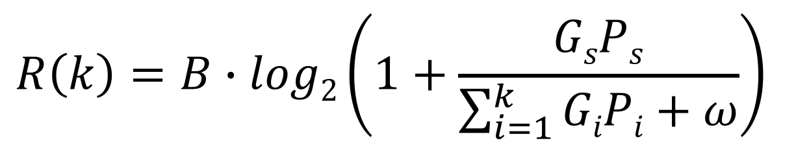
Reward function R(k)
B - bandwidth
P - power
G - channel gain
ω - ambient white Gaussian noise
$$R\left(k\right)=B∙log2\left(1+\frac{GsPs}{\sum_{i=1}^{k}{GiPi+ω}}\right)$$
k is the number of SUs sharing band b with s
Notes:
The performance metric is defined as follows:
Each SU receives a transmission rate (reward) according to the R function which depends on the number of SU sharing a band.
-k is the number of SUs sharing band b with s
Note: To isolate the impact of the proposed paradigm, we do not consider path loss and shadowing.
In this sense SUs are homogenous, they all experience the same power P and channel gain G (in the reward function).

Slide 8
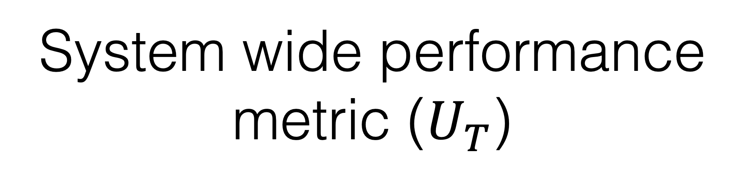

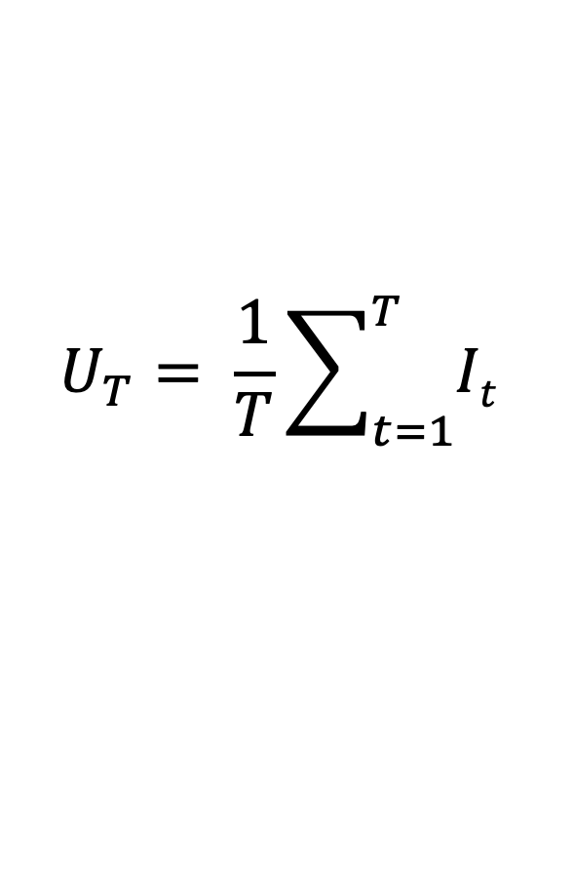
System wide performance metric ($U_{T}$)
Average utility per SU per unit time up to time T
$$U_{T}= \frac{1}{T}\sum_{t=1}^{T}{It}$$
Average instantaneous utility per SU at time t where W is the system wide utility at time t and C is the system wide switching cost at time t.
$$I_{t}=W_{T}−C_{T}$$
Notes:
Finally, the system wide utility U_T (the average utility per SU per unit time up to time T) is obtained by taking the sum of the instantaneous utility (I_t) of all SUs and subtracting the instantaneous cost of all SU who switched bands from this total reward. The system wide instantaneous utility W is obtained by calculating the reward R(k) for each SU in the system.

Slide 9
THE BEHAVIORAL MODEL
Notes:
Next, let's look at the underlying behavioral model

Slide 10
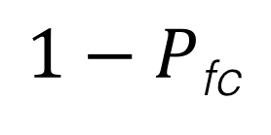
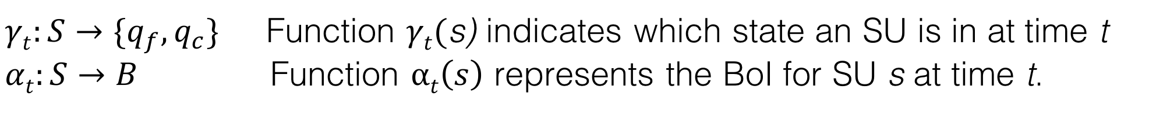
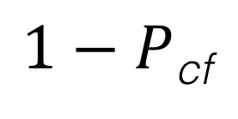
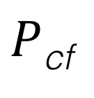
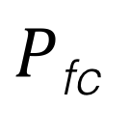
Forage-Consume FSM
$1−P$_{fc}
$1−P$_{cf}
$P$_{fc}
_{Forage}
_{Consume}
$P$_{cf}
$γt:S→\{q_{f},q_{c}\}$ Function $γt($s) indicates which state an SU is in at time t
$αt:S→B$ Function $αt\left(s\right)$ represents the BoI for SU s at time t.
Notes:
In this model each SU can at each point in time either “forage” (search) for good spectrum bands or “consume” (transmit in) its present band of interest.
More formally,
Each SU operate via the forage-consume FSM consisting of two states
the forage state qf
the consume state qc
and one state variable
the band of interest (BoI).
If an SU is in the consume state, it has committed to transmit in its band of interest (BoI) and receives a reward of R(k) defined previously.
If an SU is in the forage state, it is not transmitting but rather “observing” its band of interest (BoI) before making the decision to committing to it.
Since an SU is not transmitting in the forage state, it is not receiving any reward.

Slide 11
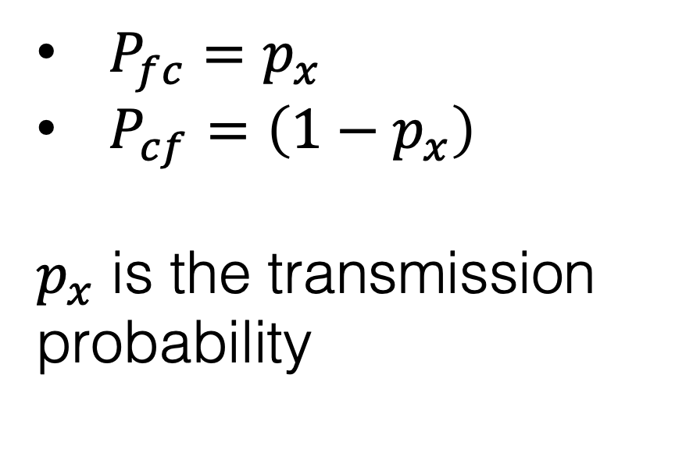
Baseline model
$1−P$_{fc}
$1−P$_{cf}
$P_{fc}=p_{x}$
$P_{cf}=\left(1−p_{x}\right)$
$p_{x}$ is the transmission probability
$P$_{fc}
_{Forage}
_{Consume}
$P$_{cf}
Notes:
Next we define the baseline model that will be compared to the proposed contention-sensing model.
In the baseline model, SU transition between the two state when they have data to transmit. We introduce a system-wide transmission probability p_x that achieves this where P_fc in the FSM is equal to p_x and P_cf is equal to (1-p_x).

Slide 12
Behavioral model using testbed data
Contention-sensing model
MAC/physical address detection leads to security risk
Wireless physical layer signature to estimate band occupancy
Notes:
To formulate our proposed contention-sensing behavioral model, we discuss the USRP testbed next.
In our previous work, we assumed that MAC/physical address detection using packet sniffing was utilized to determine the contention in a band.
This poses a security issue where SU can spoof MAC address to gain an advantage.
Here we propose a technique to utilize wireless physical layer signature to estimate band occupancy.

Slide 13
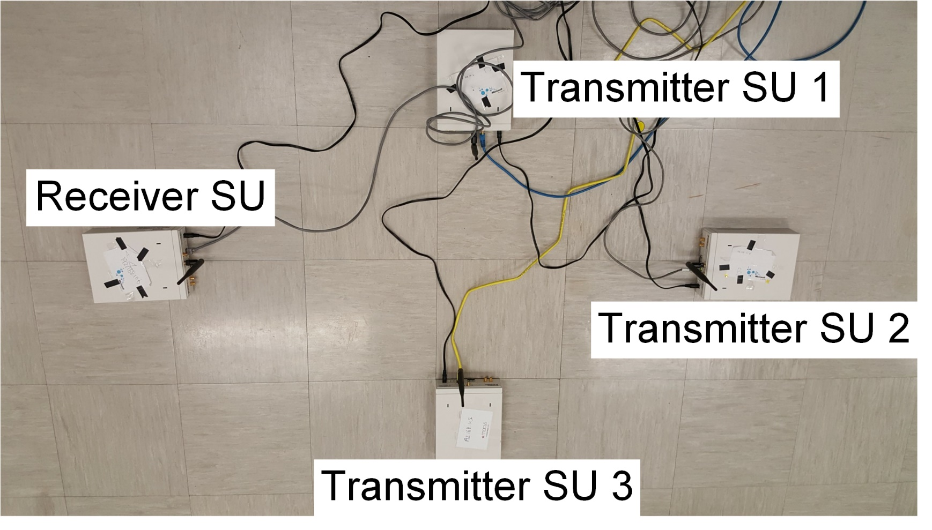
Fast Detection – Testbed
Notes:
We implemented fast-detection at the SUs using PHY-layer characteristics to pinpoint the number of active SUs in a particular band. The motivation of using PHY-layer as compared to MAC addresses is that detection can be made within the first few samples received in contrast to extracting MAC address after receiving the whole frame. For the fast detection strategy, we implement a received signal strength (RSS) strategy. In this strategy, the receiver or the detector SU marked received frames from different SUs, if they are received at different RSS. This is under the assumption that the transmitting SUs are transmitting at the same power and are separated by enough distance such that the channel from the transmitter to the receiver is sufficiently different.
Setup: To evaluate the band occupancy level, we set up four NI-USRP 2921 devices in an indoor laboratory environment. Three USRP devices represented the transmitting SUs whereas a fourth USRP device is placed at 4 feet away acting as an SU receiver for detection. The transmit power was set to 20dBm for all the SUs with a symbol duration of 1ms, and each frame comprising of 100 samples. The transmitting SUs are separated by a distance of 4ft. between them. The devices were set to work at 2.45GHz and were synchronized. The SUs transmitted their data according to time division multiple access and selected to transmit in the assigned slot according to system-wide transmission probability: The sampling frequency was set to 2MHz.
The receiver used the following equation to count the number of nodes where nb is the number of SUs, Pt is the average power of first 20 samples starting at time t; and T is the total time.

Slide 14
Fast Detection – Results
Notes:
First figure shows the band occupancy level with increasing time when we fixed the actual number of SUs to 3 and varied the individual transmission probability.
Second figure shows the band occupancy level with increasing time when we fixed the individual transmission probability to 0.75 and varied the number of
SUs. From the plots, we observe that the detection probability increases with increasing time, and eventually all the nodes are detected.
We see this behavior because of the TDMA followed by the nodes.
In the plots, we observed the range f() is [0; 1] with maximum slope of =; and takes the central value at t = C; where C / nb=px and / 1=nbpx: This gives the first functions.
From the first figure we observed that the individual the system wide transmission probability px is inversely proportional to C and, from second figure we observed that the number of nodes nb is directly proportional to C and inversely proportional to \alpha.

Slide 15
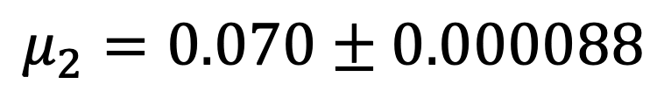
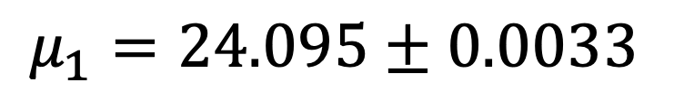
Fast Detection – Curve Fitting
$$μ_{1}=24.095±0.0033$$
$$μ_{2}=0.070±0.000088$$
Notes:
Combining these two observations, the function takes central value when t = 1nb=px with a slope 1=nbpx: Thus we can rewrite the function as.
We evaluated the constants using the curve fitting function on MATLAB with the data collected from the experiments. The constants were acceptable due to their p-value being in range or less than 0.05.

Slide 16
Contention-sensing model
Contention threshold parameter τ - to determine whether a BoI has “low” occupancy or “high” occupancy.
Contention bias parameter ε - determines how responsive an SU is to the contention level.
Introducing two new parameters:
Notes:
In the baseline model, transition between the FSM states is based on the transmission probability and SUs are powerless to acquire any useful information about the current transmission characteristics of the observed band.
We extend the baseline model to include contention-sensing which allowing SUs to “sense” the approximate number of SU at each band before committing to it.
To allow contention-sensing we introduce two new parameters:
SUs determine whether the occupancy at the BoI is “low” or “high” for a fixed system-wide integer contention threshold parameter τ.
In addition, the transition probabilities in the FSM must be modified in order to, for example, allow SU to commit to a band with higher probability if contention levels are low. A contention bias parameter ε is used to determine how responsive an SU is to the contention levels at the BoI.

Slide 17
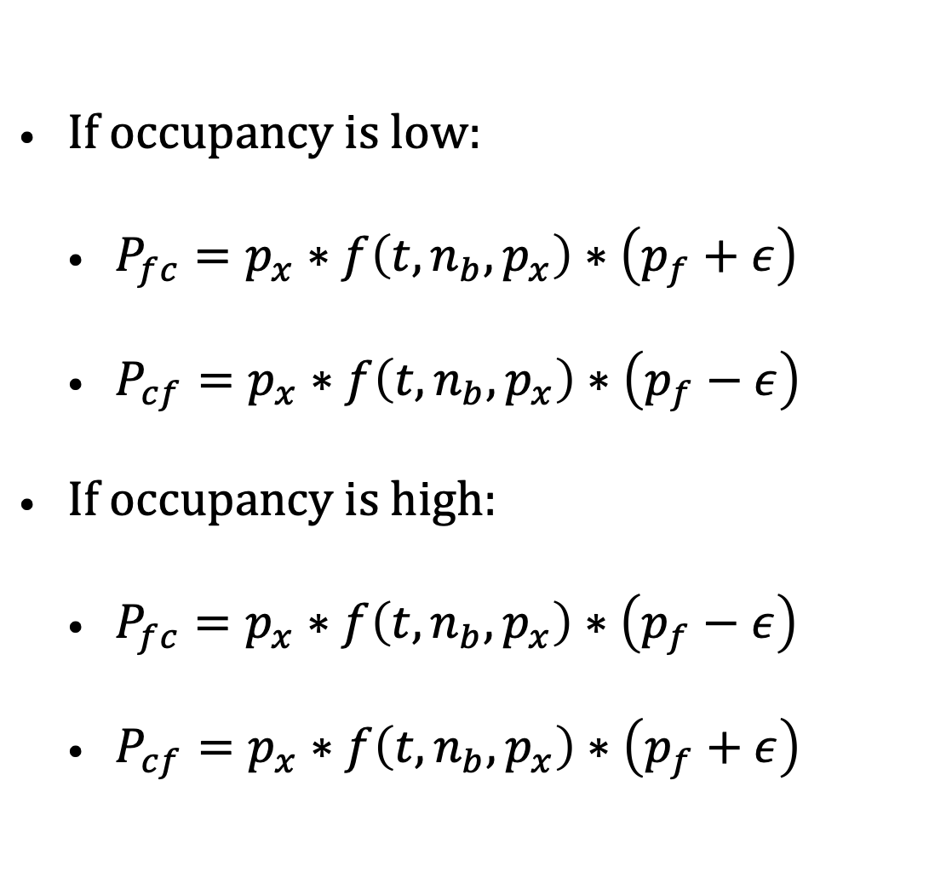




Contention-sensing
If occupancy is low:
$P_{fc}=p_{x}∗f\left(t,n_{b},p_{x}\right)∗\left(p_{f}+ε\right)$
$P_{cf}=p_{x}∗f\left(t,n_{b},p_{x}\right)∗\left(p_{f}−ε\right)$
If occupancy is high:
$P_{fc}=p_{x}∗f\left(t,n_{b},p_{x}\right)∗\left(p_{f}−ε\right)$
$P_{cf}=p_{x}∗f\left(t,n_{b},p_{x}\right)∗\left(p_{f}+ε\right)$
$1−P$_{fc}
$1−P$_{cf}
$P$_{fc}
_{Forage}
_{Consume}
$P$_{cf}
Notes:
The transition probabilities are adjusted to incorporate the previously defined function f() to demine occupancy level of a band and the contention bias parameter \epsilon in addition to the transmission probability p_x.
Depending on the estimated occupancy level, the transition probability will be adjusted with \epsilon as follows:
If an SU is in the forage state and occupancy is low, the transition probability is increased by epsilon.
If an SU is in the consume state and occupancy is low, the transition probability is decreased by epsilon.
If an SU is in the forage state and occupancy is high, the transition probability is decreased by epsilon.
If an SU is in the consume state and occupancy is high, the transition probability is increased by epsilon.

Slide 18
Results
Notes:
Let’s take a look at the results.

Slide 19

Utility $U_{T}$ Contention-sensing model compared to Baseline model
Notes:
We begin by comparing the utility U_T of the contention-sensing model to the baseline model (BM).
In the figure, the x-axis is transmission probability and the y-axis is utility U_T. The baseline model is represented by the black curve and the colored covers represent the contention-sensing populations with varying contention sensing thresholds \tao.
As can been seen in the figure, the contention-sensing society outperforms the baseline model for all values of transmission probability p_x below 0.97 where the most significant difference in utility occurs for intermediate values for transmission probability p_x.

Slide 20
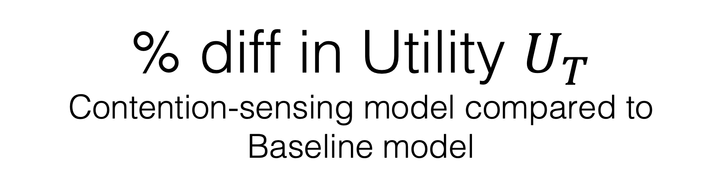
% diff in Utility $U_{T}$ Contention-sensing model compared to Baseline model
Notes:
The figure shows percentage difference in utility U_T obtained by the contention-sensing society for varying contention threshold normalized by the utility obtained by the baseline society. We can see the the contention-sensing society enjoys up to 35% more utility when compared to baseline.
The figure also confirms that the advantage that the contention-sensing society is insignificant when transmission probability is higher than 0.97.
This is since the consume-to-forage transition probability is governed by the transmission probability p_x and the contention–sensing mechanism has little to no effect when p_x is higher than 0.97.

Slide 21
% diff. time spent in bands

Slide 22
Scalability
Notes:
Finally, we consider the scalability by increasing the SUs to band ration. The figure shows the percentage difference in utility U_T between the baseline model and the contention-sensing model with varying contention threshold \tao over the transmission probability p_x.
We can see that the difference in utility that the contention-sensing population enjoys increases as the SU-to-band ratio increases.

Slide 23
Conclusion
USRP testbed-data-infused simulation experiments
Showed contention-sensing behavioral model outperforms the baseline model without contention sensing
Wireless physical layer signature method provides a secure method to estimate band utilization
Notes:
Our objective here was to determine if contention-sensing is advantageous as SU compete over limited resources.
We used a USRP testbed-data-infused simulation experiments to evaluate the contention sensing scheme.
We showed that the contention-sensing behavioral model outperforms the baseline model where SU are indifferent to contention in the bands even with the overhead of having to estimate the band occupancy level.
Furthermore, we showed that the approach is scalable.
Finally, the wireless physical layer signature method provides a secure method to estimate band utilization by preventing MAC spoofing potentially used by rogue nodes when band occupancy estimation is obtained by packet sniffing.

Slide 24
Thank you for your attention! Any questions?

