Slide 1

Secure Device Bootstrapping without Secrets Resistant to Signal Manipulation Attacks
Nirnimesh Ghose, Loukas Lazos, and Ming Li
Department of Electrical and Computer Engineering,
University of Arizona, Tucson
Presented at the:
39th IEEE Symposium on Security and Privacy (Oakland), San Francisco, CA

Slide 2
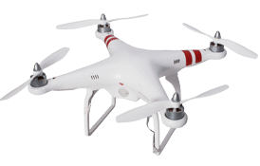
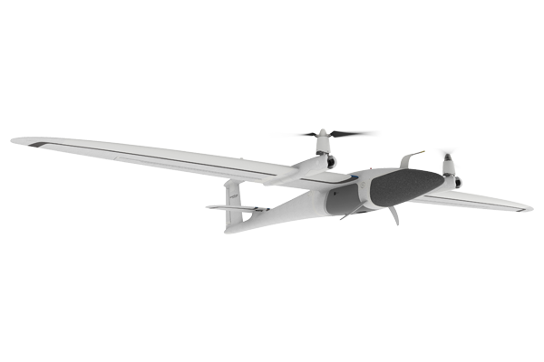
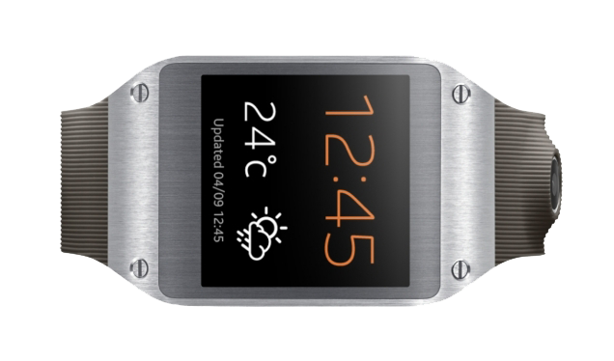
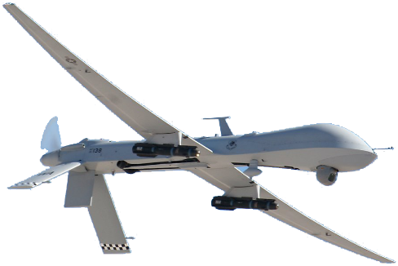


Deployment of Groups
Unmanned Aerial Vehicle Swarm
Body Area Network
Drone
UAV
Implant
Wearable
Controller
Hub
UAV
Wearable
Leader
Battlefield Network

Slide 3
Trust Establishment in a Group Setting
D₁
D₃
A
D₂
M
Securely pair a group of devices with a hub
By the end of the device pairing
Each D_{i} has achieved mutual authentication with A
Each D_{i} and A share a common key

Slide 4
Existing Solutions for Trust Establishment
password
password
exchange key primitives
D
A
K_{D,A}
K_{D,A}
Secret-based:
Manually enter a password to the device
Preload a key to each device
Secret-free:
Execute a Diffie-Hellman (DH) key exchange – Vulnerable to MitM
Perform out-of-band verification (light, sound, etc.) – requires advanced interfaces
Context-based verification techniques – requires multiple sensor modalities
In-band verification techniques – only require a common RF interface

Slide 5
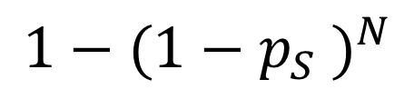

Extension of Secure Pairing Methods to Groups
$$p_{S}:$$
𝑆𝑢𝑐𝑐𝑒𝑠𝑠 𝑝𝑟𝑜𝑏𝑎𝑏𝑖𝑙𝑖𝑡𝑦
𝑓𝑜𝑟 𝑜𝑛𝑒 𝑝𝑎𝑖𝑟𝑖𝑛𝑔
$$1−{(1−p_{S} )}^{N}$$

Slide 6
Threat Model
D₁
D₃
A
D₂
M
M
M
Means: Aware of the channel between D_{i} and A (predictable and relatively stable)
Aware of the D_{i} – M and M – A channels
Can synchronize with D_{i} (by listening to preambles)
Can perform overshadowing and/or signal cancellation attacks (worst-case adversary)

Slide 7


MitM Over Wireless – One Tx to One Rx
$$r_{D}$$
D
A
$$r_{M}$$
r_{M}
Im
M
r_{D}
Re
Overshadowing

Slide 8
MitM Over Wireless – One Tx to One Rx
1
1
0
0
0
$$r_{D}$$
D
0
0
0
1
1
$$r_{M}$$
A
Im
M
Adversary can lie anywhere on the ellipse
r_{D}
Re
$$d_{DM}+ d_{MA} − d_{DA}=\left(2w+1\right)\frac{λ}{2}, w=0,1,2,⋯$$
r_{M}
cancellation

Slide 9
MitM Over Wireless – One Tx to Two Rxs
$$d_{D_{1}M}+ d_{MA} − d_{D_{1}A}=\left(2w_{1}+1\right)\frac{λ}{2}, w_{1}=0,1,2,⋯$$
$$d_{D_{2}M}+ d_{MA} − d_{D_{2}A}=\left(2w_{2}+1\right)\frac{λ}{2}, w_{2}=0,1,2,⋯$$
D₁
A
Adversary can lie on an intersection point between the two ellipses
M
D₂

Slide 10
MitM Over Wireless – One Tx to Three Rxs
A
D₃
D₁
D₂
No intersection point between three or more ellipses sharing a focal point

Slide 11
MitM Over Wireless – Evaluation (One Tx to Three Rxs)
Experimental Setup
Cancellation probability was non-zero due to high ON slot detection threshold (-50dBm)

Slide 12


















VERSE – Message Exchange Phase
$$s= m_{1},m_{2}$$
$$s= m_{1}$$
$$s= m_{1},m_{2},m_{3},m_{A}$$
D₂
$$m_{2}$$
$$m_{1}$$
$$m_{2}$$
D₁
$$m_{1}$$
$$m_{2}$$
A
$$s= m_{1},m_{2},m_{3},m_{A}$$
$$s= m_{1},m_{2}$$
$$s= m_{1}$$
$$s= m_{1},m_{2}$$
$$s= m_{1}$$
$$s= m_{1},m_{2},m_{3},m_{A}$$
$$m_{1}$$
D₃
$$s= m_{1},m_{2}$$
$$s= m_{1}$$
$$s= m_{1},m_{2},m_{3},m_{A}$$

Slide 13



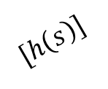
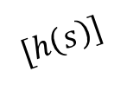


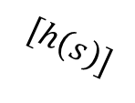
VERSE – Integrity Verification Phase
$$s= m_{1},m_{2},m_{3},m_{A}$$
D₂
$$[∙]$$
$$[h\left(s\right)]$$
$$[h\left(s\right)]$$
$$[h\left(s\right)]$$
D₁
$$[h\left(s\right)]$$
A
$$[h\left(s\right)]$$
$$[h\left(s\right)]$$
D₃

Slide 14














VERSE – Attack on the Message Exchange Phase
$$s_{M}= m_{M}$$
$$s_{M}= m_{M},m_{2},m_{3},m_{A}$$
D₂
$$m_{1}$$
$$s_{M}= m_{M}$$
$$m_{1}$$
$$s_{M}= m_{M},m_{2},m_{3},m_{A}$$
$$m_{M}$$
D₁
$$s= m_{1}$$
A
$$s= m_{1},m_{2},m_{3},m_{A}$$
$$m_{1}$$
$$m_{M}$$
D₃
$$m_{M}$$
$$s_{M}= m_{M},m_{2},m_{3},m_{A}$$
$$s_{M}= m_{M}$$
M
$$s_{M}= m_{M},m_{2},m_{3},m_{A}$$
$$s_{M}= m_{M}$$

Slide 15



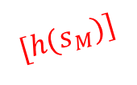
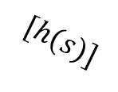


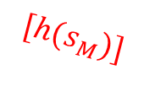

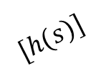

VERSE – Attack on the Integrity Verification Phase
D₂
$$s_{M}= m_{M},m_{2},m_{3},m_{A}$$
$$s= m_{1},m_{2},m_{3},m_{A}$$
$$[∙]$$
$$[h(s_{M})]$$
$$[h(s)]$$
D₁
$$[h(s)]$$
$$[h(s_{M})]$$
$$[h(s_{M})]$$
A
$$[h(s)]$$
$$[h(s_{M})]$$
$$[h(s_{M})]$$
D₃
M

Slide 16







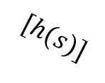


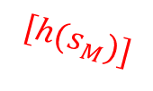


VERSE – Raising an Alarm
D₂
$$[∙]$$
$$[E]$$
$$[h(s_{M})]$$
$$[E]$$
$$[E]$$
$$[h(s)]$$
$$[h(s)]$$
$$[E]$$
D₁
$$[E]$$
$$[h(s_{M})]$$
A
$$[E]$$
$$[E]$$
$$[h(s_{M})]$$
D₃
M

Slide 17
Device Pairing with VERSE
D_{i}
A
Pick DH key primitive Pick DH key primitive
Transmit DH key primitive
Compile transmission Compile transmission
transcript transcript
Verify number of
participating devices
Transmit hash of transcript in ON-OFF keying
Verify no energy during Verify no energy during
OFF slots OFF slots
Generate pairwise key Generate pairwise key

Slide 18
Highlights of VERSE
PHY-layer integrity protection, resistant to advanced signal manipulation attacks (overshadowing, cancellation)
In-band bootstrapping for a group of devices without pre-shared secrets or advanced interfaces
Security derived from the presence of multiple devices, that are used to thwart MitM attacks over wireless
Security improves with the introduction of more devices – Harder to manipulate signals
Thank you

Slide 19
MitM Over Wireless – Experimental Evaluation
A
D₁
D
A
M
D₂
M
Cancellation Probability
Cancellation Probability
Cancellation probability close to one from the perfect position
Cancellation probability diminishes when the attacker moved from perfect position

Slide 20
Our Contributions
Proposed VERSE: a scalable in-band message integrity verification primitive, for group of devices that do not share any secrets
Analyzed security and showed using VERSE, signal cancellation attack becomes infeasible if three or more verifiers are present
Constructed VERSE assisted, DH-based authenticated bootstrapping protocol, resistant to MitM attacks based on signal cancellation
Implemented VERSE on the USRP testbed and validated the
effectiveness of the primitive in detecting message injections/modifications
adversary’s diminishing success in pairing rogue devices

Slide 21
Signal Manipulation Attack – Evaluation (1 TX to 1 RX)
Experimental Result
Experimental Setup

Slide 22
Signal Manipulation Attack – Evaluation (1 TX to 2 RXs)
Experimental Setup
Experimental Results

Slide 23
VERSE – Initialization

Slide 24
VERSE – Attack on Initialization

Slide 25
VERSE – Transcript Exchange

Slide 26
VERSE – Raising Alarm on Adversary Detection

Slide 27



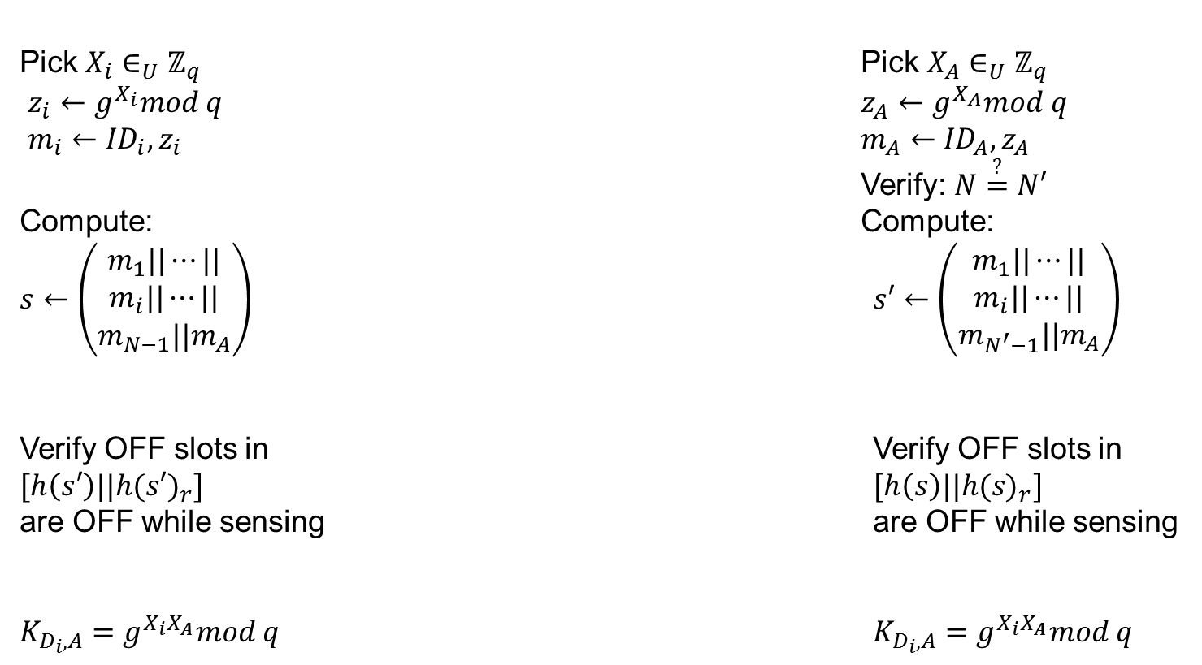






Device Pairing with VERSE
$$IDi, (G,q, g)$$
$$IDA, (G,q, g)$$
$$D_{i} ∀ i=1,⋯,N−1$$
$$A$$
Pick $X_{i}∈_{U}ℤ_{q}$ Pick $X_{A}∈_{U}ℤ_{q}$
$z_{i}←g^{X_{i}}mod q$ $z_{A}←g^{X_{A}}mod q$
$m_{i}←{ID}_{i},z_{i}$ $m_{A}←{ID}_{A},z_{A}$
Verify: $N\overset{?}{=}N′$
Compute: Compute:
$s←\left(\begin{aligned}m_{1}||⋯|| \\ m_{i}||⋯|| \\ m_{N−1}||m_{A}\end{aligned}\right)$ $s′←\left(\begin{aligned}m_{1}||⋯|| \\ m_{i}||⋯|| \\ m_{N^{′}−1}||m_{A}\end{aligned}\right)$
Verify OFF slots in Verify OFF slots in
$[h\left(s′\right)||{h(s′)}_{r}]$ $[h\left(s\right)||{h(s)}_{r}]$
are OFF while sensing are OFF while sensing
$K_{D_{i},A}=g^{X_{i}X_{A}}mod q$ $K_{D_{i},A}=g^{X_{i}X_{A}}mod q$
$$mi$$
$$mA$$
$$[h\left(s\right)||{h(s)}_{r}]$$
$$[h\left(s′\right)||{h(s′)}_{r}]$$

Slide 28
Synchronization Error During ON-OFF transmission

Slide 29
Synchronization Error – Evaluation
Experimental Setup
Experimental Results

