Slide 1

Verifying ADS-B Navigation Information Through Doppler Shift Measurements
Nirnimesh Ghose and Loukas Lazos
Department of Electrical and Computer Engineering,
University of Arizona
Presented at:
34th Digital Avionics Systems Conference, Prague

Slide 2
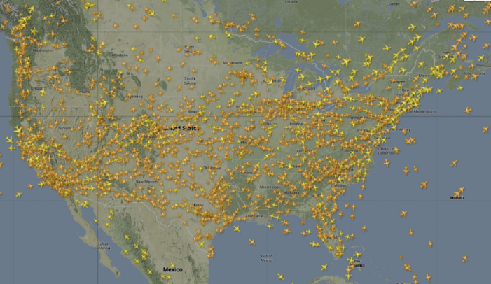
Air Traffic Growth
Air traffic continues to grow to unprecedented volume
NextGen system is expected to modernize air traffic management and cope with congestion, safety, and cost

Slide 3
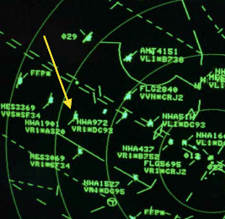
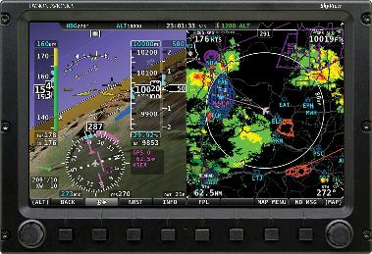
Migration from Radar to NextGen
Radar system
Automatic Dependent Surveillance – Broadcast
(ADS-B)
Uncooperative
Independent analogue system
Ground station dependent
Expensive to deploy and maintain
Coarse navigation information
Cooperative
Dependent digital system
Aircraft-to-aircraft communications
Cheaper to deploy and maintain
Fine-grained navigation information

Slide 4



ADS-B Architecture
Location from GPS
Location from GPS
ADS-B In
Navigation Information:
Location, Speed, Heading etc.
ADS-B Out
ADS-B Out
Air Traffic Controller

Slide 5
ADS-B Frame Format
DF: Downlink Format
CA: Message Subtype
AA: ICAO aircraft address
ME: Data frame
FI: Flight Identification Pos: Position PI: Position Integrity BGA: Barometric and geometric Altitude VR: Vertical Rate
TAGS: Track Angle and Ground Speed EI: Emergency Indication SPI: Special Position Indication
PI: Parity check

Slide 6
(In)Security of ADS-B
ADS-B standard does not provision for secure communications
No sender authentication
No message integrity
Weak location verification between aircraft and ground stations
Numerous vulnerabilities have been demonstrated
Costin and Francillon [1] experimentally demonstrated eavesdropping, message injection, replaying, jamming, using a USRP and COTS components
Sampigethaya et al. [2] have enumerated eavesdropping, jamming, aircraft impersonation, active manipulation of data, and others.
Krozel et al. [3] have proposed the use of intent conformance and geometric conformance to verify the integrity of ADS-B signals
[1] Costin, Andrei, and Aurélien Francillon. "Ghost in the Air (Traffic): On insecurity of ADS-B protocol and practical attacks on ADS-B devices." Black Hat, USA
(2012).
[2] Sampigethaya, Krishna, et al. "Future e-enabled aircraft communications and security: The next 20 years and beyond." Proc. of the IEEE 99.11 (2011):
2040-2055.
[3] Krozel, Jimmy, et al. "Aircraft ADS-B Data Integrity Check." Proc. of the AIAA Aviation, Technology, Integration, and Operations Conference (2004).

Slide 7








Fundamental Security Problems in ADS-B
Sender Authentication (point-to-point, broadcast)
Message Integrity
Freshness
Resistance to Jamming
Crypto solutions readily available
ADS-B In
ADS-B Out
ADS-B Out
Air Traffic Controller

Slide 8
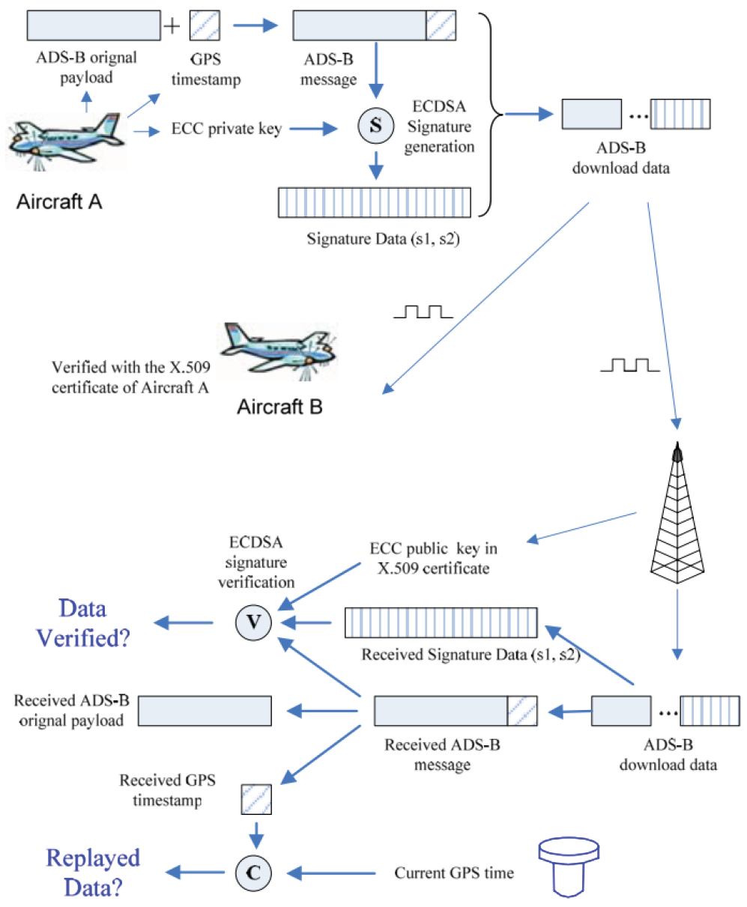
ADS-B Security using Classic Cryptography
Requires worldwide key management
Key establishment, revocation, refresh, certificate management, etc.
Requires substantial revision of the existing standard
Can we verify ADS-B broadcasts
without crypto?
Strohmeier, Martin, Vincent Lenders, and Ivan Martinovic. "Security of ADS-B: State of the Art and Beyond." arXiv preprint (2013).

Slide 9
Our Contributions
We propose a PHY-layer based mechanism for verifying the integrity of ADS-B navigation information without modifying the ADS-B standard
Verification of the aircraft’s position and velocity, by exploiting the Doppler spread phenomenon
Malicious ground station cannot spoof a “ghost" aircraft by transmitting ADS-B frames containing rogue navigation vectors
Defeating our verification method is equivalent to forging signatures in unbalanced oil and vinegar signature schemes

Slide 10
Problem Statement
Spoofed Trajectory
B
A
n_{B}= {l_{B}, v_{B}}
Navigation Information:
n_{X} = {l_{X}, v_{X}}
n_{A} = {l_{A}, v_{A}}
Position
Velocity
Rogue transmitter G
Verify navigation information from an aircraft

Slide 11

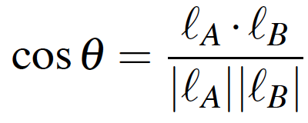
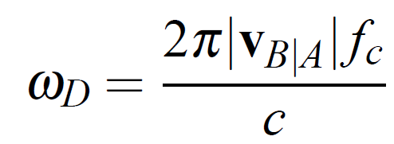
Velocity and Position Verification
Velocity and position are inter-connected via Kinematic equations
Doppler spread is calculated from velocity and carrier frequency

Slide 12
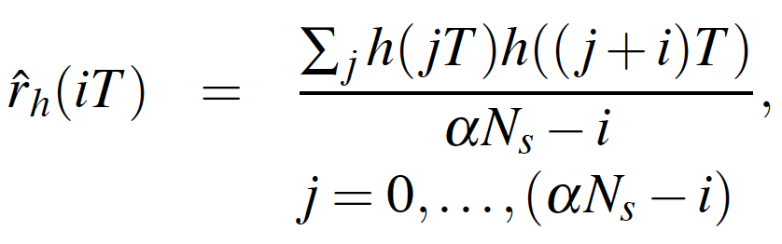
Maximum Doppler Spread Estimation
B
A
Estimate Doppler Spread
We estimate the Doppler spread using channel correlation measurements [Tepedelenlioglu and Giannakis, 2001]*
Based on averaging M+1 samples
*Tepedelenlioğlu, Cihan, and Georgios B. Giannakis. "On velocity estimation and correlation properties of narrow-band mobile communication channels.“ Vehicular Technology, IEEE Transactions on 50.4 (2001): 1039-1052.

Slide 13
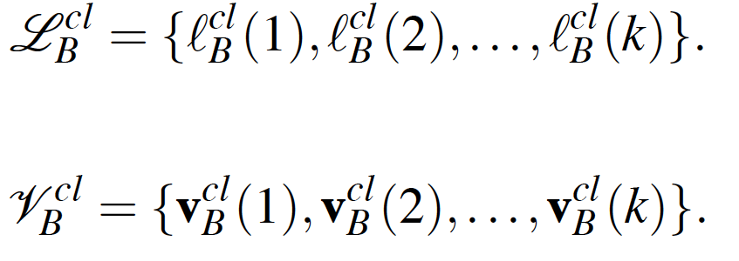
Verification Process: Step 1
Claimed Trajectory
B
A
1
2
…
k
Claimed location and velocity vectors received by verifier (A)

Slide 14
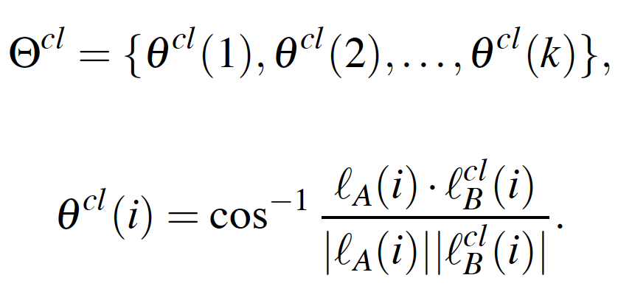
Verification Process: Step 2
Claimed Trajectory
B
A
1
2
…
k
Claimed heading estimated by the verifier (A)

Slide 15
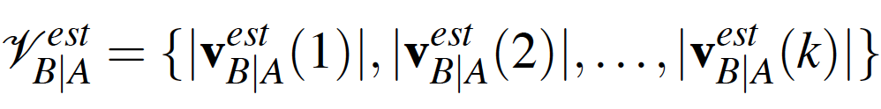
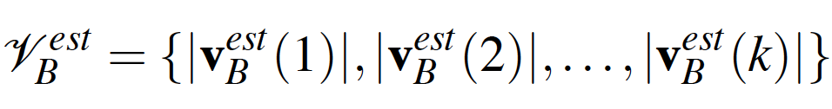
Verification Process: Step 3
Claimed Trajectory
B
A
1
2
…
k
Velocity of prover (B) estimated from Doppler spread by verifier (A)

Slide 16
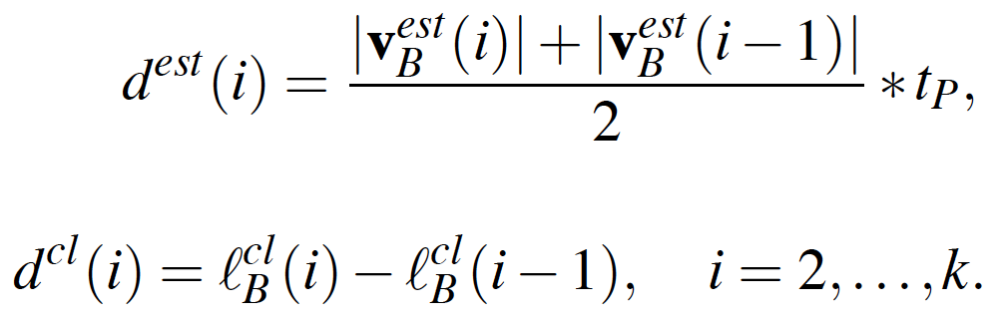
Verification Process: Step 4
Claimed Trajectory
B
A
1
2
…
k
Estimated and claimed distance covered by prover (B) in inter-frame time (t_{P})

Slide 17
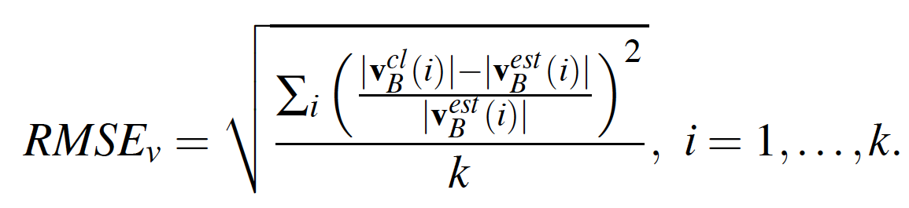
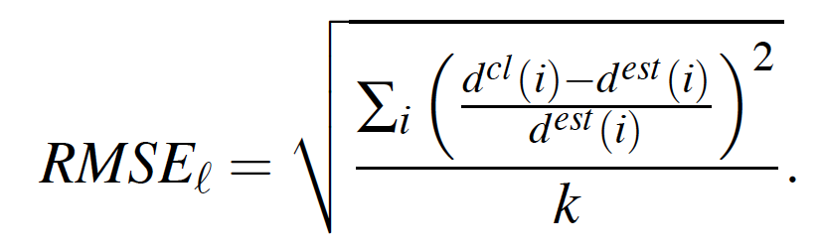
Verification Process: Step 5
Claimed Trajectory
B
A
1
2
…
k
RMSE for velocity and location estimated by verifier (A)

Slide 18
Security Analysis: Spoofing a Desired Trajectory
h_{BA}
Claimed Trajectory
B
A
l_{B}(1)
l_{B}(2)
…
l_{B}(k)
v_{B|A}(1)
v_{B|A}(2)
…
v_{B|A}(k)
h_{GA}
ω_{D}(1)
ω_{D}(2)
…
ω_{D}(k)
n_{A} = {l_{A}, v_{A}}
preamble
Rogue transmitter G

Slide 19
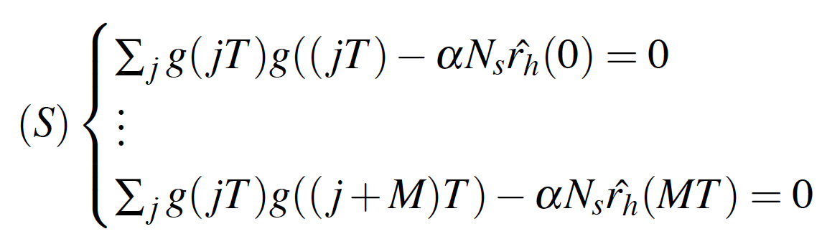




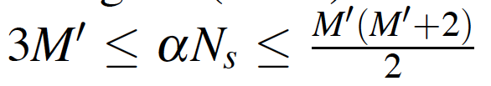
Security Analysis: Spoofing a Desired Trajectory
S, has many solutions Ψ due to underdefined nature of equation system
To spoof ω_{D}^{sp}, the rogue ground station needs to have a whole solution set
Equivalent to an “Oil” and “Vinegar” signature scheme [ Kipnis et al.]
M’ “oil” variables and αN_{S} - M’ “vinegar” variables
T_{S} symbol duration
T sampling period
Kipnis, Aviad, Jacques Patarin, and Louis Goubin. "Unbalanced oil and vinegar signature schemes." Advances in Cryptology—EUROCRYPT’99. Springer Berlin Heidelberg, 1999.

Slide 20
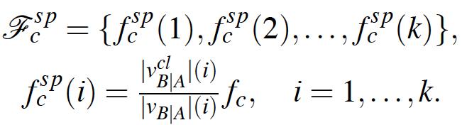
Security Analysis: Shifting the Central Frequency
For ADS-B scenario with f_{c} = 1090MHz and frequency offset upto 312.5KHz
Change in radial velocity is up to 0.03%

Slide 21
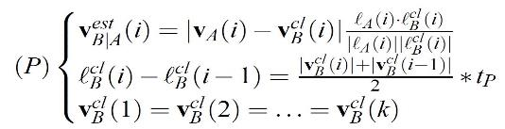
Security Analysis: Alt Trajectory for Max Doppler Spread

Slide 22
Evaluation: Simulation Setup
Two aircrafts model cruising at constant velocity of 900km/h
Symbol duration (T_{S} ) of 10⁻⁶ sec
A Rician channel with K-factor of 50 (LoS communication)
Doppler spectrum is simulated using Jake’s model
ADS-B preamble set to 8 symbols (N_{S} = 8), with a sampling period (T = 5 * 10⁻⁸ sec)
This gives us 16 equations with 16 “oil” variables and 134 “vinegar” variables

Slide 23
Evaluation: Scenario 1
Aircraft B proves its true trajectory to aircraft A
Distance between the aircrafts varies linearly from 130Km to 80Km which varies the number of captured frames (k) and record RMSE_{v} and RMSE_{l}

Slide 24
Evaluation: Scenario 1
Aircraft B proves its true trajectory to aircraft A
Distance between the aircrafts varies linearly from 130Km to 80Km which varies the SNR and record RMSE_{v} and RMSE_{l}

Slide 25
Evaluation: Scenario 2
A rogue ground station G spoofing a ghost aircraft B at aircraft A
Probability of success is measured for different values of captured frames (k)

Slide 26
Conclusion and Future Work
We proposed and PHY-layer navigation information verification scheme for ADS-B
An aircraft can verify the location and velocity of another aircraft
Exploited the Doppler spread to measure velocity
Showed that emulating a ghost aircraft is equivalent to solving underdefined quadratic equation system
Future Work:
Collusion of multiple ground stations to spoof a “ghost” aircraft
Emulates of a “ghost” aircraft by an airborne attacker
Verification in other flight phases such as takeoff and landing

Slide 27
Thank you!

