Slide 1
CSCE 436 – Advanced Embedded Systems
Lecture 29-31 – Lab 4 – Function Generation
Prof Jeffrey Falkinburg
Avery Hall 368
472-5120

Slide 2
Lesson Outline
Time Logs!
Lab 4 – Function Generation

Slide 3
Lab 4 – Function Generation

Slide 4
Lab 4 – Lab Goal
The goal of this lab is to generate an audio waveform with a high degree of accuracy in both its period and frequency.

Slide 5
Lab 4 – Lab Overview
You are to use Direct Digital Synthesis to reproduce your audio waveform.
  You may choose any waveform so long as its not Piecewise Linear.
  A few interesting examples would be sinusoids, the sinc function, exponentially damped sinusoids, or a waveform from a musical instrument (guitar, piano, or clarinet).

Slide 6
Lab 4 – Lab Overview Cont
It is your responsibility to get the samples for this waveform.
  I would suggest either deriving the waveform using a program like Python, using a spreadsheet, or digitizing the samples using Lab 3.
Once you have your data, hardwired it into BRAM using "init" statements. Consult the handout associated with lesson 26 for more details on how to accomplish this.

Slide 7
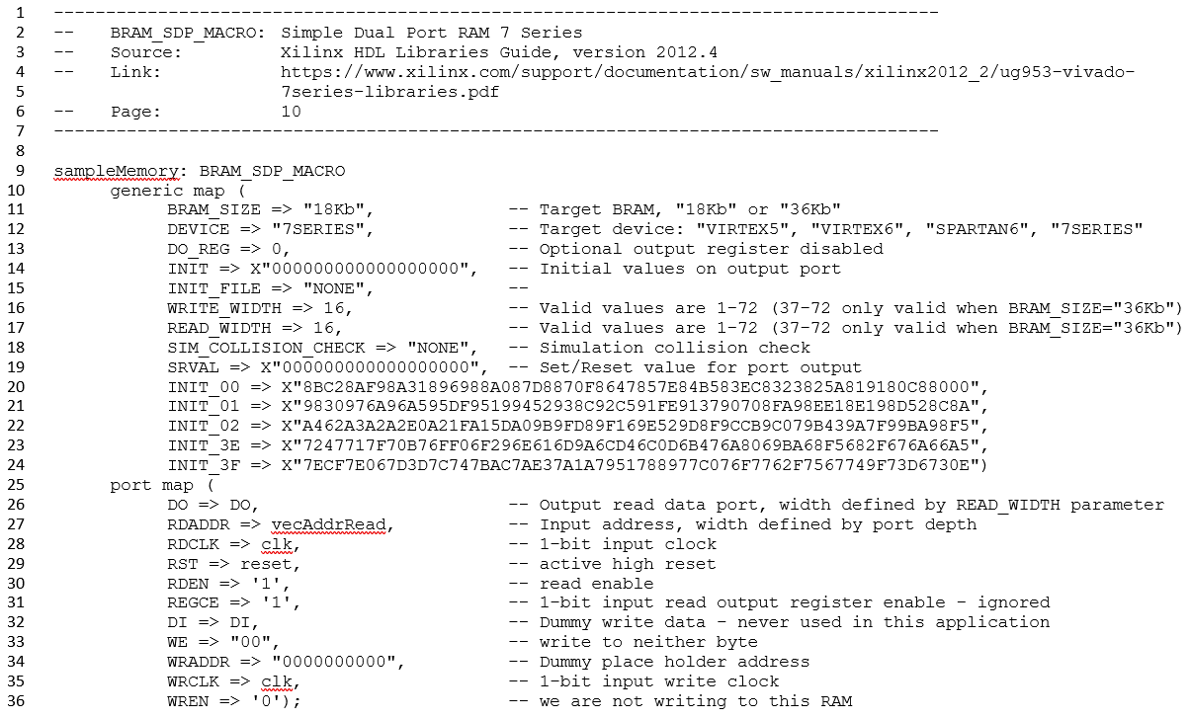
Initializing BRAM LUT from Lesson 26
Addr 9
Addr 1
Mem Addr 0
Addr 16
I skip rows 03 → 3D for brevity
Addr 1023 on Row 63

Slide 8

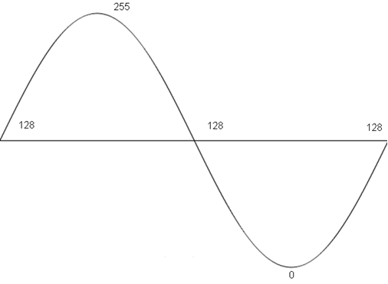

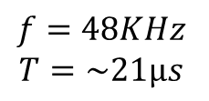
Lab 4 - Phase Increment
16-Bits Total
Keep In Mind we do have to convert DOUT back to a Signed Value (i.e. subtract 0x8000)
ctrl
Counter (unsigned)
BRAM_SDP
ctrl
Q
$$∙$$
Audio Codec Wrapper
10
6
Audio Out
RDADDR
Sin Wave in BRAM
Fractional steps previously trashed
will now be Offset
ready
Ready edge
L_bus_in
DOUT
18
$$f=48KHz$$
$$T=\sim 21μs$$

Slide 9
Lab 4 – Lab Requirements
While you have the flexibility to design the waveform generator as you see fit, your system must meet the following requirements:
  Use an update rate of 48kHz
  At 440Hz, the LUT should be incremented by about 1 index.
  Be able to make between a 1Hz and 0.25Hz change in frequency.
  Be able to generate a full amplitude waveform.

Slide 10
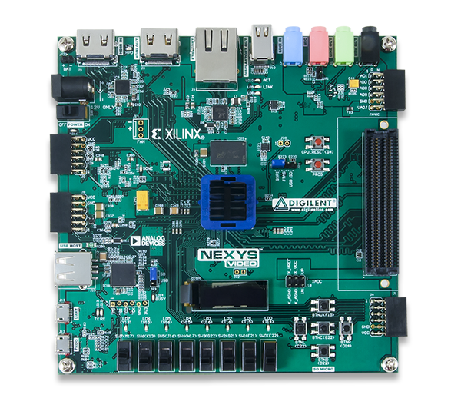
Lab 4 – Connections
HDMI Out
Audio
Input
Audio
Output
Power
CPU Reset
JB PMOD
Connector
For Test Signals
USB UART
Buttons
USB Prog
Switches

Slide 11
Lab 4 – Requirements
Required Functionality
Required Functionality
  Use the slide switches and push buttons to manipulate the phase angle and the amplitude of the waveform as follows:
    Pressing the left button should decrease the frequency of the waveform by the amount set on the slide switches.
    Pressing the right button should increase the frequency of the waveform by the amount set on the slide switches.
  The waveform should be played back through the Audio Codec interface. Remember to wait for the ready signal.

Slide 12
Lab 3 – Requirements
B-Level Functionality
B-level Functionality
  Achieve required functionality.
  Pressing the up button should increase the amplitude of the waveform by the amount set on the slide switches.
  Pressing the down button should decrease the amplitude of the waveform by the amount set on the slide switches.
  Pressing the center button should toggle between 2-different waveforms.

Slide 13
Lab 3 – Requirements
A-Level Functionality
A-level Functionality
  Use the microBlaze to capture a keyboard input to manipulate the amplitude and frequency. The user will enter in an integer frequency and you are to produce a waveform with that frequency.
  Don’t overcomplicate this…
    If you set up one slave register for an external select
    The other slave register would update your Phase index value
    All frequency calculations will be done in C-Code

Slide 14
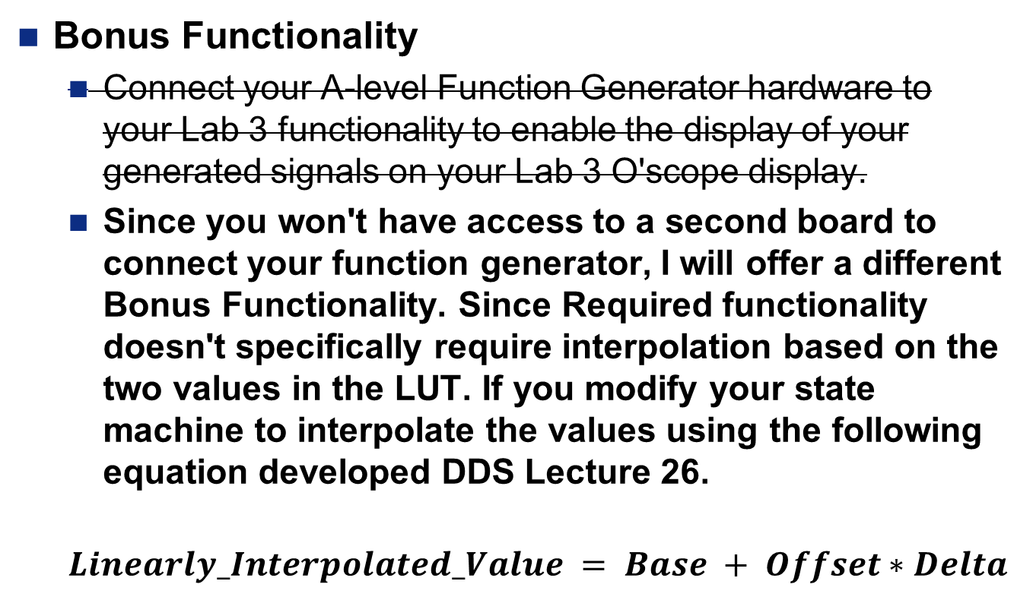
Lab 3 – Requirements
Bonus Functionality
Bonus Functionality
  Connect your A-level Function Generator hardware to your Lab 3 functionality to enable the display of your generated signals on your Lab 3 O'scope display.
  Since you won't have access to a second board to connect your function generator, I will offer a different Bonus Functionality. Since Required functionality doesn't specifically require interpolation based on the two values in the LUT. If you modify your state machine to interpolate the values using the following equation developed DDS Lecture 26.
  $$Linearly_Interpolated_Value = Base + Offset∗Delta$$

Slide 15
Lab 4 – Requirements
Gate Check 1
Gate Check 1
  At the end of the first lab session, you should have a completed hardware diagram drawn in paint or another image editing software that is readable and can be printed onto an 8.5x11 sheet of paper. Provide me with a digital copy of your schematic via Canvas at the end of class. This diagram must contain the following:
    A border defining the top-level entity. Borders for each of the components instantiated within the top-level entity.
    All components must be named in the upper left corner.
    All signals entering and exiting components must have their port name defined just inside the border.
    All signals outside the components must have their width defined as well as be labeled with their names.

Slide 16
Lab 4 – Requirements
Gate Check 2
Gate Check 2
  At the end of the second lab period, you should have a working testbench. When simulating your design, have the testbench supply a mock ready signal in place of the ready signal generated the Audio_Codec_Wrapper (when put in a testbench, the Audio_Codec_Wrapper is not able to generate a ready signal without a lot of extra work).

Slide 17
Lab 4 – Requirements
Gate Check 2 Cont 1
Gate Check 2
  When complete, I expect your timing diagram to look like the image below and contain at least:
    clk
    reset
    ready (simulated using CSA statements in testbench)
    FSM state
    BRAM address
    Phase increment
    BRAM data out
    Amplitude coefficient (if aiming for B or A functionality)
    Multiplied data out (if aiming for B or A functionality)
    Slide switches
    Button values

Slide 18
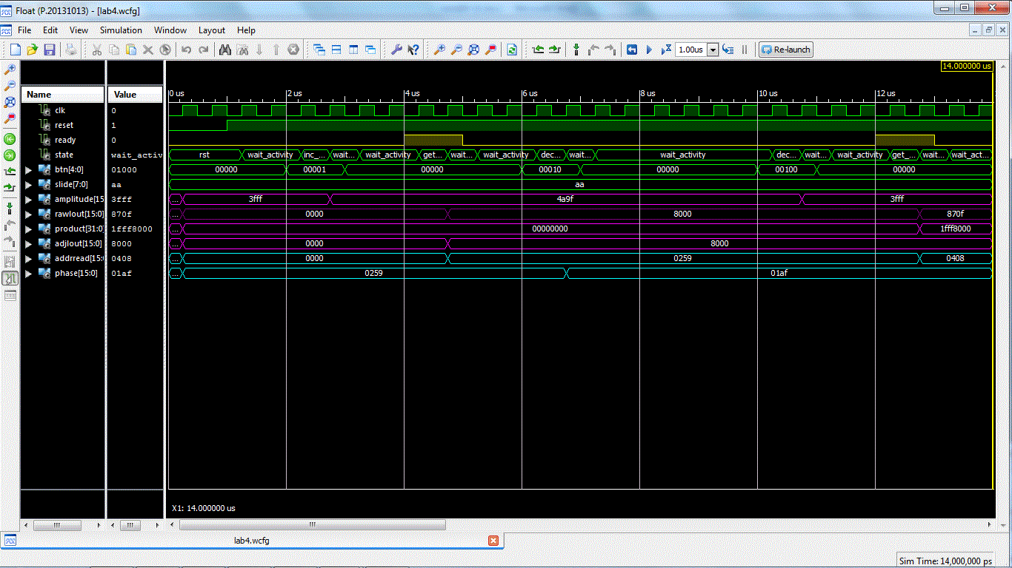
Lab 4 – Requirements
Gate Check 2 Cont 2
Gate Check 2
  Your simulation needs to simulate a button press (and release) to change the phase increment. After that is done, you need to show that the BRAM address is being incremented by your new phase increment value.
if right_button then
phase_inc <= phase_inc + (x"00" & switches);
if up_button then
amplitude <= amplitude + (x"0" & switches & x"0");

Slide 19
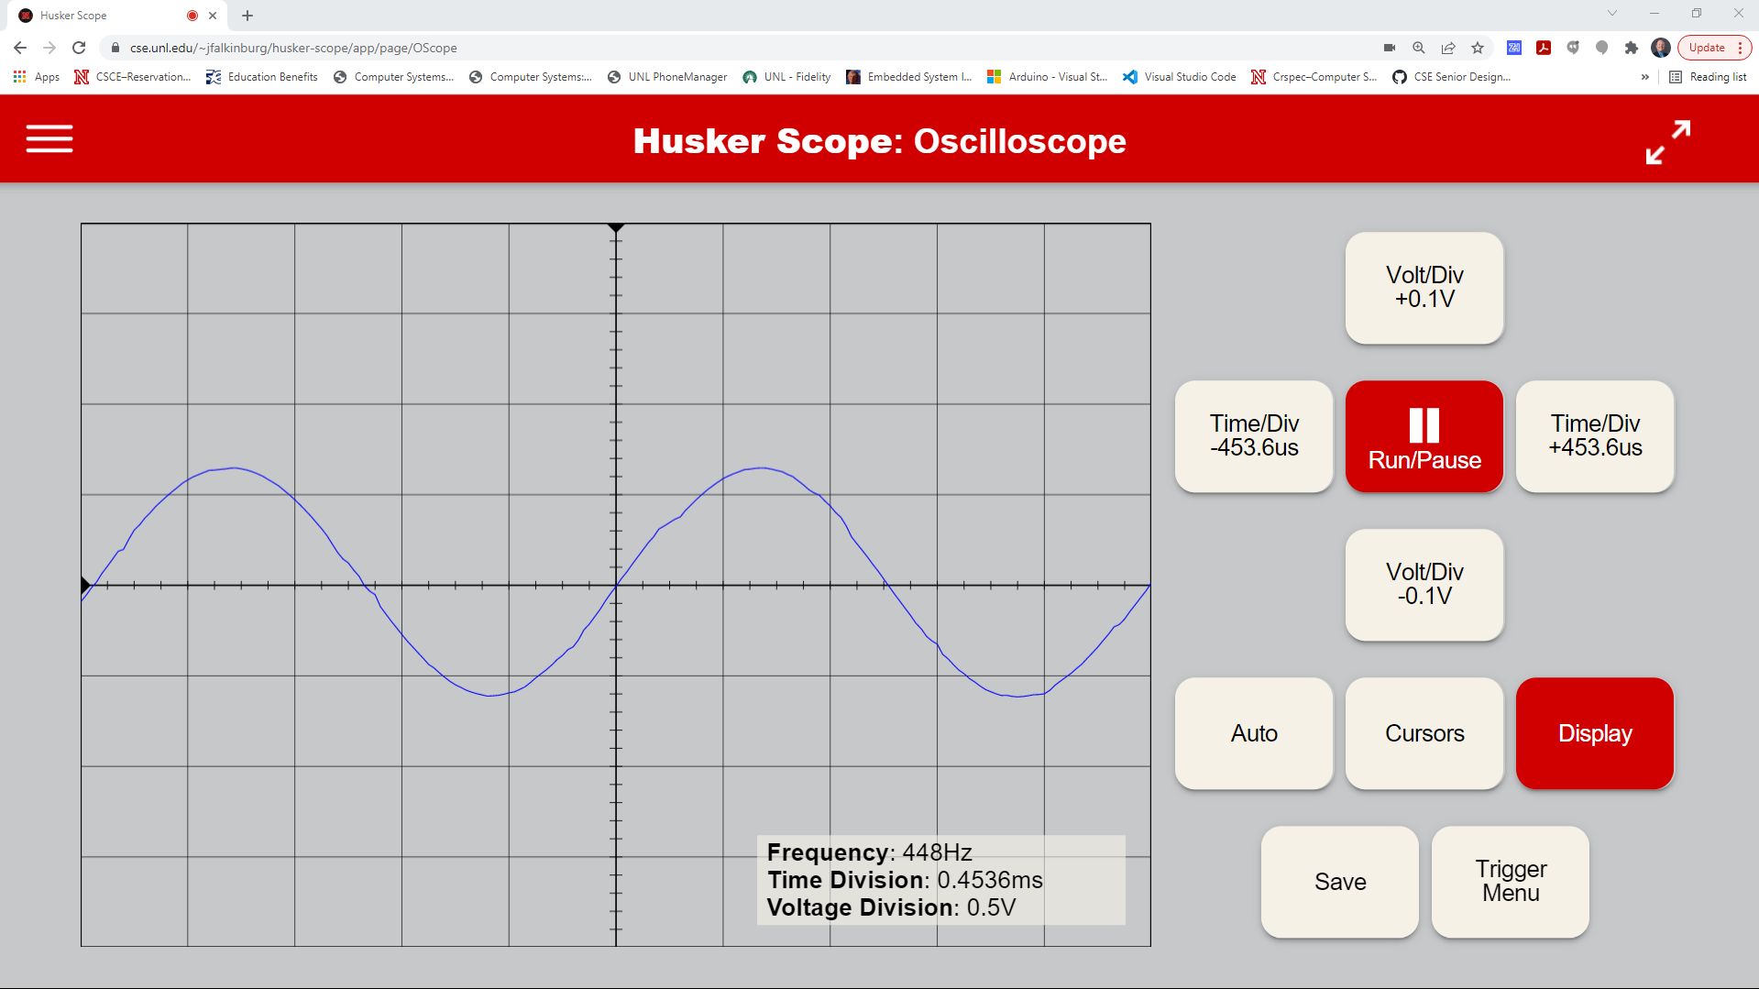
Lab 4 – Example Output 1
Example Output 1
  Sin Wave LUT on huskerscope.com/app

Slide 20
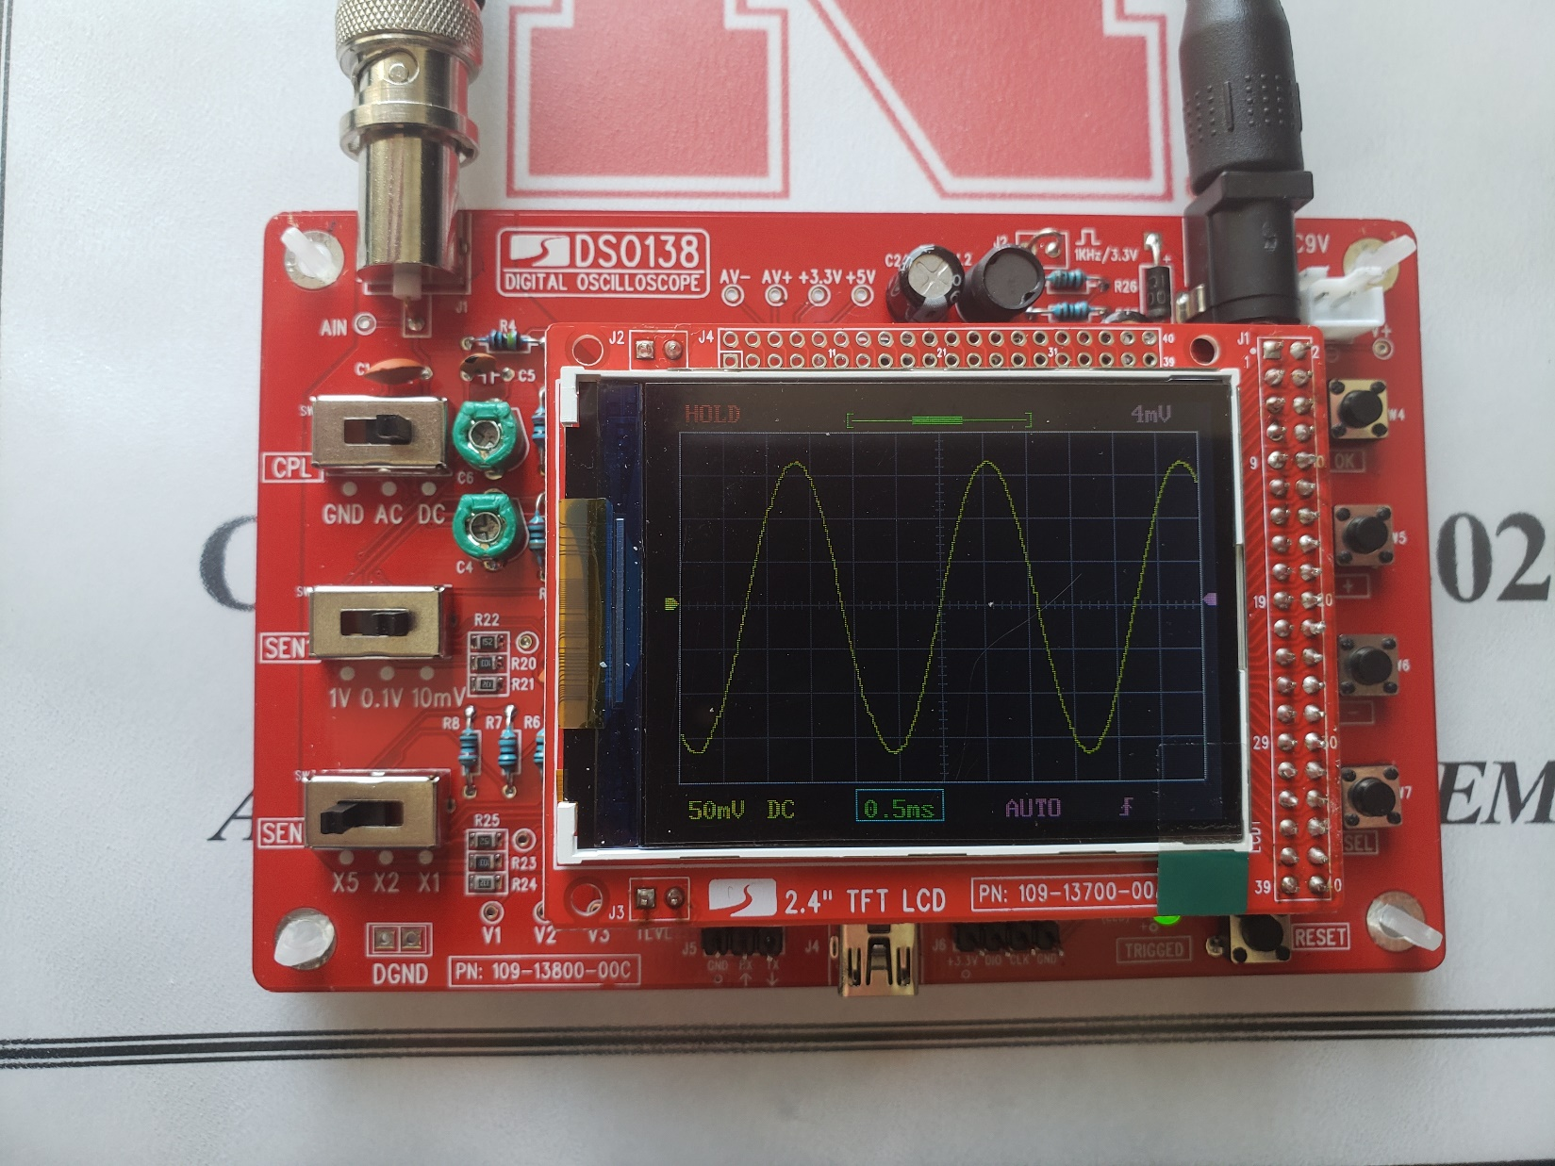
Lab 4 – Example Output 1
Example Output 1
  Sin Wave LUT

Slide 21

Lab 4 – Example Output 1
Example Output 1
  Similar to Heartbeat LUT on huskerscope.com/app

Slide 22
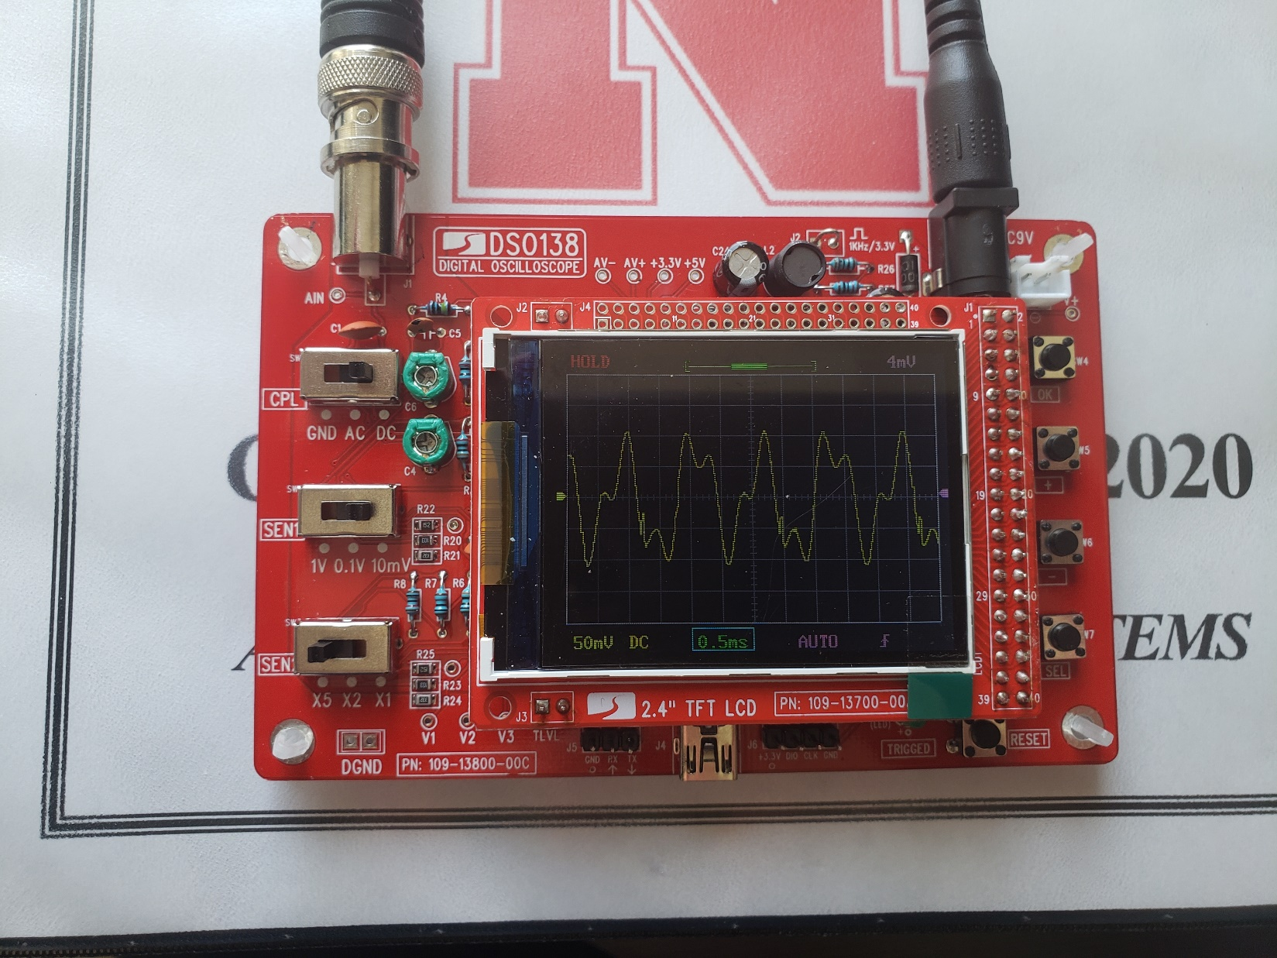
Lab 4 – Example Output 2
Example Output 2
  Similar to Heartbeat LUT

