Slide 1
CSCE 436 – Advanced Embedded Systems
Lecture 21-25 – Lab 3 – Software control of a datapath
Prof Jeffrey Falkinburg
Avery Hall 368
472-5120

Slide 2
Lesson Outline
Lab 3 – Software control of a datapath

Slide 3
Lab 3 – Software control of a datapath

Slide 4
Lab 3 – Lab Overview
Lab Overview - In this lab we will integrate the video display controller developed in Lab 2 with the MicroBlaze processor built using the fabric of the FPGA. In the preceding lecture we have learned about the EDK and SDK tool chains, now its time to put that knowledge to the test by building a software controlled datapath. Lab 2 revealed some shortcomings of our oscilloscope that this lab intends on correcting. Specifically, we will add:
  A Horizontal trigger point
  Ability to enable and disable channels to display
  Ability to trigger off channel 2
  Ability to change the slope direction for the trigger.

Slide 5
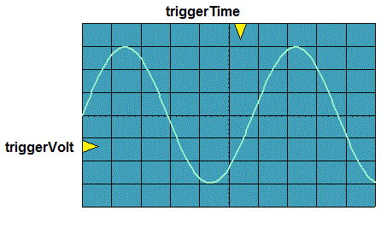
Lab 3 – Lab Overview
The following figure shows required functionality - your program should allow the user to change the position of the triggerVolt and triggerTime indicators with the result that the waveform should be drawn so that the periodic waveform is increasing through that voltage at that time.

Slide 6
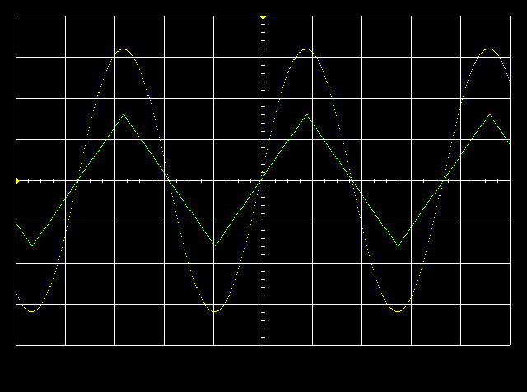
Lab 3 – Lab Overview
The following figure shows required functionality - your program should allow the user to change the position of the triggerVolt and triggerTime indicators with the result that the waveform should be drawn so that the periodic waveform is increasing through that voltage at that time.

Slide 7
Lab 3 – Architecture
Artix 7 (design_1 for Lab 3)
AA19
V18
axi_uartlite_0 @ 40600000
RX
RX
Top Level
TX
TX
User Logic
my_oscope_ip_v2_0.vhd @ 0x44a00000
MicroBlaze
Design_1.xdc
axi_lite
my_oscope_ip_v2_0_S00_AXI.vhd
Lab3.c
R4
G4
S_AXI_ACLK
Lab2_dp.vhd
clk
clk
reset_n
S_AXI_ARESETN
reset_n
32x32
main()
slv_reg0 → 31
To/From Microblaze
Lab2 Signals
myISR()
Interrupt
ready
Lab2.xdc
cw
sw
Pins off
chip
Lab2_fsm.vhd
Signals going In/Out of Artix 7 Chip
Nets to Pins

Slide 8
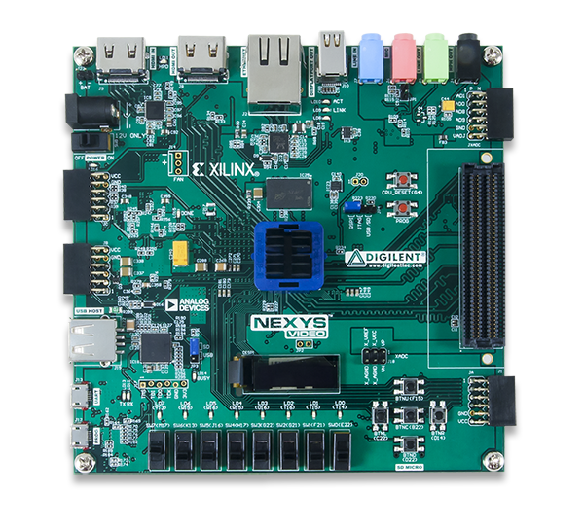
Lab 3 – Connections
HDMI Out
Audio
Input
Audio
Output
Power
CPU Reset
JB PMOD
Connector
For Test Signals
USB UART
Buttons
USB Prog

Slide 9
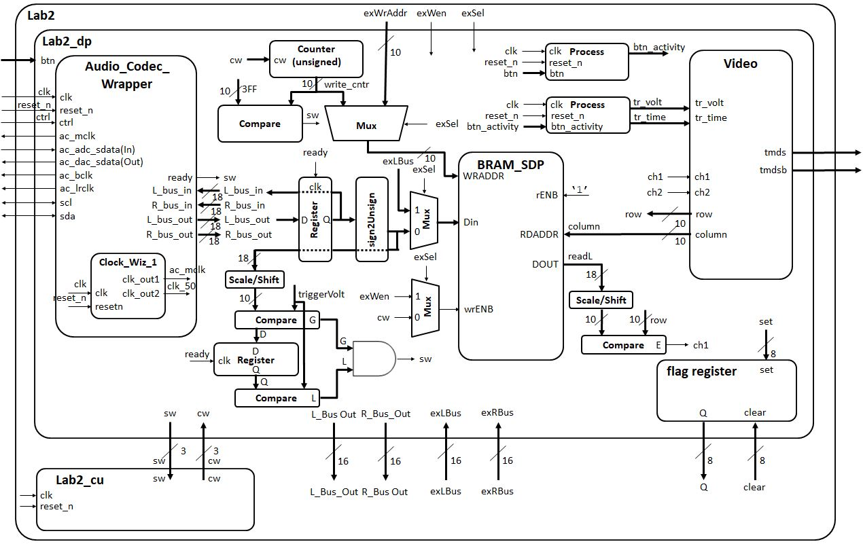
Lab 2 – Architecture
Expansion/Setup for Lab 3
Register connections for Lab 3 soft core connections

Slide 10
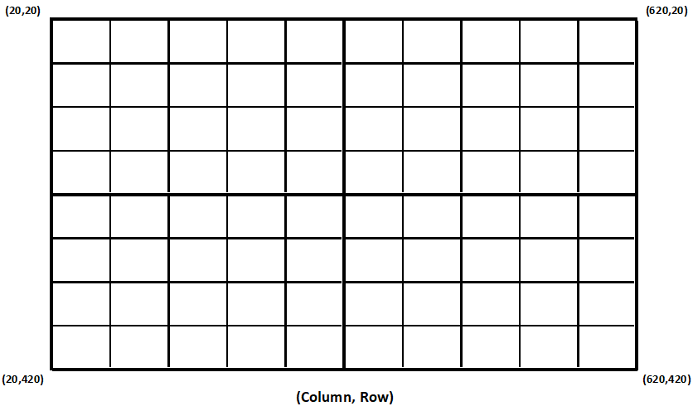
Lab 3 – Lab Overview
tr_time
tr_volt

Slide 11
Lab 3 – Lab Overview
tr_time
tr_volt
Row Value
 |  |  |  |  |  |  |  |  |  |  | Left and Right Channel in MicroBlaze Array
0 | 1 | 2 | 3 | 4 | 5 | 6 | 7 | 8 | 9 | 10 | … |  |  |  |  |  |  |  |  |  |  |  |  |  |  |  | … | 1023
20 | 30 | 40 | 50 | 60 | 70 | 80 | 70 | 60 | 50 | 40 | Left and Right Channel in MicroBlaze Array
0 | 1 | 2 | 3 | 4 | 5 | 6 | 7 | 8 | 9 | 10 | … |  |  |  |  |  |  |  |  |  |  |  |  |  |  |  | … | 1023
Column

Slide 12
Lab 3 – Architecture
Artix 7 (design_1 for Lab 3)
AA19
V18
axi_uartlite_0 @ 40600000
RX
RX
TX
TX
my_oscope_ip_v2_0.vhd @ 0x44a00000
MicroBlaze
Design_1.xdc
axi_lite
my_oscope_ip_v2_0_S00_AXI.vhd
Lab3.c
R4
G4
S_AXI_ACLK
Lab2_dp.vhd
clk
clk
reset_n
S_AXI_ARESETN
reset_n
32x32
main()
slv_reg0 → 31
To/From Microblaze
Lab2 Signals
myISR()
Interrupt
ready
Lab2.xdc
cw
sw
Pins off
chip
Lab2_fsm.vhd
Signals going In/Out of Artix 7 Chip
Nets to Pins

Slide 13
Lab 3 – UART Note
Note: In your program, you may want to check if the users has hit the key on the keyboard without having to actually read the key. For these cases the following command will prove useful. Note that "uartRecReg" is a constant, the address of the uart.
XUartLite_IsReceiveEmpty(uartRecReg);

Slide 14
Lab 3 – Hardware
With the expectation of the following engineering change orders (ECO) in the table below, the hardware you developed in lab2 will be unchanged. For the following ECO, please refer to the high-level architecture in lab 2.
Name: | Trigger Voltage, Trigger Time
Scope: | lab2_dp and lab2
Type: | Change to the entity descriptions.
Details: | Add the triggerVolt and triggerTime signals as inputs to the lab2_dp entity description. Inside the lab2_dp component, update the logic driving the triggerVolt and triggerTime signals with an extra condition when exSel = ‘1’ to take in the external triggerVolt and triggerTime values as inputs from the MicroBlaze. Drive the triggerTime and triggerVolt inputs on the video component with the corresponding signals on the lab2_dp entity if exSel =‘1’ and the original Lab 2 buttons configuration when exSel = ‘0’.

Slide 15
Lab 3 – Hardware
With the expectation of the following engineering change orders (ECO) in the table below, the hardware you developed in lab2 will be unchanged. For the following ECO, please refer to the high-level architecture in lab 2.
Name: | Trigger Voltage, Trigger Time
Scope: | lab2_dp and lab2
Type: | Change to the entity descriptions.
Details: | Inside the lab2_dp component, remove the logic driving the triggerVolt and triggerTime signals into the video component. Remove the buttons signal from the lab2 and lab2_dp entities. Remove the buttons signal from the xdc file. Add the triggerVolt and triggerTime signals to the lab2 and lab2_dp entity descriptions. Drive the triggerTime and triggerVolt inputs on the video component with the corresponding signals on the lab2_dp entity.

Slide 16
Lab 3 – Signals
Your first step will be to create a component for your lab2 component in your Vivado repository. This will require you to think about what signals are routed to the MicroBlaze and those going outside the Artix 7 chip.
To/From MicroBlaze | Outside Artix 7
exWrAddr | clk
exWen | reset
exSel | ac_mclk
L_bus_out, R_bus_out | ac_adc_sdata
exLbus, exRbus | ac_dac_sdata
flagQ | ac_bclk
flagClear | ac_lrclk
triggerTime | sda
triggerVolt | scl
ready (from Flag Reg) | tmds
 | tmdsb
 | btn

Slide 17
Lab 3 – Architecture
Artix 7 (design_1 for Lab 3)
AA19
V18
axi_uartlite_0 @ 40600000
RX
RX
TX
TX
my_oscope_ip_v2_0.vhd @ 0x44a00000
MicroBlaze
Design_1.xdc
axi_lite
my_oscope_ip_v2_0_S00_AXI.vhd
Lab3.c
R4
G4
S_AXI_ACLK
Lab2_dp.vhd
clk
clk
reset_n
S_AXI_ARESETN
reset_n
32x32
main()
slv_reg0 → 31
To/From Microblaze
Lab2 Signals
myISR()
Interrupt
ready
Lab2.xdc
cw
sw
Pins off
chip
Lab2_fsm.vhd
Signals going In/Out of Artix 7 Chip
Nets to Pins

Slide 18
Lab 3 – Software
All the memory mapped hardware registers will have their names setup as #define's with a name ending in "Reg".
Any register with bit fields will have the bit index setup as #define's with a name ending in "Bit".
The flagQ and flagClear registers need to be at the same address.

Slide 19
Lab 3 – Requirements
Gate Check 1
Gate Checks for Required Functionality
  There are 2 gate checks associated with this lab, each worth 5 points - see the rubric below.
Gate Check 1
  By the beginning of lesson 22, you need to have all of your Lab 2 functionality implemented with the Microblaze. That is, you need to export your Lab 2 design into the SDK and be able to achieve the same functionality as you did in Lab 2.

Slide 20
Lab 3 – Requirements
Gate Check 2
Gate Check 2
  By the beginning of lesson 23, you need to be able to send USART commands using Tera Term (or another terminal emulator) to your FPGA to adjust the trigger on the screen. The trigger on the screen should properly react to moving the trigger either up or down.

Slide 21
Lab 3 – Requirements
Required Functionality
Required Functionality
  In order to make required functionality you will need to properly trigger the oscilloscope on channel 1 using a positive edge trigger. Control of this process is to be performed using the MicroBlaze. The main tasks of the MicroBlaze will include:
    Moving audio samples into a pair of circular buffer. These circular buffers will be maintained in the address space of the MicroBlaze. That is you should have two big arrays defined in your program. Use polling of the ready bit of the flag register.
    Examining the samples looking for a trigger event.
    Fill the remaining sample slots in memory.

Slide 22
Lab 3 – Requirements
Required Functionality Cont 1
Required Functionality cont
    Move the appropriate buffer values into the display memory of the oscilloscope (lab2) component.
    Provide a user menu (through the terminal) allowing the user to adjust the trigger voltage and trigger time.

Slide 23
Lab 3 – Requirements
B-Level Functionality
B-level Functionality
  Achieve required functionality.
  Use the ready bit of the flag register to trigger an interrupt. The ISR should store the samples (left and right), look for a triggering even, and signal when the stored samples should be transferred to the BRAM in the oscilloscope component.

Slide 24
Lab 3 – Requirements
A-Level Functionality
A-level Functionality
  Achieve B-level functionality. Ability to enable and disable channels to display
  Ability to trigger off channel 2
  Ability to change the slope direction for the trigger.

Slide 25
Lab 3 – Requirements
Turn In
Turn In Requirements
  All your work in this lab is to be submitted using Bitbucket. The main part of the lab is your README, documenting your design.

