Slide 1
CSCE 436 – Advanced Embedded Systems Lecture 14–17 – Lab 2 – Data Acquisition, Storage and Display
Prof Jeffrey Falkinburg Avery Hall 368 472-5120

Slide 2
Lesson Outline
Lab 2 – Data Acquisition, Storage and Display

Slide 3
Lab 2 – Data Acquisition, Storage and Display

Slide 4
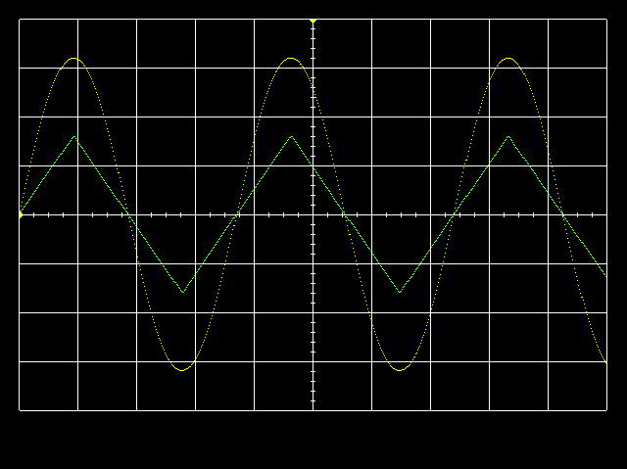
Lab 2 – Lab Overview
Lab Overview - Integrate the video display controller developed in Lab 1 with the audio codec on the Nexys Video board to build a basic 2-channel oscilloscope.

Slide 5
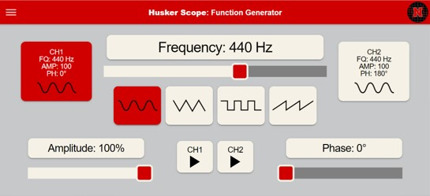

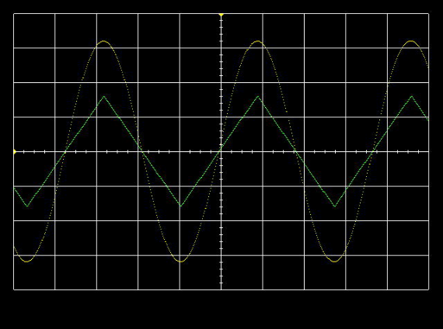
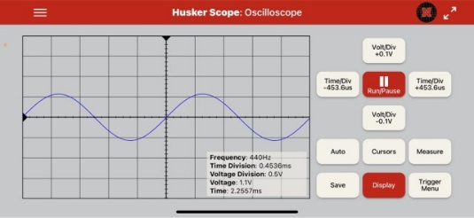
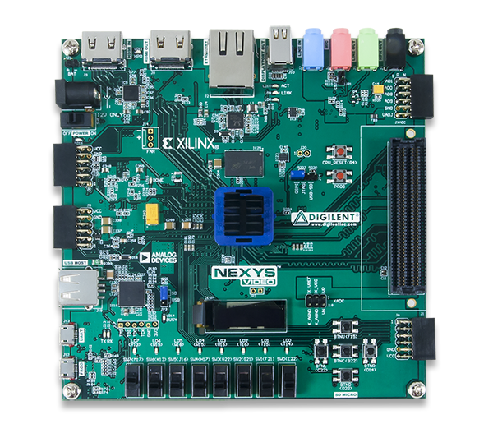
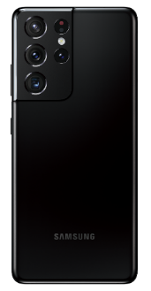
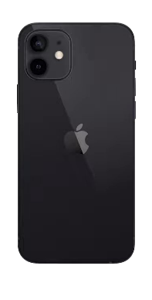







Husker Scope Interface Overview
HDMI Output
Advanced Embedded Systems Oscilloscope / Function Generator
3.5mm Audio Cable
Huskers Scope App

Slide 6


Husker Scope Website/Download QR Codes

Slide 7
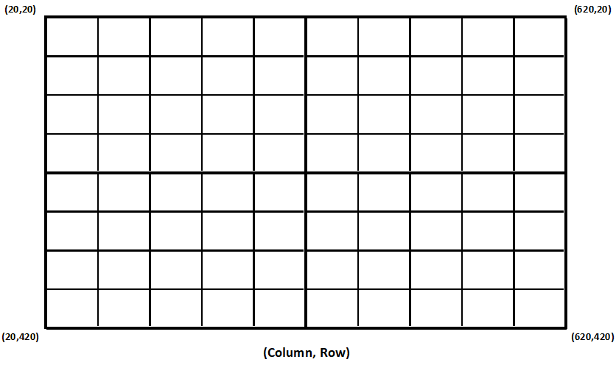
Lab 2 – Lab Overview
tr_volt

Slide 8
Lab 2 – Lab Overview
Left Channel BRAM Value
Row
=
Draw
Ch1
tr_volt
Right Channel BRAM Value
Row
=
Draw
Ch2
Row Value
 |  |  |  |  |  |  |  |  |  |  | Left and Right Channel in BRAM
0 | 1 | 2 | 3 | 4 | 5 | 6 | 7 | 8 | 9 | 10 | … |  |  |  |  |  |  |  |  |  |  |  |  |  |  |  | … | 1023
20 | 30 | 40 | 50 | 60 | 70 | 80 | 70 | 60 | 50 | 40 | Left and Right Channel in BRAM
0 | 1 | 2 | 3 | 4 | 5 | 6 | 7 | 8 | 9 | 10 | … |  |  |  |  |  |  |  |  |  |  |  |  |  |  |  | … | 1023
Column

Slide 9
Lab 2 – Lab Overview
Where do we want to start our BRAM count?
Probably @ Column = 20 ?
You can make the counter roll over from 1023 (0x3FF) to 20 instead of zero

Slide 10
Lab 2 – Connections
HDMI Out
Audio
Input
Audio
Output
Power
CPU Reset
JB PMOD
Connector
For Test Signals
Buttons
USB Prog

Slide 11
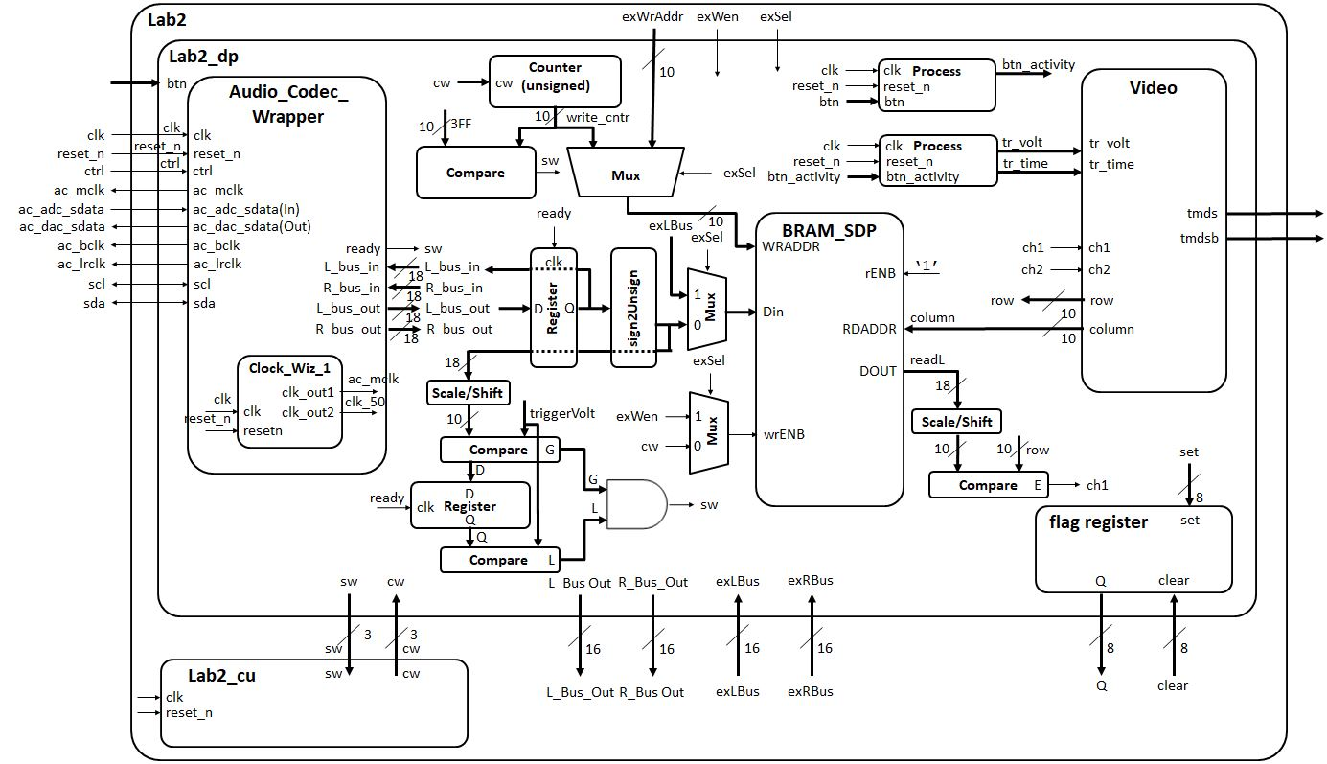
Lab 2 – Architecture

Slide 12
Lab 2 – Architecture Connecting things we already learned
Given
Lab 1 Code
Create!
Lecture 11
Given
Lecture 13
Just a multi-bit register
Create!
Comparators and Muxes can be implemented as a “When” statements
Registers are created with a process

Slide 13
Lab 2 – Architecture Datapath / Control Communication
cw
sw
sw
cw
sw
Status
Signals
Control Signals
Status Words | Control Words
Ready | Write_Enable (2)
Trigger | Count_ctrl (1 downto 0)
Max_Count

Slide 14
Lab 2 – Architecture Audio Codec Wrapper
Works very similar to the PS2 Keyboard from Lecture 12 and Homework #8

Slide 15
Lab 2 – ADAU1761 SigmaDSP Audio Codec
Analog Devices ADAU1761 SigmaDSP Audio Codec.
http://www.analog.com/media/en/technical-documentation/data-sheets/ADAU1761.pdf
1. Loop back L_bus_out and R_bus_out and listen on the HP_OUT Jack
process (clk)
begin
if (rising_edge(clk)) then
if reset_n = '0' then
L_bus_in <= (others => '0');
R_bus_in <= (others => '0');
elsif(ready = '1') then
L_bus_in <= L_bus_out;
R_bus_in <= R_bus_out;
end if;
end if;
end process;

Slide 16
Lab 2 – Connections
HDMI Out
Audio
Input
Audio
Output
Power
CPU Reset
JB PMOD
Connector
For Test Signals
Buttons
USB Prog

Slide 17
Lab 2 – Architecture Audio Codec Wrapper
Signed to Unsigned 18-Bit Conversion

Slide 18
Lab 2 – ADAU1761 SigmaDSP Audio Codec
Signed to Unsigned 18-bit Conversion:
2. Convert L_bus_out signal is to send it, in an unsigned format, to be stored in the block ram (BRAM).
Essentially, we can convert the std_logic_vector by typecasting to unsigned and then adding 131072
Input Value |  | Ouput Value
2's complement | 2's value | unsigned | unsigned value
100...000 | -131072 | 000...000 | 0
111...111 | -1 | 011...111 | 131071
000...000 | 0 | 100...000 | 131072
000...001 | 1 | 100...001 | 131073
011...111 | 131071 | 111...111 | 262143

Slide 19
Lab 2 – Architecture Datapath

Slide 20
Lab 2 – Datapath
entity lab2_datapath is
Port( clk : in STD_LOGIC;
reset_n : in STD_LOGIC;
ac_mclk : out STD_LOGIC;
ac_adc_sdata : in STD_LOGIC;
ac_dac_sdata : out STD_LOGIC;
ac_bclk : out STD_LOGIC;
ac_lrclk : out STD_LOGIC;
scl : inout STD_LOGIC;
sda : inout STD_LOGIC;
tmds : out STD_LOGIC_VECTOR (3 downto 0);
tmdsb : out STD_LOGIC_VECTOR (3 downto 0);
sw: out std_logic_vector(2 downto 0);
cw: in std_logic_vector (2 downto 0);
btn: in STD_LOGIC_VECTOR(4 downto 0);
exWrAddr: in std_logic_vector(9 downto 0);
exWen, exSel: in std_logic;
Lbus_out, Rbus_out: out std_logic_vector(15 downto 0);
exLbus, exRbus: in std_logic_vector(15 downto 0);
flagQ: out std_logic_vector(7 downto 0);
flagClear: in std_logic_vector(7 downto 0));
end lab2_datapath;

Slide 21
Lab 2 – Architecture Control Unit

Slide 22
Lab 2 – Control Unit
Here is the port map for the Control Unit:
entity lab2_fsm is
Port ( clk : in STD_LOGIC;
reset_n : in STD_LOGIC;
sw: in std_logic_vector(2 downto 0);
cw: out std_logic_vector (2 downto 0) );
end lab2_fsm;
Status Words | Control Words
Ready | Write_Enable (2)
Trigger | Count_ctrl (1 downto 0)
Max_Count

Slide 23
Lab 2 – Architecture Flag Register
Multi-bit register that bits can be set or cleared

Slide 24
Lab 2 – Flag Register
entity flagRegister is
Generic (N: integer := 8);
Port( clk: in STD_LOGIC;
reset_n : in STD_LOGIC;
set, clear: in std_logic_vector(N-1 downto 0);
Q: out std_logic_vector(N-1 downto 0));
end flagRegister;
reset_n | clk | set | clear | Q+
0 | X | X | X | 0
1 | 0,1,falling | X | X | Q
1 | rising | 0 | 0 | Q
1 | rising | 1 | 0 | 1
1 | rising | 0 | 1 | 0
1 | rising | 1 | 1 | X

Slide 25
Lab 2 – Flag Register
Your flag register will be set up as an 8-bit register that will take in two other values (set and clear) and conduct bitwise operations on them.
Just like in many registers you will have a signal named something like process_Q (interim Q value before being assign to the output Q).
On reset the process_Q will get set to zero, but on any other clock edge it will perform the following function:
process_Q OR set AND NOT clear (all bitwise operations)
That way if the input signals are say:
process_Q = 101
set = 010
clear = 001
Then the output would be Q = 110!

Slide 26
Lab 2 – Architecture Expansion/Setup for Lab 3
Register connections for Lab 3 soft core connections

Slide 27
VHDL Package file
Packages – Package for Lab 2
https://cse.unl.edu/~jfalkinburg/cse_courses/2026/436/lab/lab2/code/lab2_pack.vhdl
This is where you will put all your component declarations
Include this at the top of your file:
use work.lab2Parts.all; -- all my components are declared here

Slide 28
VHDL Code
Overall Lab 2 File: lab2.vhd
Lab 2 Datapath: Lab2_datapath_tb.vhd
Audio Codec Wrapper: Audio_Codec_Wrapper.vhd (Audio Codec Wraper for Xilinx Vivado)
i2s_ctl.vhd (I2S Transmitter portion of Audio Codec Wraper for Xilinx Vivado)
audio_init.v (Audio Initializer portion of Audio Codec Wraper for Xilinx Vivado)
TWICtl.vhd (TWI Controller portion of Audio Codec Wraper for Xilinx Vivado)
You need to add a clocking wizard for the Audio Codec and set the output frequencies to what is required (see comments in the Audio Codec Wrapper file).
Constraint file: Lab2.xdc

Slide 29
Lab 2 – Generating Audio Waveforms
Since you need to use a 3.5mm jack to input signals to the Nexys Video board, your phone's audio output works quite well. However, make sure you get an app where you can control both the left and right audio channels individually (i.e. the green and yellow signals in the figure above).
The Husker Scope app is an easy to use all-in-one cross platform (iOS, Android, and Web App) application that implements a Dual Channel Function Generator and Oscilloscope functionality for use in your lab

Slide 30
Lab 2 – Requirements Gate Check 1
Gate Checks for Required Functionality
There are 2 gate checks associated with this lab, each worth 5 points - see the rubric.
Gate Check 1
By COB Lesson 14, you must have started a Lab 2 Vivado project and downloaded the template files and drop in your Video, VGA, Scopeface, dvid, and tdms files from Lab 1 into your Lab 2 project in order to test your Lab 1 Scopeface works when you implement you Audio Code Wrapper. Notice from the block diagram…you will copy your Video instantiation and button processes from Lab 1 into your Lab 2 Datapath. You will also have to re-implement the Lab 1 Clocking Wizard in you Lab 2 project. Doing this will eliminate a lot of errors from un-driven output signals on lab 2 top.

Slide 31
Lab 2 – Requirements Gate Check 1
Gate Check 1
Next, you will need to have implement another Clocking Wizard and the Audio Codec Wrapper inside the Datapath entity to get your Audio Codec to begin functioning. Once you fully implement the Audio Codec Wrapper, you will drop in the Loopback process and make connections to loopback the serial ADC input back out to the DAC output (i.e. send the signal back into the Codec). Once you implement the design on the board, you can verify functionality by applying an audio signal to the audio line in jack (Blue) and listening to it on the audio line out jack (Green) using a standard oscilloscope. Additionally, your Scopeface and Button inputs from Lab 1 should be functional as well.

Slide 32
Lab 2 – Requirements Gate Check 2
Gate Check 2
NOTE: THIS IS THE HARDEST PART! By BOC Lesson 16, you must have implemented and connected the left channel BRAM and BRAM Address Counter to write Audio Codec data to BRAM. Once implemented, you can verify your BRAM works by using the given datapath testbench and watching the BRAM write address increment and data be written/read from the BRAM.

Slide 33
Lab 2 – Requirements Gate Check 2 Cont
Gate Check 2
Once this is working, you must implement Video entity (from Lab 1) to take the left channel output from BRAM and send it to the Channel 1 waveform to be displayed when the readL value equals the row value. Once implemented, this functionality can be verified first with the given datapath testbench to verify the channel 1 values are being updated properly when readL equals the row value. Additionally, you may try to implement this on the hardware and verify that your scopeface is still present and some values are being displayed for Channel 1 (at this point the waveform will be scrolling across the display or may be scaled wrong).

Slide 34
Lab 2 – Requirements Required Functionality
Required Functionality
Get a single channel of the oscilloscope to display with reliable triggering that holds the waveform at a single point on the left edge of the display. A 220Hz waveform should display something similar to what is shown in the screenshot at the top of the lab page. Additionally, you must have the following done:
Use a package file to contain all your component declarations.
Use separate datapath and control unit.

Slide 35
Lab 2 – Requirements Required Functionality Cont 1
Required Functionality
Your datapath must use processes which are similar to our basic building block (counter, register, mux, etc.). I do not want to see one massive process that attempts to do all the work in the datapath.
Testbench for the flagRegister.
Testbench for the control unit.

Slide 36
Lab 2 – Requirements Required Functionality Cont 2
Required Functionality
Testbench for the datapath unit showing data (different value than what is given in the testbench) coming out of the audio codec and being converted from signed to unsigned and then to std_logic_vector to go into your BRAM. Include calculations to back up what the waveform shows.
For Bonus Points: Testbench for the datapath unit showing that same data coming out of the BRAM. Make sure you show the read address and the data values coming out. This will require you to set your control words on the testbench.

Slide 37
Lab 2 – Requirements B-Level Functionality
B-level Functionality
Meet all the requirements of required functionality
Add a second channel (in green).
Integrate a button debouncing strategy in HW #7 to debounce the buttons controlling the trigger time and trigger voltage.
Move the cursors on the screen.

Slide 38
Lab 2 – Requirements A-Level Functionality
A-level Functionality
Meet all the requirements of B-level functionality.
Use the trigger voltage marker to establish the actual trigger voltage used to capture the waveform. As the trigger is moved up and down, you should see the point at which the waveform intersects the left side of the screen change.

Slide 39
Lab 2 – Requirements Turn In
Turn In Requirements
All your work in this lab is to be submitted using Bitbucket. The main part of the lab is your README, documenting your design. Your README must include the following:
Objectives or Purpose - Provide a brief overview of the problem.
Preliminary Design - Include prelab material or lab handout info.
Software Flowchart - Include a flowchart at a high level showing your oscilloscope functionality. PowerPoint or Google Drawings works well for this.

Slide 40
Lab 2 – Requirements Turn In Continued 1
Turn In Requirements
Hardware Schematic or Implementation - Provide block-diagram of your solution using the signal names in your code. The block diagram given above is somewhat incomplete, make sure to include corrections to this diagram. An editable block diagram PPT is provided at the top of the page. For each module that you built, explain its overall purpose, inputs, outputs, and behavior. Include all your vhdl files (code and testbench), wcfg file, and bit files. Leave them in your Lab project folder where Vivado puts them. Do not move them to a "code" folder.

Slide 41
Lab 2 – Requirements Turn In Continued 2
Turn In Requirements
Debugging - List the major problems you encountered and how you fixed them. This should cover all the problems you encountered in the lab and how you fixed them. Break each problem and solution into separate paragraphs..
Test Methodology or Results - Briefly describe the methods used to verify system functionality. Show proof of functionality for Gate Checks and Functionalities. For Required Functionality a picture of your scopeface is acceptable, but A-Functionality will probably require video. Additionally, you should be pushing a copy of your bit file.

Slide 42
Lab 2 – Requirements Turn In Continued 3
Turn In Requirements
Questions on Capability - Well you have built a oscilloscope, what are its capabilities?
The horizontal axis represents time. There are 10 major divisions on the display; how long does each major division represent?
Each major time division is split into 4 minor division, how long does each minor division represent?
Generate a sine wave that can be fully captured on your display (like the yellow channel in the image at the top of this web page). Record its height in major and minor vertical divisions. Measure this same audio output using the break out audio cable or connect to the tip or ring and ground to the sleeve ground. Record the peak-to-peak voltage. Compute the number of volts in each major and minor vertical division.

Slide 43
Lab 2 – Requirements Turn In Continued 4
Turn In Requirements
Questions on Capability Continued -
Starting at address 0, how long does it take to fill the entire memory with audio samples (coming in at 48kHz)?
How long does it take to completely draw the display once?
The question is likely relevant to Lab 3 - how long is the v_synch signal held low?
Conclusion - Explain what your learned from this lab and what changes you would recommend in future years to this lab or the lectures leading up to this lab.
Documentation - Document any help or resourses used for the lab.

