Slide 1
CSCE 436 – Advanced Embedded Systems
Lecture 4 – Sequential Element
Prof Jeffrey Falkinburg
Avery Hall 368
472-5120

Slide 2
Using Unsigned and Decimal Numbers
Convert Decimal number to Unsigned Vector (7 downto 0)
  to_unsigned(17, 8)
  First argument is the decimal number
  Second argument is the number of bits
Conditional with unsigned number
  LED_Trigger <= '1' when (Binary_Input = to_unsigned(17, 8) ) else
  ‘0';

Slide 3
Lesson Outline
Time Logs!
HW #3 Due Now!
Sequential Elements
Mod 10 Counter Example
  Truth Table
  Timing Diagram
  Circuit Diagram
  VHDL
General VHDL Rules
Adding Signals to Xsim

Slide 4
Sequential Elements

Slide 5
Sequential Elements
Goals:
  basic sequential process and sensitivity list
  register, counter in VHDL
  Combination of sequential and combinational logic (counters)
  Translate between schematic, truth table, and VHDL code

Slide 6
Cascaded Counters
Mod 10 Counter
Mod 10 Counter
clk
clk
rollQ
clk
clk
roll
reset_n
reset_n
reset_n
ctrl
ctrl
ctrl
ctrl
Least Significant Digit
Most Significant Digit
6

Slide 7

Cascaded Counters
Mod 10 Counter
Mod 10 Counter
glue
clk
clk
rollQ
clk
clk
roll
reset_n
reset_n
reset_n
ctrl
ctrl
ctrl
Least Significant Digit
Most Significant Digit
7

Slide 8
Combinational vs Sequential Counter
Combinational Way:
  Output = F(inputs)
Sequential Way
  Output = F(input, state)
    With the state we accumulate memory or a history of inputs

Slide 9
Mod 10 Counter Example

Slide 10
Mod 10 Counter Example
State Table
clk | reset | ctrl | D | Q+
0,1,falling | x | xx | x | Q
rising | 0 | xx | x | 0
rising | 1 | 00 | x | Q
rising | 1 | 01 | x | Q+1 mod 10
rising | 1 | 10 | D | D
rising | 1 | 11 | x | 0

Slide 11
Mod 10 Counter Example
Memory: The first line tells us that only a positive clock edge will result in an increment. Any other condition results in the next state of Q (denoted Q+) being unchanged (equal to Q).
clk | reset | Ctrl | D | Q+
0,1,falling | x | xx | x | Q
rising | 0 | xx | x | 0
rising | 1 | 00 | x | Q
rising | 1 | 01 | x | Q+1 mod 10
rising | 1 | 10 | D | D
rising | 1 | 11 | x | 0

Slide 12
Mod 10 Counter Example
Reset: The second line defines the behavior when the reset is active low (to agree with the active-low reset on the Nexys Video board).
clk | reset | Ctrl | D | Q+
0,1,falling | x | xx | x | Q
rising | 0 | xx | x | 0
rising | 1 | 00 | x | Q
rising | 1 | 01 | x | Q+1 mod 10
rising | 1 | 10 | D | D
rising | 1 | 11 | x | 0

Slide 13
Mod 10 Counter Example
Hold: The third row tells us that the counter will hold when the 2-bit control is equal to 00.
clk | reset | Ctrl | D | Q+
0,1,falling | x | xx | x | Q
rising | 0 | xx | x | 0
rising | 1 | 00 | x | Q
rising | 1 | 01 | x | Q+1 mod 10
rising | 1 | 10 | D | D
rising | 1 | 11 | x | 0

Slide 14
Mod 10 Counter Example
Count Up Mod 10: The fourth row tells us that the counter will count up when the 2-bit control is equal to 01. The "mod 10" means that the counter is supposed to count from 0 to 9 and then, on the next count, roll back to 0.
clk | reset | Ctrl | D | Q+
0,1,falling | x | xx | x | Q
rising | 0 | xx | x | 0
rising | 1 | 00 | x | Q
rising | 1 | 01 | x | Q+1 mod 10
rising | 1 | 10 | D | D
rising | 1 | 11 | x | 0

Slide 15
Mod 10 Counter Example
Load D: The fifth row tells us that the counter will load in the value 'D' when the 2-bit control is equal to 10.
clk | reset | Ctrl | D | Q+
0,1,falling | x | xx | x | Q
rising | 0 | xx | x | 0
rising | 1 | 00 | x | Q
rising | 1 | 01 | x | Q+1 mod 10
rising | 1 | 10 | D | D
rising | 1 | 11 | x | 0

Slide 16
Mod 10 Counter Example
Sync Reset: The sixth row tells us that the counter will synchronously reset when the 2-bit control is equal to 11.
clk | reset | Ctrl | D | Q+
0,1,falling | x | xx | x | Q
rising | 0 | xx | x | 0
rising | 1 | 00 | x | Q
rising | 1 | 01 | x | Q+1 mod 10
rising | 1 | 10 | D | D
rising | 1 | 11 | x | 0

Slide 17
Mod 10 Counter Example
Truth Table Behavior Summary:
clk | reset | Ctrl | D | Q+ | Behavior
0,1,falling | x | xx | x | Q | Memory
rising | 0 | xx | x | 0 | Reset
rising | 1 | 00 | x | Q | Hold
rising | 1 | 01 | x | Q+1 mod 10 | Count Up
rising | 1 | 10 | D | D | Load D
rising | 1 | 11 | x | 0 | Sync Reset

Slide 18
Timing Diagram

Slide 19
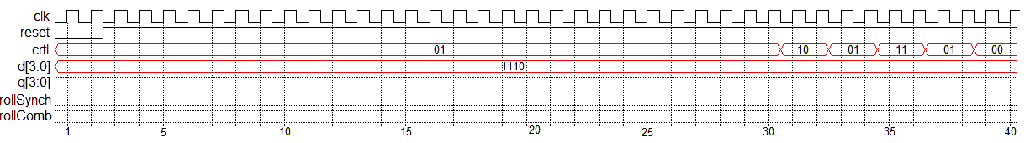
Mod 10 Counter - Timing Diagram
Complete the Q trace in the following timing diagram based on the state table for the mod-10 counter.
clk | reset | Ctrl | D | Q+ | Behavior
0,1,falling | x | xx | x | Q | Memory
rising | 0 | xx | x | 0 | Reset
rising | 1 | 00 | x | Q | Hold
rising | 1 | 01 | x | Q+1 mod 10 | Count Up
rising | 1 | 10 | D | D | Load D
rising | 1 | 11 | x | 0 | Sync Reset

Slide 20
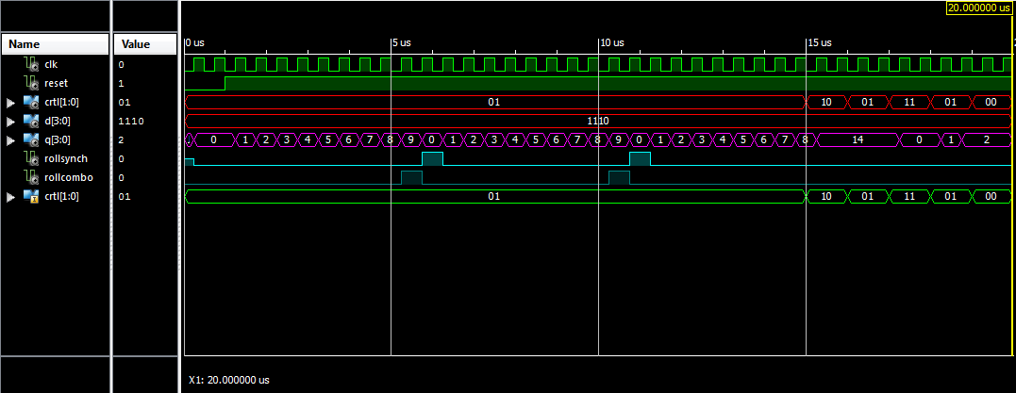
Mod 10 Counter - Timing Diagram

Slide 21
Mod 10 Counter - Timing Diagram

Slide 22
Mod 10 Counter - Timing Diagram

Slide 23
Circuit Diagram

Slide 24
Circuit Diagram
After completing the timing diagram, see if you can figure out how to construct the counter using the arrangement of devices show in the picture below.
  You may assume that all these inputs are able to handle 4-bit values - to indicate this, draw a hash through the signal lines with a "4" next to it.
  You should not draw additional lines in this picture. Instead, label the wires with names and use these names to create logical connections between signals with the same name.
  Draw a border around your circuit. The only signals that should cross the boundary are those which are part of the entity description.

Slide 25
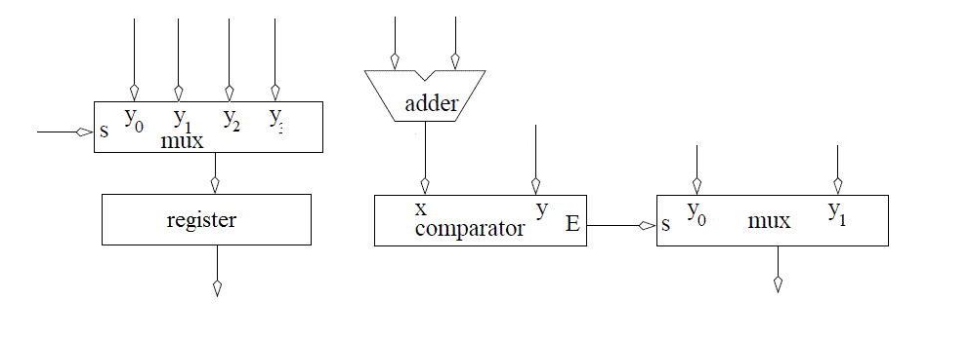
Circuit Diagram
Build the Architecture for the Mod 10 Counter

Slide 26
VHDL

Slide 27
Mod 10 Counter – VHDL Code Entity
  entity lec4 is
  Port( clk: in STD_LOGIC;
  reset : in STD_LOGIC;
  ctrl: in std_logic_vector(1 downto 0);
  D: in unsigned (3 downto 0);
  Q: out unsigned (3 downto 0));
  end lec4;
  1. architecture behavior of lec4 is
  2. signal rollSynch, rollCombo: STD_LOGIC;
  3. signal processQ: unsigned (3 downto 0);
  4. begin

Slide 28
Mod 10 Counter – VHDL Code
Architecture
Sensitivity List
  process(clk)
  begin
  if (rising_edge(clk)) then
  if (reset = '0') then
  processQ <= (others => '0');
  rollSynch <= '0';
  elsif ((processQ < 9) and (ctrl = "01")) then
  processQ <= processQ + 1;
  rollSynch <= '0';
  elsif ((processQ = 9) and (ctrl = "01")) then
  processQ <= (others => '0');
  rollSynch <= '1';
  elsif (ctrl = "10") then
  processQ <= unsigned(D);
  elsif (ctrl = "11") then
  processQ <= (others => '0');
  end if;
  end if;
  end process;
Line 1 of State Table
Line 2 of ST: -- Reset
Line 3 of ST: Not Here -- Hold
Line 4
-- Count Up
Line 5 of ST: -- Load D
Line 6 of ST: -- Synch Reset

Slide 29
Mod 10 Counter – VHDL Code
Architecture
  -- Concurrent Signal Assignments
  rollCombo <= '1' when (processQ = 9) else '0';
  Q <= processQ;
  end behavior;
Can add “and (ctrl = "01")” to confirm it only happens when counting up and count = 9

Slide 30
General VHDL Rules

Slide 31
General VHDL Rules
Introduce the following rules for designing in VHDL in order to write code that can be synthesized.
  Never use processes for combinational logic.
  Only the clk should appear in the sensitivity list
  The outermost structure should be "if (rising_edge(clk)) then"
  Inside this structure should be "if (reset = '0') then" to reinitialize the state element used by the process
  The else clause of the reset element (the body) should consist of a set of exclusive signal conditions in an if/then case structure.
  Any signal on the left-hand side of an assignment statement (in the body) may not be put on the left-hand side of any assignment statement outside the process.

Slide 32
Adding Signals in Xsim

Slide 33
Adding Signals in Xsim
Sometimes it is necessary to examine signals not directly visible in a design. In the Instances and Process subwindow, reveal the instances inside the lec4_tb by clicking on the arrow to the left lec4_tb.
  Reveal the signals inside the lec4 instance (called uut) by clicking on the label "uut".
  In the Objects subwindow select the signal that you want to observe on the timing diagram. In our case the ctrl signal.
  Drag and drop the signal into the timing diagram.
  In most cases you will have to restart the simulation to get a complete trace of the newly added signal.
  And the rerun it for the needed amount of time.

Slide 34
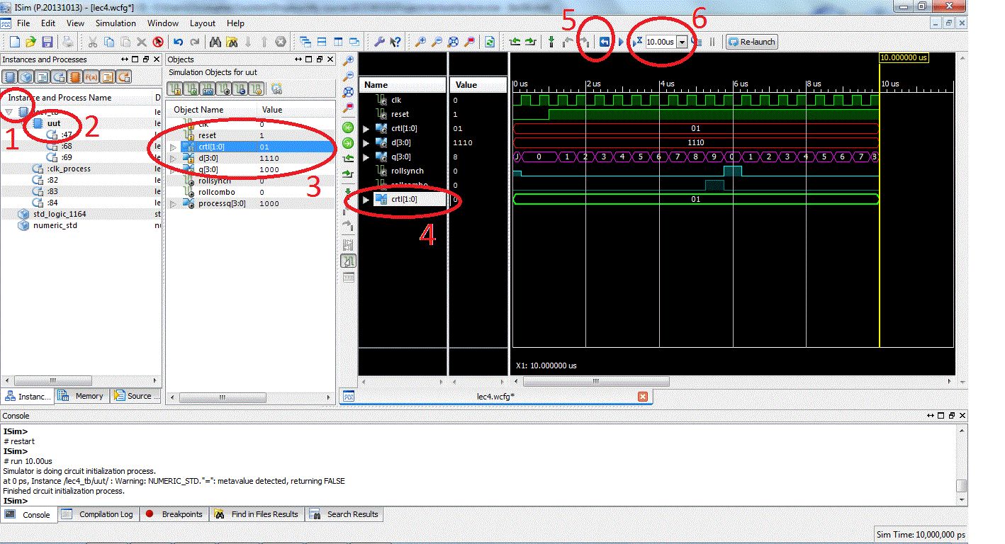
Adding Signals in Xsim Vivado Simulator

Slide 35
Lesson Outline
Sequential Elements
Mod 10 Counter Example
  Truth Table
  Timing Diagram
  Circuit Diagram
  VHDL
General VHDL Rules
Adding Signals to Xsim

