Slide 1
CSCE 436 – Advanced Embedded Systems
Lecture 28 – Digital Low Pass Filter
Prof Jeffrey Falkinburg
Avery Hall 368
472-5120

Slide 2
Lesson Outline
Time Logs!
Project Proposals Revisions Due Today
Digital Low Pass Filter
  Digital Filter in Theory

Slide 3
Digital Filter in Theory

Slide 4
Digital Filter in Theory
In today's class we will be building filters.
Our filters are called Infinite Impulse Response filter (IIR) because if they are given an impulse as an input signal, it will "ring" forever (i.e., have an infinite impulse response).
  From within this broad class of filters, we will be examining Biquadratic so names because the system function consists of two quadratic equations.
You can build a digital version of the analog filters we discussed last lecture.

Slide 5
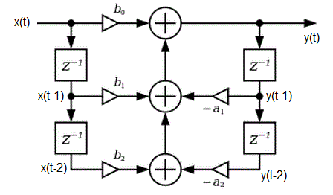
Digital Filter in Theory
The process of calculating a filtered output y(t) is described by the following imaged, a slightly modified version that I copied from the Wikipedia page on Digital Biquad Filters.

Slide 6
Digital Filter in Theory
Some comments are in order.
The input stream of digitized inputs is described by x(t). The blocks labeled "z-1" is a delay block. We will call the nodes below each of the blocks on the left side as x(t-1) and x(t-2), in order to indicate that they are 1 and 2 time units older than x(t). Note that x(t-2) will get the value of x(t-1), in 1 time unit from now. Likewise y(t-1) and y(t-2) are the old outputs 1 and 2 time units ago.
The triangles are multipliers, the two inputs to the multiplier are the input to the triangle and the variable above or below.
The circles with "+" inside of them are adders.

Slide 7
Digital Filter in Theory
output y(t) = x(t)*b₀ + x(t-1)*b₁ + x(t-2)*b₂ - y(t-1)*a₁ - y(t-2)*a₂

Slide 8
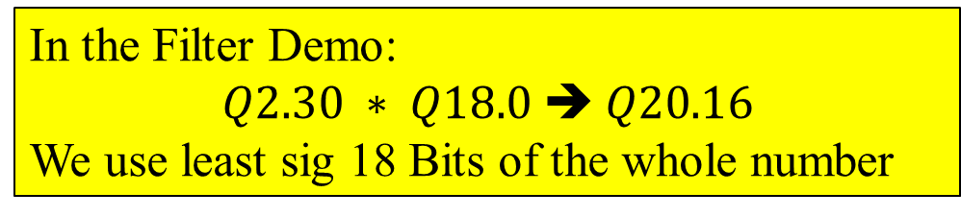
Digital Filter in Theory
b₀, b₁, b₂, -a₁, & -a₂ depend on f₀ & f_{s}=48KHz
output y(t) = x(t)*b₀ + x(t-1)*b₁ + x(t-2)*b₂ - y(t-1)*a₁ - y(t-2)*a₂
Coefficients
Q2.16
format
Product would be 32 Bits
(i.e. Q20.16)
Feedback
Q18.0
format
In the Filter Demo:
$$Q2.30 ∗ Q18.0 \text{➔} Q20.16$$
We use least sig 18 Bits of the whole number
All Synchronous systems have history (i.e. feedback to the inputs)

Slide 9
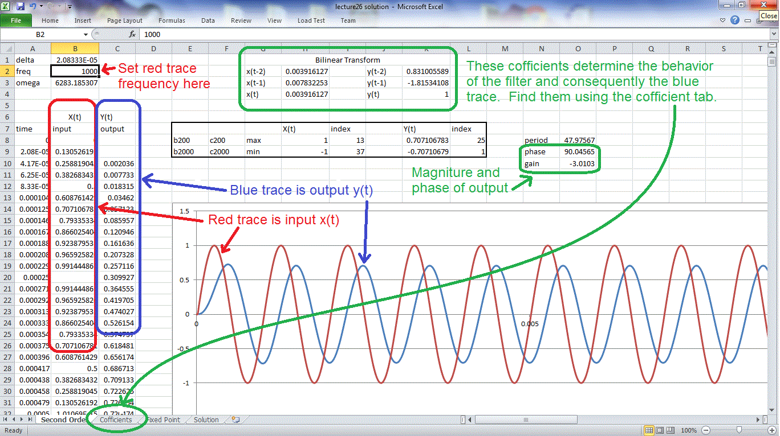
Second Order Tab

Slide 10
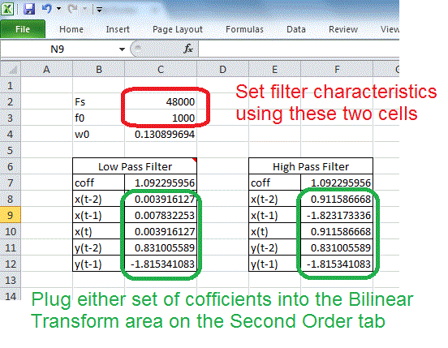
Coefficient Tab

Slide 11
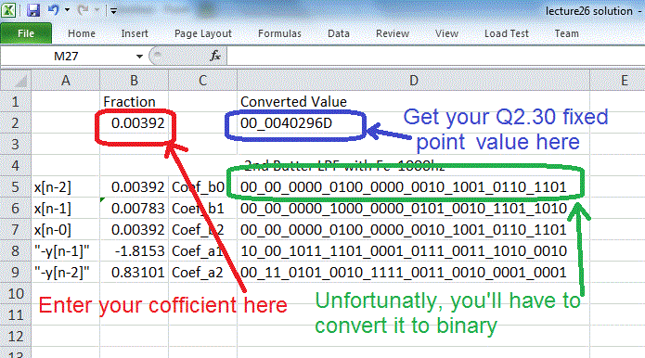
Fixed Point Tab

Slide 12
Digital Filter in VHDL
I borrowed code from eewiki for the filter linked here.
------------------------------------------------------------------
-- Low pass 2nd order butterworth filter with
-- f0 = 1000Hz, Fs = 48000Hz
------------------------------------------------------------------
left_filter_lpf500: entity work.IIR_Biquad(arch)
generic map(
Coef_b0 => B"00_00_0000_0100_0000_0010_1001_0110_1101", -- +0.003916127
Coef_b1 => B"00_00_0000_1000_0000_0101_0010_1101_1010", -- +0.007832253
Coef_b2 => B"00_00_0000_0100_0000_0010_1001_0110_1101", -- +0.003916127 Coef_a1 => B"10_00_1011_1101_0001_0111_0011_1010_0010", -- -1.815341083 Coef_a2 => B"00_11_0101_0010_1111_0011_0010_0001_0001") -- +0.831005589
port map ( clk => clk, -- Normal 100Mhz clock
n_reset => reset, -- Our normal active low reset
sample_trig => ready, -- This is the ready signal from the AC'97 wrapper
X_in => Ladc, -- The adc output from the ac'97 wrapper
filter_done => L_done, -- A status signal from the filter block
Y_out => Ladc_lpf1000); -- The 18-bit filtered output

Slide 13
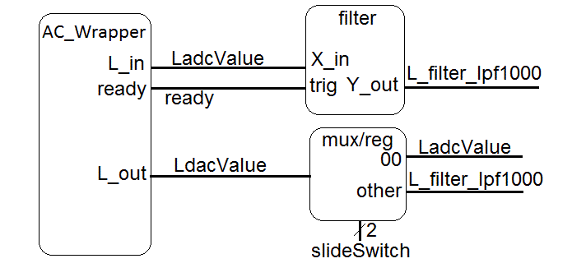
Digital Filter in VHDL
The VHDL code in the file digitalFilterDemo.vhd (linked at top), needs to be paired with the Audio Codec Wrapper to produce the block diagram shown below.

Slide 14
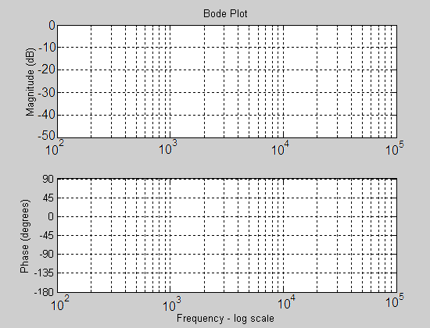
Digital Filter in VHDL
Generate the data in the table using the “second order” tab and plot the phase and magnitude plots.
Frequency Cell B2 | Gain Cell P10 | Phase Cell P9
100
300
500
1,000
1,300
1,500
3,000
5,000
7,000
10,000
13,000
15,000
Frequency Cell B2 | Gain Cell P10 | Phase Cell P9
100 | -0.00045 | 8.254185
300
500
1,000
1,300
1,500
3,000
5,000
7,000
10,000
13,000
15,000

Slide 15
Digital Filter in VHDL
Use the equations presented in class to generate the coefficients for a 2nd order low pass filter with a cut-off frequency of 300Hz.
Build a project around the VHDL code for this lesson. Plug the coefficients for your filter above into the right channel filter. Synthesize your design, download and listen to the difference between the left and right audio channels.
Coefficient | Decimal | Fixed Point
X[n-2]
X[n-1]
X[n-0]
Y[n-1]
Y[n-2]

