Slide 1
CSCE 436 – Advanced Embedded Systems
Lecture 1 – Intro to Digital System Design
Prof Jeffrey Falkinburg
Avery Hall 368
472-5120

Slide 2
Lesson Outline
Why digital systems?
Instructor/Course Introduction
Methods of implementing digital systems
Custom digital device technologies
Abstraction
Digital System Design
Design Goals
Digital Design – Majority Circuit

Slide 3
Why Digital Systems?

Slide 4
Why Digital Systems?
Advantages
  Reproducibility of information
  Flexibility and functionality: easier to store, transmit and manipulate information
  Economy: cheaper device and easier to design
Digital circuitry replaces many analog systems:
  Audio recording: from tape to music CD to MP3 (MPEG Layer 3) player
  Image processing: from silver-halide film to digital camera
  Telephone switching networks
  Control of mechanical system: e.g., “fly-by-wire”

Slide 5
Why Digital Systems?
Fly-By-Wire Digital System

Slide 6
Instructor/Course Intro

Slide 7
About me…
Education - Computer Engineering
  BSCpE, University of Nebraska Lincoln – Omaha Campus
  MSCpE, Air Force Institute of Technology (AFIT)
Teaching Experience
  Assistant Professor of Practice – University of Nebraska – Lincoln, Department of Computer Science and Engineering
  Assistant Professor – Air Force ROTC at UNL, Department of Aerospace Studies
  Assistant Professor – Air Force Academy, Department of Electrical and Computer Engineering
Research Experience
  Computer engineering education, VLSI systems, computer architecture, embedded systems, simulation design, and advanced digital design.

Slide 8
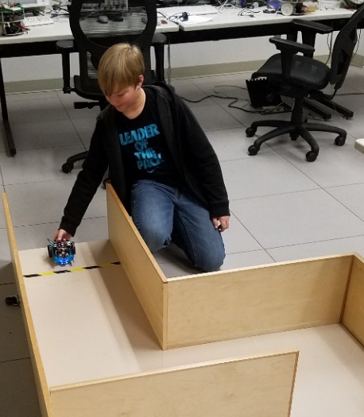
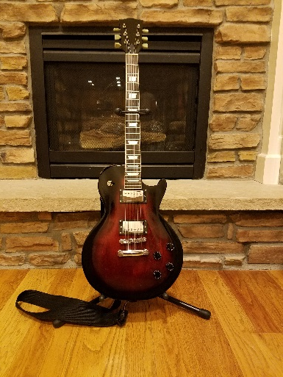


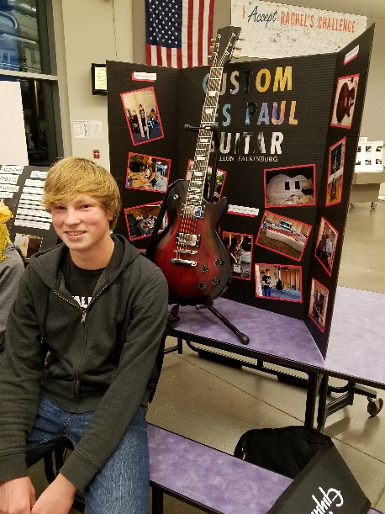
Hobbies/Interests
spending time w/ my Family
computers/robotics
watching movies
woodworking
getting outside

Slide 9
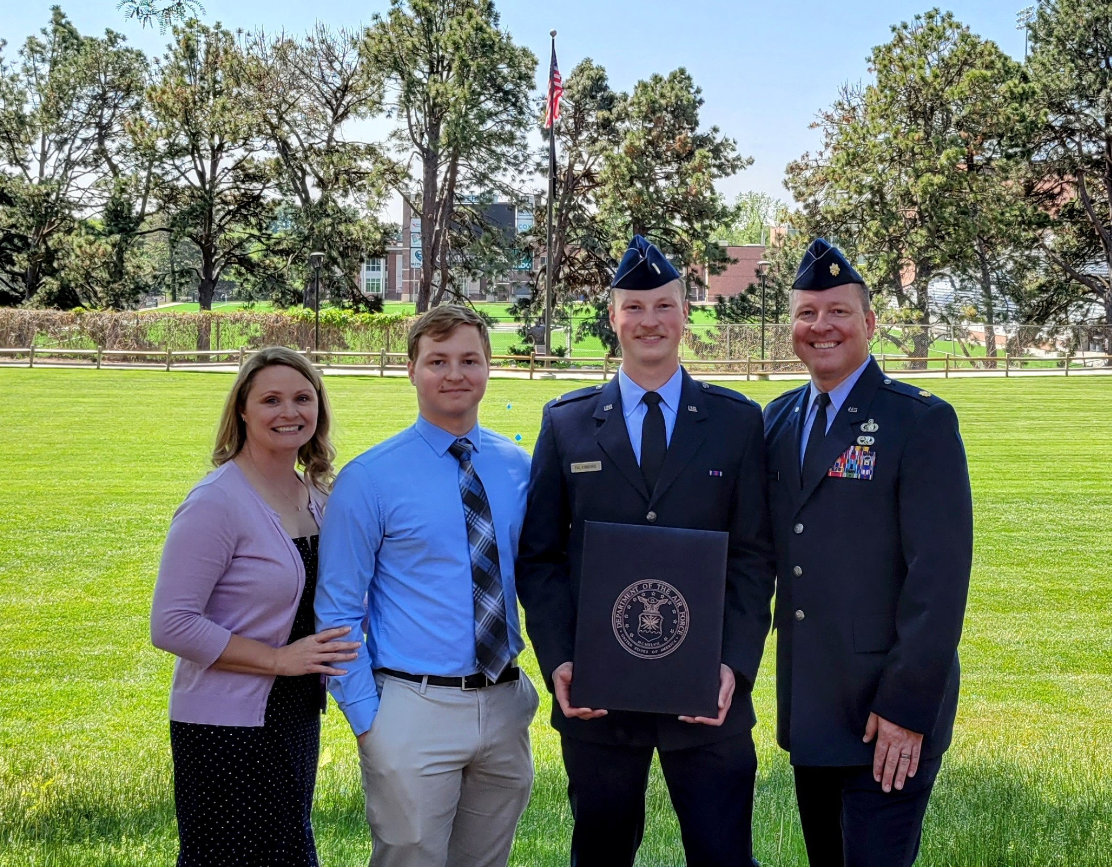
Why I do what I do
Britney, Dillon, and Brendan

Slide 10
Information Sheet
Name
Hometown
Hobbies / Interests
Course Goals?
Issues / Concerns about this course?
Anything else I should know?

Slide 11

Why I do what I do
Britney, Dillon, and Brendan

Slide 12
Rules
Be prepared for class (reading/homework)
Pay attention in lecture
Be productive during labs time

Slide 13
Course Materials
Website:
  https://cse.unl.edu/~jfalkinburg/cse_courses/2025/436/
Recommended Textbook:
  RTL Hardware Design Using VHDL
  Pong P. Chu
BitBucket:
  Sign up for an account using your unl.edu e-mail.
  You will need to create a Private Repository named "CSCE_436_YourLastName" and give me read/write access.
  Note: It is very important that you put this repository in a location on your computer that doesn't have any spaces in the path!

Slide 14
Methods of implementing digital systems

Slide 15
Digital Implementation Methods
General-purpose hardware with custom software
  General purpose processor
    Performance-oriented processor (e.g., Core i7)
    Cost-oriented processor (e.g., PIC microcontroller)
  Special purpose processor
    DSP processor (multiplication-addition)
    Network processor (buffering and routing)
    Graphics engine (3D rendering)
Custom software on a custom processor (known as hardware-software co-design)
Custom hardware
Note: A complex project may use more than one of these!

Slide 16
Digital Implementation Methods
General Purpose Hardware
Custom Software
Custom Hardware
Custom Software
Custom Hardware
Increasing Development Time
Increasing Performance
Increasing Cost
Increasing Power Consumption

Slide 17
Custom digital device technologies

Slide 18
Custom Digital Device Technologies
Where customization is done:
  In a fab (fabrication facility): ASIC (Application
  Specific IC)
  In the “field”: non-ASIC
Six device technology classifications:
  Full-custom ASIC
  Standard cell ASIC
  Gate array ASIC
  Complex field programmable logic device
  Simple field programmable logic device
  Off-the-shelf SSI (Small Scaled IC)/MSI (Medium Scaled IC) components

Slide 19
Full-custom ASIC
All aspects (e.g., size of a transistor) of a circuit are tailored for a particular application.
Circuit fully optimized
Design extremely complex and involved
Only feasible for small components
Masks needed for all layers
Full-Custom
ASIC
Standard-Cell
ASIC
Gate-Array
ASIC
Complex
PLDs
Simple
PLDs
SSI/MSI

Slide 20
Standard-Cell ASIC
Circuit made of a set of pre-defined logic, known as standard cells
  Basic logic gates
  1-bit adder,
  D FF
  etc.
Layout of a cell is pre-determined, but layout of the complete circuit is customized
Masks needed for all layers
Full-Custom
ASIC
Standard-Cell
ASIC
Gate-Array
ASIC
Complex
PLDs
Simple
PLDs
SSI/MSI

Slide 21
Gate array ASIC
Circuit is built from an array of a single type of cell (known as base cell)
Base cells are pre-arranged and placed in fixed positions, aligned as one- or two-dimensional array
More sophisticated components (macro cells) can be constructed from base cells
Masks needed only for metal layers (connection wires)
Full-Custom
ASIC
Standard-Cell
ASIC
Gate-Array
ASIC
Complex
PLDs
Simple
PLDs
SSI/MSI

Slide 22
Complex Field Programmable Device
Device consists of an array of generic logic cells and general interconnect structure
Logic cells and interconnect can be “programmed” by utilizing semiconductor fuses or switches
Customization is done “in the field” vs. fab
Two categories:
  CPLD (Complex Programmable Logic Device)
  FPGA (Field Programmable Gate Array)
No custom mask needed
Full-Custom
ASIC
Standard-Cell
ASIC
Gate-Array
ASIC
Complex
PLDs
Simple
PLDs
SSI/MSI

Slide 23
Simple Field Programmable Device
Programmable device with simple internal structure
  PROM (Programmable Read Only Memory)
  PAL (Programmable Array Logic)
  etc.
No custom mask needed
Replaced by CPLD/FPGA
Full-Custom
ASIC
Standard-Cell
ASIC
Gate-Array
ASIC
Complex
PLDs
Simple
PLDs
SSI/MSI

Slide 24
SSI/MSI components
Small parts with fixed, limited functionality
  7400 TTL series (more than 100 parts)
  etc.
Resource is consumed by package but not silicon:
  Power
  Board area
  Manufacturing cost
  etc.
No longer a viable option
Full-Custom
ASIC
Standard-Cell
ASIC
Gate-Array
ASIC
Complex
PLDs
Simple
PLDs
SSI/MSI

Slide 25
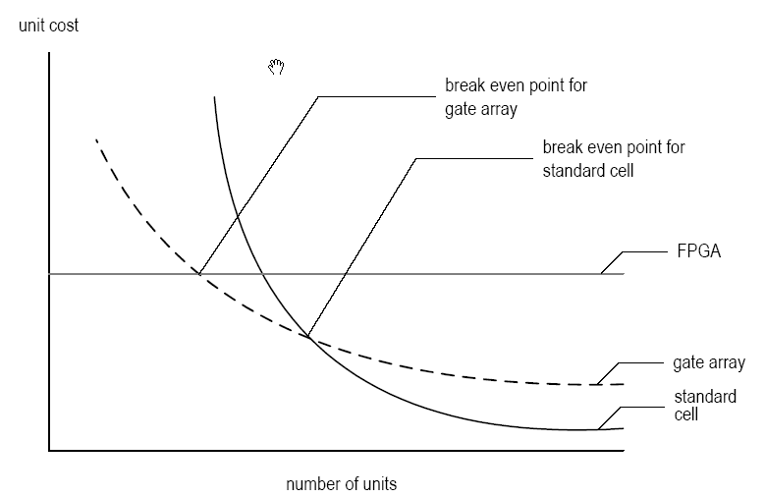
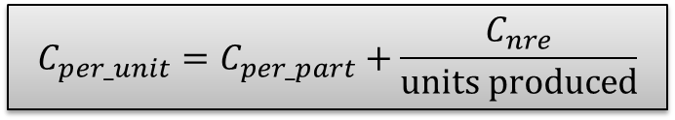
Types of Cost
  NRE (Non-Recurrent Engineering) cost: one-time, per-design cost
  Part cost: per-unit cost
  Time-to-market cost: loss of revenue
$$C_{per_unit}=C_{per_part}+\frac{C_{nre}}{units produced}$$

Slide 26
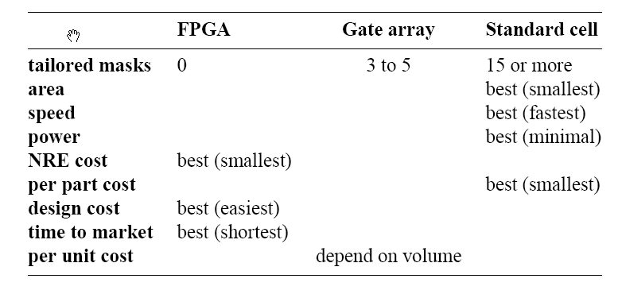
Technology Summary
Trade-off between optimal use of hardware resource and design effort/cost
No single best technology

Slide 27
Abstraction

Slide 28
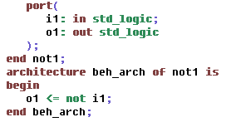
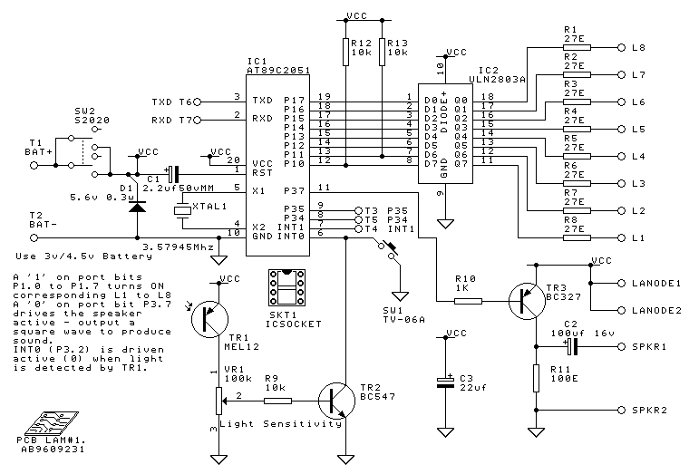
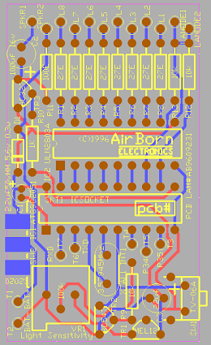
Digital System Views
Behavioral view:
  Describe functionalities and I/O behavior
  Treat the system as a black box
Structural view:
  Describe the internal implementation (components and interconnections)
  Essentially block diagram
Physical view:
  Add more info to structural view: component size, component locations, routing wires
  E.g., layout of a print circuit board

Slide 29
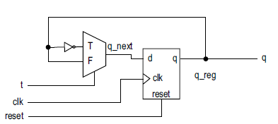
Register-Transfer Abstraction
Contains higher-level components (register, adder, mux, etc.) – think of datapaths in CSCE 230/236
Based on clock “tick” event
Described as a finite state machine
Later on: a design methodology in which the system operation is described by how the data is manipulated and moved among registers

Slide 30
Digital system design

Slide 31
VHDL Design
VHDL is just a language which is used to describe hardware circuits.
A piece of hardware is described in VHDL in two separate ways.
  Entity – Describes the inputs and outputs
  Architecture – Describes what transformation the box performs.
There are two good reasons to realize a design in VHDL, you can simulate and synthesize hardware specified.

Slide 32
Digital System Simulation
Simulation
  When a design is simulated you have complete control of time and the values of all the signals (wires) in the design.
  Aids in Debugging
  We will use Xilinx Vivado to perform our VHDL simulations.

Slide 33
Digital System Implementation
Synthesis
  Maps a higher-level description to lower-level components (RT, gate, technology map levels)
  Results in structural view
Physical Design
  Generates netlist based on synthesis
  Floor Plan – layout based on RT/processor level
  Place & Route – gate level
  Circuit Extraction – Compute propagation delays (Cp/R)
  Power/Clock Networks
  Etc.

Slide 34
Digital System Implementation
Verification – Checking whether a design meets the functional and timing goals
  Simulation
  Formal verification
  Hardware emulation
Testing – Process of detecting physical defects of a die or package that occurred during manufacturing

Slide 35
Design goals

Slide 36
Design Goals
Design for Efficiency
  Synthesis cannot convert bad designs into good ones
  Know what hardware your HDL will create
Design for Large
  Design a large module
  Design to be incorporated into a larger system
  Design to facilitate the overall development process
Design for Portability
  Device independent
  Software independent
  Design reuse

Slide 37
Digital Design – Majority Circuit

Slide 38
Digital Design – Majority Circuit
Word Statement: Build a circuit (SOP min) with 3-bits of input and 1-bit of output. The output equals 1 when a majority of the three inputs equal 1.
Abstract word or statement
Truth
Table
Symbolic
Circuit Design Diagram
VHDL

Slide 39
Important Notes
You can use all the standard logic gates including:
  AND
  OR
  XOR
  NAND
  NOR
  XNOR
  NOT

Slide 40
Important Notes
The "data type" std_logic can represent much more than just a logic 0 or 1.
  'U', -- Uninitialized
  'X', -- Forcing Unknown
  '0', -- Forcing 0
  '1', -- Forcing 1
  'Z', -- High Impedance
  'W', -- Weak Unknown
  'L', -- Weak 0
  'H', -- Weak 1
  '-' -- Don't care

Slide 41
Lesson Outline
Why digital systems?
Instructor/Course Introduction
Methods of implementing digital systems
Custom digital device technologies
Abstraction
Digital System Design
Design Goals
Digital Design – Majority Circuit

