Slide 1
CSCE 436 – Advanced Embedded Systems Lecture 20 – Soft Core (MicroBlaze) + Custom IP with Interrupt
Prof Jeffrey Falkinburg
Avery Hall 368
472-5120

Slide 2
Lesson Outline
Time Logs!
MicroBlaze + Custom IP with Interrupt

Slide 3
Interrupts

Slide 4
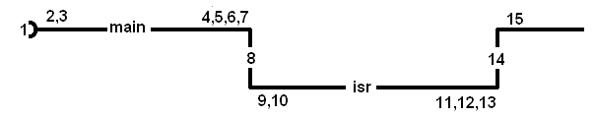
Interrupts
Interrupts are used when you want to your system to do more than one thing at a time.
An interrupt service routine (ISR) is a subroutine called by hardware. The following figure illustrates the process of "calling" and returning from an ISR.

Slide 5
Interrupts
MCU powers up, jumps to RESET vector
MCU starts execution of main
Dynamic configuration
  configure hardware
  clear hardware interrupt flag
  enable hardware interrupt

Slide 6
Interrupts
Event occurs which sets interrupt flag
MCU stops running main
MCU saves PC
MCU disables interrupts
Executes "GOTO ISR" at interrupt vector address

Slide 7
Interrupts
ISR: Poll interrupt flags
ISR: Execute appropriate code in ISR
ISR: Clear interrupt flag
ISR: executes rted
Interrupts are enabled
PC is restored
MCU resumes running main

Slide 8
Interrupts in the MicroBlaze
Today we will examine how to generate an interrupt into the MicroBlaze.

Slide 9
MicroBlaze + Custom IP with Interrupt

Slide 10
MicroBlaze + Custom IP with Interrupt
Artix 7 (design_1)
AA19
V18
axi_uartlite_0 @ 40600000
RX
RX
TX
TX
MicroBlaze
my_counter_ip_v2_0.vhd @ 0x44a00000
Design_1.xdc
Lec20.c
axi_lite
my_counter_ip_v2_0_S00_AXI.vhd
R4
G4
clk
Lec20.vhd
reset_n
S_AXI_ACLK
clk
S_AXI_ARESETN
T14
T15
T16
U16
V15
W16
W15
Y13
reset_n
main()
slv_reg1
myISR()
ctrl
32
slv_reg0
Q/D
32
Lec19.xdc
Interrupt
slv_reg2
flagQ
set
roll
slv_reg3
clear
LED
8

Slide 11
Lab 3
Artix 7 (design_1 for Lab 3)
AA19
V18
axi_uartlite_0 @ 40600000
RX
RX
TX
TX
my_oscope_ip_v2_0.vhd @ 0x44a00000
MicroBlaze
Design_1.xdc
axi_lite
my_oscope_ip_v2_0_S00_AXI.vhd
Lab3.c
R4
G4
S_AXI_ACLK
Lab2_dp.vhd
clk
clk
reset_n
S_AXI_ARESETN
reset_n
32x32
main()
slv_reg0 → 31
To/From Microblaze
Lab2 Signals
myISR()
Interrupt
ready
Lab2.xdc
cw
sw
Pins off
chip
Lab2_fsm.vhd
Signals going In/Out of Artix 7 Chip
Nets to Pins

Slide 12
MicroBlaze + Custom IP – Workflow
The work flow has three main steps.
  Define a new hardware design (MicroBlaze + axi_uartlite) in Vivado IP Integrator (using the MicroBlaze Tutorial from Lecture 18)
  Create and package new custom IP (your custom hardware) and import it into your Vivado design
  Program the resulting hardware in the SDK environment.
Lets start with the first step.

Slide 13
Xilinx Vivado – IP Integrator
  This step requires that you start a new hardware design (MicroBlaze + axi_uartlite) in Vivado IP Integrator in a new project called Lecture_20.
  You will add a new Block Design with a MicroBlaze and axi_uartlite following the MicroBlaze Tutorial.
https://reference.digilentinc.com/learn/programmable-logic/tutorials/nexys-video-getting-started-with-microblaze/start

Slide 14
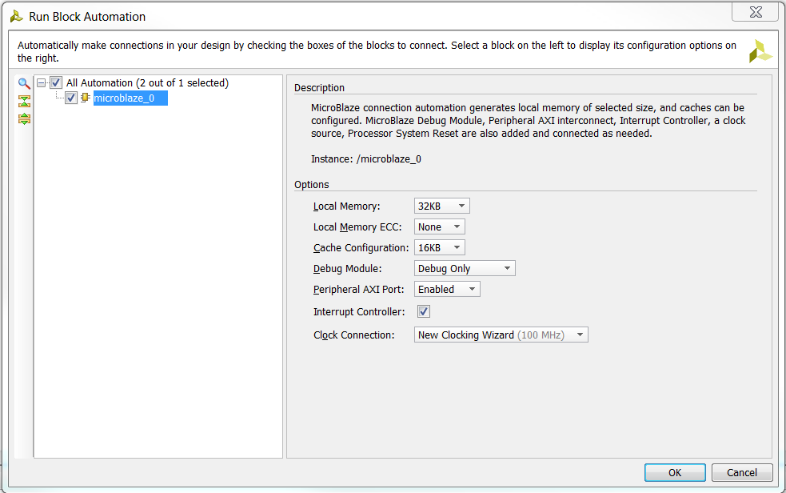
Xilinx Vivado – IP Integrator
  This step requires that you start a new hardware design (MicroBlaze + axi_uartlite) in Vivado IP Integrator in a new project called Lecture_19.
  You will add a new Block Design with a MicroBlaze and axi_uartlite following the MicroBlaze Tutorial.
https://reference.digilentinc.com/learn/programmable-logic/tutorials/nexys-video-getting-started-with-microblaze/start
Don’t Select!

Slide 15
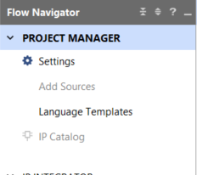
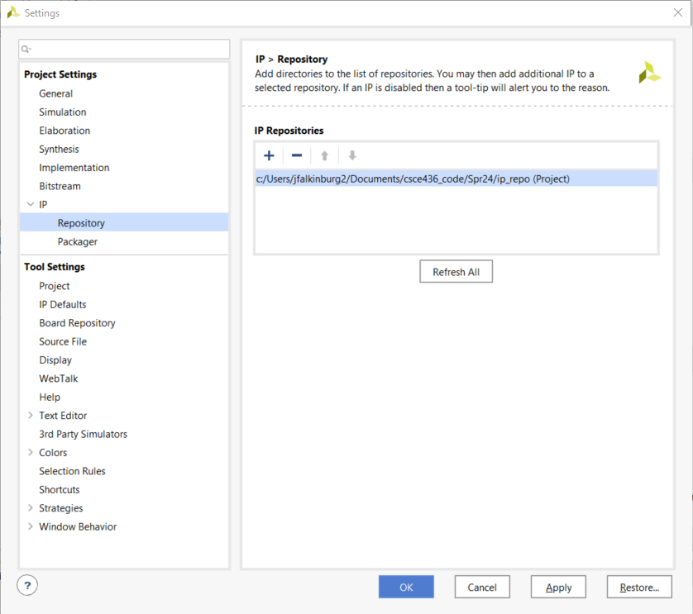
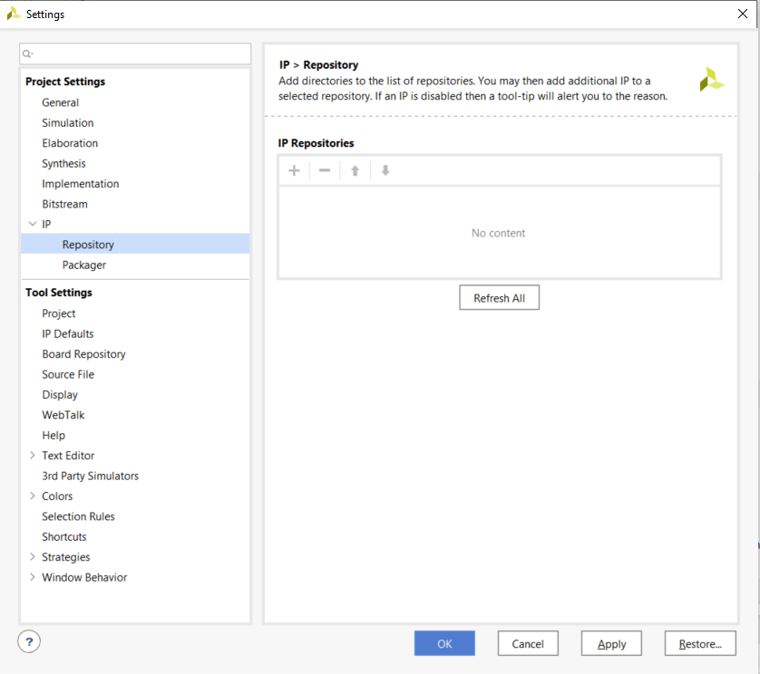
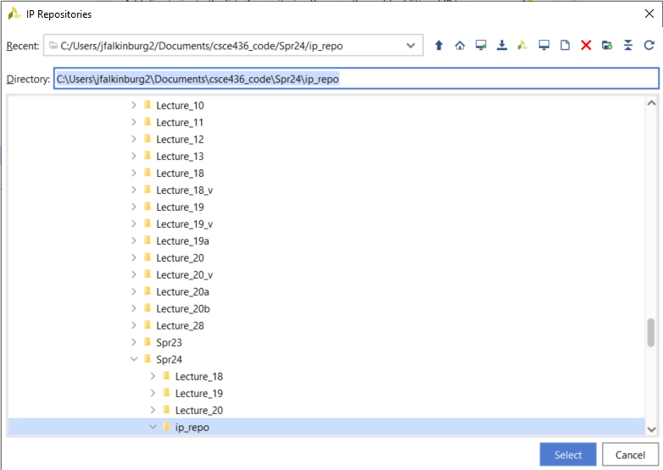
IP Catalog – Adding IP Repo
Open IP Catalog Settings and click on Repository Manager and add your IP Repo to your IP Repositories
  /path_to_ip_repo/git_repo/ip_repo
1
4
2
3
5
6

Slide 16
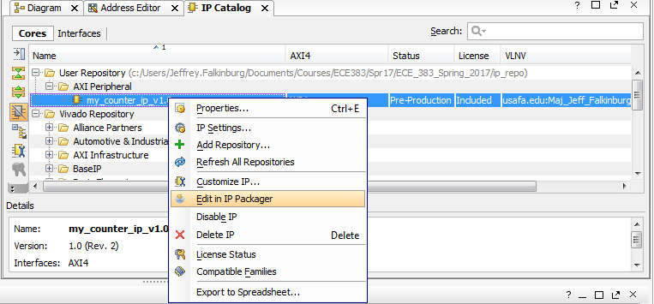
Edit/Create New IP Package
Edit Counter in IP Packager or create a new IP package
I chose to create a new package with a new version.

Slide 17
Edit/Create New IP Package
Expose the Roll Signal to the Artix 7 (design_1) block diagram by following the LED port maps

Slide 18
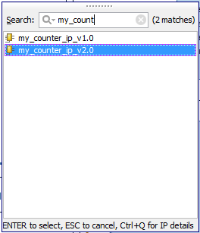
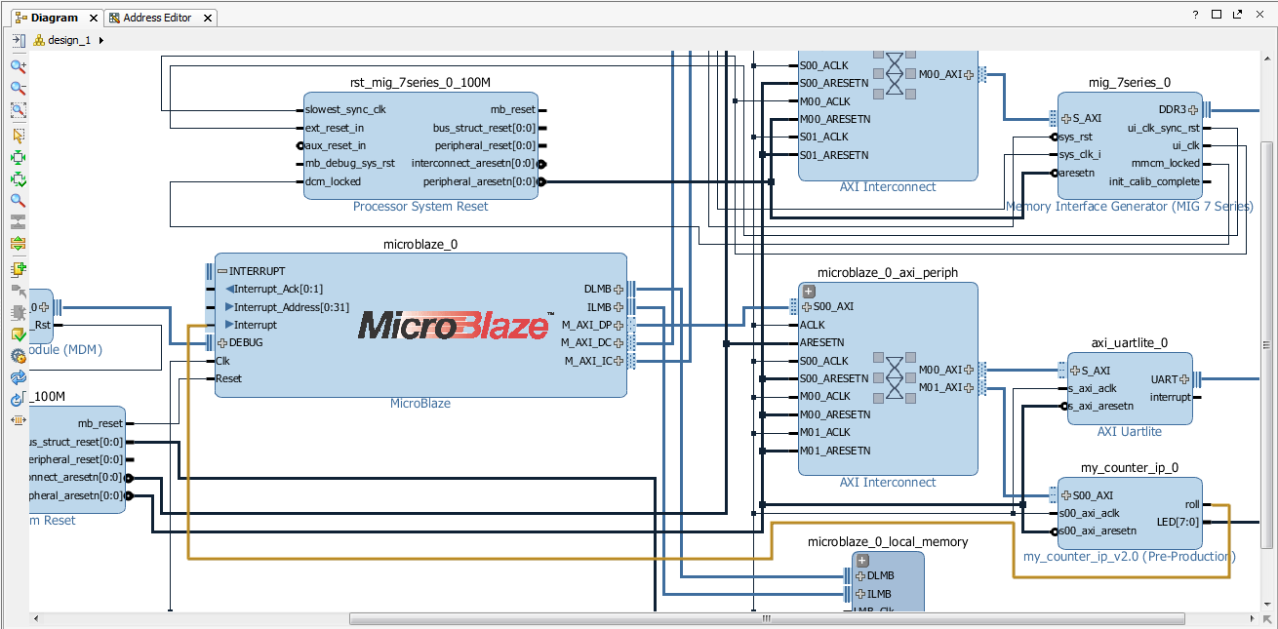
Xilinx Vivado – Create and Package Custom IP
8. Add Custom IP to your design
  8.1) In the project manager page of the original window, click Open Block Design. This adds a block design to the project.
  8.2) Use the Add IP button to add our v2.0 of our Lec 11 Counter IP Core with the exposed roll signal.
Notice it is v2.0

Slide 19
Edit/Create New IP Package
Click the ‘+’ sign by the MicroBlaze to connect the Roll Signal to the MicroBlaze Interrupt input directly
1
3
2

Slide 20
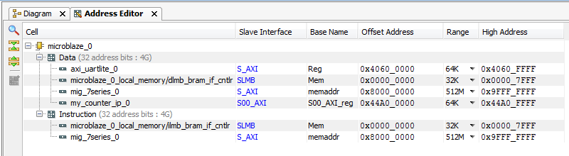
Verify Design
You should verify the addressing for all your design components before continuing.
Verify that the base addresses are the same addresses used in the template C-code.
Should be no changes at this time.
1
2
3

Slide 21
Verify Design
You should verify the addressing for all your design components before continuing.
Verify that the base addresses are the same addresses used in the template C-code.
Should be no changes at this time.

Slide 22
Validate and Export Design
First click validate design_1
Regenerate the design_1 HDL wrapper.
Finally you need to generate the Generate Design bitstream
Take a coffee break while it builds

Slide 23

Coffee Break
This Photo by Unknown Author is licensed under CC BY-NC

Slide 24
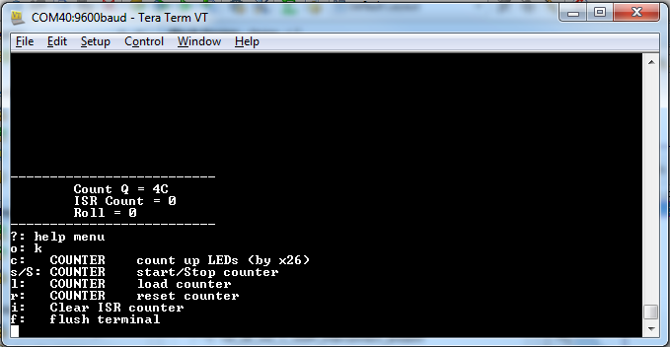
SDK Project
Start with a “Hello World” project once in the SDK.
Rename the hello_world.c to Lec20.c and use the given Lec20.c code to get started
Modify the code to handle the interrupt generated from the counter and increment a counter variable for display.

Slide 25
MicroBlaze Interrupts in
C Programming

Slide 26
MicroBlaze Interrupts
In order to understand how interrupts are handled by the MicroBlaze, its important to understand something about the hardware.
I found most of the following information in the MicroBlaze Users Guide.
  http://www.xilinx.com/support/documentation/sw_manuals/mb_ref_guide.pdf

Slide 27
MicroBlaze Interrupts
The Machine Status Register contains control and status bits for the processor. Bit 30 of this register, IE, is the interrupt enable.
The MicroBlaze is a three stage pipeline machine - interrupts will need to flush the pipe before proceeding.
The interrupt vector is located at address 0x10-0x14 in memory.
MicroBlaze supports a single interrupt source.
When an interrupt occurs, the following actions happen.
  r14 <- PC
  PC <- 0x00000010
  MSR[IE] <- 0
When the interrupt service routine terminates, control is turned over to the instruction at address r14 and MSR[IE] is set.

Slide 28
MicroBlaze Interrupts
C Programming Example
//-------------------------------------------------------------------------
//-- Name: Prof Jeff Falkinburg
//-------------------------------------------------------------------------
#include <xil_exception.h>
void myISR(void);
int main(void) {
microblaze_register_handler((XInterruptHandler) myISR, (void *) 0);
microblaze_enable_interrupts();
stuff();
} // end main
void myISR(void) {
isrCount = isrCount + 1;
Xil_Out8(countClearReg, 0x01); // Clear the flag and then you MUST
Xil_Out8(countClearReg, 0x00); // allow the flag to be reset later
}

Slide 29
Manual Easter Egg Hunt
Consult the MicroBlaze Processor Reference Guide and convert the following
  addik r22,r19,1
  swi r23, r1, 60
  bgei r18, -44
Solutions can be found in the source code of the html page

Slide 30
OS and Libraries Document
Consult the OS and Libraries Document Collection.
  What string formats are supported by the xil_print instruction?

