Slide 1
CSCE 436 – Advanced Embedded Systems Lecture 19 – Soft Core (MicroBlaze) + Custom IP
Prof Jeffrey Falkinburg Avery Hall 368 472-5120

Slide 2
Lesson Outline
MicroBlaze + Custom IP

Slide 3
MicroBlaze + Custom IP

Slide 4
MicroBlaze + Custom IP
Artix 7 (design_1)
AA19
V18
axi_uartlite_0 @ 40600000
RX
RX
TX
TX
MicroBlaze
my_counter_ip_v1_0.vhd @ 0x44a00000
Design_1.xdc
Lec19.c
axi_lite
my_counter_ip_v1_0_S00_AXI.vhd
R4
G4
clk
Lec19.vhd
reset_n
S_AXI_ACLK
clk
T14
T15
T16
U16
V15
W16
W15
Y13
S_AXI_ARESETN
reset_n
slv_reg1
ctrl
32
slv_reg0
Q/D
32
Lec19.xdc
slv_reg2
roll
LED
8

Slide 5
MicroBlaze + Custom IP with Interrupt
Artix 7 (design_1)
AA19
V18
axi_uartlite_0 @ 40600000
RX
RX
TX
TX
MicroBlaze
my_counter_ip_v2_0.vhd @ 0x44a00000
Design_1.xdc
Lec20.c
axi_lite
my_counter_ip_v2_0_S00_AXI.vhd
R4
G4
clk
Lec20.vhd
reset_n
S_AXI_ACLK
clk
S_AXI_ARESETN
T14
T15
T16
U16
V15
W16
W15
Y13
reset_n
main()
slv_reg1
myISR()
ctrl
32
slv_reg0
Q/D
32
Lec19.xdc
Interrupt
slv_reg2
flagQ
set
roll
slv_reg3
clear
LED
8

Slide 6
Lab 3
Artix 7 (design_1)
AA19
V18
axi_uartlite_0 @ 40600000
RX
RX
TX
TX
MicroBlaze
my_oscope_ip_v2_0.vhd @ 0x44a00000
Design_1.xdc
Lab3.c
axi_lite
my_oscope_ip_v2_0_S00_AXI.vhd
R4
G4
clk
Lab3_dp.vhd
reset_n
S_AXI_ACLK
clk
S_AXI_ARESETN
T14
T15
T16
U16
V15
W16
W15
Y13
reset_n
main()
slv_reg1
myISR()
ctrl
32
slv_reg0
Q/D
32
Lec19.xdc
Interrupt
slv_reg2
flagQ
set
roll
slv_reg3
clear
LED
8

Slide 7
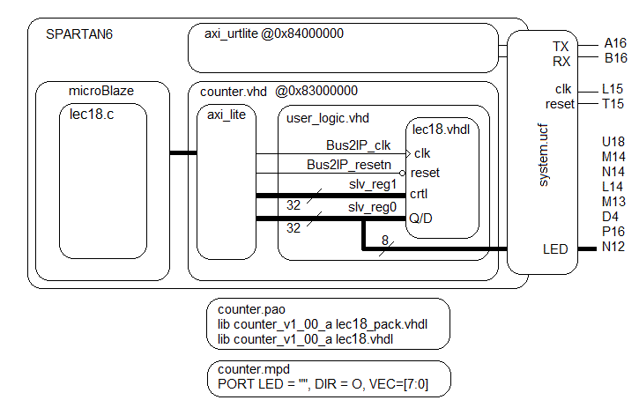
MicroBlaze + Custom IP

Slide 8
MicroBlaze + Custom IP – Workflow
The work flow has three main steps.
Define a new hardware design (MicroBlaze + axi_uartlite) in Vivado IP Integrator
Create and package new custom IP (your custom hardware) and import it into your Vivado design
Program the resulting hardware in the SDK/Vitis environment.
Lets start with the first step.

Slide 9
Xilinx Vivado – IP Integrator
This step requires that you start a new hardware design (MicroBlaze + axi_uartlite) in Vivado IP Integrator in a new project called Lecture_19.
You will add a new Block Design with a MicroBlaze and axi_uartlite following the MicroBlaze Tutorial.
https://digilent.com/reference/programmable-logic/guides/getting-started-with-ipi (New Tutorial for Vitis)
https://reference.digilentinc.com/learn/programmable-logic/tutorials/nexys-video-getting-started-with-microblaze/start (Old Tutorial for SDK)

Slide 10
Xilinx Vivado – Create and Package Custom IP
This step requires Create and package new custom IP (your custom hardware) and import it into your Vivado design.
You will defined the logical arrangement of the component in VHDL. Your entity description will contain two types of connections; those targeted at external ports on the Artix 7 chip and those intended to be accessible to the MicroBlaze processor.
You can also use this online tutorial to help guide you.
https://reference.digilentinc.com/learn/programmable-logic/tutorials/zedboard-creating-custom-ip-cores/start

Slide 11
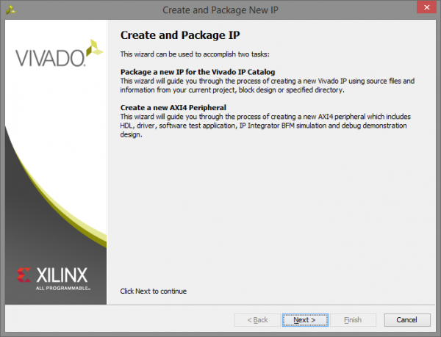
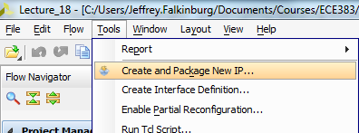
Xilinx Vivado – Create and Package Custom IP
1. Open Vivado and create a new project
Go to Tools→Create and package IP

Slide 12
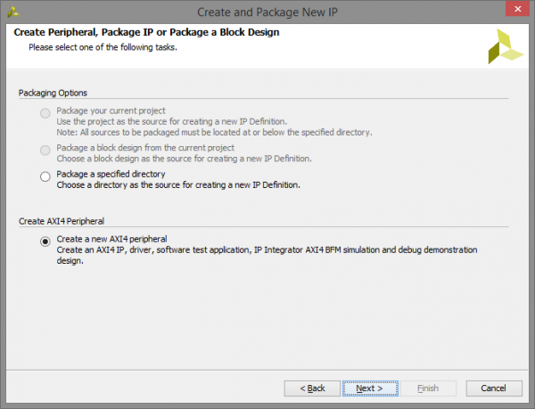
Xilinx Vivado – Create and Package Custom IP
2. Create your custom IP project
2.1) Select Create a new AXI4 peripheral and click Next

Slide 13
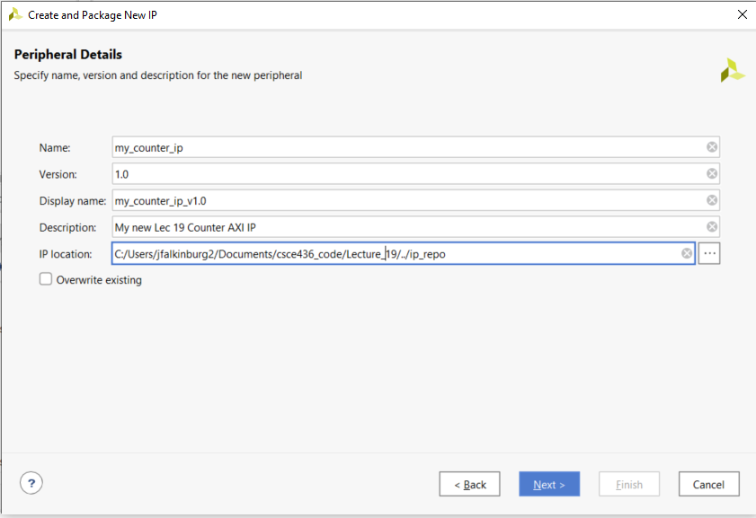
Xilinx Vivado – Create and Package Custom IP
2.2) Input “My_Counter_IP” in the name field and click Next

Slide 14
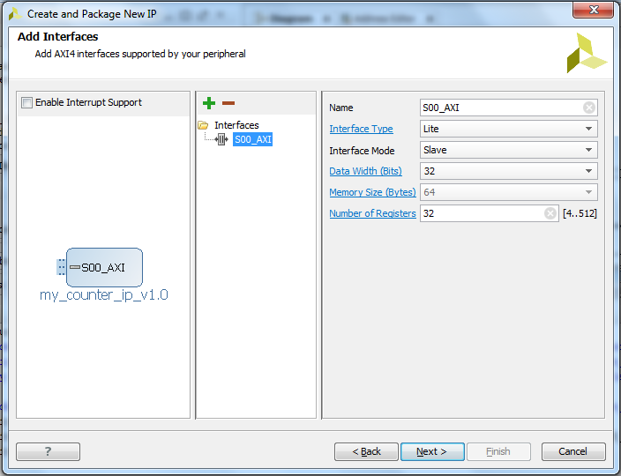
Xilinx Vivado – Create and Package Custom IP
2.3) Change the number of Registers to 32 on the AXI interface and click Next

Slide 15
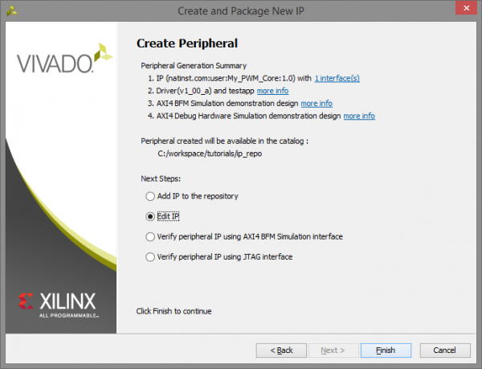
Xilinx Vivado – Create and Package Custom IP
2.4) Select Edit IP and click Finish

Slide 16
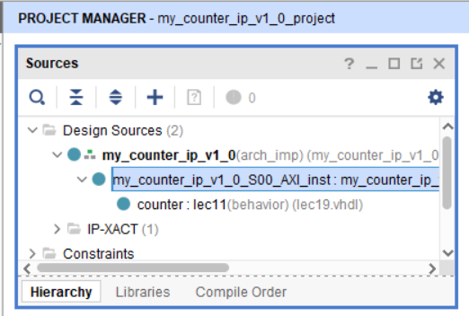
Xilinx Vivado – Create and Package Custom IP
3. Designing the IP core
3.1) A new instance of Vivado will open up for the new IP core. Expand the top level file My_Counter_IP_v1_0. Then double-click on My_Counter_IP_v1_0_S00_AXI to open it in the editor.

Slide 17
Xilinx Vivado – Create and Package Custom IP
Error opening My_Counter_IP_v1_0 in editor. Vivado getting stuck initializing language server:
Change the option "Tools -> Settings -> Tool Settings -> Text Editor -> Syntax Checking -> Syntax checking" from Sigasi to Vivado, then restart Vivado.

Slide 18
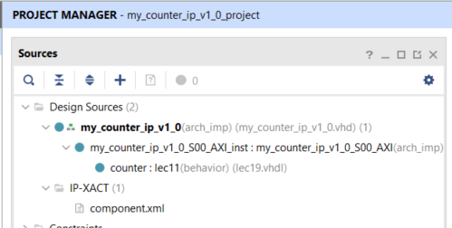
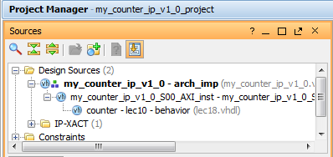
Xilinx Vivado – Create and Package Custom IP
4. Adding the Lec 11 Counter to the My_Counter_IP_v1_0 project by adding the source lec19.vhd file
Your counter will not yet be connected to the top level design

Slide 19
Part 1a: Hardware Questions/ Notes related to handout
Note: the truth table for the counter is in the comments.
Q: In lec19.vhdl, what other library must be added?
Q: In lec19.vhdl, does the use work.lec19Parts.all library need to be added?

Slide 20
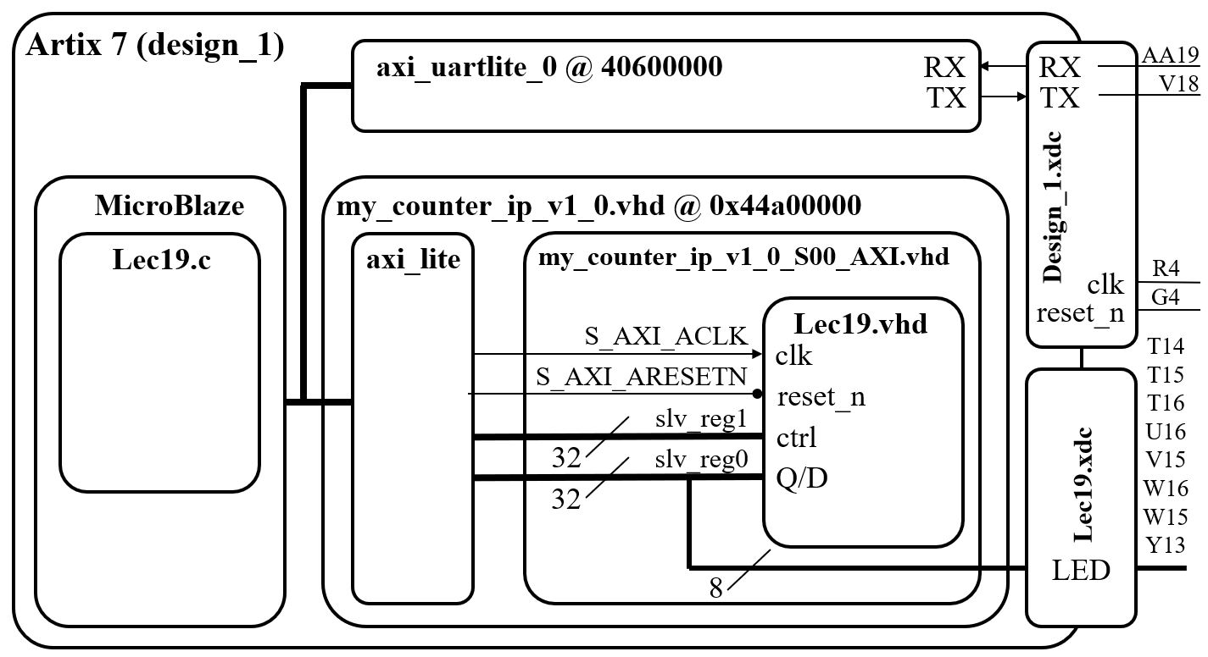
MicroBlaze + Custom IP

Slide 21
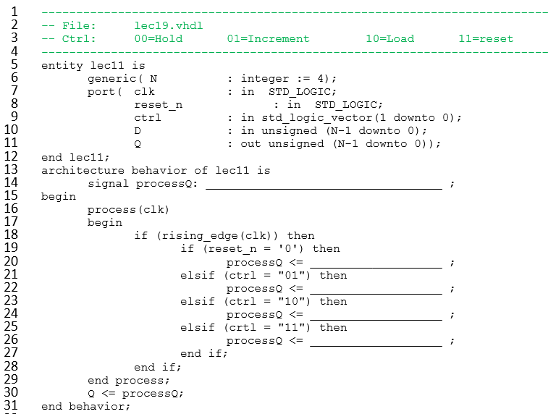
lec19.vhdl – Lec 11 Counter
unsigned (N-1 downto 0)
(others => '0')
processQ + 1
unsigned(D)
(others => '0')

Slide 22
Part 1b: Hardware Questions/ Notes related to handout
Q: In my_counter_ip_v1_0_S00_AXI.vhd, what do the generics C_S_AXI_DATA_WIDTH do?
Q: In my_counter_ip_v1_0_S00_AXI.vhd, what two roles is slv_reg0 serving?
Q: In my_counter_ip_v1_0_S00_AXI.vhd, what roles does slv_reg1 serve?
Q: In my_counter_ip_v1_0_S00_AXI.vhd, slv_reg0 is on the left and right-hand side of an assignment. Identify the two lines where this happens.
Q: In my_counter_ip_v1_0_S00_AXI.vhd, on line 73, what is the role does X"000000" serve?

Slide 23
MicroBlaze + Custom IP

Slide 24
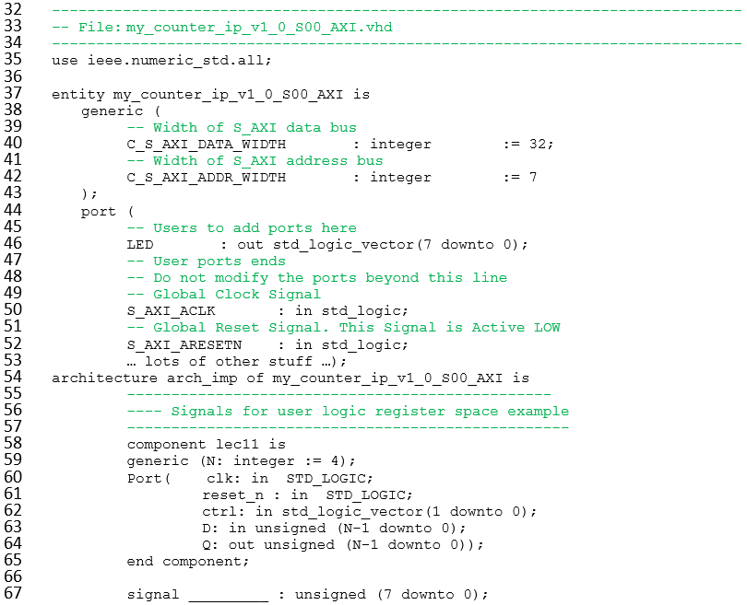
my_counter_ip_v1_0_S00_AXI.vhd – User Logic
Q

Slide 25
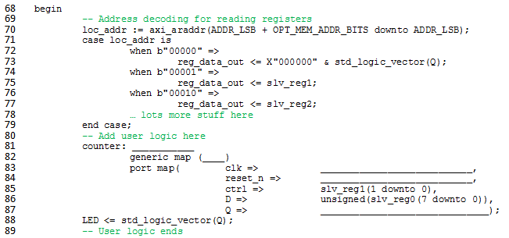
my_counter_ip_v1_0_S00_AXI.vhd – User Logic
lec11
8
S_AXI_ACLK
S_AXI_ARESETN
Q

Slide 26
Xilinx Vivado – Create and Package Custom IP
5. Modifying My_Counter_IP_v1_0_S00_AXI axi bus interface file
Add numeric standard library at the top of the file:
use ieee.numeric_std.all;

Slide 27
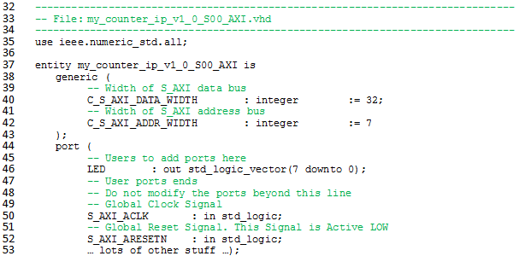
Xilinx Vivado – Create and Package Custom IP
5. Modifying My_Counter_IP_v1_0_S00_AXI axi bus interface file
Add a port for the LEDs in the my_counter_ip_v1_0_S00_AXI entity between the comments:
port (
-- Users to add ports here
LED : out std_logic_vector(7 downto 0);
-- User ports ends
-- Do not modify the ports beyond this line
-- Global Clock Signal
S_AXI_ACLK : in std_logic;

Slide 28
Xilinx Vivado – Create and Package Custom IP
5. Modifying My_Counter_IP_v1_0_S00_AXI axi bus interface file
Add the counter declaration and a signal for Q before begin in the my_counter_ip_v1_0_S00_AXI architecture:
component lec11 is
generic (N: integer := 4);
Port( clk: in STD_LOGIC;
reset_n : in STD_LOGIC;
--roll : out STD_LOGIC; --don’t add this yet
ctrl: in std_logic_vector(1 downto 0);
D: in unsigned (N-1 downto 0);
Q: out unsigned (N-1 downto 0));
end component;
signal Q : unsigned (7 downto 0);

Slide 29
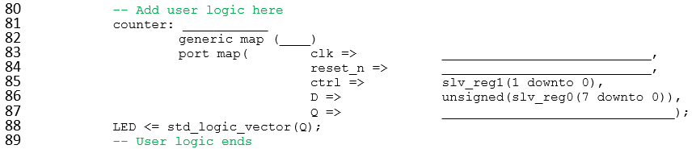
Xilinx Vivado – Create and Package Custom IP
5. Modifying My_Counter_IP_v1_0_S00_AXI axi bus interface file
Add the counter implementation and connect the wires within the my_counter_ip_v1_0_S00_AXI architecture:
-- Add user logic here
counter: lec11
generic map (8)
port map( clk => S_AXI_ACLK,
reset_n => S_AXI_ARESETN,
--roll => roll_sig, --don’t add this yet
ctrl => slv_reg1(1 downto 0),
D => unsigned(slv_reg0(7 downto 0)),
Q => Q);
LED <= std_logic_vector(Q);

Slide 30
Xilinx Vivado – Create and Package Custom IP
5. Modifying My_Counter_IP_v1_0_S00_AXI axi bus interface file
Connect the counter implementation Q output signal to slave register 0 (slv_reg0) in the my_counter_ip_v1_0_S00_AXI architecture:
loc_addr := axi_araddr(ADDR_LSB + OPT_MEM_ADDR_BITS downto ADDR_LSB); case loc_addr is
when b"00000" =>
reg_data_out <= x"000000" & std_logic_vector(Q);
when b"00001" =>
reg_data_out <= slv_reg1;
when b"00010" =>
reg_data_out <= slv_reg2;

Slide 31
Part 1c: Hardware Questions/ Notes related to handout
Q: If you want a signal to go outside the Artix 7 chip...
What files must it appear on the entity description?
What other files must contain information about the signal?
Q: If you want a signal to go to the MicroBlaze...
In order for the MicroBlaze to read the signal, what must you do?
In order for the MicroBlaze to write to the signal, what must you do?

Slide 32
MicroBlaze + Custom IP

Slide 33
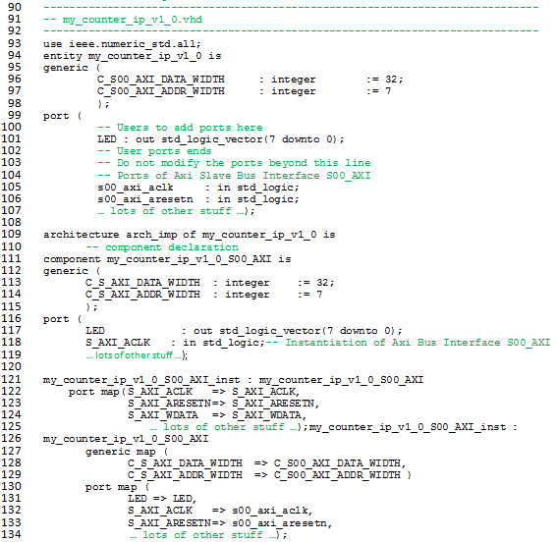
My_Counter_IP_v1_0.vhd – Top Level

Slide 34
My_Counter_IP_v1_0.vhd – Top Level

Slide 35
Xilinx Vivado – Create and Package Custom IP
6. Modifying My_Counter_IP_v1_0 top level file
Add numeric standard library at the top of the file:
use ieee.numeric_std.all;

Slide 36
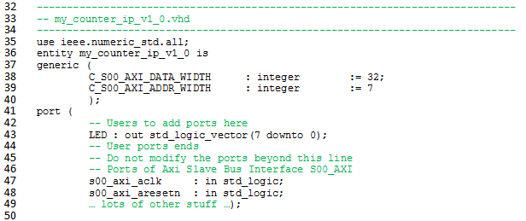
Xilinx Vivado – Create and Package Custom IP
6. Modifying My_Counter_IP_v1_0 top level file
Add a port for the LEDs in the my_counter_ip_v1_0 entity between the comments to expose it to externally:
port (
-- Users to add ports here
LED : out std_logic_vector(7 downto 0);
-- User ports ends
s00_axi_aclk : in std_logic;

Slide 37
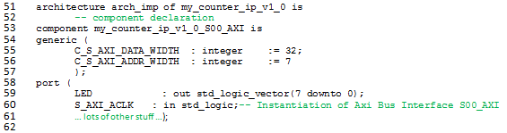
Xilinx Vivado – Create and Package Custom IP
6. Modifying My_Counter_IP_v1_0 top level file
Add a port for the LEDs in the my_counter_ip_v1_0_S00_AXI component declaration:
port (
LED : out std_logic_vector(7 downto 0);
S_AXI_ACLK : in std_logic;

Slide 38

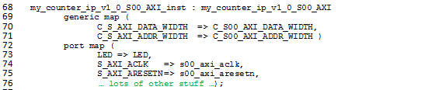
Xilinx Vivado – Create and Package Custom IP
6. Modifying My_Counter_IP_v1_0 top level file
Add a port map for the LEDs in the my_counter_ip_v1_0_S00_AXI component instantiation:
port map (
LED => LED,
S_AXI_ACLK => s00_axi_aclk,

Slide 39
Xilinx Vivado – Create and Package Custom IP
7. Packaging the IP core
Now that we have written the core, it is time to package up the HDL to create a complete IP package.
7.1) Now click on Package IP in the Flow Navigator and you should see the Package IP tab. Select Compatibility and make sure “Artix7” are present. If those are not there, you can add them by clicking the plus button. The Life Cycle does not matter at this point.

Slide 40
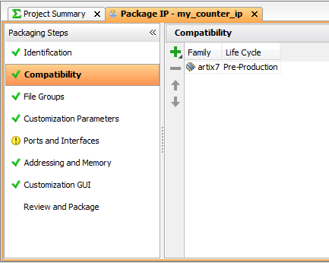
Xilinx Vivado – Create and Package Custom IP
7. Packaging the IP core

Slide 41
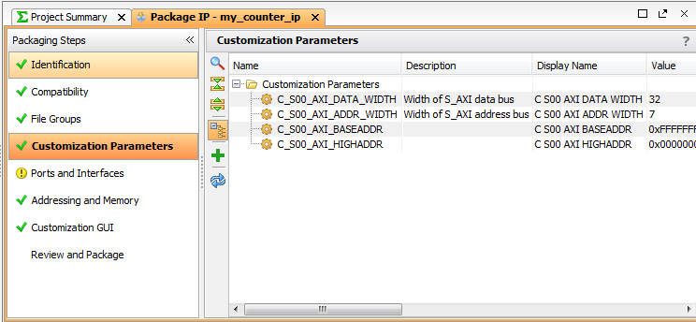
Xilinx Vivado – Create and Package Custom IP
7.2) Select Customization Parameters and select the line for Merge Changes from Customization Parameters Wizard. This will have the My_Counter_IP parameters from the top file.

Slide 42
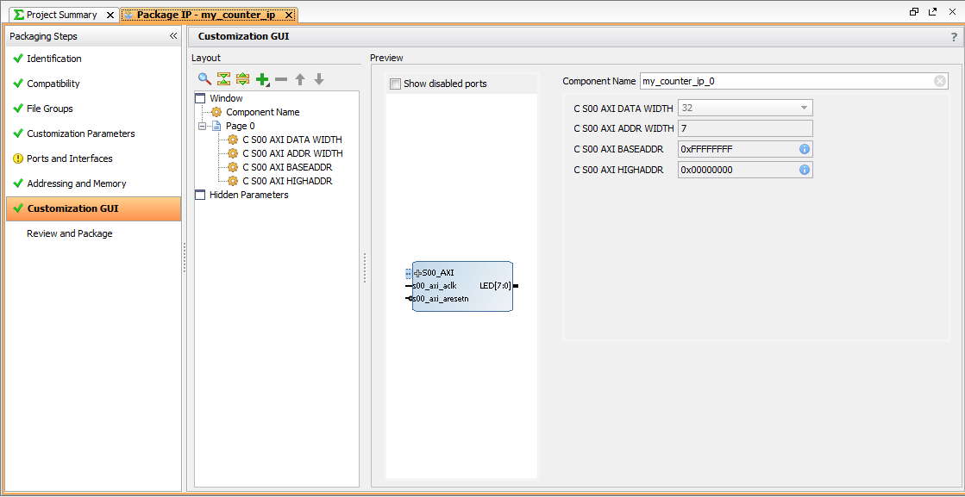
Xilinx Vivado – Create and Package Custom IP
7.3) Select Customization GUI. This is were we get to change our graphical interface. No changes at this time.

Slide 43
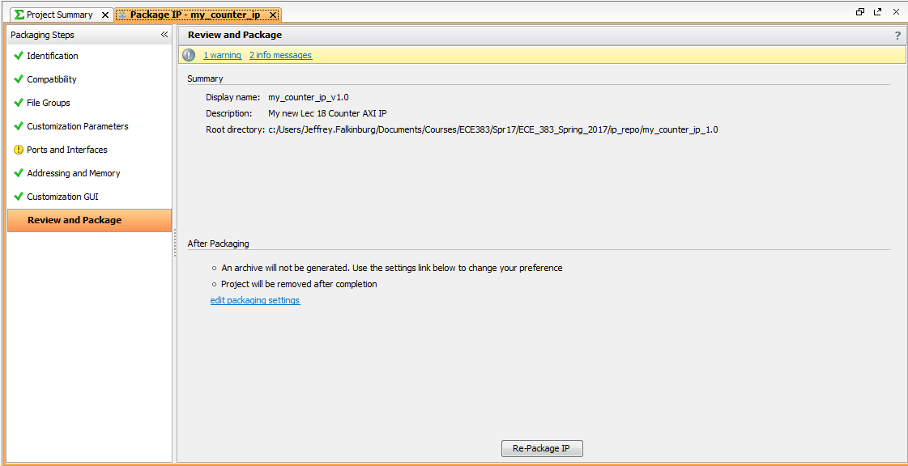
Xilinx Vivado – Create and Package Custom IP
7.4) Now the core should be complete so select Review and Package and click the Re-package IP button.

Slide 44
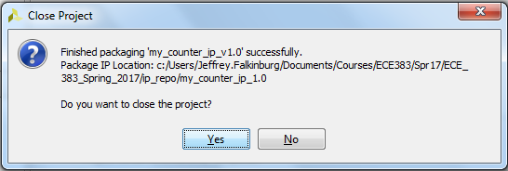
Xilinx Vivado – Create and Package Custom IP
7.5) A popup will ask if you want to close the project, Select Yes.

Slide 45
Xilinx Vivado – Create and Package Custom IP
Before you add your Custom IP to your design update the Makefile in the ip_repo/my_counter_ip_1.0/drivers folder using the following code (Fixing this now will eliminate issues later in Vitis):
COMPILER=
ARCHIVER=
CP=cp
COMPILER_FLAGS=
EXTRA_COMPILER_FLAGS=
LIB=libxil.a
RELEASEDIR=../../../lib
INCLUDEDIR=../../../include
INCLUDES=-I./. -I${INCLUDEDIR}
INCLUDEFILES=*.h
LIBSOURCES=$(wildcard *.c)
OBJECTS = $(addsuffix .o, $(basename $(wildcard *.c)))
ASSEMBLY_OBJECTS = $(addsuffix .o, $(basename $(wildcard *.S)))
libs:
echo "Compiling simple_adder..."
$(COMPILER) $(COMPILER_FLAGS) $(EXTRA_COMPILER_FLAGS) $(INCLUDES) $(LIBSOURCES)
$(ARCHIVER) -r ${RELEASEDIR}/${LIB} ${OBJECTS} ${ASSEMBLY_OBJECTS}
make clean
include:
${CP} $(INCLUDEFILES) $(INCLUDEDIR)
clean:
rm -rf ${OBJECTS} ${ASSEMBLY_OBJECTS}

Slide 46
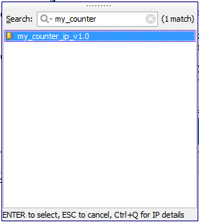
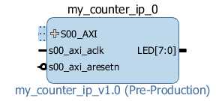
Xilinx Vivado – Create and Package Custom IP
8. Add Custom IP to your design
8.1) In the project manager page of the original window, click Open Block Design. This adds a block design to the project.
8.2) Use the Add IP button to add our Lec 11 Counter IP Core.

Slide 47
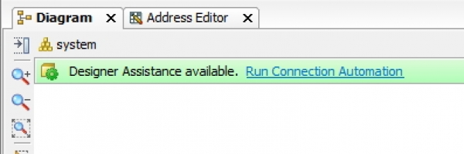
Xilinx Vivado – Create and Package Custom IP
8. Add Custom IP to your design
8.3) Right click on LEDs and select Make External and then run Connection Automation

Slide 48
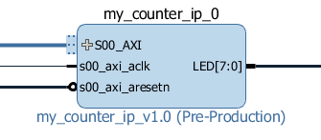
Xilinx Vivado – Create and Package Custom IP
8. Add Custom IP to your design
8.4) The MIG block should read my_counter_ip_0. Place your cursor on this symbol || next to the LED[7:0] port name. Your cursor will change to look like a pencil. Right click here and in the drop down list select Make External or left click on || and use the keyboard shortcut, “Ctrl+t”.

Slide 49
Xilinx Vivado – Create and Package Custom IP
8. Add Custom IP to your design
8.5) Your custom IP should now be connected. Now you need to add a constraints file to add the LED net to the pins on the Artix 7 chip by adding the following lines to the lec19.xdc file.
## LEDs
set_property -dict { PACKAGE_PIN T14 IOSTANDARD LVCMOS25 } [get_ports { LED[0] }]; #IO_L15P_T2_DQS_13 Sch=led[0]
set_property -dict { PACKAGE_PIN T15 IOSTANDARD LVCMOS25 } [get_ports { LED[1] }]; #IO_L15N_T2_DQS_13 Sch=led[1]
set_property -dict { PACKAGE_PIN T16 IOSTANDARD LVCMOS25 } [get_ports { LED[2] }]; #IO_L17P_T2_13 Sch=led[2]
set_property -dict { PACKAGE_PIN U16 IOSTANDARD LVCMOS25 } [get_ports { LED[3] }]; #IO_L17N_T2_13 Sch=led[3]
set_property -dict { PACKAGE_PIN V15 IOSTANDARD LVCMOS25 } [get_ports { LED[4] }]; #IO_L14N_T2_SRCC_13 Sch=led[4]
set_property -dict { PACKAGE_PIN W16 IOSTANDARD LVCMOS25 } [get_ports { LED[5] }]; #IO_L16N_T2_13 Sch=led[5]
set_property -dict { PACKAGE_PIN W15 IOSTANDARD LVCMOS25 } [get_ports { LED[6] }]; #IO_L16P_T2_13 Sch=led[6]
set_property -dict { PACKAGE_PIN Y13 IOSTANDARD LVCMOS25 } [get_ports { LED[7] }]; #IO_L5P_T0_13 Sch=led[7]

Slide 50
MicroBlaze + Custom IP

Slide 51
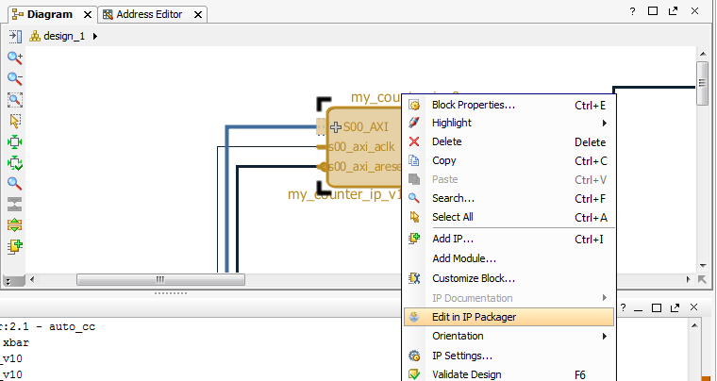
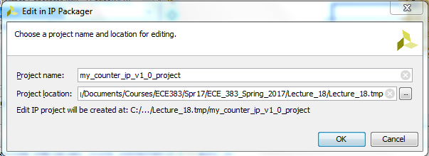
Updating Custom IP
Right click on custom IP and click Edit in IP Packager if you want to modify! Otherwise skip to validate design.
9
9
2
1

Slide 52
Xilinx Vivado – Create and Package Custom IP
Now that you updated the core you need to re-select Review and Package and click the Re-package IP button.

Slide 53
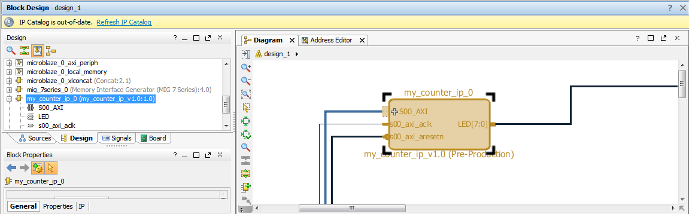
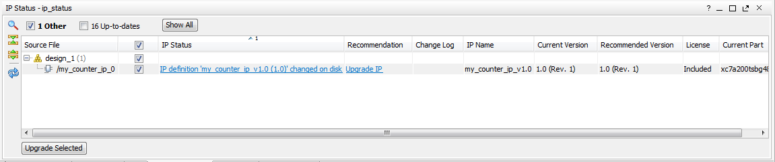
Updating Custom IP
Refresh IP Catalog, Upgrade IP and then Re-Generate
1
2

Slide 54
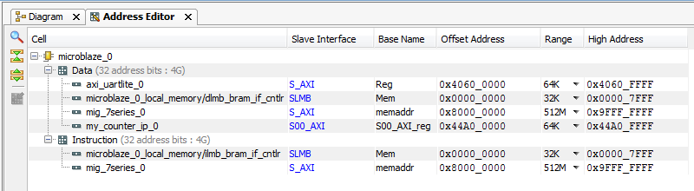
Verify Design
You should verify the addressing for all your design components before continuing.
Verify that the base addresses are the same addresses used in the template C-code.
Should be no changes at this time.
1
2
3

Slide 55
Validate and Export Design
First click validate design_1
Regenerate the design_1 HDL wrapper.
Finally you need to generate the Generate Design bitstream
Take a coffee break while it builds

Slide 56

Coffee Break
This Photo by Unknown Author is licensed under CC BY-NC

Slide 57
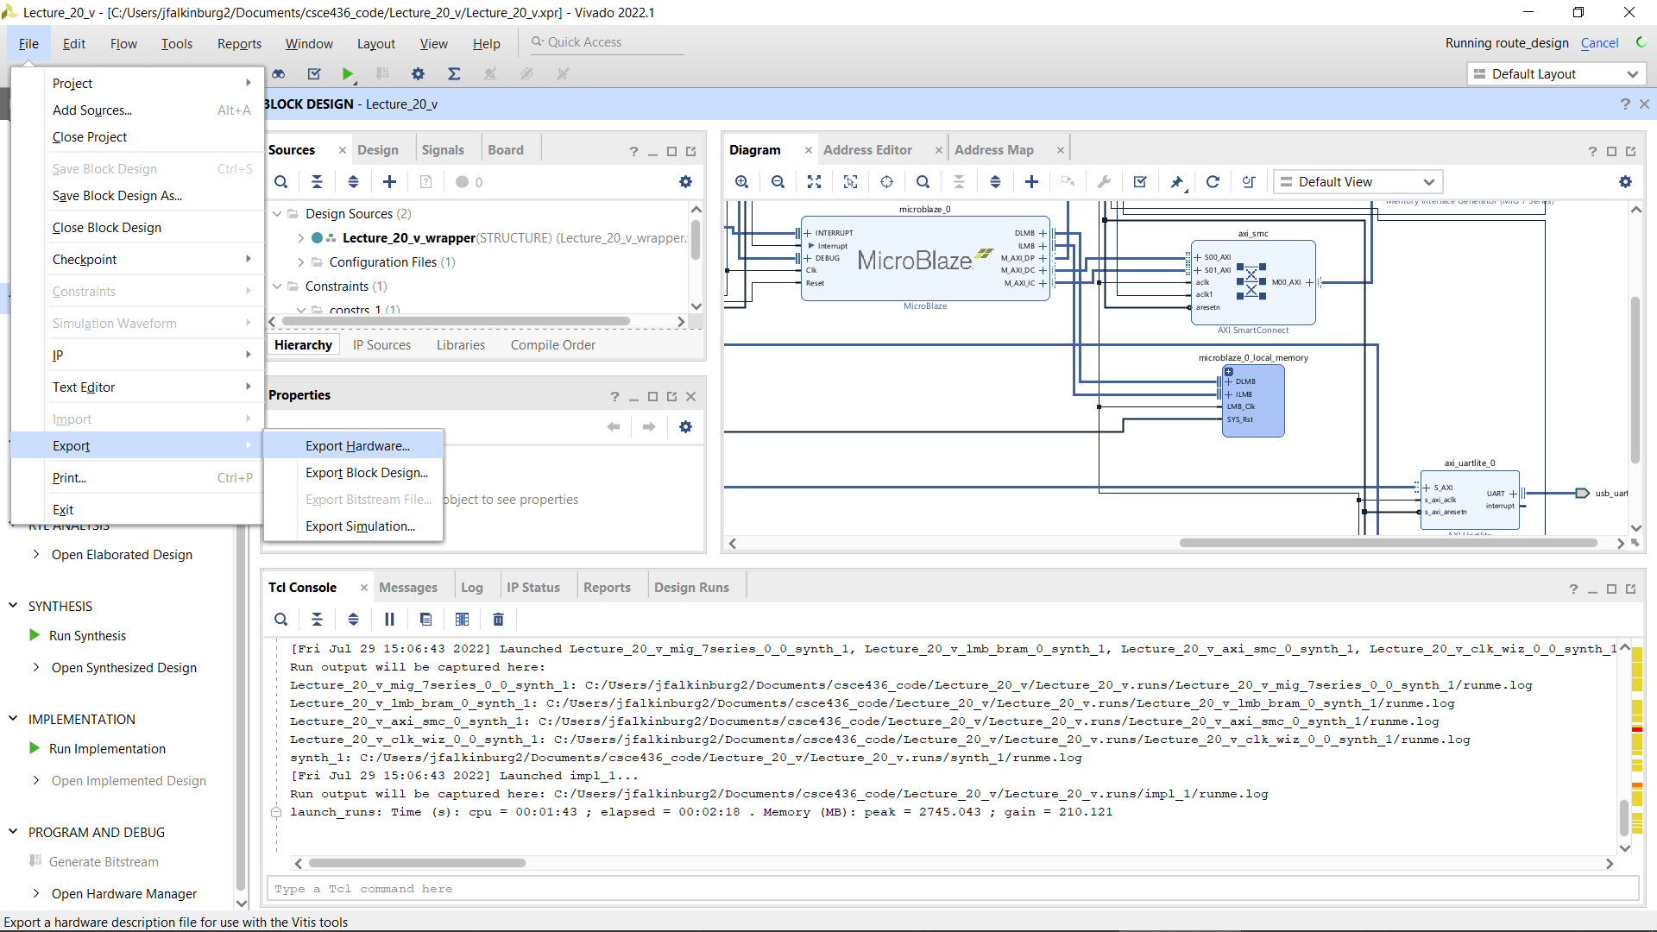
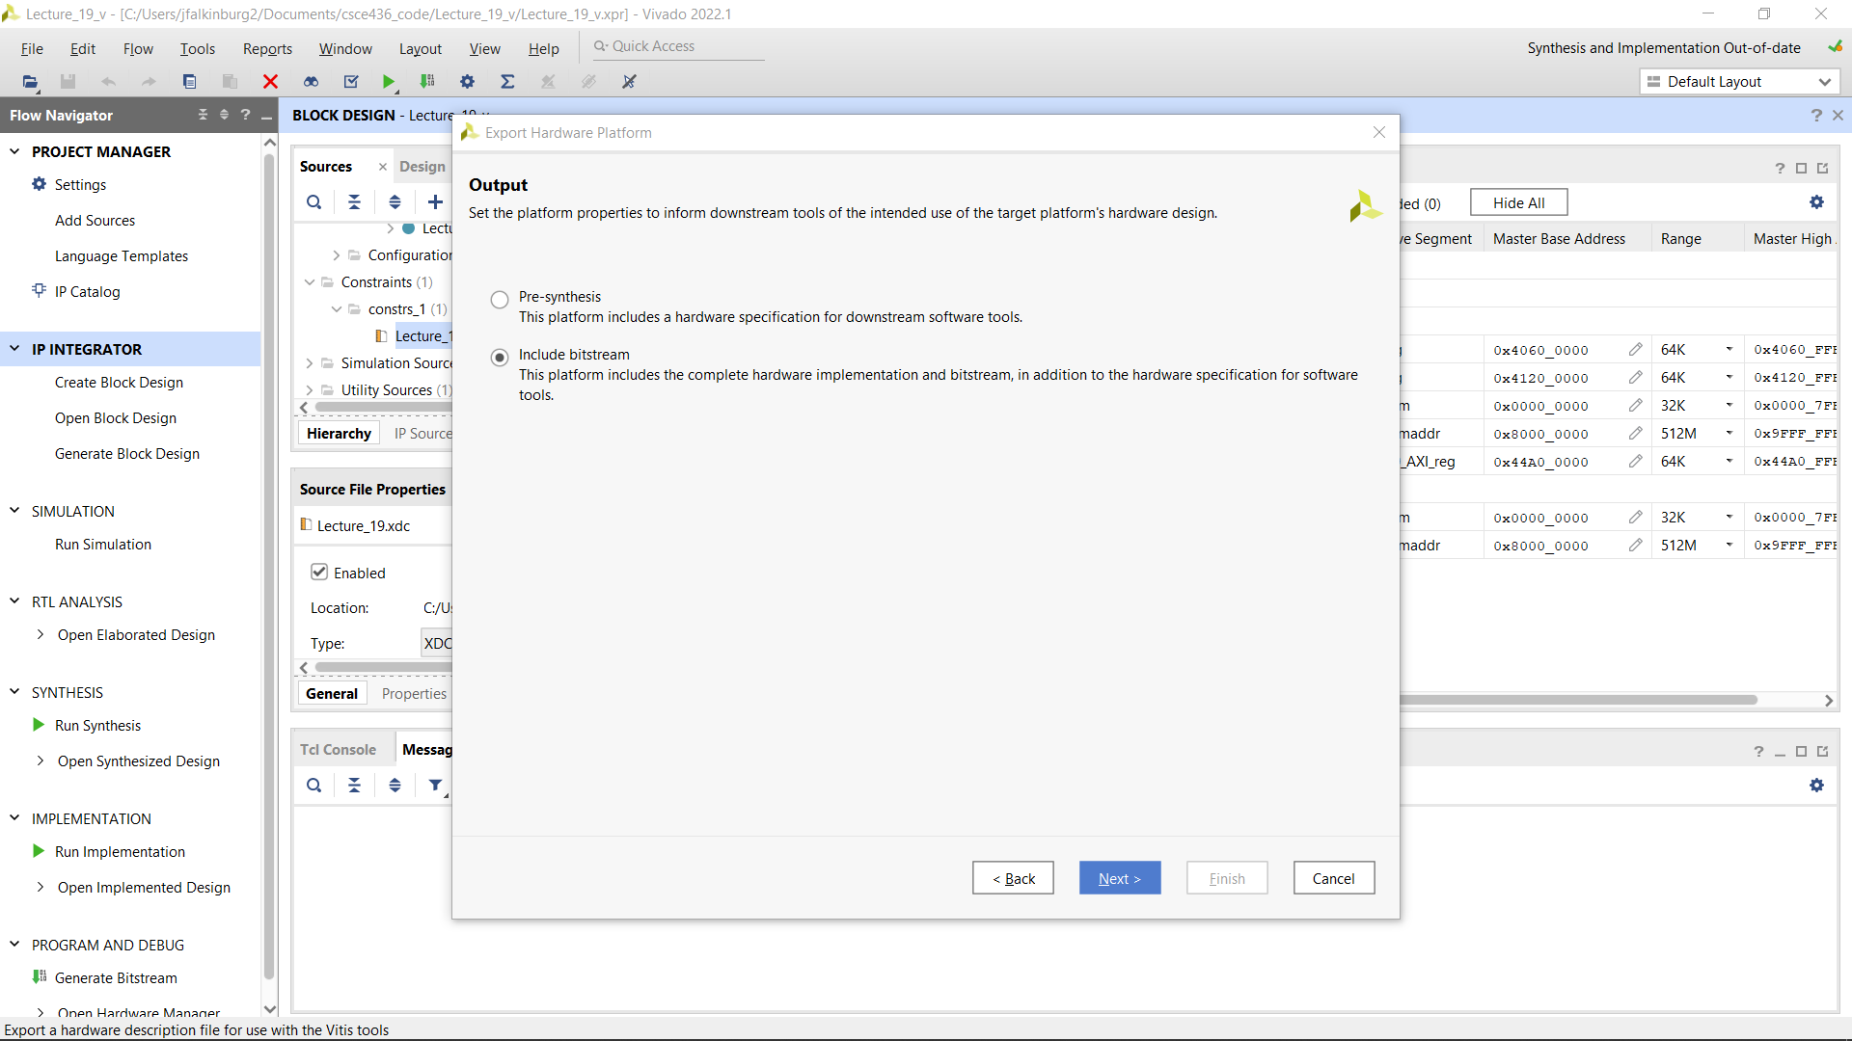
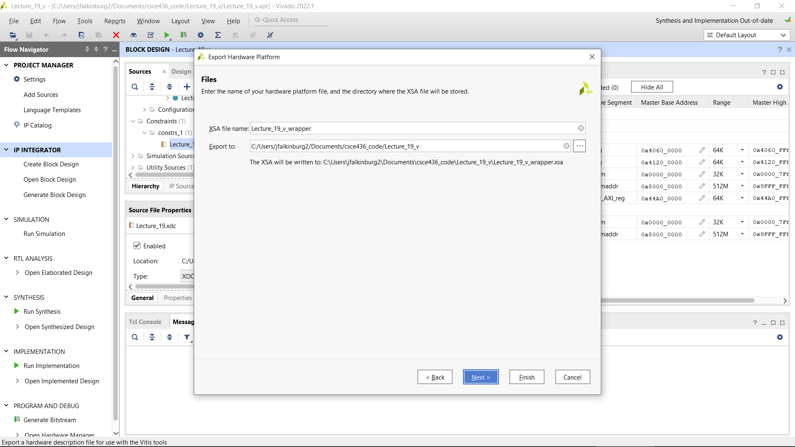
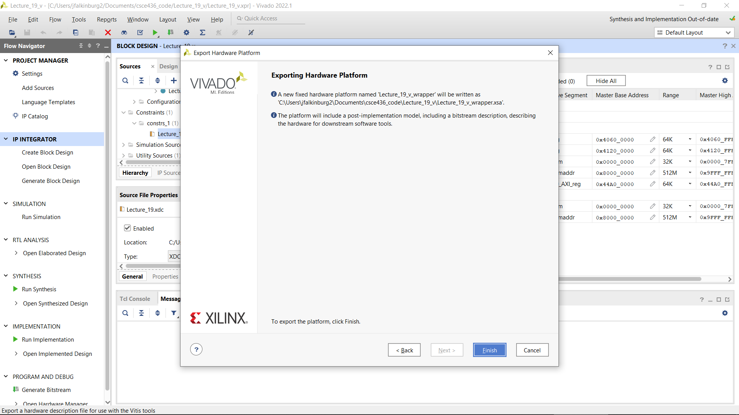
Export Design
Exporting Hardware Design to Vitis…be sure to include the bitstream…assuming no errors

Slide 58
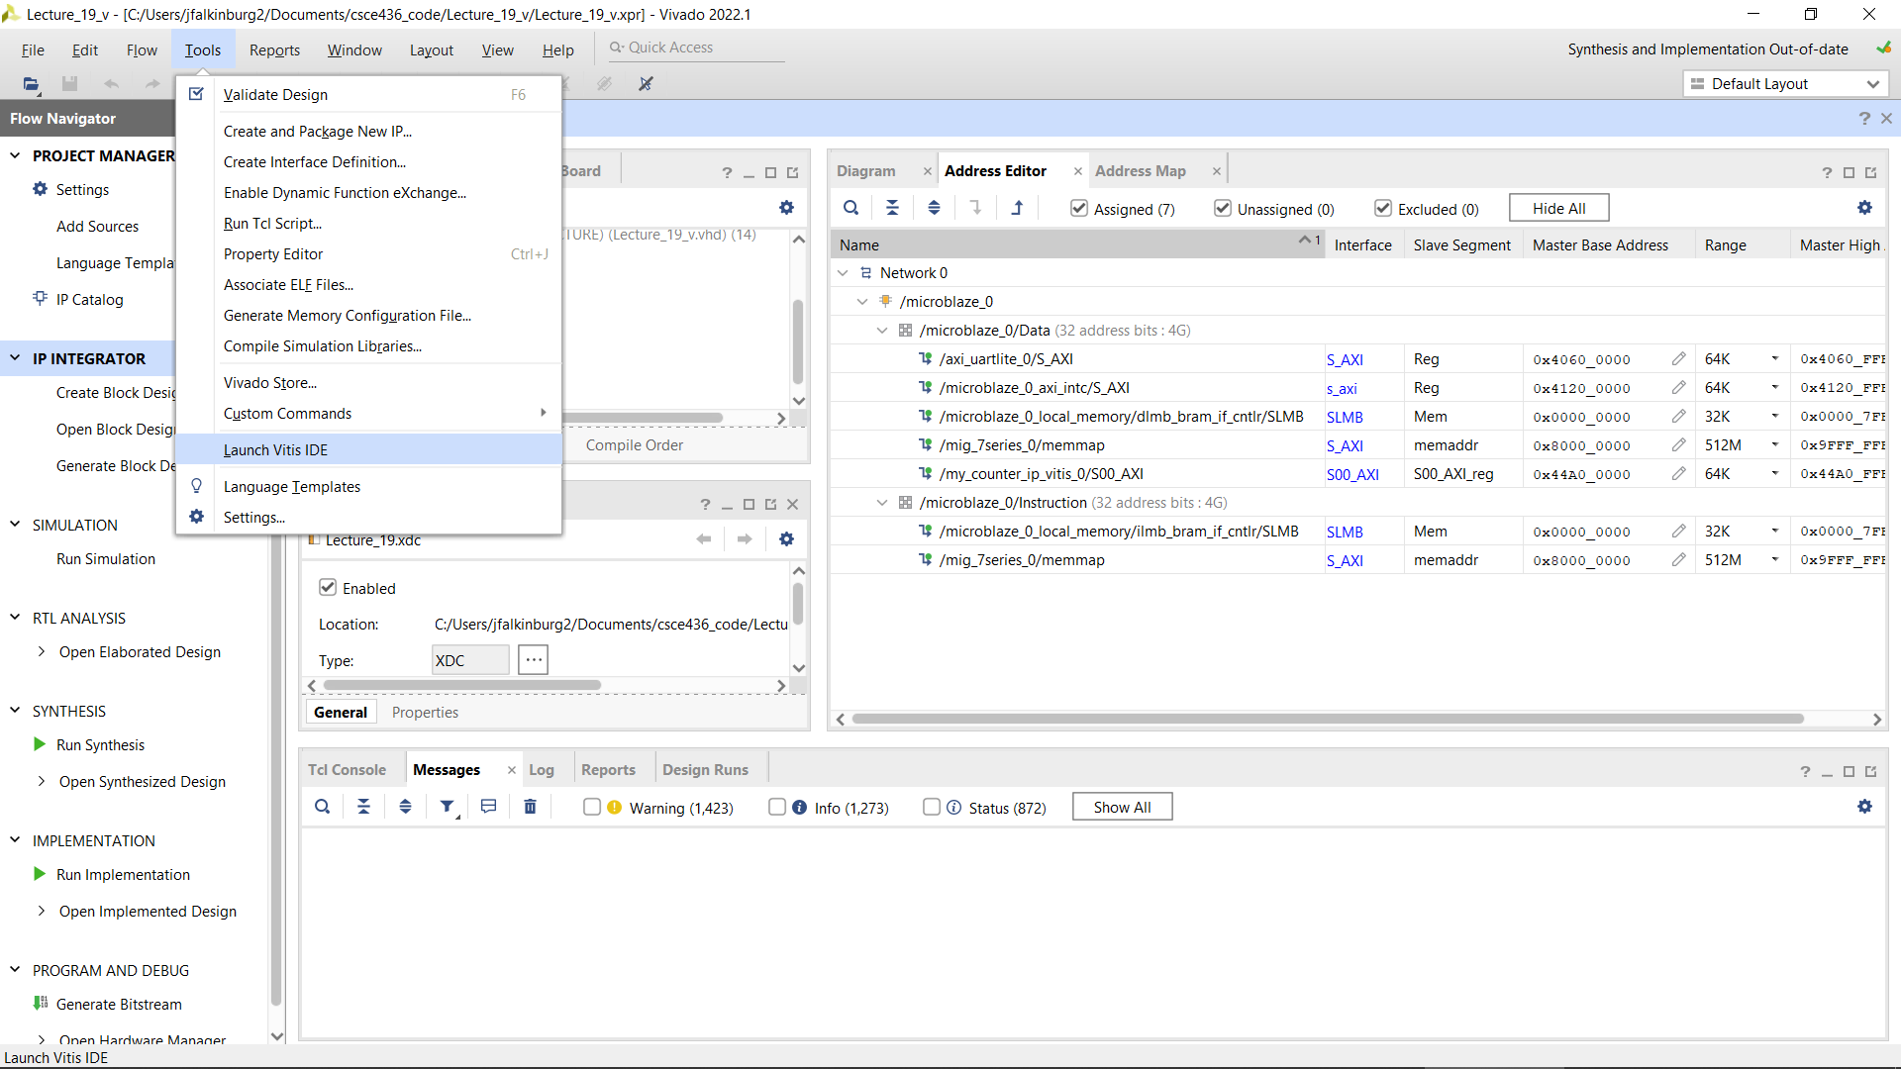
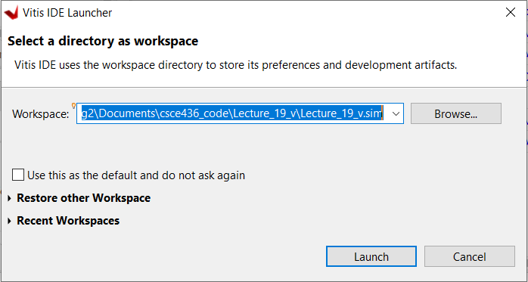
Launch Vitis
Go to Tools, select Launch Vitis IDE, select the .sim folder in your current project folder and click Launch.

Slide 59
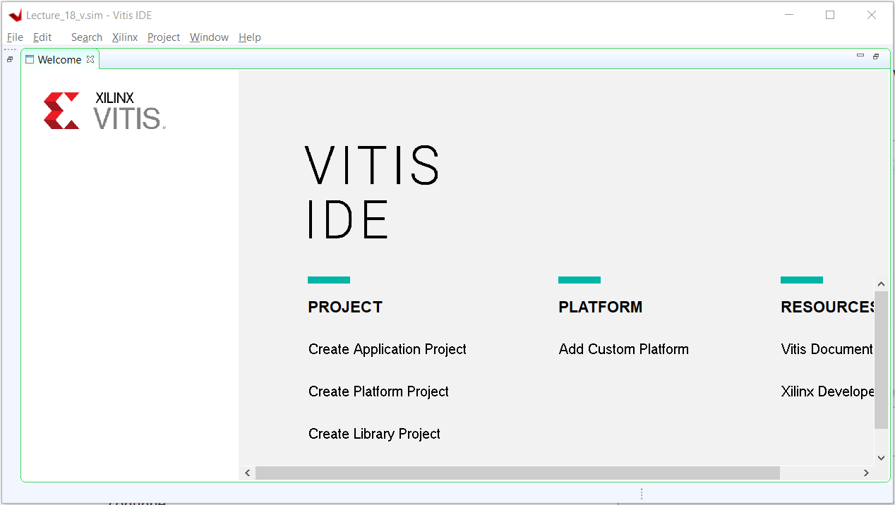
New Vitis Project

Slide 60
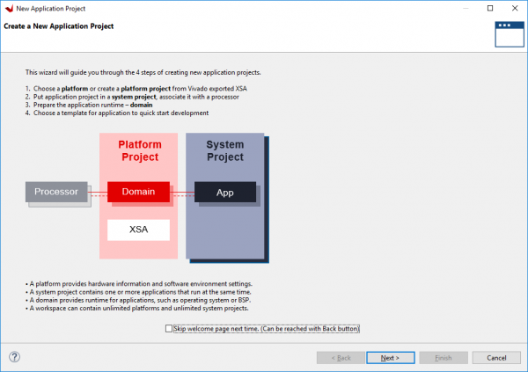
Xilinx Vitis
Click Next

Slide 61
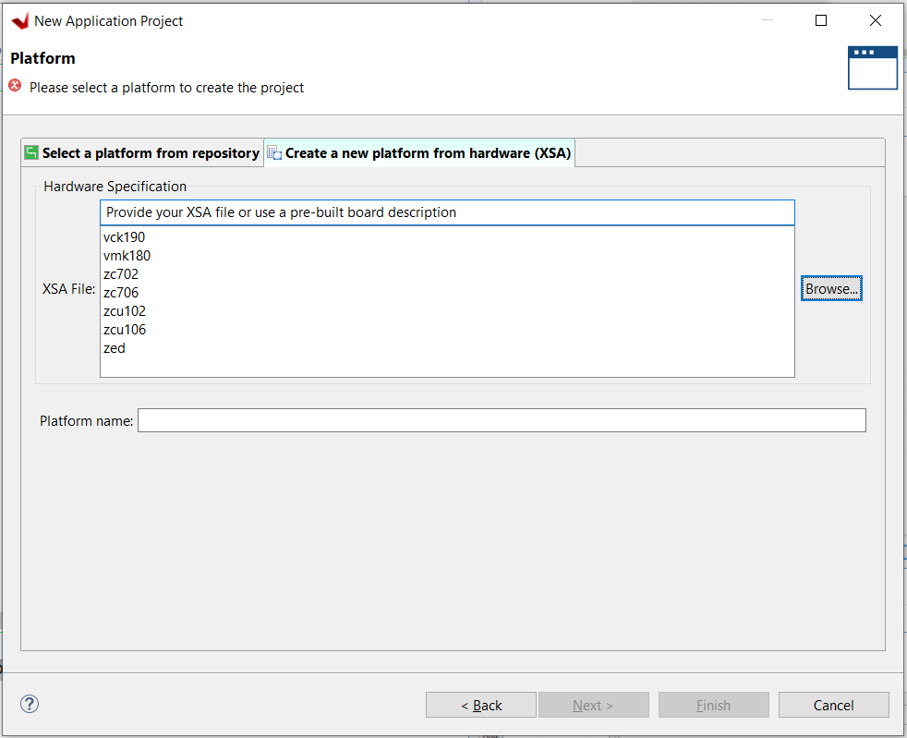
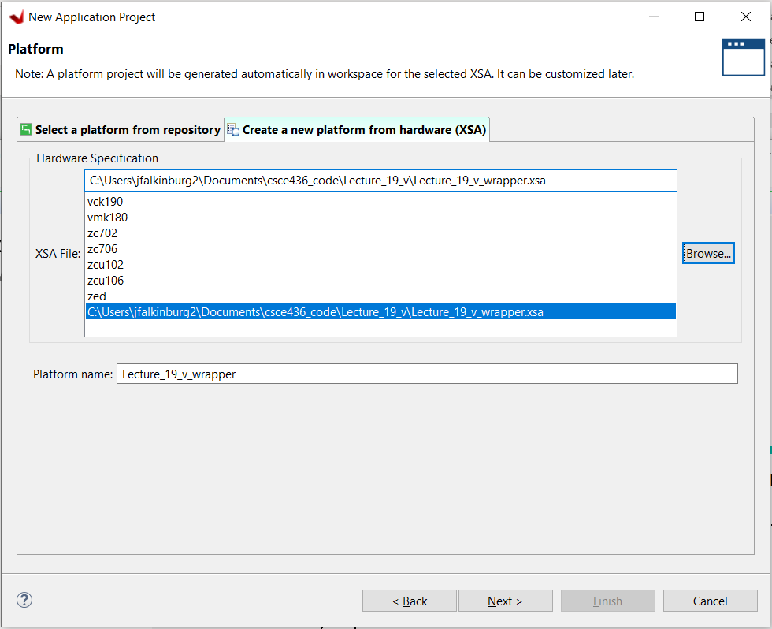
Xilinx Vitis
Create a new platform…
Add your previously created XSA file and click next

Slide 62
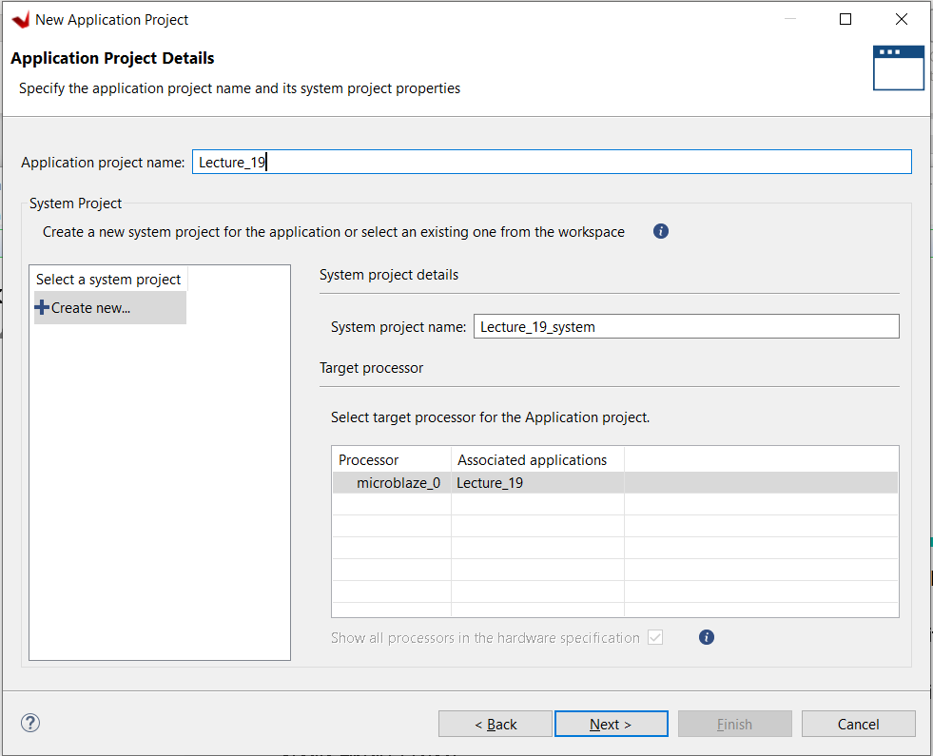
Xilinx Vitis
Name project and click next

Slide 63
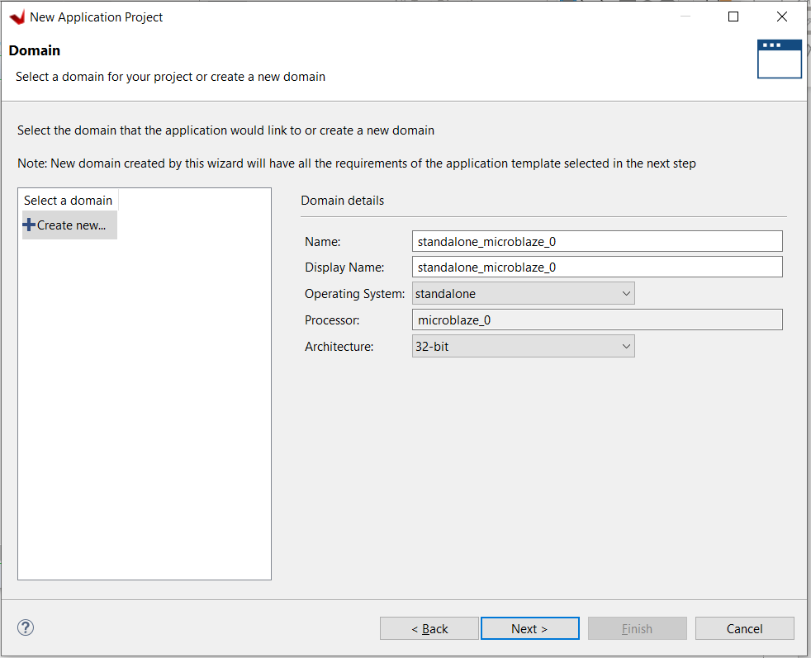
Xilinx Vitis
Keep default domain settings and click next.

Slide 64
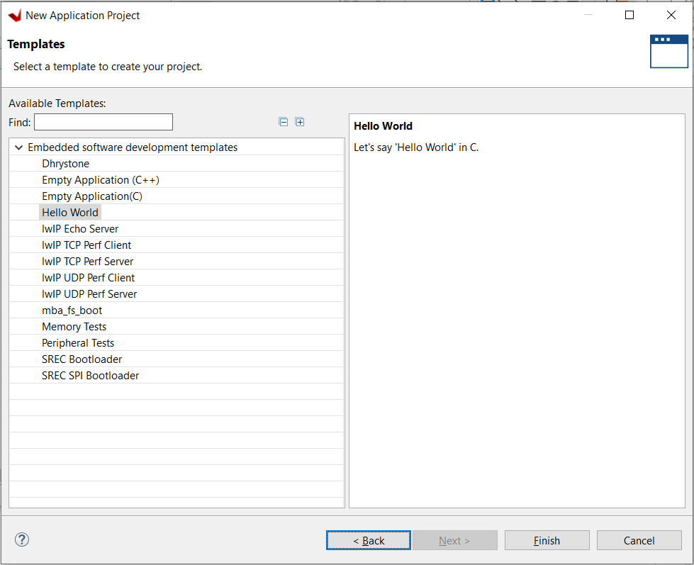
Xilinx Vitis
Choose Hello World Application so it creates the platform.c and .h files for the example program.

Slide 65
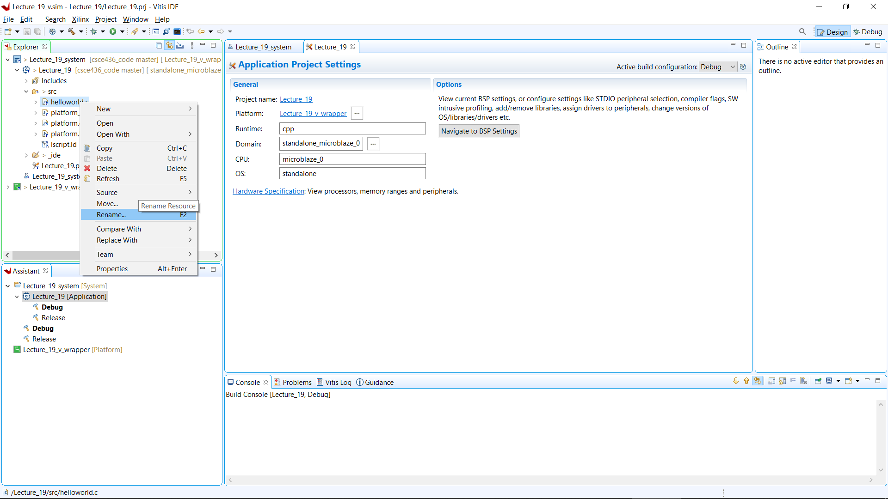
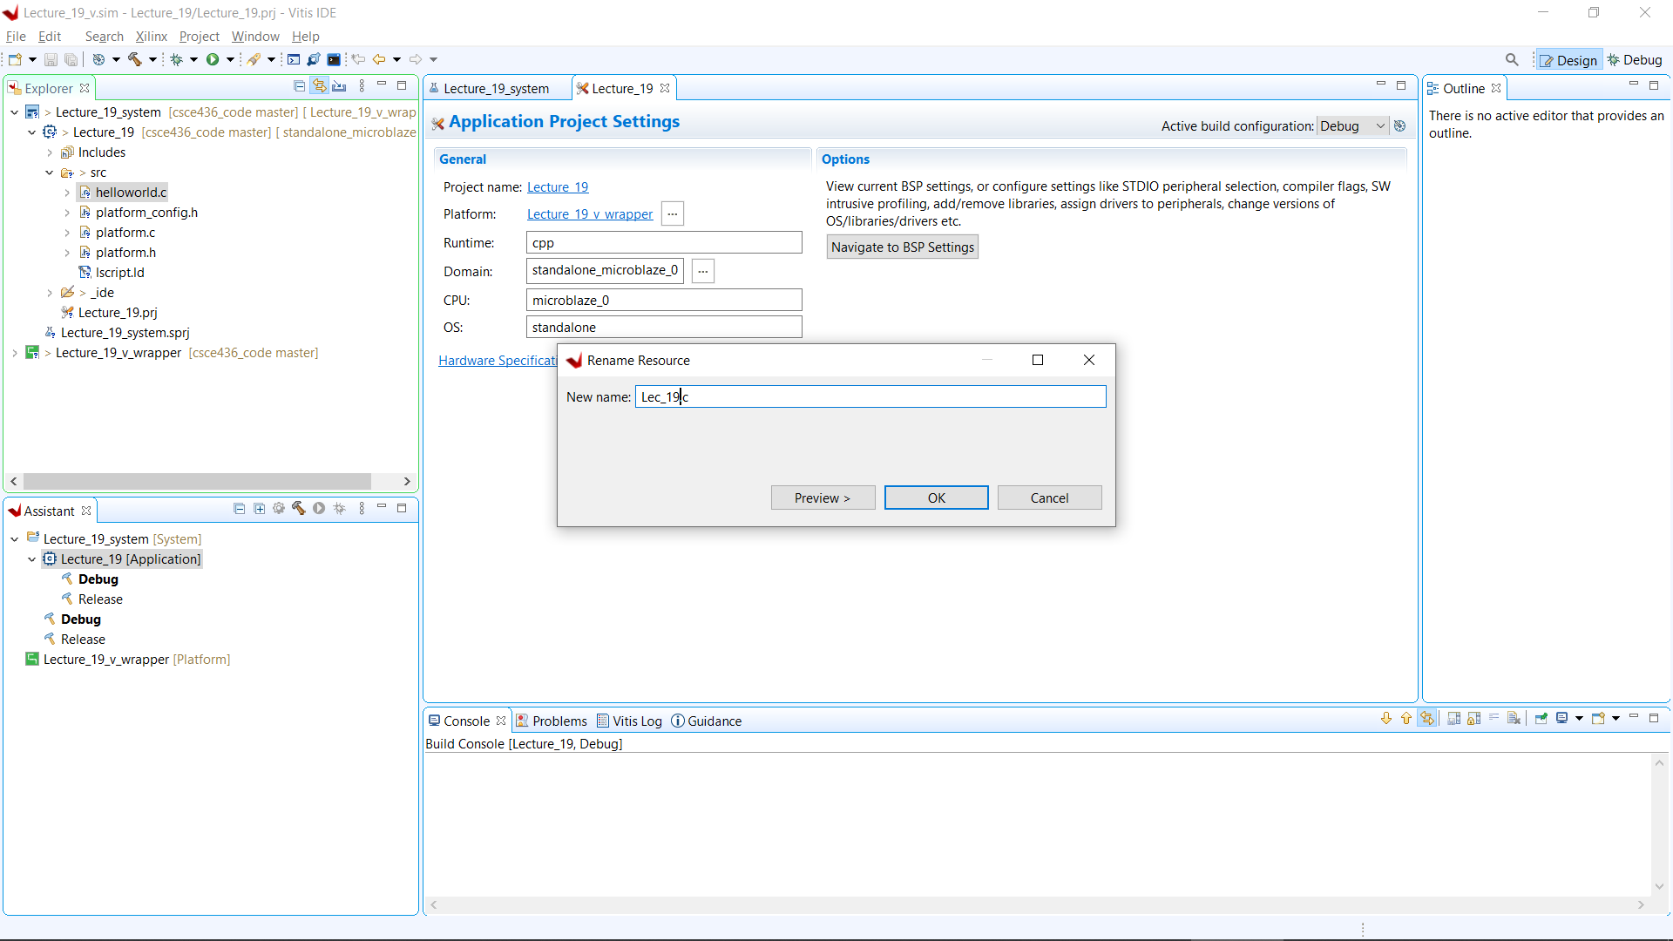
Rename helloworld.c
In Vitis' Explorer pane, find the application projects “src” directory. Right click on helloworld.c and rename it to Lec_19.c.

Slide 66
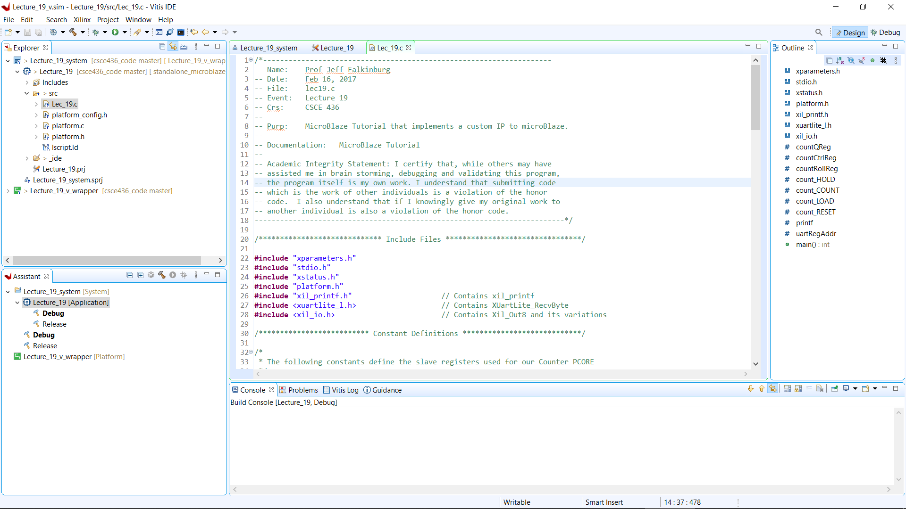
Xilix Vitis
Copy Lec19.c code from course website.

Slide 67

Lec19.c

Slide 68

Lec19.c

Slide 69

Lec19.c

Slide 70

Lec19.c

Slide 71

Lec19.c

Slide 72

Lec19.c

Slide 73
Part 2: Software Questions/ Notes related to handout
Why doesn't the 'c' command cause the counter to count up by 1?
On line 130, why did I subtract 0x30?
After loading the counter on line 132, something should be done that is missing.
What line of VHDL code in my_counter_ip_v1_0_S00_AXI.vhd is "activated" when line 80 executes?
What line of VHDL code in my_counter_ip_v1_0_S00_AXI.vhd is "activated" when line 141 executes?
What line of VHDL code in lec19.vhdl "activated" when line 141 executes?
What appears to be the naming convention for hardware registers?

Slide 74
Add C code to Source File
Copy Lec19.c code from course website.

Slide 75
Issues with Vitis and IP Cores
Major error with export of Custom IP from Vivado to Vitis. Error may present as:
Missing xparameters.h error
Failed to build the bsp sources for domain error
Cannot find the *.xpfm file
Solutions:
https://support.xilinx.com/s/article/75527?language=en_US
https://support.xilinx.com/s/question/0D52E00006jpcvVSAQ/fatal-error-xparametersh-no-such-file-or-directoryxilinx-platform-definition-filexpfm-is-removed-after-building-the-project?language=en_US
Update both Makefiles in the following Vitis subfolders (otherwise you should be able to update the Makefile in the ip_core driver folder prior to build/export):
Lecture_19_v.sim\Lecture_19_v_wrapper\hw\drivers\my_counter_ip_vitis_v1_0\src
Lecture_19_v.sim\Lecture_19_v_wrapper\microblaze_0\standalone_microblaze_0\bsp\microblaze_0\libsrc\my_counter_ip_vitis_v1_0\src

Slide 76
Issues with Vitis and IP Cores Makefile Solution
Update the both Makefiles in the following subfolders using the following code (make sure you build the wrapper before the software project):
Lecture_19_v.sim\Lecture_19_v_wrapper\hw\drivers\my_counter_ip_vitis_v1_0\src
Lecture_19_v.sim\Lecture_19_v_wrapper\microblaze_0\standalone_microblaze_0\bsp\microblaze_0\libsrc\my_counter_ip_vitis_v1_0\src
COMPILER=
ARCHIVER=
CP=cp
COMPILER_FLAGS=
EXTRA_COMPILER_FLAGS=
LIB=libxil.a
RELEASEDIR=../../../lib
INCLUDEDIR=../../../include
INCLUDES=-I./. -I${INCLUDEDIR}
INCLUDEFILES=*.h
LIBSOURCES=$(wildcard *.c)
OBJECTS = $(addsuffix .o, $(basename $(wildcard *.c)))
ASSEMBLY_OBJECTS = $(addsuffix .o, $(basename $(wildcard *.S)))
libs:
echo "Compiling simple_adder..."
$(COMPILER) $(COMPILER_FLAGS) $(EXTRA_COMPILER_FLAGS) $(INCLUDES) $(LIBSOURCES)
$(ARCHIVER) -r ${RELEASEDIR}/${LIB} ${OBJECTS} ${ASSEMBLY_OBJECTS}
make clean
include:
${CP} $(INCLUDEFILES) $(INCLUDEDIR)
clean:
rm -rf ${OBJECTS} ${ASSEMBLY_OBJECTS}

Slide 77
Xilinx Software Development Kit - Vitis
In the Vitis environment, you program the hardware built in the previous step.
The key concept here is that the peripheral defined in Vivado design are accessible through the slave registers as memory mapped devices.
Verify your my_counter_ip_v1_0 Base Address in system.hdf file is assigned to be 0x44a00000.
In the my_counter_ip_v1_0_S00_AXI.vhdl file, I (arbitrarily) assigned counter ports to slave register according to the table below.
Signal | direction | Slave Register | Address
D | Input | slv_reg0(7 downto 0) | 0x44a00000
ctrl | Input | slv_reg1(1 downto 0) | 0x44a00004
Q | Output | slv_reg0(7 downto 0) | 0x44a00000

Slide 78

Xilinx Vitis
Build Application
To build the project and all of its dependencies, select the system project in the Assistant pane, and either click the Build button ( ), or press Ctrl-B on your keyboard.

Slide 79

Increase Stack and Heap Size
You may have to add more Stack and Heap to your design
9
9
3
2
1

Slide 80


Launch Xilinx Vitis on FPGA
Launch a Vitis Baremetal Software Application
First, many applications require that a serial console is connected to the board, so that standard output (from print statements) can be viewed. For this purpose, a serial terminal like Tera Term. Use a serial terminal application to connect to the board's serial port. Unless otherwise stated, Microblaze designs with an AXI UART Lite IP use a baud rate of 9600.

Slide 81

Launch Xilinx Vitis on FPGA
Launch a Vitis Baremetal Software Application
In the Explorer pane at the left side of the screen, right click on the application or system project that is to be run, and select Run as → 1 Launch on Hardware (Single Application Debug). The FPGA will be programmed with the bitstream, the ELF file created by the software build is loaded into system memory, and the application project will begin to run. You will need to click back over to the Vitis Serial Terminal from the Console tab.
You should see the welcome and hitting “?” gives you the menu to observer counter operation on the LEDs

Slide 82

Re-Exporting Hardware
When you Re-Export Hardware from Vivado to Vitis you have to Update Hardware Specification.

Slide 83
MicroBlaze + Custom IP

