Slide 1
CSCE 436 – Advanced Embedded Systems
Lecture 18 – Soft CPU – “MicroBlaze”
Prof Jeffrey Falkinburg
Avery Hall 368
472-5120

Slide 2
Lesson Outline
HW# 9 BOC Next Lesson!
Soft CPU – MicroBlaze
  MicroBlaze Intro
  MicroBlaze Tutorial
  Adding LEDs GPIO

Slide 3
MicroBlaze Intro

Slide 4
Microblaze Intro
The goal of today's class is to bring you up to speed on how to instantiate a microBlaze processor on our Artix 7, integrate a custom piece of VHDL code to the processor, and then to write some C code to run on the microBlaze to control the custom VHDL module. Here are some specifications on the microBlaze processor: It has thirty-two 32-bit general purpose registers.
It uses a 32-bit instruction word with three operands, and has two addressing modes.
It has a 32-bit address bus.
It uses a single issue (3 or 5)-stage pipeline.

Slide 5
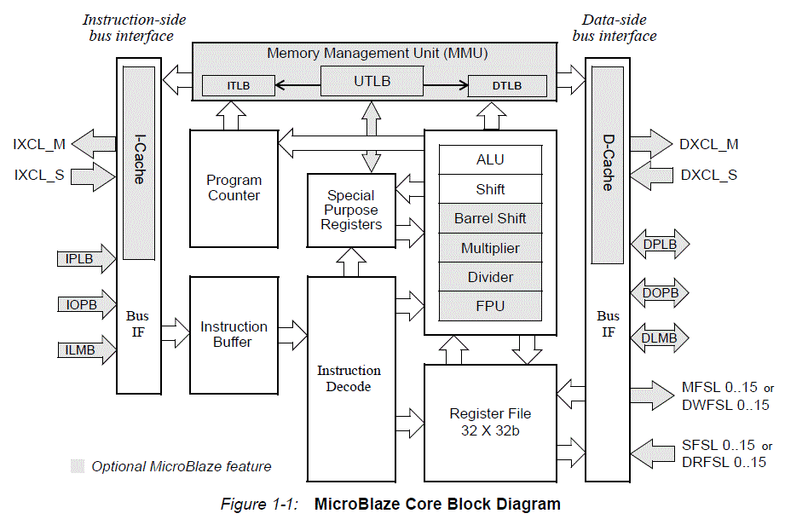
Microblaze Intro

Slide 6
MicroBlaze Tutorial

Slide 7
Microblaze – Tutorial Overview
In this tutorial, you will be introduced to the tool flow for simple MicroBlaze designs. Specifically, you will create a design that continuously reads the input from UART and writes that value to the LEDs. The UART will be connected from the FPGA to your computer via a micro USB cable.
You will follow the tutorial here step by step for Vitis.
  https://digilent.com/reference/programmable-logic/guides/getting-started-with-ipi

Slide 8
Microblaze - Tutorials
https://digilent.com/reference/programmable-logic/guides/getting-started-with-ipi (New Tutorial for Vitis)
https://reference.digilentinc.com/learn/programmable-logic/tutorials/nexys-video-getting-started-with-microblaze/start (Old Tutorial for SDK)
https://reference.digilentinc.com/learn/programmable-logic/tutorials/pmod-ips/start (Using PMOD IPs)
https://reference.digilentinc.com/learn/programmable-logic/tutorials/zedboard-creating-custom-ip-cores/start (Custom IP core tutorial)

Slide 9
Microblaze – Getting Started
What you need before proceeding with this guide
Software
  Xilinx Vivado with the Vitis package.
    Follow this Wiki guide (Installing Vivado) on how to install and activate Vivado 2022.1
Board Support Files
  Board Support Files. These files will describe GPIO interfaces on your board and make it easier to select your FPGA board and add GPIO IP blocks.
    Follow the Wiki guide on how to install Board Support Files for Vivado 2022.1
Hardware
  Digilent Nexys Video FPGA Board and Micro USB Cable for UART communication and JTAG programming

Slide 10
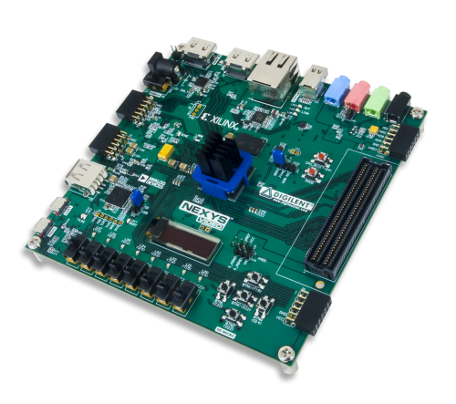
Microblaze – Tutorial Overview
You will follow the tutorial here step by step for Vitis.
  https://digilent.com/reference/programmable-logic/guides/getting-started-with-ipi

Slide 11
Microblaze - Introduction
Microblaze is a soft IP core from Xilinx that will implement a microprocessor entirely within the Xilinx FPGA general purpose memory and logic fabric. For this tutorial, we are going to add a Microblaze IP block using the Vivado IP Integrator tool.
In addition to the Microblaze IP block, we will also make use of the DDR3 SDRAM component on the Nexys Video. Therefore a MIG ( Memory Interface Generator ) IP block will be added to our design.
Additionally, instead of waiting until later we will also add in some GPIO LEDs to our hardware design.
Finally, a UART ( Universal Asynchronous Receiver/Transmitter ) IP block will be added to communicate between the host PC and the soft processor core running on the Nexys Video.

Slide 12
Microblaze
General Design Flow - Vivado
  Open Vivado and select Nexys Video board
  Create a new Vivado Project
  Create empty block design workspace inside the new project
  Add required IP blocks using the IP integrator tool and build Hardware Design
    We will also add some GPIO LEDs into our design for this lecture
  Validate and save block design
  Create HDL system wrapper
  Run design Synthesis and Implementation
  Generate Bit File
  Export Hardware Design including the generated bit stream file to Vitis tool
  Launch Vitis

Slide 13
Microblaze
Now the Hardware design is exported to the Vitis tool. The Vivado to Vitis hand-off is done through Xilinx Shell Architecture (XSA) file. We will use Vitis to create a Software application that will use the customized board interface data and FPGA hardware configuration by importing the hardware design information from Vivado.
General Design Flow - Vitis
  Create new application project and select default Hello World template
  Program FPGA
  Run configuration by selecting the correct UART COM Port and Baud Rate

Slide 14
MicroBlaze Tutorial Deviations
Deviations from the Vitis Tutorial
  Call your project "L18" or "Lecture_18".
  Select the Nexys Video board.
  In “Add a Processor to a Block Design Section”
    Expand “Add a Microblaze Processor to a Block Design”
    Expand and use “Follow the steps in this dropdown for boards with DDR memory”
  No need to delete the “clk_ref_i” pin…it doesn’t exist…
  A few modifications on clocking the Mig_7 clocking and reset:
    We need to create a 200 MHz clk_out2 on our clk_wiz_0 to connect to the sys_clk_i on the Mig_7. The sys_clk_i should be connected to the clk_in1 on the clk_wiz_0. Shown on next slide.
  Add LED GPIO
  Export Hardware to Vitis
  Open Vitis and create/run a software application

Slide 15
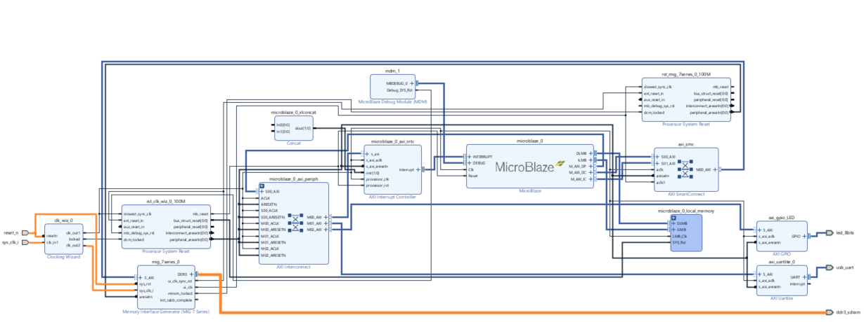
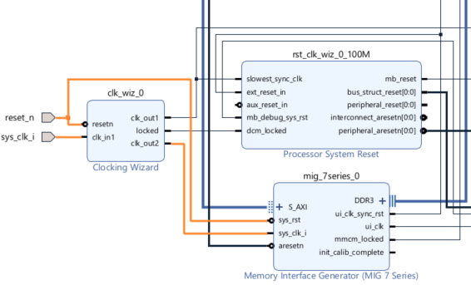
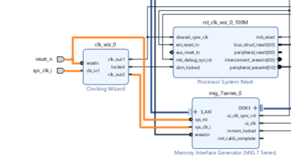
MicroBlaze Tutorial
Modifications on clocking the Mig_7 clocking and reset!
  We need to create a 200 MHz clk_out2 on our clk_wiz_0 to connect to the sys_clk_i on the Mig_7. The sys_clk_i should be connected to the clk_in1 on the clk_wiz_0

Slide 16
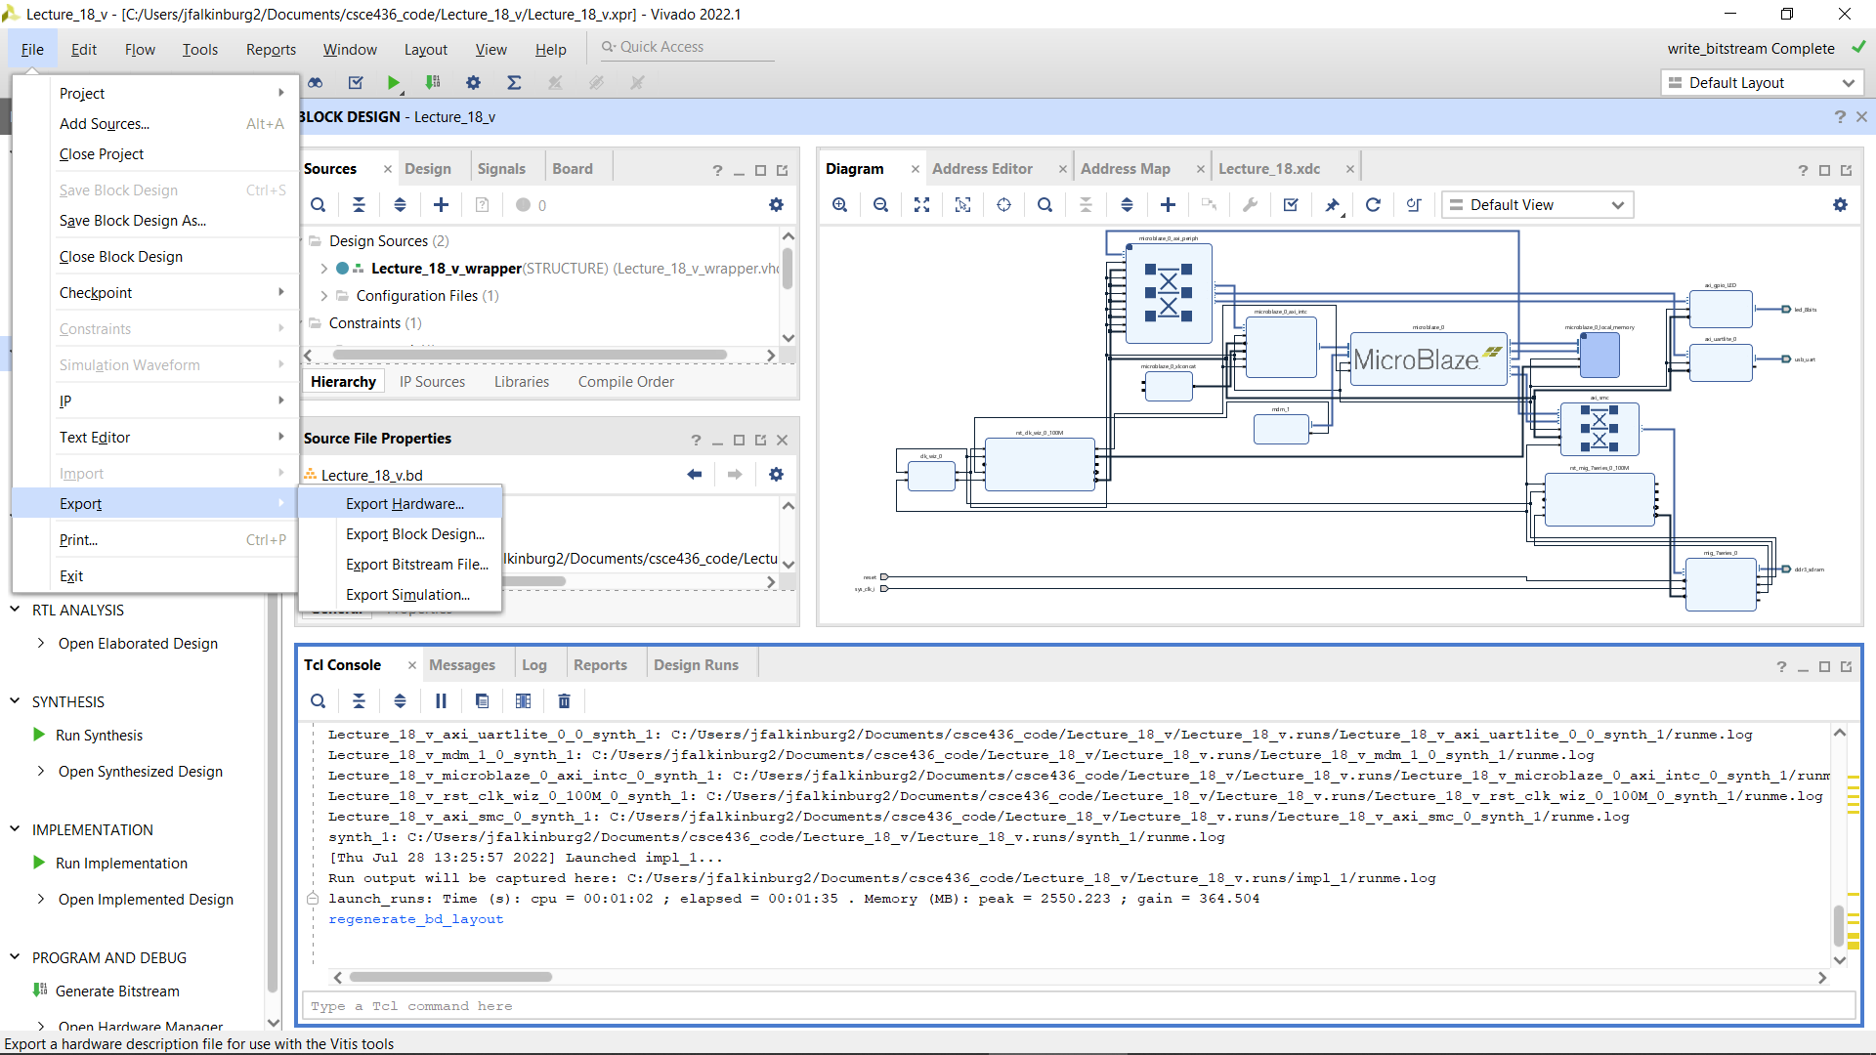
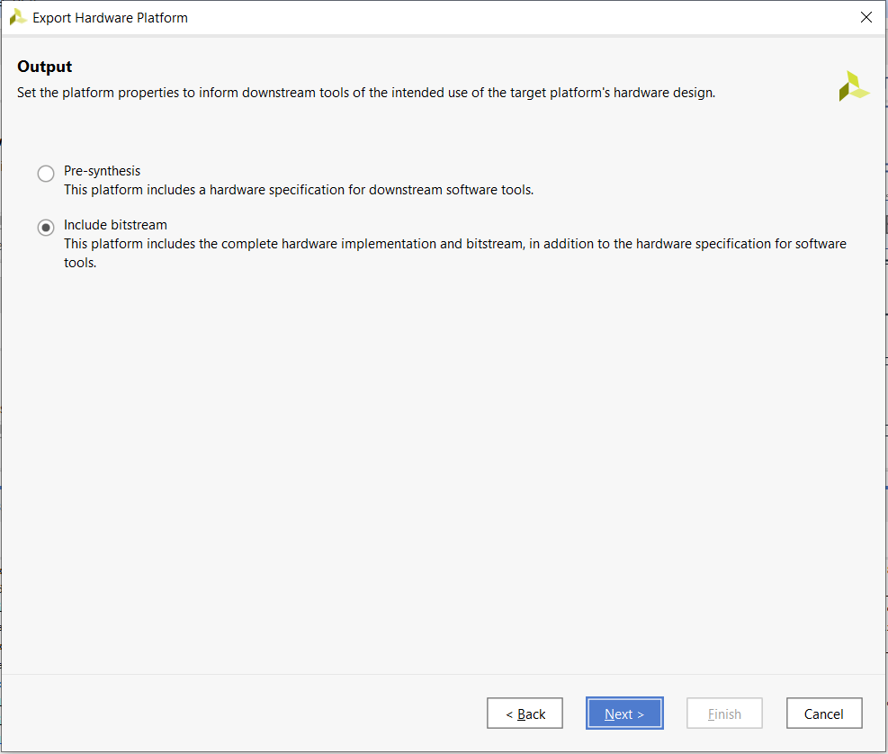
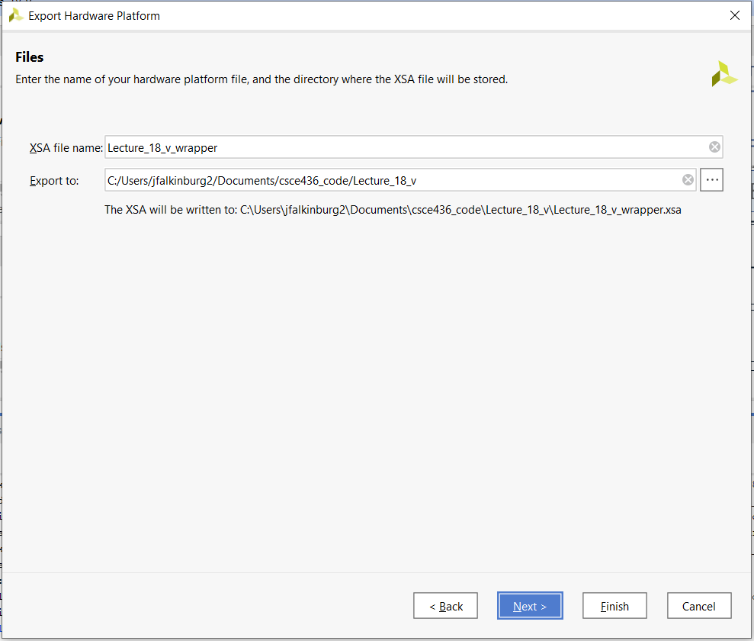
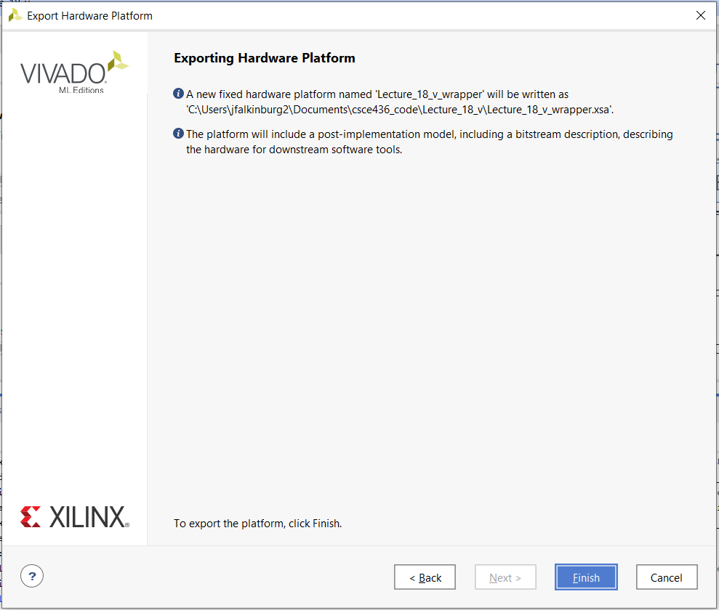
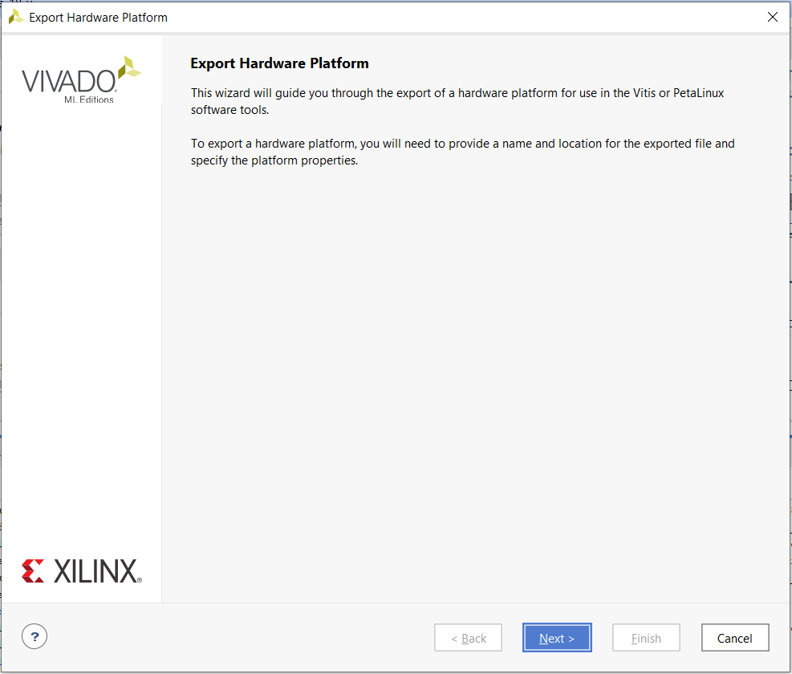
Export Hardware Design

Slide 17
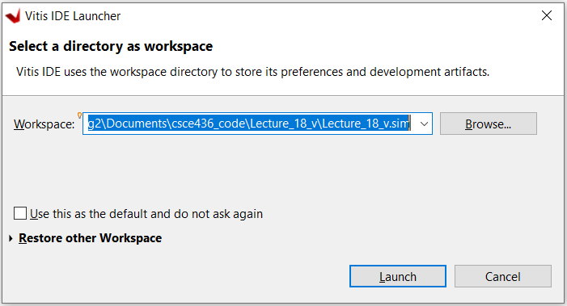
Launch Vitis
Launch Vitis
Select your workspace directory as the sim folder in your current project folder (e.g., Lecture_18.sim).

Slide 18
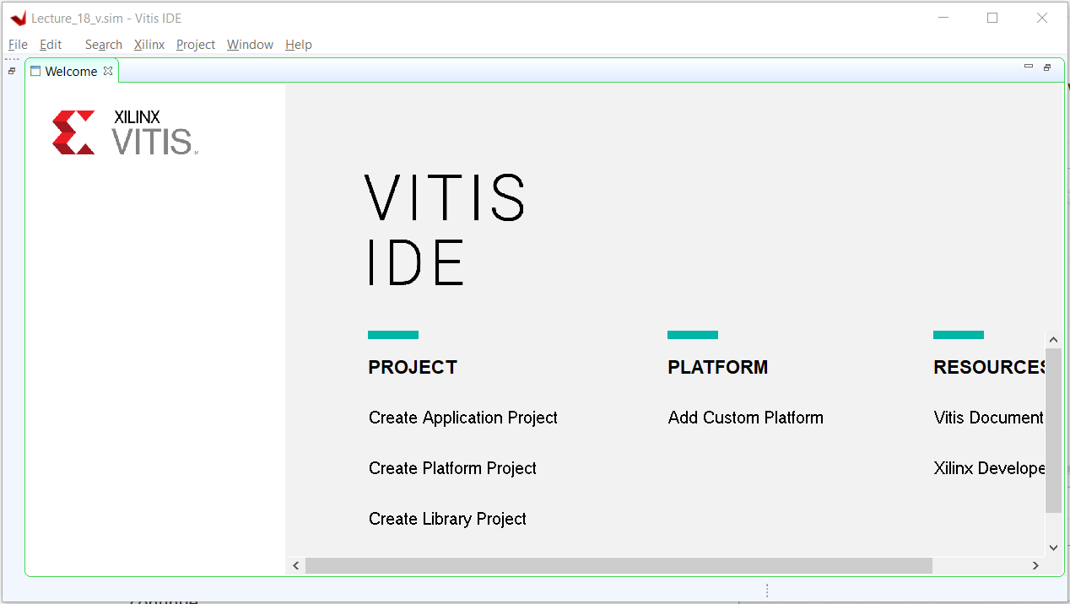
Xilinx Vitis
Create Application Project

Slide 19
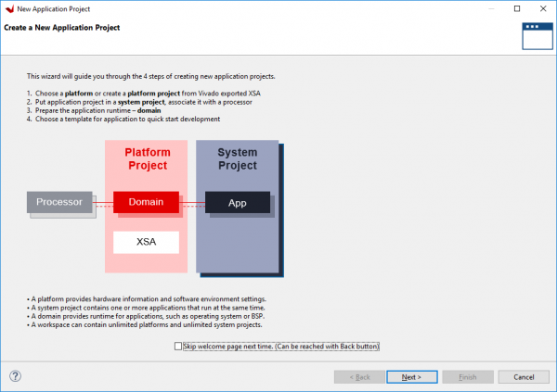
Xilinx Vitis
Click Next

Slide 20
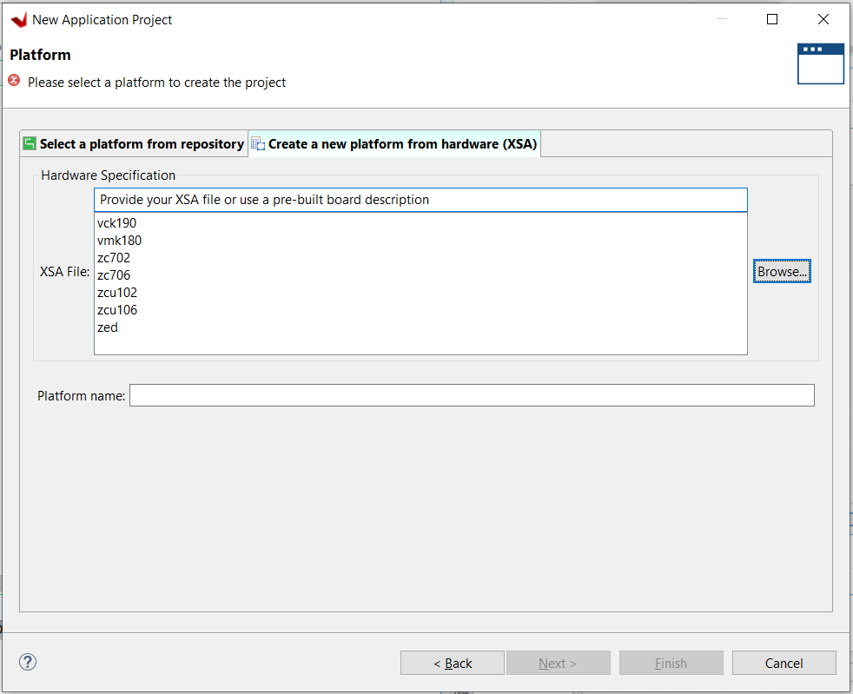
Xilinx Vitis
Create a new platform…
  Add your previously created XSA file and click next

Slide 21
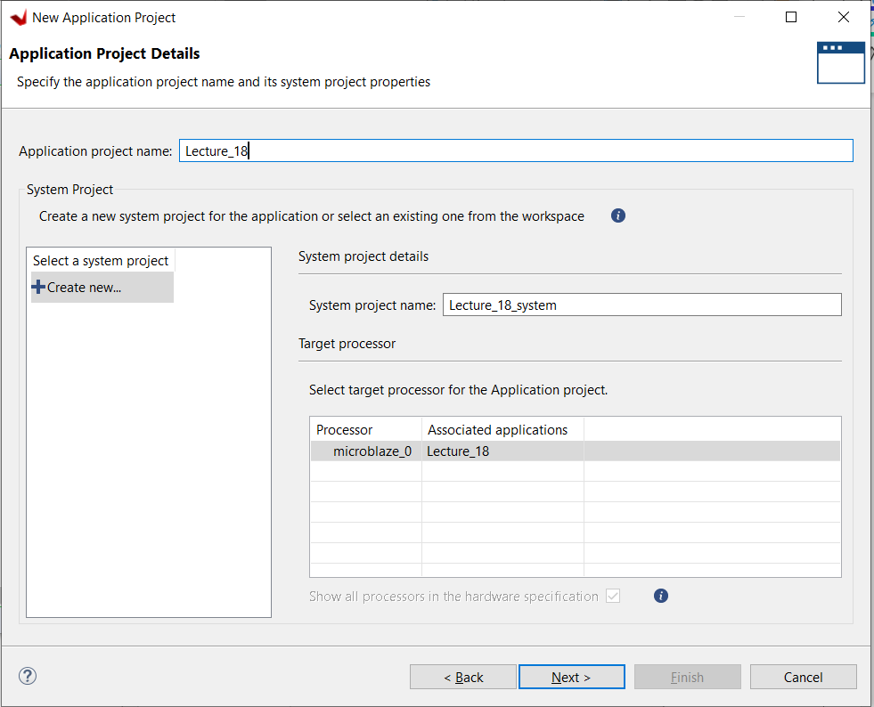
Xilinx Vitis
Name project and click next

Slide 22
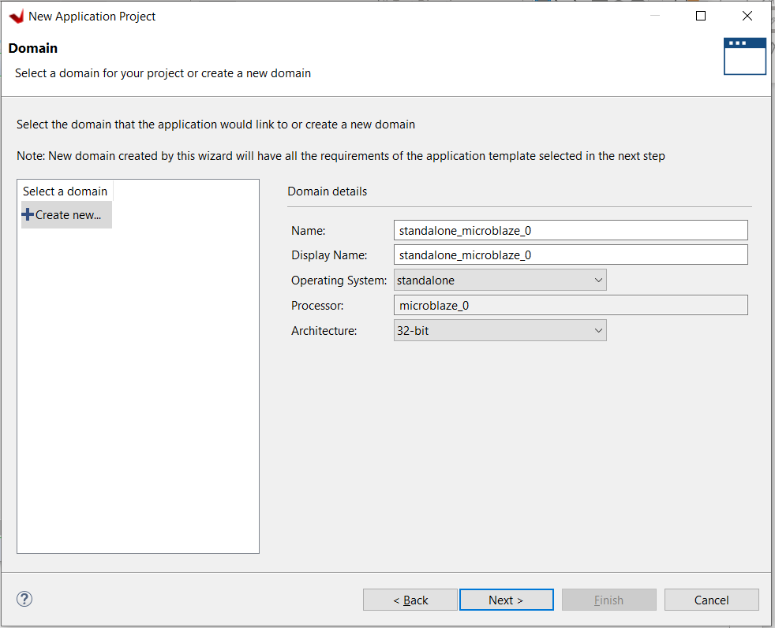
Xilinx Vitis
Keep default domain settings and click next.

Slide 23
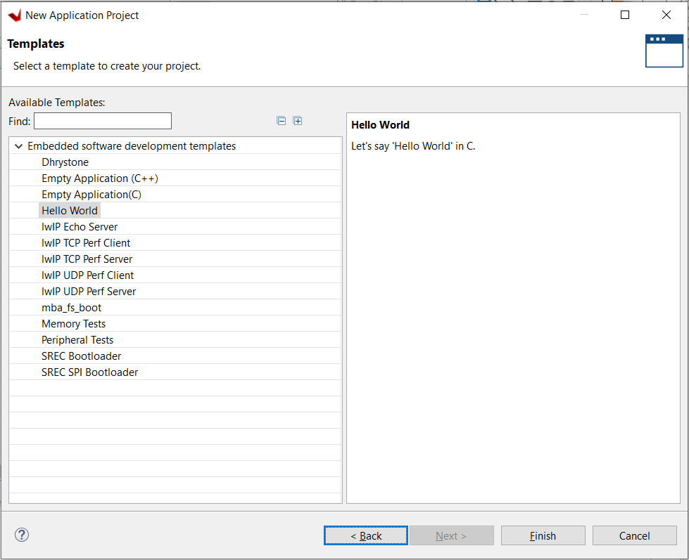
Xilinx Vitis
Choose Hello World Application so it creates the platform.c and .h files. If you use the sample code you can use an Empty Application (C++)

Slide 24
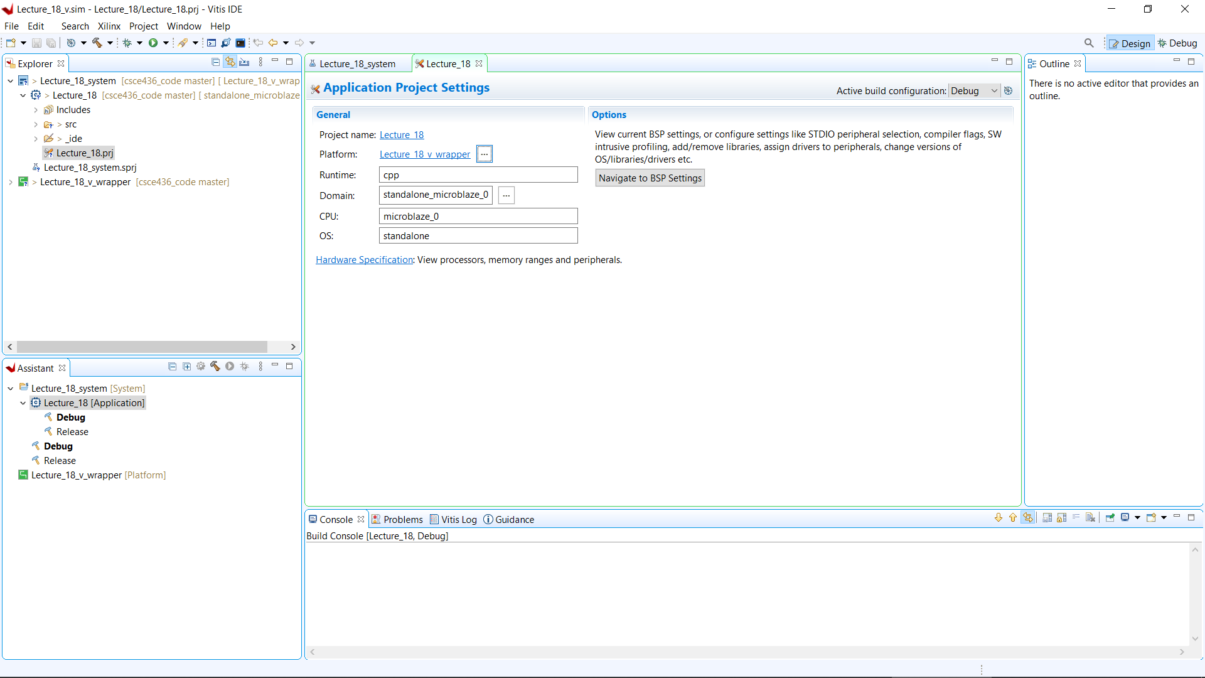
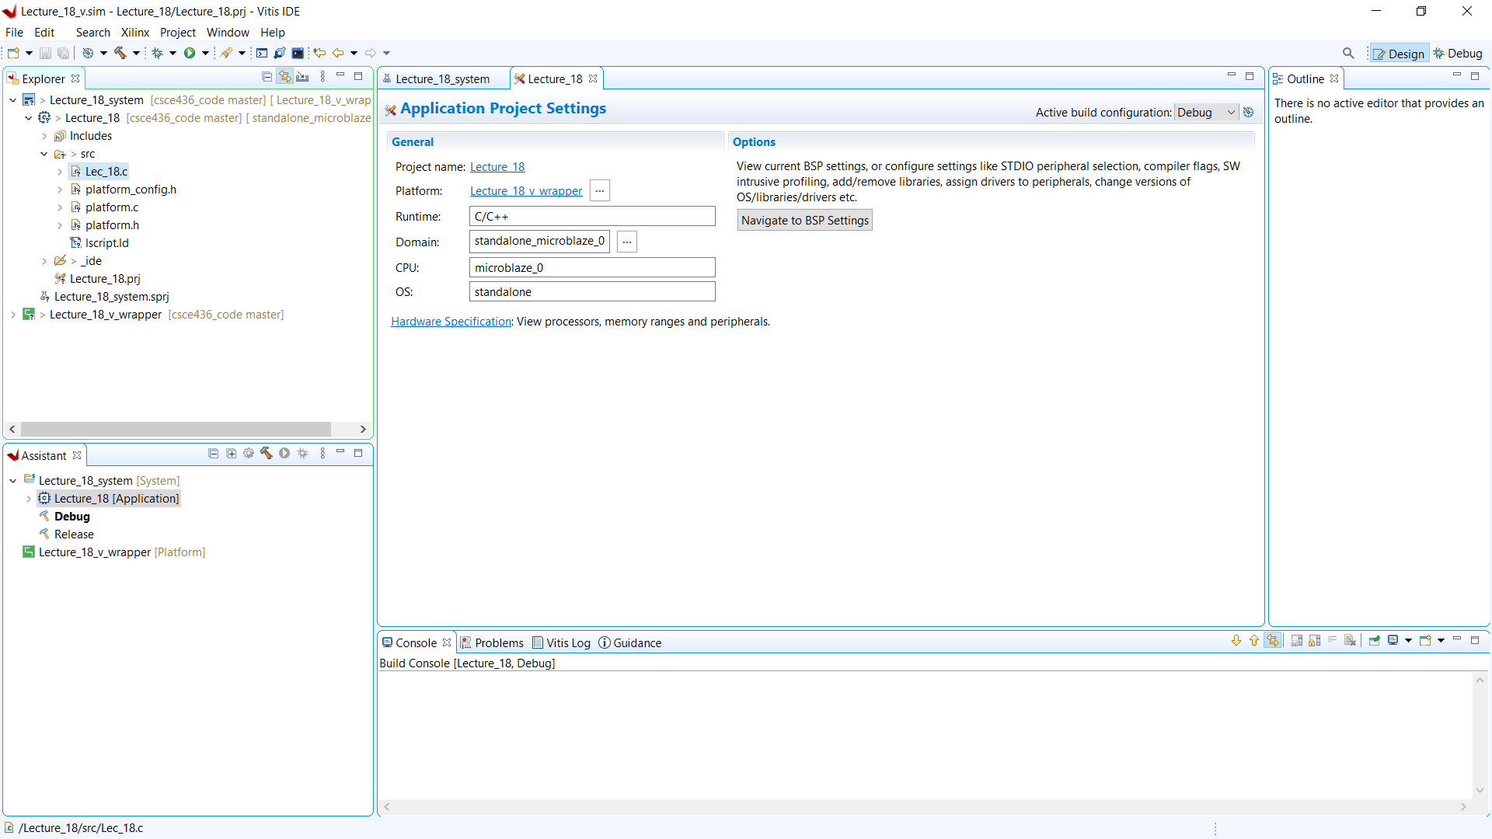
Xilinx Vitis
Create a Main C Source to Control AXI GPIO Peripherals
  In Vitis' Explorer pane, find the application projects “src” directory. Right click on helloworld.c and rename it to Lec_18.c.

Slide 25
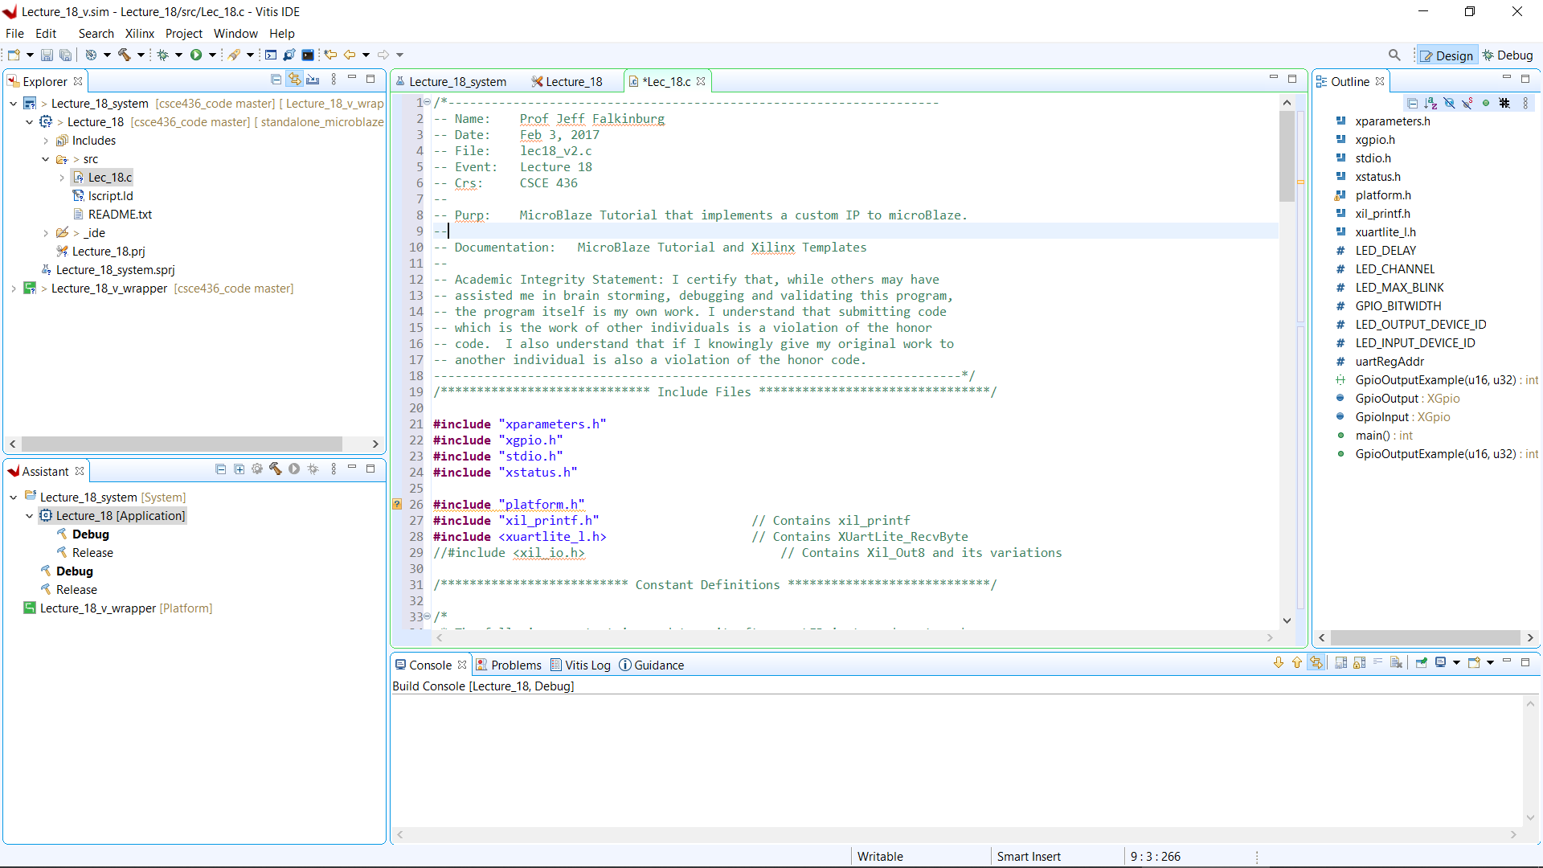
Xilinx Vitis
Copy Lec18_v2.c code from course website.

Slide 26
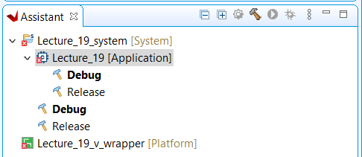
Xilinx Vitis
Build Application
  To build the project and all of its dependencies, select the system project in the Assistant pane, and either click the Build button ( ), or press Ctrl-B on your keyboard.

Slide 27
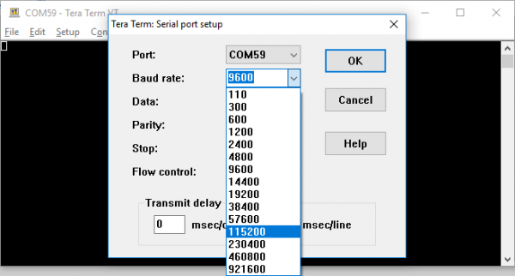
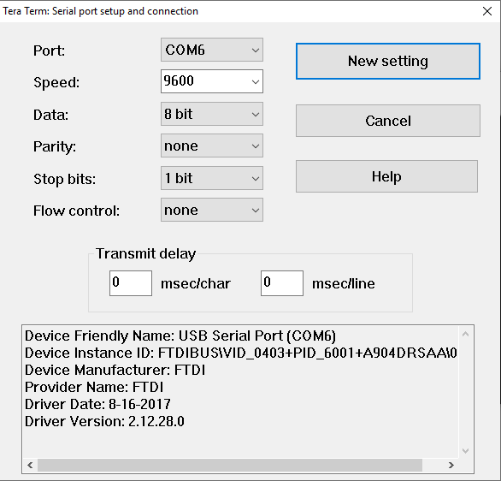
Launch Xilinx Vitis on FPGA
Launch a Vitis Baremetal Software Application
  First, many applications require that a serial console is connected to the board, so that standard output (from print statements) can be viewed. For this purpose, a serial terminal like Tera Term. Use a serial terminal application to connect to the board's serial port. Unless otherwise stated, Microblaze designs with an AXI UART Lite IP use a baud rate of 9600.

Slide 28
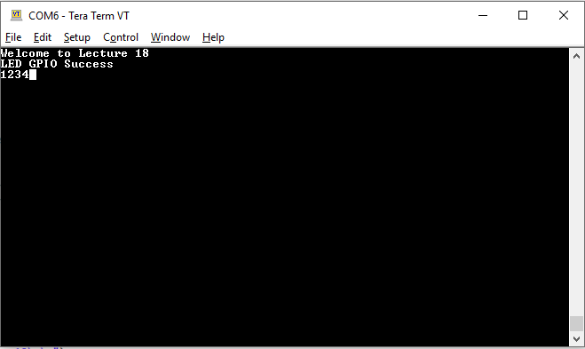
Launch Xilinx Vitis on FPGA
Launch a Vitis Baremetal Software Application
  In the Explorer pane at the left side of the screen, right click on the application or system project that is to be run, and select Run as → 1 Launch on Hardware (Single Application Debug). The FPGA will be programmed with the bitstream, the ELF file created by the software build is loaded into system memory, and the application project will begin to run. You will need to click back over to the Vitis Serial Terminal from the Console tab.
You should see the welcome and the keypresses should echo on the terminal and LEDs

Slide 29
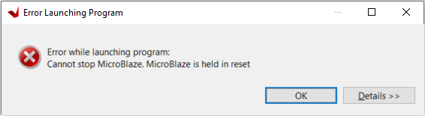
Xilinx Vitis Errors
MicroBlaze held in reset:
  Error: On the software side when running the software on the FPGA, an error message comes up saying "Error while launching program: Cannot stop MicroBlaze. MicroBlaze is held in reset".
  Fix: The block design needs to be changed to have the reset as ACTIVE LOW. This is also needs to be set in the clocking wizard ip core.

Slide 30
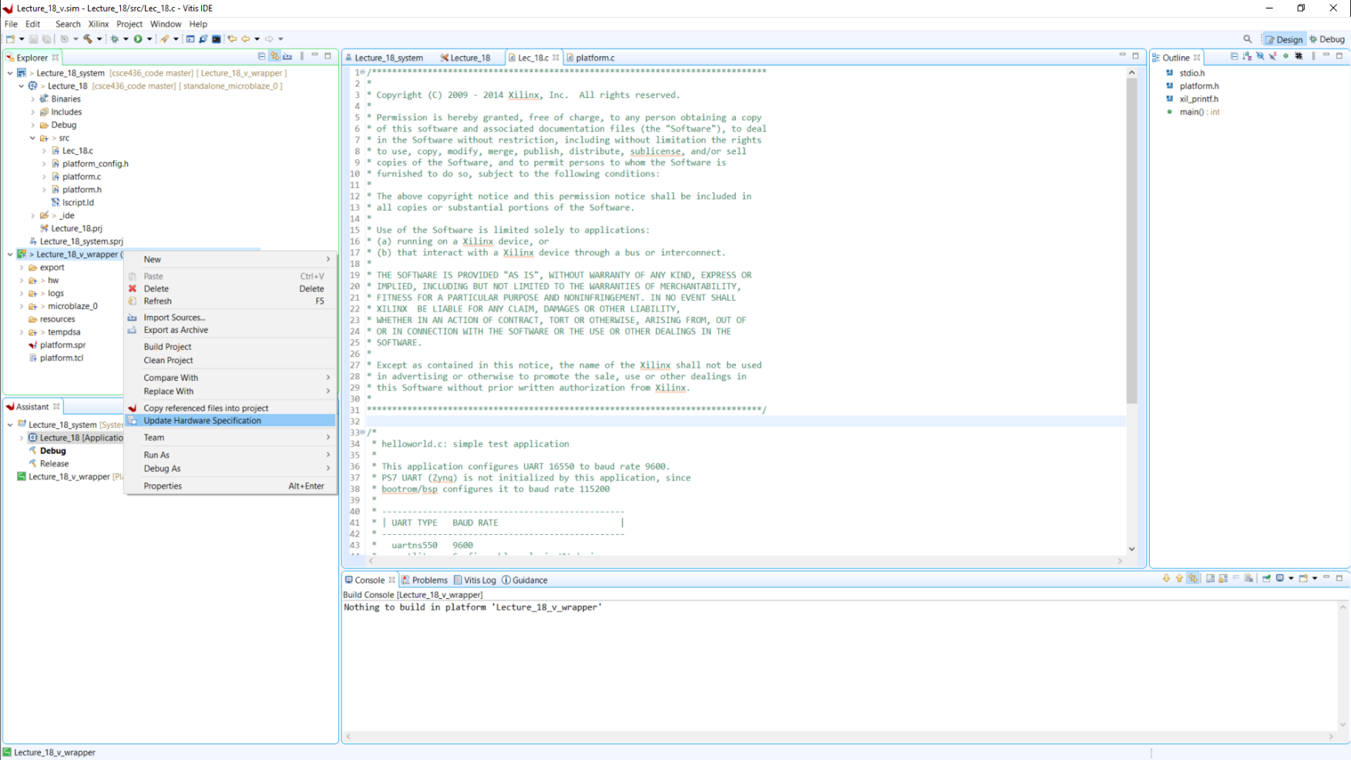
Re-Exporting Hardware
When you Re-Export Hardware from Vivado to Vitis you have to Update Hardware Specification.

Slide 31
Microblaze
https://reference.digilentinc.com/learn/programmable-logic/tutorials/nexys-video-getting-started-with-microblaze/start

Slide 32
Microblaze

Slide 33
Adding LEDs GPIO

Slide 34
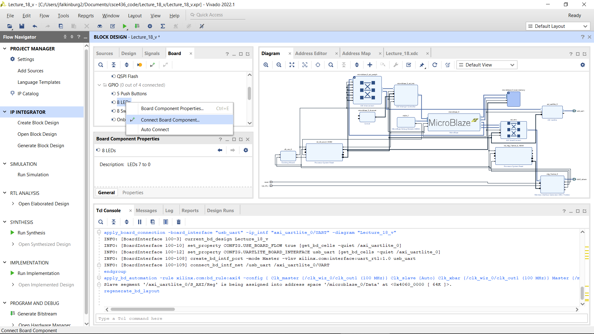
Microblaze – Adding LEDs GPIO

Slide 35
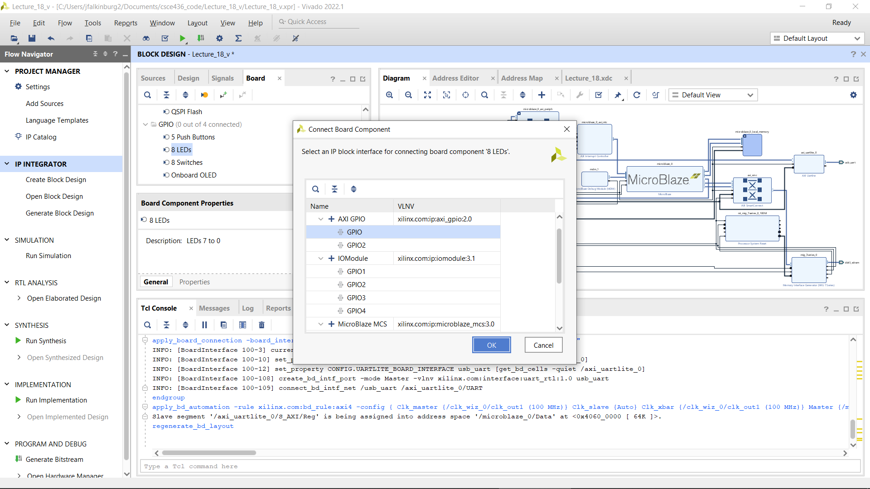
Microblaze – Adding LEDs GPIO

Slide 36
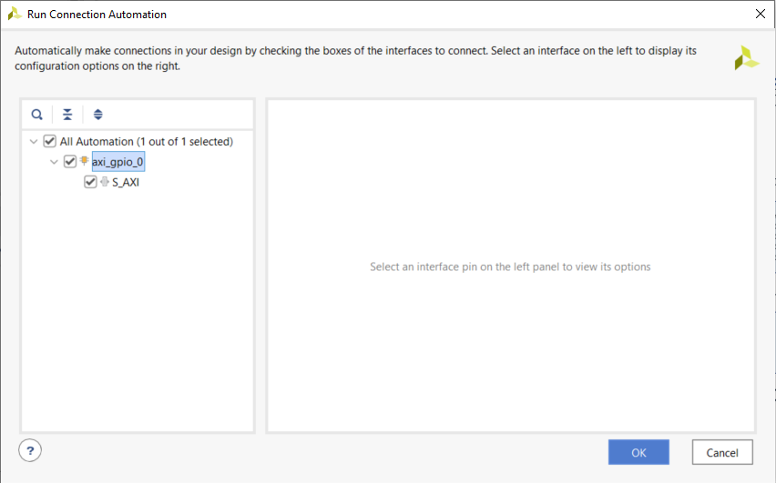
Microblaze – Adding LEDs GPIO
Run Connection Automation

Slide 37
Microblaze – Adding LEDs GPIO
Generate Bitstream
Then Re-Export to Vitis project and use Lec18_v2.c (Example code to interface with GPIO LEDs)

