Slide 1
CSCE 436 – Advanced Embedded Systems Vivado Installation
Prof Jeffrey Falkinburg Avery Hall 368 472-5120

Slide 2
Vivado Installation
Installing WebPack Version follow these instructions:
https://reference.digilentinc.com/vivado/installation
Follow the next few slides for the CSCE 436 specific installation
2

Slide 3
Vivado Installation
If you want to download the 18 GB of installation files then click on Xilinx_Vivado_SDK_2019.1_Win64.exe
***Note: This option is not advised since it will take several hours to download the installation files***
Otherwise skip the next two slides!
3

Slide 4
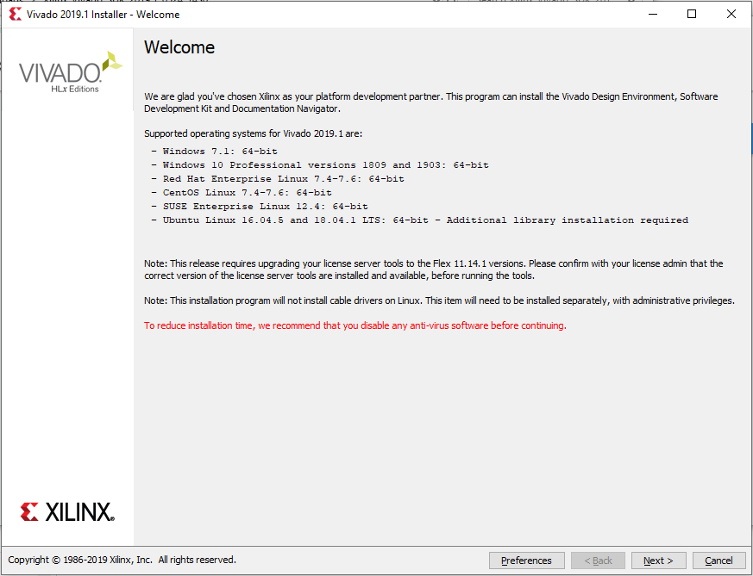
Vivado Installation
4

Slide 5
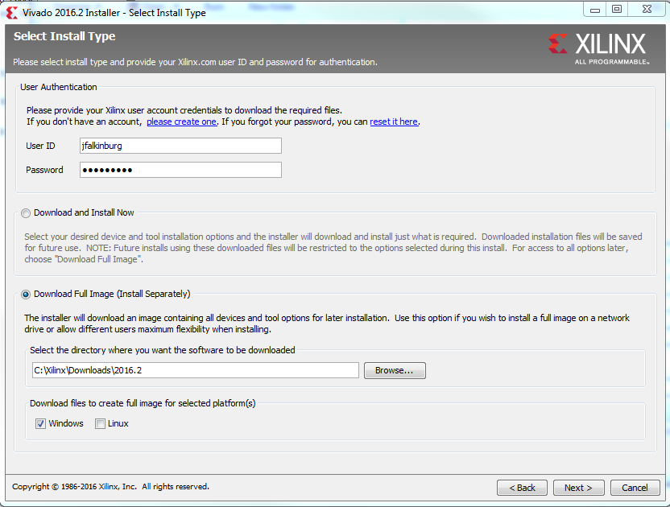
Vivado Installation
5

Slide 6
Vivado Installation
Run xsetup.exe in the Xilinx_2019.1 folder with full downloaded image
6

Slide 7
Vivado Installation
7

Slide 8
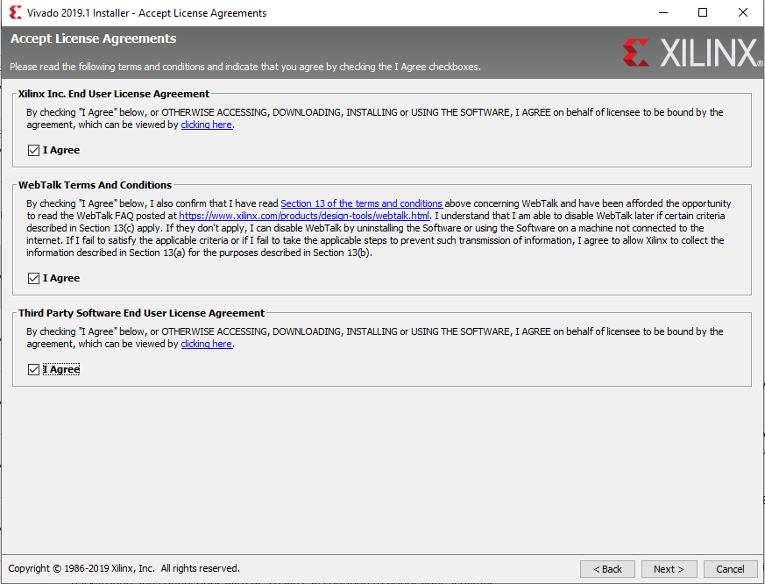
Vivado Installation
8

Slide 9
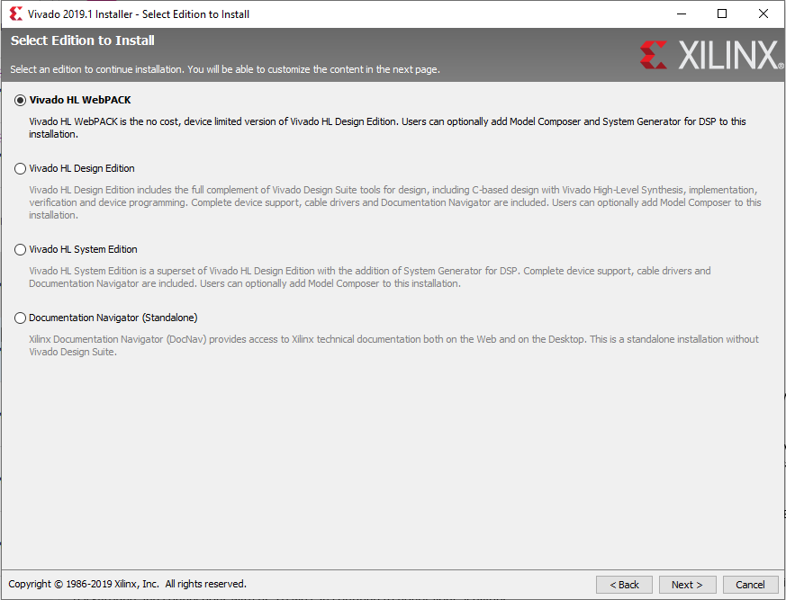
Vivado Installation
Use this if you want to use software at home
Use this if you want to use software at school
9

Slide 10
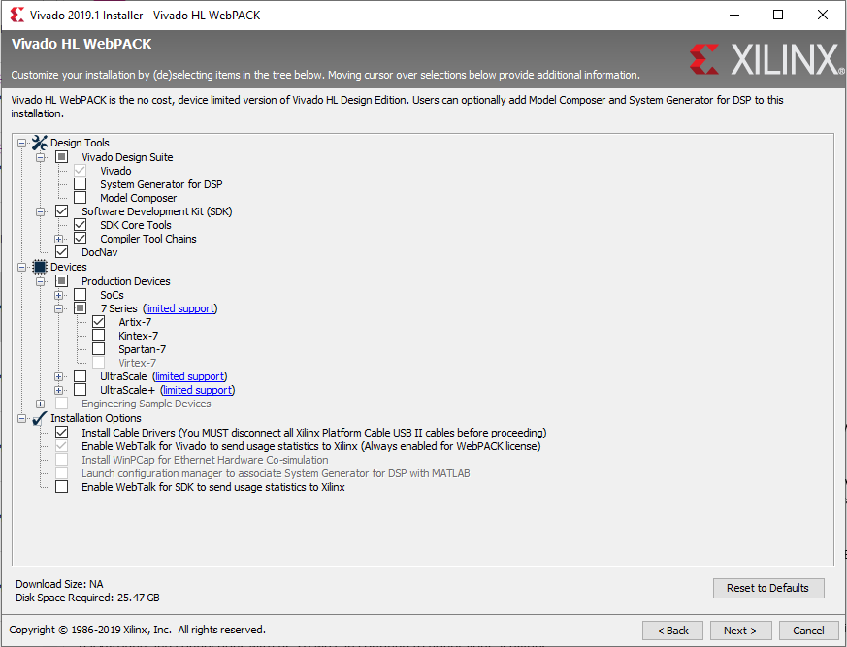
Vivado Installation
Check SDK (for CSCE 436) and quietly weep as your HDD space is obliterated
Only this device family is needed
10

Slide 11
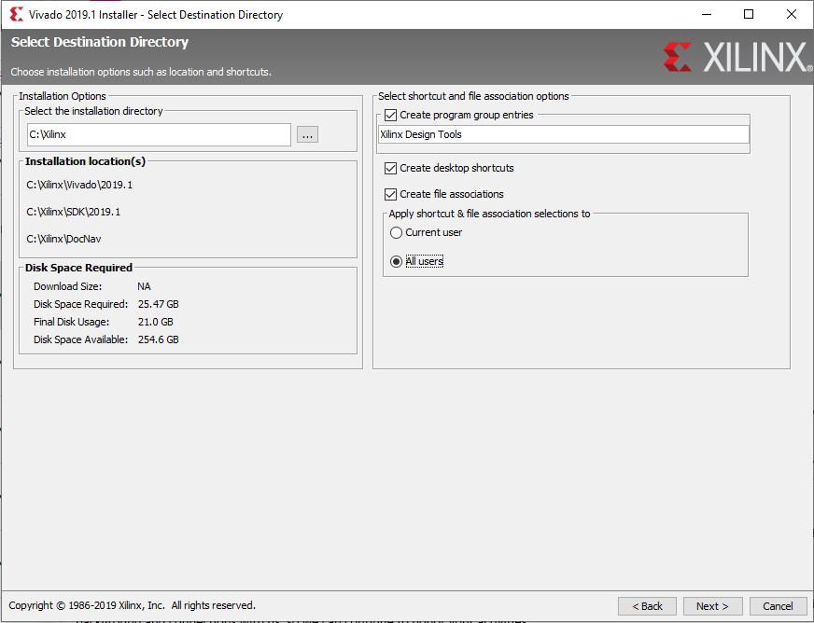
Vivado Installation
11

Slide 12
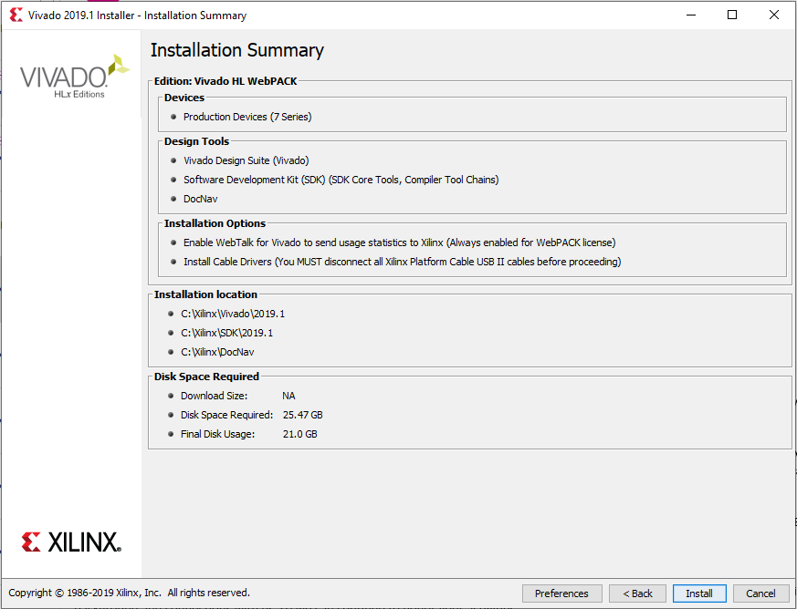
Vivado Installation
12

Slide 13
Vivado Installation
13

Slide 14
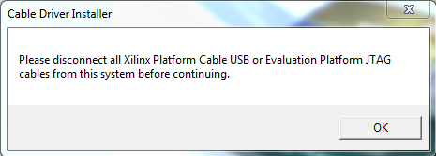
Vivado Installation
Click OK that you do not have any cables connected to a FPGA

Slide 15
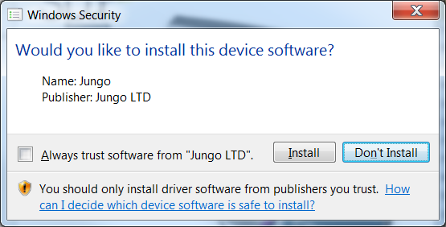
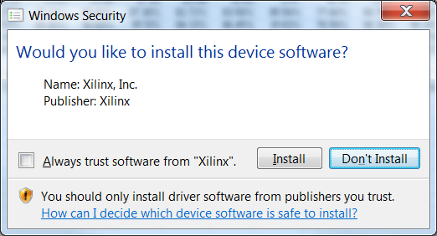
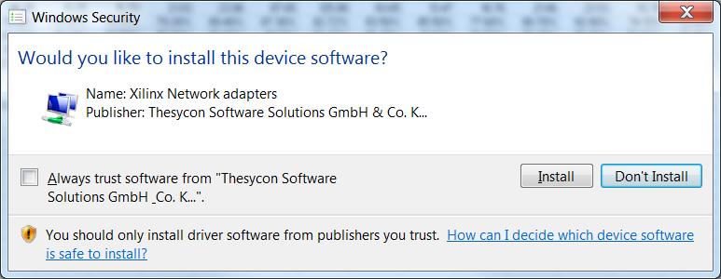
Vivado Installation
You may see a series of device software popups.
Click Install for each.

Slide 16
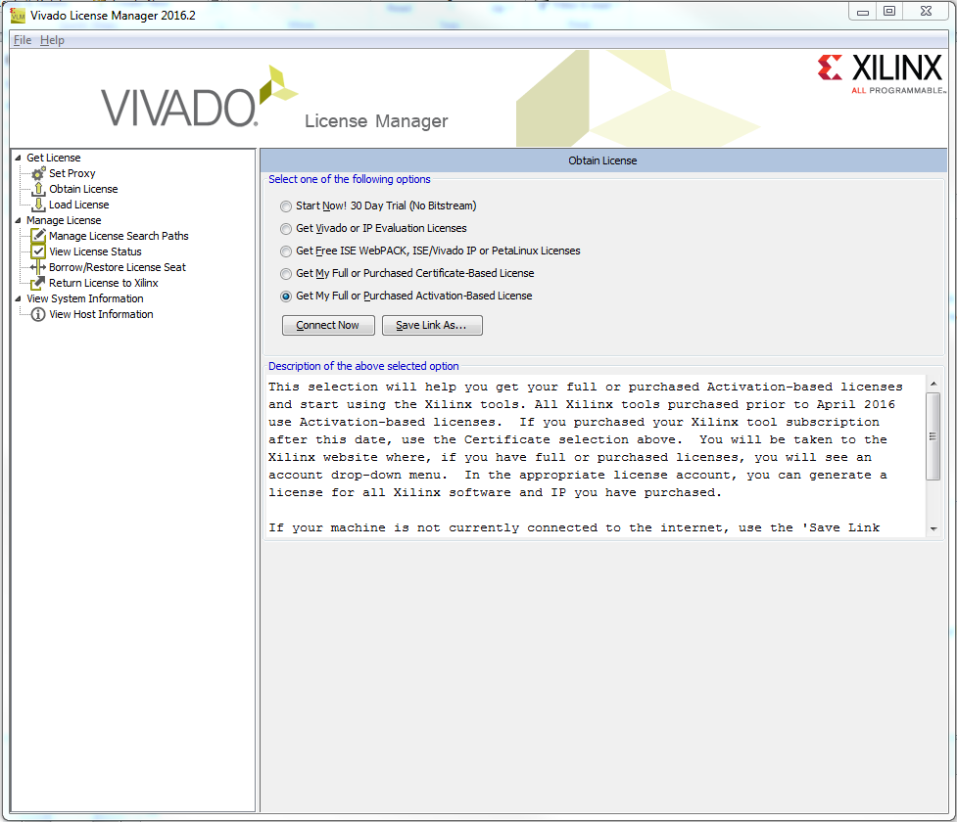
Vivado Installation
16

Slide 17
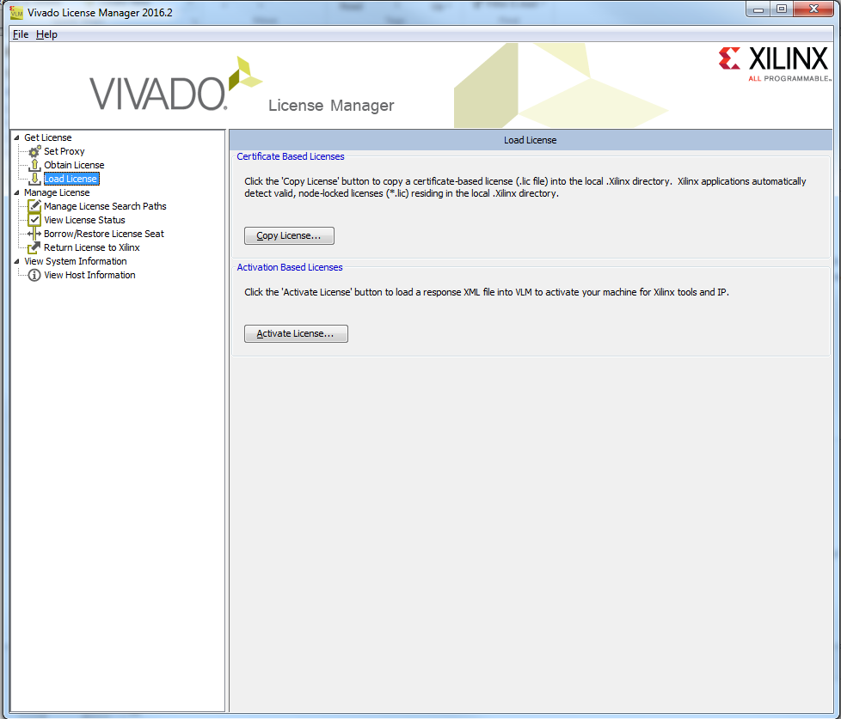
Vivado Installation
Load xilinx.lic file from drive otherwise retrieve a WebPack license from Xilinx.
17

Slide 18
Vivado Installation
18

Slide 19
Vivado Board Files
Install the Digilent Board Support Files: (also included on Drive)
https://reference.digilentinc.com/vivado/boardfiles2015
19

Slide 20
Vivado Tutorial
Vivado Tutorial:
http://www.xilinx.com/support/documentation/university/Vivado-Teaching/HDL-Design/2013x/Nexys4/Verilog/docs-pdf/Vivado_tutorial.pdf
20

Slide 21
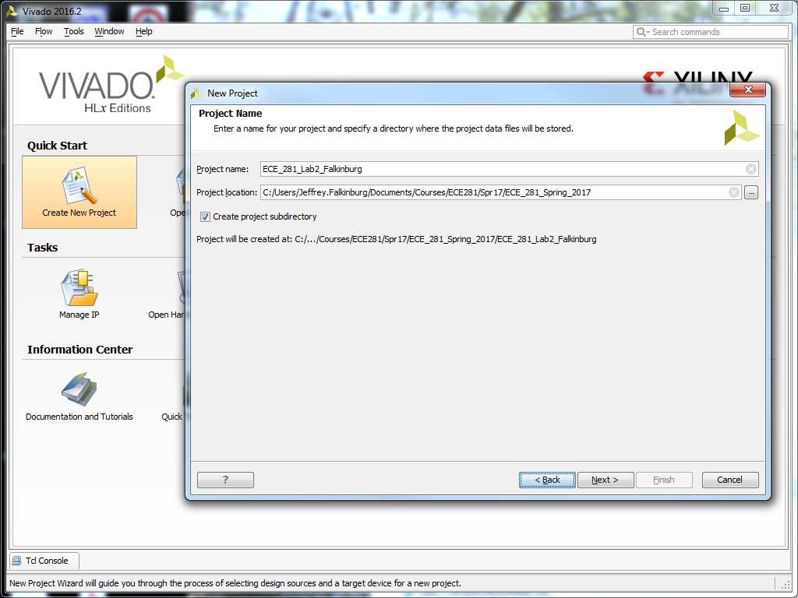
Vivado Project
21

Slide 22
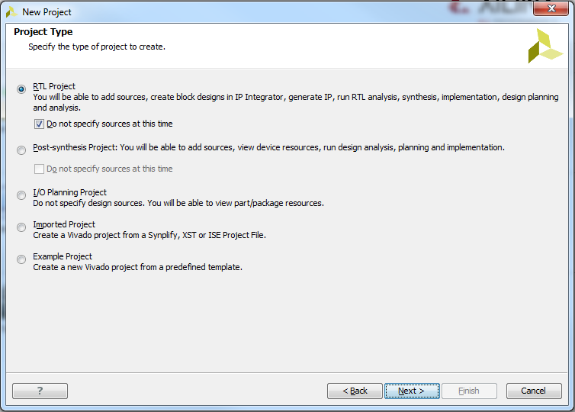
Vivado Project
22

Slide 23
Vivado Tutorial
23

Slide 24
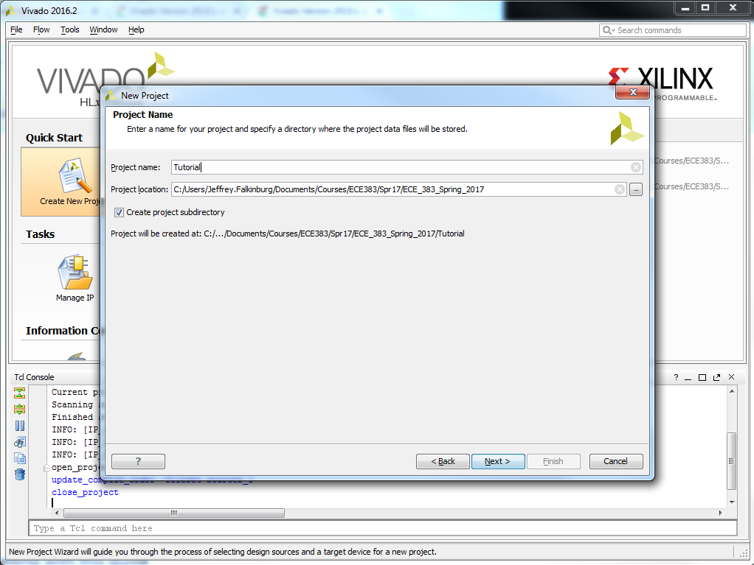
Vivado Tutorial
24

Slide 25
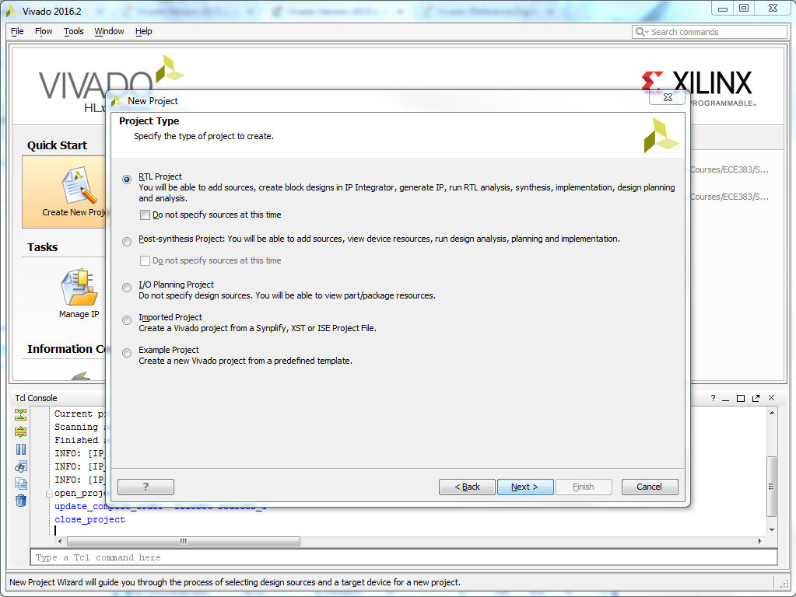
Vivado Tutorial
25

Slide 26
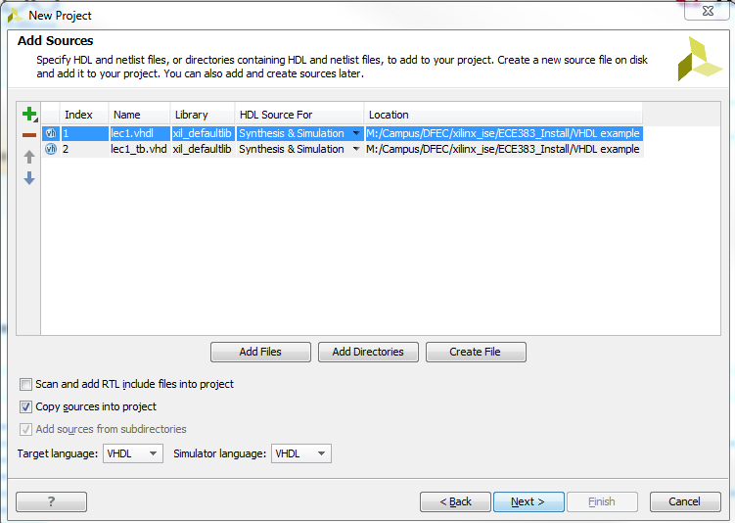
Vivado Tutorial
Select VHDL as the Target language and Simulator language in the Add Sources form.
Click on the Add Files… button, browse to the M:\Campus\DFEC\xilinx_ise\ECE383_Install\VHDL example directory, select lec1.vhdl, click Open, and then click Next.
26

Slide 27
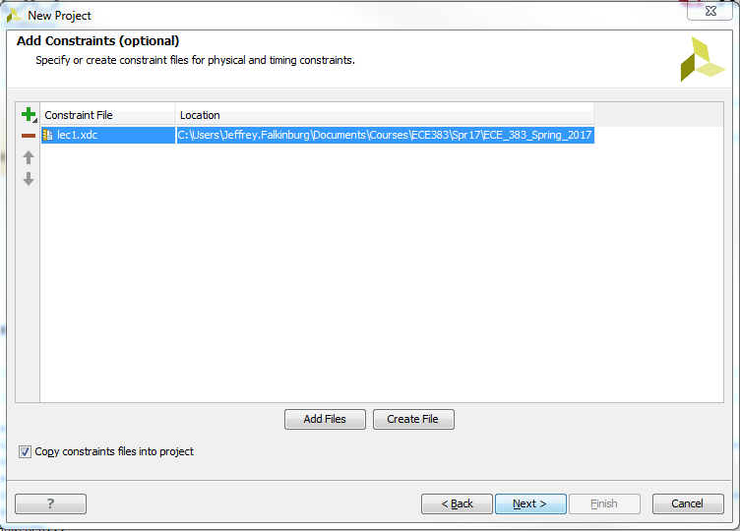
Vivado Tutorial
Click Next to get to the Add Constraints form.
Click Next if the entry is already auto-populated, otherwise click on the Add Files… button, browse to the M:\Campus\DFEC\xilinx_ise\ECE383_Install\VHDL example directory and select tutorial.xdc, and click Open.
27

Slide 28
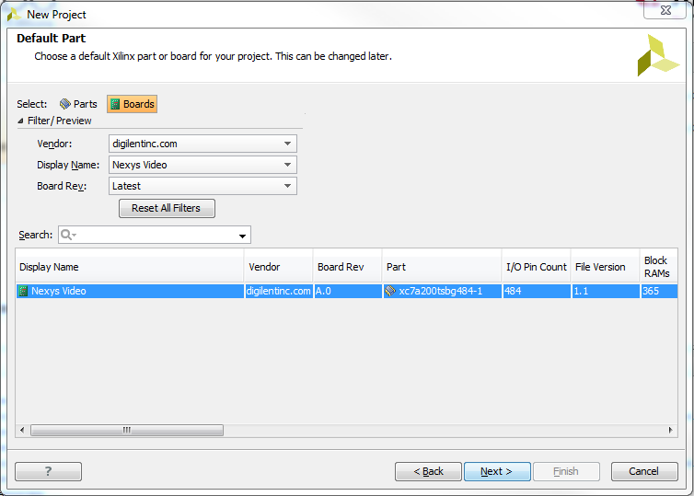
Vivado Tutorial
28

Slide 29
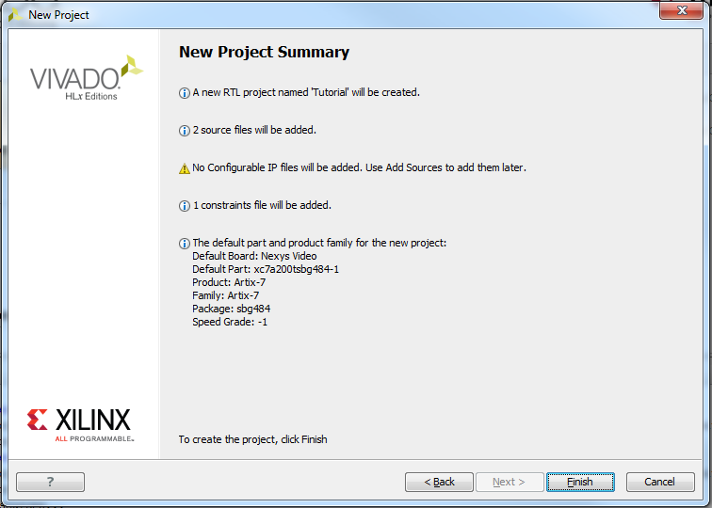
Vivado Tutorial
29

Slide 30
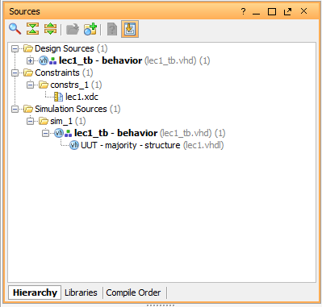
Vivado Tutorial
30

Slide 31
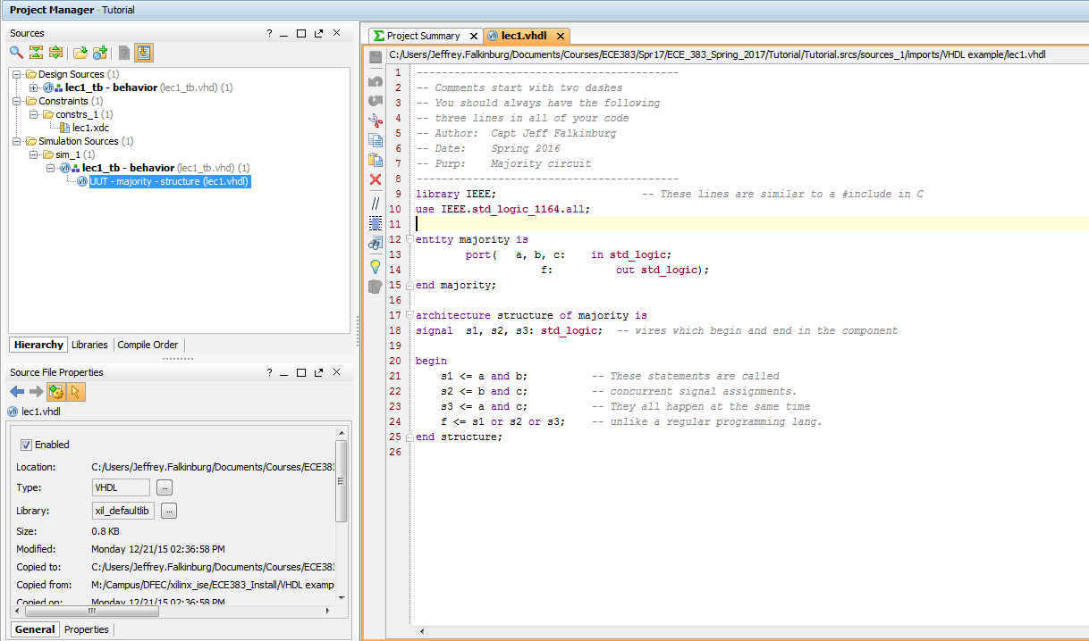
Vivado Tutorial
31

Slide 32
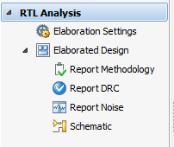
Vivado Tutorial
Perform RTL analysis on the source file.
Expand the Open Elaborated Design entry under the RTL Analysis tasks of the Flow Navigator pane and click on Schematic.
The model (design) will be elaborated and a logic view of the design is displayed.
32

Slide 33
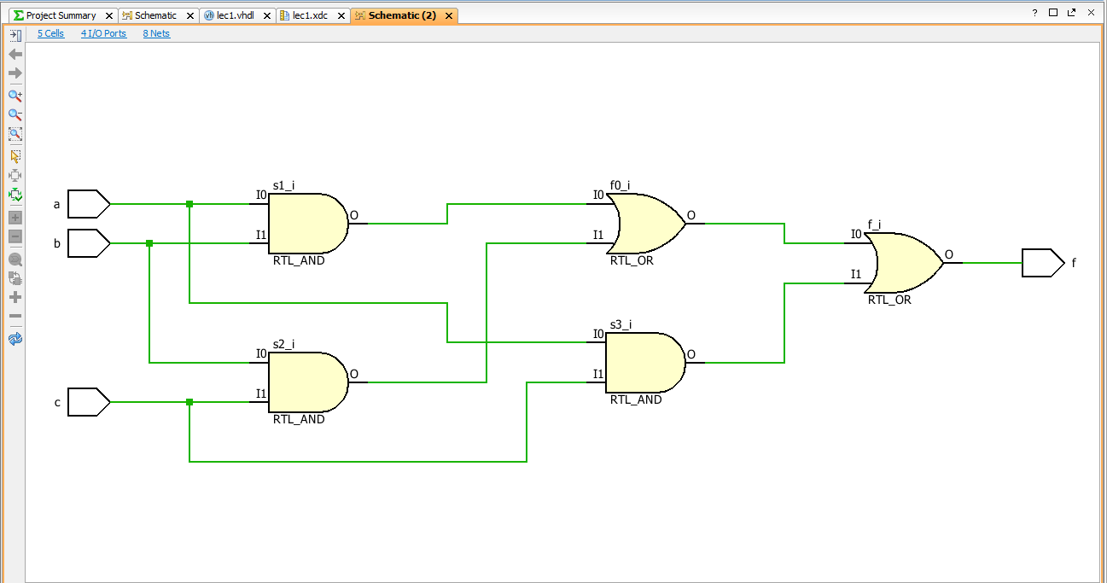
Vivado Tutorial
33

Slide 34
Implement Design
34

Slide 35
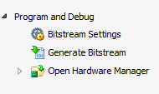
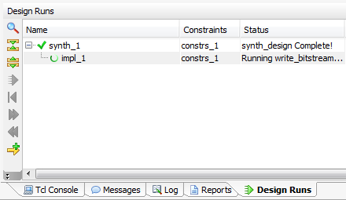
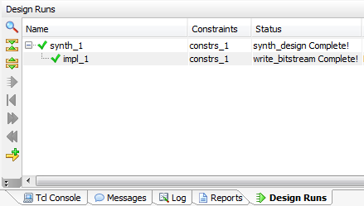
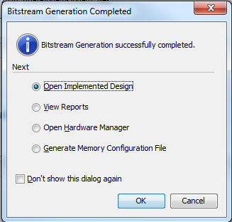
Generate Bitstream
Generate Bitstream
35

Slide 36
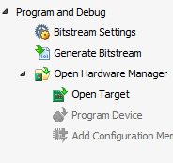
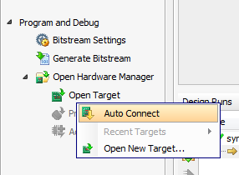
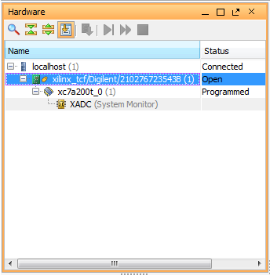
Open Target
Open Target
Board/Chip show up in Hardware list
36

Slide 37
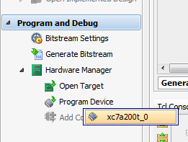
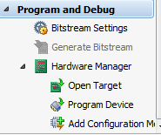
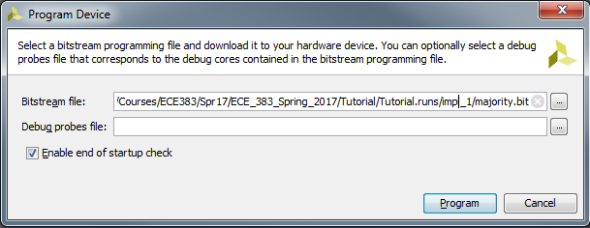
Program Device
Program Device
37

Slide 38
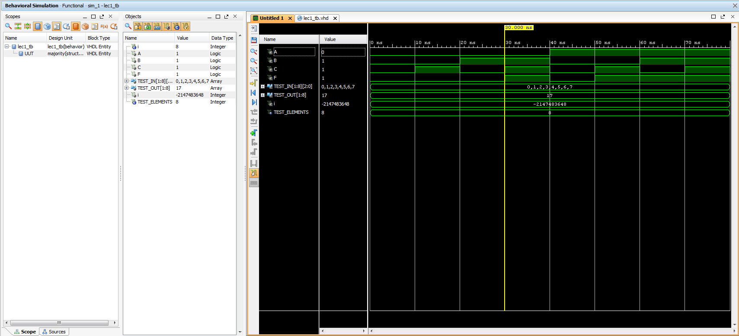
XSim Simulator
Simulate the Design using the XSim Simulator
38

Slide 39
XSim Simulator
39

Slide 40
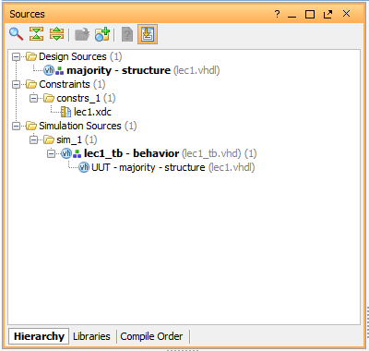
Lecture 1

Slide 41
41

