Slide 1
Processor Architecture: Introduction to RISC Datapath (MIPS and Nios II)
CSCE 230

Slide 2
Nios II Instruction Set
Is available for download at: https://www.altera.com/content/dam/altera-www/global/en_US/pdfs/literature/hb/nios2/n2cpu_nii51017.pdf

Slide 3
Instruction Format: R-Type
MIPS
Nios II
Add R4, R3, R2
0
rs
rt
rd
shamt
funct
31:26
25:21
20:16
15:11
10:6
5:0
Rsrc1
Rsrc2
Rdst
OPX
OP code
31:27
26:22
21:17
16:6
5:0

Slide 4
Instruction Format: I-Type
MIPS
Nios II
addi R4, R3, 0x10, ldw R5, 4(R4), beq R0, R1, label
opcode
rs
rt
address
31:26
25:21
20:16
15:0
Rsrc
Rdst
Immediate Operand
OP code
31:27
26:22
21:6
5:0

Slide 5
Instruction Format: J- or call-Type
MIPS
Nios II
j label, call label
Jump
0x02
address
31:26
25:0
Call
address
0x00
31:6
5:0

Slide 6
Example Instruction
jmp R3
r-type
i-type
j-type
Encoding: 00011 00000 00000 00 1101 00000 111010
OPX

Slide 7
Datapath Illustrations
Assume MIPS instruction set
R-type
0
rs
rt
rd
shamt
funct
31:26
25:21
20:16
15:11
10:6
5:0
I-type
opcode
rs
rt
address
31:26
25:21
20:16
15:0
J-type
0x02
address
31:26
25:0

Slide 8
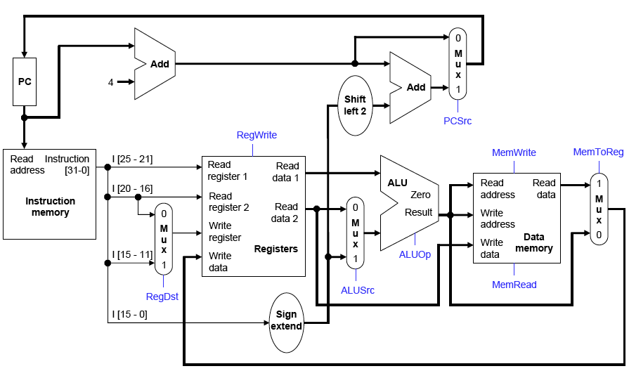
Simple RISC Datapath

Slide 9
Instruction Execution: General Considerations
Classical von-Neumann architecture: Each instruction read from the memory, decoded, and executed according to its meaning.
The program counter “remembers” current point in program execution.
Additional access(es) to the memory may be necessary during the execution because of instructions like ldw and stw.
Datapath components must be selected to accommodate different types of instructions
Datapath complexity also depends on whether every instruction must complete in one clock cycle or more – very little flexibility in sharing components when all work must be done in one clock cycle.

Slide 10
Five Stages of Instruction Execution
Classical – goes back to von-Neumann machines:
Fetch instruction from memory (all)
Decode it (all)
Read registers (all but call or j)
Execute (most use ALU but in different ways)
Write back to register file or memory

Slide 11
Single-cycle Design
All five stages executed in one clock cycle. Implications:
All instructions take the same amount of time
Clock cycle time set according to the worst-case instruction execution time
Sequential dependencies implemented by chaining combinational logic
Dedicated functional units – no reuse possible

Slide 12
Single-Cycle Design: Constraint and Initial Architectural Choices
Constraint: Need separate memories for instructions and data. (Harvard architecture) Why?
Choice: No caches (to simplify design).
Choice: Register File has two output ports (speed up reading two operand registers) and one input port (don’t need to write two registers in one instruction)
Choice: A programmable ALU, instead of separate functional units (simplifies design)

Slide 13
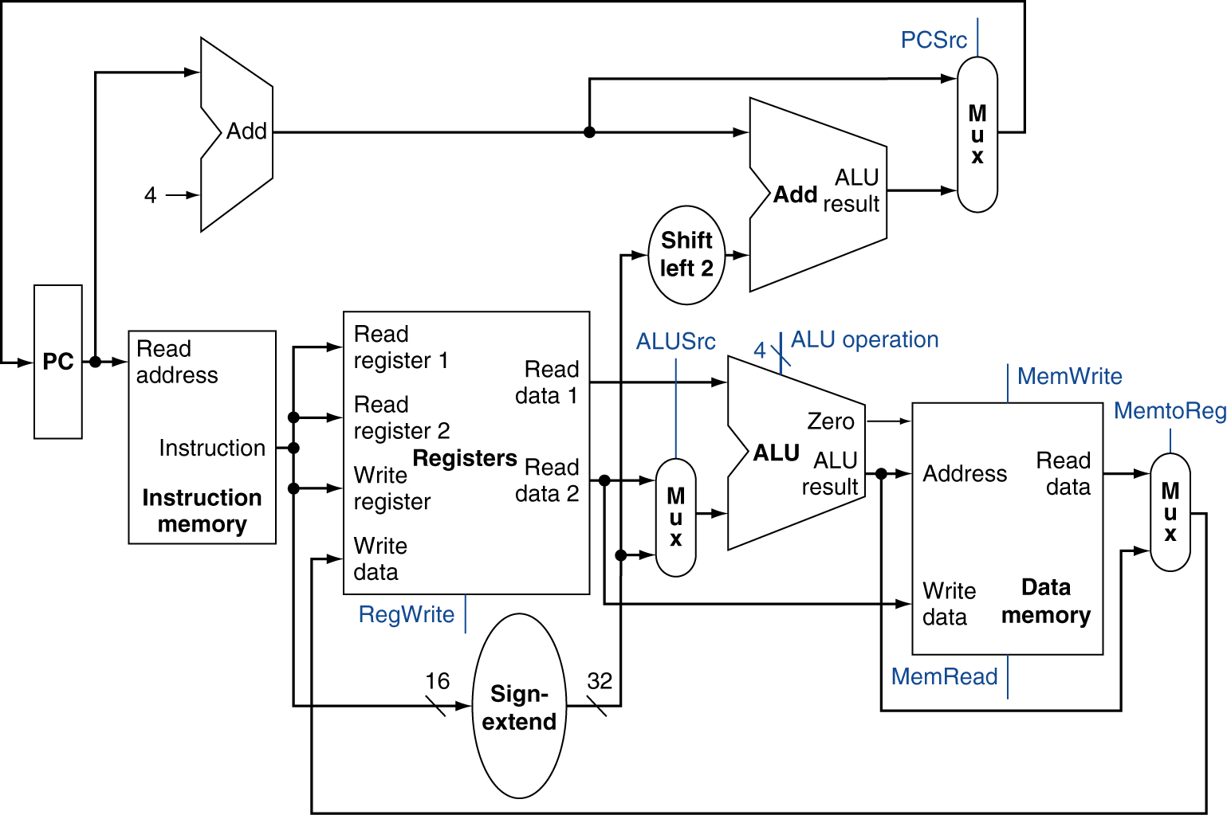
Full Datapath

Slide 14
ALU Control
ALU used for
Load/Store: F = add
Branch: F = subtract
R-type: F depends on funct field
ALU control
(Ainv, Bneg, Op1, Op0)
§4.4 A Simple Implementation Scheme
4
A
32
ALU
F
ALU control | Function
0000 | AND
0001 | OR
0010 | add
0110 | subtract
0111 | set-on-less-than
1100 | NOR
32
B
32
CarryOut

Slide 15
The Main Control Unit
Control signals derived from instruction
R-type
0
rs
rt
rd
shamt
funct
31:26
25:21
20:16
15:11
10:6
5:0
Load/ Store/
i-type
opcode
rs
rt
address
31:26
25:21
20:16
15:0
Branch
4
rs
rt
address
31:26
25:21
20:16
15:0
opcode
always read
Read for R-Type, write for I-type
write for R-type and
I-type
sign-extend and add

Slide 16
The Main Control Unit
Control signals derived from instruction
R-type
Rsrc1
Rsrc2
Rdst
OP code
31:27
26:22
21:17
16:0
I-type
Load
Store
Branch
Rsrc
Rdst
Immediate Operand
OP code
31:27
26:22
21:6
5:0
always read
write for R-type and load
sign-extended immediate
opcode

Slide 17
Implementing Jumps
Jump (MIPS)
2
address
31:26
25:0
Call
address
OP code
31:6
5:0
Jump uses word address
Update PC with concatenation of
Top 4 bits of old PC
26-bit jump address
Shift left by two bits
Need an extra control signal decoded from opcode

Slide 18
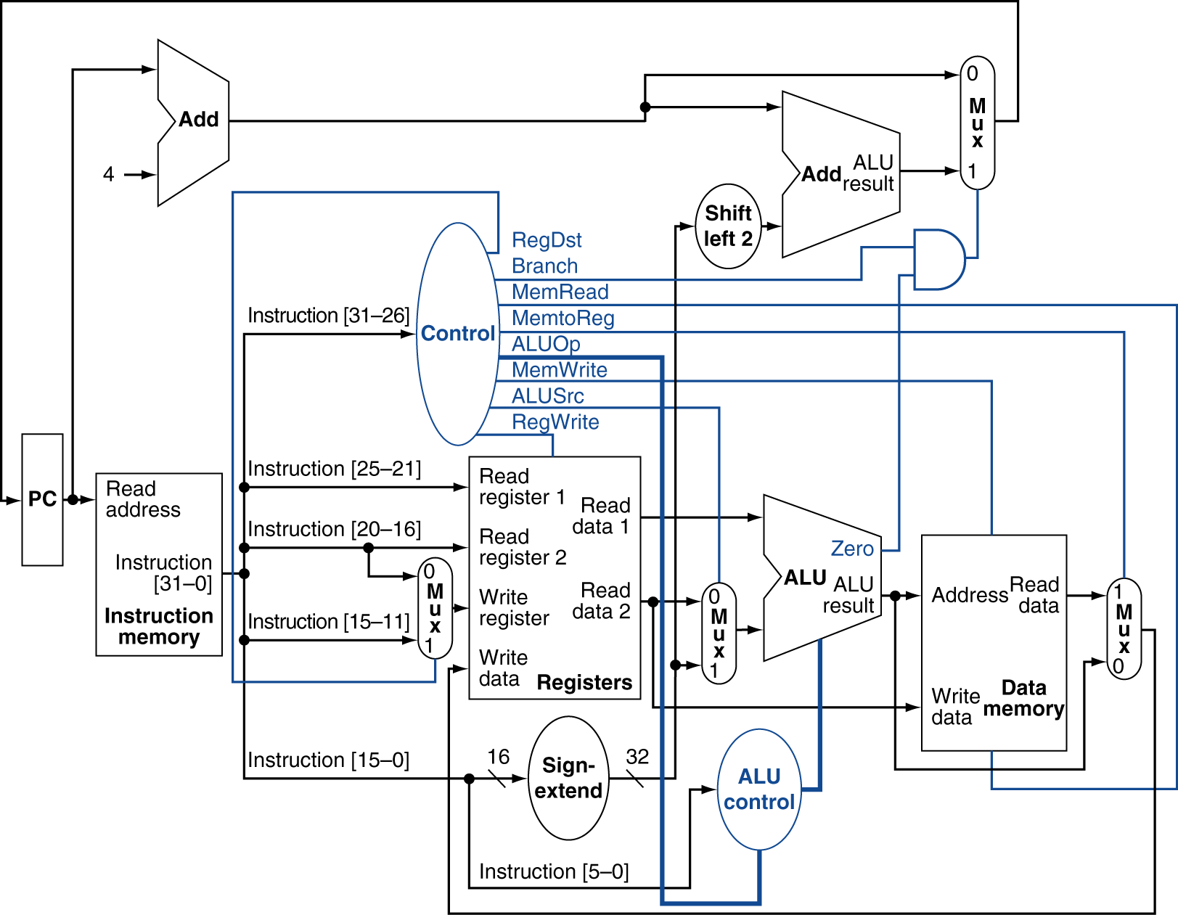
Datapath With Control

Slide 19
Datapath With Control
Fetch

Slide 20
Datapath With Control
Decode/Read

Slide 21
Datapath With Control
Execute

Slide 22
Datapath With Control
Write-back

Slide 23
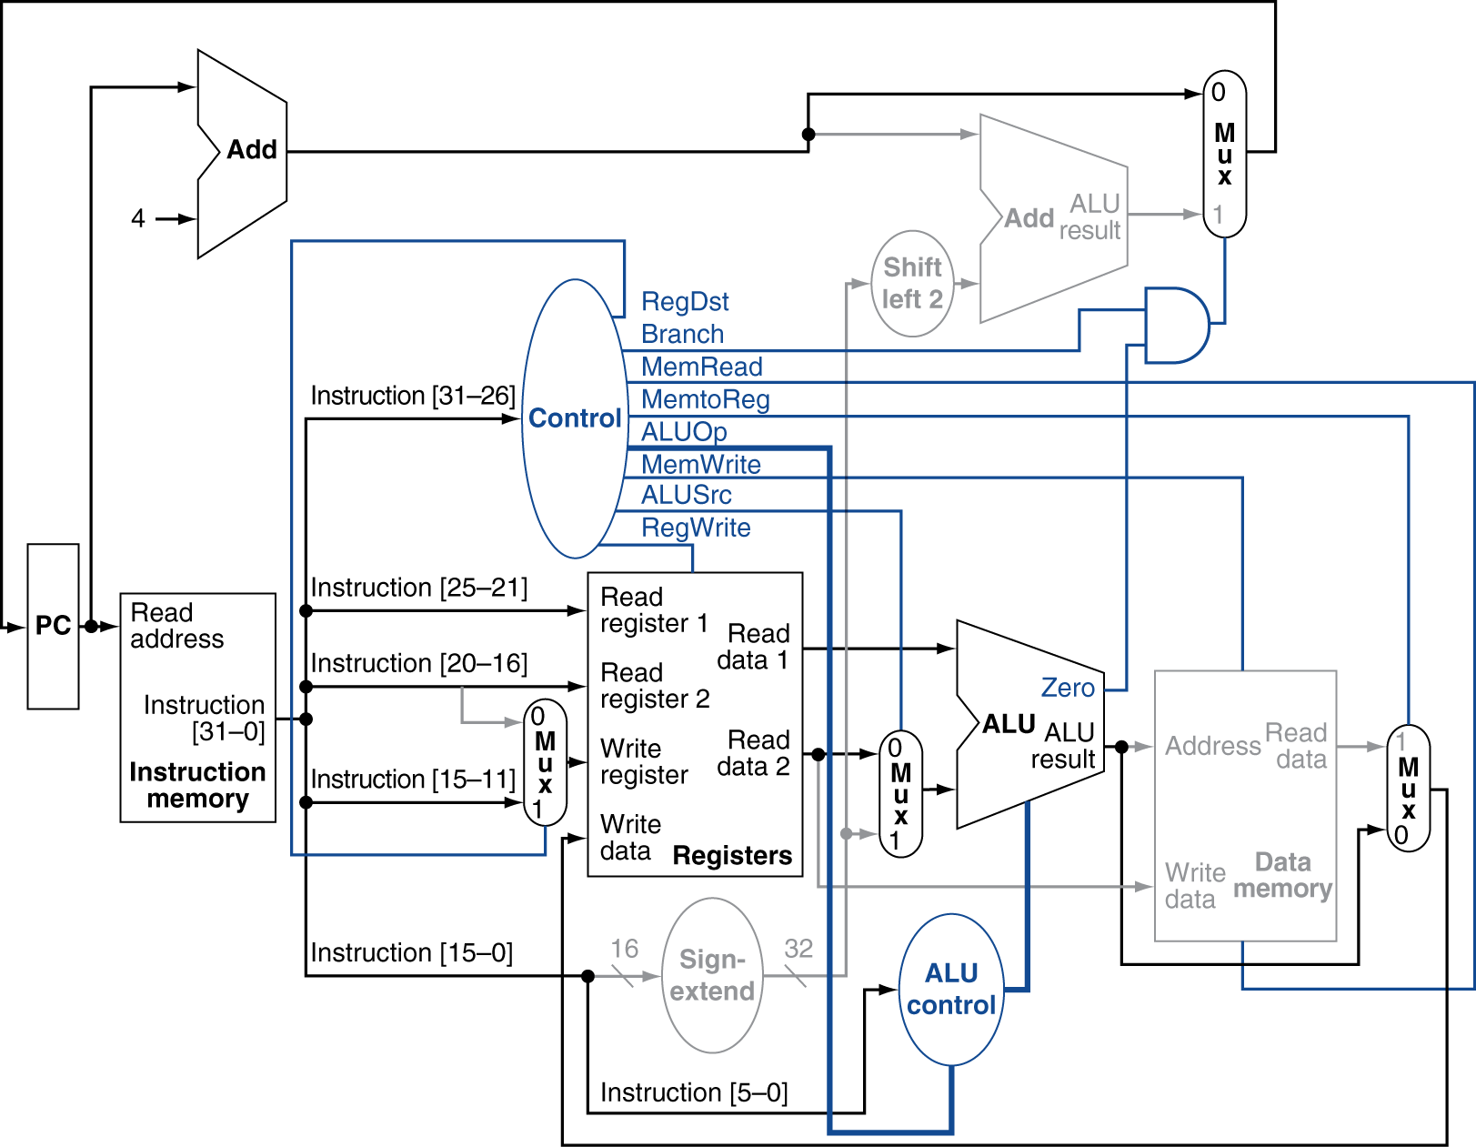
R-Type Instruction

Slide 24
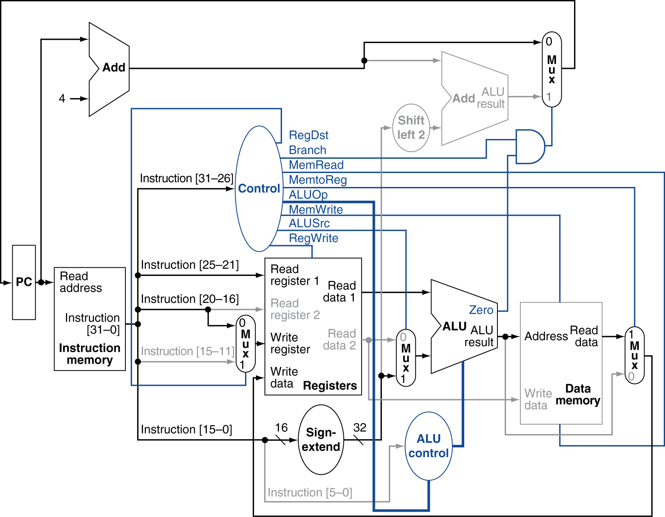
Load Instruction

Slide 25
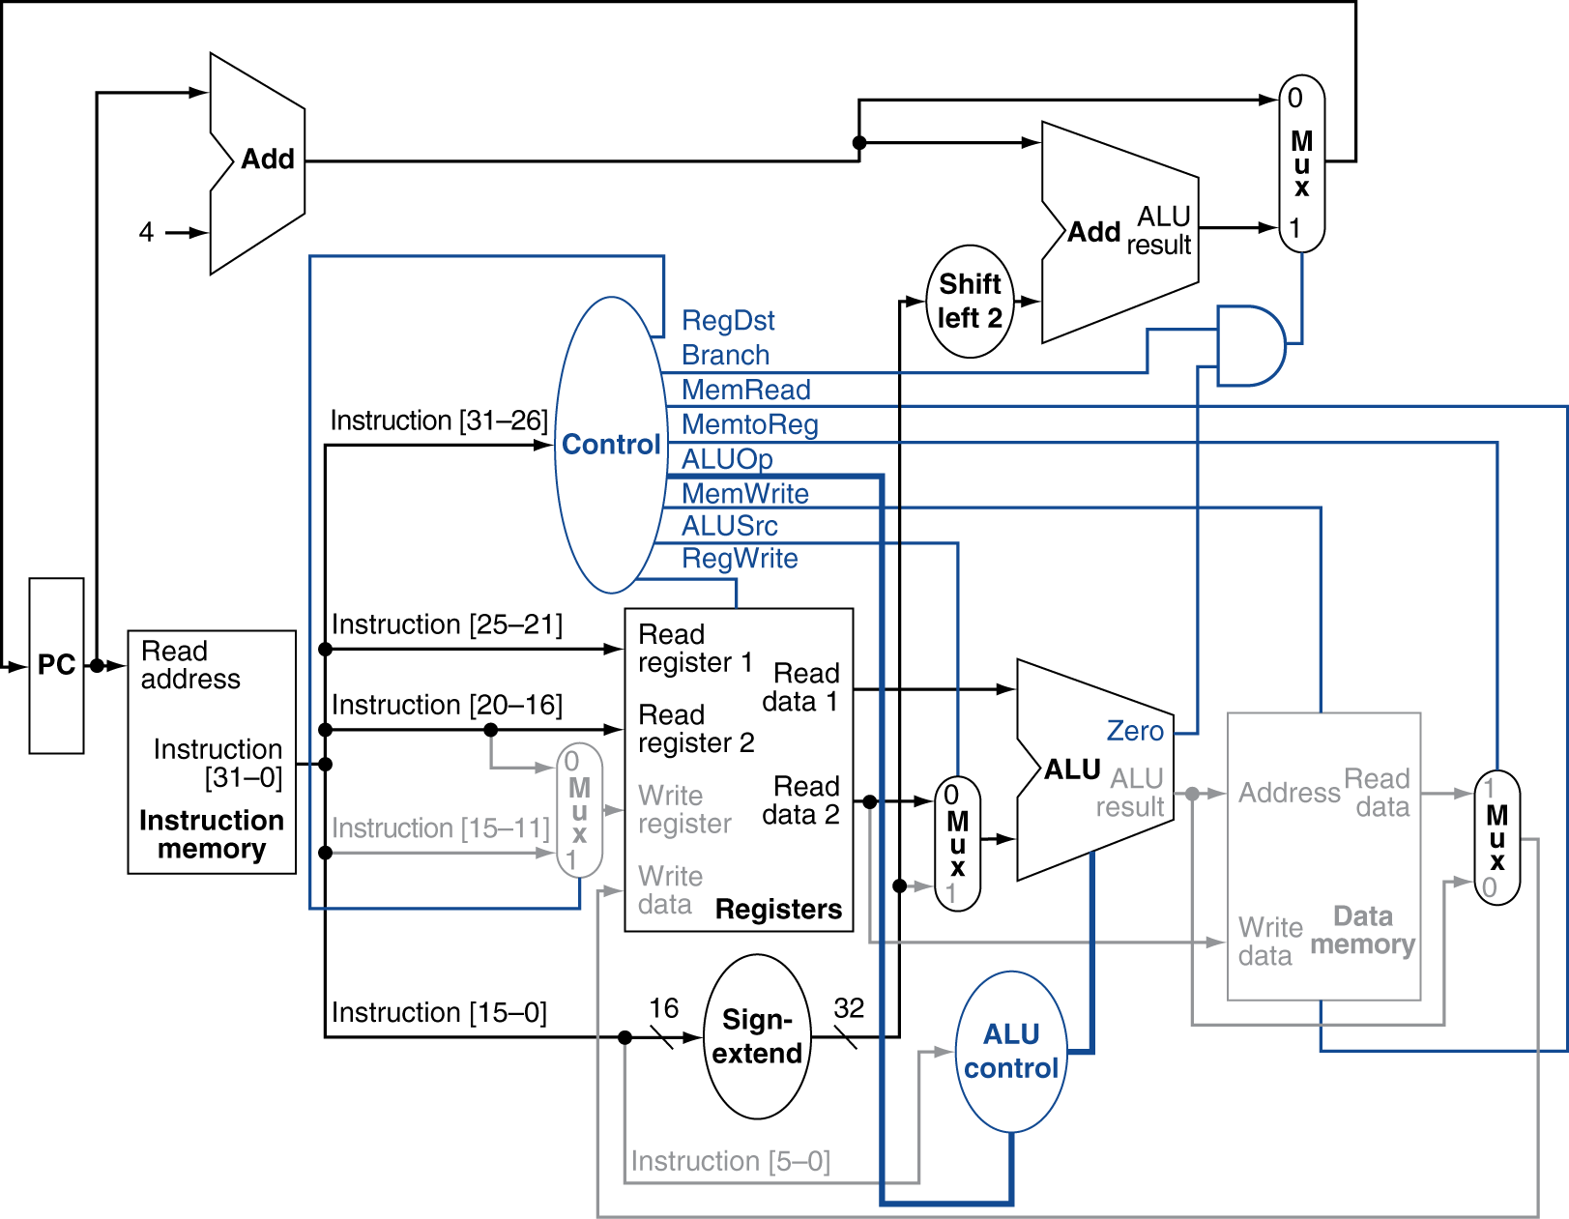
Branch-on-Equal Instruction

Slide 26
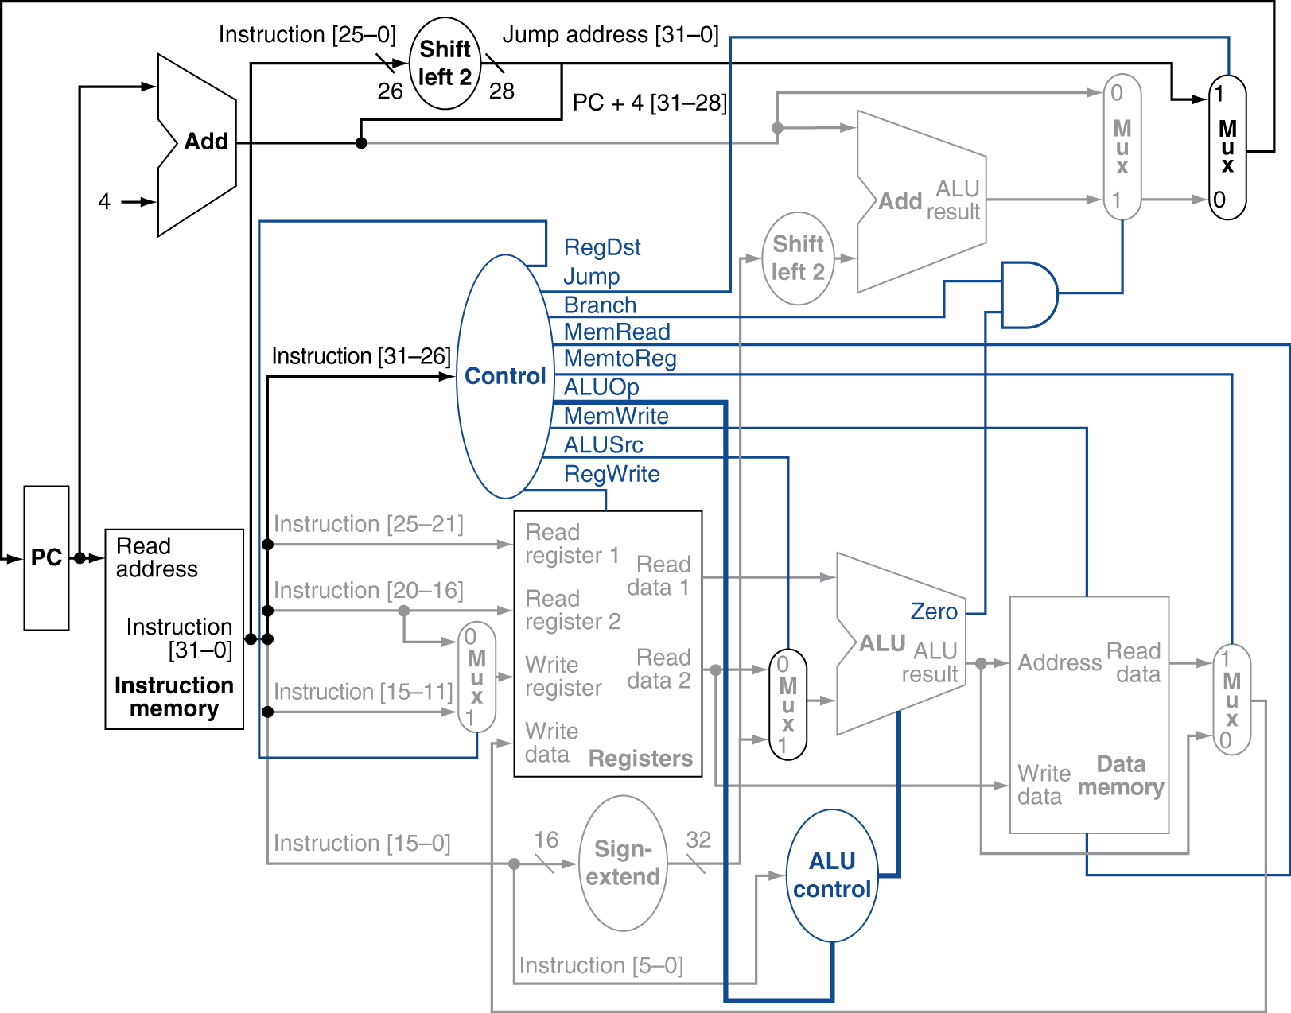
Datapath With Jumps Added
Fig. 4.24

Slide 27
Performance Issues
Longest delay determines clock period
Critical path: load instruction
Instruction memory → register file → ALU → data memory → register file
Not feasible to vary period for different instructions
Violates design principle
Making the common case fast (Amdahl’s Law)
We will improve performance by pipelining

Slide 28
R-Type: add $1, $2, $3

Slide 29
I-Type: addi $1, $2, 0x10

Slide 30
I-Type: beq $1, $2, 0x20

Slide 31
I-Type: lw $1, 4($2)

