Slide 1

CSCE 230, Fall 2013
Chapter 8
Memory Hierarchy
Mehmet Can Vuran, Instructor
University of Nebraska-Lincoln
Acknowledgement: Overheads adapted from those provided by the authors of the textbook

Slide 2
Genesis*
Increasing gap between processor and main memory speeds since the 1980s, became the cause of primary bottleneck in overall system performance.
  in the decade of 1990s, processor clock rates increased at 40%/year, while main memory (DRAM) speeds went up by only 11%/year.
Building small fast cache memories emerged as a solution. Effectiveness illustrated by experimental studies:
  1.6x improvement in the performance of VAX 11/780 (c. 1970s) vs. 15x improvement in performance of HP9000/735 (c. early 1990s) [Jouppi, ISCA 1990]
See Trace-Driven Memory Simulation: A Survey, Computing Surveys, June 1997.
See, also, IBM’s Cognitive Computing initiative for an alternative way
of organizing computation..

Slide 3
CPU + memory Abstraction
memory
address
CPU
PC
200
data
ADD a,b,c
ADD a,b,c
200
IR

Slide 4
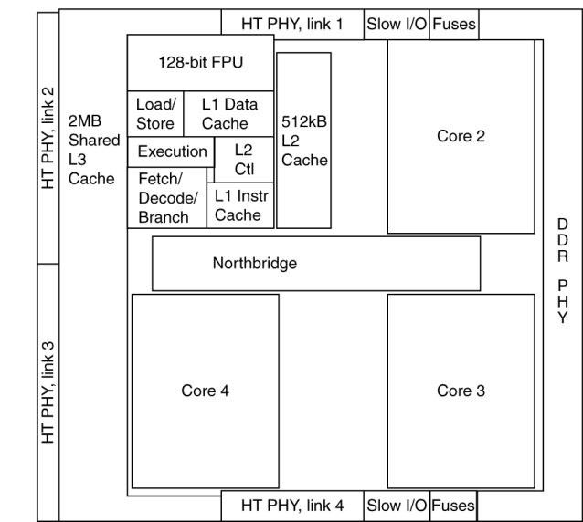
In reality…
Main
Memory
Storage
Processor
Level-3
Cache
Level-2
Cache
Level-1
Cache

Slide 5


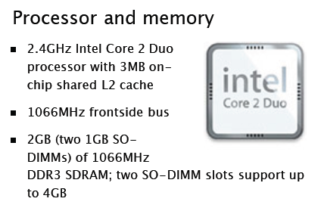
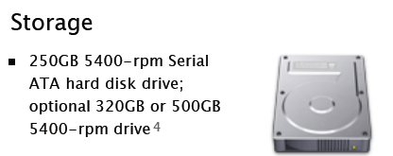
In reality…
L1 Instruction Cache: 32.0 KB, L1 Data Cache: 32.0 KB

Slide 6
Cache Operation
Cache hit
address
data
cache
main
memory
CPU
cache
controller
address
data
data
Cache miss

Slide 7
Quick Review: Memory Hierarchy
Memory Hierarchy: Registers, Caches, Main, Disk (upper to lower)
Upper levels faster, costlier
Lower levels larger in capacity
Design Goal: Strive for access time of the highest level for the capacity available at the lowest level
Made possible because of locality of instruction and data references to memory

Slide 8
Memory Hierarchy
Processor registers are fastest, but do not use the same address space as the memory
Cache memory often consists of 2 (or 3) levels, and technology enables on-chip integration
Holds copies of program instructions and data stored in the large external main memory
For very large programs, or multiple programs active at the same time, need more storage
Use disks to hold what exceeds main memory

Slide 9
Memory Hierarchy with One-Level Cache
PROCESSOR
CACHE
Access Time: 1 unit
Capacity: O(10KB)
MAIN MEMORY
Access Time: 100 units
Capacity: O(GB)
MAGNETIC DISK
Access Time: 10⁷ units
Capacity: O(100GB)

Slide 10
Caches and Locality of Reference
The cache is between processor and memory
Makes large, slow main memory appear fast
Effectiveness is based on locality of reference
Typical program behavior involves executing instructions in loops and accessing array data
Temporal locality: instructions/data that have been recently accessed are likely to be again
Spatial locality: nearby instructions or data are likely to be accessed after current access

Slide 11
More Cache Concepts
To exploit spatial locality, transfer cache block with multiple adjacent words from memory
Later accesses to nearby words are fast, provided that cache still contains the block
Mapping function determines where a block from memory is to be located in the cache
When cache is full, replacement algorithm determines which block to remove for space

Slide 12
Cache Operation
Processor issues Read and Write requests
as if it were accessing main memory directly
But control circuitry first checks the cache
If desired information is present in the cache, a read or write hit occurs
For a read hit, main memory is not involved; the cache provides the desired information
For a write hit, there are two approaches

Slide 13
Handling Cache Writes
Write-through protocol: update cache & mem.
Write-back protocol: only updates the cache; memory updated later when block is replaced
Write-back scheme needs modified or dirty bit to mark blocks that are updated in the cache
If same location is written repeatedly, then write-back is much better than write-through
Single memory update is often more efficient,
even if writing back unchanged words

Slide 14
Handling Cache Misses
If desired information is not present in cache, a read or write miss occurs
For a read miss, the block with desired word is transferred from main memory to the cache
For a write miss under write-through protocol, information is written to the main memory
Under write-back protocol, first transfer block containing the addressed word into the cache
Then overwrite location in cached block

Slide 15
Mapping Functions
Block of consecutive words in main memory must be transferred to the cache after a miss
The mapping function determines the location
Study three different mapping functions
Use small cache with 128 blocks of 16 words
  Block size: 16 words
  Cache size: 128x16 = 2048 words
Use main memory with 64K words (4K blocks)
  Number of blocks = 64K/16 = 4K
Word-addressable memory, so 16-bit address
  2^16 = 64K

Slide 16
Mapping Functions
Study three different mapping functions
  Direct Mapping
  Associative Mapping
  Set-associative Mapping

Slide 17
Direct Mapping
Simplest approach uses a fixed mapping:
memory block j → cache block ( j mod 128 )
Only one unique location for each mem. block
Two blocks may contend for same location
New block always overwrites previous block
Divide address into 3 fields: word, block, tag
Block field determines location in cache
Tag field from original address stored in cache
Compared with later address for hit or miss

Slide 18
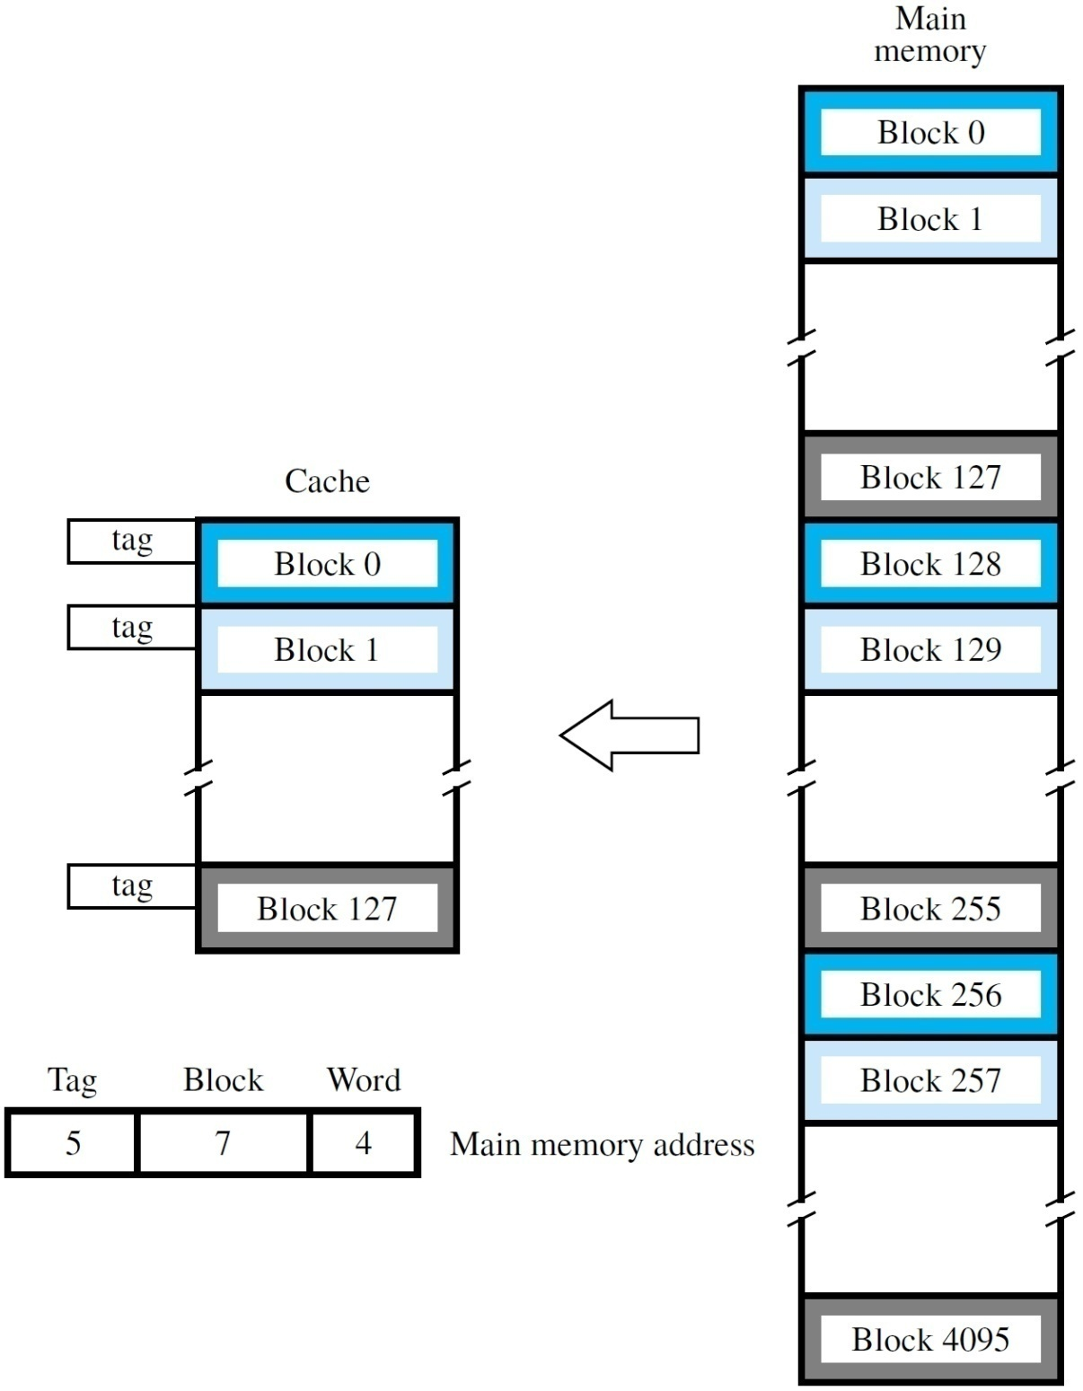

Slide 19
Example
Word#
0
15
0
0
.
.
.
1
1
5 bits
16x32 bits
Cache
Block#
V
D
TAG
D A T A
127
Block#
One Block Wide
Memory Address
Cache Block # =
Block # mod 128
15
4
3
0
Block#
Word#
Cache Address
10
4
3
0
4K-1
Cache Block#
Word#
One Block Wide

Slide 20
Resulting Partitioning of Memory Address and Address Mapping
Memory Address = <Tag, Cache Block #, Word #>
where,
  Tag is 5 bits – range is 0-31
  Cache Block # is 7 bits – range is 0-127
  Word # is 4 bits – range is 0-15
  Example:
    Memory address <27, 87, 11> will map to Cache Block # 87 and will have a tag value of 27. The addressed word will be Word # 11 in this block.

Slide 21
Associative Mapping
Full flexibility: locate block anywhere in cache
Block field of address no longer needs any bits
Tag field is enlarged to encompass those bits
Larger tag stored in cache with each block
For hit/miss, compare all tags simultaneously in parallel against tag field of given address
This associative search increases complexity
Flexible mapping also requires appropriate replacement algorithm when cache is full

Slide 22
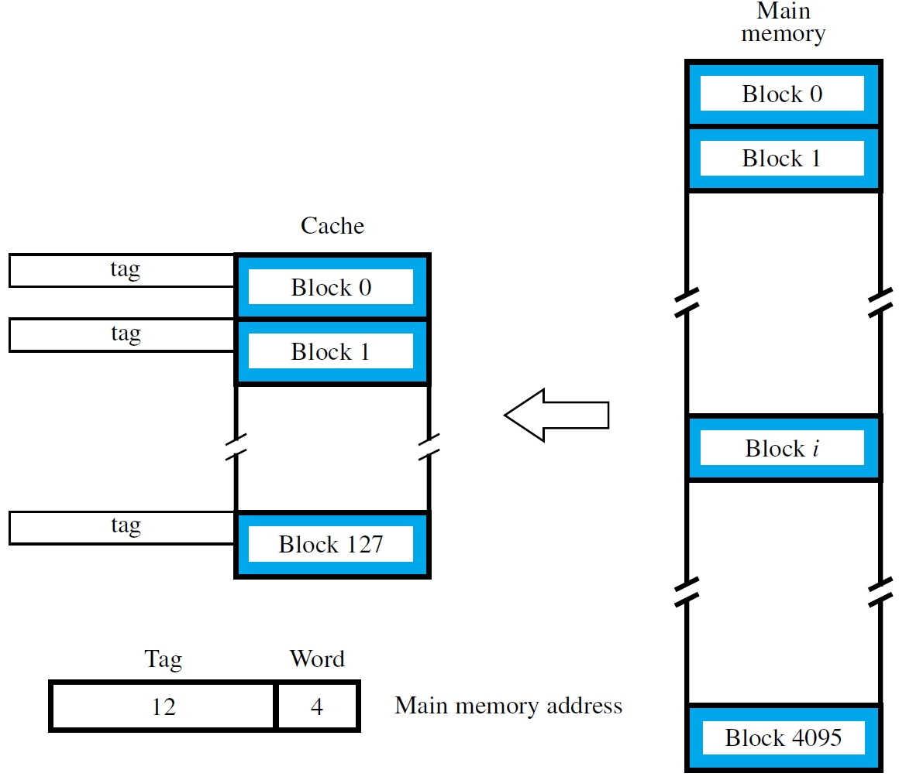

Slide 23
Set-Associative Mapping
Combination of direct & associative mapping
Group blocks of cache into sets
Block field bits map a block to a unique set
But any block within a set may be used
Associative search involves only tags in a set
Replacement algorithm is only for blocks in set
Reducing flexibility also reduces complexity
k blocks/set → k-way set-associative cache
Direct-mapped = 1-way; associative = all-way

Slide 24
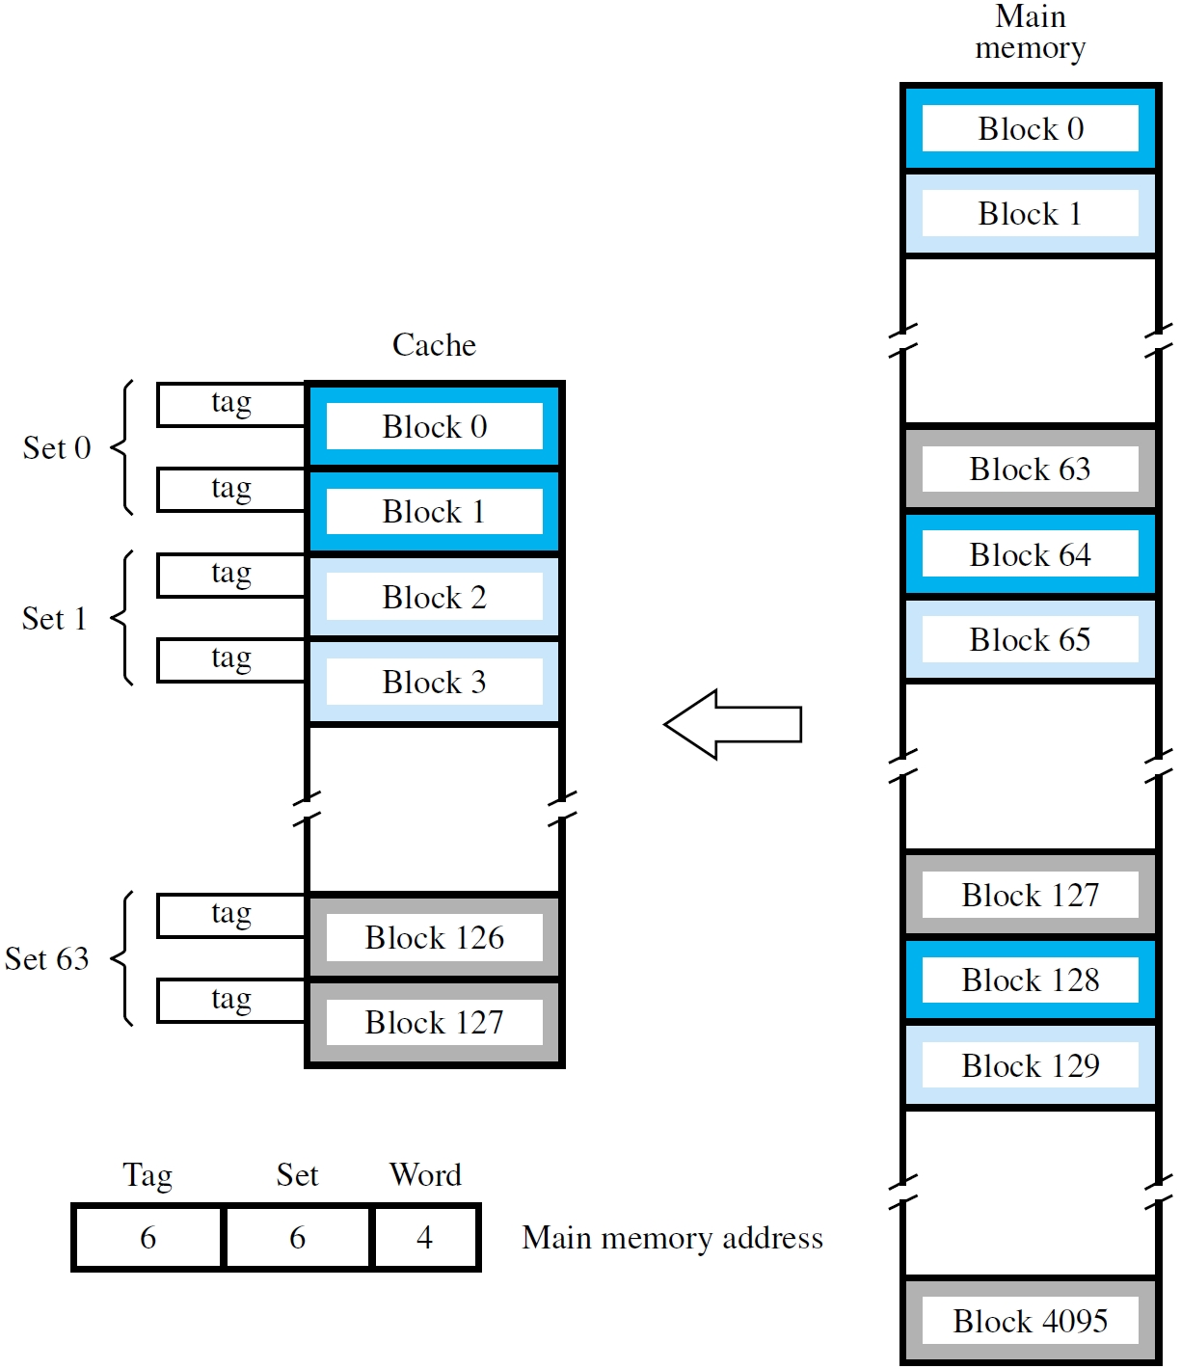
2-way set-associative

Slide 25
Stale Data
Each block has a valid bit, initialized to 0
No hit if valid bit is 0, even if tag match occurs
Valid bit set to 1 when a block placed in cache
Consider direct memory access, where data is transferred from disk to the memory
Cache may contain stale data from memory, so valid bits are cleared to 0 for those blocks
Memory→disk transfers: avoid stale data by flushing modified blocks from cache to mem.

Slide 26
LRU Replacement Algorithm
The following algorithm implements the FIFO based LRU algorithm by associating and updating the FIFO position of each element in a k–way set dynamically, as new elements are brought in the set or old ones replaced.
For k-way set associativity, each block in a set has a counter ranging from from 0 to k−1
On hit:
  Set counter of hit block as 0; increment others with counters lower than original counter value of the hit block
On miss and the set is not full:
  Set counter of incoming block as 0 and increment all other block counters by 1
On miss and the set full:
  Replace the block with Counter=k-1, set counter of incoming block as 0 and increment all other block counters by 1

Slide 27
LRU Algorithm in terms of FIFO
FIFO size = number of ways (4 for 4-way set associative)
FIFO positions numbered 0 (for MRU) to 3 (for LRU)
Insertions and promotions at the MRU position
Eviction at the LRU position.
For access to a new block (miss):
  Evict block at LRU position (if no room)
  Insert the new block at the MRU position (other blocks move one position)
For access to an existing block (hit)
  Promote it to the MRU position (other blocks that were ahead in FIFO move one position)
Needs log₂A bits/block, where A=#ways.
Can use smaller FIFO (fewer bits) with reduced accuracy.

Slide 28
LRU Algorithm in terms of FIFO - Example
0 | 1 | 2 | 3
– | – | – | –
0 | 1 | 2 | 3
55 | 17 | 25 | –
0 | 1 | 2 | 3
30 | 22 | 25 | 55
0 | 1 | 2 | 3
17 | – | – | –
0 | 1 | 2 | 3
25 | 55 | 17 | –
0 | 1 | 2 | 3
29 | 30 | 22 | 25
55 evicted
0 | 1 | 2 | 3
25 | 17 | – | –
0 | 1 | 2 | 3
30 | 25 | 55 | 17
Reference Sequence:
17, 25, 17, 55, 25, 30,
22, 30 29
0 | 1 | 2 | 3
17 | 25 | – | –
0 | 1 | 2 | 3
22 | 30 | 25 | 55
17 evicted

Slide 29
Example

Slide 30
Problem 8.11
Byte addressable computer
Data cache can hold 8 32-bit words, initially empty
Block size = 32 bits (4 bytes)
Processor reads data from the following hex addresses:
  200, 204, 208, 20C, 2F4, 2F0, 200, 204, 218, 21C, 24C, 2F4
  This pattern is repeated four times.
Show the contents of the cache at the end of each pass through the loop, if (a) a direct-mapped cache is used Compute the hit rate. (b) Repeat part (a) for fully associative cache with LRU replacement policy. (c) Repeat part (a) for a 4-way set-associative cache. (Assume, for simplicity, address length is 12 bits).

Slide 31
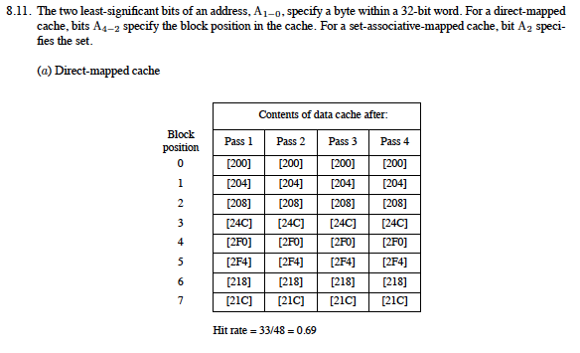
SOLUTION TO 8.11 (on this and next two pages):
This solution is provided by the textbook authors –
do verify its correctness.

Slide 32
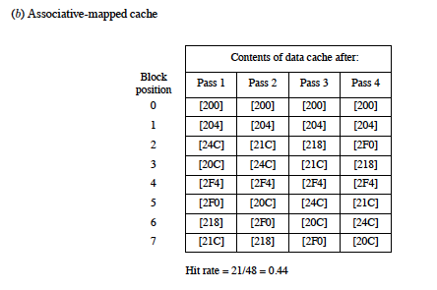

Slide 33
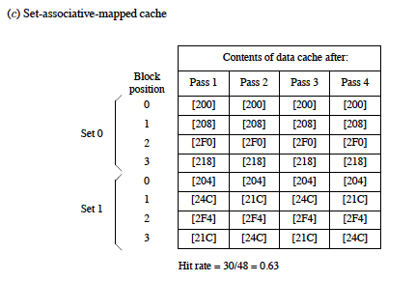

Slide 34
Example of LRU Algorithm
Consider 4-way associative (k = 4). Consider references to a specific set, say Set # 10, and assume initially this set is empty. Consider the following reference (read) sequence (Note: Both Tag and Set # have the range 0–63):
(Showing only Tag field since Set # is fixed and Word # does not affect the LRU)
17, 25, 17, 55, 25, 30, 22, 30 29

Slide 35
Reference Sequence:
17, 25, 17, 55, 25, 30, 22, 30 29
– | – | – | –
– | – | – | –
1 | 2 | 0 | –
17 | 25 | 55 | –
1 | 2 | 3 | 0
22 | 25 | 55 | 30
0 | – | – | –
17 | – | – | –
2 | 0 | 1 | –
17 | 25 | 55 | –
2 | 3 | 0 | 1
22 | 25 | 29 | 30
1 | 0 | – | –
17 | 25 | – | –
3 | 1 | 2 | 0
17 | 25 | 55 | 30
0 | 1 | – | –
17 | 25 | – | –
0 | 2 | 3 | 1
22 | 25 | 55 | 30

Slide 36
Cache Performance
Primary Measure: Average Access Time
  Can compute for each level of cache in terms of its hit rate (h), cache access time (C) and miss penalty (M):
  Then, can combine successive levels, say L1 and L2, by noting that the average miss penalty of L1 is the same as the average access time of L2. Hence,
  assuming unified L1 cache for instructions and data (not the common case). If $L1D and $L1I are separate, use weighted average.

Slide 37
Example 8.4
Given:
  Cache with two levels: L1 and L2
  Performance data:
    L1: access time: T, hit rate: 0.96
    L2: access time: 15T, hit rate: 0.8
    Transfer times: L2 to L1: 15 T, M to L2: 100T
What fraction of accesses miss both L1 and L2?
What is the av. access time seen by processor?
By what factor would it reduce If L2’s hit rate were perfect, i.e. 1.0?
What is the av. access time seen by processor if L2 is removed and L1 is increased so as to halve its miss rate?
Note: Answers to (b) – (d) depend on
assumptions made about the miss penalty.

Slide 38
Solution
20% of 4% = .2*.04 = .008
AMAT_{proc} = h₁*HT_{L1} + (1-h₁)MP_{L1}
MP_{L1} = h₂*HT_{L2} + (1-h₂)MP_{L2}
MP_{L2} = HT_{Main}
Assume: Whenever the data is transferred from one level of the memory hierarchy to the next lower level, it is also made available to the processor at the same time (assumes additional data paths). Hence:
AMAT_{proc} = h₁*HT_{L1} + (1-h₁)[h₂*HT_{L2} + (1-h₂) HT_{Main}]
= 0.96*T + 0.04(0.8*15T + 0.2*100T)
= 2.24T
Parts (c) and (d) can be answered in a similar way.

Slide 39
Performance Enhancement Methods
Use Write Buffer when using write-through.
  Obviates the need to wait for the write-through to complete, e.g. the processor can continue as soon as the buffer write is complete. (see further details in the textbook)
Prefetch data into cache before they are needed. Can be done in software (by user or compiler) by inserting special prefetch instructions. Hardware solutions also possible and can take advantage of dynamic access patterns.
Lockup-Free Cache: Redesigned cache that can serve multiple outstanding misses. Helps with the use of software-implemented prefetching.
Interleaved main memory. Instead of storing successive words in a block in the same memory module, store it in independently accessible modules – a form of parallelism. Latency of first word still the same but the successive words can be transferred much faster.

Slide 40
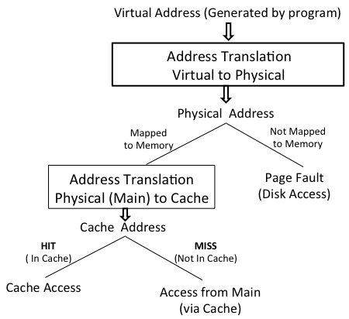
Address Translation with Caches

Slide 41
Virtual Memory (Why?)
Physical mem. capacity ≤ address space size
A large program or many active programs may not be entirely resident in the main memory
Use secondary storage (e.g., magnetic disk) to hold portions exceeding memory capacity
Needed portions are automatically loaded into the memory, replacing other portions
Programmers need not be aware of actions; virtual memory hides capacity limitations
Notes:
In early days of computing, when memory capacity was at a premium, programmers would do the memory management manually by loading overlays of memory blocks needed at any particular time of execution. Automatic memory management by the OS removed this burden from the programmers. Now, even with much larger capacities, memory management is still very relevant not only for being able to run a large program (or many active programs) that don’t fit in memory, but also to protect concurrently resident programs from intruding into one another’s physical space. That is, another important function of memory management is protection of data in memory.

Slide 42
Virtual Memory (What?)
Programs written assuming full address space
Processor issues virtual or logical address
Must be translated into physical address
Proceed with normal memory operation
when addressed contents are in the memory
When no current physical address exists, perform actions to place contents in memory
System may select any physical address;
no unique assignment for a virtual address
Notes:
The conceptual similarity with the cache is apparent from this description: both involve address translation (from physical main memory address to cache address in one case and from virtual to physical in the other case), detection of hit vs. miss and the consequent actions. The last bullet also points to a significant difference: physical addresses map to a unique block (for directly mapped caches) or to a unique set of a small (k) number of blocks for k-way set-associative caches. An arbitrary mapping allows much greater flexibility in the placement of pages (bigger than cache blocks by an order or more of magnitude) from the disk to the main memory – it would be akin to the fully-associative cache where a main-memory block can go any where in the cache. The difference is that large fully associative caches are very expensive to build in hardware, hence caches are rarely fully associative. The virtual address mapping, on the other hand, is implemented in software by means of table lookup, so it is feasible in terms of cost, although not in terms of access time. We will see soon why short access time is important here also and how it is achieved.

Slide 43
Memory Management Unit
Implementation of virtual memory relies on a memory management unit (MMU)
Maintains virtual→physical address mapping to perform the necessary translation
When no current physical address exists, MMU invokes operating system services
Causes transfer of desired contents from disk to the main memory using DMA scheme
MMU mapping information is also updated
Notes:
All the functions related to implementing the virtual memory abstraction are integrated into the MMU: address mapping, OS-service invocation in case of a page fault, and keeping the dynamically changing page-table information up-to-date.

Slide 44
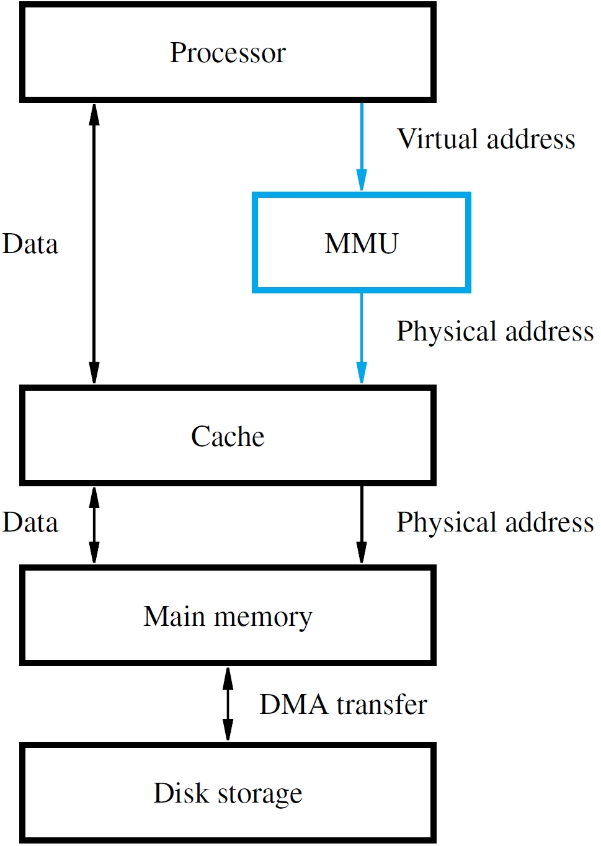
The Big Picture:
Full Memory Hierarchy
Disk address
Notes:
This is the common picture in which caches are physically mapped – i.e. the processor address references are first translated from virtual to physical before being used for referencing caches and higher (slower) levels of the memory hierarchy. Note that MMU mapping provides the physical memory address if there is hit and disk page address when there is a miss (here called a page fault).

Slide 45
Address Translation
Use fixed-length unit of pages (2K-16K bytes)
Larger size than cache blocks due to slow disks
For translation, divide address bits into 2 fields
Lower bits give offset of word within page
Upper bits give virtual page number (VPN)
Translation preserves offset bits, but causes VPN bits to be replaced with page frame bits
Page table (stored in the main memory) provides information to perform translation
Notes:
Just as we divided the physical address into two parts (block#, block-offset) for cache mapping, here we divide the virtual address similarly and translation uses only the upper part (VPN).

Slide 46
Page Table
MMU must know location of page table
Page table base register has starting address
Adding VPN to base register contents gives location of corresponding entry about page
If page is in memory, table gives frame bits
Otherwise, table may indicate disk location
Control bits for each entry include a valid bit and modified bit indicating needed copy-back
Also have bits for page read/write permissions
Notes:
One page table per active program. In addition to the base register, there might be a limit register to limit the size of the table. As with caches, we have the Valid and Modified control bits. Additional bits may indicate read/write permissions, especially if there is sharing of code or data between two active programs. One may have the write permission while the other may have only the read permission.
Copy-back is like write-back. There is no analog for write-through because it would be too expensive here, given the relative access times of of the main memory and the disk.

Slide 47
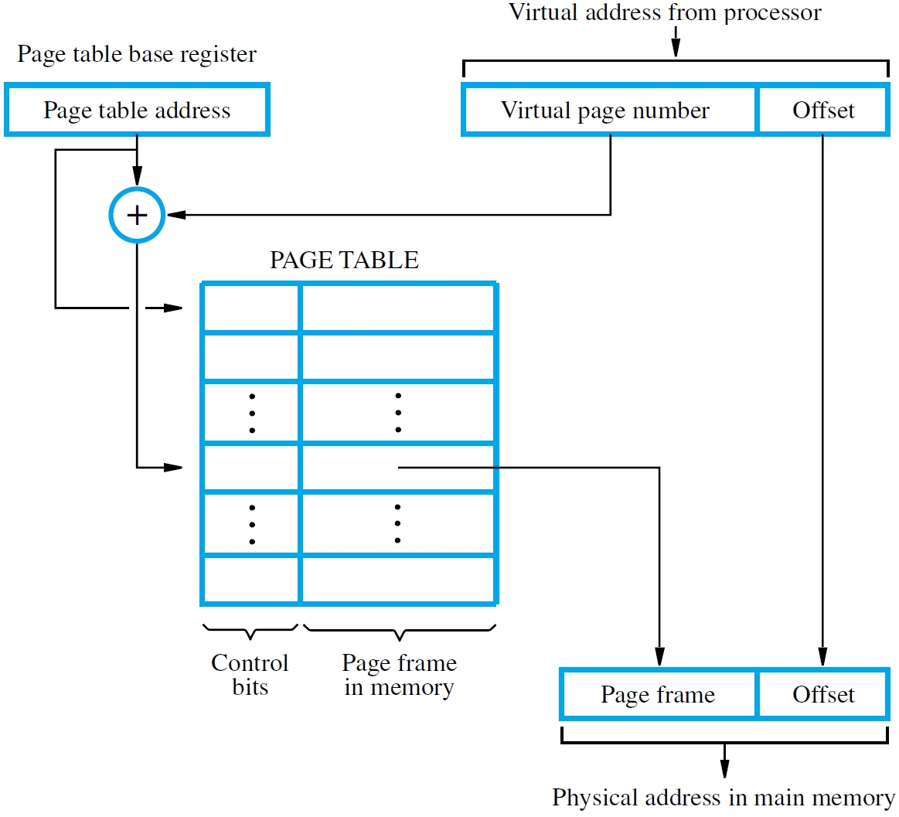
Virtual-to-Physical Address Translation Using Page Tables
Notes:
How the translation process works.

Slide 48
Translation Lookaside Buffer
MMU must perform lookup in page table
for translation of every virtual address
For large physical memory, MMU cannot hold entire page table with all of its information
Translation lookaside buffer (TLB) in the MMU holds recently-accessed entries of page table
Associative searches are performed on the TLB with virtual addresses to find matching entries
If miss in TLB, access full table and update TLB
Notes:
With virtual memory, every address reference must be looked up at least twice to perform the two address translations: from virtual to physical and from physical to cache (the latter may involve cascading through the cache hierarchy, involving more look ups). This is too high a price to pay, particularly since the page tables can be very large and only a small portion might actually reside in fast caches.
The solution is to use a cache to store the most recent virtual to physical translations. This cache is called the TLB. It may be fully associative or have a high degree of associativity. For this reason, it must be relatively small.
The TLB must be updated whenever the information is not found in the TLB.

Slide 49
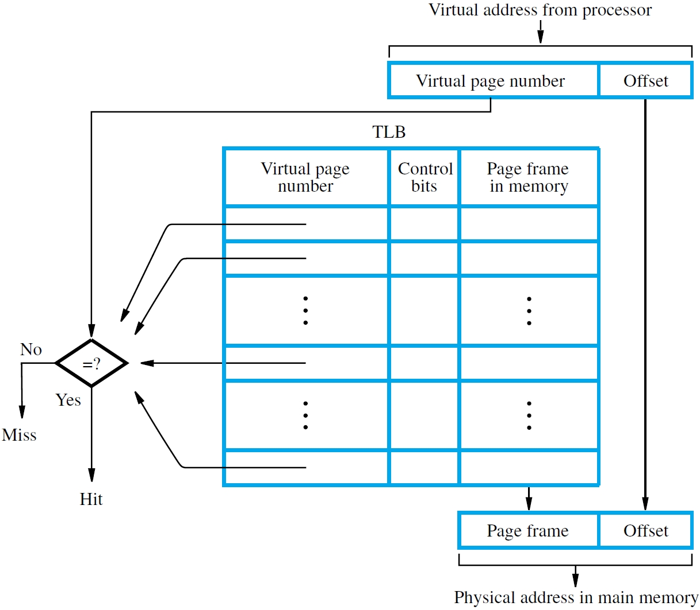
TLB Operation

Slide 50
Page Faults
A page fault occurs when a virtual address has no corresponding physical address
MMU raises an interrupt for operating system to place the containing page in the memory
Operating system selects location using LRU, performing copy-back if needed for old page
Delay may be long, involving disk accesses, hence another program is selected to execute
Suspended program restarts later when ready

Slide 51
Example 8.5
Computation: Normalize a 1024x1024 array of 32-bit words by dividing each element by the largest element in each column. Do the computation column-by-column.
Given:
  1 Mbyte of memory for data storage (can only store a quarter of the array at a time)
  4 Kbyte pages
  10 ms transfer time per page
Problem:
  (a) How many page faults and how long does it take to normalize if the array elements are stored in column-major order

Slide 52
Example 8.5 (Continued)
  (b) Repeat if elements are stored row-major
  (c) Propose alternative computational scheme for part (b) to reduce the number of page faults and the processing time.

Slide 53
Consider the following pseudo-code for normalizing the array elements.
for j = 1, 1024 {
max[j] = -∞ /* A large negative value */
for i = 1, 1024 {
if(A[i,j]>max[j]) then max[j] = A[i,j]
}
for i = 1, 1024 {
A[i,j] = A[i,j]/max
}
}
Q1: How many page faults will occur if array A is stored in the
column-major order?
Q2: How many page faults will occur if array A is stored in the
row-major order?
Notes:
Q1: If the elements are stored in the column major order, then, in the first i loop there will be a page fault for accessing A[1,j] for all j but no other page faults. There will be no page fault for the second for loop because the array elements in the column is already in memory. Hence a total of 1K page faults, yielding a time of 1.024 s.
Q2: If the elements are stored in the row-major order then every access of A[i,j] (for all values of i, and j) will result in a page fault in both the loops. Hence the processing time will be 2M*10ms = 5.8 hours.

Slide 54
Consider the modified pseudo-code for normalizing the array elements.
  for j = 1, 1024 {max[j] = -∞} /* A large negative value */
for k = 1,4 {
  for i = (k-1)*256+1, k*256
  for j = 1, 1024 {
  if(A[i,j]>max[j]) then max[j] = A[i,j]
  }
  }
  for i = (k-1)*256+1, k*256
  for j = 1, 1024 {
  A[i,j] = A[i,j]/max[j]
    }
  }
}
Q3: How many page faults will occur if array A is stored in the
row-major order?
Notes:
Q3: For row major order, the first access to the element A[i,1], will result in a page fault that brings in the whole row i into the memory, hence there will be no further page faults in the subsequent iterations of the j loop. Thus, for each value of i in the top and bottom halves, there will be a page fault. Hence, a total of 2K page faults. Ignoring processing time, the total time is 2K*10 ms = 2.408 s

Slide 55
Memory Organization: Basic Concepts
Access provided by processor-memory interface
Address and data lines, and also control lines for command (Read/Write), timing, data size
Memory access time is time from initiation to completion of a word or byte transfer
Memory cycle time is minimum time delay between initiation of successive transfers
Random-access memory (RAM) means that access time is same, independent of location
Notes:
We have already discussed the processor-memory interface as consisting of three kinds of signals, data, address, and control. The memory may operate without a clock (asynchronously) or with a clock (synchronous). In either case, the access time refers to how long it takes to complete a word or byte transfer. Random access implies that this time is essentially independent of which memory word or byte is being addressed.

Slide 56
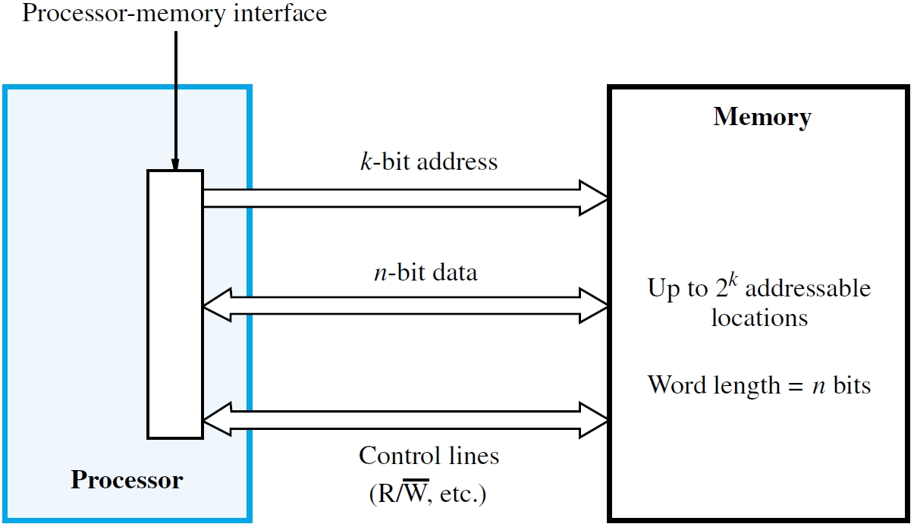
Notes:
Basic relations on the dimensions of the memory in terms of the widths of address and data bus widths are shown.

Slide 57
Semiconductor RAM Memories
Memory chips have a common organization
Cells holding single bits arranged in an array
Words are rows; cells connected to word lines (cells per row ≠ bits per processor word)
Cells in columns connect to bit lines
Sense/Write circuits are interfaces between
internal bit lines and data I/O pins of chip
Common control pin connections include
Read/Write command and chip select (CS)
Notes:
Physically, the standard arrangement of cells on a chip is 2D array. The number of rows and columns are are determined by the desireto keep close-to-a square aspect ratio, i.e. the number of rows is equal to the number of columns, whereas, the word size is determined by the processor architecture, hence cells per row is typically not the same as the numbers of bits per processor words. The number of columns would typically be much larger than the word size. The row and column operation is not entirely symmetric. The row decoder selects all the cells in a particular row, i.e. many words are selected. The column address connects to a mux that selects the desired word out of all the bit lines selected by the row decoder. The sense/write circuits interface the internals bit lines to the external data I/O pins on the chip.
Control signals would typically include at least one R/W-bar line to indicate read (1) or write (0) operation and a chip select line to allow the chip to be selected for access (read and write) only when the data request falls within the chip. This allows a systematic way of creating larger memories by hierarchical selection of chips.

Slide 58
Memory Chips: Internal Organization
Depends on if address decoding is 1-D or 2-D
  Fig. 8.2 shows example of 1-D decoding
  Fig. 8.3 shows example of 2-D decoding

Slide 59
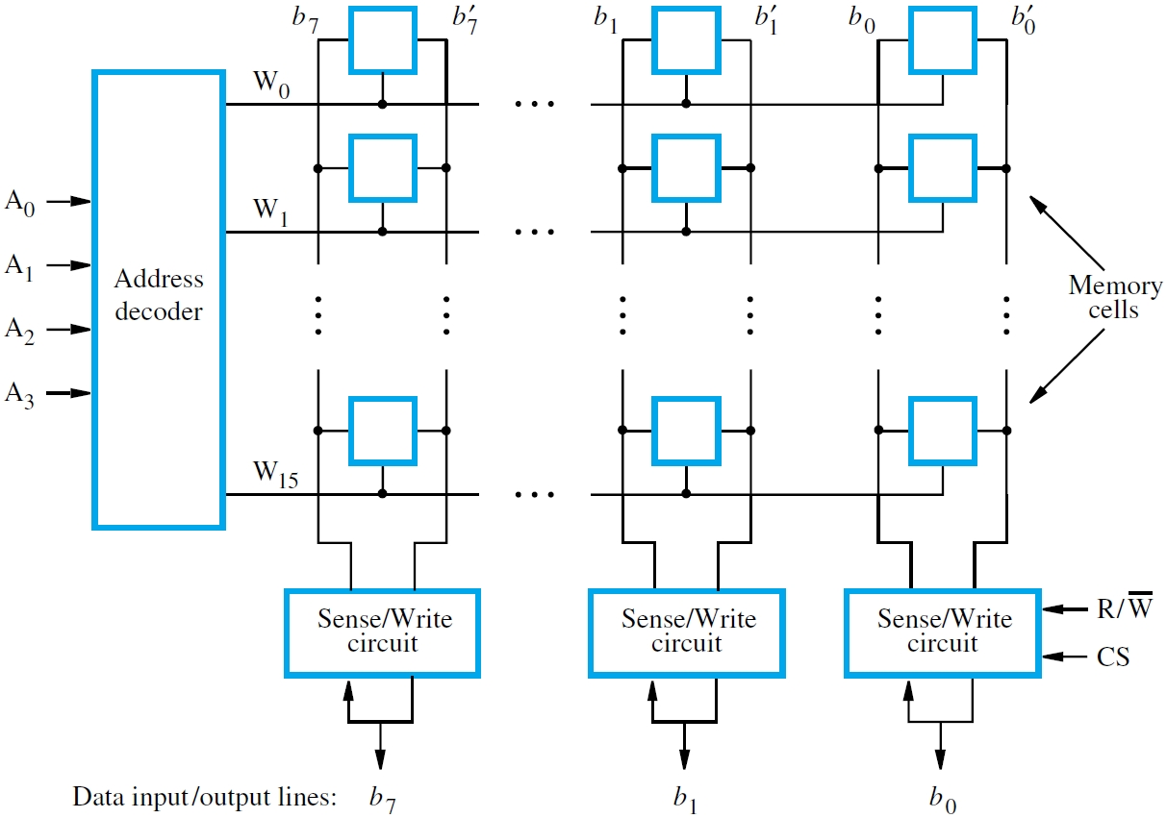
Fig. 8.2
Notes:
Note that internally, there are two bit lines (true and false) per bit. These carry complementary signals. Externally, these are encoded into a single line. From this picture, it is possible to figure out how the number of pins relate to the specification of the chip.

Slide 60
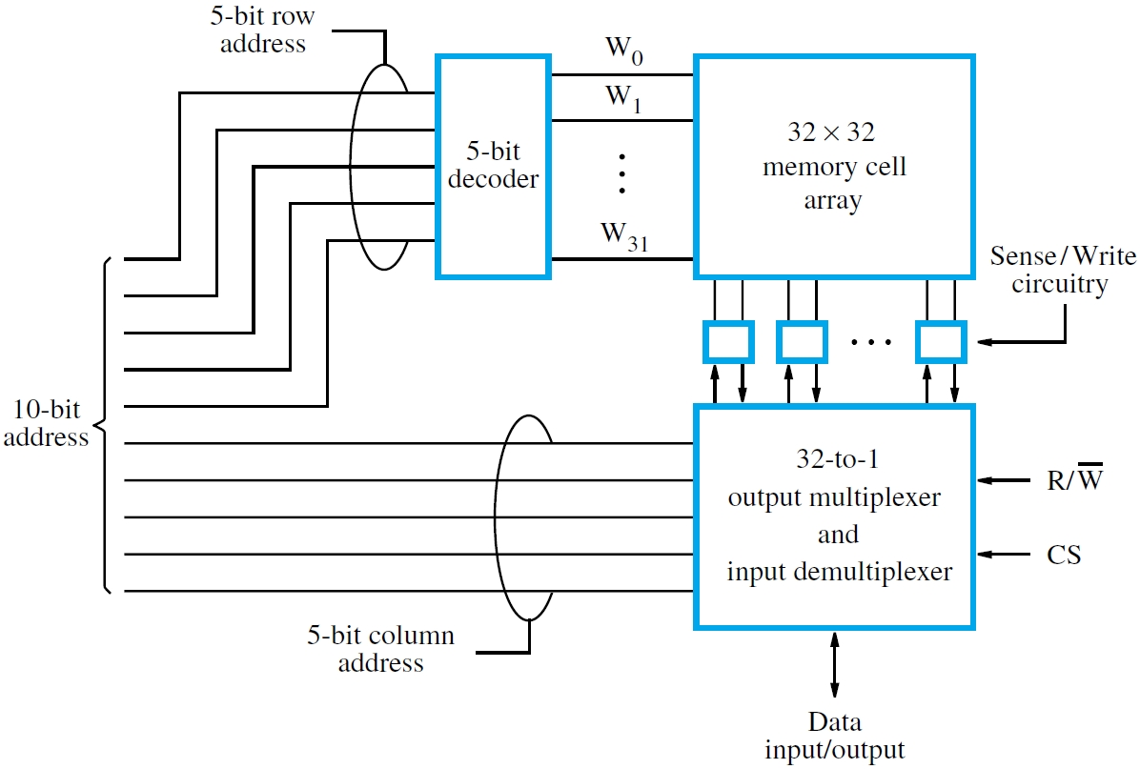
Fig. 8.3
Notes:
Generally, logic schematics, meant for human communication, assume power and ground pins and don’t show them explicitly. Hence to the 13 pins shown, we must add two more to get the correct count of 15 pins.

Slide 61
An Example Block Diagram of a Commercial Chip
64Kx16 High-Speed CMOS Static RAM

Slide 62
Another Example of a Commercial Chip
128Kx8 Low-Voltage Ultra Low Power Static RAM

Slide 63
Building Larger Memories from Chips
Consider building:
  32x4 memory using 4 chips
  128x1 memory using 4 chips
  128x4 memory using 16 chips
Assume a 32x1 chip:
Address
5
CE
Data
V_{DD}
GND

Slide 64
32x4
A₄₋₀
1
1
V_{DD}
Data
4
GND
1
1

Slide 65
128x1
A₄₋₀
3
V_{DD}
GND
2
A₆₋₅
Data
D e c o d e r
1
0

Slide 66
128x4: Exercise
(See Fig. 8.10 for a larger example of a static memory system)

Slide 67
Dynamic RAM Chips
Consider 32M × 8 chip with 16K × 2K array
16,384 cells per row organized as 2048 bytes
14 bits to select row, 11 bits for byte in row
Use multiplexing of row/column on same pins
Row/column address latches capture bits
Row/column address strobe signals for timing (asserted low with row/column address bits)
Asynchronous DRAMs: delay-based access, external controller refreshes rows periodically
Notes:
Note that 32Mx8 = 256M bits = 16Kx16K bits. This is a byte addressable chip, i.e there are 8 data-in and data-out lines. Row decoder selects 16,348 cells, i.e. 2048 bytes that include the specific byte addressed by the full address. The column address selects the correct byte among these. The bit size of row and column select lines follows from these calculation.
DRAMs requires refresh of rows periodically. Reading a DRAM cell is a destructive process, discharging the cell and thus erasing its content. Hence reading is always followed by writing the data just read back into the cell. This is called refreshing the cell, i.e. it is fully recharged after the refresh. As the DRAM cells lose charge over a matter for milliseconds, they must be periodically refreshed.

Slide 68
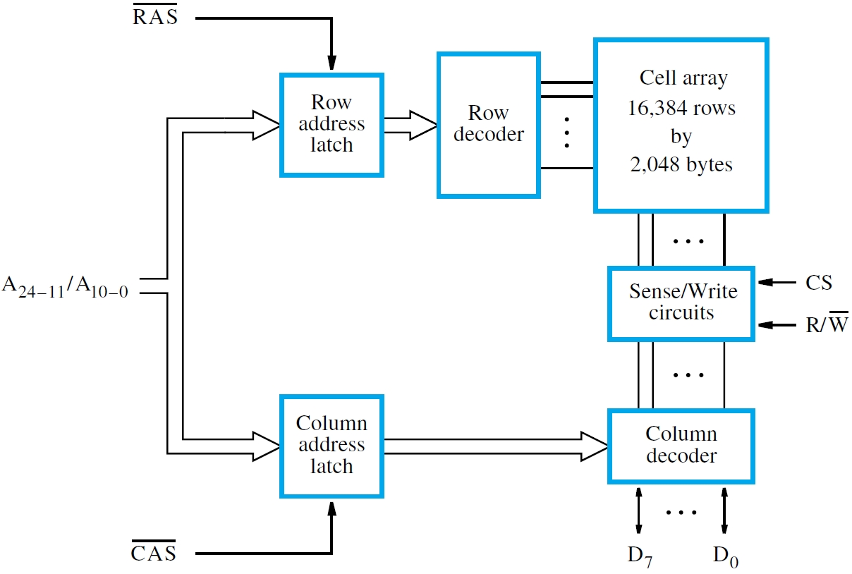
Notes:
The desire to reduce the number of pins in a large memory chips is reflected in time multiplexing of the row and column select lines. These are latched so that they are available even if the external address-line signals change in value. The number of pins with and without time multiplexing can be calculated as follows:
with: max(14,11) for address + 2 for row and column select lines + 2 for CS and R/W-bar) + 8 for bidirectional data lines + 2 for power and ground = 28 pins
without: 14+11+ the rest = 28+11 = 39 pins.

Slide 69
Read on your own:
Fast Page Mode
SRAM, DRAM, SDRAM
Double Data-Rate (DDR) SDRAMs
Dynamic Memory Systems
Memory Controller
ROM, PROM, EPROM, and Flash

Slide 70
Concluding Remarks
Memory hierarchy is an important concept
Considers speed/capacity/cost issues and also reflects awareness of locality of reference
Leads to caches and virtual memory
Semiconductor memory chips have a common internal organization, differing in cell design
Importance of block transfers for efficiency
Magnetic & optical disks for secondary storage

Slide 71
Summary of Cache Memory

Slide 72
Basic Concepts
Motivation: Growing gap between processor and memory speeds (Memory Wall)
Smaller the memory faster it is, hence memory hierarchy is created: L1, L2, L3, Main, Disk.
  Access caches before main
  Access lower level cache before upper level
Reason it works: Temporal and spatial locality of accessed in program execution
An access can be read or write, either can result in a hit or a miss.

Slide 73
Handling Reads
Hits are easy: Just access the item
Read miss requires accessing higher level to retrieve the block that contains the item to be accessed.
  Require placement and replacement schemes
Placement: Where to place the block in cache (mapping function)
Replacement: kicks in only if (a) there is a choice in placement and (b) if the incoming block would overwrite an already placed block.
Recency of access used as the criterion for replacement – requires extra bits to keep track of dynamic accesses to the block.

Slide 74
Writes
Two design options: write-through and write-back.
Write hit: means block already in cache so write the field within it.
  Also write to higher levels for write-through,
  Otherwise, set the dirty for write-back
Write miss:
  Just write the upper level and not the cache for write through
  Otherwise, read the block first and then write

Slide 75
Summary of Cache Memory

Slide 76
Address Translation with Caches

Slide 77
Address Mapping
Goal: Given a physical main-memory bloc address, determine where to access it in the cache.
Elaboration:
  The mapping has to be many-to-one: multiple main memory blocks mapped to a cache block.
  All commonly used mapping schemes can be thought of as mapping the address to a set in the cache, where the set can hold k blocks for a k-way set associative cache. In case of a miss, the incoming block can be placed in any of the k blocks, the actual choice being determined by the replacement policy.

Slide 78
Example: 16-bit physical address, byte addressability,
block-size = 16 bytes; cache size = 128 blocks.
15
m
4
3
0
Tag | Set # | Block Offset
1-way set associative
(Direct Mapped)
Fully set associative
(128-ways)
4-way set associative
8-way set associative
#Blocks/set:
1
128
4
8
#Sets:
128
1
32
16
m-4+1:
7
0
5
4
#Tag-bits:
5
12
7
8

Slide 79
Define a cache line:
V | D | U | Tag | Data Block
Direct Mapped
4-ways
1 Cache Line
1 Cache Line
Set 0
. . . . . . . . .
0
. . | . . | . . | . .
Set 1
1
31
Set 127

Slide 80
Fully set-associative
128-ways
1 Cache Line
Set 0
 |  | . . .
128 Cache Lines

