Slide 1
CSCE 230, Fall 2013 Chapter 6: Pipelining
Mehmet Can Vuran, Instructor
University of Nebraska-Lincoln
Acknowledgement: Overheads adapted from those provided by the authors of the textbook

Slide 2
Chapter Outline
Pipelining: overlapped instruction execution
Hazards that limit pipelined performance gain
Hardware/software implications of pipelining
Influence of pipelining on instruction sets

Slide 3
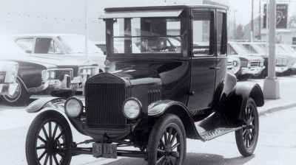
Pipelining
Notes:
Model T

Slide 4
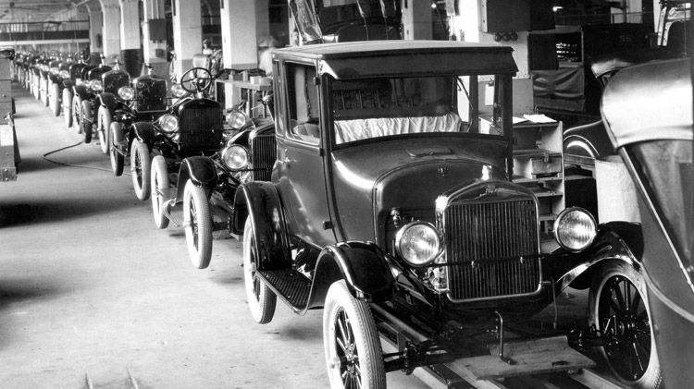
Pipelining

Slide 5
Basic Concept of Pipelining
Circuit technology and hardware arrangement influence the speed of execution for programs
All computer units benefit from faster circuits
Pipelining involves arranging the hardware to perform multiple operations simultaneously
Similar to assembly line where product moves through stations that perform specific tasks
Same total time for each item, but overlapped

Slide 6
Recall: Pipelining allows overlapped computations
Time
F
G
H
F
G
H
F
G
H
F
G
H

Slide 7
Pipelining in a Computer
Focus on pipelining of instruction execution
Multistage datapath in Chapter 5 consists of: Fetch, Decode, Execute, Memory, Write Back
Instructions fetched & executed one at a time with only one stage active in any cycle
With pipelining, multiple stages are active simultaneously for different instructions
Still 5 cycles to execute, but rate is 1 per cycle

Slide 9
Pipeline Organization
Use program counter (PC) to fetch instructions
A new instruction enters pipeline every cycle
Carry along instruction-specific information as instructions flow through the different stages
Use interstage buffers to hold this information
These buffers incorporate RA, RB, RM, RY, RZ, IR, and PC-Temp registers from Chapter 5
The buffers also hold control signal settings

Slide 10
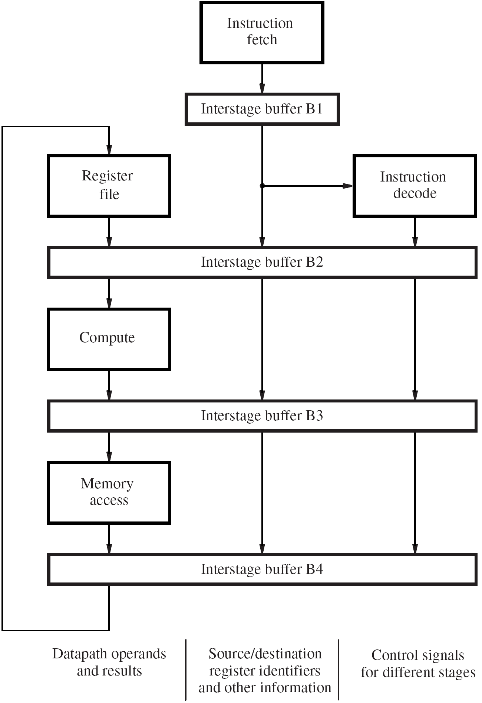
Stage 1
Stage 2
Stage 3
Stage 4
Stage 5

Slide 11
Adapting Chapter 5
Design to Pipeline
Instruction
Fetch
Stage 1
IR
Register File
Instruction Decode
Stage 2
RA
RB
Ctl3
Ctl4
Ctl5
ALU
Stage 3
RY
Ctl4
Ctl5
MEM Access
Stage 4
RZ
Ctl5
Stage 5

Slide 12
Specific Example
sw r8, 100(r9)
sub r2, r1, r3
and r3, r6, r7
or r2, r4, r5
add r3, r6, r7
sw r8, 100(r9)
Instruction
Fetch
add r3, r6, r7
Register File
Instruction Decode
RA
RB
or r2, r4, r5
Ctl3
Ctl4
Ctl5
ALU
RY
and r3, r6, r7
Ctl4
Ctl5
MEM access
RZ
Sub r1, r2, r3
Ctl5

Slide 13
Pipelining Issues
Consider two successive instructions I_{j} and I_{j+1}
Assume that the destination register of I_{j} matches one of the source registers of I_{j+1}
Result of I_{j} is written to destination in cycle 5
But I_{j+1} reads old value of register in cycle 3 (1+2)
Due to pipelining, I_{j+1} computation is incorrect
So stall (delay) I_{j+1} until I_{j} writes the new value
Condition requiring this stall is a data hazard

Slide 14
Data Dependencies
Now consider the specific instructions Add R2, R3, #100 Subtract R9, R2, #30
Destination R2 of Add is a source for Subtract
There is a data dependency between them because R2 carries data from Add to Subtract
On non-pipelined datapath, result is available in R2 because Add completes before Subtract

Slide 15
Stalling the Pipeline
With pipelined execution, old value is still in register R2 when Subtract is in Decode stage
So stall Subtract for 3 cycles in Decode stage
New value of R2 is then available in cycle 6

Slide 16
Details for Stalling the Pipeline
Control circuitry must recognize dependency while Subtract is being decoded in cycle 3
Inter-stage buffers carry register identifiers for source(s) and destination of instructions
In cycle 3, compare destination identifier in Compute stage against source(s) in Decode
R2 matches, so Subtract kept in Decode while Add allowed to continue normally

Slide 17
Details for Stalling the Pipeline
Stall the Subtract instruction for 3 cycles by keeping contents of interstage buffer B1
What happens after Add leaves Compute?
Control signals are set in cycles 3 to 5 to create an implicit NOP (No-operation) in Compute
NOP control signals in interstage buffer B2 create a cycle of idle time in each later stage
The idle time from each NOP is called a bubble

Slide 18
Stalling: Example
or r13, r6, r2
sub r2, r1, r3
and r12, r2, r5
or r13, r6, r2
add r14, r2, r2
sw r15, 100($2)
Instruction
Fetch
and r12, r2, r5
Register File
Instruction Decode
RA
RB
sub r2, r1, r3
Ctl3
Ctl4
Ctl5
ALU
Detect data
dependency
RY
Ctl4
Ctl5
Memory Access
RZ
Ctl5

Slide 19
Stalling
or r13, r6, r2
sub r2, r1, r3
and r12, r2, r5
or r13, r6, r2
add r14, r2, r2
sw r15, 100($2)
Instruction
Fetch
and r12, r2, r5
Register File
Instruction Decode
RA
RB
Noop
Noop
Noop
ALU
Allow sub
Hold and
Create bubble
RY
sub r2, r1, r3
Ctl4
Ctl5
Memory Access
RZ
Ctl5

Slide 20
Stalling
or r13, r6, r2
sub r2, r1, r3
and r12, r2, r5
or r13, r6, r2
add r14, r2, r2
sw r15, 100($2)
Instruction
Fetch
and r12, r2, r5
Register File
Instruction Decode
RA
RB
Noop
Noop
Noop
Bubble moves
down the pipeline
ALU
RY
Noop
Noop
Memory Access
RZ
sub r2, r1, r3
Ctl5

Slide 21
Stalling
sub r2, r1, r3
and r12, r2, r5
or r13, r6, r2
add r14, r2, r2
sw r15, 100($2)
or r13, r6, r2
Instruction
Fetch
and r12, r2, r5
Register File
Instruction Decode
RA
RB
Noop
Noop
Noop
until completion
of subtract
ALU
RY
Noop
Noop
Memory Access
RZ
Noop

Slide 22
Stalling
or r13, r6, r2
sub r2, r1, r3
and r12, r2, r5
or r13, r6, r2
add r14, r2, r2
sw r15, 100($2)
Instruction
Fetch
and r12, r2, r5
Register File
Instruction Decode
RA
RB
CTl5
Ctl4
Ctl3
Now and can
be decoded and
proceed down
the pipeline
ALU
RY
Noop
Noop
Memory Access
RZ
Noop

Slide 23
Operand Forwarding
Operand forwarding handles dependencies without the penalty of stalling the pipeline
For the preceding sequence of instructions, new value for R2 is available at end of cycle 3
Forward value to where it is needed in cycle 4

Slide 24
Details for Operand Forwarding
Introduce multiplexers before ALU inputs to use contents of register RZ as forwarded value
Control circuitry now recognizes dependency in cycle 4 when Subtract is in Compute stage
Interstage buffers still carry register identifiers
Compare destination of Add in Memory stage with source(s) of Subtract in Compute stage
Set multiplexer control based on comparison

Slide 25
Forwarding from
Buffer 3
add r14, r2, r2
sub r2, r1, r3
and r12, r2, r5
or r13, r6, r2
add r14, r2, r2
sw r15, 100($2)
Instruction
Fetch
or r13, r6, r2
Register File
Instruction Decode
muxes
RA
RB
and r12, r2, r5
Ctl3
Ctl4
Ctl5
ALU
RY
sub r2, r1, r3
Ctl4
Ctl5
Memory Access
RZ
Ctl5

Slide 26
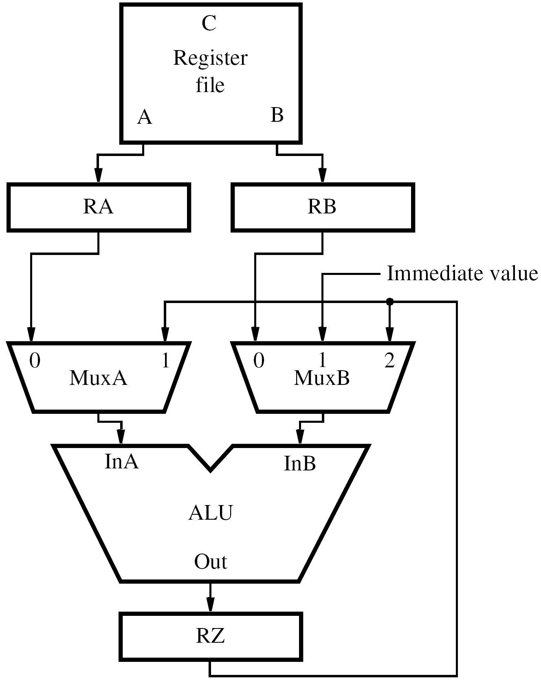

Slide 27
Forwarding from
Buffer 4
sw r15, 100($2)
sub r2, r1, r3
and r12, r2, r5
or r13, r6, r2
add r14, r2, r2
sw r15, 100($2)
Instruction
Fetch
add r14, r2, r2
Register File
Instruction Decode
muxes
RA
RB
or r13, r6, r2
Ctl3
Ctl4
Ctl5
ALU
RY
and r12, r2, r5
Ctl4
Ctl5
Memory Access
RZ
sub r2, r1, r3
Ctl5

Slide 28
Software Handling of Dependencies
Compiler can generate & analyze instructions
Data dependencies are evident from registers
Compiler puts three explicit NOP instructions between instructions having a dependency
Delay ensures new value available in register but causes total execution time to increase
Compiler can optimize by moving instructions into NOP slots (if data dependencies permit)

Slide 29
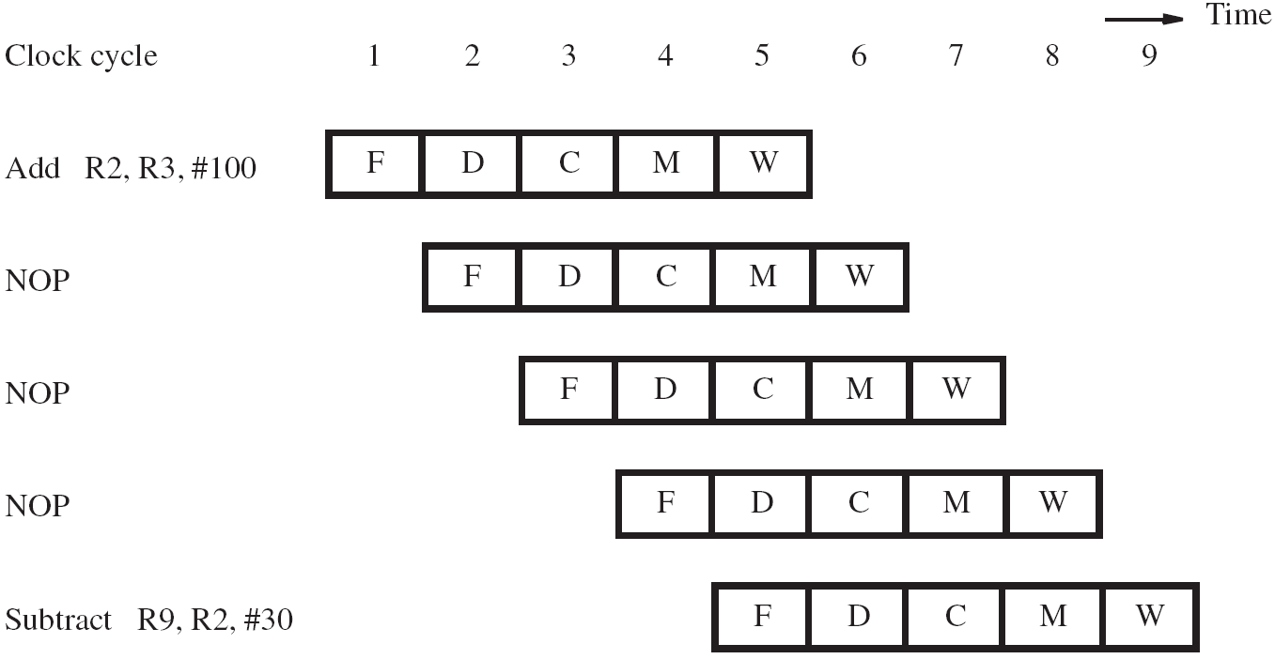

Slide 30
Memory Delays
Memory delays can also cause pipeline stalls
A cache memory holds instructions and data from the main memory, but is faster to access
With a cache, typical access time is one cycle
But a cache miss requires accessing slower main memory with a much longer delay
In pipeline, memory delay for one instruction causes subsequent instructions to be delayed

Slide 31
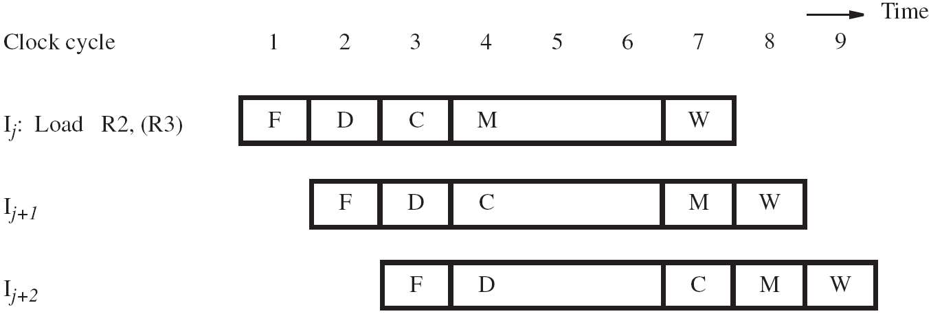

Slide 32
Memory Delays
Even with a cache hit, a Load instruction may cause a short delay due to a data dependency
One-cycle stall required for correct value to be forwarded to instruction needing that value
Optimize with useful instruction to fill delay
Forwarded from Stage 4

Slide 33
A Code Schedule with Stalls
C code for A = B + E; C = B + F;
lw r2, 0(r1)
lw r3, 4(r1)
add r4, r2, r3
sw r4, 12(r1)
lw r5, 8(r1)
add r6, r2, r5
sw r6, 16(r1)
Does this code require
Forwarding to work?
If so, where?
stall
stall
13 cycles

Slide 34
Reordering Code to Avoid Stalls
Reorder code to avoid use of load result in the next instruction
C code for A = B + E; C = B + F;
lw r2, 0(r1)
lw r3, 4(r1)
add r4, r2, r3
sw r4, 12(r1)
lw r5, 8(r1)
add r6, r2, r5
sw r6, 16(r1)
lw r2, 0(r1)
lw r3, 4(r1)
lw r5, 8(r1)
add r4, r2, r3
sw r4, 12(r1)
add r6, r2, r5
sw r6, 16(r1)
stall
stall
13 cycles
11 cycles

Slide 35
Performance Impact of Memory Delays – Cache Hit
We have 1 cycle stall due to data dependency, when there is cache hit.
How can we assess impact of this on pipeline throughput?
Need statistics on how often the 1-cycle penalty due to stall occurs.
Inst_{i} is load/store (called data-transfer or D-type in the project) and
Inst_{i+1} has data dependency of Inst_{i}.

Slide 36
Performance Impact of Memory Delays – Cache Miss
Miss can occur either during instruction fetch or data transfer.
Miss rates may defer for the two.
Also need to know the miss penalty (number of cycles to read the slower non-cache memory) and the frequency of data transfer instructions with dependency as in the last example.

Slide 37
Parameters and Impact Equation
Instruction miss rate: m_{i}
Data miss rate: m_{d}
Frequency of D-type instructions: d
Miss penalty: p_{m} cycles
Increase in cycles/instructions over ideal:
For typical values (see p. 211), the impact is
much larger than for cache-hit

Slide 38
Reading Assignment
For more analysis of the impacts of various delays and hazards on pipeline performance, Read Section 6.8.1.

Slide 39
Branch Delays
Ideal pipelining: fetch each new instruction while previous instruction is being decoded
Branch instructions alter execution sequence, but they must be processed to determine the effect
Any delay for determining branch outcome leads to an increase in total execution time
Techniques to mitigate this effect are desired
Understand branch behavior to find solutions

Slide 40
Unconditional Branches
Consider instructions I_{j} , I_{j+1} , I_{j+2} in sequence
I_{j} is an unconditional branch with target I_{k}
In Chapter 5, the Compute stage determined the target address using offset and PC+4 value
In pipeline, target I_{k} is known for I_{j} in cycle 4, but instructions I_{j+1} , I_{j+2} fetched in cycles 2 & 3
Target I_{k} should have followed I_{j} immediately, so discard I_{j+1} , I_{j+2} and incur two-cycle penalty

Slide 41
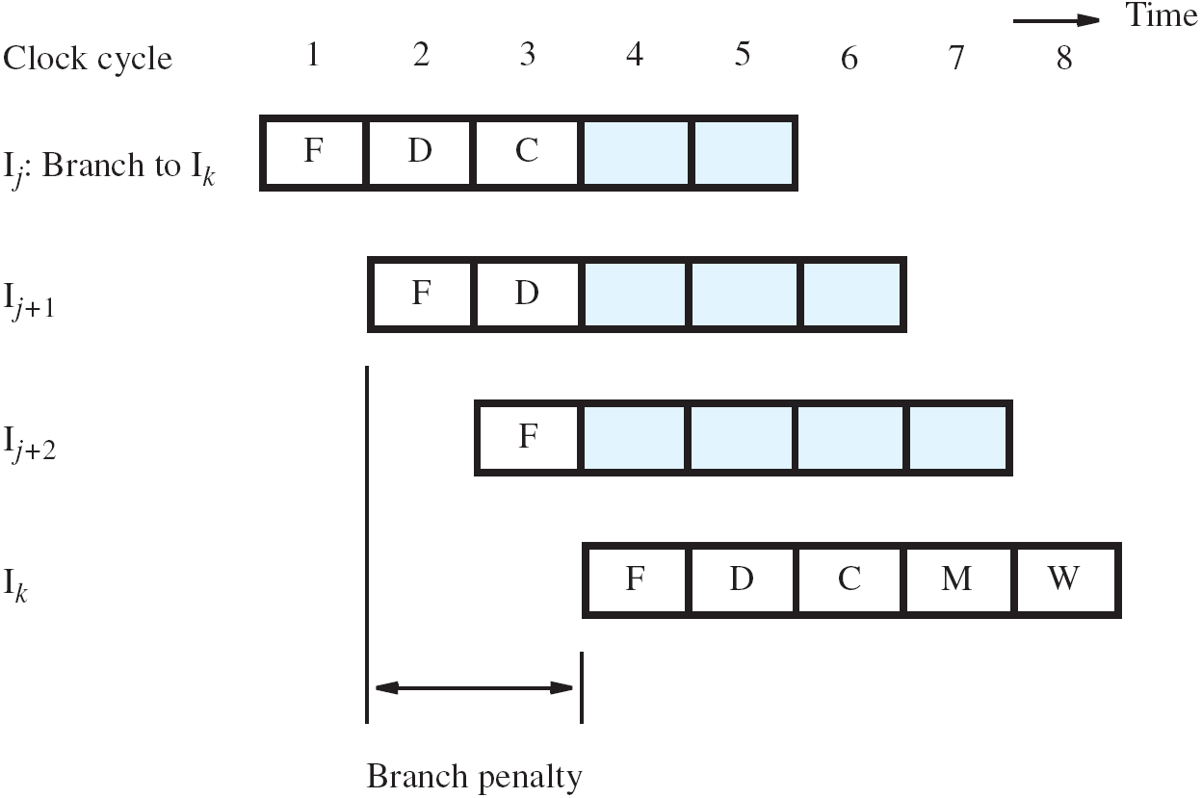

Slide 42
Reducing the Branch Penalty
In pipeline, adder for PC is used every cycle, so it cannot calculate the branch target address
So introduce a second adder just for branches
Place this second adder in the Decode stage to enable earlier determination of target address
For previous example, now only I_{j+1} is fetched
Only one instruction needs to be discarded
The branch penalty is reduced to one cycle

Slide 43
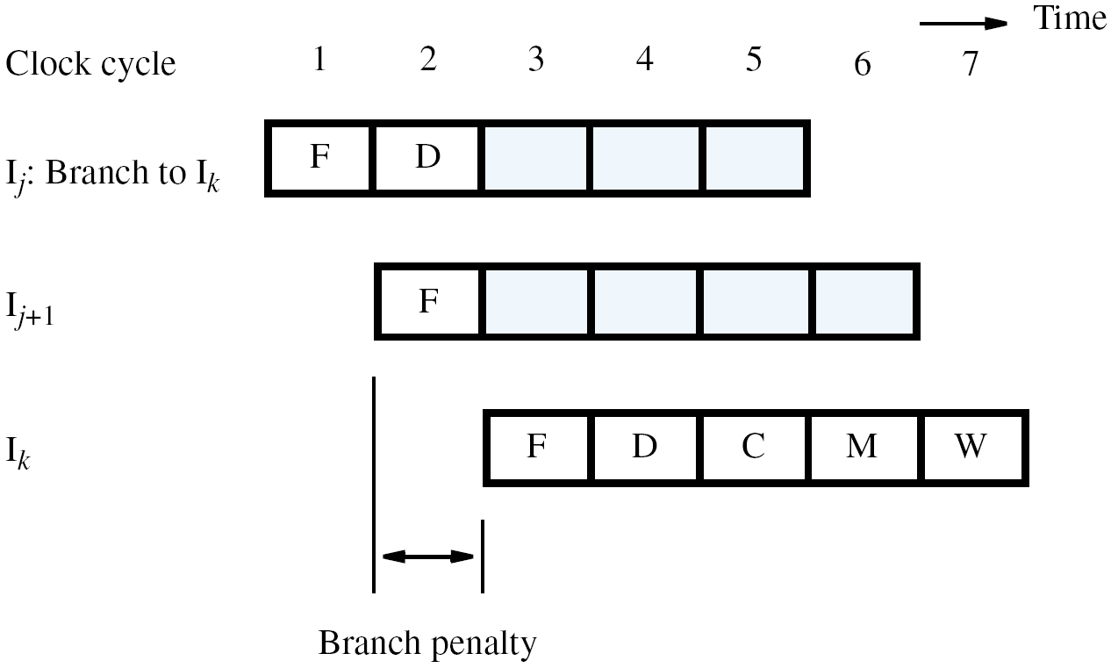

Slide 44
Conditional Branches
Consider a conditional branch instruction: Branch_if_[R5]=[R6] LOOP
Requires not only target address calculation, but also requires comparison for condition
In Chapter 5, ALU performed the comparison
Target address now calculated in Decode stage
To maintain one-cycle penalty, introduce a comparator just for branches in Decode stage

Slide 45
The Branch Delay Slot
Let both branch decision and target address be determined in Decode stage of pipeline
Instruction immediately following a branch is always fetched, regardless of branch decision
That next instruction is discarded with penalty, except when conditional branch is not taken
The location immediately following the branch is called the branch delay slot

Slide 46
The Branch Delay Slot
Instead of conditionally discarding instruction in delay slot, always let it complete execution
Let compiler find an instruction before branch to move into slot, if data dependencies permit
Called delayed branching due to reordering
If useful instruction put in slot, penalty is zero
If not possible, insert explicit NOP in delay slot for one-cycle penalty, whether or not taken

Slide 47
