Slide 1
CSCE 230, Fall 2013 Chapter 5: Basic Processing Unit Part 2: Control Unit
Mehmet Can Vuran, Instructor
University of Nebraska-Lincoln
Acknowledgement: Overheads adapted from those provided by the authors of the textbook

Slide 2
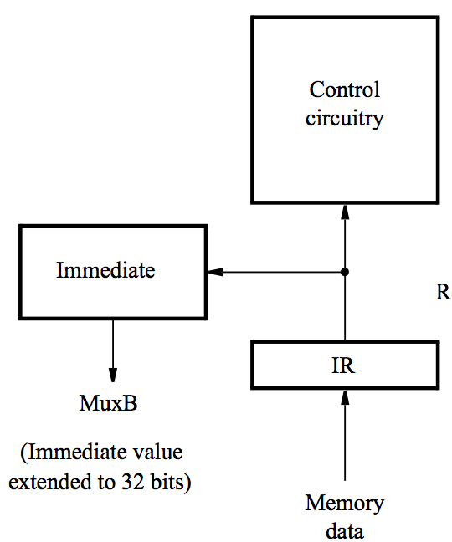
Processor control section
When an instruction is read, it is placed in IR.
The control circuitry decodes the instruction.
It generates the control signals that drive all units.
The Immediate block extends the immediate operand to 32 bits as specified in the instruction.

Slide 3
Control signal generation
There are two basic approaches: hardwired control and microprogramming
Hardwired control involves implementing circuitry that considers step counter, IR, ALU result, and external inputs. Step counter keeps track of execution progress, one clock cycle for each of the five steps described earlier.
Microprogramming involves creating another layer of interpretation, below ISA, for interpreting each ISA instruction.

Slide 4
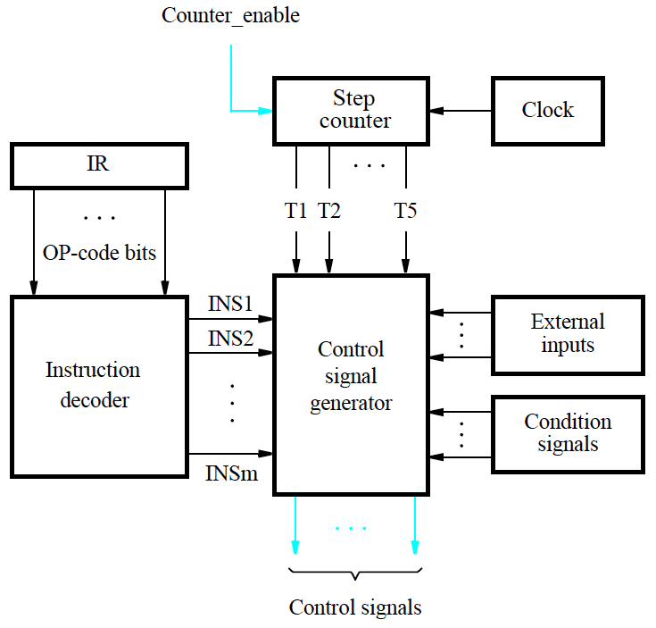
Hardwired generation of control signals

Slide 5
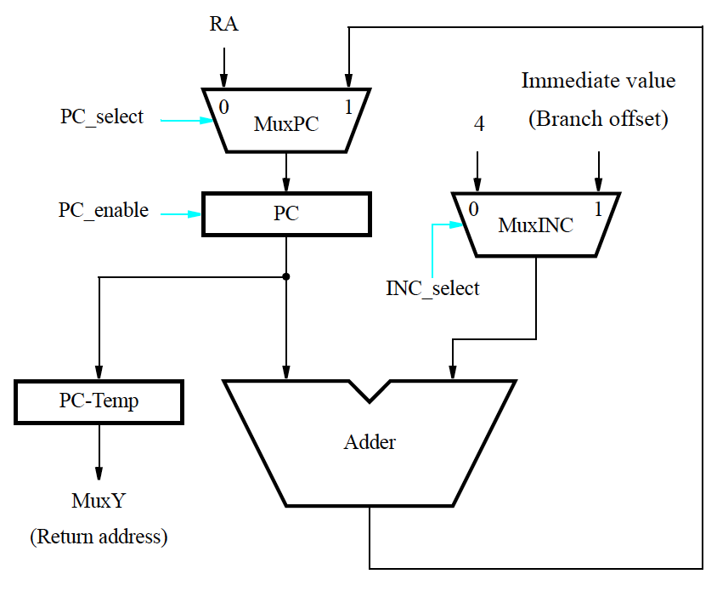
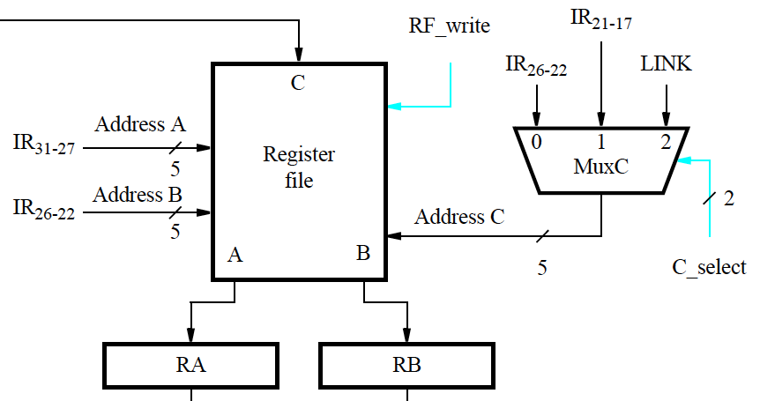
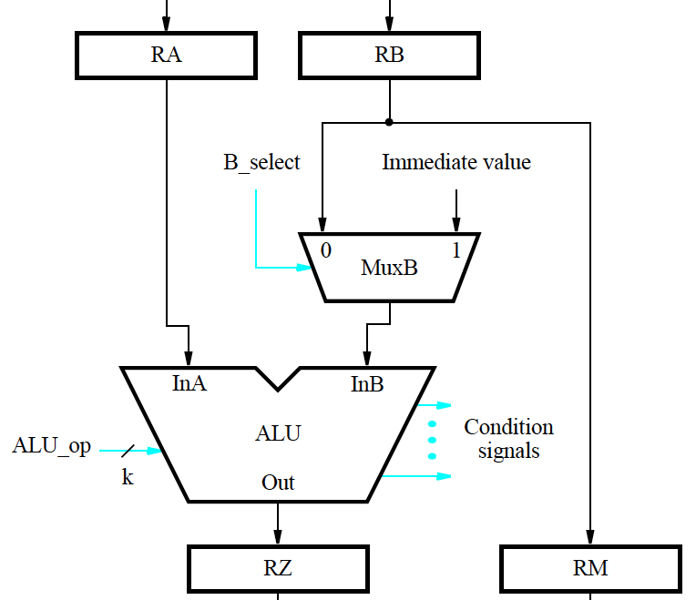
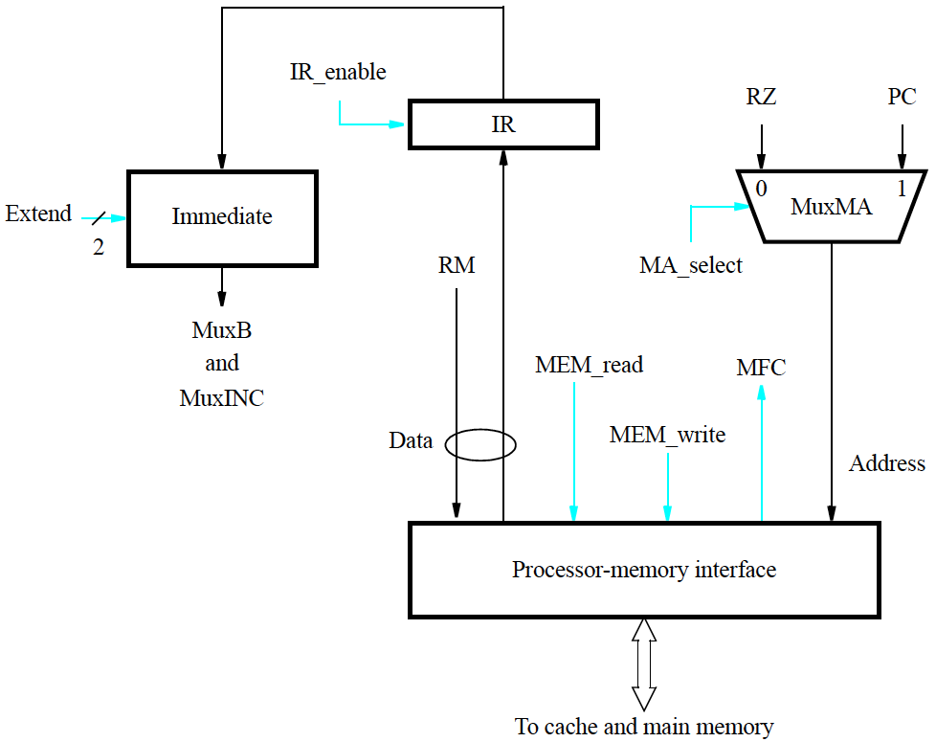
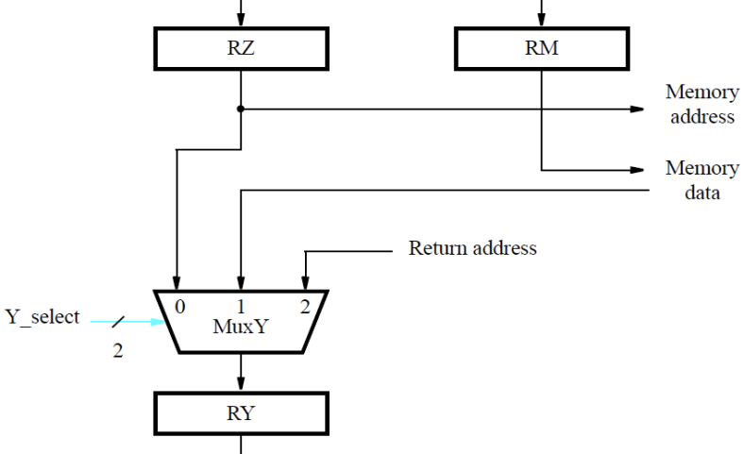
Datapath + Control

Slide 6
Stage 1: Instruction Fetch
Address = PC,
PC = PC+4
MA_select = 1
MEM_read
INC_select =0
PC_select = 1
PC_enable
if(MFC=1) IR = MemData
if(MFC) IR_enable = 1

Slide 7
Stage 2: Instruction Decode
Instruction in IR decoded by the Control Unit logic (not shown)
Source-register fields in IR (IR₃₁₋₂₇ and IR₂₆₋₂₂) determine Address A and Address B of Register File.

Slide 8
Stages 2-5: R-Type
Stage 2:
RA = RegFile[AddressA],
RB = RegFile[AddressB]
(These and other buffer registers can be enabled for every clock cycle so no enable signals necessary)
Stage 3:
RZ = [RA] op [RB]
B_select = 0,
ALU_op = op
Stage 4:
RY = [RZ]
Y_select = 0
Stage 5:
RegFile[AddressC] = RY
RF_write = 1
C_select = 01

Slide 9
Stages 2-5: Load Inst.
Stage 2:
RA = RegFile[AddressA],
RB = RegFile[AddressB]
Stage 3:
RZ = [RA] op Immediate
B_select = 1,
ALU_op = Add
Stage 4:
Memory address = [RZ]
MA_select = 0
MEM_read
if(MFC=1) RY= MemData
if(MFC) Y_select = 1
Stage 5:
RegFile[AddressC] = RY
RF_write = 1
C_select = 00

Slide 10
Stages 2-5: Store Inst.
Stage 2:
RA = RegFile[AddressA],
RB = RegFile[AddressB]
Stage 3:
RZ = [RA] op Immediate
RM = [RB]
B_select = 1,
ALU_op = Add
Stage 4:
Memory address = [RZ]
Memory data = [RM]
MA_select = 0
MEM_write
while(!MFC)
Wait for MFC
Stage 5: Idle

Slide 11
Stages 2-5: Call Inst.
Assume the Immediate block extends the 26-bit immediate value in the instruction to 32-bits Immediate Value (address of the called routine).
If Fetch and Decode stages remain unchanged, we must do the following operations in the remaining stages:
PC-Temp = PC,
PC = Immediate Value
Link-Reg = PC-Temp
We will discuss why these operations cannot be completed in the given datapath and consider solutions to the problem.
Must change datapath for absolute calls

Slide 12
Stages 2-5: Call Inst.
Solution 1
Fetch
Decode
PC-Temp=PC,
PC=Immediate value
RY=PC-Temp
Register-LINK=RY
This solution requires modifying data path to allow Immediate value to be loaded in PC in Step 3. This can be done by including a third input to MuxPC from Immediate value.

Slide 13
Stages 2-5: Call Inst.
Solution 2
Fetch
Decode, RA = Immediate value
PC-Temp=PC, PC=RA
RY=PC-Temp
Register-LINK=RY
This solution also requires modifying the data path for Step 2: introduce a mux at the input of RA to allow Immediate value to be loaded to RA.
Q: Which solution is better?
A: Most likely, Solution 1 because it does not extra delay in the Register File to RA path that is used by most instructions.

Slide 14
In-class Exercise
Clock Cycle

Slide 15
What is the delay in each stage?
Component delays
Control – 100ps
Mem – 350ps
Add – 100ps
Mux – 30ps
ALU – 120ps
Reg File – 200ps
Sign-extend – 20ps
Reg (write) – 10ps
Reg (read) – 0 ps
Fetch
R-format
Load/store
Unconditional PC-relative branch
Conditional PC-relative branch

Slide 16
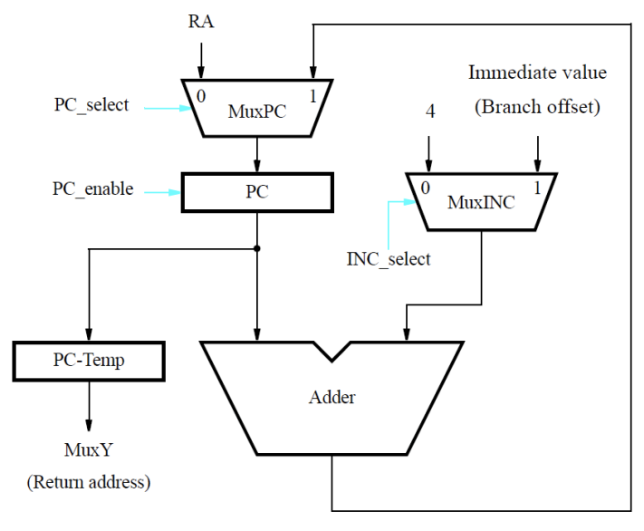
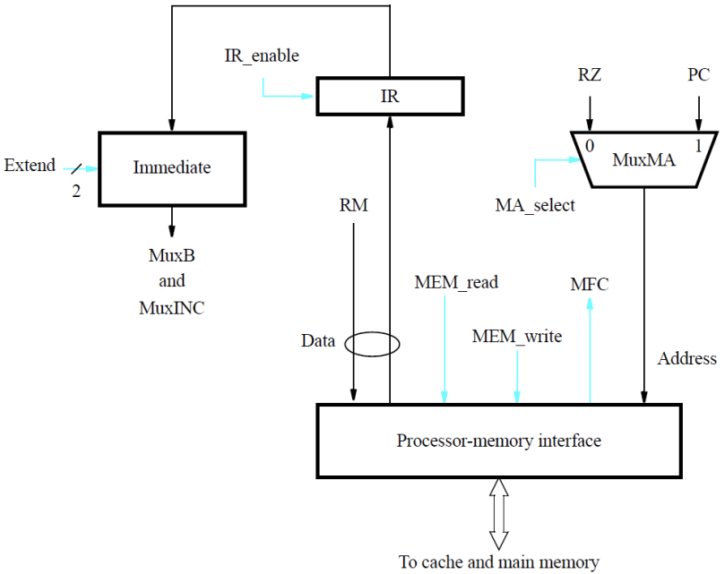
Datapath + Control

Slide 17
Stage/Instruction |  |  |  |  |  |  |  |  | Delay
Fetch | MuxMA | MEM | IR | Add | MuxPC | PC
 | 30 | 350 | 10 | 100 | 30 | 10 |  |  | 530
Fetch | MuxMA | MEM | IR
(Optimized) | 30 | 350 | 10 |  |  |  |  |  | 390
 | MuxINC | Add | PC
 | 30 | 100 | 10
Decode | RegFile | RA/RB
 | 200 | 10 |  |  |  |  |  |  | 210
 | Control
 | 100

Slide 18
Stage/Instruction |  |  |  |  |  |  |  |  | Delay
EXE
R-Type | MuxB | ALU | RZ
 | 30 | 120 | 10 |  |  |  |  |  | 160
Load/St | MuxB | ALU | RZ
 | 30 | 120 | 10 |  |  |  |  |  | 160
Uncond. Branch | MuxINC | Adder | MuxPC | PC
 | 30 | 100 | 30 | 10 |  |  |  |  | 170
Cond. PC-rel Branch | MuxB | ALU | Control | MuxINC | Adder | MuxPC | PC
 | 30 | 120 | 100 | 30 | 100 | 30 | 10 |  | 420

Slide 19
Stage/Instruction |  |  |  |  |  |  |  |  | Delay
MEM
Load | MuxMA | MEM | MuxY | RY
 | 30 | 350 | 30 | 10 |  |  |  |  | 420
R-Type | MuxY | RY
 | 30 | 10 |  |  |  |  |  |  | 40
Branch | MuxY | RY
 | 30 | 10 |  |  |  |  |  |  | 40
WB | MuxC | RegFile
 | 30 | 200 |  |  |  |  |  |  | 230

Slide 20
Hardwired generation of control signals

Slide 21
Step Counter FSM Description
Stage time determined by the longest stage delay.
For all but Stage-4 time, the processor design can determine the longest stage delay by analysis of inter-stage logic.
The time for the Memory stage for memory instructions (load and store), depends on the time to complete the requested memory operation
For maximum flexibility asynchronous communication may be used, i.e.
create a wait for memory function completion (WMFC) signal, asserted to 1 in Stage 4 if read/write requested; the Memory Unit signals completion by asserting MFC.
Hence the Stage counter is enabled whenever the WFMC is not asserted. Otherwise it is enabled when the memory function complete signal is received.
Counter_enable = WMFC’ + MFC

Slide 22
Control Unit Logic – General Principles
Two ways to describe:
For each instruction determine which control signals must be activated, i.e
if(Instruction=INSi) then (list of active control signals by stages)
This is like a truth table specification of the control signals, we have considered many examples already.
For each control signal, determine the Boolean condition which captures all the cases under which it is active.
This is like synthesizing the logic of each control signal from the truth-table specification

Slide 23
Control Unit Logic: 5-Stage Hardwired Control
Two ways to analyze:
Focus on each instruction and contingency (like interrupt):
if (Instruction = INSi, and step counter = Tj, and Condition signals = …, and External input = ...) then (list of active signals for the if condition)
This is essentially specifying the truth tables of the control signals and we let a synthesis program figure out the logic for each control signal.
Focus on control signals. For each control signal (or group), write conditions based on instructions (or instruction types), Step counter value (T1 through T5), condition signals (NZVC, MFC, …), and external inputs (interrupt signals) to determine when that particular signal should be activated. (This is harder to do)

Slide 24
Example (Hardwired Control)
Describe the conditions under which C_select will be active to specify destination register?
Consider the three cases for C_select = 0, 1, and 2.
IR₂₁₋₁₇ for Register-operand instructions
IR₂₆₋₂₂ for Immediate-operand instructions
LINK for Call type of instructions.
For reference the instruction formats
are reproduced on the next slide.
Notes:
C_select is 0 for all immediate instructions, 1 for all computational instructions with both operands in registers, and 2 for all link instructions.

Slide 25
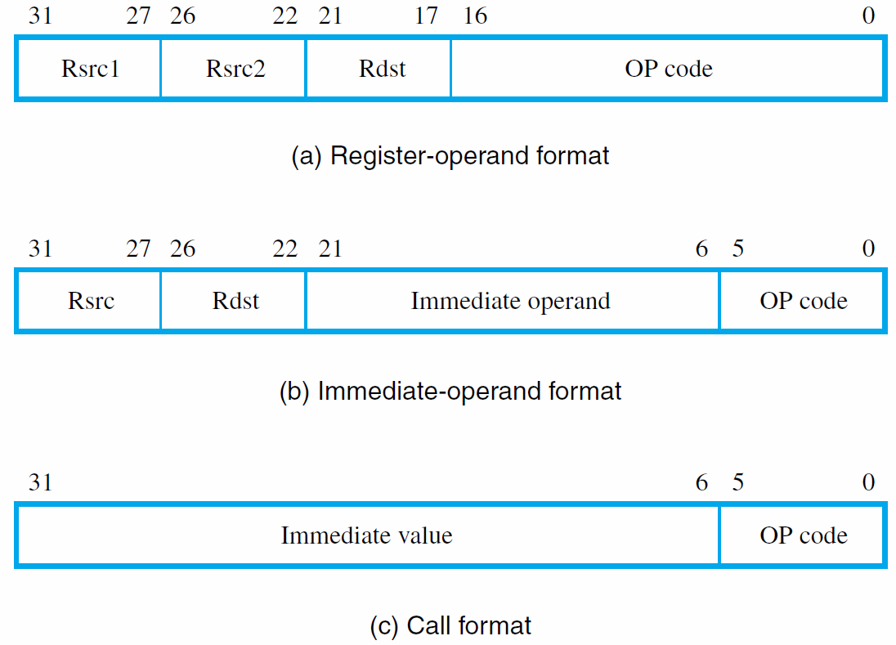
Instruction Formats (Chapter 5 Processor)
Fig. 5.12

Slide 26
Reading Assignment
Review all the solved problems in Section 5.9 that include several other examples of datapath and control logic design.

Slide 27
In-class Exercise
Control Implementation

Slide 28
Control Implementation
Divide into two parts
ALU Control
The rest

Slide 29
ALU
G
F,G
AND
A
00
B
A
ALU
R
OR
A
01
B
B
F
MUX
R
C
ADD/
SUB
A
Basic
ALU
F | G1 | G0 | R
- | 0 | 0 | And
- | 0 | 1 | Or
0 | 1 | 0 | Add
1 | 1 | 0 | Sub
- | 1 | 1 | -
10
B
C

Slide 30
Control Design
Based on the following ISA
R-type (add, sub, or, and), lw, sw
23 |  |  | 20 | 19 | 18 |  | 16 | 15 |  |  | 12 | 11 |  |  | 8 | 7 |  |  | 4 | 3 |  |  | 0
Cond |  |  |  | S | opx |  |  | rd |  |  |  | rt |  |  |  | rs |  |  |  | 0 | 0 | 0 | 0
R-Type
23 |  |  | 20 | 19 | 18 |  |  |  |  |  | 12 | 11 |  |  | 8 | 7 |  |  | 4 | 3 |  |  | 0
Cond |  |  |  | S | Imm |  |  |  |  |  |  | rd |  |  |  | rs |  |  |  | 0 | 1 | X | X
D-Type

Slide 31
ALU Control
Based on the following ISA
R-type (add, sub, or, and), lw, sw
instruction | op | Operation | Opx | ALU function | ALU control
lw | 0100 | load word | XXX | add | 010
sw | 0101 | store word | XXX | add | 010
R-type | 0000 | add | 010 | add | 010
 |  | subtract | 000 | subtract | 110
 |  | AND | 101 | AND | X00
 |  | OR | 100 | OR | X01

Slide 32
ALU Control
Op |  |  |  | opx |  |  | ALU Control
op3 | op2 | op1 | op0 | opx2 | opx1 | opx0 | F | G1 | G0

Slide 33
ALU Control
Op |  |  |  | opx |  |  | ALU Control
op3 | op2 | op1 | op0 | opx2 | opx1 | opx0 | F | G1 | G0
0 | 1 | 0 | 0 | X | X | X | 0 | 1 | 0
0 | 1 | 0 | 1 | X | X | X | 0 | 1 | 0
0 | 0 | 0 | 0 | 0 | 1 | 0 | 0 | 1 | 0
0 | 0 | 0 | 0 | 0 | 0 | 0 | 1 | 1 | 0
0 | 0 | 0 | 0 | 1 | 0 | 1 | X | 0 | 0
0 | 0 | 0 | 0 | 1 | 0 | 0 | X | 0 | 1

Slide 34
ALU Control
op |  |  |  | opx |  |  | ALU Control
op3 | op2 | op1 | op0 | opx2 | opx1 | opx0 | F | G1 | G0
0 | 1 | 0 | 0 | X | X | X | 0 | 1 | 0
0 | 1 | 0 | 1 | X | X | X | 0 | 1 | 0
0 | 0 | 0 | 0 | 0 | 1 | 0 | 0 | 1 | 0
0 | 0 | 0 | 0 | 0 | 0 | 0 | 1 | 1 | 0
0 | 0 | 0 | 0 | 1 | 0 | 1 | X | 0 | 0
0 | 0 | 0 | 0 | 1 | 0 | 0 | X | 0 | 1
G0

Slide 35
ALU Control
op |  |  |  | opx |  |  | ALU Control
op3 | op2 | op1 | op0 | opx2 | opx1 | opx0 | F | G1 | G0
0 | 1 | 0 | 0 | X | X | X | 0 | 1 | 0
0 | 1 | 0 | 1 | X | X | X | 0 | 1 | 0
0 | 0 | 0 | 0 | 0 | 1 | 0 | 0 | 1 | 0
0 | 0 | 0 | 0 | 0 | 0 | 0 | 1 | 1 | 0
0 | 0 | 0 | 0 | 1 | 0 | 1 | X | 0 | 0
0 | 0 | 0 | 0 | 1 | 0 | 0 | X | 0 | 1
$$=\overline{op3}∙\overline{op2}∙\overline{op1}∙\overline{op0}∙opx2∙\overline{opx1}∙\overline{opx0}$$
G0
$$=opx2∙\overline{opx0}$$

Slide 36
ALU Control
op |  |  |  | opx |  |  | ALU Control
op3 | op2 | op1 | op0 | opx2 | opx1 | opx0 | F | G1 | G0
0 | 1 | 0 | 0 | X | X | X | 0 | 1 | 0
0 | 1 | 0 | 1 | X | X | X | 0 | 1 | 0
0 | 0 | 0 | 0 | 0 | 1 | 0 | 0 | 1 | 0
0 | 0 | 0 | 0 | 0 | 0 | 0 | 1 | 1 | 0
0 | 0 | 0 | 0 | 1 | 0 | 1 | X | 0 | 0
0 | 0 | 0 | 0 | 1 | 0 | 0 | X | 0 | 1
G1

Slide 37
ALU Control
op |  |  |  | opx |  |  | ALU Control
op3 | op2 | op1 | op0 | opx2 | opx1 | opx0 | F | G1 | G0
0 | 1 | 0 | 0 | X | X | X | 0 | 1 | 0
0 | 1 | 0 | 1 | X | X | X | 0 | 1 | 0
0 | 0 | 0 | 0 | 0 | 1 | 0 | 0 | 1 | 0
0 | 0 | 0 | 0 | 0 | 0 | 0 | 1 | 1 | 0
0 | 0 | 0 | 0 | 1 | 0 | 1 | X | 0 | 0
0 | 0 | 0 | 0 | 1 | 0 | 0 | X | 0 | 1
G1
$$=\overline{opx2}$$

Slide 38
ALU Control
op |  |  |  | opx |  |  | ALU Control
op3 | op2 | op1 | op0 | opx2 | opx1 | opx0 | F | G1 | G0
0 | 1 | 0 | 0 | X | X | X | 0 | 1 | 0
0 | 1 | 0 | 1 | X | X | X | 0 | 1 | 0
0 | 0 | 0 | 0 | 0 | 1 | 0 | 0 | 1 | 0
0 | 0 | 0 | 0 | 0 | 0 | 0 | 1 | 1 | 0
0 | 0 | 0 | 0 | 1 | 0 | 1 | X | 0 | 0
0 | 0 | 0 | 0 | 1 | 0 | 0 | X | 0 | 1
F

Slide 39
ALU Control
op |  |  |  | opx |  |  | ALU Control
op3 | op2 | op1 | op0 | opx2 | opx1 | opx0 | F | G1 | G0
0 | 1 | 0 | 0 | X | X | X | 0 | 1 | 0
0 | 1 | 0 | 1 | X | X | X | 0 | 1 | 0
0 | 0 | 0 | 0 | 0 | 1 | 0 | 0 | 1 | 0
0 | 0 | 0 | 0 | 0 | 0 | 0 | 1 | 1 | 0
0 | 0 | 0 | 0 | 1 | 0 | 1 | X | 0 | 0
0 | 0 | 0 | 0 | 1 | 0 | 0 | X | 0 | 1
F
$$=\overline{op2}∙\overline{opx2}∙\overline{opx1}$$

Slide 40
ALU Control
opx (2-0)
opx2
opx0
G0
G1
opx1
op (3-0)
F
op2

Slide 41
Control Design (limited edition)
Limited to
Stages 3,4,5
R-type (add, sub, or, and), lw, sw
Control signals on ALU path and Proc-Mem interface path (PC path omitted)
Immediate control
00 – sign-extend 7-bit Immediate field (IR₁₈₋₁₂)
01 – 0-extend 7-bit immediate field (IR₁₈₋₁₂)
10 – sign-extend 16-bit label field (IR₁₉₋₄)
11 – 0-extend 20-bit Const field (IR₂₃₋₄)
Inter-stage registers hold value during a stage

Slide 42
Control Hardware

Slide 43
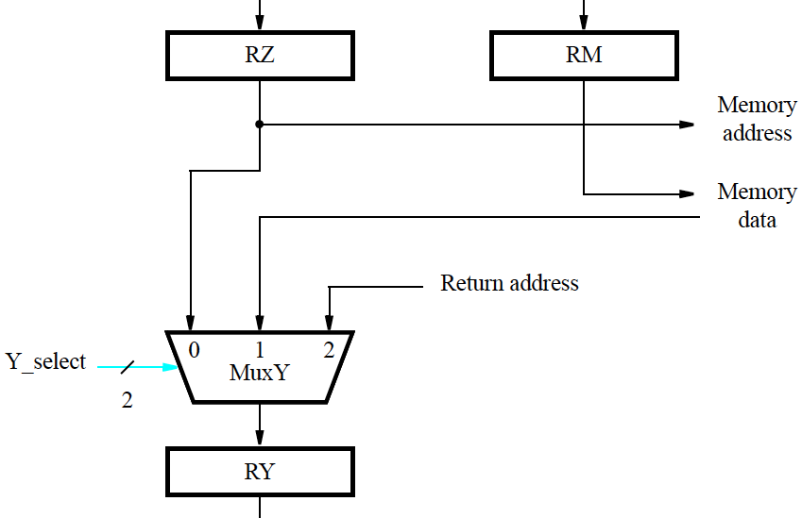
Datapath + Control

Slide 44
Control Design (limited edition)
R-Type | T3 | T4 | T5 | RF_write | C_select |  | B_select | Y_select |  | MEM_read | MEM_write | MA_select | Extend
 |  |  |  |  | C1 | C0 |  | Y1 | Y0 |  |  |  | E1 | E0
0000 | 1 | 0 | 0 | 0 | X | X | 0 | X | X | 0 | 0 | X | X | X
0000 | 0 | 1 | 0 | 0 | X | X | X | 0 | 0 | 0 | 0 | X | X | X
0000 | 0 | 0 | 1 | 1 | 0 | 1 | X | X | X | 0 | 0 | X | X | X

Slide 45
Control Design (limited edition)
 | T3 | T4 | T5 | RF_write | C_select |  | B_select | Y_select |  | MEM_read | MEM_write | MA_select | Extend
 |  |  |  |  | C1 | C0 |  | Y1 | Y0 |  |  |  | E1 | E0

Slide 46
Control Design (limited edition)
lw | T3 | T4 | T5 | RF_write | C_select |  | B_select | Y_select |  | MEM_read | MEM_write | MA_select | Extend
 |  |  |  |  | C1 | C0 |  | Y1 | Y0 |  |  |  | E1 | E0
0100 | 1 | 0 | 0 | 0 | X | X | 1 | X | X | 0 | 0 | X | 0 | 0
0100 | 0 | 1 | 0 | 0 | X | X | X | 0 | 1 | 1 | 0 | 0 | X | X
0100 | 0 | 0 | 1 | 1 | 0 | 0 | X | X | X | 0 | 0 | X | X | X

Slide 47
Control Design (limited edition)
sw | T3 | T4 | T5 | RF_write | C_select |  | B_select | Y_select |  | MEM_read | MEM_write | MA_select | Extend
 |  |  |  |  | C1 | C0 |  | Y1 | Y0 |  |  |  | E1 | E0
0101 | 1 | 0 | 0 | 0 | X | X | 1 | X | X | 0 | 0 | X | 0 | 0
0101 | 0 | 1 | 0 | 0 | X | X | X | X | X | 0 | 1 | 0 | X | X
0101 | 0 | 0 | 1 | 0 | X | X | X | X | X | 0 | 0 | X | X | X

Slide 48
Control Truth Table (LE)
Input or Output | Signal Name | R(3) | R(4) | R(5) | lw(3) | lw(4) | lw(5) | sw(3) | sw(4) | sw(5)
Inputs | op3 | 0 | 0 | 0 | 0 | 0 | 0 | 0 | 0 | 0
 | op2 | 0 | 0 | 0 | 1 | 1 | 1 | 1 | 1 | 1
 | op1 | 0 | 0 | 0 | 0 | 0 | 0 | 0 | 0 | 0
 | op0 | 0 | 0 | 0 | 0 | 0 | 0 | 1 | 1 | 1
 | T3 | 1 | 0 | 0 | 1 | 0 | 0 | 1 | 0 | 0
 | T4 | 0 | 1 | 0 | 0 | 1 | 0 | 0 | 1 | 0
 | T5 | 0 | 0 | 1 | 0 | 0 | 1 | 0 | 0 | 1
Outputs | RF_write | 0 | 0 | 1 | 0 | 0 | 1 | 0 | 0 | 0
 | C_select (C1) | X | X | 0 | X | X | 0 | X | X | X
 | C_select (C0) | X | X | 1 | X | X | 0 | X | X | X
 | B_select | 0 | X | X | 1 | X | X | 1 | X | X
 | Y_select (Y1) | X | 0 | X | X | 0 | X | X | X | X
 | Y_select (Y0) | X | 0 | X | X | 1 | X | X | X | X
 | MEM_read | 0 | 0 | 0 | 0 | 1 | 0 | 0 | 0 | 0
 | MEM_write | 0 | 0 | 0 | 0 | 0 | 0 | 0 | 1 | 0
 | MA_select | X | X | X | X | 0 | X | X | 0 | X
 | Extend (E1) | X | X | X | 0 | X | X | 0 | X | X
 | Extend (E0) | X | X | X | 0 | X | X | 0 | X | X

Slide 49
op3
op2
op1
op0
T3
T4
T5
R(3)
R(4)
R(5)
lw(3)
lw(4)
lw(5)
sw(3)
sw(4)
sw(5)
0
RF_write
C_select (C1)
C_select (C0)
B_select
Y_select (Y1)
Y_select (Y0)
MEM_read
MEM_write
MA_select
Extend (E1)
Extend (E0)

Slide 50
ARM – Conditional Execution

Slide 51
Conditional Execution in ARM
Most instruction sets only allow branches to be executed conditionally
ARM ISA is described in Appendix D
Several documents on ARM are on BB
Conditional execution of instructions:
All instructions, including branches, are executed conditionally, based on a 4-bit condition field value in each instruction
Project processor borrows this concept from ARM

Slide 52
S

Slide 53
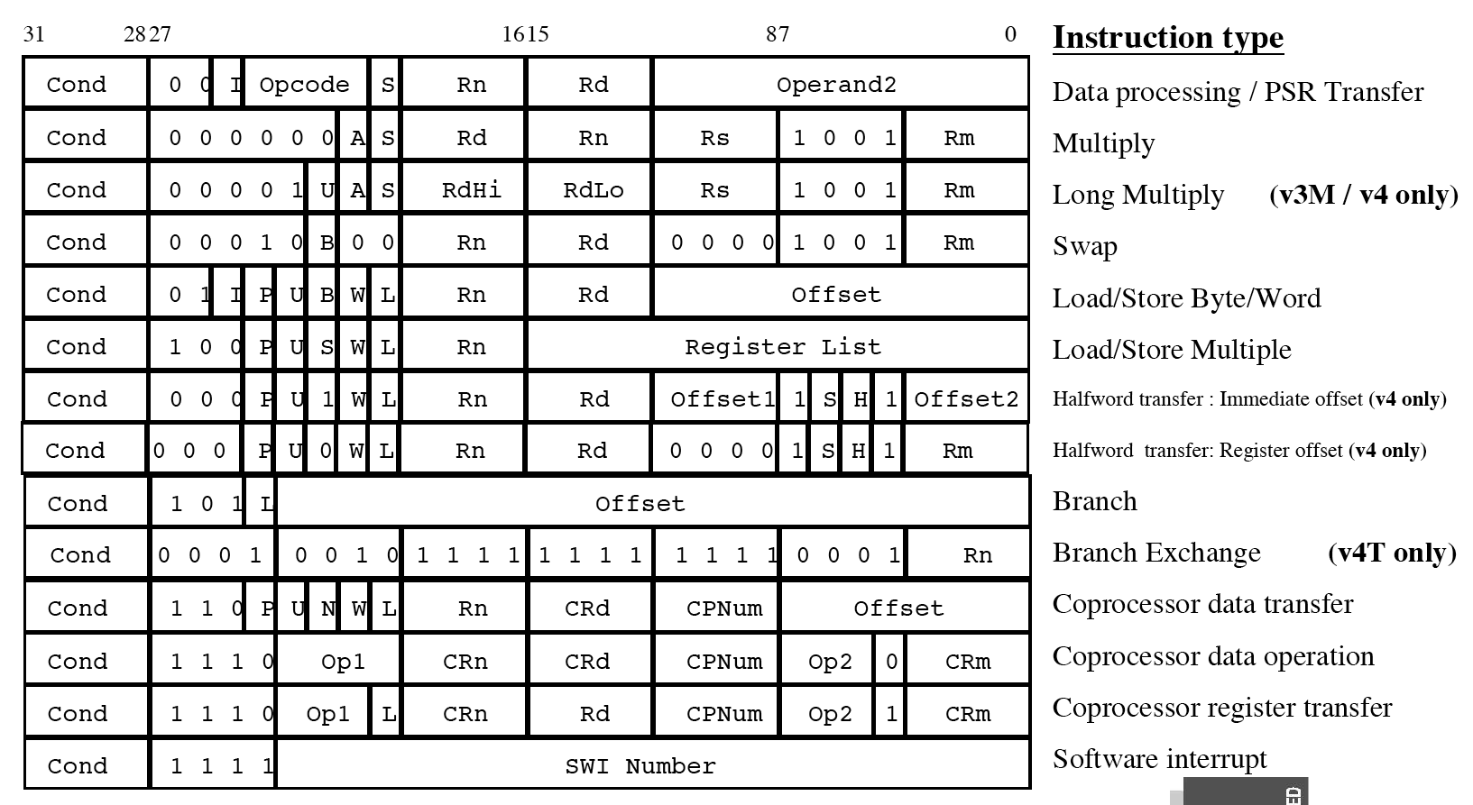

Slide 54
Register Structure in ARM
Sixteen 32-bit processor registers, labeled R0 through R15
Register R15 is the program counter (PC)
Registers R13 and R14 have dedicated uses related to subroutine and processor stack management
A current program status register (CPSR) holds the condition code flags (N, Z, C, V), two interrupt-disable bits, and five processor mode bits

Slide 55
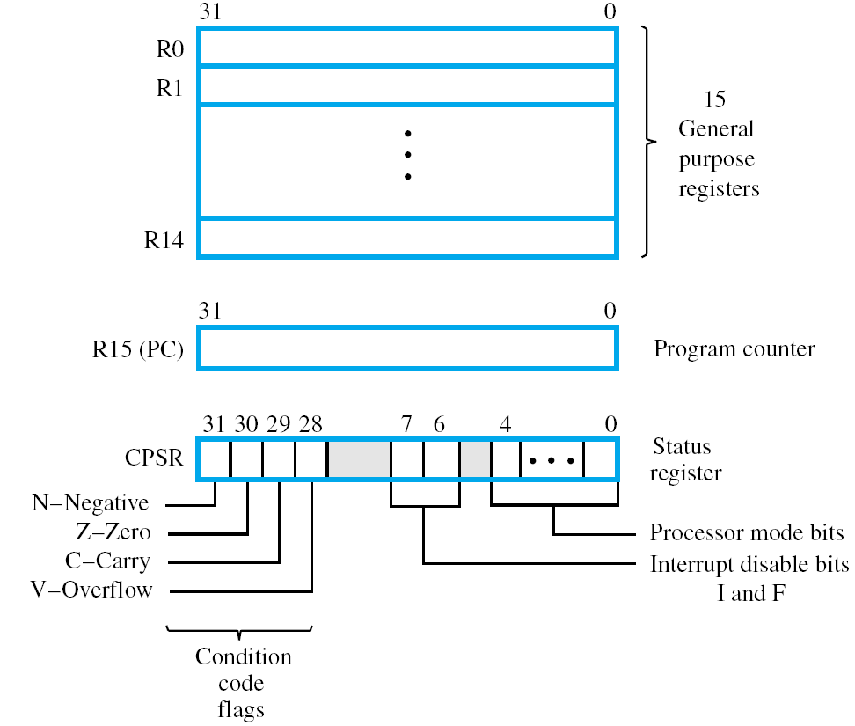

Slide 56
Conditional Instructions
Instruction behavior changes based on the status of the condition flags
Different (15) types of instructions can be generated from a single instruction with the use of conditions
By reusing the condition evaluation hardware, ARM effectively increases number of instructions.
All instructions contain a condition field which determines whether the CPU will execute them.
Non-executed instructions soak up 1 cycle.
Still have to complete cycle so as to allow fetching and decoding of following instructions.

Slide 57
Conditional Instructions
Branch: B{condition} LOCATION branches to LOCATION if the settings of the condition code flags satisfy {condition} BEQ LOCATION branches if Z = 1

Slide 58
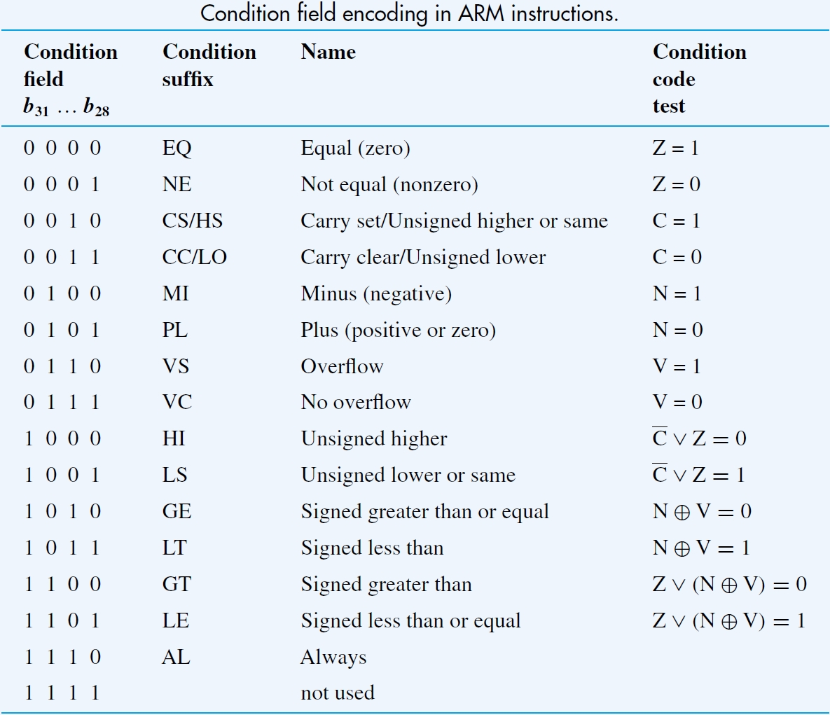

Slide 59
Condition Flags
Each instruction checks the CPSR register to see if the instruction conditions match CPSR conditions
e.g. ADDEQ r0,r1,r2
If zero flag set then… r0 = r1 + r2
Check CPSR
If Z==1, execute
Else, nop
e.g., ADD r0, r1, r2
= ADDAL r0, r2, r2
Always execute, no need to check CPSR

Slide 60
Condition Flags
How is CPSR set?
S field
Compare instructions

Slide 61
Condition Flags (S Field)
By default, data processing operations do not affect the condition flags (apart from the comparisons where this is the only effect)
E.g., ADD ro, r1, r2
Does NOT affect CPSR (condition signals are still generated by ALU but to no effect)
To cause the condition flags to be updated, the S bit of the instruction needs to be set by postfixing the instruction (and any condition code) with an “S”.
e.g., ADDS r0,r1,r2
Perform r0 = r1 + r2 and set flags based on the result

Slide 62
Condition Flags (Compare)
The only effect of the comparisons is to
UPDATE THE CONDITION FLAGS
No need to set S bit.
Operations in ARM:
CMP operand1 - operand2, but result not written
CMN operand1 + operand2, but result not written
TST operand1 AND operand2, but result not written
TEQ operand1 EOR operand2, but result not written
Syntax:
<Operation>{<cond>} Rn, Operand2
Examples:
CMP r0, r1
TSTEQ r2, #5

Slide 63
Typical ARM Instruction
<Operation>{<cond>}{S} Rd, Rn, Operand2
Lack of <cond> → AL
Lack of S → S=0

Slide 64
Example
MOVS ro, r1
MOVEQS r0, r2
MOVEQ r0, r3
1st instruction
Moves r1 to r0 unconditionally
Sets the condition flags
Z flag is set if r1=0
2nd instruction
Executed only if Z=1 (r1=0)
Moves r2 to r0
Sets the condition flags
Z flag is set if r2=0
3rd instruction
Executed only if Z=1 (r2=0)
Moves r3 to r0
Condition flags are not set
3rd instruction is executed only if r1=0 and r2=0

Slide 65
Summary
Covered main concepts of designing a basic processor in class.
Some real features of modern processors not yet covered: pipelining, floating point, memory hierarchy, multi-core processors (aka chip multiprocessors or CMPs).
Some of these will be covered in the coming weeks.

