Slide 1

CSCE 230, Fall 2013 Chapter 5: Basic Processing Unit Part 1: Fundamental Concepts and Datapath Design
Mehmet Can Vuran, Instructor
University of Nebraska-Lincoln
Acknowledgement: Overheads adapted from those provided by the authors of the textbook

Slide 2
Hardware Implementation of A = B+C
Add
Common clock
Operation takes one clock cycle.
Clock period* ≥
Propagation_Delay(A or B) +
Propagation_Delay(ALU) +
Setup_Time(C)
A
C
B
*This computation ignores wire
delays which can be quite significant,
especially, in FPGA implementations

Slide 3
Generalization to Composition of Combinational-Logic Functions
F
G
H

Slide 4
Pipelining computations
Add buffers between stages to achieve independence.
F
G
H
Again, ignoring wire delays

Slide 5
A note on processor of Chapter 5
The design uses inter-stage buffers
Motivation:
Easier-to-understand control
Easier to generalize to pipelined implementation in Chapter 6

Slide 6
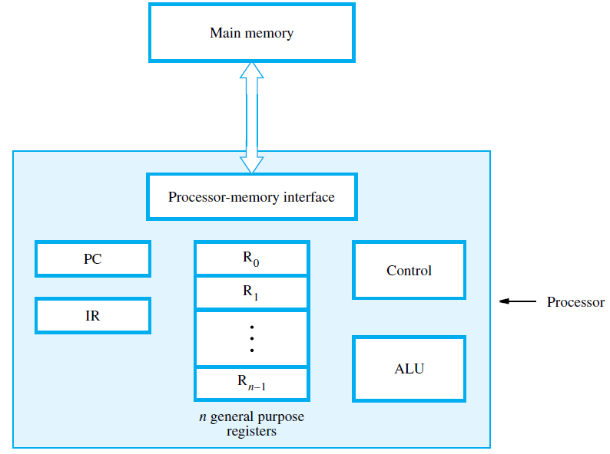
Computer Architecture
(Memory-mapped)
I/O

Slide 7
CPU + memory Abstraction
memory
address
CPU
PC
200
data
ADD a,b,c
ADD a,b,c
200
IR

Slide 8
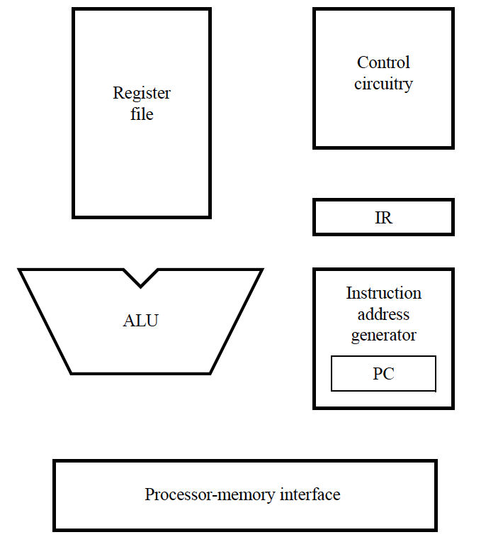
Processor’s main building blocks
PC provides instruction address.
Instruction is fetched into IR
Instruction address generator updates PC
Control circuitry interprets instruction and generates control signals to perform the actions needed.

Slide 9
Datapath and controlpath examples for different instruction types.

Slide 10
Processor’s main building blocks
MAX: Subtract SP, SP, #20
Store R1, 16(SP) Push R1
Store R2, 12(SP) Push R2
… …
Store R5, (SP) Push R5
Load R3, 24(SP)
Load R5, 20(SP)
Move R2, #1
Loop: Add R5, R5, #4
Load R4, (R5)
Branch_if_(R1>=R4) Skip
Move R1, R4
Skip: Add R2, R2, #1
Branch_if_(R3>R2) Loop
Store R1, 24(SP)
Load R1, 16(SP) Restore R1
Load R2, 12(SP) Restore R2
… …
Load R5, (SP) Restore R5
Return

Slide 11
Processor Loop
1. Instruction Fetch
2. Instruction Decode
3. Instruction Execute

Slide 12
Instruction Fetch
Common to all instructions
(Essential) Read instruction word in memory pointed to by PC into IR
(Optional) Increment PC (may be overwritten if the next instruction is different)
Important architectural principle: Make the common case fast.

Slide 13
Instruction Decode
Common to all instructions
(Essential) Figure out what the instruction is so that the control signals can be correctly generated for instruction execution.
Done by decoding the instruction opcode field(s)
(Optional) Read source registers specified in by the register fields of instructions involving register operands.
Wasted effort if the instruction does not involve register reads but this is the common case.

Slide 14
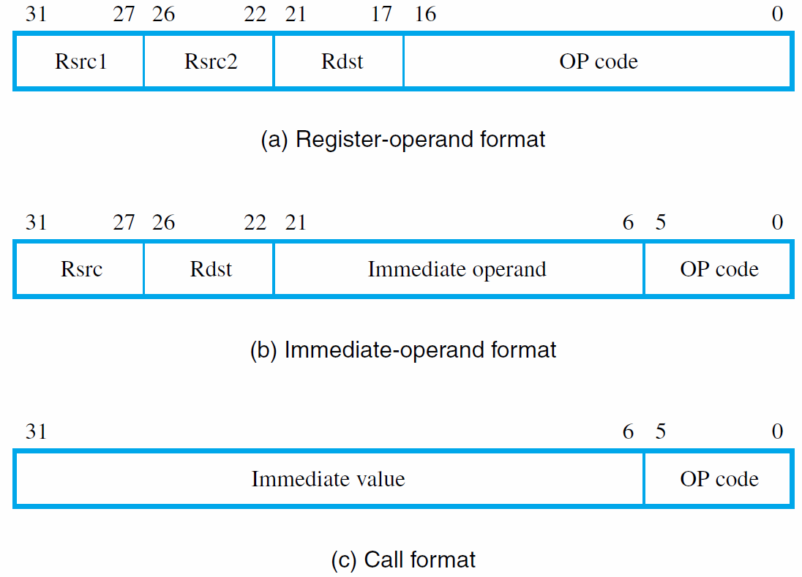
Instruction Decode
Add R3, R4, R5
Load R5, X(R7)
Branch LOOP

Slide 15
Instruction Execution
Depends on instruction type.
Can be further divided into stages

Slide 16
Instruction Execution
Load R5, X(R7)
Add R3, R4, R5
Add R3, R4, #100
Store R6, X(R8)

Slide 17
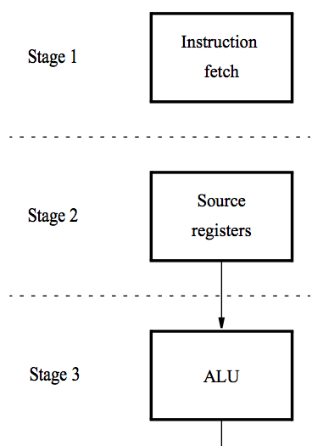
Five-Stage Execution
Instruction processing moves from each stage to the next in every clock cycle, after fetch in Stage 1.
The instruction is decoded and the source registers are read in stage 2.
Computation takes place in the ALU in stage 3.
If a memory operation is involved, it takes place in stage 4.
The result of the instruction is stored in the destination register in stage 5.

Slide 18
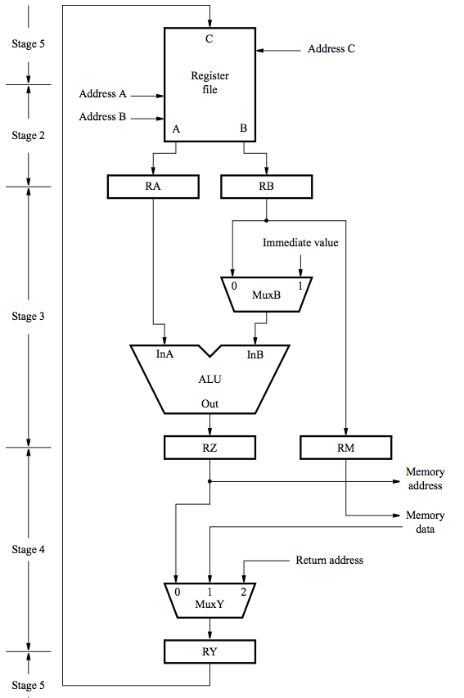
Datapath: Stages 2–5
2. Register
Stage 1
(Instruction Fetch)
is shown later.
3. ALU
4. Memory
5. Writeback

Slide 19
Computer Architecture
(Memory-mapped)
I/O

Slide 20
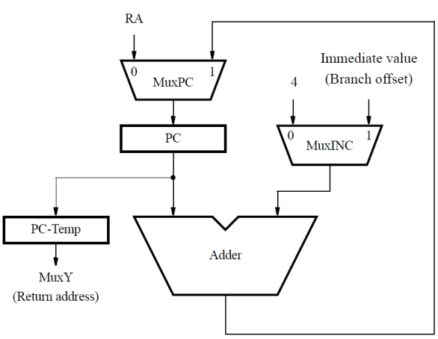
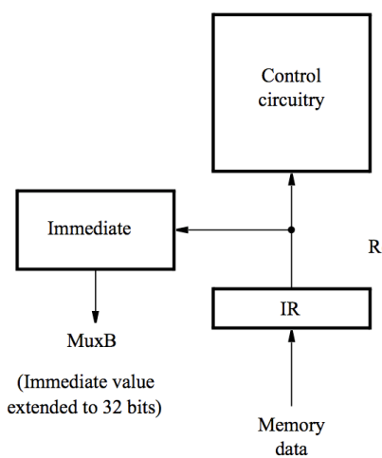
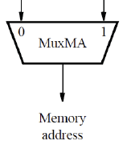
Complete Datapath
INSTRUCTION ADDRESS GENERATOR
CONTROL UNIT
Data
address
Instruction
address
DATA PATH
Memory
Data Out
Memory
Data In
Memory
Address
PROCESSOR-MEMORY INTERFACE

Slide 21
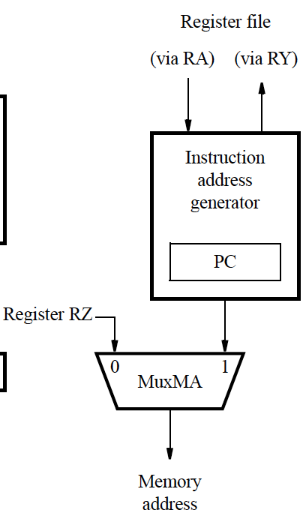
Memory address generation
Two kinds:
Instruction address (via Input 1)
Data address (Via Input 0)
Instruction address generator updates PC after instruction fetch.
Also generates (subroutine) branch and subroutine return addresses.
MuxMA selects RZ when reading or writing data operands.
RZ stores the address computed by the ALU.

Slide 22

Instruction address generator
Connections to RA and RY (via MuxY) are used for subroutine call and return.

Slide 23
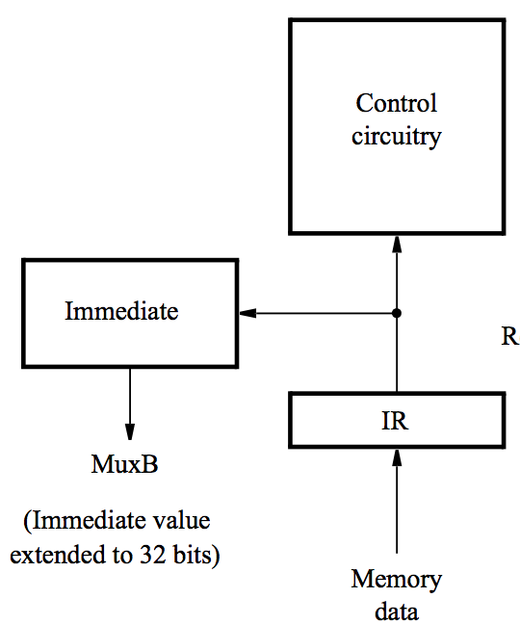
Processor control section
When an instruction is read, it is placed in IR.
The control circuitry decodes the instruction and generates the control signals that drive all units (more on this later).
The Immediate block extends the immediate operand to 32 bits as specified in the instruction.

Slide 24
Instruction Formats (Chapter 5 Processor)
Fig. 5.12

Slide 25
Example: Add R3, R4, R5
Memory address ← [PC], Read memory, IR ←Memory data, PC ← [PC] + 4
Decode instruction, RA ← [R4], RB ← [R5]
RZ ← [RA] + [RB]
RY ← [RZ]
R3 ← [RY]

Slide 26
Example: Load R5, X(R7)
Memory address ← [PC], Read memory, IR ← Memory data, PC ←[PC] + 4
Decode instruction, RA ←[R7]
RZ ←[RA] + Immediate value X
Memory address ←[RZ], Read memory, RY ← Memory data
R5 ←[RY]

Slide 27
Example: Store R6, X(R8)
Memory address ←[PC], Read memory, IR ← Memory data, PC ← [PC] + 4
Decode instruction, RA ←[R8], RB ←[R6]
RZ ←[RA] + Immediate value X, RM ←[RB]
Memory address ←[RZ], Memory data ←[RM], Write memory
No action

Slide 28
Unconditional branch
Memory address ←[PC], Read memory, IR ← Memory data, PC ←[PC] + 4
Decode instruction
PC ←[PC] + Branch offset
No action
No action

Slide 29
Conditional branch: Branch_if_[R5]=[R6] LOOP
Memory address ←[PC], Read memory, IR ← Memory data, PC ←[PC] + 4
Decode instruction, RA ←[R5], RB ←[R6]
Compare [RA] to [RB], If [RA] = [RB], then PC ←[PC] + Branch offset
No action
No action
Complete the data flow diagram on your own.

Slide 30
Subroutine call with indirection: Call_register R9
Memory address ←[PC], Read memory, IR ← Memory data, PC ←[PC] + 4
Decode instruction, RA ←[R9]
PC-Temp ←[PC], PC ←[RA]
RY ← [PC-Temp]
Register LINK ← [RY]
Complete the data flow diagram on your own.

Slide 31
Course Project
20% of your course grade
Goals
Understand software/hardware interface better by implementing a substantial subset of a Reduced Instruction Set Computer (RISC) instruction set architecture (ISA).
Understand design parameters that determine the performance of hardware design in terms of timing and utilization of hardware resources.
Learn to work as a team to carry out a complex design task requiring task partitioning, effective communication, and cooperation.
Produce a report that accurately describes your work according to the best practice in technical communication.

Slide 32
Course Project
Implement a basic processor with
an ISA that strongly resembles a subset of the MIPS architecture
some features that are unique to ARM
all instructions are 24-bits wide and data is 16-bits wide.
pipelining
(optional) interrupt capabilities

Slide 33
Project Timeline
Consists of 7 steps
Step 7 – Optional enhancements = Extra credit
1- Oct. 29/31 : ALU and Register File (done in lab)
2- Nov. 5/7 : Connect ALU and Reg File to datapath & mini report
3- Nov. 12/14 : Implement remaining instructions & mini report
4- Nov. 19/21 : Add I/O and ARM-like conditional execution & mini report
5- Dec. 3/5 : Add pipelining & mini report
6- Dec 10/12: Ideally have project done (including extra credit), report started.
7- Dec 19 : (Finals week) Present (actually need everything done): Project, Report, Demonstration
One week before each due date, a handout will be given with more detail on what is due.

Slide 34
Project Reporting
Every week you will submit a three-page report describing the portion of the project you worked on that week.
Concluded with a final report
More information ➔ Course Documents/ Project section of Blackboard.

Slide 35
Project Grading
500 points → 20% of course grade (+150)
Parts 2-4: 50 Pts each
Part 5: 100 Pts
Final Part: 200 Pts
100 Pts: Report
50 Pts: Presentation
50 Pts: Demonstration
Individual: 50 Pts
Our assessment of each member’s contribution (5 Pts/week)
Peer evaluation form (25 Pts)
Bonus: Up to 150 Pts – Depends on the difficulty and success of the extras

Slide 36
Upcoming…
Homework 4 – Chapter A
Due Friday, Oct. 25th
Quiz 4 – Chapter A (A.1-A.5)
Monday, Oct. 28th (15 min)
Midterm – Chapter 1, 2, 3
Monday, Nov. 4th (50 min)
Test 2 – Chapters A & 5
Monday, Nov. 11th (50 min)

