Slide 1
CSCE 230, Fall 2013 Chapter 4: System Software Part 2 Compiler, HLL for I/O, OS
Mehmet Can Vuran, Instructor
University of Nebraska-Lincoln
Acknowledgement: Overheads adapted from those provided by the authors of the textbook

Slide 2
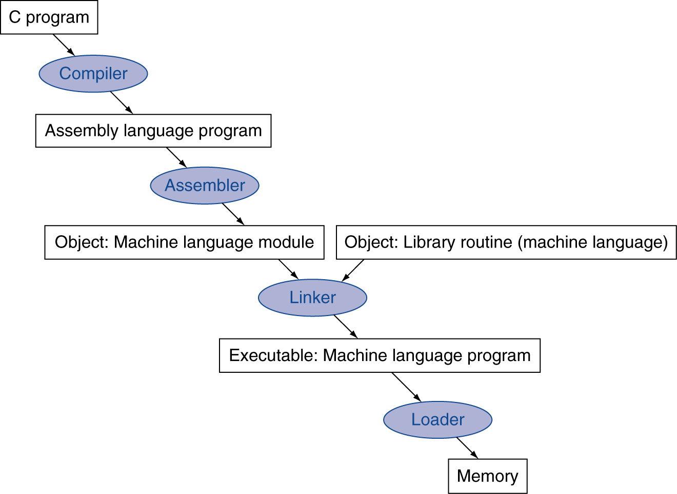
System Software
Debugger
Processor
I/O

Slide 3
Read the next five slides and the related text material on compilers on your own

Slide 4
The Compiler
Assembly-language programming requires knowledge of machine-specific details
Programming in a high-level language (like C) reduces need for machine-specific knowledge
Program in high-level language must be translated into assembly language for machine
The compiler performs this translation
The assembler processes compiler output file

Slide 5
The Compiler
Just as in assembly language, use multiple files to partition a program in high-level language
Must declare external subroutines & variables
Enables checking of data types across all files
Assembler invoked for each output file, then linker combines object files (with any libraries)
Compiler automates various tedious tasks, such as managing stack frames for subroutines

Slide 6
Compiler Optimizations
Assembly-language program from compiler may not be efficient in size or execution time
An optimizing compiler applies techniques to enhance performance or reduce code size
Much execution time is spent in loops
Optimize performance by using registers to hold value of loop index and other variables
Use Load/Store instructions before/after loop

Slide 7
Programs Using Multiple Languages
Once assembler generates an object file, original source language is less relevant
Linker combines object files & library routines for source programs written in any language
Machine-specific calling conventions define register usage and stack frames
Routines written in assembly language can call high-level language routines, and vice-versa

Slide 8
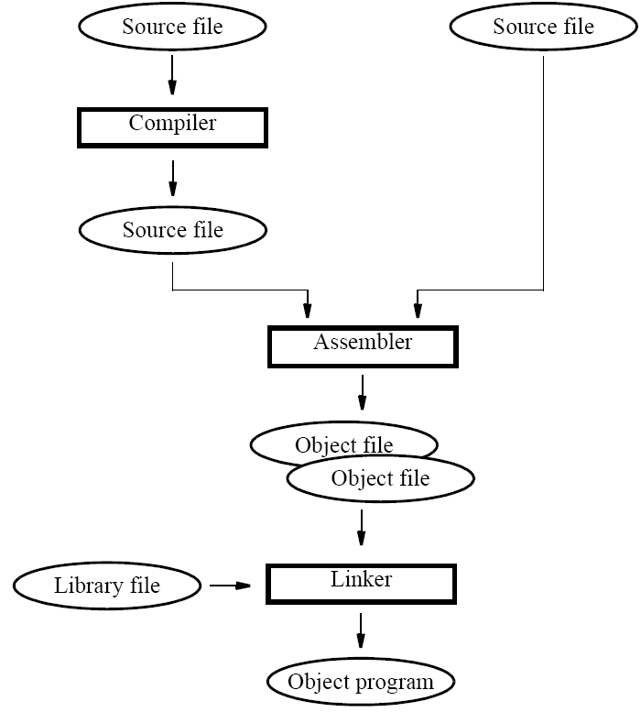

Slide 9
Using a High-Level Language for I/O
Use of high-level language preferred due to ease of program development & maintenance
Consider example in assembly-language and C for I/O task to show use of high-level language
Polling of keyboard, sending chars to display
Assembly-language reads/writes I/O registers and uses polling loop to check device status
C program must perform same operations

Slide 10
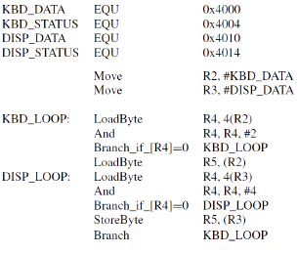
Textbook Example: Using HLL for IO
C Code
Assembly Code

Slide 11
Textbook Example: Using HLL for IO
C Code
Assembly Code

Slide 12
Textbook Example: Using HLL for IO
C Code
Assembly Code

Slide 13
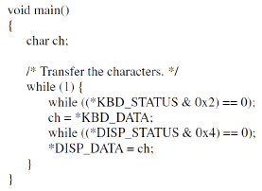
Textbook Example: Using HLL for IO
C Code
Assembly Code
Notes:
#define statements in C are similar to EQU for associating a symbolic name with an address
They also define pointer type for C code
Use of volatile qualifier is important for I/O
Prevents unwanted compiler optimizations to that might use register instead of I/O location
Also necessary in presence of cache memory; ensures cache is bypassed when accessing I/O

Slide 14
Textbook Example: Using HLL for IO
#define statements in C are similar to EQU for associating a symbolic name with an address
They also define pointer type for C code
Use of volatile qualifier is important for I/O
Prevents unwanted compiler optimizations to that might use register instead of I/O location
Also necessary in presence of cache memory; ensures cache is bypassed when accessing I/O

Slide 15
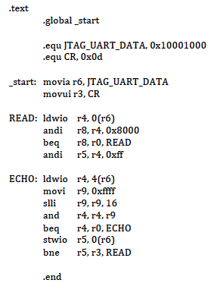
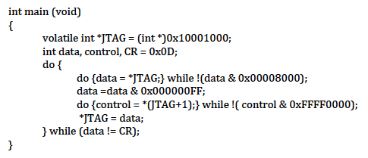
DE1 Example: Using HLL for IO
Nios II Assembly
Equivalent C Program

Slide 16
Using HLL of Interrupt I/O Requires Interaction: C ↔ Assembly Language
Program may need access to control registers
Example: enabling processor interrupts
Assembly-language instructions used for this, but no equivalent in high-level language like C
Compilers therefore permit inclusion of such instructions within high-level source program
Use similar keyboard/display example, but now with interrupts from keyboard interface

Slide 17
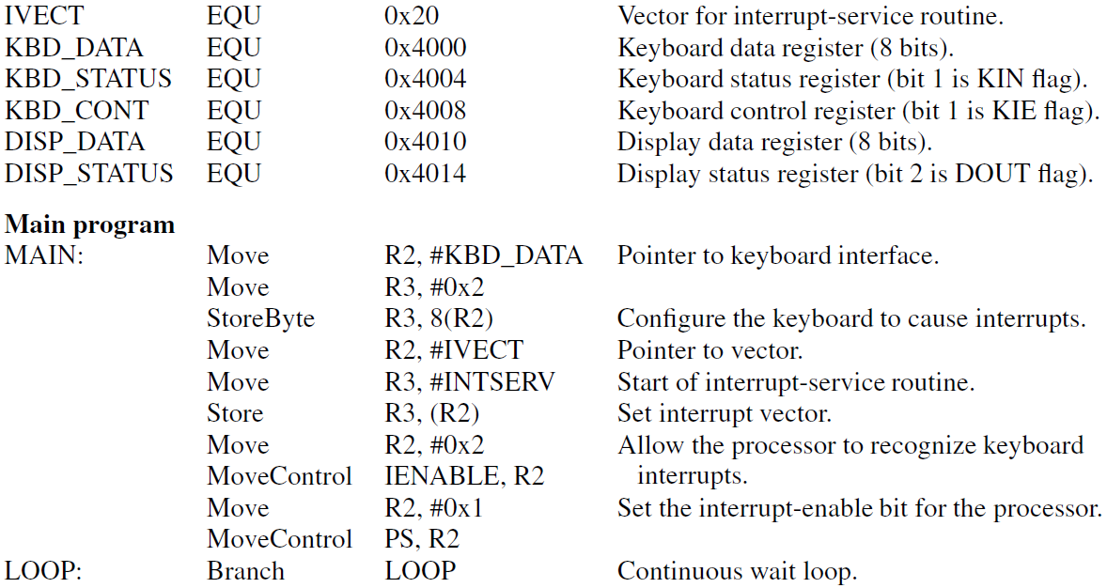
Interrupt I/O in Assembly (1/2)
Notes:
This program assumes a very simple form of vectored interrupts, with just interrupt vector for the keyboard interrupts.
It further assumes that when keyboard interrupts, the character is ready to be read. It echoes this character on the display device without checking for its status (to keep the example simple).
The main program needs to enable interrupts in the keyboard I/O interface, initialize the the vector for interrupt service routine to point to the INTSERV routine used here. Additionally, it must enable the interrupts from keyboard in the processor control register (IENABLE) and enable interrupts in the PS. Normally, it would then do useful computation during which occasionally the keyboard interrupts would cause the I/O to take place concurrently with the computation. Here, no useful computation is done and the program waits in an infinite loop.

Slide 18
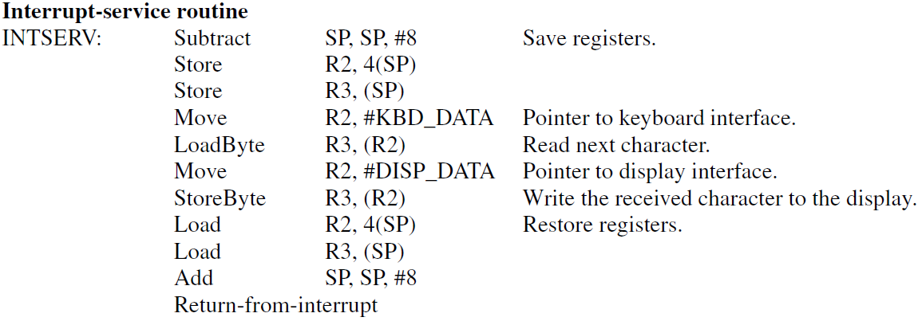
Interrupt I/O in Assembly (2/2)
Notes:
Straightforward, saves and restores registers as usual. The main task is to read the character from keyboard data register and send it to the display – this is done by the four instructions starting with the first Move instruction.

Slide 19
Interaction: C ↔ Assembly Language
Main routine peforms necessary initialization
Accesses keyboard I/O control register to enable interface to assert interrupt request
Writes service routine address to location in memory that holds interrupt vector
Accesses processor control register using special instruction to enable interrupts
Service routine sends each char. to display

Slide 20
Interaction: C ↔ Assembly Language
Processor control register has no address, so #define technique cannot be used as before
Must use special instruction that compiler does not emit in output assembly language
Use special asm() directive to insert desired assembly-language instructions where needed
Service routine must end with proper return instruction; use special interrupt directive

Slide 21
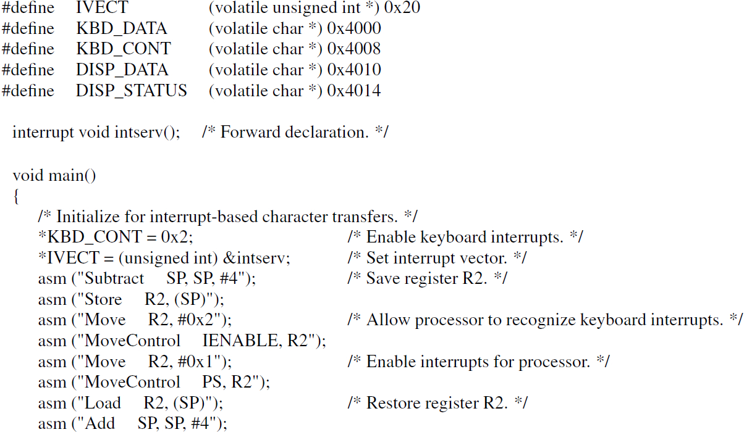
Notes:
This solution uses a special keyword “interrupt” in front of function declaration to alert the compiler to emit return_from_interrupt instruction, instead of the simple return instruction, at the end of the interrupt service routine.
Other features of this code are the volatile declaration (that we have seen earlier), use of #degine to declare pointer variables corresponding to the I/O interface addresses and the interrupt vector address, and the “asm” directive to emit assembler code within a C program.

Slide 22
Notes:
The interrupt service routine is quite simple. The C compiler takes care of register saves and restores and the data transfer from keyboard interface to the display is performed by just a single instruction (instead of four in the assembly language) that uses pointer variables.

Slide 23
The Operating System
Coordinates all activities in a computer system
Comprises essential memory-resident routines and utility programs stored on magnetic disk
Manages processing, memory, I/O resources
Interprets user commands, allocates storage, transfers information, handles I/O operations
Loader discussed previously is part of OS
Used by OS to execute application programs
Notes:
One main task is to coordinate use of system level resources: processor, memory, i/o, some or all of which
may be shared between processes. Hence process scheduling (which process to schedule next on a processor)
memory management (disk, main, caches), and i/o management (performing i/o tasks on behalf of the processes, are
the main tasks. With better management of resource, it is no longer necessary to run just one process to completion before
another is scheduled because the process may be doing I/O like printing, leaving the processor and disk etc. to be used by another process.
Another main task is to provide an interface to users to issue commands for navigating through the system or running programs (applications).
The system utilities we discussed earlier are all part of the OS.

Slide 24
The Boot-strapping Process
OS for general-purpose computer is large
All parts, including memory-resident, on disk
Boot-strapping loads memory-resident part, enabling OS to assume control over resources
At power-up, processor fetches instructions initially from permanent memory to read disk
Progressively larger programs transfer OS into memory in preparation for user commands

Slide 25
Read the next ten slides and the related text material on operating systems on your own

Slide 26
Managing Execution of Programs
Discuss OS operation with example computer having keyboard, display, disk, and printer
User enters command, loader transfers code and data in object file to memory to execute
To read data file on disk, request made to OS
OS and I/O activity occur while program waits
Program waits again after sending to printer
Timeline diagram illustrates this behavior

Slide 27
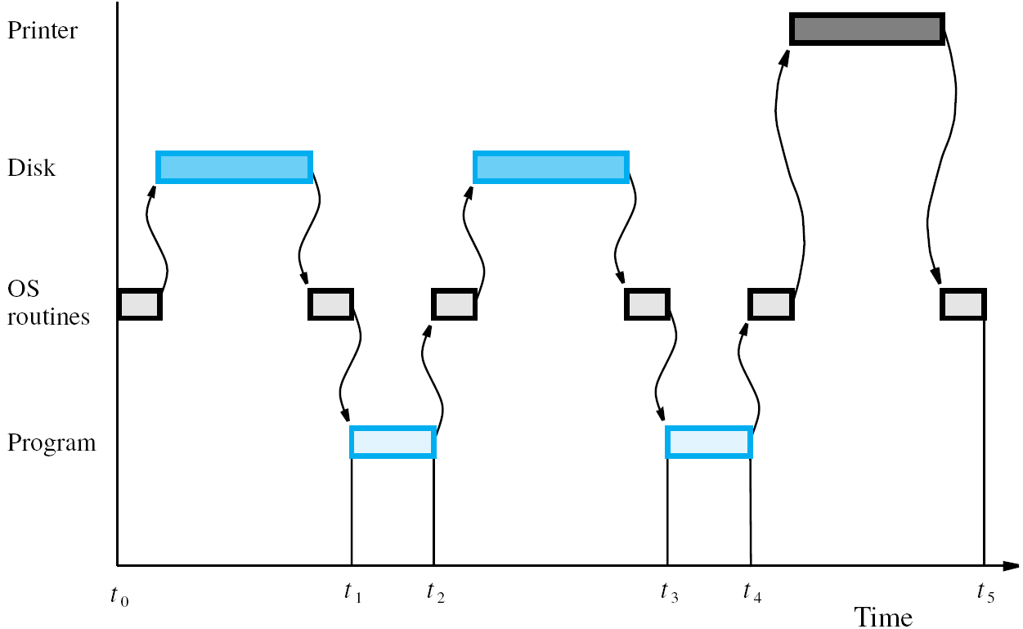

Slide 28
Managing Execution of Programs
Computer resources not being used efficiently when I/O devices and processor are idle
Start execution of other application programs before initial program terminates
Concurrent processing for computation and I/O requests can result whenever possible
OS manages activity for efficient utilization
Called multiprogramming or multitasking

Slide 29
Use of Interrupts in Operating Systems
Interrupts used extensively for I/O operations
Also enable OS to assign execution priorities, switch between programs, coordinate I/O, etc.
Service routines for I/O devices are part of OS
I/O requests made through library routines that raise software interrupt to enter OS
OS initiates I/O activity while program waits
Hardware interrupts signal completion to OS

Slide 30
Example of Multitasking
Multitasking requires various OS capabilities
OS uses hardware timer for time slicing when managing execution of multiple programs
Enables fair allocation of processor usage
OS must also support I/O requests to enable concurrent computation and I/O activity
Consider organization of OS software with initialization, scheduler, I/O routines, drivers

Slide 31
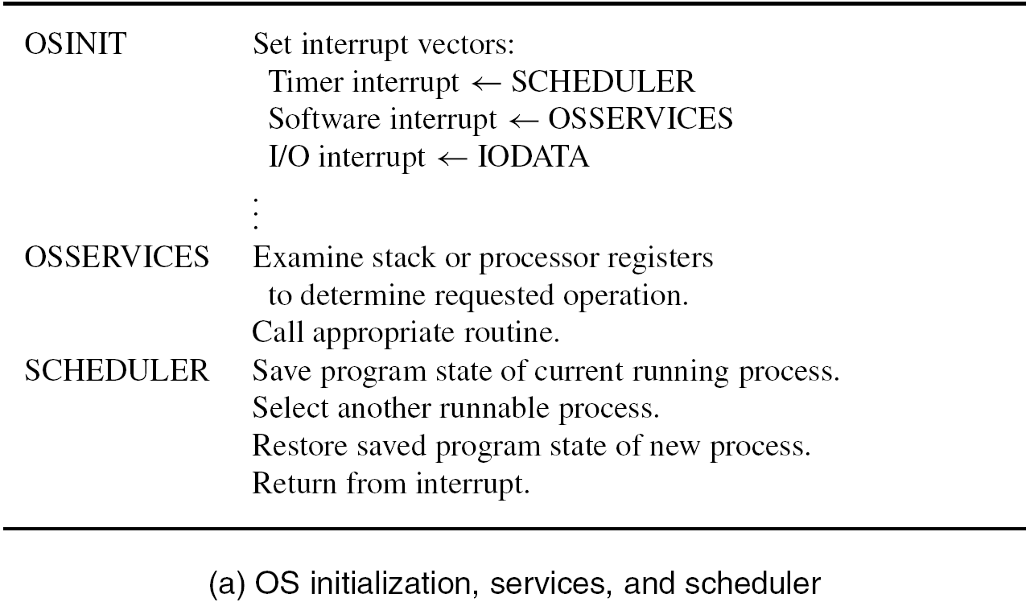

Slide 32
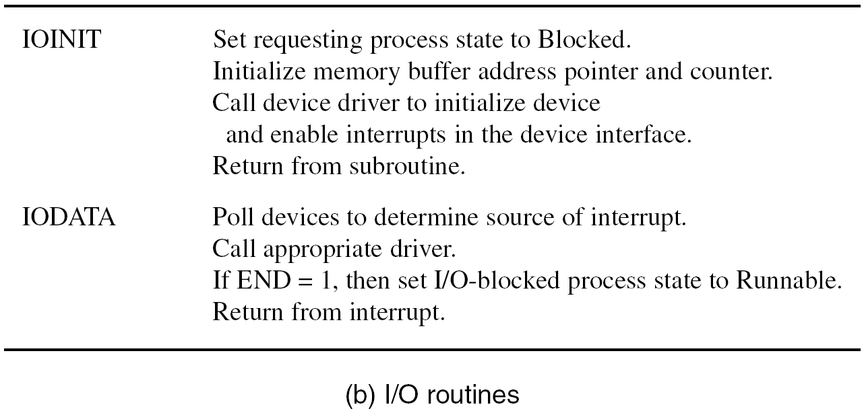

Slide 33
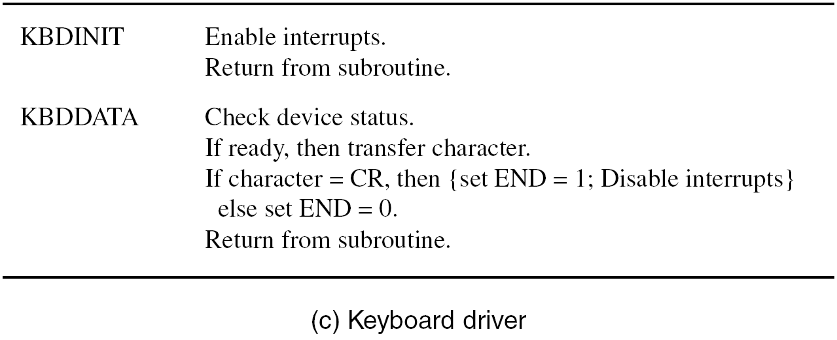

Slide 34
Example of Multitasking
A process is a program with its execution state
Can be Running, Runnable, or Blocked for I/O
Assume application programs A and B initiated
If A is executing when time slice expires, SCHEDULER is entered and registers are saved
OS then selects B, restores its register values, then uses return-from-interrupt to resume B
This event sequence is called a context switch

Slide 35
Example of Multitasking
Now A calls I/O routine for software interrupt
OS calls IOINIT, then KBDINIT in device driver
Device interrupts are enabled for transfer
SCHEDULER routine in OS then selects B
Keyboard interrupt invokes IODATA routine which polls devices to find interrupt source
A made Runnable, OS lets B resume execution
After later context switch, A executes again

Slide 36
Concluding Remarks
Software makes computers useful & versatile
Utility programs enable creation, execution, and debugging of application software
High-level language and assembly language can be used for the same program
Where necessary, assembly language can be included within high-level source program
OS and multitasking provide more versatility

