Slide 1
CSCE 230, Fall 2013 Chapter 4: System Software Part 1 (Assembler), Linker, Loader, Debugger
Mehmet Can Vuran, Instructor
University of Nebraska-Lincoln
Acknowledgement: Overheads adapted from those provided by the authors of the textbook

Slide 2
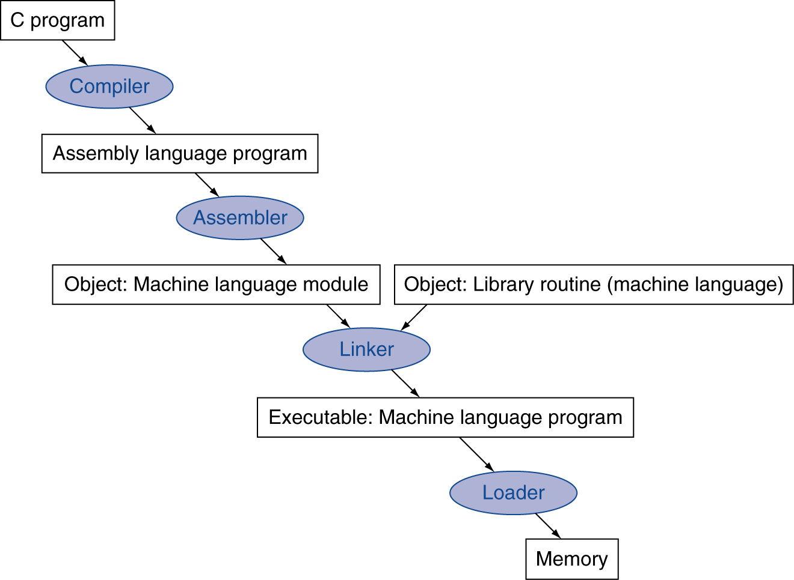
System Software
Debugger
Processor
I/O

Slide 3
Chapter Outline
Assembler, compiler, and linker are tools for generating object programs
Loader transfers programs into memory and handles execution initiation/termination
Debugger identifies programming errors
I/O and other tasks can be programmed in multiple languages
Operating system manages everything

Slide 4
The Assembly Process
We discussed this earlier in the course; review it if you have forgotten.

Slide 5
Separate Processing of Object Files
Can partition one program into multiple files
Can also use subroutines defined by others
Let assembler process each file separately, making list of unknown external names
Object file augmented with list of names and list of instructions with external references
Programmer must also export names from an object file that could be used with other files

Slide 6
The Linker
Combines object files into object program
Constructs map of full program in memory using length information in each object file
Map determines addresses of all names:
Relocation information used to update absolute references
External names matched with exported names
Instructions referring to external names are finalized with addresses determined by map
Unmatched names are reported as errors

Slide 7
Linker Example
We will work through the details of linking in class

Slide 8
Object File Info Needed for Linker
File 1:
Internal Symbols |  | External Symbols
Symbol | Value | Symbol | Reference List
_start | 0 | TEXT_STRING | @Loc8
LOOP | 12 | PUT_JTAG | @Loc20, @Loc48
GET_JTAG | 32
Global (Exported): _start
Code Length: 56 Bytes
File 2:
Internal Symbols |  | External Symbols
Symbol | Value | Symbol | Reference List
PUT_JTAG | 0 | <None>
END_PUT | 24
TEXT_STRING | 36
Global (Exported): PUT_JTAG, TEXT_STRING
Code Length: 61 Bytes (36 Bytes of text + 25 Bytes of data)

Slide 9
Linker Example

Slide 10
Linker Steps
Placement of Object Files:
0:
Obj1
55:
56:
Obj2
116:

Slide 11
Linker Steps
Resolving References: Add offset of 56 to internal symbols in Obj2 referenced in Obj1:
TEXT_STRING (original value = 36) will have new value = 36+56 = 92
Hence the TEXT_STRING @Loc8 in Obj1 will be 92
PUT_JTAG (original value = 0) will have new value = 0+56 = 56
Hence PUT_TAG @Loc20 and @Loc48 in Obj1 will be 56

Slide 12
Linker Steps
After resolving all the references, the linker is able to create a single executable object file.

Slide 13
Summary of Linker Steps
Place object-code modules
Location of object code arbitrary unless specified by ORIGIN specification by user
Order of placement does not matter
Determine the value of all internally defined symbols in each module.
Resolve external references using known values determined in Step 2. If there are still unresolved references, report error.

Slide 14
Libraries
Subroutines that are useful in one program are often useful in other programs
Separate file assembly and linking enables reuse of source files with these subroutines
Alternatively (common case), generate object files once and use archiver to collect them into a library file
Library includes name information to aid in resolving references from calling program

Slide 15
Static vs. Dynamic Linking
Static: Before execution starts, Linker/Loader identifies all the routines that are called any where in the linked source files and links them.
Dynamic: Delayed linking/loading at execution time.
Static linking is fast but:
Library routines become part of executable code and cannot be updated without linking again.
Loads routines in the library that are called anywhere in the executable, even if those calls are not executed

Slide 16
Dynamic Linking
Non-local routines linked at run time when called (lazy procedure linkage)
Implementation depends on indirection.

Slide 17
Dynamic Linking
On first call:
The non-local routine calls a dummy routine at the end of the program;
One dummy routine per non-local routine, contains an indirect jump.
The dummy routine puts a number in a register to identify the desired library routine and then jumps to the dynamic linker/loader.
The linker loader finds the desired routine, remaps it, and changes the address in the indirect jump location to point to that routine. It then jumps to it.
On subsequent calls to the routine, the program uses the indirect jump to go directly to the routine, bypassing the dynamic linker/loader

Slide 18
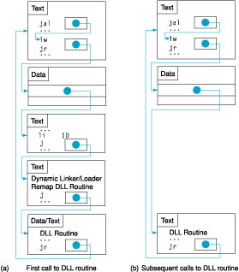
1 Call to a
non-local
Routine
Requires extra space for the information needed for dynamic linking but does not require whole libraries to be copied or linked.
Substantial overhead on first call; only a single indirect jump thereafter.
No overhead for return.
Commonly used today – DLL (Windows) or Shared Objects (Unix)
2 Indirect
Jump
3 Dummy
Routine puts ID of the DLL Routine
5 Indirect jump address changed to DLL Routine by Linker/Loader
4 DLL Routine linked (remapp-ed)

Slide 19
Advantages and Disadvantages
Advantages
Often-used libraries (for example the standard system libraries) need to be stored in only one location, not duplicated in every single binary.
If an error in a library function is corrected by replacing the library, all programs using it dynamically will benefit from the correction after restarting them. Programs that included this function by static linking would have to be re-linked first.
Disadvantages
Known on the Windows platform as "DLL Hell", an incompatible updated DLL will break executables that depended on the behavior of the previous DLL.
A program, together with the libraries it uses, might be certified (e.g. as to correctness, documentation requirements, or performance) as a package, but not if components can be replaced. (This also argues against automatic OS updates in critical systems; in both cases, the OS and libraries form part of a qualified environment.)

Slide 20
Loading/Executing Object Programs
Loader invoked when user types command or clicks on icon in graphical user interface
User input identifies object file on disk
Object file has information on starting location in memory and length of program
Loader transfers object program from disk to memory and branches to starting address
At program termination, loader recovers space in memory and awaits next command

Slide 21
The Debugger
Programming errors, or bugs, can cause an object program to produce incorrect results
The debugger enables the programmer to identify such errors at execution time
Execution can be stopped at points of interest
At such points, debugger accepts commands to display contents of registers or memory
Execution resumed until next point of interest

Slide 22
Trace Mode and Breakpoints
The debugger can use trace mode interrupts
Service routine invoked after each instruction to enable user to inspect registers/memory
Trace mode disabled within debugger, then re-enabled upon return from interrupt
Breakpoints involve placing software-interrupt instruction in program to enter debugger
Old instruction restored to resume execution

Slide 23
Basic Idea: How Breakpoints are Implemented
Assume the user sets a breakpoint at the
instruction at LOOP in the debugger.

Slide 24
Debugger response to setting a breakpoint …
In response, the debugger installs a software trap at LOOP,
saving the original instruction at that location.

Slide 25
When breakpoint is reached during execution …
When execution reaches LOOP the software trap brings
control back to the debugger …

Slide 26
Debugger actions …
The debugger restores the original instruction at LOOP, installs
software trap at the following instruction and saves that instruction

Slide 27
After execution of ldb, another trap brings control back to …
When the second software trap occurs at location after LOOP …

Slide 28
the debugger and it restores the conditions for breakpointing again
The debugger restores the instruction at the location after LOOP,
sets a software trap at LOOP, saving the instruction at that location.
Now we are back to the conditions prevailing after initial set up.

Slide 29
Conclusion
Discussed the low-level systems programs used for generating, running, and debugging programs.
Will only briefly touch on two other important systems programs: compilers and OS.

