Slide 1
CSCE 230, Fall 2013 Chapter 3: Basic Input/Output(Part 2) I/O Devices: Interrupts
Mehmet Can Vuran, Instructor
University of Nebraska-Lincoln
Acknowledgement: Overheads adapted from those provided by the authors of the textbook

Slide 2
Interrupts: Rationale
Drawback of a wait loop: processor is busy waiting for I/O; cannot perform other useful computation
Instead, let I/O device alert the processor when it is ready
Hardware sends an interrupt-request (IRQ) signal to the processor at the appropriate time
Meanwhile, processor performs useful tasks

Slide 3
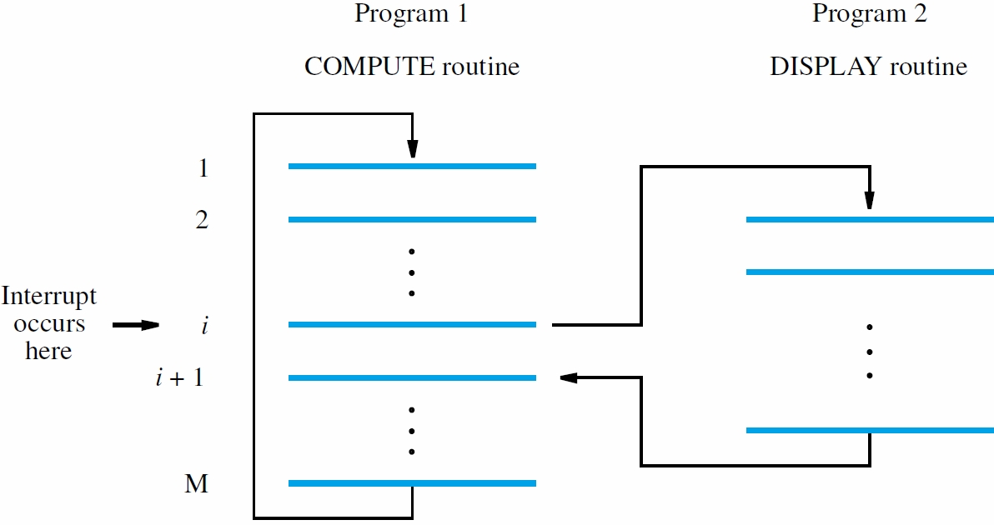
(Interrupt Service Routine)
In Nios II, execution of instruction i stops without completion.

Slide 4
Enabling and Disabling Interrupts
Must processor always respond immediately to interrupt requests from I/O devices?
Some tasks cannot tolerate interrupt latency and must be completed without interruption
Need ways to enable and disable interrupts, both in processor and in device interfaces
Provides flexibility to programmers
Use control bits in processor and I/O registers

Slide 5
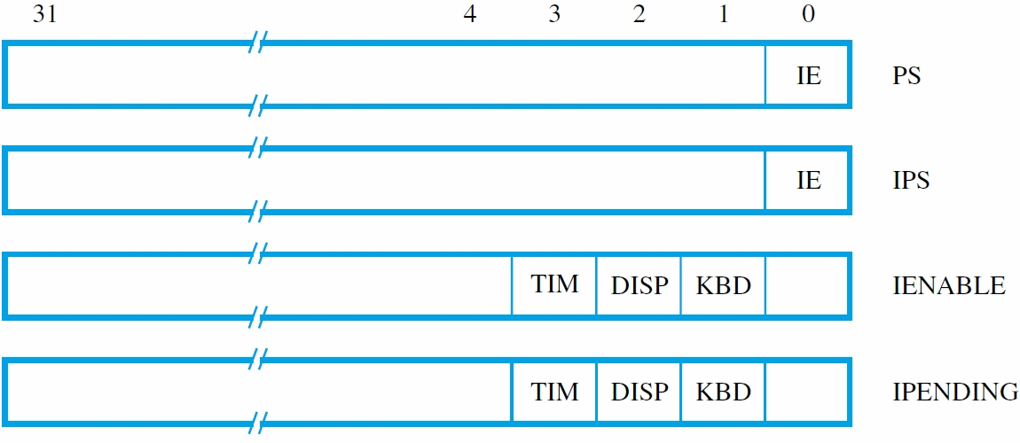
Generic Processor Control Registers (Chapter 3)
IPS register is where PS is automatically saved when an interrupt request is recognized
IENABLE has one bit per device to control if requests from that source are recognized
IPENDING has one bit per device to indicate if interrupt request has not yet been serviced

Slide 6
Interrupt I/O Architecture
Processor Control Registers
I/O Device 1:
Processor
Status
Status
IRQ
PIE
IRQ₁
Control
IE
n
2
1
…
Interrupt
Enable
I/O Device n:
Status
IRQ
…
Interrupt
Pending
IRQ_{n}
IE
n
2
1
Control
IRQ_{i} asserted only if Device i makes interrupt request (IRQ_{i}=1) and its IE bit is 1.
IRQ_{i} sets the corresponding Interrupt Pending bit of Processor Control Register.
Processor can selectively enable a subset of pending interrupt with the in Interrupt Enable Register
Processor can globally turn off all interrupts by controlling the PIE bit.

Slide 7
Conditions for Interrupt Occurring
An interrupt is generated only if all of the following conditions are true:
The PIE bit in the Processor Status Register is set to 1
An interrupt request input, IRQ_{i}, is asserted
The corresponding bit in the Interrupt Enable Register is set to 1.

Slide 8
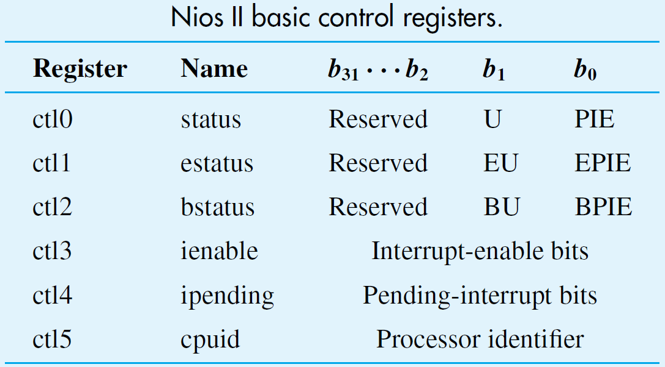
Exception/Interrupt
Breakpoint (debugging)
Interrupt

Slide 9
Accessing Control Registers
Use special Move instructions that transfer values to and from general-purpose registers
Transfer pending interrupt requests to R4: MoveControl R4, IPENDING
Transfer current processor IE setting to R2: MoveControl R2, PS
Transfer desired bit pattern in R3 to IENABLE: MoveControl IENABLE, R3

Slide 10
Accessing Control Registers (Nios II)
Use special Move instructions that transfer values to and from general-purpose registers
Transfer pending interrupt requests to R4: MoveControl R4, IPENDING
rdctl r4, ipending (or ctl4)
Transfer current processor IE setting to R2: MoveControl R2, PS
rdctl r2, status (or ctl0)
Transfer desired bit pattern in R3 to IENABLE: MoveControl IENABLE, R3
wrctl ienable (or ctl3), r3

Slide 11
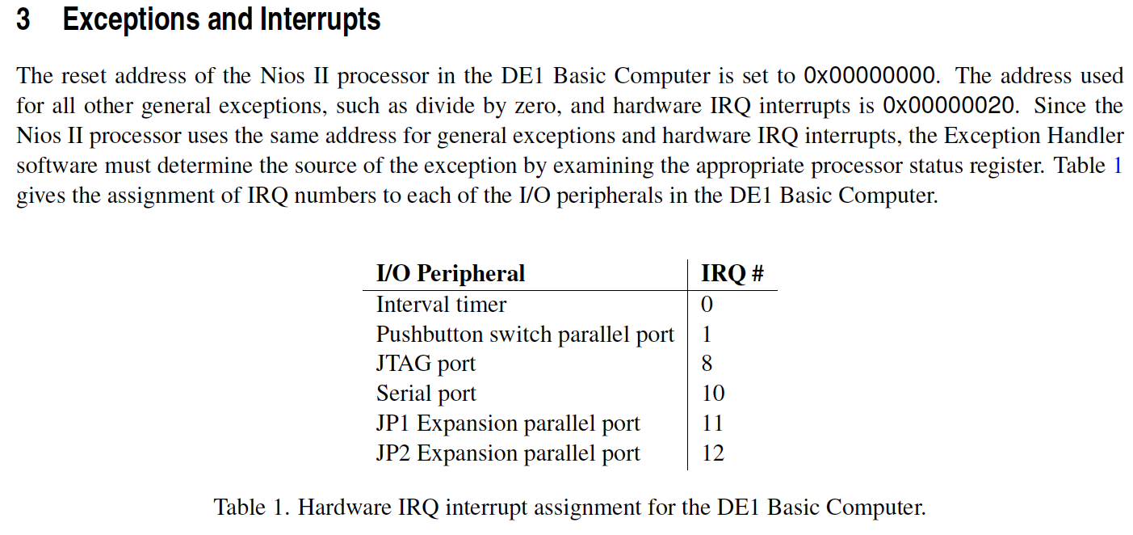
Nios II IRQ Numbers and Exception Handling*
*From Basic Computer System for the Altera DE1 Board from Altera, May 2011.

Slide 12
Event Sequence for an Interrupt
When an interrupt is recognized, processor saves program counter and status register
IE bit cleared to 0 so that same or other signal does not cause further interruptions
After acknowledging and servicing interrupt, restore saved state, which sets IE to 1 again

Slide 13
Examples of Interrupt Programs
Use keyboard interrupts to read characters, but polling within service routine for display
Illustrate initialization for interrupt programs, including data variables and control registers
Show saving of registers in service routine
Consider RISC-style and CISC-style programs
We assume that predetermined location ILOC is address of 1st instruction in service routine and PNTR points to the first address in the memory to which characters are written

Slide 14
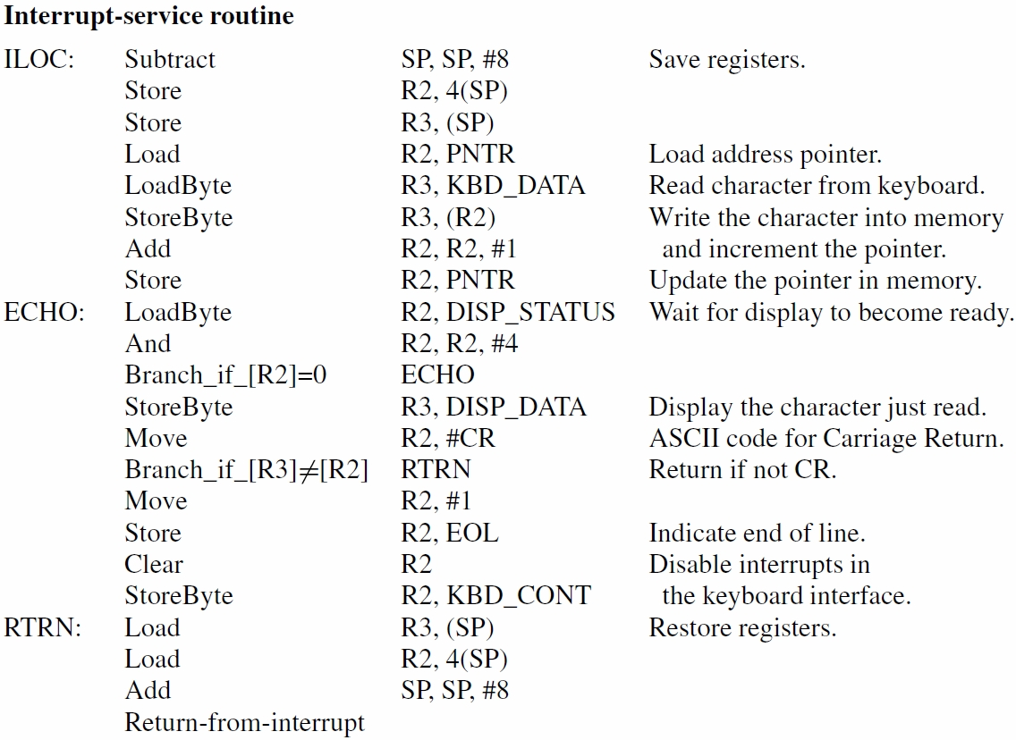
(RISC)

Slide 15
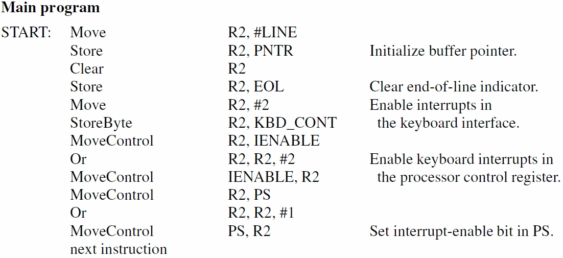
(RISC – Continued)

Slide 16
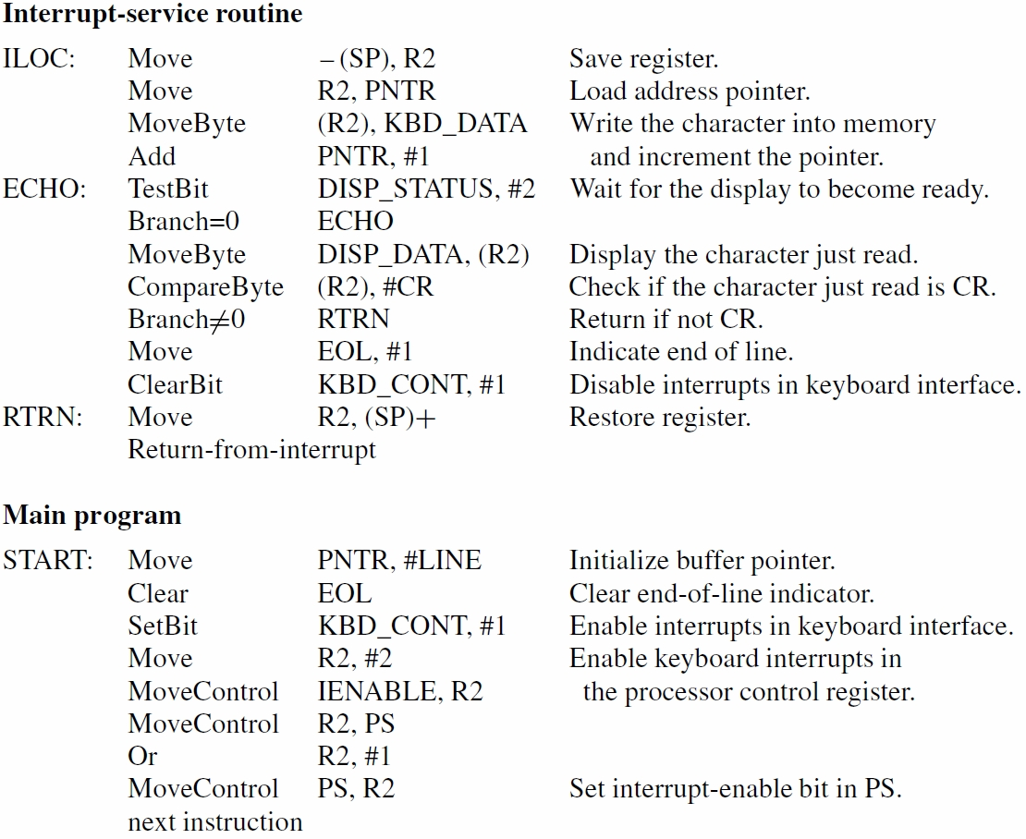
(CISC)

Slide 17
DE1 Nios II Version
Textbook, Fig. B.13, is Nios II version of the RISC program we just looked at.
It uses the keyboard/display interface shown in Fig. 3.3

Slide 18
Exercise
So far, we have seen two versions of programs to echo a line of characters from keyboard, while also storing the same in memory:
Using wait loops
Using interrupts
Try the third alternative, i.e. using periodic polling, where the timing for polls is provided using interrupts from the interval timer.

Slide 19
Handling Multiple Devices
Which device is requesting service?
How is appropriate service routine executed?
Should interrupt nesting be permitted?
How are two simultaneous requests handled?
For 1st question, poll device status registers, checking if IRQ bit for each device is set
For 2nd question, call device-specific routine for first set IRQ bit that is encountered
For 3rd question, see Interrupt Nesting ahead
For 4th question, see Simultaneous Requests ahead.

Slide 20
Vectored Interrupts
Vectored interrupts reduce service latency; no instructions executed to poll many devices
Let requesting device identify itself directly with a signal or a binary code
Processor uses info to find address of correct routine in an interrupt-vector table
Table lookup is performed by hardware
Vector table is located at fixed address, but routines can be located anywhere in memory

Slide 21
V1
Interrupt
Vector
Table
V2
.
.
.
Vn
Device 1 Service Routine
Device 2 Service Routine
Device n Service Routine

Slide 22
Interrupt Nesting
Service routines usually execute to completion
To reduce latency, allow interrupt nesting by having service routines set IE bit to 1
Acknowledge the current interrupt request before setting IE bit to prevent infinite loop
Save return address in stack
For more control, use different priority levels
Current level held in processor status register
Accept requests only from higher-priority devices

Slide 23
Simultaneous Requests
Two or more devices request at the same time
Arbitration or priority resolution is required
With software polling of I/O status registers, service order determined by polling order
With vectored interrupts, hardware must select only one device to identify itself
Use arbitration circuits that enforce desired priority or fairness across different devices

Slide 24
Back to our Example: Multiple Interrupt Sources
To use interrupts for both keyboard & display, call subroutines from ILOC service routine
Service routine reads IPENDING register
Checks which device bit(s) is (are) set to determine which subroutine(s) to call
Service routine must save/restore Link register
Also need separate pointer variable to indicate output character for next display interrupt

Slide 25
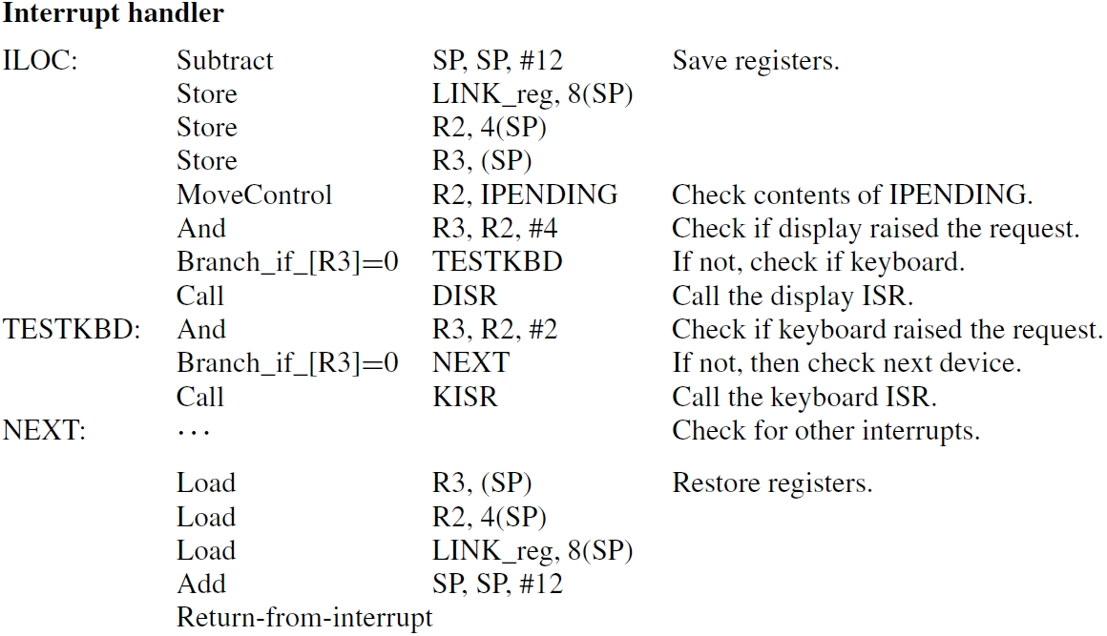
Notes:
In this simple form this does not work quite right because we need to allow the display interrupt conditionally, when
there is a keyboard interrupt and the service routine reads an input character. At other times, the display interrupt should
be disabled.
The logic would be a bit more complex: The main program initially enables kbd interrupts and disables them for disp. The kbd routine
Then enables the disp interrupt after it has read the character.

Slide 26
Exceptions
An exception is any interruption of execution
This includes interrupts for I/O transfers
But there are also other types of exceptions
Recovery from errors: detect division by zero, or instruction with an invalid OP code
Debugging: use of trace mode & breakpoints
Operating system: software interrupt to enter
the last two cases are discussed in Chapter 4

Slide 27
Recovery from Errors
After saving state, service routine is executed
Routine can attempt to recover (if possible) or inform user, perhaps ending execution
With I/O interrupt, instruction being executed at the time of request is allowed to complete
If the instruction is the cause of the exception, service routine must be executed immediately
Thus, return address may need adjustment

Slide 28
Concluding Remarks
Two basic I/O-handling approaches: program-controlled and interrupt-based
1st approach has direct control of I/O transfers
Drawback: wait loop to poll flag in status reg.
2nd approach suspends program when needed to service I/O interrupt with separate routine
Until then, processor performs useful tasks
Exceptions cover all interrupts including I/O

Slide 29
Upcoming…
HW 2 – Chapter 2
Assign Monday, Sep. 16th
Due Monday, Sep. 23rd
Quiz 2 – Chapter 2 (2.1-2.7)
Wednesday, Sep. 25th (15 min)

