Slide 1

CSCE 230, Fall 2013 Chapter 3: Basic Input/Output(Part 1) I/O Devices: Characteristics & Accessing Methods
Mehmet Can Vuran, Instructor
University of Nebraska-Lincoln
Acknowledgement: Overheads adapted from those provided by the authors of the textbook

Slide 2
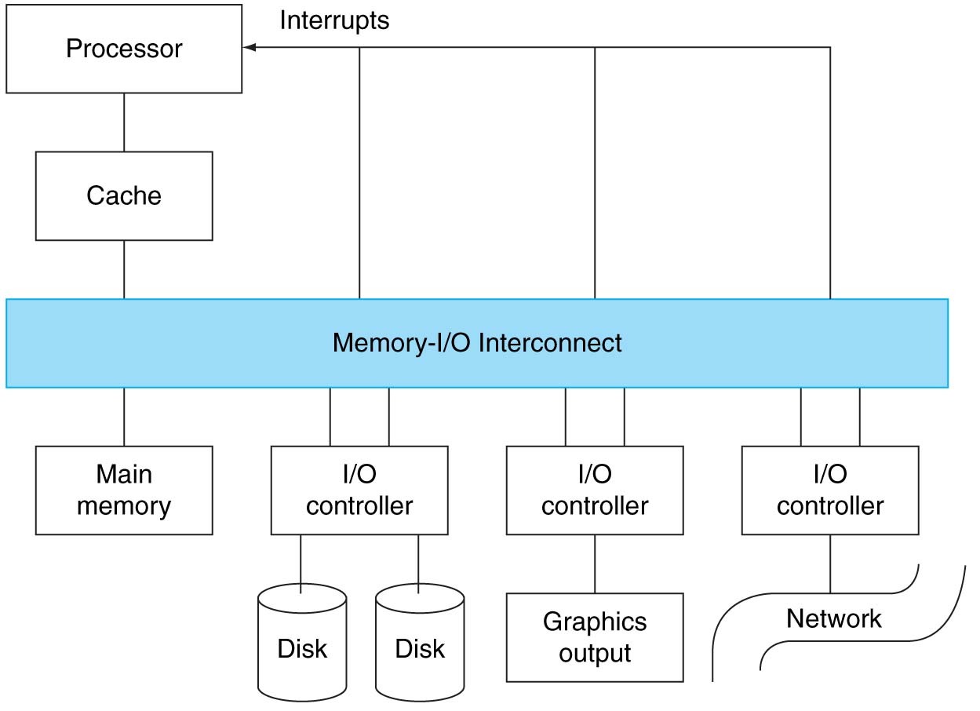
Processor, Memory, and I/O Organization (Architectural View)
Dedicated Bus
I/O Transfers either direct to Main memory or via Processor
Shared Bus
aka I/O Interface
Trend toward narrow pipe-width, high-BW, standard I/O interfaces
(e.g. USB, Firewire, ATA, Ethernet)

Slide 3
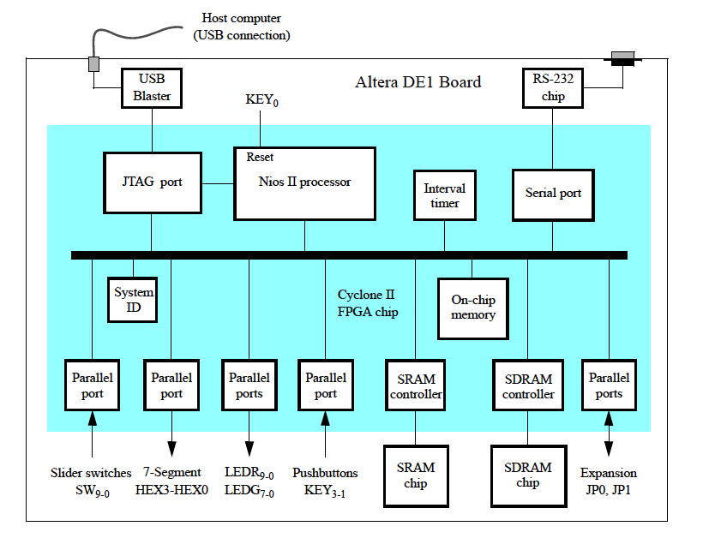
I/O Interfaces on Nios II DE1 Board

Slide 4
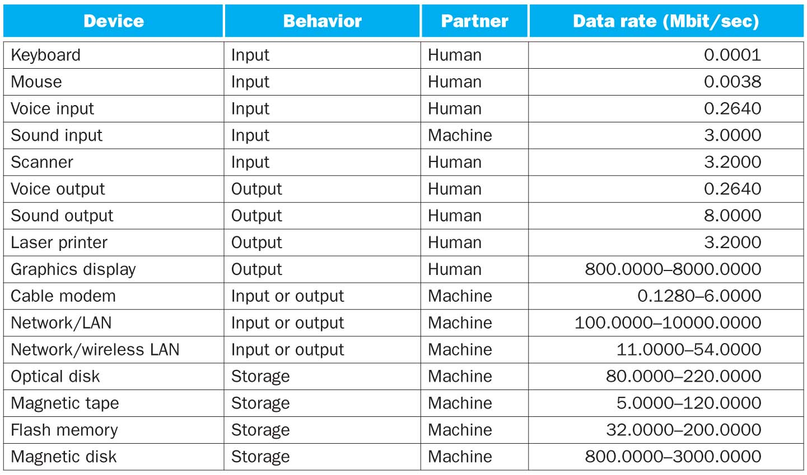
Data Rates of I/O Devices
Keypoints:
1. Huge data-rate range – 12 orders of magnitude
2. Higher data-rate range when machine is partner
3. Network treated as an I/O device

Slide 5
I/O Management
I/O is mediated by the OS
Multiple programs share I/O resources
Need protection and scheduling
I/O events happen asynchronously relative to processor clock
I/O programming requires attention to detail
OS provides abstractions to programs

Slide 6
Different Ways of Handling I/O
Programmed I/O (Processor involved in I/O transfers)
Wait-Loop (Continuous Polling)
CPU checks device status and waits if device is not ready for I/O, otherwise performs the I/O
Interrupt-driven I/O
CPU can selectively enable interrupts from I/O devices
A ready device, with interrupts enabled, causes CPU interrupt.
Interrupt service routine performs the I/O
Periodic Polling
Periodically check I/O status register and perform I/O if device is ready.

Slide 7
Different Ways of Handling I/O
Non-Programmed I/O (Intelligent I/O interface handles transfers)
Example: Direct memory access (DMA)
OS provides starting address in memory
I/O controller transfers to/from memory autonomously
Controller interrupts on completion or error
We will focus on programmed I/O

Slide 8
Wait Loop
.
.
.
In its basic form, Wait-loop I/O
is not very useful because it makes
a very fast processor wait on
relatively slow I/O devices.
No
Device
Ready?
Yes
Perform
I/O
.
.
.

Slide 9
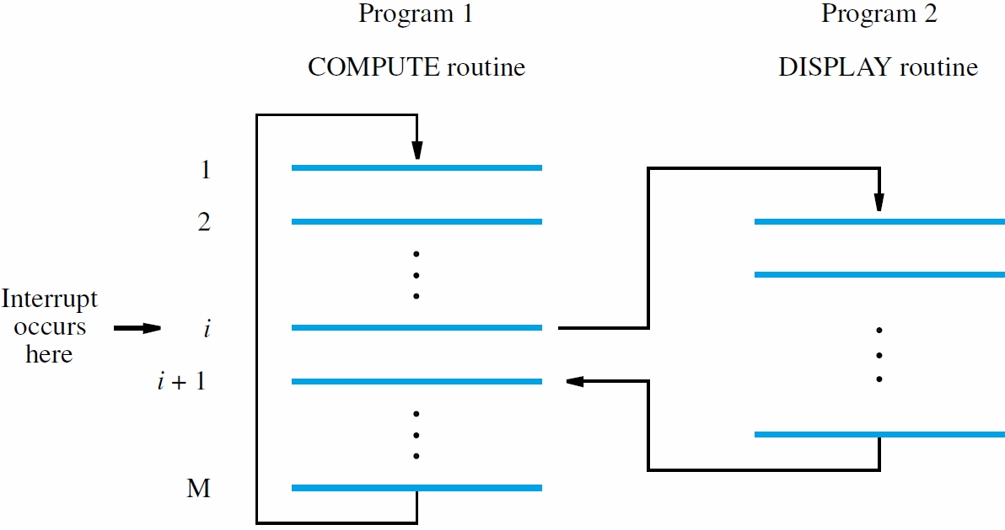
Interrupt
Can’t predict where Program 1 will be interrupted.

Slide 10
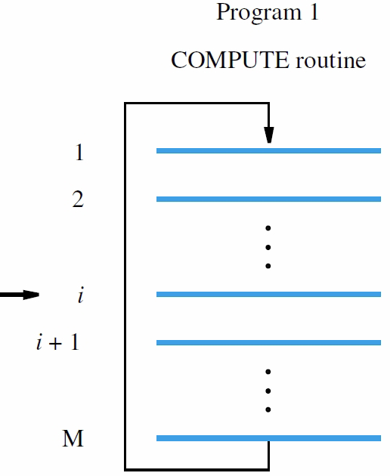
Polling
Program 2
POLLING Routine
Device
Ready?
Yes
Timer
Interrupt
Perform
I/O
No

Slide 11

A Simple Scenario
Keyboard Input:
c maximum chars/s
rc average chars/s
Keyboard operates asynchronously
I/O Interface
I/O Programming Options
Polling:
On each poll, Polling routine queries the keyboard, grabs a character, if ready, and places it in memory.
Time: T s/poll
2. Interrupt:
On interrupt, a service routine queries the keyboard, grabs the character, places it in memory, and returns.
Time: T s/interrupt-service-call
Computer
Question: What fraction of processor
time is spent in Polling I/O vs.
Interrupt I/O?
Answer:
Polling: cT
Interrupt: rcT

Slide 12
Key Idea: Polling vs. Interrupt
The cost of polling I/O is based on the worst-case (maximum I/O data rate), whereas the cost of interrupt I/O is based on the average case (average I/O data rate).

Slide 13
Polling vs. Interrupt for Devices with a Range of I/O Data Rates
Assume for a processor with a 1GHz clock it takes 500 clock cycles for a polling operation and 1000 clock cycles for each interrupt service . Determine % of processor time for polling vs. interrupt in each of the following cases:
Mouse: Must be polled 30 times/sec so as not to miss user movement. Active 10% of the time (r = 0.1).
Floppy disk: transfers data in 2-Byte units and has the (maximum) data rate of 50 KB/second. No data transfer can be missed. Active 5% of the time (r= .05)
Hard disk: transfers data in 16-Byte chunks and can transfer at 16 MB/second. Again, no transfer can be missed. Active 10% of the time (r = 0.1)
Notes:
Mouse: 30 polls/sec x 400 clock cycles/poll = 12000 clock cycles/sec
The processor has 10^9 clock cycles/sec (1 GHz), hence 12000/10^9
Is the fraction of the processor time polling of mouse takes.
Floppy disk: number of polls per second should be 50KB/2B = 25K polls/sec
Clock cycles for polling = 25Kx400 = 10M
Fraction of processor cycles = 10M/1000M = 1/100 = 1%
Hard disk: 1M polls/sec x 400 = 400M cycles/sec
= 40% of processor clock cycles.

Slide 14
Polling vs. Interrupt for Devices with a Range of I/O Data Rates
Mouse: Must be polled 30 times/sec so as not to miss user movement. Active 10% of the time (r = 0.1).
Polling cost in fraction of processor cycles/s =
(30 polls * 500 cycles/poll)/10⁹ cycles/s = 15*10⁻⁶ = .000015 or .0015%
Interrupt I/O cost is 5 times smaller (.0015*2r)
Floppy disk: transfers data in 2-Byte units and has the (maximum) data rate of 50 KB/second. No data transfer can be missed. Active 5% of the time (r= .05)
Polling cost: 25000*500/10⁹ = 1.25*10⁻² = 1.25% vs. Interrupt I/O cost = .125%
Hard disk: transfers data in 16-Byte chunks and can transfer at 16 MB/second. Again, no transfer can be missed. Active 10% of the time (r = 0.1)
Polling cost: 10⁶*500/10⁹ = 50% vs. Interrupt I/O cost = 10%
Notes:
Mouse: 30 polls/sec x 400 clock cycles/poll = 12000 clock cycles/sec
The processor has 10^9 clock cycles/sec (1 GHz), hence 12000/10^9
Is the fraction of the processor time polling of mouse takes.
Floppy disk: number of polls per second should be 50KB/2B = 25K polls/sec
Clock cycles for polling = 25Kx400 = 10M
Fraction of processor cycles = 10M/1000M = 1/100 = 1%
Hard disk: 1M polls/sec x 400 = 400M cycles/sec
= 40% of processor clock cycles.

Slide 15
DMA
Program Running on CPU
DMA is like a special-purpose processor – can transfer to and from memory without involving processor.
Processor can start and test DMA operation through interrupt I/O
Bus contention between DMA and CPU during data transfers (DMA steals cycles from CPU)
.
.
.
Issue Read Block
Command to DMA
Interrupt
.
.
.
DMA Interface
Read status
of DMA
.
.
.

Slide 16
DMA Benefit: Example
Consider the previous hard-disk example:
Polling cost: 50% Interrupt I/O cost: 10%
Now Consider DMA:
8KB of data transferred per DMA operation:
Takes 8KB/(16MB/s) ≅ 0.5 ms per transfer
1000 processor clock cycles to start DMA
500 processor clock cycles @DMA completion
If r = 1 (disk continuously transferring):
(1500 cycles/transfer)/0.5*10⁻³ s/transfer) = 3*10⁶ cycles/s, or 3*10⁶/10⁹ = .3% of processor cycles
If r=0.1, the cost is .03% of processor cycles

Slide 17
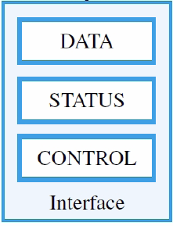
I/O Device Interface Registers

Slide 18
Visibility of I/O Interface Registers
Registers in an I/O interface are accessible by both the device and the processor
Here concerned primarily with processor access.
How does the processor access them? What options are available?

Slide 19
Option 1: Disjoint Memory and I/O Spaces
By creating a separate logical space for I/O addresses, we can add a new class of I/O instructions to the ISA that access this space, e.g.
Read #I/O-Register
Write #I/O-Register

Slide 20
Option 2: Common Memory and I/O Space
Overload existing ISA instructions for I/O.
load and store are obvious candidates – already used by processor to communicate with memory. Hence, e.g.:
Load R2, I/O-Register(R0)
Store R2, I/O-Register(R0)
where, R0 stores the starting address of the I/O device
This scheme is called memory-mapped I/O
Need to make sure that there is no real memory in the address space assigned to I/O.
Hence special forms of load and store (Nios II uses loadio and storeio) must be used.

Slide 21
I/O in Cache-Based Systems
Cache is a small fast memory that holds copies of data from the main memory
When the data is in the cache, Load and Store access cache instead of the main memory.
However, data from I/O registers should not be kept in cache because these registers are controlled by external devices.
Hence special forms of load and store (Nios II uses loadio and storeio) must be used.

Slide 22
Memory-mapped I/O Example: Keyboard & Display
Echo entered characters on display
Upon a key press
Get the character
Store it in memory
Wait for display to be available
Display the character
Repeat until end-of-line (carriage return) is pressed

Slide 23
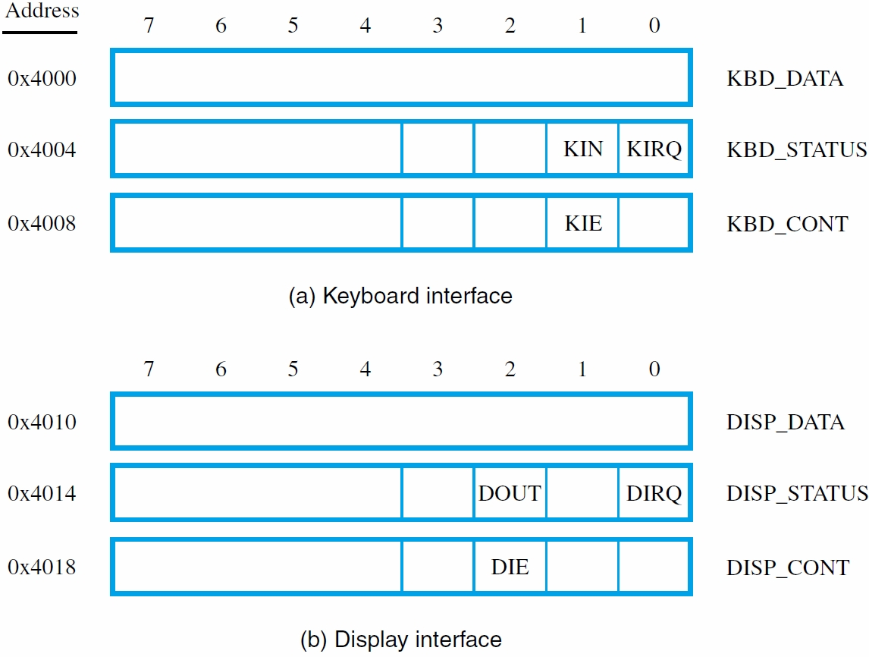
Memory-mapped I/O Example: Keyboard & Display Interface Registers

Slide 24
Wait Loop for Polling I/O Status
Keyboard circuit places character in KBD_DATA and sets KIN flag in KBD_STATUS
Circuit clears KIN flag when KBD_DATA read
Program-controlled I/O implemented with a wait loop for polling keyboard status register:
READWAIT: LoadByte R4, KBD_STATUS And R4, R4, #2 Branch_if_[R4]=0 READWAIT LoadByte R5, KBD_DATA

Slide 25
Wait Loop for Polling I/O Status
Display circuit sets DOUT flag in DISP_STATUS after previous character has been displayed
Circuit automatically clears DOUT flag when character is moved to the display buffer, DISP_DATA.
Similar wait loop for display device:
WRITEWAIT:
LoadByte R4, DISP_STATUS And R4, R4, #4 Branch_if_[R4]=0 WRITEWAIT StoreByte R5, DISP_DATA

Slide 26
RISC- and CISC-style I/O Programs
Consider a complete program that uses wait loops to read, store, and display a line of characters
Each keyboard character echoed to display
Program finishes when carriage return (CR) character is entered on keyboard
LOC is address of first character in stored line
CISC has TestBit, CompareByte instructions as well as auto-increment addressing mode

Slide 27
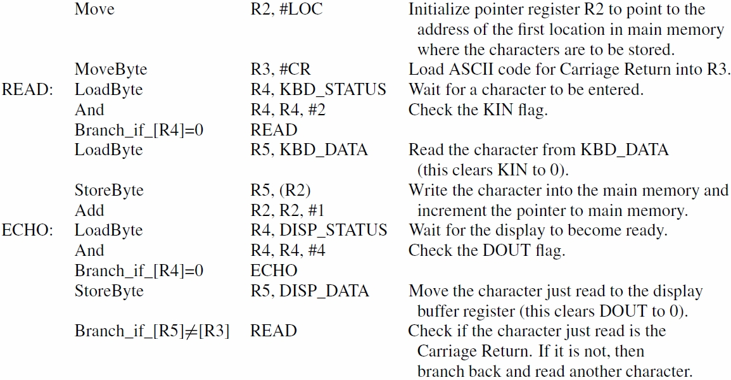
A RISC Implementation (Fig. 3.4)

Slide 28
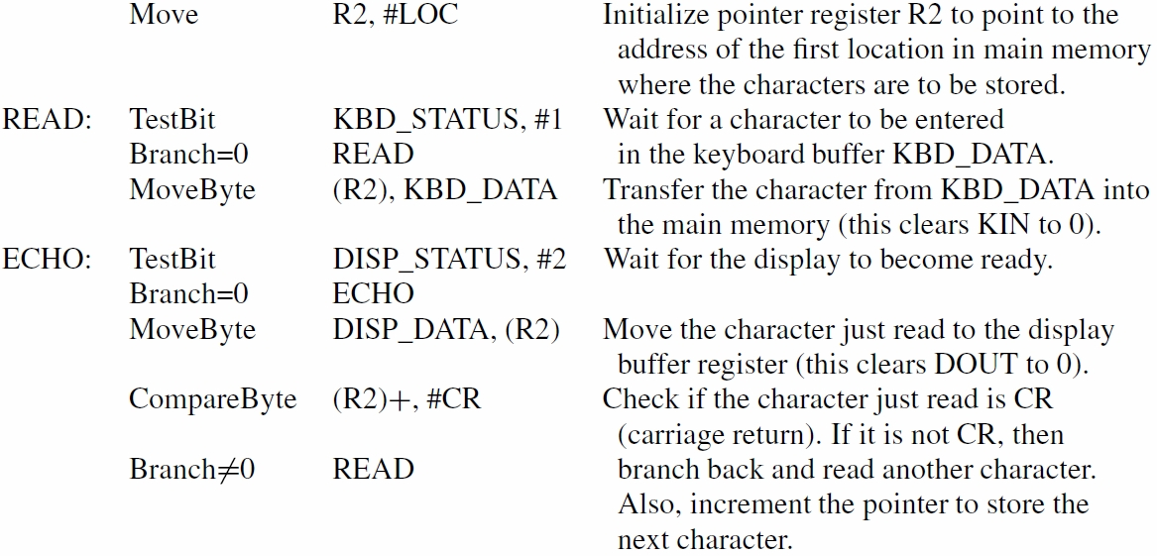
A CISC Implementation (Fig. 3.5)

Slide 29
A Nios II Implementation

Slide 30
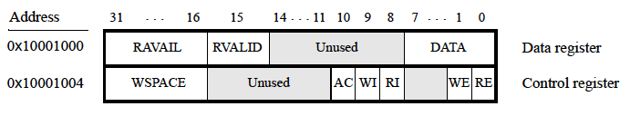
DE 1: JTAG UART Port
JTAG UART
Used by Quartus to download soft designs
Used by Altera Monitor Program to transfer data to and from terminal window.
Two 64-byte FIFO buffers for receiving /transmitting data from/to computer

Slide 31

Terminal Output
Terminal Input
Transmit
Buffer
(Queue)
Receive
Buffer
(Queue)
DE 1 - Altera Monitor Program
0x10001000
0x10001004
DE 1 JTAG UART PORT

Slide 32
DE 1: JTAG UART Port
RAVAIL: #characters in the receive buffer; if >=0 ➔ RVALID = 1
WSPACE: Amount of space available in the send buffer
Reading DATA yields the character at the head of receive FIFO, decrements RAVAIL and returns this value as part of the read.
Writing DATA only adds to the transmit FIFO, if the transmit buffer is not full. It does not affect the receive FIFO.
RE and WE: Enable interrupts associated with receive and transmit buffers, respectively. When enabled interrupts are generated whenever RAVAIL > 7 or WSPCE > 7.
RI and WI are receive and transmit interrupt signals. AC indicates if the port has been accessed.

Slide 33
Terminal Output
Terminal Input
Transmit
Buffer
(Queue)
Receive
Buffer
(Queue)
DE 1 - Altera Monitor Program
0x10001000
0x10001004
DE 1 JTAG UART PORT

Slide 34
Exercise
Study the Nios II Implementation of Fig. 3.4 on Fig. B.12

Slide 35
Conclusion
I/O devices vary tremendously in range, bandwidth, and response requirements
OS must mediate because multiple programs may share an I/O resource and I/O programming requires a lot of attention to detail
Complexity reduced by standard interfaces
So far, considered only the polling method – appropriate for low bandwidth devices.

Slide 36
Upcoming…
HW 2 – Chapter 2
Assign Monday, Sep. 16th
Due Monday, Sep. 23rd
Quiz 2 – Chapter 2 (2.1-2.7)
Wednesday, Sep. 25th (15 min)

