Slide 1

CSCE 230, Fall 2013 Chapter 2: Assembly Language(Part 3)
Mehmet Can Vuran, Instructor
University of Nebraska-Lincoln
Acknowledgement: Overheads adapted from those provided by the authors of the textbook

Slide 2
Additional Instructions (§ 2.8)

Slide 3
Logic Instructions
AND, OR, and NOT. Others by composition.
Syntax similar to arithmetic, however, operations are bit-parallel: corresponding bits of the operands are operated on independently and concurrently.
Using RISC-style instructions, all operands are in registers or specified as immediate values: Or R4, R2, R3 And R5, R6, #0xFF
16-bit immediate is zero-extended to 32 bits

Slide 4
Shift and Rotate Instructions
Shifting binary value left/right = mult/div by 2
Arithmetic shift preserves sign in MS bit
Rotate copies bits from one end to other end
Shift amount in register or given as immediate
Carry flag (discussed later) may be involved
Examples: LShiftL R3, R3, #2 (mult by 4) RotateL R3, R3, #2 (MS bits to LS bits)

Slide 5
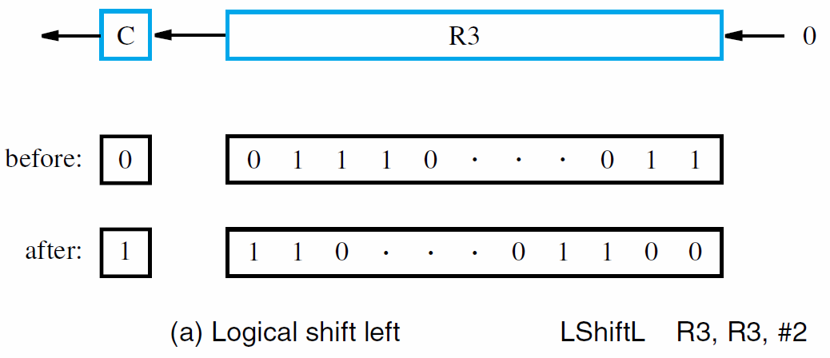
Example 1: Logical Shift Left

Slide 6
Example 2: Arithmetic Shift Right

Slide 7
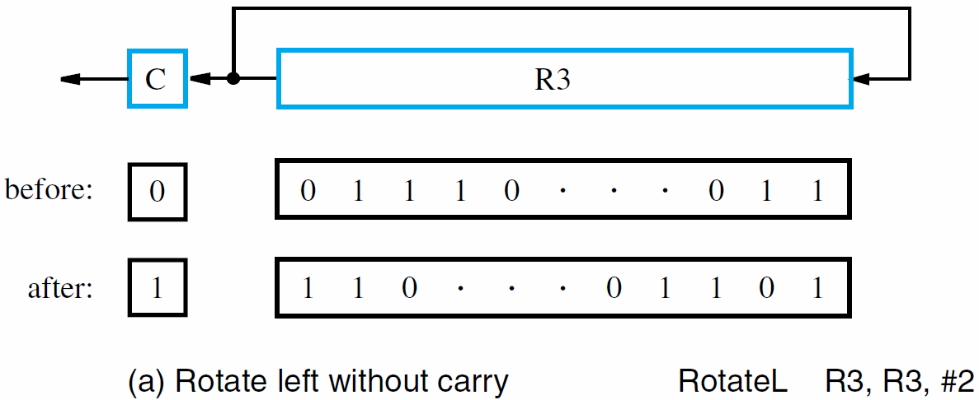
Example 3: Rotate Left Without Carry

Slide 8
Example 4: Rotate Left with Carry

Slide 9
Example Program: Digit Packing
Binary coded decimal (BCD): Use 8 bytes to code each decimal digit
4 bits are sufficient to code 0-9
Problem: Pack two BCD digits, stored one per byte packed into a single byte.

Slide 10
Example Program: Digit Packing
Pointer set to 1st byte for index-mode access to load 1st digit, which is shifted to upper bits
Upper bits of 2nd digit are cleared by ANDing
ORing combines 2nd digit with shifted 1st digit for result of two packed digits in a single byte
32-bit registers, but only 8 lowest bits relevant

Slide 11
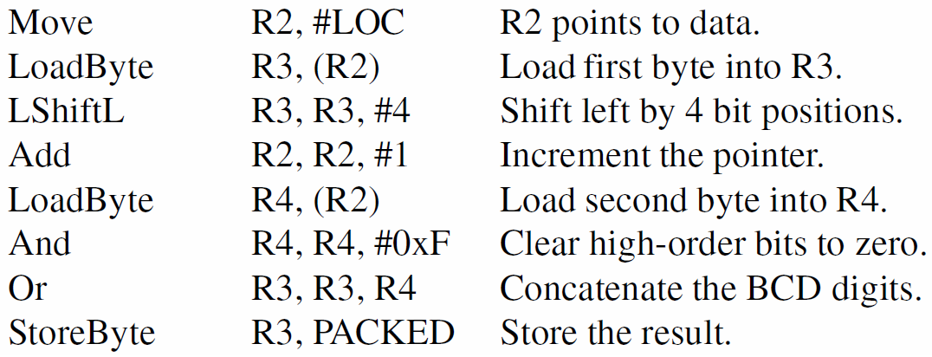
Example Program: Digit Packing
Given two BCD digits, stored one per byte, pack them into a single byte.
Variable: | #LOC= Addr. of Unpacked Data | #PACKED = Addr. of Packed Data | Packed Data | Temporary
Register: | R2 | R3 | R3 | R4

Slide 12
Multiplication and Division
Not always implemented in hardware
Iterative hardware algorithms may result in slower execution time than add and subtract
Signed integer multiplication of n-bit numbers produces a product with as many as 2n bits
Processor truncates product to fit in a register: Multiply Rk, Ri, Rj (Rk ← [Ri] × [Rj])
For general case, 2 registers may hold result
Integer division produces quotient as result: Divide Rk, Ri, Rj (Rk ← [Ri] / [Rj])
Remainder is discarded or placed in a register

Slide 13
Encoding of Machine Instructions
Assembly-language instructions express the actions to be performed by processor circuitry
Assembler converts to machine instructions
Three-operand RISC instructions require enough bits in single word to identify registers
16-bit immediates must be supported
Instruction must include bits for OP code
Call instruction also needs bits for address

Slide 14
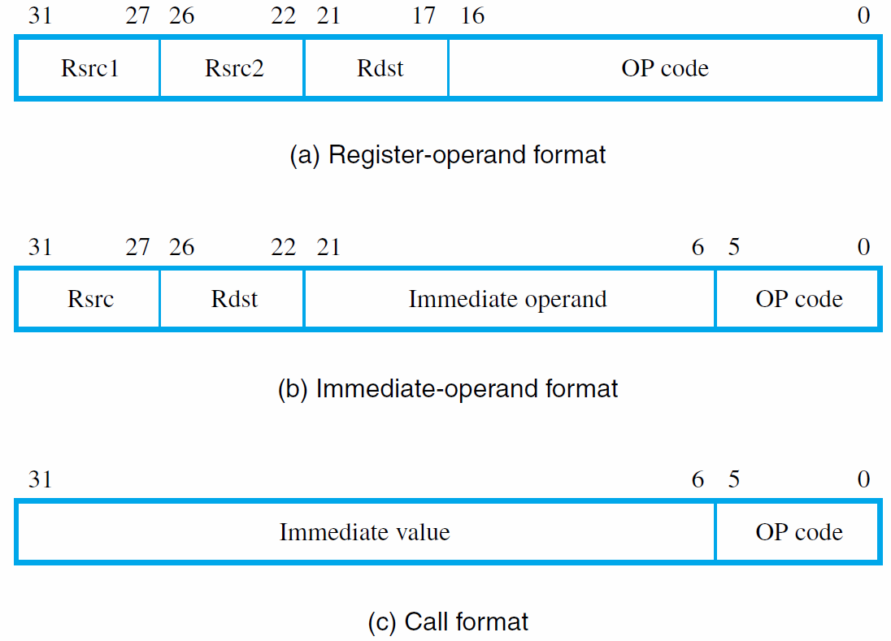

Slide 15
RISC vs. CISC (§ 2.10-12) and Instruction Encoding (§ 2.13)

Slide 16
CISC vs. RISC
Complex instruction set computer (CISC)
Many addressing modes
Many operations
Reduced instruction set computer (RISC)
Load/store
Fixed-size and Pipelinable instructions.

Slide 17
CISC Instruction Sets
CISC instructions:
Memory reference not constrained to only load/store
Instructions may be larger than one word
Typically use two-operand instruction format, with at least one operand in a register
Implementation of C = A + B using CISC: _{Move Ri, A} _{Add Ri, B} _{Move C, Ri}

Slide 18
CISC Instruction Sets
Move instruction equivalent to Load/Store
But also can transfer immediate values and possibly between two memory locations
Arithmetic instructions may employ addressing modes for operands in memory: Subtract LOC, Ri Add Rj, 16(Rk)

Slide 19
Additional Addressing Modes
CISC style has other modes not usual for RISC
Autoincrement mode: effective address given by register contents; after accessing operand, register contents incremented to point to next
Useful for adjusting pointers in loop body: Add SUM, (Ri)+ MoveByte (Rj)+, Rk
Automatically increment by 4 for words, and by 1 for bytes

Slide 20
Additional Addressing Modes
Autodecrement mode: before accessing operand, register contents are decremented, then new contents provide effective address
Notation in assembly language: Add Rj, −(Ri)
Use autoinc. & autodec. for stack operations: Move −(SP), NEWITEM (push) Move ITEM, (SP)+ (pop)

Slide 21
Condition Codes
Processor can maintain information on results to affect subsequent conditional branches
Results from arithmetic/comparison & Move
Condition code flags in a status register: N (negative) 1 if result negative, else 0 Z (zero) 1 if result zero, else 0 V (overflow) 1 if overflow occurs, else 0 C (carry) 1 if carry-out occurs, else 0

Slide 22
Branches using Condition Codes
CISC branches check condition code flags
For example, decrementing a register with a positive value causes N and Z flags to be cleared if result is not zero
A branch to check logic condition N + Z = 0: Branch>0 LOOP
Other branches test conditions for <, =, ≠, ≤, ≥
Also Branch_if_overflow and Branch_if_carry
Consider CISC-style list-summing program:

Slide 23
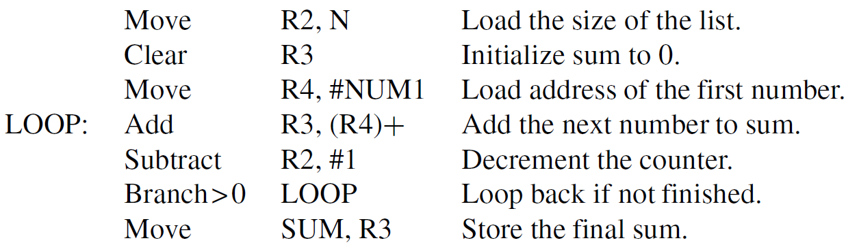

Slide 24
RISC and CISC Styles
RISC characteristics include: simple addressing modes all instructions fitting in a single word fewer total instructions arithmetic/logic operations on registers load/store architecture for data transfers more instructions executed per program
Simpler instructions make it easier to design faster hardware (e.g., use of pipelining)

Slide 25
RISC and CISC Styles
CISC characteristics include: more complex addressing modes instructions spanning more than one word more instructions for complex tasks arithmetic/logic operations on memory memory-to-memory data transfers fewer instructions executed per program
Complexity makes it somewhat more difficult to design fast hardware, but still possible

Slide 26
Complex Instruction Set Computer (CISC)
Single processing unit (or multi-core)
External memory
Small register
Simple compiler
Complicated instruction set
A – input a string of characters from I/O port
Intel x86, Motorola 68xxx, National Semiconductor
Requires less frequent memory access
Makes sense when memory was expensive
Dominates PC market (Intel x86)

Slide 27
Reduced Instruction Set Computer (RISC)
Move complexity from silicon to compiler
Smaller form factor
Better energy efficiency → less heat!
Load/store architecture
Only memory access instructions are load and store
Other instructions performed on registers
MIPS, Sun SPARC, ARM, Atmel AVR, Microchip PIC
iX (iPod, iPhone, iPad), BB, PlayStation (1,2,3), …

Slide 28
Reduced Instruction Set Computer (RISC)
Pipelined Instruction Execution
Simultaneously
Execute an instruction
Decode the next instruction
Fetch the third
Improved efficiency

Slide 29
CISC vs. RISC
Complex instruction set
Smaller code size
Longer instruction time
Simpler instruction set
Larger code size
Shorter instruction time
Smaller size
Lower power consumption

Slide 30
Read the following example to illustrate RISC vs. CISC programming style on your own and contact me or a TA if you have any questions.

Slide 31
Example Programs
First example program computes:
First elements of each array, A(0) and B(0), are stored at memory locations AVEC and BVEC
Consider RISC and CISC versions of program
Use Multiply instruction on pairs of elements and accumulate sum with Add instruction
Some processors have MultiplyAccumulate

Slide 32
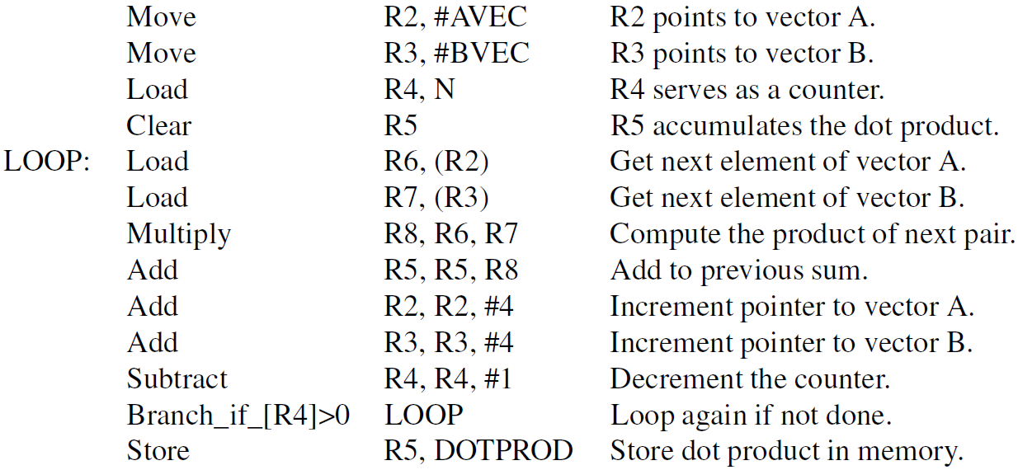

Slide 33
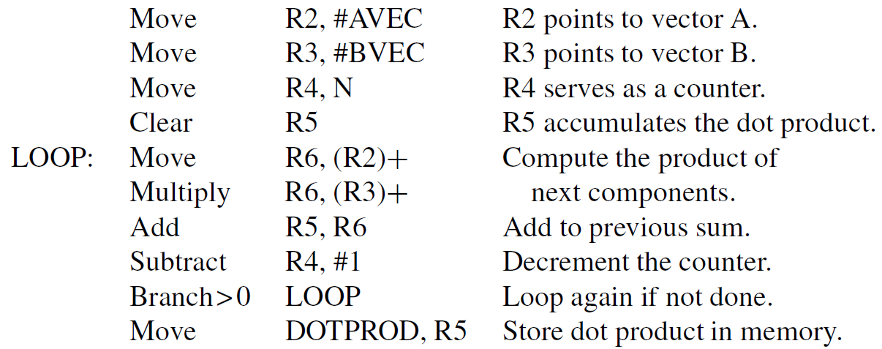

Slide 34
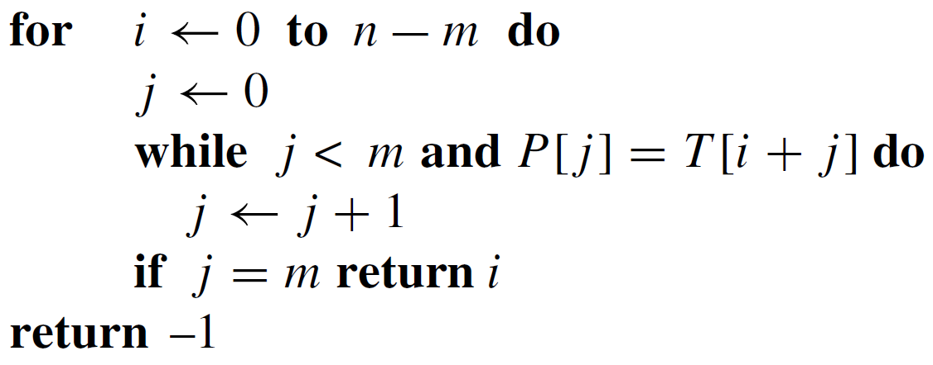
Example Programs
Second example searches for 1st occurrence of pattern string P in target string T
String P has length m and string T has length n
Algorithm to implement in RISC/CISC styles:

Slide 35
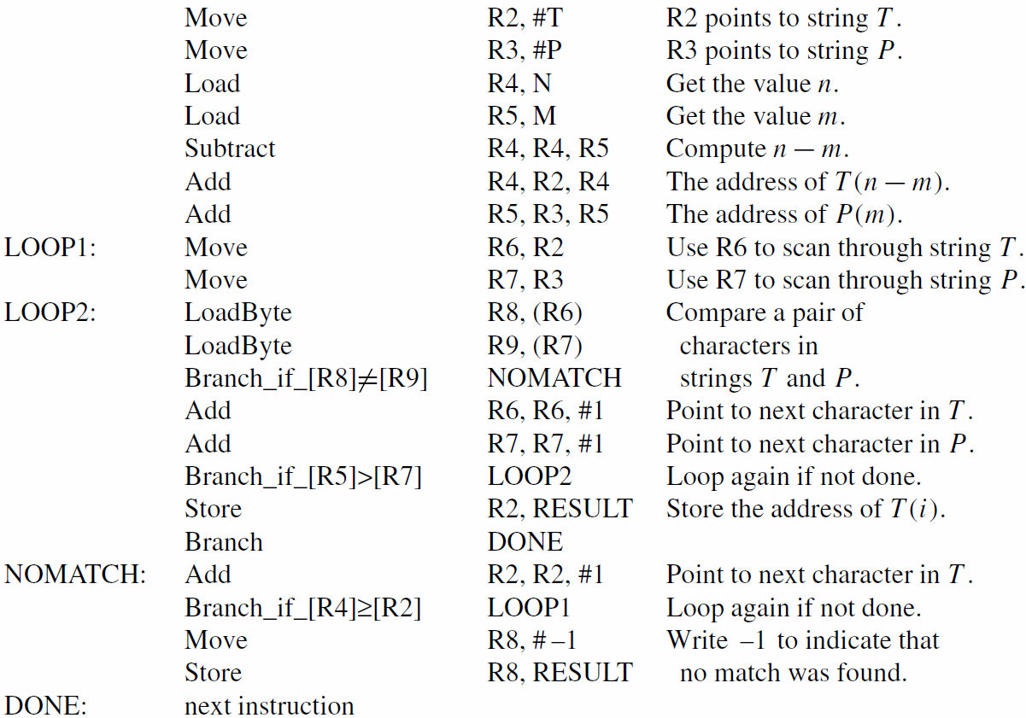

Slide 36
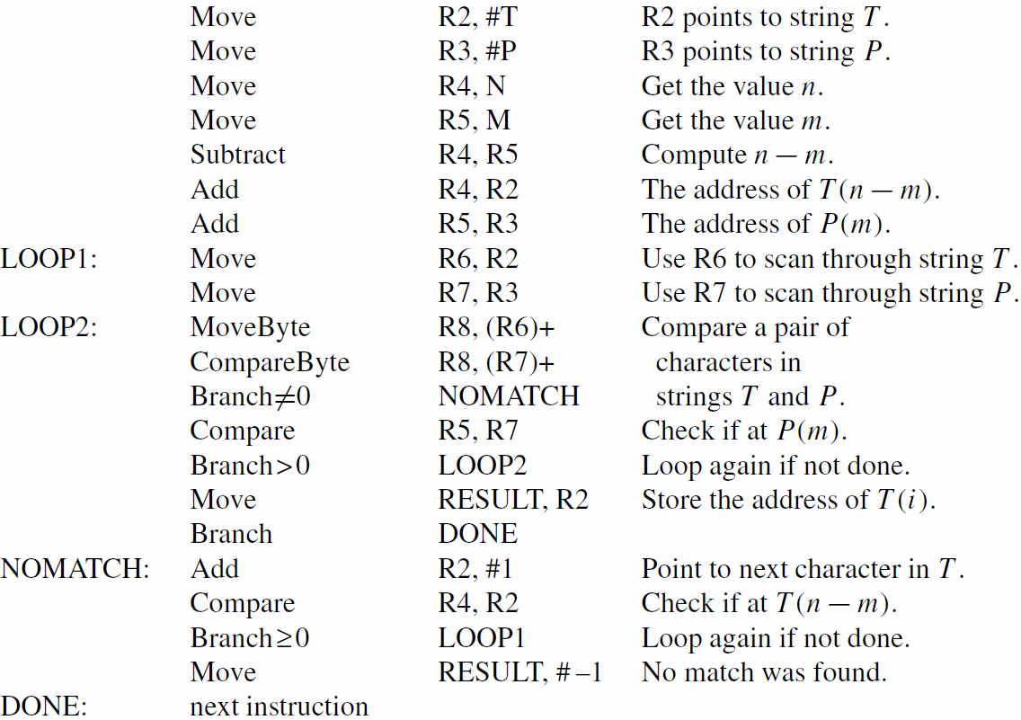

Slide 37
Concluding Remarks
Many fundamental concepts presented:
memory locations, byte addressability
addressing modes and instruction execution
subroutines and the processor stack
assembly-language and register-transfer notation
RISC-style and CISC-style instruction sets
Later chapters build on these concepts

