Slide 1

CSCE 230, Fall 2013 Chapter 2 (part 1) Introduction to Assembly Language (§2.1–2.5 and §B.1–B.6)
Mehmet Can Vuran, Instructor
University of Nebraska-Lincoln
Acknowledgement: Overheads adapted from those provided by the authors of the textbook

Slide 2
Simplified Assembly Notation Used in Chapter 2
Assembly languages for different processors often use different mnemonics for a given operation.
To avoid the need for details of a particular assembly language at this early stage, Chapter 2 uses English words rather than processor specific mnemonics.
This would, hopefully, ease the learning of specific assembly languages described in Appendices A–D:
Nios II (App. B) – RISC (used in 230L)
Coldfire (App. C) – CISC
ARM (App. D) – RISC
Intel IA-32 (App. E) – CISC

Slide 3
Mapping of Variables

Slide 4
HLL to Assembly Language: Example 1
Translate D = A+B+C to assembly
Translation Process:
In assembly, can only add two at a time, hence
D = A+B;
D = D+C
Assign variables:
For safe keeping in memory: Locations named #A, #B, #C, and #D
Temporarily, to processor registers R1–R4 respectively.
(Can think of each variable as having a static image in memory and dynamic image in registers.)
Code each assignment statement in part 1) to assembly.

Slide 5
Translation 1
Load R1, #A
Load R2, #B
Add R4, R1, R2 # D = A+B
Load R3, #C
Add R4, R4, R3 # D = D+C
Store R4, #D

Slide 6
HLL to Assembly Language: Example 1 Revisited
Translate HLL Statement: D = A+B+C to assembly, minimizing the use of registers
Key Idea: Not all variables are needed concurrently in the registers for doing the computation. Can reuse registers to minimize their number.

Slide 7
Translation 2
Load R1, #A
Load R2, #B
Add R2, R1, R2
Load R1, #C
Add R2, R1, R2
Store R2, #D
Note that both R1 and R2 are reused to represent different
variables during the computation.
A good compiler tries to minimize register usage.

Slide 8
Assembly Language Basics

Slide 9
Instruction Characteristics
Number of operands: One, two, or three
Type: Arithmetic, Logical, Data Transfer, Control Transfer
Instruction Length: Fixed or variable – we’ll consider fixed
Addressing Modes: How operands are found

Slide 10
Special Register R0
In many RISC architectures (including Nios II), register R0 is defined to be a read-only, constant register with value 0.
R0 = 0
Can use to implement new instructions with existing ones, e.g.
Add R1, R0, R2 == Move R1, R2

Slide 11
Pseudoinstructions
In the previous examples, Move is not really implemented on the processor but the assembler can translate it into a real instruction.
In general, a pseudoinstruction can be thought of as a macro translated by the assembler into one or more ISA instructions.
One of the ways, the assembly language can be made to appear richer than the ISA of the processor.

Slide 12
Addressing Modes
Load R1, #A
#A → ?

Slide 13
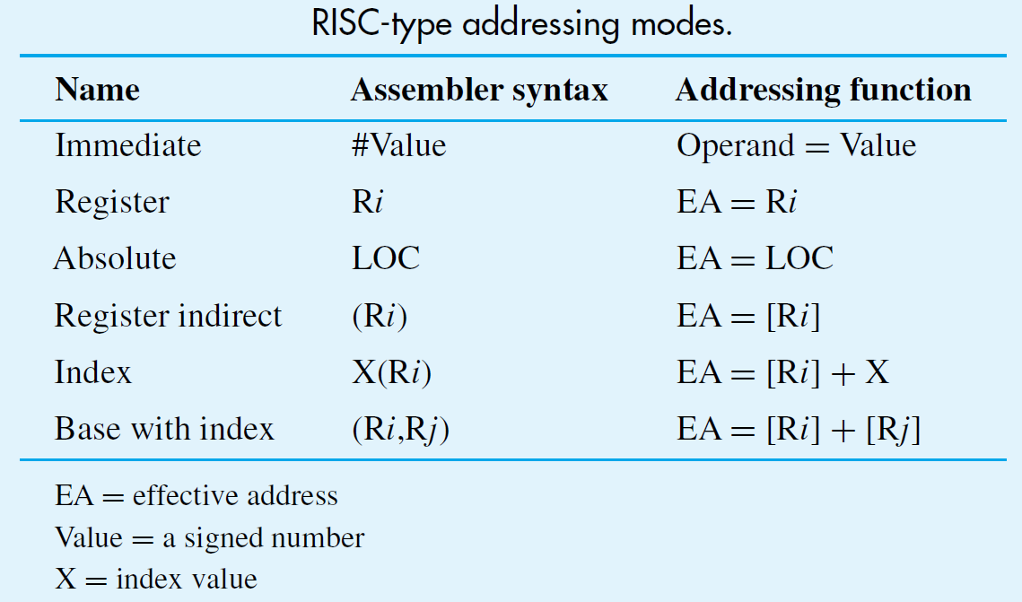
Addressing Modes

Slide 14
Addressing Modes: Indirection and Pointers
Register, absolute, and immediate modes directly provide the operand or address
Other modes provide information from which the effective address of operand is derived
For program that steps through an array, can use register as pointer to next number and use the Indirect mode to access array elements:
Load R2, (R5)

Slide 15
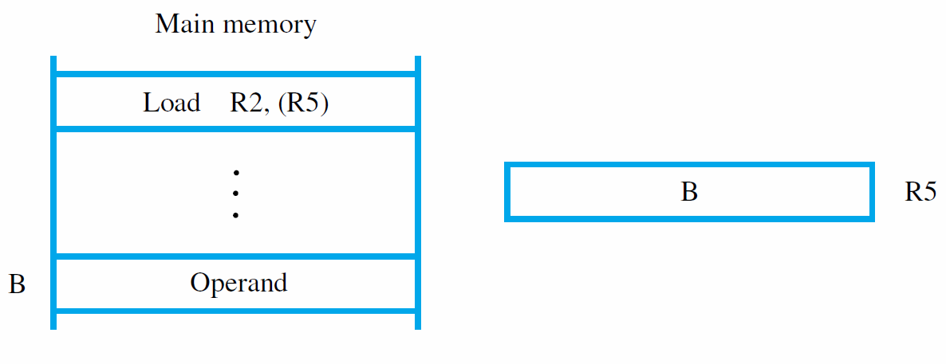

Slide 16
Addressing Modes: Indexing
Consider index mode in: Load R2, X(R5)
Effective address is given by [R5] + X
For example, assume operand address is 1020, 5 words (20 bytes) from start of array at 1000
Can put start address in R5 and use X=20
Alternatively, put offset in R5 and use X=1000
Base with index mode: Load Rk, X(Ri, Rj)
Effective address is given by [Ri] + [Rj] + X

Slide 17
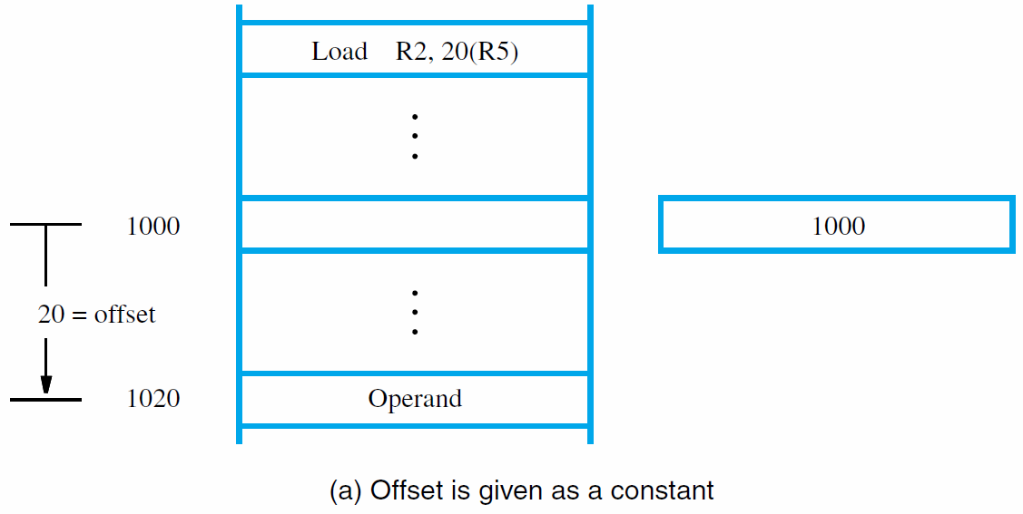
R5

Slide 18
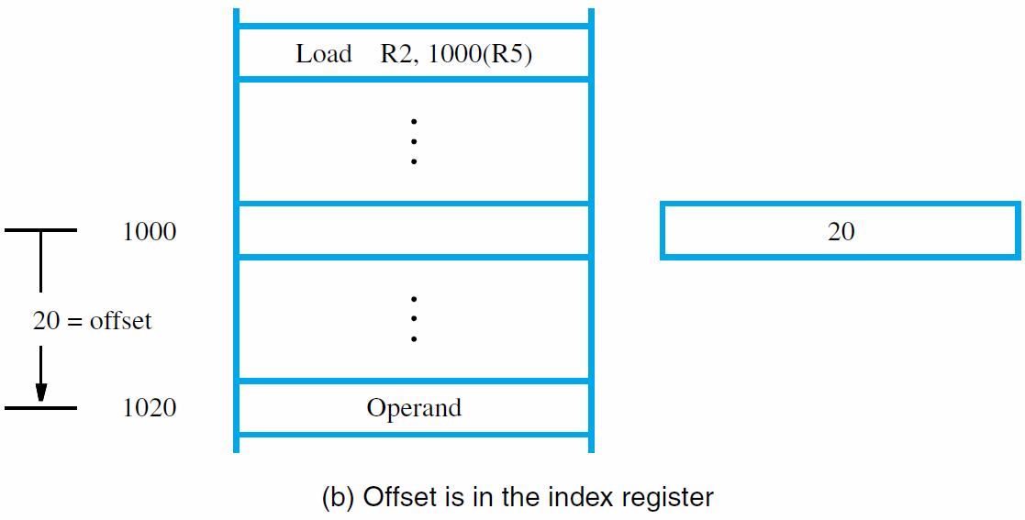
R5

Slide 19
For Loop Semantics
Example:
for i=0, i<N, i=i+1
{Body of Loop}
Semantics of the three parts:
The first part, i=0, done once, before the loop is entered
The second part, the condition, i<N, is evaluated.
If true, the body of the loop is executed. Then the third part, the re-initialization step i=i+1 is done and the condition is reevaluated.
The loop terminates when the condition becomes false.

Slide 20
For Loop Implementation
Register Map
for i=0, i<N, i=i+1
{Body of Loop}
i | N
R1 | R2
Intermediate Code
Assembly Code
i=0;
Loop: if(!(i<N)) goto Exit
{Body of Loop}
i = i+1
goto Loop
Exit: …
Move R1, #0
Loop: Branch_if_(i>=N) Exit
{Body of Loop}
Add R1, R1, #1
Branch Loop
Exit: …

Slide 21
For Practice
Try implementing the following program control constructs:
If (condition) then {…} else {…}
While (condition) {Body of Loop}
Do {Body of Loop} until (condition)

Slide 22
Stepping through an Array: Solution 1 – Explicit Indexing
Example
for i=0, i<N {A[i] = A[i]+1}
Maintain the base A[0] and offset of A[i] from A[0] in two separate registers.
Register Map:
i | N | A[i] | #A=Address A[0] | Offset A[i]
R1 | R2 | R3 | R4 | R5

Slide 23
Stepping through an Array: Solution 1 –Index Arithmetic (Contd.)
i | N | A[i] | Address A[0] | Offset A[i]
R1 | R2 | R3 | R4 | R5
Initialization: R5 = 0; R4 = Address of (A[0])
Code: Move R5, #0; Load R4, #A
Body of Loop:
Code:
Load R3, (R4,R5) # R3 = A[i]
Add R3, R3, #1
Store R3, (R4,R5) # A[i] = A[i]+1
Add R5, R5, 4 # Update offset for the next

Slide 24

Stepping through an Array: Solution 2: Pointer Arithmetic
Maintain pointer to A[i] in a register
Initialization: R4 = Address of A[0]
Load R4, #A
Body of Loop:
Load R3, (R4) # R3 = A[i]
Add R3, R3, #1
Store R3, (R4) # A[i] = A[i]+1
Add R4, R4, 4 # Update pointer to array element

Slide 25
Array Processing: A Larger Example
Find the max of N numbers:
A[0], A[1], …, A[N-1].
HLL Code:
Max = A[0]
for i=1, i<N {
if(A[i]>Max) Max = A[i]
}

Slide 26
HLL to Assembly Code
Max = A[0]
for i=1, i<N {
if(A[i]>Max) Max = A[i]
}
Variable: | Max | i | #N = (Addr. N) | A[i] | #A= Addr. A[0]
Register | R1 | R2 | R3 | R4 | R5
Intermediate Code
Assembly Code
Move R3, #N
Load R3, (R3)
Move R5, #A
Load R1, (R5)
Move R2, #1
Loop: Add R5, R5, #4
Load R4, (R5)
Branch_if_(R1>=R4) Skip
Move R1, R4
Skip: Add R2, R2, #1
Branch_if_(R3>R2) Loop
Move R2, #Max
Store R1, (R2)
Max = A[0]
i = 1
Loop: if(!(A[i])>Max)) goto Skip
Max = A[i]
Skip: i = i+1
if(N>i) goto Loop
Note: R2 is reused after the for loop
to store the address #Max

Slide 27
Reading Assignment
For another example of array processing using a for loop:
Read and study the LISTADD example, Section 2.4.3 (pp. 45–47) of the textbook.

Slide 28
Loading Large Constants
In the last example, “Load R5, #A” cannot be a RISC ISA instruction if #A is an absolute 32-bit address. Why?
Because it is a pseudoinstruction that must be expanded to real instruction.
General problem, solved in RISC processors by assembling 32-bit constants in two parts: high and low, e.g.
Load_high R5, #A₃₁₋₁₆
Add R5, R5, # A₁₅₋₀

Slide 29
Real Assembly Languages (§2.5)
Mnemonics (LD/ADD instead of Load/Add) used when programming specific computers
The mnemonics represent the OP codes
Assembly language is the set of mnemonics and rules for using them to write programs
The rules constitute the language syntax
Example: suffix ‘I’ to specify immediate mode ADDI R2, R3, 5 (instead of #5)

Slide 30
Assembler Directives
Other information also needed to translate source program to object program
How should symbolic names be interpreted?
Where should instructions/data be placed?
Assembler directives provide this information
ORIGIN defines instruction/data start position
RESERVE and DATAWORD define data storage
EQU associates a name with a constant value

Slide 31
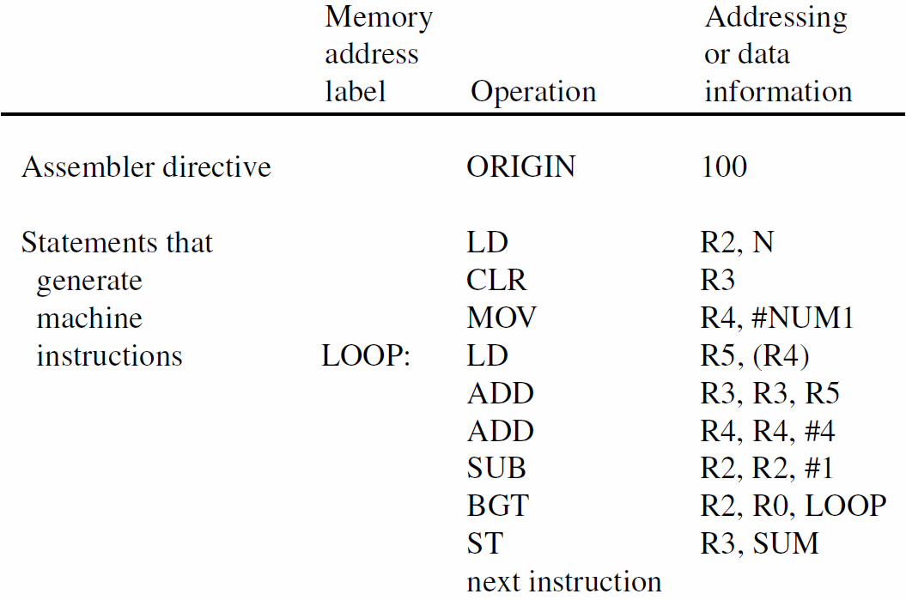
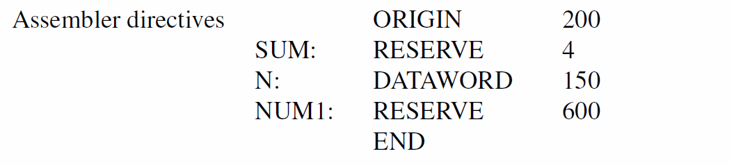

Slide 32
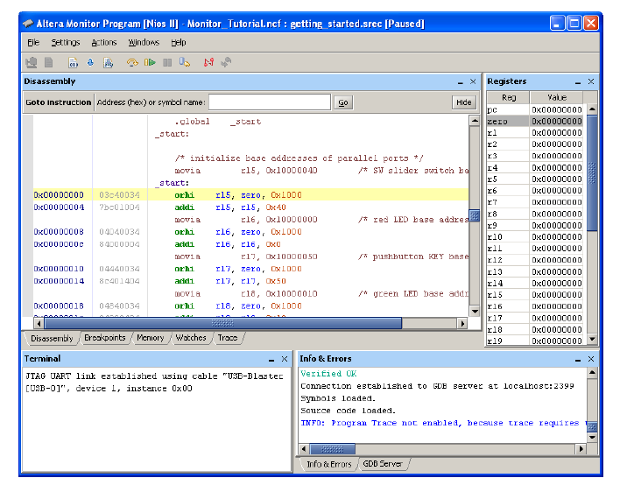
Nios II
Assembly
Lang.
Address Label
Assembler Directive
Comment
Pseudo-op
Operation
Register Operands
Operands
Immediate
Operand
Memory Addresses
Assembled Machine Code

Slide 33
Number Notation
Decimal numbers used as immediate values: ADDI R2, R3, 93
Assembler translates to binary representation
Programmer may also specify binary numbers: ADDI R2, R3, %01011101
Hexadecimal specification is also possible: ADDI R2, R3, 0x5D
Note that 93 = 1011101₂ = 5D₁₆

Slide 34
HLL vs. Assembly
Operations:
HLL: on variables & constants
Assembly: on registers & constants
Typing
HLL: Typed variables – can’t add a number to a character string
Assembly: Registers are not typed – operation determines how register contents are treated.
Staging of instructions and data
HLL: Abstracted – programmer unaware of the need
Assembly: Since program and data initially in memory, all instructions and data must be staged on the processor for interpretation and operation.

Slide 35
Nios II Assembly Language (§B.1–B.6)

Slide 36
Registers
Register names should always in lower-case in Nios II assembler
Other symbols, e.g. labels, are case-sensitive
r0 is constant 0
Don’t use r1 in your programs.
r2–r23 can be freely used as general-purpose regs.

Slide 37
Addressing Modes

Slide 38
Load/Store
Load
Form
ldw r2, 20(r3) /* Load word instruction */
Can also apply to bytes and halfword (ldb, ldh)
Can control sign extension for byte and halfword operand by using ldb (sign extended) or ldbu (sign not extended)
Store: Similarly

Slide 39
Pseudoinstructions Move
mov ri, rj
movi ri, value-16 /* 16-bit value */
movui ri, value-16 /* unsigned */
movia ri, LABEL /* 32-bit value – typically an address */
Assembler implements as:
orhi ri, r0, LABEL_HIGH
ori ri,ri, LABEL_LOW

Slide 40
Branch and Jump
Form
br LABEL
beq ri, rj, LABEL
where LABEL is 16-bit offset relative to PC
Signed and Unsigned versions, e.g, beq and bequ
Full range of comparisons:
beq, bne, bge, bgt, ble, plus their unsigned versions

Slide 41
Pseudoinstructions
Move type already mentioned
Subtract-Immediate:
subi ri, rj, value-16 == addi ri, rj, -value-16
Branch Greater Than Signed
bgt ri, rj, LABEL == blt rj, ri, LABEL

Slide 42
Assembler Directives
.org Value /* ORIGIN */
.equ LABEL, Value /* LABEL = Value */
.byte expression /* Places byte size data
into memory */
.halfword and .word work similarly
.skip size /* Reserves memory space */
.end /* End of source-code file */

Slide 43
Example Assembly Program: Ch. 2 Notation vs. Nios II
Chapter 2
Nios II
movia r3, N /* addr. N */
ldw r3, (r3)
movia r5, A
ldw r6, (r5)
movi r2, 1
Loop: addi r5, r5, 4
ldw r4, (r5)
bge r6, r4, Skip
mov r6, r4
Skip: addi r2, r2, 1
bgt r3, r2, Loop
movia r2, Max
stw r6, (r2)
Move R3, #N
Load R3, (R3)
Move R5, #A
Load R1, (R5)
Move R2, #1
Loop: Add R5, R5, #4
Load R4, (R5)
Branch_if_(R1>=R4) Skip
Move R1, R4
Skip: Add R2, R2, #1
Branch_if_(R3>R2) Loop
Move R2, #Max
Store R1, (R2)
Note: R1 is mapped to r6 because r1 is reserved as an assembler temporary register in Nios II.

Slide 44
Adding Data Segment
Nios II
movia r3, N
ldw r3, (r3)
movia r5, A
ldw r6, (r5)
movi r2, 1
Loop: addi r5, r5, 4
ldw r4, (r5)
bge r6, r4, Skip
mov r6, r4
Skip: addi r2, r2, 1
bgt r3, r2, Loop
movia r2, Max
stw r6, (r2)
.org 2000 /* Optional */
Max: .skip 4 /* Reserve 4 bytes for Max */
N: .word 20 /* Reserve word for N, initialized to 20 */
A: .skip 80 /* Reserve 80 bytes, or 20 words, for array A */

Slide 45
Program Assembly & Execution
From source program, assembler generates machine-language object program
Assembler uses ORIGIN and other directives to determine address locations for code/data
For branches, assembler computes ±offset from present address (in PC) to branch target
Loader places object program in memory
Debugger can be used to trace execution

Slide 46
Program Assembly Example
movia r3, N
ldw r3, (r3)
movia r5, A
ldw r6, (r5)
movi r2, 1
Loop: addi r5, r5, 4
ldw r4, (r5)
bge r6, r4, Skip
mov r6, r4
Skip: addi r2, r2, 1
bgt r3, r2, Loop
movia r2, Max
stw r6, (r2)
.org 2000
Max: .skip 4
N: .word 20
A: .skip 80
Consider two-pass assembly relative to starting address of 0:
Pass 1 builds the symbol table
Pass 2 generates code

Slide 47
Pass 1
0 movia r3, N
ldw r3, (r3)
movia r5, A
ldw r6, (r5)
movi r2, 1
Loop: addi r5, r5, 4
ldw r4, (r5)
bge r6, r4, Skip
mov r6, r4
Skip: addi r2, r2, 1
bgt r3, r2, Loop
movia r2, Max
stw r6, (r2)
.org 2000
Max: .skip 4
N: .word 20
A: .skip 80
Symbol Table
Symbol | Value
N | undefined

Slide 48
Pass 1
0 movia r3, N
4 ldw r3, (r3)
8 movia r5, A
ldw r6, (r5)
movi r2, 1
Loop: addi r5, r5, 4
ldw r4, (r5)
bge r6, r4, Skip
mov r6, r4
Skip: addi r2, r2, 1
bgt r3, r2, Loop
movia r2, Max
stw r6, (r2)
.org 2000
Max: .skip 4
N: .word 20
A: .skip 80
Symbol Table
Symbol | Value
N | undefined
A | undefined

Slide 49
Pass 1
0 movia r3, N
4 ldw r3, (r3)
8 movia r5, A
12 ldw r6, (r5)
16 movi r2, 1
20 Loop: addi r5, r5, 4
ldw r4, (r5)
bge r6, r4, Skip
mov r6, r4
Skip: addi r2, r2, 1
bgt r3, r2, Loop
movia r2, Max
stw r6, (r2)
.org 2000
Max: .skip 4
N: .word 20
A: .skip 80
Symbol Table
Symbol | Value
N | undefined
A | undefined
Loop | 20

Slide 50
Pass 1
0 movia r3, N
4 ldw r3, (r3)
8 movia r5, A
12 ldw r6, (r5)
16 movi r2, 1
20: addi r5, r5, 4
24 ldw r4, (r5)
28 bge r6, r4, Skip
mov r6, r4
Skip: addi r2, r2, 1
bgt r3, r2, Loop
movia r2, Max
stw r6, (r2)
.org 2000
Max: .skip 4
N: .word 20
A: .skip 80
Symbol Table
Symbol | Value
N | undefined
A | undefined
Loop | 20
Skip | undefined

Slide 51
Pass 1
0 movia r3, N
4 ldw r3, (r3)
8 movia r5, A
12 ldw r6, (r5)
16 movi r2, 1
20: addi r5, r5, 4
24 ldw r4, (r5)
28 bge r6, r4, Skip
32 mov r6, r4
36 Skip: addi r2, r2, 1
bgt r3, r2, Loop
movia r2, Max
stw r6, (r2)
.org 2000
Max: .skip 4
N: .word 20
A: .skip 80
Symbol Table
Symbol | Value
N | undefined
A | undefined
Loop | 20
Skip | undefined -> 36

Slide 52
Pass 1
0 movia r3, N
4 ldw r3, (r3)
8 movia r5, A
12 ldw r6, (r5)
16 movi r2, 1
20: addi r5, r5, 4
24 ldw r4, (r5)
28 bge r6, r4, Skip
32 mov r6, r4
36: addi r2, r2, 1
40 bgt r3, r2, Loop➔20
movia r2, Max
stw r6, (r2)
.org 2000
Max: .skip 4
N: .word 20
A: .skip 80
Symbol Table
Symbol | Value
N | undefined
A | undefined
Loop | 20
Skip | 36

Slide 53
Pass 1
0 movia r3, N
4 ldw r3, (r3)
8 movia r5, A
12 ldw r6, (r5)
16 movi r2, 1
20: addi r5, r5, 4
24 ldw r4, (r5)
28 bge r6, r4, Skip
32 mov r6, r4
36: addi r2, r2, 1
40 bgt r3, r2, 20
44 movia r2, Max
stw r6, (r2)
.org 2000
Max: .skip 4
N: .word 20
A: .skip 80
Symbol Table
Symbol | Value
N | undefined
A | undefined
Loop | 20
Skip | 36
Max | undefined

Slide 54
Pass 1
0 movia r3, N
4 ldw r3, (r3)
8 movia r5, A
12 ldw r6, (r5)
16 movi r2, 1
20: addi r5, r5, 4
24 ldw r4, (r5)
28 bge r6, r4, Skip
32 mov r6, r4
36: addi r2, r2, 1
40 bgt r3, r2, 20
44 movia r2, Max
stw r6, (r2)
.org 2000
2000 Max: .skip 4
N: .word 20
A: .skip 80
Symbol Table
Symbol | Value
N | undefined
A | undefined
Loop | 20
Skip | 36
Max | undefined ->2000

Slide 55
Pass 1
0 movia r3, N
4 ldw r3, (r3)
8 movia r5, A
12 ldw r6, (r5)
16 movi r2, 1
20 : addi r5, r5, 4
24 ldw r4, (r5)
28 bge r6, r4, Skip
32 mov r6, r4
36: addi r2, r2, 1
40 bgt r3, r2, 20
44 movia r2, Max
stw r6, (r2)
.org 2000
2000: .skip 4
2004: N .word 20
A: .skip 80
Symbol Table
Symbol | Value
N | undefined ->2004
A | undefined
Loop | 20
Skip | 36
Max | 2000

Slide 56
Pass 1
0 movia r3, N
4 ldw r3, (r3)
8 movia r5, A
12 ldw r6, (r5)
16 movi r2, 1
20: addi r5, r5, 4
24 ldw r4, (r5)
28 bge r6, r4, Skip
32 mov r6, r4
36: addi r2, r2, 1
40 bgt r3, r2, 20
44 movia r2, Max
stw r6, (r2)
.org 2000
2000: .skip 4
2004: .word 20
2008 A: .skip 80
2088 …
Symbol Table
Symbol | Value
N | 2004
A | undefined->2008
Loop | 20
Skip | 36
Max | 2000

Slide 57
Pass 1
0 movia r3, N
4 ldw r3, (r3)
8 movia r5, A
12 ldw r6, (r5)
16 movi r2, 1
20: addi r5, r5, 4
24 ldw r4, (r5)
28 bge r6, r4, Skip
32 mov r6, r4
36: addi r2, r2, 1
40 bgt r3, r2, 20
44 movia r2, Max
stw r6, (r2)
.org 2000
2000: .skip 4
2004: .word 20
2008: .skip 80
2088 …
Symbol Table
Symbol | Value
N | 2004
A | 2008
Loop | 20
Skip | 36
Max | 2000

Slide 58
Pass 2
0 movia r3, N ➔2004
4 ldw r3, (r3)
8 movia r5, A
12 ldw r6, (r5)
16 movi r2, 1
20: addi r5, r5, 4
24 ldw r4, (r5)
28 bge r6, r4, Skip
32 mov r6, r4
36: addi r2, r2, 1
40 bgt r3, r2, 20
44 movia r2, Max
stw r6, (r2)
.org 2000
2000: .skip 4
2004: .word 20
2008: .skip 80
2088 …
Symbol Table
Symbol | Value
N | 2004
A | 2008
Loop | 20
Skip | 36
Max | 2000

Slide 59
Pass 2
0 movia r3, 2004
4 ldw r3, (r3)
8 movia r5, A➔2008
12 ldw r6, (r5)
16 movi r2, 1
20: addi r5, r5, 4
24 ldw r4, (r5)
28 bge r6, r4, Skip
32 mov r6, r4
36: addi r2, r2, 1
40 bgt r3, r2, 20
44 movia r2, Max
stw r6, (r2)
.org 2000
2000: .skip 4
2004: .word 20
2008: .skip 80
2088 …
Symbol Table
Symbol | Value
N | 2004
A | 2008
Loop | 20
Skip | 36
Max | 2000

Slide 60
Pass 2
0 movia r3, 2004
4 ldw r3, (r3)
8 movia r5, 2008
12 ldw r6, (r5)
16 movi r2, 1
20: addi r5, r5, 4
24 ldw r4, (r5)
28 bge r6, r4, Skip➔36
32 mov r6, r4
36: addi r2, r2, 1
40 bgt r3, r2, 20
44 movia r2, Max
stw r6, (r2)
.org 2000
2000: .skip 4
2004: .word 20
2008 A: .skip 80
2088 …
Symbol Table
Symbol | Value
N | 2004
A | 2008
Loop | 20
Skip | 36
Max | 2000

Slide 61
Pass 2
0 movia r3, 2004
4 ldw r3, (r3)
8 movia r5, 2008
12 ldw r6, (r5)
16 movi r2, 1
20: addi r5, r5, 4
24 ldw r4, (r5)
28 bge r6, r4, 36
32 mov r6, r4
36: addi r2, r2, 1
40 bgt r3, r2, 20
44 movia r2, Max➔2000
stw r6, (r2)
.org 2000
2000: .skip 4
2004: .word 20
2008 A: .skip 80
2088 …
Symbol Table
Symbol | Value
N | 2004
A | 2008
Loop | 20
Skip | 36
Max | 2000

Slide 62
Pass 2
0 movia r3, 2004
4 ldw r3, (r3)
8 movia r5, 2008
12 ldw r6, (r5)
16 movi r2, 1
20: addi r5, r5, 4
24 ldw r4, (r5)
28 bge r6, r4, 36
32 mov r6, r4
36: addi r2, r2, 1
40 bgt r3, r2, 20
44 movia r2, 2000
stw r6, (r2)
.org 2000
2000: .skip 4
2004: .word 20
2008 A: .skip 80
2088 …
Symbol Table
Symbol | Value
N | 2004
A | 2008
Loop | 20
Skip | 36
Max | 2000

