Slide 1
CSCE 230, Fall 2013 Chapter 1, part 2 Number Systems
Mehmet Can Vuran, Instructor
University of Nebraska-Lincoln
Acknowledgement: Overheads adapted from those provided by the authors of the textbook

Slide 2
Decimal Number Representation & Arithmetic

Slide 3
Overview
We will illustrate the basic concepts of number representation using the familiar decimal base or radix.
Concepts generalize to any other base.
Consider three categories of numbers
Unsigned Integers
Signed Integers
Floating-point numbers (“Reals”)

Slide 4
Unsigned Integers
Useful for representing addresses, IDs, etc. In computers, useful for representing memory addresses.
Positional notation
Radix or base, e.g.
38₁₀ = 3*10¹ + 8*10⁰
100110₂ = 1*2⁵+0*2⁴+0*2³+1*2²⁺1*2¹+0*2⁰ = 32+4+2 = 42₁₀
When number of digits of representation is bounded, we use modulo arithmetic. E.g.
With 2 decimal digits: 99+1 = 0 (modulo 100)

Slide 5
Exercises
Express 42₁₀ in ternary (base 3) and hexadecimal (base 16) representations.
Express: A68C₁₆ == 0xA68C as a decimal number.
Express 2012₃ as a decimal number.
Express 10011100011₂ as the equivalent hexadecimal number.
(you can do these conversions using online tools but I would like you to learn algorithmic ways to do them. These will be explained in recitation; follow up with sources on the Internet).

Slide 6
Signed Integers: Unbounded Range
First consider unbounded number of digits available for representation. Also decimal representation
Two common representations:
Sign-magnitude, e.g. +267, -37, ..
10’s complement

Slide 7
9’s Complement
Define 9’s complement of integer x as:
…999…999 – x
E.g. 9’s complement of ...00675 = …99324
and represent negative integers by their 9’s complement. Positives in the usual way.
Can do away with the + or - sign: leading 0’s represent positives and leading 9’s represent negatives.

Slide 8
9’s complement arithmetic
Perform 532 – 20 in 9’s complement
Equivalent to 532 + (-20)
In 9’s complement, we have
…00532
+ …99979
…00511 (hence 1 to the result if there is carry out of the sign bits)
What if we computed 20 – 532 in 9’s complement?
…00020
+ …99467
…99487 = -512 (hence when there is no carry, the result is correct)

Slide 9
10’s Complement
Define 10’s complement of integer x as:
…000 – x (ignore borrow)
E.g. 10’s complement of ...00532:
…00000
- …00532
99468
Represent positives same as unsigned, negatives by the 10’s complement of their magnitude.
No explicit + or – sign needed. Leading 9’s represent negatives and leading 0’s positives.

Slide 10
10’s Complement Arithmetic
Perform 20 + (-532) in 10’s complement
00020
+ 99468
99488 (verify that this is equal to -512 by negating it, i.e. subtracting from …00000 and ignoring the borrow.

Slide 11
Limited Range
When signed integers can only be represented by a limited number of digits, only a limited range of numbers can be represented.
Numbers falling outside this range will cause overflow or underflow.
There are simple ways of detecting these situations.

Slide 12
Limited Range: 9’s Complement
Assume only two decimal digits available for representation.
What is the range of representable numbers?
Positives: 000 to 099 (where the leading 0 means the number is positive)
Negatives: 900 to 999 or -99₁₀ to -00₁₀
Note: Two representations for 0. Range is [-99, +100].

Slide 13
Overflow in 9’s complement
Perform 67₁₀ + 45₁₀ in 9’s complement:
067
+ 045
112
(The overflow is indicated by the incorrect sign digit –should be 0 instead of 1)
Perform (-67₁₀)+(-45₁₀) in 9’s complement:
932
+ 954
886+1 (end around carry) = 867
(Again, the overflow is indicate by the incorrect sign digit – should be 9 instead of 8).

Slide 14
Limited Range: 10’s Complement
Assume only two decimal digits available for representation of number (3 digits in total).
What is the range of representable numbers?
Positives: 000 to 099 (where the leading 0 means the number is positive)
Negatives: 900 to 999 or -100₁₀ to -00₁₀
The range is [-100, +99].

Slide 15
Overflow in 10’s complement
Perform 67₁₀ + 45₁₀ in 10’s complement:
067
+ 045
112
(The overflow is indicated by the incorrect sign digit –should be 0 instead of 1)

Slide 16
Binary Number Representation & Arithmetic

Slide 17
Numbers
A 32-bit integer in positional binary notation has its bits labeled as:
B = b₃₁ b₃₀ . . . b₁ b₀
If bit b_{i} = 1, then 2^{i} is added into the sum that determines the value of B

Slide 18
Unsigned Binary Numbers
Positional Notation:
Bit Position: | 3 | 2 | 1 | 0
Binary Number: | 1 | 0 | 1 | 1
Bit Value: | 8 | 4 | 2 | 1
Unsigned Value: | 1x8 | 0x4 | 1x2 | 1x1
= 8+0+2+1 =11

Slide 19
Adding Two Unsigned Binary
Example of adding 4-bit unsigned numbers:
Binary Decimal
Number 1: 0 1 0 1 5
Number 2: 0 0 0 1 1
Carry_in/out: 0 0 1 0 0
Sum: 0 1 1 0 6

Slide 20
Binary Addition Table
Bit 1 | Bit 2 | Bit 3 (Carry-in) | Carry-out | Sum
0 | 0 | 0 | 0 | 0
0 | 0 | 1 | 0 | 1
0 | 1 | 0 | 0 | 1
0 | 1 | 1 | 1 | 0
1 | 0 | 0 | 0 | 1
1 | 0 | 1 | 1 | 0
1 | 1 | 0 | 1 | 0
1 | 1 | 1 | 1 | 1
Binary addition of two numbers can be carried out by table lookup for each bit position, from right to left.

Slide 21
Signed Binary Numbers and Arithmetic

Slide 22
Signed Binary Numbers
For signed integers, the leftmost bit always
indicates the sign:
0 for positive
1 for negative
There are three ways to represent signed integers:
Sign and magnitude
1’s complement
2’s complement

Slide 23
Sign-Magnitude Representation
Put the sign bit (0 for plus, 1 for minus) in front of the unsigned number:
Examples:
+11₁₀: 0 1011₂
-11₁₀: 1 1011₂

Slide 24
1’s Complement Representation
Positives same as in Sign-Magnitude. Negatives represented by 1’s complement of their magnitude.
Examples:
+11₁₀: 0 1011₂
-11₁₀: 1 <1’s complement of 1011₂>
= 1 0100

Slide 25
2’s Complement Representation
Positives same as in Sign-Magnitude. Negatives represented by 2’s complement of their magnitude.
Examples:
+11₁₀: 0 1011₂
-11₁₀: 1 <2’s complement of 1011₂>
= 1 <1’s complement of 1011₂+1> = 1 0100
+ 1
1 0101

Slide 26
Negation of a Signed Number
Sign-Magnitude: Flip the sign bit
1’s Complement : Flip all the bits
2’s Complement:
Flip all the bits, add 1, and Ignore carry from the left-most bit), or
Subtract from 0 and ignore carry from the left-most bit.

Slide 27
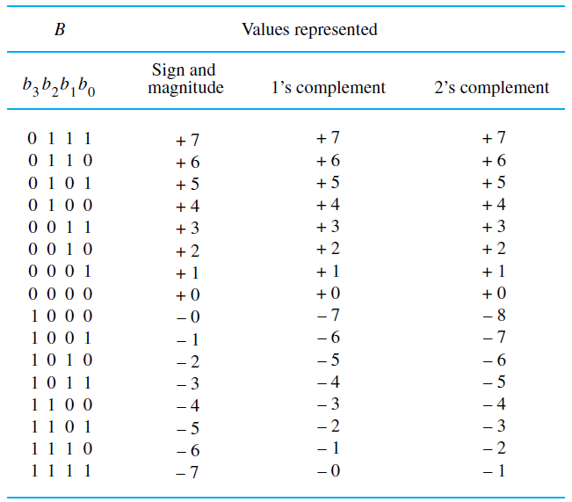

Slide 28
Addition in 2’s Complement
Examples of adding 4-bit numbers
0 0 0 1 +1 0 1 0 0 +4
+ 0 1 0₁1 + +5 + 1 0 1 0 + -6
-------------- -------- ------------- ------
0 1 1 0 +6 1 1 1 0 -2

Slide 29
C = A+B in Sign Magnitude
Y
s(A)=
s(B)?
N
m(C)=
m(A)+m(B)
m(A)>m(B)?
m(C)=
m(A)-m(B)
m(C)=
M(B)-m(A)
s(C)=s(A)
s(C)=s(A)
s(C)=s(B)
Detect Overflow

Slide 30
C = A+B in 1’s Complement
1c(C)=
1c(A)+1c(B)
Y
Carry?
N
1c(C)=
1c(C) + 1
Detect Overflow

Slide 31
C = A+B in 2’s Complement
2c(C)=
2c(A)+2c(B)
Detect Overflow

Slide 32
Subtraction in 2’s Complement
Form the 2’s complement of the subtrahend and then perform addition
1 1 1 0 -2 1 1 1 0
- 1 0 1 1 - -5 + ₁ 0₁1 0 0₁
------------ ------ --------------
+3 0 0 1 1

Slide 33
2’s Complement
Let’s solve…
2+3
4+(-6)
(-5)+(-2)
7+(-3)
(-3)-(-7)
2-4
6-3
(7)-(-5)
(-7)-1
2-(-3)

Slide 34
Overflow in 2’s Complement
Two examples of overflow; that is, when the answer does not fit in the number range
0 1 1 0 +6 1 1 1 0 -2
+ 0₁1 0 0 + +4 ₁1 0 0 1 + -7
------------ ------ ---------- ------
1 0 1 0 +10 0 1 1 1 -9

Slide 35
Sign extension
Extend 4-bit signed integers to 8-bit signed
integers
0 1 0 1 0 0 0 0 0 1 0 1
1 1 1 0 1 1 1 1 1 1 1 0

Slide 36
Integers vs. Fixed-Point
Integers are a special case of fixed-point representations.
For a given a sequence of digits, say, 3,1,4,5,9 in decimal, we could fix the decimal point any where to get different fixed-point values for the same digits, e.g. 31459 3145.9, …, 3.1459, .31459, …

Slide 37
Doing Arithmetic with Fixed Point
Assume representing unsigned decimal integers
Want to do the following sum:
2.457 + 0.00036
(Note the fixed-point of given numbers does not match the fixed point of representation)

Slide 38
Doing Arithmetic with Fixed Point
Process:
Scale the number with smaller fraction to integer
Use the same scale to convert the other number to integer
Add the two integers
“Un-scale” the result
0.00036 = 36*10^-5
2.457 = 245700*10-5
Sum = (36+245700)*10^-5 = 245736*10^-5
245736*10^-5 = 2.45736

Slide 39
Why Floating Point?
For a given number of digits, the fixed-point range can be limiting, e.g. [0, 999] for three unsigned decimal digits.
Floating-point representation allows increased range at the cost of reduced precision.

Slide 40
Simple Illustrative Example
Fixed point: Unsigned decimals, three digits
Range: [0, 999]
Precision: three decimal digits or 1 in 1000.
Floating point: Partition the three decimal digits to:
2 digits for unsigned integers (Significand)
1 digit for decimal scale factor (Exponent)
What is the range and precision of the floating-point representation?
(In general, both the significand and the exponent are signed fixed-point numbers.)

Slide 41
Floating Point Representation
Consider +0.00036 in the scientific notation:
+3.6*10^-4
Can represent this by two fixed-point numbers: <exponent, significand> = <-4, +3.6>
Representations, based on the IEEE 754 standard, used in processors.

Slide 42
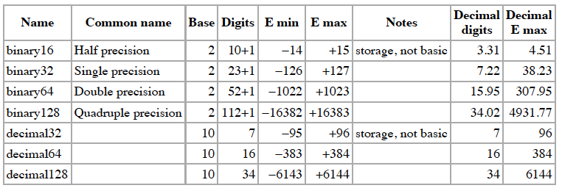
Basic Formats: IEEE 754
Read the Wikipedia article and follow the links to
Half precision, Single Precision, Double Precision, and
Quadruple Precision for more details of each.

Slide 43
Character encoding
American Standard Code for Information Interchange (see Wikipedia article: ASCII)
uses 7-bit codes, e.g.:
character code
A 1 0 0 0 0 0 1
7 0 1 1 0 1 1 1
+ 0 1 0 1 0 1 1
The Unicode industry standard used for text in most of world’s writing systems. Can be implemented by different character encodings.
UTF-8 uses one byte for ASCII characters, same code values
UCS-2 (now obsolete) uses 2 bytes/char but limited in range
UTF-16 extends UCS-2, using 4 bytes for each additional character

Slide 44
Performance
How quickly can a program be executed ?
Some factors:
Speed of electronic circuits in the processor
Access times to the cache and main memory
Design of the instruction set
Number of operations that can be done at the same time (parallelism)

Slide 45
Parallelism
Multiple processors, called cores, can be
fabricated on a single VLSI chip
The cores can execute different parts of a program at the same time
A large number of multi-core processors with
multiple caches and memory modules
can be organized into a multiprocessor
system to execute programs at the same time

Slide 46
Historical perspective
Up to the 1940s: mechanical devices, electromechanical relay devices
First generation computers, 1945-1955:
vacuum tube circuits, magnetic core memories

Slide 47
Historical perspective
Second generation, 1955-1965: transistor circuitry, magnetic disk data storage
Third generation, 1965-1975: integrated circuits for processors and memory
Fourth generation, 1975-present: microprocessors on a single VLSI chip, personal computers, embedded systems, very high performance multiprocessors

Slide 48
Upcoming…
Review Chapter 1 and problems
HW 1 – Chapter 1
Assign Wednesday, Sept. 4th
Due Friday, Sept. 13th
Quiz 1 – Chapter 1
Monday, Sept. 16th
15 min

