Slide 1
CSCE 230, Fall 2013 Chapter 1, part 1 Basic Structure of Computers
Mehmet Can Vuran, Instructor
University of Nebraska-Lincoln
Acknowledgement: Overheads adapted from those provided by the authors of the textbook

Slide 2
Chapter Outline
computer types, structure, and operation
instructions and programs
numbers, arithmetic operations, and characters
performance issues

Slide 3
What is a computer?
Components:
input (mouse, keyboard)
output (display, printer)
memory (disk drives, DRAM, SRAM, CD)
network
processor

Slide 4
What is a computer?
Components:
input (mouse, keyboard)
output (display, printer)
memory (disk drives, DRAM, SRAM, CD)
network
processor

Slide 5
Inside the Processor (CPU)
Datapath: performs operations on data
Control: sequences datapath, memory, ...
Cache memory
Small fast SRAM memory for immediate access to data

Slide 6
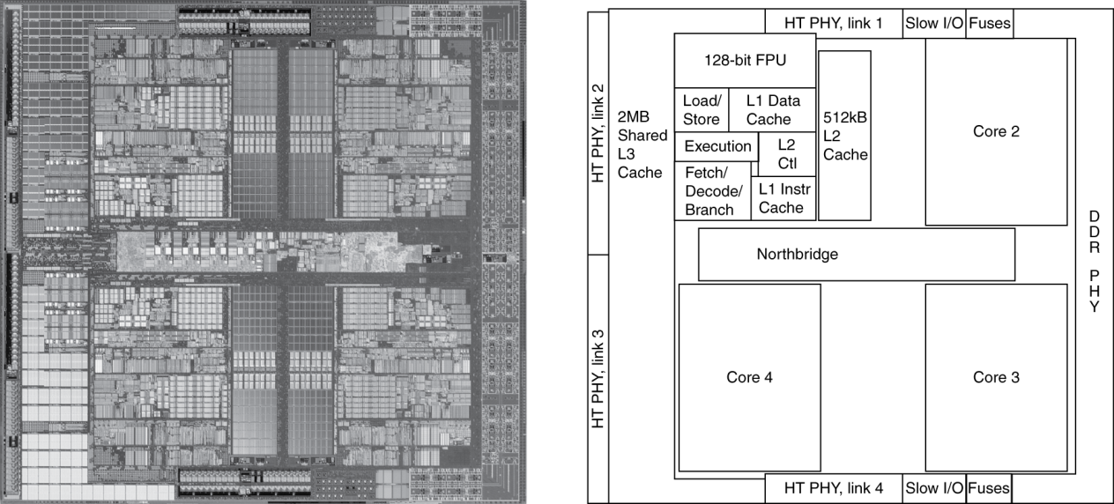
Inside the Processor
AMD Barcelona: 4 processor cores

Slide 7
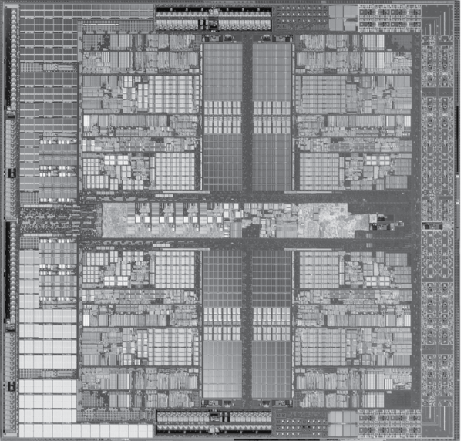
Processor
implemented using millions of transistors
Impossible to understand by looking at each transistor
We need...

Slide 8
Abstractions
Abstraction helps us deal with complexity
Hide lower-level detail
Instruction set architecture (ISA)
The hardware/software interface
Application binary interface
The ISA plus system software interface
Implementation
The details underlying and interface

Slide 9
Computer Architecture
output
analog
CPU
input
analog
mem
computer

Slide 10
CPU + memory
memory
address
CPU
PC
200
data
ADD r5,r1,r3
ADD r5,r1,r3
200
IR

Slide 11
Memory Structure
Processor
Primary
Memory
Secondary Memory
Cache

Slide 12
Functional units
Secondary memory
Magnetic disks, optical disks, flash memory devices
Used to store program and data files
Stored data organized hierarchically, e.g. sectors, tracks, cylinders, etc. for a magnetic disk.

Slide 13
Functional units
Primary memory (also called Main memory)
Hierarchical: Banks, blocks, words, bytes, bit cells.
Semiconductor bit cells, organized into words of typically 32 bits
A 32-bit word contains four 8-bit bytes
Programs and their data must be in this memory to be executed
Memory cells have associated addresses
Can read or write a word or a block at a time, given its address.

Slide 14
Instructions and Programs
An instruction specifies an operation and the locations of its data operands
A 32-bit word typically holds one encoded instruction
A program in static form consists of sequence of instructions; its dynamic form corresponds to the sequence of instructions executed during a particular run.
Both a program and its data are stored in the main memory

Slide 15
Program and Data in Memory
A
<value of A>
B
<value of B>
Data
C
<value of C>
.
.
.
Addresses
i
Load R1, B
i+4
Load R2, C
i+8
Add R3, R1, R2
Program
i+12
Store R3, A
.
.
.

Slide 16
Functional units
Cache memory
An adjunct to the main memory, fabricated on the processor chip
Much smaller and faster than the main memory
Holds sections of the program and data currently being executed

Slide 17
Functional units
Processor
logic circuits for performing arithmetic and logic operations on word-size data operands
timing and control circuits for fetching program instructions and data from memory, one after another
registers (typically 16 or 32), each of which hold one word of operand data

Slide 18
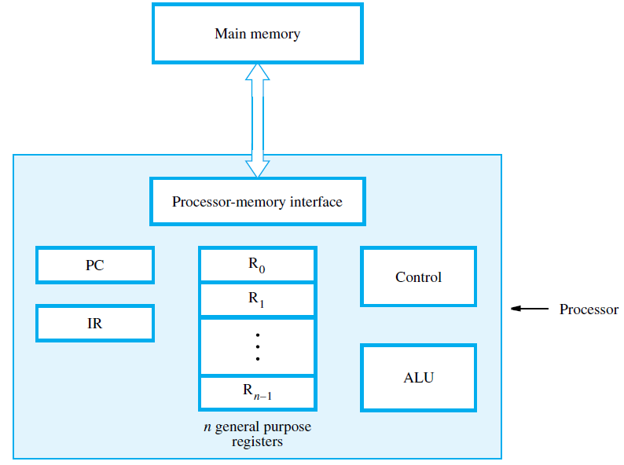

Slide 19
Processor components
The program counter (PC) register holds the memory address of the current instruction
The instruction register (IR) holds the current instruction
General purpose registers hold data and addresses
Control circuits and the arithmetic and logic unit (ALU) fetch and execute instructions

Slide 21
Instruction types
Three basic instruction types:
Load - Read a data operand from memory or an input device into the processor
Store - Write a data operand from a processor register to memory or an output device
Operate - Perform an arithmetic, logic operation on data operands in processor registers

Slide 22
Program and Data in Memory
A
<value of A>
B
<value of B>
Data
C
<value of C>
.
.
.
Addresses
i
Load R1, B
i+4
Load R2, C
i+8
Add R3, R1, R2
Program
i+12
Store R3, A
.
.
.

Slide 23
Example program
A, B, and C, are labels representing memory word addresses; Ri are processor registers
A program for the calculation A = B + C is: Load R1, B Load R2, C Add R3, R1, R2 Store R3, C

Slide 24
Fetching and executing instructions
Example: Load R2, LOC The processor control circuits do the following:
Send address in PC to memory; issue Read
Load instruction from memory into IR
Increment PC to point to next instruction
Send address LOC to memory; issue Read
Load word from memory into register R2

Slide 25
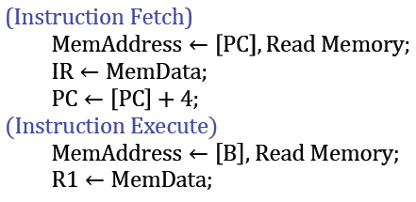
Two Levels of Interpretation
Machine
Language
HLL
Hardware
Load R1, B Load R2, C Add R3, R1, R2 Store R3, C
A=B+C

Slide 26
Handling I/O devices
An application program can:
Read data (such as a keyboard character) from an input device
Write data (such as letter character) to an output display screen
Sense the readiness of an input or output (I/O) device to perform a transfer

Slide 27
Interrupts
A device ( such as an alarm indicator) can raise an interrupt signal to cause a service program to be executed
The interrupt signal causes the processor to
suspend the current program and execute an
interrupt-service program

