Slide 1
CSCE 230, Fall 2013 Constructing a Basic Arithmetic and Logic Unit (ALU)
Mehmet Can Vuran, Instructor
University of Nebraska-Lincoln
Acknowledgement: Schematics adapted from those provided by the authors
Hennessey and Patterson.

Slide 2
Basic ALU
Common functions
AND
OR
NAND
NOR
Add
Sub

Slide 3
Basic ALU
Common functions
AND
OR
NAND
NOR
Add
Sub

Slide 4
Logical Operations (Bitwise)
A₀
B₀
R₀
Symbol:
A₁
R₁
B₁
A
B
R
A₂
B₂
R₂
A
A₃
B
R
R₃
B₃

Slide 5
Binary Addition S=A+B
Basic Building Block:
A_{i}
B_{i}
A: 1 0 0 1
B: 0 1 0 1
C: 0 0 0 1 0
1 1 1 0
Full
Adder
C_{i+1}
C_{i}
S_{i}
Truth Table:
A_{i} | B_{i} | C_{i} | C_{i+1} | S_{i}
0 | 0 | 0 | 0 | 0
0 | 0 | 1 | 0 | 1
0 | 1 | 0 | 0 | 1
0 | 1 | 1 | 1 | 0
1 | 0 | 0 | 0 | 1
1 | 0 | 1 | 1 | 0
1 | 1 | 0 | 1 | 0
1 | 1 | 1 | 1 | 1
A: A₃ A₂ A₁ A₀
B: B₃ B₂ B₁ B₀
C:
C₄
C₃
C₂
C₁
C₀
S₃
S₂
S₁
S₀

Slide 6
Adder (Ripple-Carry)
A₃
B₃
A₂
B₂
A₁
B₁
A₀
B₀
C₄
Full
Adder
C₃
Full
Adder
C₂
Full
Adder
C₁
Full
Adder
C₀=0
S₃
S₂
S₁
S₀
A-B ?
A: A₃ A₂ A₁ A₀
B: B₃ B₂ B₁ B₀
C:
C₄
C₃
C₂
C₁
C₀
S₃
S₂
S₁
S₀

Slide 7
Subtractor (A-B) in 2’s Comp.
A₃
B’₃
A₂
B’₂
A₁
B’₁
A₀
B’₀
C₄
Full
Adder
C₃
Full
Adder
C₂
Full
Adder
C₁
Full
Adder
C₀=1
S₃
S₂
S₁
S₀

Slide 8
Adder (A+B)/ Subtractor (A-B)
B₃
Add/Sub
B₂
B₁
B₀
A₃
A₂
A₁
A₀
C₄
Full
Adder
C₃
Full
Adder
C₂
Full
Adder
C₁
Full
Adder
S₃
S₂
S₁
S₀
A
B
Any other way?
B-A ?
Symbol:
Basic
ALU
Function
Select F:
0: Add
1: Sub
Carry C
S

Slide 9
ALU with More Functions
G
F,G
AND
A
00
B
A
ALU
R
OR
A
01
B
B
F
MUX
R
C
ADD/
SUB
A
Basic
ALU
F | G1 | G0 | R
10
B
C

Slide 10
ALU with More Functions
G
F,G
AND
A
00
B
A
ALU
R
OR
A
01
B
B
F
MUX
R
C
ADD/
SUB
A
Basic
ALU
F | G1 | G0 | R
- | 0 | 0 | And
- | 0 | 1 | Or
0 | 1 | 0 | Add
1 | 1 | 0 | Sub
- | 1 | 1 | -
10
B
C

Slide 11
Flags
Carry (C): Already seen in the design of Adder/Subtractor
Overflow (V): Next slide
Sign (N): Just the sign bit
Zero (Z): Zero result
Exercise: Add logic to the ALU design to
generate V, N and Z flags.

Slide 12
Overflow Detection in Add/Subtract
Use the rule:
Carry-in to Sign-bit != Carry-out of Sign-bit
carry-out
carry-in
What is the truth table?
!=
Overflow
Exercise: Find the logic to implement overflow by other
rules discussed earlier.

Slide 13
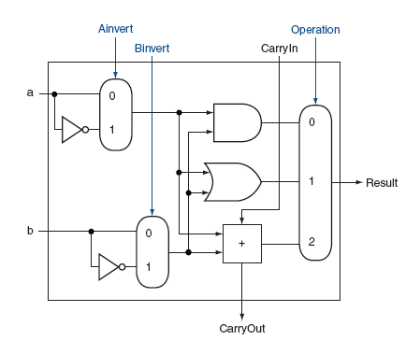
Doing Logical Nor and Nand
Both A and B can be inverted before arithmetic and logical operations.
If Ainvert = Binvert = 1 and Operation = 00, we do:
A’ and B’ = A nor B
Similarly, Nand with Operation = 01.
Doing both A-B and B-A will require connecting Carryin via a mux.
Fig. B.5.9

Slide 14
Upcoming…
Quiz 3 – Chapter 3
Friday, Oct. 11th (15 min)
Midterm – Chapter 1, 2, 3
Wednesday, Oct. 23rd (50 min)
Quiz 4 – Chapter A
Monday, Oct. 28th (15 min)
Test 2 – Chapters A & 5
Monday, Nov. 4th (50 min)

