Slide 1

CSCE 230, Fall 2013
Appendix A: Logic Circuits, part 2
Decoders, Multiplexers, Technological Basics, and Sequential Logic Circuits
Mehmet Can Vuran, Instructor
University of Nebraska-Lincoln
Acknowledgement: Overheads adapted from those provided by the authors of the textbook

Slide 2
DECODERS and MULTIPLEXERS

Slide 3
Decoding
Changing one representation of information into another.
Usually, the first type is more cryptic.
Example: Unsigned numbers
Number | Binary | One-hot
0 | 00 | 0001
1 | 01 | 0010
2 | 10 | 0100
3 | 11 | 1000
Decode: Binary to One-hot
Encode: One-hot to binary

Slide 4
Examples
  2-bit Decoder: Changes from binary to 1-hot code:
  BCD-to-7-segment decoder: Changes from 4-bit binary to seven-segment code
  3-bit Gray-code (reflected binary) to decimal:
00 | 01 | 10 | 11
0001 | 0010 | 0100 | 1000
000 | 001 | 011 | 010 | 110 | 111 | 101 | 100
0 | 1 | 2 | 3 | 4 | 5 | 6 | 7

Slide 5
Binary Decoder: Symbol & Truth Table
2-to-4 Binary Decoder
b₁
b₀
b₁ | b₀ | z₃ | z₂ | z₁ | z₀
0 | 0 | 0 | 0 | 0 | 1
0 | 1 | 0 | 0 | 1 | 0
1 | 0 | 0 | 1 | 0 | 0
1 | 1 | 1 | 0 | 0 | 0
2-to-4
Decoder
z₃
z₂
z₁
z₀
What are the Boolean expressions
for the outputs?

Slide 6
2-to-4 Binary Decoder Logic Implementation
b₁
b₀
z₃
z₂
z₁
z₀

Slide 7
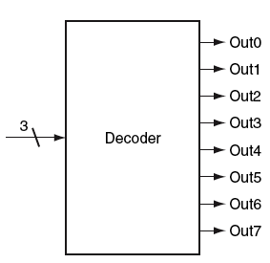
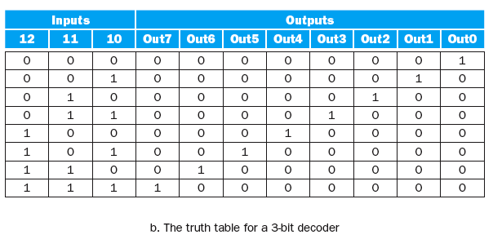
3-bit Decoder

Slide 8
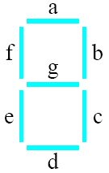
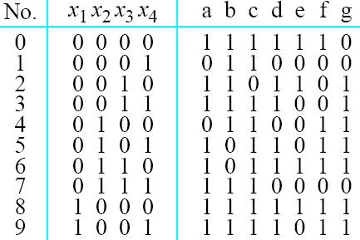
A BCD-to-7-segment
display decoder

Slide 9
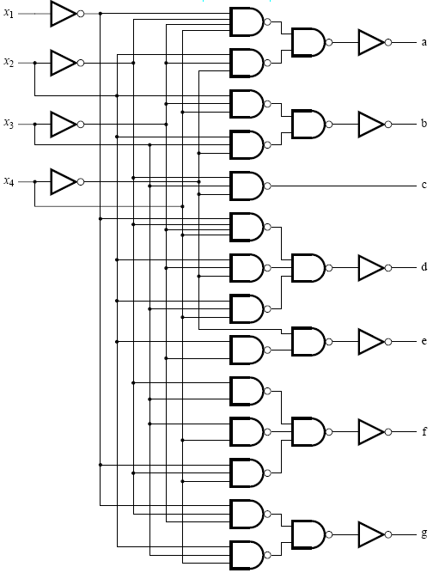
A BCD-to-7-segment
display decoder

Slide 10
Multiplexor (Mux)
A switching circuit
Lets many sources to connect to a common sink, in a time-shared way
In processors, used to select a register from the register file to connect to the arithmetic logic unit.
Nomenclature: 4-input 2-bit-wide Mux, means there are four data inputs, each consisting of 2-bits; Mux connects the selected input to the 2-bit output.

Slide 11
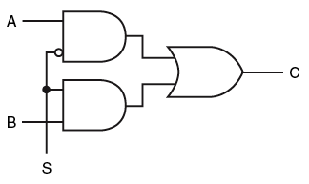
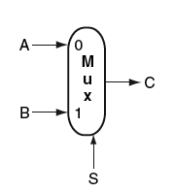
2-input (1-bit-wide) Mux
Symbol
Gate Implementation
Notice the extra select input S. In general how many
select-input bits are required?

Slide 12
2-input (1-bit-wide) Mux
Symbol
Gate Implementation
Notice the extra select input S. In general how many
select-input bits are required?

Slide 13
4-input 1-bit multiplexer: Symbol and Logic
s₁
s₀
x₃
x₂
x₁
z
x₀
s₁
s₀
x₃
x₂
x₁
x₀
z

Slide 14
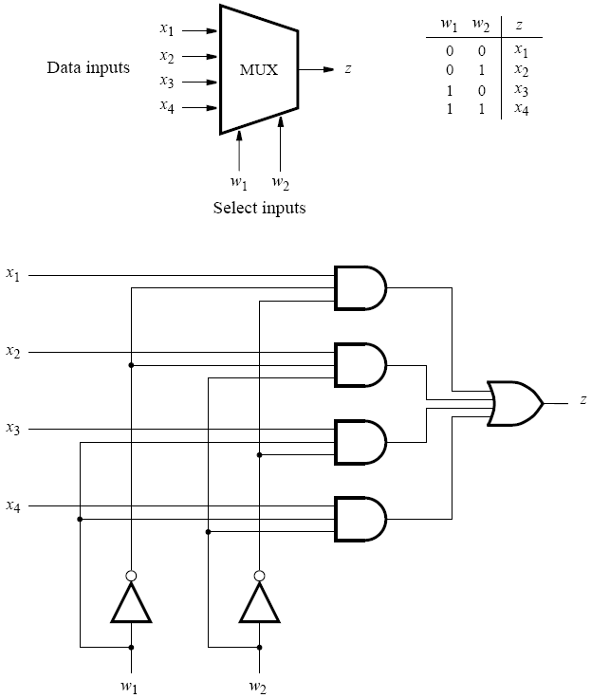
Another Implementation

Slide 15
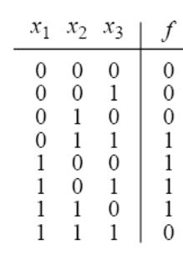

Multiplexer implementation of a logic function
0
0
0
1
0
2
1
3
1
4
f
1
5
1
6
0
7
x₁
x₂
x₃

Slide 16
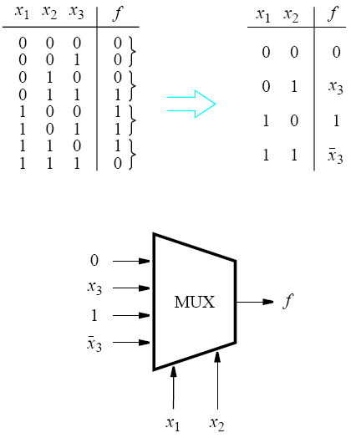
Another implementation of a logic function using a multiplexer

Slide 17
SEQUENTIAL LOGIC:
LATCHES, FLIP-FLOPS, REGISTERS, AND COUNTERS

Slide 18
Sequential circuits
A logic circuit whose output is determined entirely by its present inputs is called a combinational circuit (e.g. decoders and multiplexers).
A logic circuit whose output depends on both the present inputs and the state of the circuit is called a sequential circuit (e.g. counters).

Slide 19
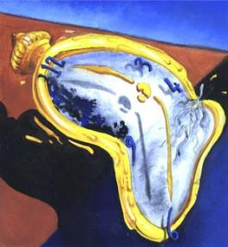
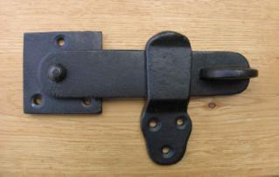
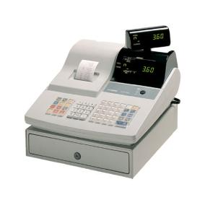


Sequential Logic
Clocks
Latches
Flip-flops
Registers
RAM
  SRAM
  DRAM
    SDRAM, DDRAM

Slide 20
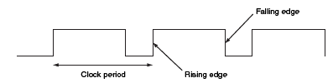
Clocks
Timing device for sequential logic
  Determines when an element that contains state should be updated
  Free-running signal, with fixed cycle time (or, clock period) and clock frequency, where:
    Clock-frequency = 1/clock-cycle-time
  In the above diagram, the terms, rising and falling clock edges, are based on the assumption that the horizontal dimension is time that “flows” (increases) from left to right.

Slide 21
Synchronous Operation
Control combinational & sequential logic components through the clock
Two types
  Level-triggered (operational only when the clock is 1 or 0)
  Edge-triggered (operational only during the rising or the falling edge)

Slide 22
Edge-Triggered Clocking
All state changes occur on a clock edge:
  Typically, only the rising or the falling edge, called the active edge, the choice is not important for logic design and is determined by the technology.
  Ideally, with instantaneous rise (or fall), the clock edge “discretizes” the continuous time dimension
  Clocked systems are also commonly called synchronous.

Slide 23
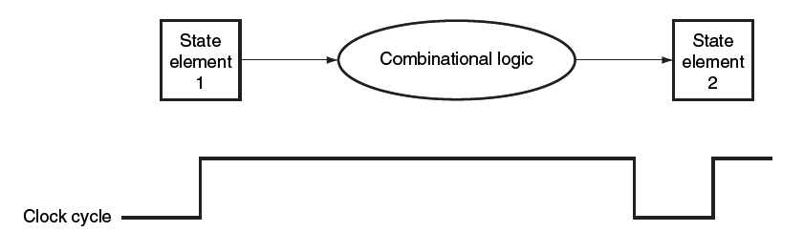
Synchronous Systems: How Combinational and Sequential Components Interact
Combinational circuits are loop-free, hence any changes on inputs must eventually lead to a stable state, which depends entirely on the inputs.
If inputs to combination logic are held stable for a time, they must come from state elements.
If outputs of the block must persist over time, they are connected to state elements.
Clock edges determine the time of update.

Slide 24
Synchronous Systems in Practice
  Practically, a narrow window around active edge defines the time period when input to a state element is sampled for updating its value.
    Input should remain stable during this interval.
    Interval divided into setup and hold times: specified minimum time periods during which input should remain stable
Setup
Time
Hold
Time

Slide 25
State Elements
  Components that hold state, i.e., memory
    Latches
    Flip-flops
    Registers
    RAMs

Slide 26
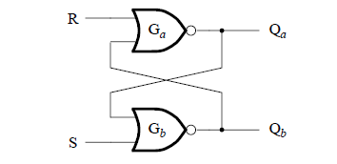
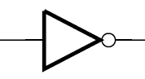
Inverter Latch to Nor Latch
SR Latch
Q’
Q
Two stable states (also, one meta-stable state!)
However, no way to control (change) state
Need control input(s)

Slide 27
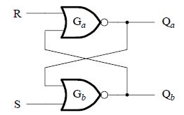
SR Latch (Nor Latch)
SR Latch
S | R | Q_{a} | Q_{b}
0 | 0 | old(Q_{a}) | old(Q_{b})
1 | 0 | 1 | 0
0 | 1 | 0 | 1
1 | 1 | 0 | 0
S
Q
R
Q’
Symbol
Table
Why sequential?
  For SR=00, the outputs Q and Q’ not uniquely determined – depend on past history of inputs.

Slide 28
SR Latch: Timing Diagram

Slide 29
SR Latch: Timing Diagram
Shows why input SR=11 is problematic:
  If input changes to SR=00, the binary states of Q_{a} and Q_{b} cannot be predicted.

Slide 30
Nand Latch
Can also use Nands to build a latch.
Can systematically derive from Nor latch by applying DeMorgan’s law: (A+B)’ = A’B’
S’
R’
The set/reset become active-low:
  SR=01 to sets, SR=10 resets, and SR=11 holds.
  For SR = 00, Q = Q’ = 1

Slide 31
SR Latch: Timing Diagram
Output changes whenever input changes
May not be desirable
Let’s add clock (synchronous) – How?

Slide 32
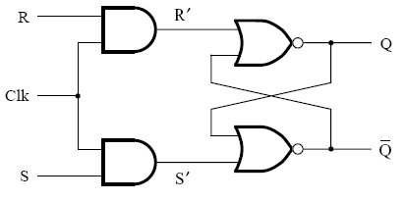
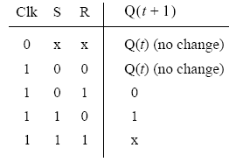
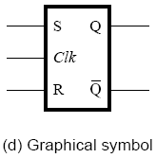
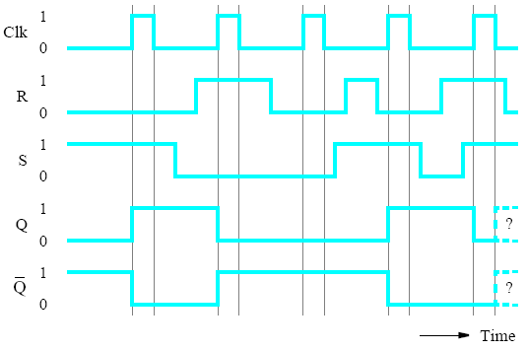
R*
S*
Gated SR latch

Slide 33
R*
S*
Gated SR latch

Slide 34
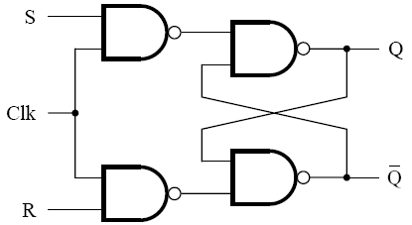
Gated SR Latch Implemented with NAND Gates
S’
1
R’
1
Clk=1
Clk=0

Slide 35
R*
S*
Gated SR latch
Let’s get rid of this problem

Slide 36
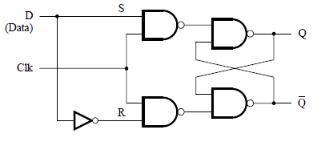
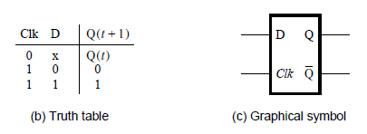
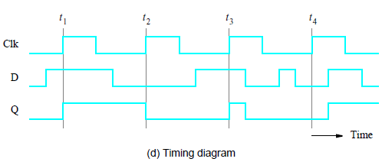
Gated D Latch

Slide 37
Gated D Latch

Slide 38
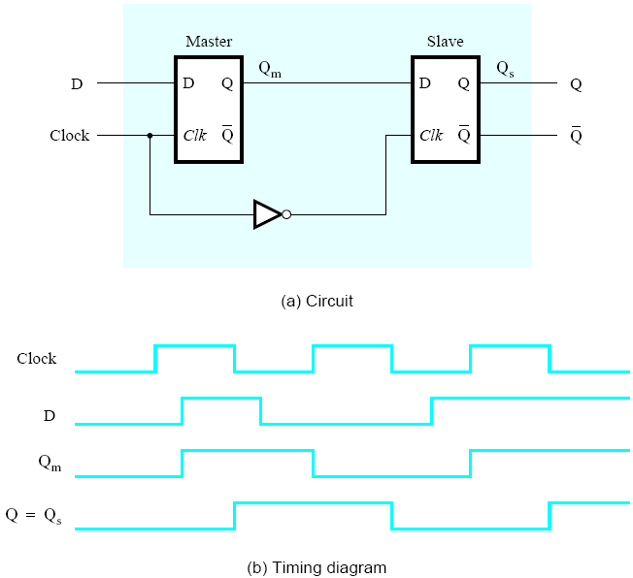
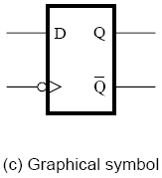
Master-slave D flip-flop

Slide 39
Master-slave D flip-flop

Slide 40
Master-slave D flip-flop

Slide 41
Exercise: Understanding differences between basic storage elements (D latch and D FFs)
C or Clk
D
Q (D Latch)
Q (+ve edge D FF)
Q (-ve edge D FF)
We will work through this in class

Slide 42
Exercise: Understanding differences between basic storage elements (D latch and D FFs)
C or Clk
J
K
JK (w/ D Latch)
JK (w/ +ve edge D FF)
JK (w/ -ve edge D FF)
We will work through this in class

Slide 43
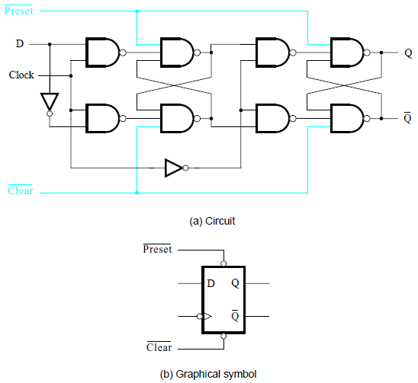
Master-slave D Flip-flop with Preset and Clear

Slide 44
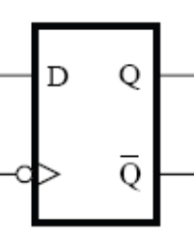
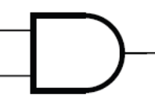
Building a 4-bit Register with D FFs
Input Bus
Output Bus
CLK
Write
Notes:
Steps:
Start with N (=4 here) D FFs
Connect inputs to a common input bus
Connect outputs to a common output bus
Connect the clock inputs to the external CLK signal qualified by (anded with) Write control.

Slide 45
Registers
General purpose registers can be held in a register file
Each register is 32 bits
There are 32 registers in the file (need 5 address bits)

Slide 46
Register File
WriteData
WriteReg
RegWrite
ReadData1
ReadData2
ReadReg1
ReadReg2

Slide 47
One-bit Register
A one-bit register can be built from either a D latch or a D FF.
Start with latch-based implementation
Easily adapted to a FF-based by connecting the clock to the control input.
A register differs from a D latch (or FF) only in controls for read and write.
Read Control: The register output is tristate (0, 1, Z).
  When Read is active, the register output is the binary value stored in the FF.
  When Read is inactive, the register output is Z.
Read Enable
Data
D
Q
Output
Data
D
Q
Output
D
Latch
D
Latch
Write
C
Write
C
With Write Control
With Read and Write Control

Slide 48
File of One-bit Registers
Suppose we have 4 registers in a file. How do we build it from one-bit registers?
Data
Output
Write
Reg
Write Data
Read
Reg#
Data
Output
D
E
C
O
D
E
R
Write
Reg 0
0
Data
Output
0
1
Write
Reg 1
Write
Reg#
2
1
Output
Data
Output
2
2
Reg 2
Write
3
3
Data
Output
Write
Reg 3
RegWrite

Slide 49
Register File
WriteData
WriteReg
RegWrite
ReadData1
ReadData2
ReadReg1
ReadReg2

Slide 50
Register File with Two Output Ports
Just needs an extra mux at the output for the second port.
Read
Reg1
WriteData
Entity View
Data
Output
D
E
C
O
D
E
R
Reg 0
0
WriteData
0
Write
1
ReadData1
2
WriteReg
Data
Output
3
RegWrite
1
Write
Reg 1
Read
Reg2
ReadData1
Write
Reg
ReadData2
Data
Output
2
Reg 2
ReadReg1
Write
0
1
ReadData2
ReadReg2
3
Data
2
Output
3
Write
Reg 3
RegWrite

Slide 51
Exercise: File of n-bit Registers
From a file of four 1-bit registers, construct a file of four 8-bit registers.

Slide 52
SRAM
Transistor-based flip-flops
Holds data while powered
Moving current switched bi-directionally between a pair of inverting gates

Slide 53
SRAM Model
m
Read or Write
Only when chip selected (CS = 1)
For Read: Also, when Output Enable = 1
For Write: Also, when Write Enable = 1
The model allows for straight-forward expansion to wider (more bits/words) or deeper (more words) SRAMs.
Address
Chip Select
N
Output Enable
Dout
Write Enable
N
DIn
M x N SRAM
M = 2^{m} = # words
N = # bits/word

Slide 54
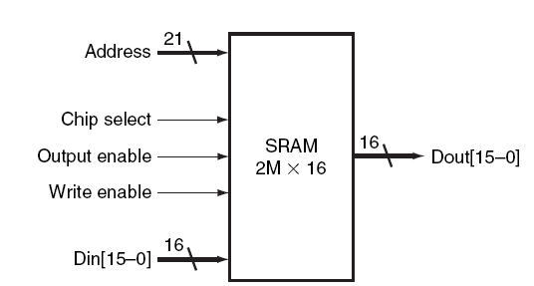
SRAM Example
Single access port:
  Either read or write at any given time, not both
Random access implies fixed access time any datum
Specification “2Mx16”:
  2M (2²¹ words) – height - where each word has 16 bits - width
  It fixes number of bits in “Address”, “Din”, and “Dout”
  The remaining signals control read or write
    Chip select: must be active to perform read or write
    With Chip select, if Output enable (i.e. Read) is active then
      Datum available in Dout
    With Chip select, if Write enable is active then
      Must provide datum on Din lines and address on Address

Slide 55
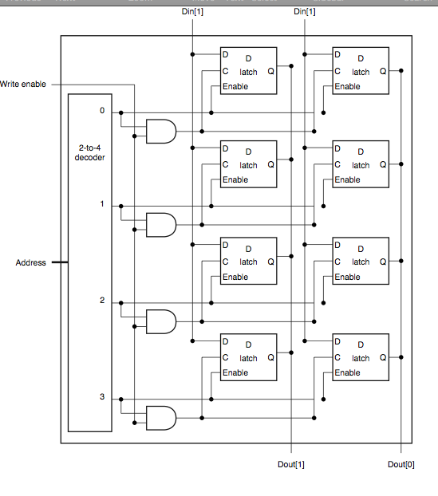
One Way to Build 4x2 SRAM
Like the register file we saw earlier.
Linear decoding of the address does not scale up: too much delay in decoding
Alternative: 2D decoding of the address bits
word line
bit line

Slide 56
Dynamic RAM (DRAM)
Includes capacitors that hold a charge (1)
Capacitors leak current
  Charge lost after some time
DRAM needs to be refreshed frequently
  Hence, the name: Dynamic RAM

Slide 57
Refreshing DRAM
Refreshing performed through memory controller
Memory controller
  Reads data before it is lost
  Reading data discharges the capacitor
  Capacitor is recharged
Additional circuitry needed for DRAM (memory controller)

Slide 58
Building Shift register
In
Out
Clock
Notes:
Again, can connect the Clock to external CLK qualified with “Right-Shift” control signal.

Slide 59
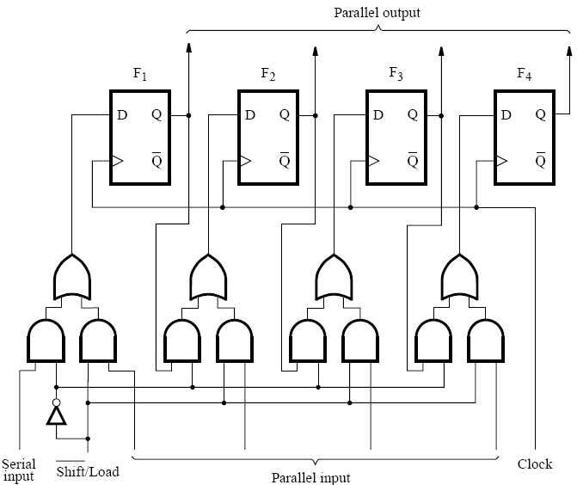
Parallel-access shift register
Notes:
Operation: two modes, right-shift and parallel load. In the first, each FF is written with the output of the previous one and the leftmost one is written with the external Serial input. In the second case, each FF is written by an external (parallel-input) bit.

Slide 60
Parallel-access shift register –
Equivalent Circuit
0
1
0
1
0
1
0
1
Notes:
Operation: two modes, right-shift and parallel load. In the first, each FF is written with the output of the previous one and the leftmost one is written with the external Serial input. In the second case, each FF is written by an external (parallel-input) bit.

Slide 61
Toggle FF: Modulo-2 Counter
T
0
Q
D
T
Q
1
Clk
Q’
Q’
When the toggle input, T, is 1, the output Q and Q’ toggle
their value at each rising edge of Clk.

Slide 62
Building a 3-bit UpCounter: Analysis
Q0 toggles always.
Q1 toggles whenever Q0 toggles from 1 to 0 (or Q0’ toggles from 0 to 1).
Q2 toggle whenever Q1 toggles from 1 to 0 (or Q1’ toggles from 0 to 1)
Q2 | Q1 | Q0
0 | 0 | 0
0 | 0 | 1
0 | 1 | 0
0 | 1 | 1
1 | 0 | 0
1 | 0 | 1
1 | 1 | 0
1 | 1 | 1
0 | 0 | 0
Notes:
To understand the circuit, we only need to understand the functionality of the T FF, without the need to know how it can be built from more basic elements, like D FFs.
The T input controls the “toggling” of the output, with toggling happening iff T=1. That is, T=0 maintains the state of the device, while T=1 toggles it at the rising edge of the clock.
Next we look at the sequence of 3-bit binary numbers and examine when each bit toggles. We find that the LSB toggles on every clock cycles, the next bit toggle when the LSB “overflows”, i.e. goes from 1 to 0 (meaning the complementary output goes from 0 to 1), and the third bit toggles when the second bit goes from 1 to 0 (or its complementary output goes from 0 to 1). Thus, there is no extra logic required, as long as both Q and Q’ outputs are available for each FF.

Slide 63
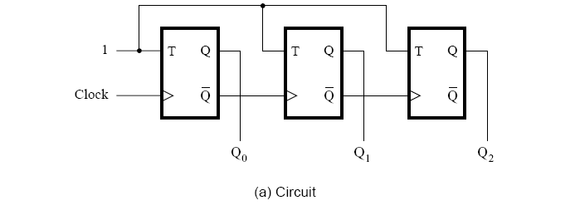
3-bit up-counter Design
Notes:
To understand the circuit, we only need to understand the functionality of the T FF, without the need to know how it can be built from more basic elements, like D FFs.
The T input controls the “toggling” of the output, with toggling happening iff T=1. That is, T=0 maintains the state of the device, while T=1 toggles it at the rising edge of the clock.
Next we look at the sequence of 3-bit binary numbers and examine when each bit toggles. We find that the LSB toggles on every clock cycles, the next bit toggle when the LSB “overflows”, i.e. goes from 1 to 0 (meaning the complementary output goes from 0 to 1), and the third bit toggles when the second bit goes from 1 to 0 (or its complementary output goes from 0 to 1). Thus, there is no extra logic required, as long as both Q and Q’ outputs are available for each FF.

Slide 64
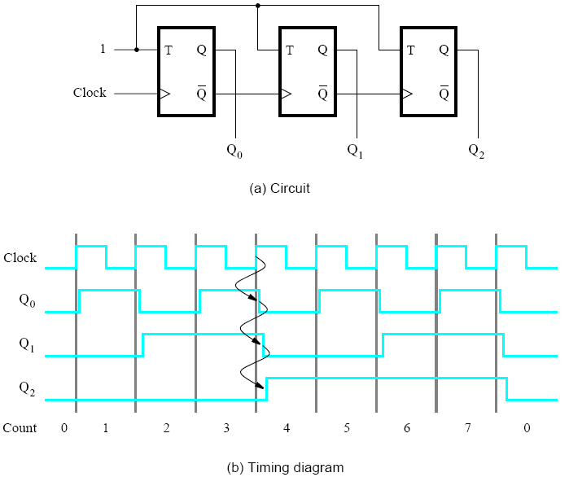
3-bit up-counter Design
Notes:
To understand the circuit, we only need to understand the functionality of the T FF, without the need to know how it can be built from more basic elements, like D FFs.
The T input controls the “toggling” of the output, with toggling happening iff T=1. That is, T=0 maintains the state of the device, while T=1 toggles it at the rising edge of the clock.
Next we look at the sequence of 3-bit binary numbers and examine when each bit toggles. We find that the LSB toggles on every clock cycles, the next bit toggle when the LSB “overflows”, i.e. goes from 1 to 0 (meaning the complementary output goes from 0 to 1), and the third bit toggles when the second bit goes from 1 to 0 (or its complementary output goes from 0 to 1). Thus, there is no extra logic required, as long as both Q and Q’ outputs are available for each FF.

Slide 65
DESIGNING SEQUENTIAL CIRCUITS

Slide 66
Toggle Flip-Flop
T
0
Q
D
1
Clk
Q’

Slide 67
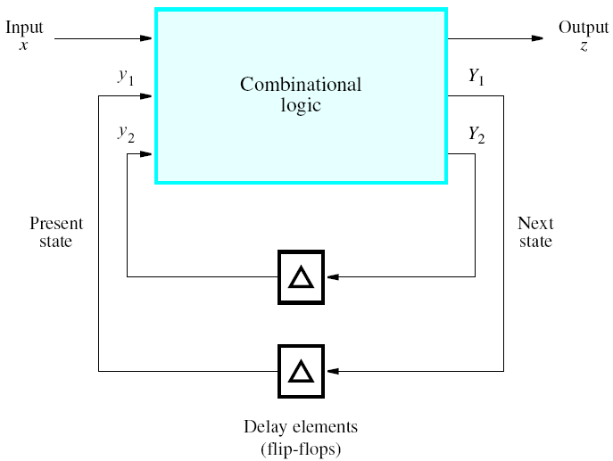
A formal model of a
Finite State Machine (FSM)

Slide 68
mod-4 up/down counter
that detects the count of 2
One input (x), one output (z)
If input x=0, count up from 0 to 3
If input x=1, count down from 3 to 0
Signal output z=1, when count is 2

Slide 69
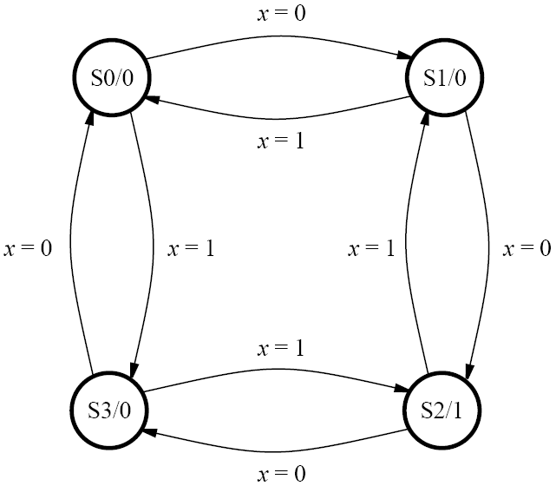
State diagram of a mod-4 up/down counter
that detects the count of 2

Slide 70
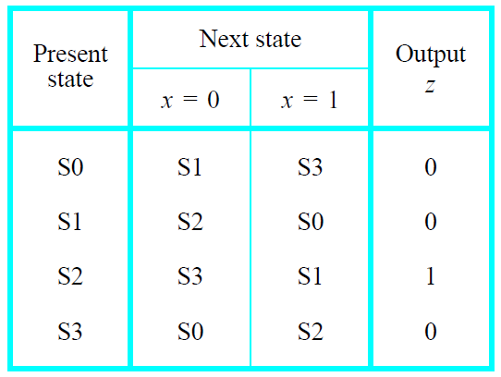
State table

Slide 71
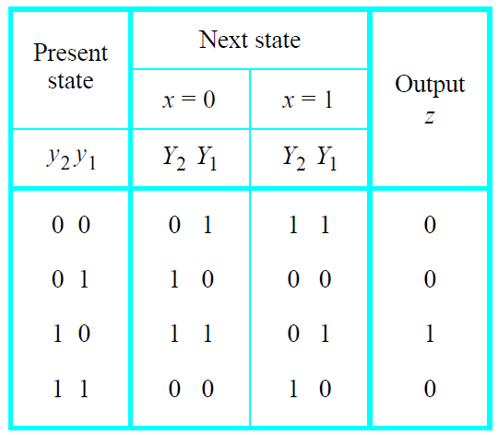
State assignment table

Slide 72
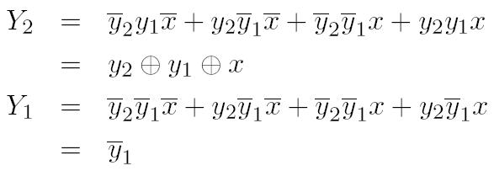

The next-state expressions are:
The output expression is

Slide 73
The next-state expressions are:
The output expression is

Slide 74
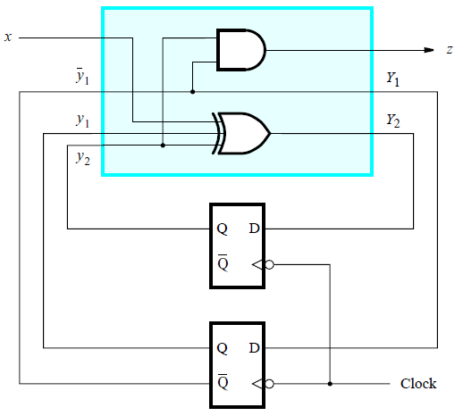
Implementation of the up/down counter

Slide 75
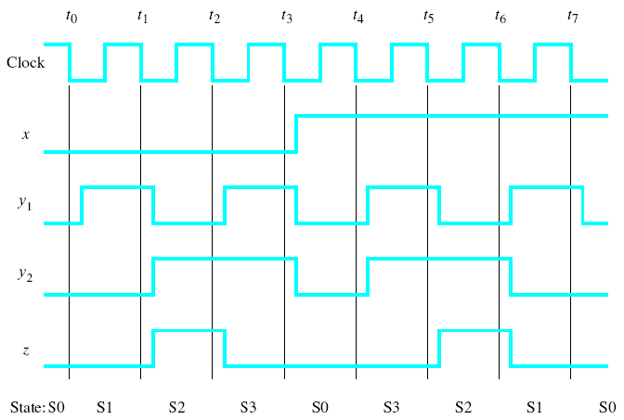
Timing diagram for the designed counter

Slide 76
A formal model of a finite state machine

Slide 77
What are FPGAs and why should we use them?
The following slides are courtesy of Altera and are
borrowed from an advanced course offered
by the Atera University Program*.
____
*You can find the complete set of
slides from the course on the Bb page
for the class.

Slide 78
FPGA
Field Programmable Gate Array
  Two-dimensional array of programmable logic elements
  Connected with programmable switches
FPGA: re-programmable hardware

Slide 79
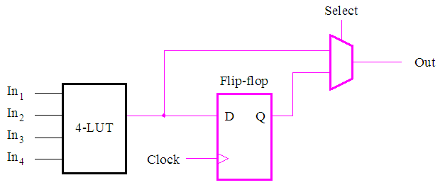
FPGA Architecture: Logic Element
Lookup table (LUT) implements any 4-input logic function
  Actual LE is significantly more complex
Notes:
The basic building block of an FPGA is a logic element. A simplified diagram of an LE is shown here. It uses a Lookup Table to implement a logic function. A lookup table is a component that stores a truth table for a logic function. In this case, the truth table is large enough to represent a 4 input function. When inputs are applied to the LUT, it produces an output that corresponds to the given input valuation.
In addition to the LUT, there is a FF that can be used to create Finite State Machines and other synchronous logic. Please note that the actual LE is far more complicated, so that it can efficiently implement common logic structures and fast arithmetic circuits.

Slide 80
FPGA Architecture
IO cells
…
Logic array block
(LAB)
…
…
…
…
…
…
…
…
Logic element
LAB
Programmable switch

Slide 81
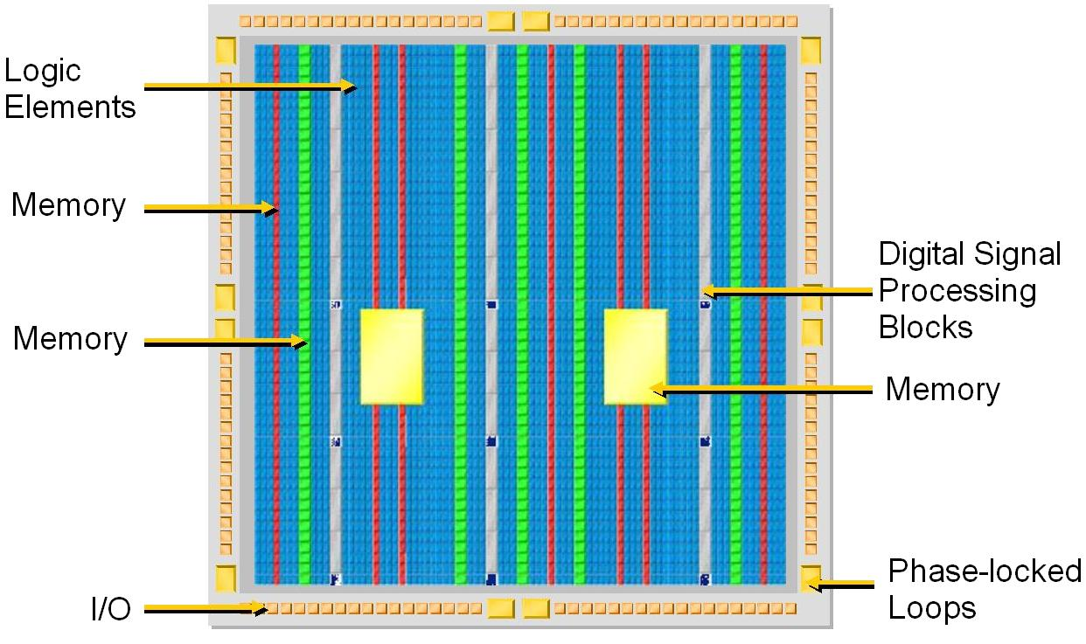
Example: Altera Stratix-series FPGA

Slide 82
Why use FPGAs?
Problem:
  Create an application to process a lot of data quickly
  How?
Alternatives:
  Processor?
    Easy to write code, low performance, power hungry
  Gate Array (ASIC)?
    Very high performance, low power, very hard to design, expensive to manufacture
  Field-Programmable Gate Array?
    no manufacturing needed (just program), easier to design for than ASIC, high performance, lower power than a processor

Slide 83
Increasing Chip Development Cost
45
40
35
30
Design /
Verification
& Layout
Total Development Cost (M$)
25
20
Software
15
Test & Product
Engineering
0
Masks & Wafers
0.18 µm
0.15 µm
0.13 µm
90 nm
65 nm
45 nm

Slide 84
How do companies justify making a custom chip?
Chip (90 nm)
Development Cost
$30M
20% of Revenue on R&D
Revenue Target
$150M
10% Market Share
Market Size
$1.5B
Result: very few products can justify a custom or semi-custom chip

Slide 85
Time-to-Market Economics
)
$
(
e
u
n
e
$99M Max Available Revenue
v
e
R
$62M Max Revenue
after Delayed Entry
Time-to-Market
Delay (3mo.)
Time (months)
PRODUCT LIFETIME – 1yr
Notes:
For W = 6 months (product life = 2W = 1year
delay = D = 3 months
RL = 62.5% of R0
Revenue Loss Equation

Slide 86


Getting a Product Out
FPGA Design Flow
Design
Test
Cyclone II
Yes
OK?
No

Slide 87


Quartus II Design Flow
Design
Entry
Timing
Constraints
Synthesis
Placement and
Routing
Timing, Area, Power
Optimization
Timing and
Power Analyzer
Optimized Design ☑
87
Notes:
87
Utilizing Altera’s programmable power technology has been made transparent to the user through advanced automated power optimization in Quartus II. The design engineer simply sets the timing constraints as part of the design entry process and synthesizes the design to meet performance. The Altera and 3rd party tools automatically select the required performance for each piece of logic as well as minimizing power through power aware placement, routing, and clocking. The resulting design meets the designers requirements with the minimum power.

Slide 88
Can I still use a Processor?
YES!
Three Altera Soft Processor Choices:
  Nios II/f Fast: Optimized for Performance
  Nios II/s Standard: Faster and Smaller than Nios
  Nios II/e Economy: Smallest FPGA Footprint
Choose peripherals you want
SOPC Builder software builds interfaces, arbitration etc.
Nios II/e
Nios II/s
Nios II/f
Faster
Smaller

Slide 89
Processor uses Small % of FPGA
Cyclone II 20
Stratix IV 820
18,752 LEs
820,000 LEs

Slide 90
Upcoming…
HW 3 – Chapter 3
  Assign Friday, Sept. 27th
  Due Wednesday, Oct. 9th
Quiz 3 – Chapter 3
  Friday, Oct. 11th (15 min)

