Slide 1
CSCE 230, Fall 2013 Appendix A: Logic Circuits, part 1
Logic Circuits
Mehmet Can Vuran, Instructor
University of Nebraska-Lincoln
Acknowledgement: Overheads adapted from those provided by the authors of the textbook

Slide 2
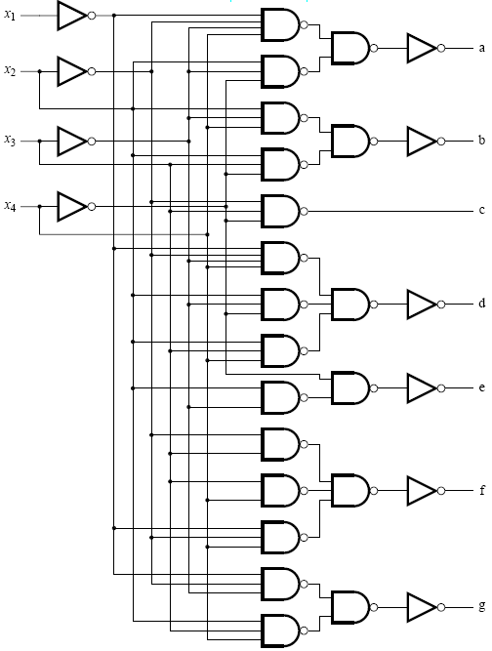
Logic Design
Notes:
2

Slide 3
Logic Design
Notes:
3

Slide 4
Logic Implementation Choices
Programmable
Software
Typically, use single-board microcontrollers to implement the logic by a program
Programmable logic devices (PLDs) and field programmable gate arrays (FPGAs)
Devices in which the logic elements and the interconnect (wiring) can be modified by programming.
Ideal for rapid prototyping and low-volume applications.
ROMs
Custom Designs
How Intel designs microprocessors
Cost-effective only for high-volume parts
Notes:
4

Slide 5
Logic circuits
Operate on binary variables that assume one of two distinct values, usually called 0 and 1
Implement functions of logic variables
Circuits have inputs and outputs
Circuits are implemented using electronic logic gates

Slide 6
Basic Gates
A
C
A
C
A
B
B
B
AND
OR
NOT

Slide 7
Truth Tables
A
C
A
C
A
B
B
B
AND
A | B | C
0 | 0
0 | 1
1 | 0
1 | 1

Slide 8
Basic Gates and Truth Tables
A
C
A
C
A
B
B
B
AND
A | B | C
0 | 0 | 0
0 | 1 | 0
1 | 0 | 0
1 | 1 | 1

Slide 9
Basic Gates and Truth Tables
A
C
A
C
A
B
B
B
AND
OR
A | B | C
0 | 0 | 0
0 | 1 | 0
1 | 0 | 0
1 | 1 | 1
A | B | C
0 | 0
0 | 1
1 | 0
1 | 1

Slide 10
Basic Gates and Truth Tables
A
C
A
C
A
B
B
B
AND
OR
A | B | C
0 | 0 | 0
0 | 1 | 0
1 | 0 | 0
1 | 1 | 1
A | B | C
0 | 0 | 0
0 | 1 | 1
1 | 0 | 1
1 | 1 | 1

Slide 11
Basic Gates and Truth Tables
A
C
A
C
A
B
B
B
AND
OR
NOT
A | B | C
0 | 0 | 0
0 | 1 | 0
1 | 0 | 0
1 | 1 | 1
A | B | C
0 | 0 | 0
0 | 1 | 1
1 | 0 | 1
1 | 1 | 1
A | B
0
1

Slide 12
Basic Gates and Truth Tables
A
C
A
C
A
B
B
B
AND
OR
NOT
A | B | C
0 | 0 | 0
0 | 1 | 0
1 | 0 | 0
1 | 1 | 1
A | B | C
0 | 0 | 0
0 | 1 | 1
1 | 0 | 1
1 | 1 | 1
A | B
0 | 1
1 | 0

Slide 13
Exclusive-Or
XOR
A | B | XOR
0 | 0
0 | 1
1 | 0
1 | 1

Slide 14
Exclusive-Or
XOR
A | B | XOR
0 | 0 | 0
0 | 1 | 1
1 | 0 | 1
1 | 1 | 0

Slide 15
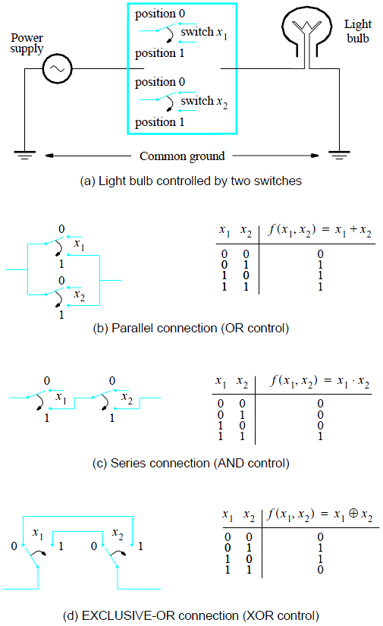
Light switch example

Slide 16
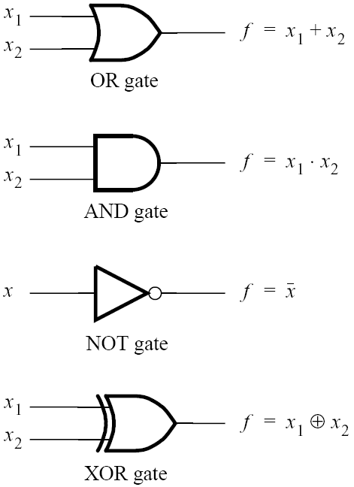
Standard logic gate symbols

Slide 17
Why? How?

Slide 18
Logic circuits
Operate on binary variables that assume one of two distinct values, usually called 0 and 1
Why?
Let’s back up…

Slide 19
Let’s Back up…

Slide 20
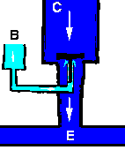
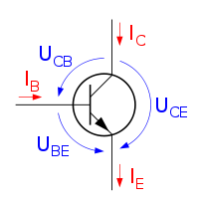
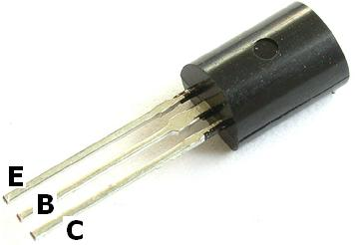
Transistors

Slide 21
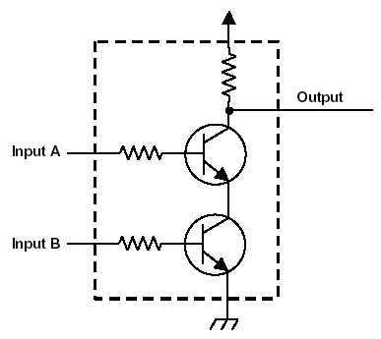
Basic Building Block for all Logic Gates
Not AND → NAND
A | B | NAND
0 | 0 | 1
0 | 1 | 1
1 | 0 | 1
1 | 1 | 0

Slide 22
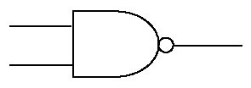
Basic Building Block for all Logic Gates - NAND
NAND
A | B | NAND
0 | 0 | 1
0 | 1 | 1
1 | 0 | 1
1 | 1 | 0

Slide 23
NOT from NAND
NOT
A | B
0 | 1
1 | 0

Slide 24
AND from NANDs
AND
A | B | C
0 | 0 | 0
0 | 1 | 0
1 | 0 | 0
1 | 1 | 1

Slide 25
OR from NAND
OR
A | B | C
0 | 0 | 0
0 | 1 | 1
1 | 0 | 1
1 | 1 | 1

Slide 26
OR from NAND
OR
A | B | C
0 | 0 | 0
0 | 1 | 1
1 | 0 | 1
1 | 1 | 1

Slide 27
XOR from NAND
XOR
A | B | C
0 | 0 | 0
0 | 1 | 1
1 | 0 | 1
1 | 1 | 0

Slide 28
NOR from NAND
NOR
A | B | C
0 | 0 | 1
0 | 1 | 0
1 | 0 | 0
1 | 1 | 0

Slide 29
XNOR from NAND
XNOR
A | B | C
0 | 0 | 1
0 | 1 | 0
1 | 0 | 0
1 | 1 | 1

Slide 30
Implementation of the XOR function using AND, OR, and NOT gates
XOR
A | B | XOR
0 | 0 | 0
0 | 1 | 1
1 | 0 | 1
1 | 1 | 0

Slide 31
Implementation of the XOR function using AND, OR, and NOT gates

Slide 32
Synthesis of logic functions
Synthesis is the process of designing and implementing a logic circuit defined by its functional specification.
The expression for f in the previous circuit is said to be in a sum-of-products form
OR and AND operations are sometimes called the sum and product functions.

Slide 33
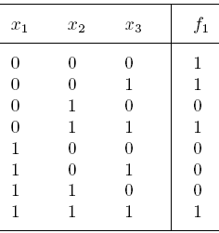
Implementation of a logic function

Slide 34
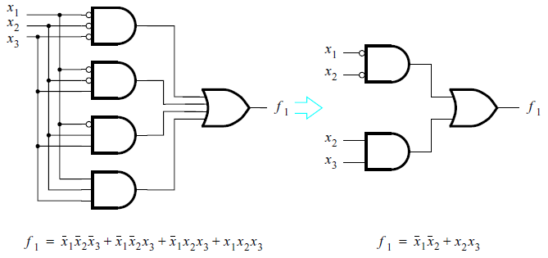
Implementation of a logic function

Slide 35
Implementation of a logic function

Slide 36
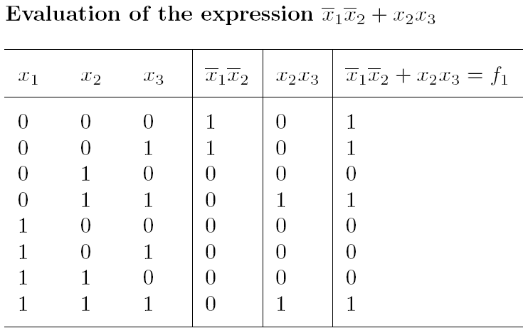
Implementation of a logic function

Slide 37
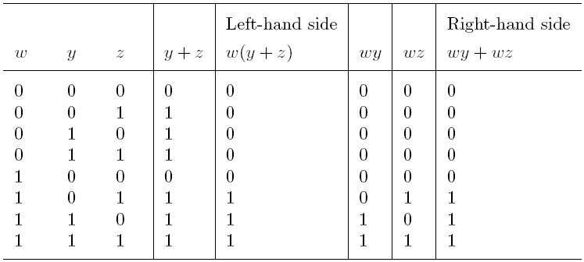
Proving equivalence of expressions

Slide 38
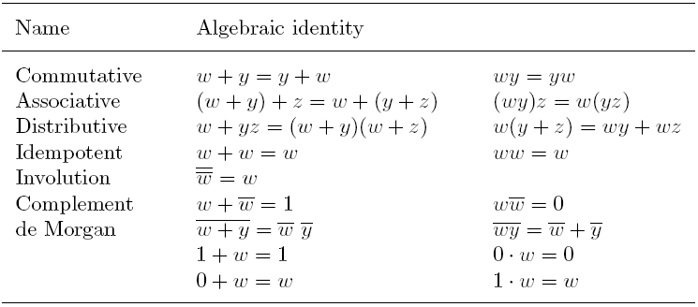
Rules of binary logic

Slide 39
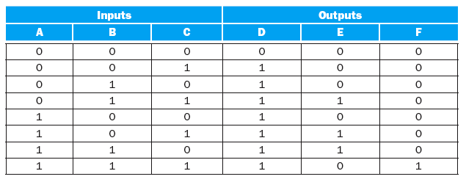
Example
Show a logic equation for the three functions shown in the following truth table:

Slide 40
Minimization of logic expressions
As illustrated in the previous example, a logic function can be implemented with circuits of different complexities.
It is useful to minimize a logic expression to reduce the cost of the synthesized circuit.

Slide 41
Karnaugh Maps

Slide 42
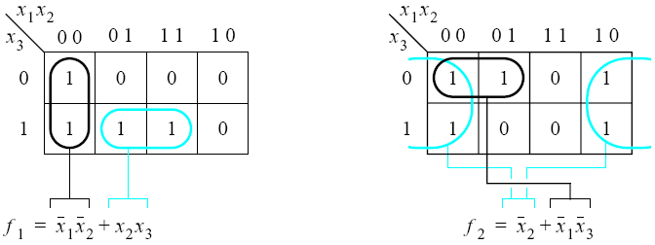
Three-variable Karnaugh maps

Slide 43
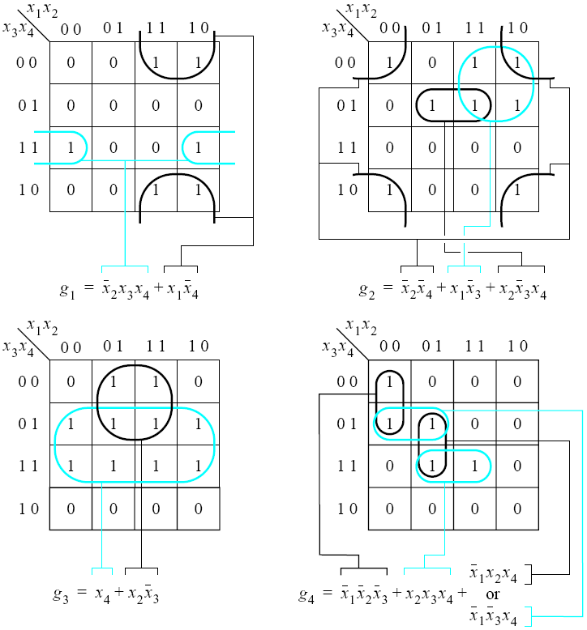
Four-variable
Karnaugh maps

Slide 44
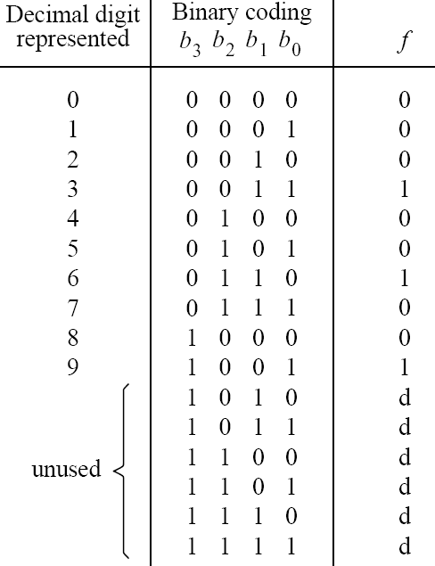
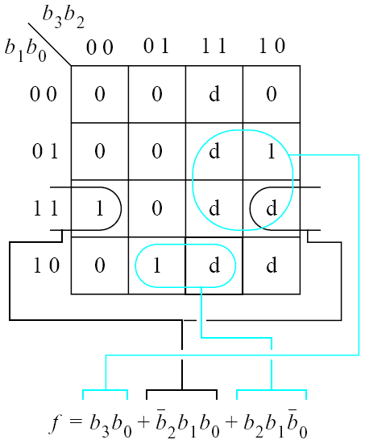
Using don’t cares

Slide 45
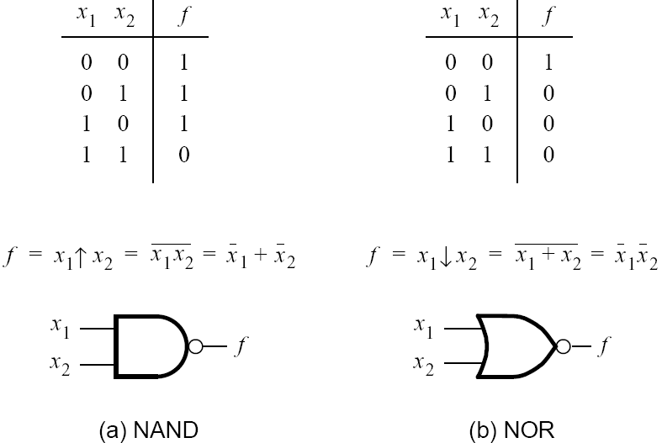
NAND and NOR gates

Slide 46
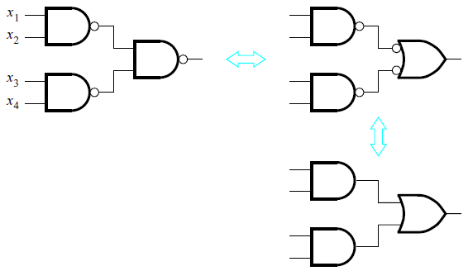
Equivalence of NAND-NAND and AND-OR networks

Slide 47
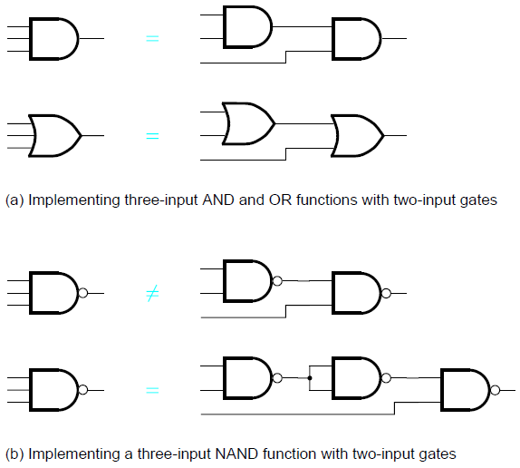
Cascading of gates

Slide 48
Section A.5 Practical Implementation of Logic Gates Read the Chapter in detail and study the following slides, we will skip most of them in class

Slide 49
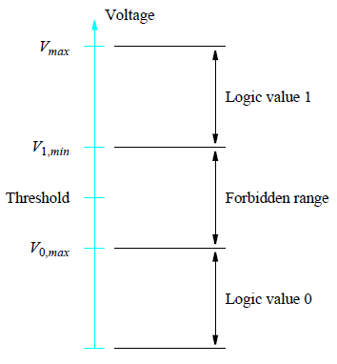
Representation of logic values by voltage levels

Slide 50
NMOS and PMOS transistors
NMOS Transistor

Slide 51
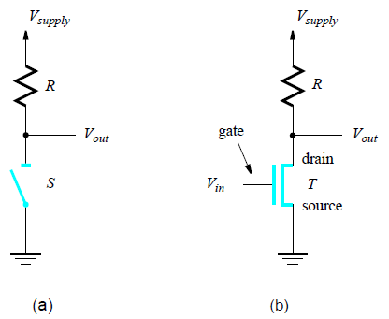
An inverter circuit

Slide 52
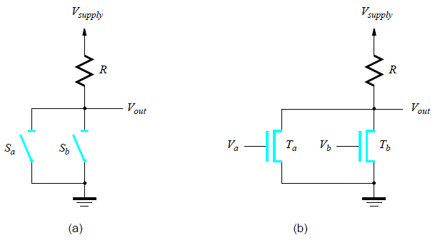
A transistor circuit implementation of a NOR gate

Slide 53
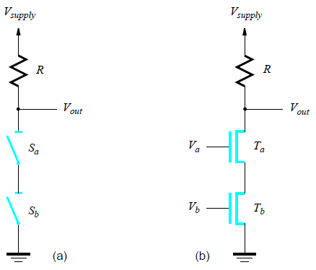
A transistor circuit implementation of a NAND gate

Slide 54
NMOS and PMOS transistors
PMOS Transistor

Slide 55
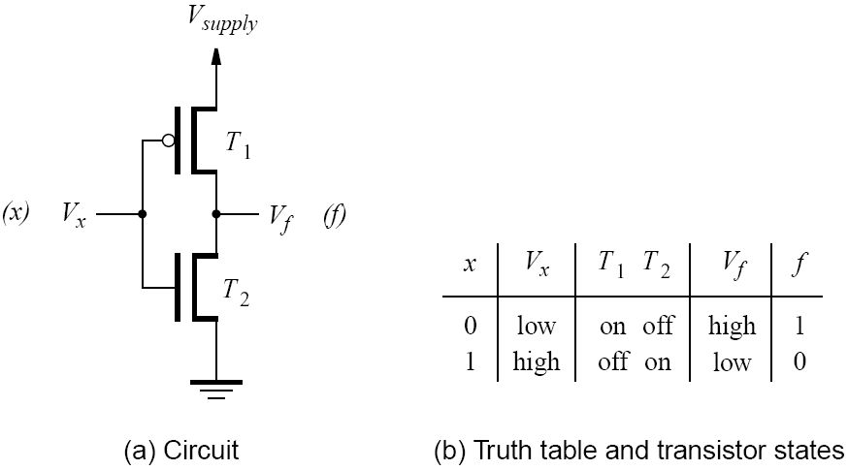
CMOS realization of a NOT gate

Slide 56
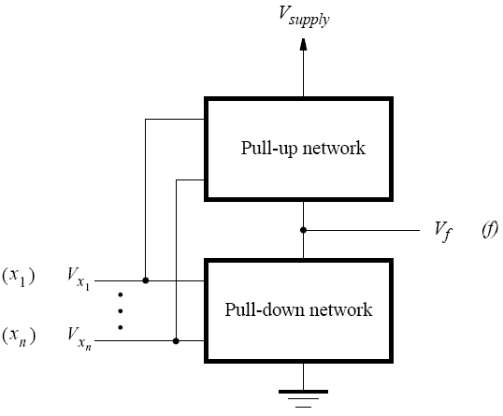
Structure of a CMOS circuit

Slide 57
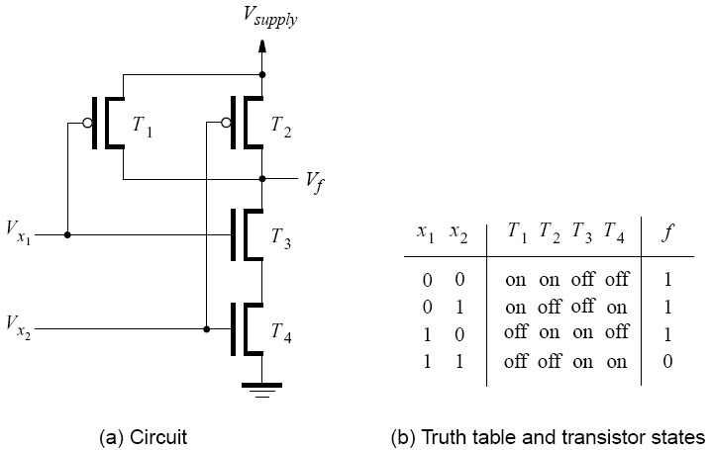
CMOS realization of a NAND gate

Slide 58
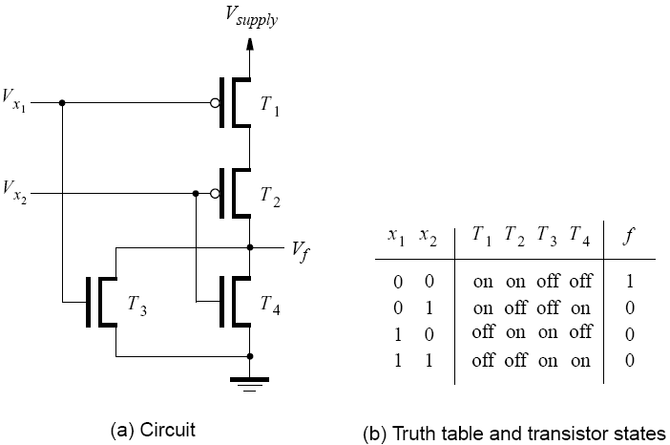
CMOS realization of a NOR gate

Slide 59
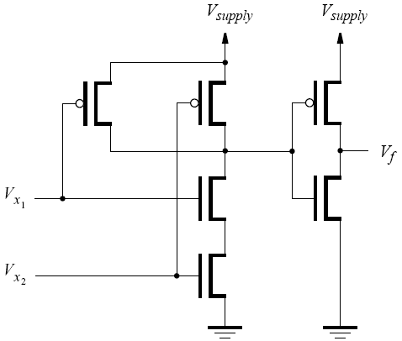
CMOS realization of an AND gate

Slide 60
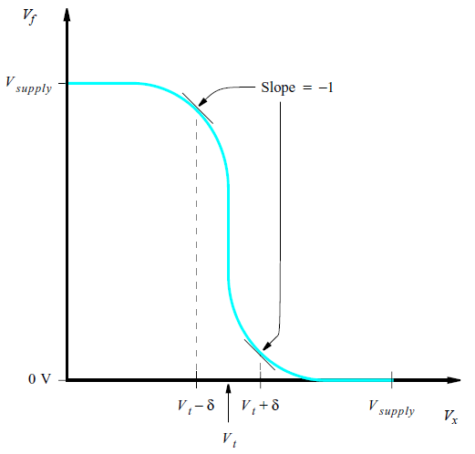
The voltage transfer characteristic for the CMOS inverter

Slide 61
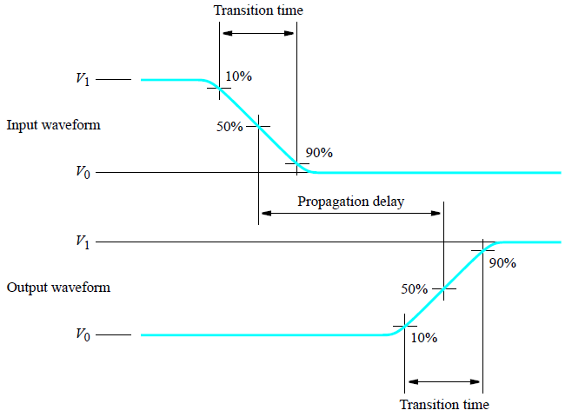
Definition of propagation delay and transition time

Slide 62
Cascading Logic Gates
Cannot directly connect logic gates
May damage the circuits in certain input combinations
May not need ALL the gates together
If a gate is not SELECTED, it should not provide 1 or 0
Need a third output – Z (high impedance)

Slide 63
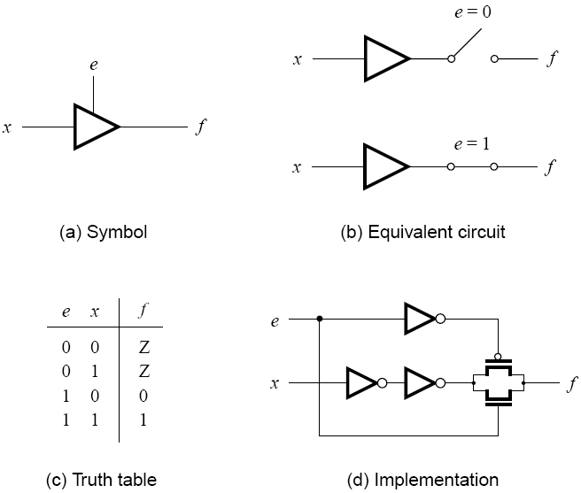
Tri-state buffer

Slide 64
Upcoming…
HW 3 – Chapter 3
Assign Friday, Sept. 27th
Due Wednesday, Oct. 9th
Test 1 – Chapters 1-2
Monday, Oct. 7th (50 min)
Quiz 3 – Chapter 3
Friday, Oct. 11th (15 min)

