Slide 1
Resources for your Future Career: Resumes Husker Hire Link Career Fairs

Slide 2
Think like an employer
Position: Software developer in technology start-up
Who will you hire?
Laney, B.S. in Computer Science, 3.45/4.00 GPA
1 internship with Amazon, 1 internship with United Way
1 independent project with advisor,
1 campus leadership position, 2 part-time jobs unrelated to major.
Bela, B.S. in Computer Science, 2.9/4.0 GPA
2 independent projects with advisor,
2 campus leadership positions,
1 part-time job related to major, bilingual.

Slide 3
Resume: High School versus Internship
Less emphasis on lists, more on description of skills gained
Selective inclusion of information – unrelated may disappear
Transition resume –may include some high school and some college

Slide 4
Resume: Objective
Optional category, include if you
are pursuing area not directly related to major
want to show a special interest or skill
Can include
job title
industry
skills you offer

Slide 5
Resume: Education
4 Parts -degree, major, institution, anticipated graduation date, GPA (optional)
Bachelor of Science in Computer Engineering University of Nebraska-Lincoln. May 201X
Bachelor of Science in Computer Science. University of Nebraska-Lincoln. Freshman status.
University of Nebraska-Lincoln. Bachelor of Science in Computer Science. Minor: Mathematics. December 201X. GPA 3.3.

Slide 6
Resume: Experience
5 parts - job title, employer, location, dates, description
Research Assistant. Dr. John Smith. UNL Computer Science Department. Fall 201X to Present.
Participated in project to develop assessment analysis tool
Web Developer. Northwest High School. Weston, CA. Fall 200X to Spring 200X. Developed activities website to include meeting times, reports of activities, and secure login for group members.
Runza. Shift Supervisor. Wahoo, NE. May 200X-July 200X. Scheduled and trained up to five staff, prepared deposit, provided customer service.
Hanson Family Farms. Laborer. Fairbury NE. 200X-Present. Assisted in 500 head cattle operation and corn crop production.

Slide 7
Resume: Skills
Operating Systems: Windows 10, Linux, UNIX, Macintosh OS
Software: MySQL, Visual Basic, Access, InDesign
Programming: JAVAscript, ASP, C++, Php
Languages: Spanish

Slide 8
Resume: Other Categories
Related Courses
Dell Certified Technician
Workshops, conferences, or training opportunities (OSHA, etc.)
Activities/Involvement
Name institution, when you went, and what you studied
Not course number, descriptive title of course
Projects
May be helpful if limited work experience
Student organizations, leadership roles, conferences
Education Abroad
Participated in NSF project on environmental impact of Midwest flooding
Certifications/Licensure/
Continuing Education

Slide 9
Resources: Husker Hire Link
Career Services-Husker Hire Link
Review job postings, apply directly to those of interest
Use additional resources
Going Global
Uniworld
And more…

Slide 10
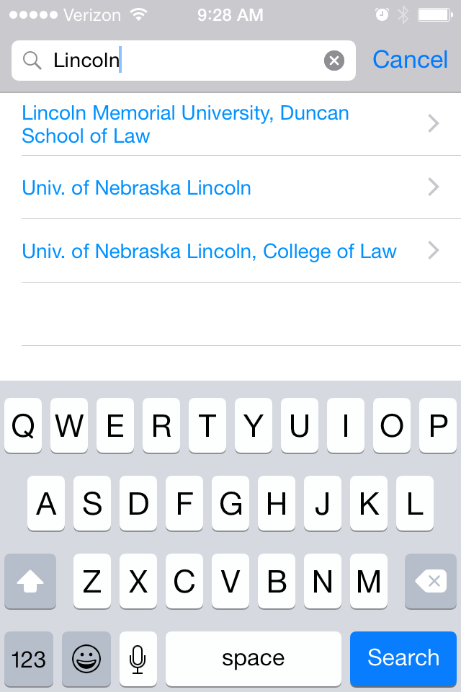
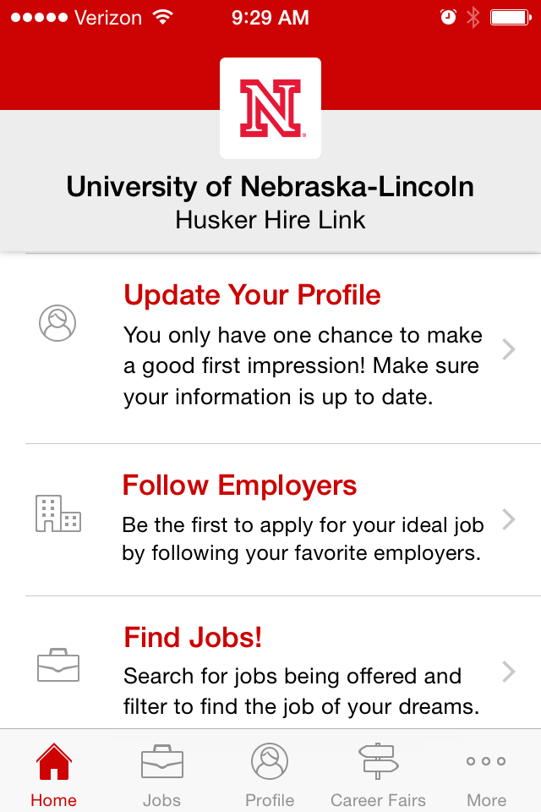
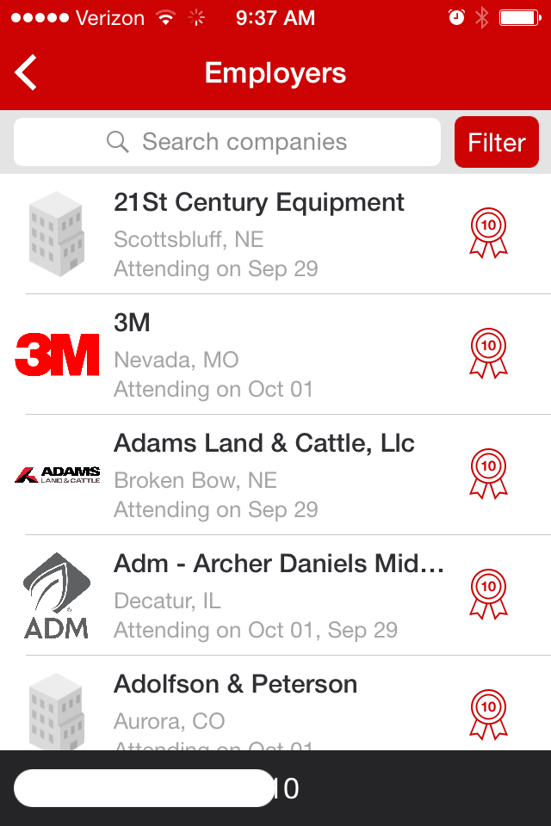
Resources: Husker Hire Link app – Careers by Symplicity

Slide 11
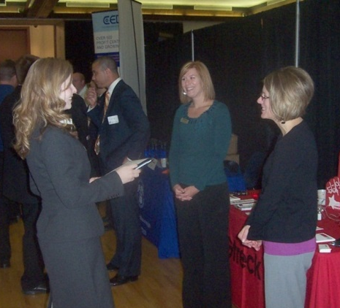
Career Fair
Career fairs and on-campus recruiting comprise more than half of employers’ recruiting budgets for interns and co-op students.
Career fairs and on-campus recruiting are rated highest in effectiveness for recruiting interns and co-ops.
Source: 2013 Internship & Co-op Survey, National Association of Colleges and Employers
Notes:
About 1000 employers were invited, about 306 participated, about 28 percent from the Midwest

Slide 12
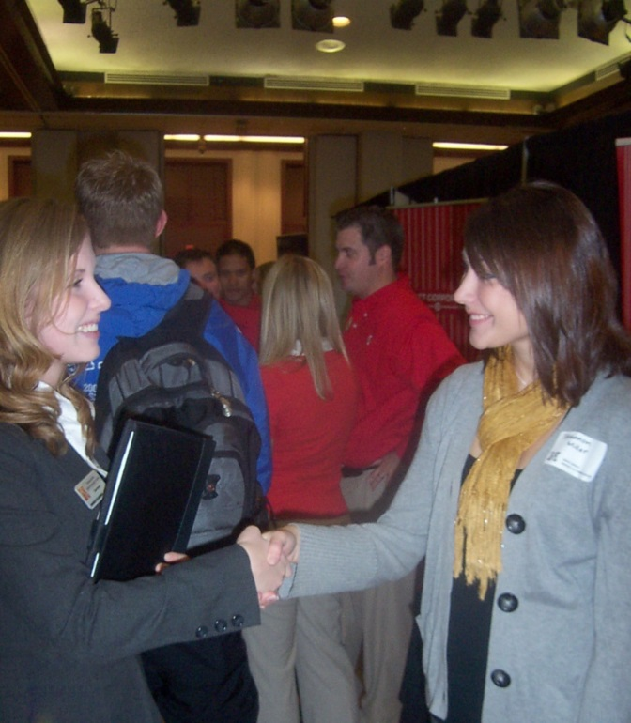
Attending career fairs
Before the fair
Review list of organizations and plan to visit wide range
Clear your calendar for the fair and day after
At the fair
Distribute resume or ask for information on online applications
Ask how to follow-up

Slide 13
Greeting People at Fairs
Nametags – Right side
Introduce yourself with handshake and
One-Minute Commercial
your name, career objective, what information you need
EXAMPLE: “Hello. I’m Laney Bela, a freshman in Computer Science. My goal is to develop software that will ease…..I'm interested in learning more about software development internships.

Slide 14
Appropriate Attire - Professional
Varies by Organization/Industry
Usually neutral color suit in a solid or subtle pattern
For Women
Pants or skirt (knee length)
Blouse or shell
Simple jewelry and make-up
Closed toe shoes
For Men
Long-sleeve collar shirt
Conservative tie
Polished leather shoes and belt

Slide 15
Appropriate Attire – Business Casual
Wide range, allows more creativity
Neat, clean, put together
Avoid
Athletic wear, sneakers, flip-flops
Too tight or revealing
Logos, images, phrases
Stock Up On
Leather shoes/belts
Dark pants, skirts
Sweaters and jackets
Button shirts and blouses

Slide 16
Career Services
225 Nebraska Union
402-472-3145
Walk-Ins M-F, 10 AM to 4 PM
By Appointment M-F, 8 AM to 5 PM
Career Services at CBA
138 CBA
Career Services East
303 Nebraska East Union
www.unl.edu/careers

