Slide 1
Computer Engineering

Slide 2
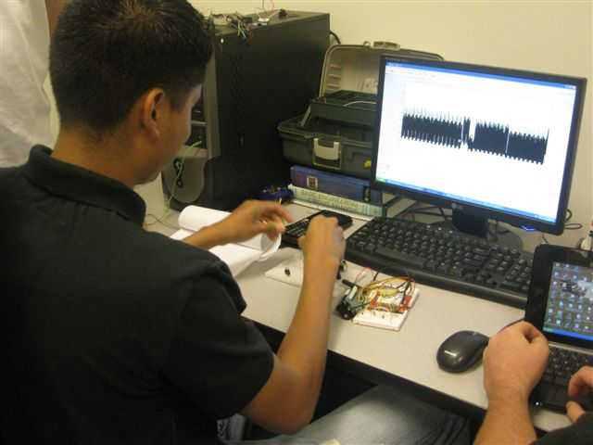
Computer Engineering (CE)
Core Curriculum
Computer Science Courses
Electrical Engineering Courses
Math Courses
Natural Science Courses
Achievement Centered Education (ACE)
Math Minor
Possible Double Major with EE

Slide 3
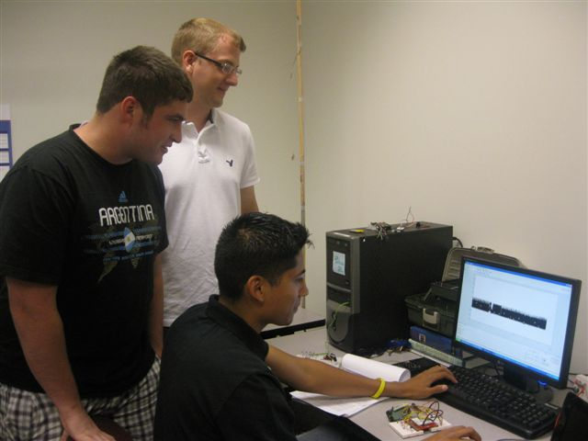
Computer Engineering (CE)
Capstone Course
Professional Development
Ethics
Current events in the field
Senior Design
Hands-on project development and design
Teamwork skills
Presentation opportunities

Slide 4
Support
Academic Advising
Dr. Charles Riedesel, Chief Undergraduate Adviser
riedesel@cse.unl.edu – Avery Hall 259
Open Door policy for all faculty
Student Resource Center
Avery Hall Room 13
9 am – 7 pm Monday - Friday
Tutor matching
Student Advisory Board

Slide 5
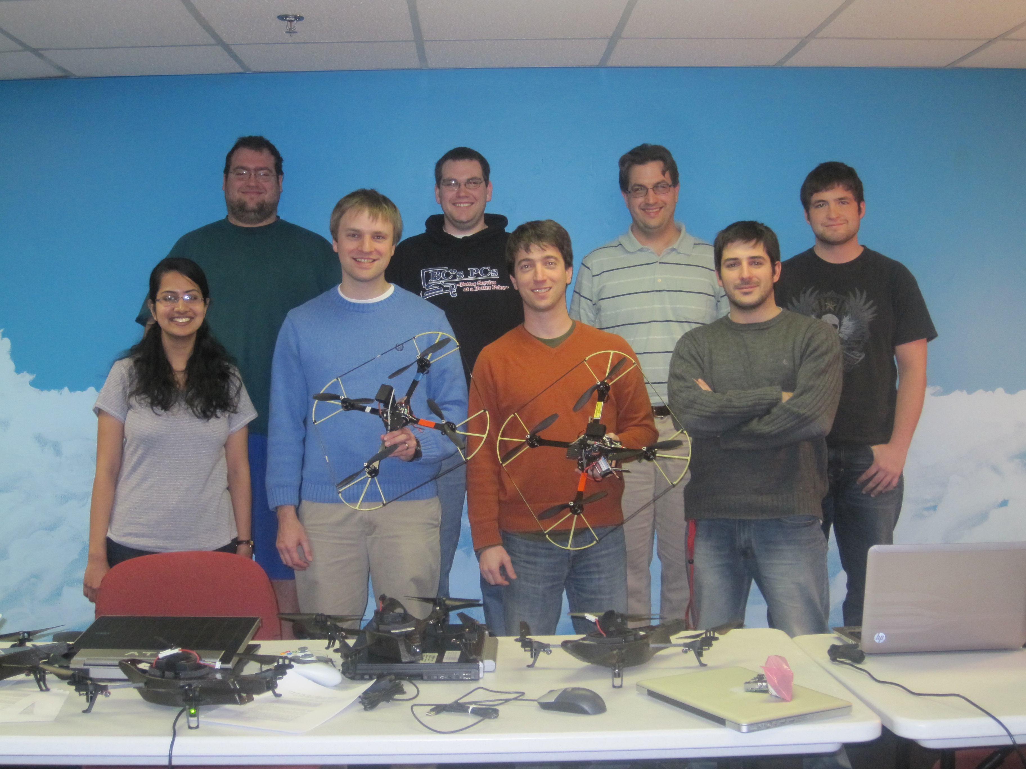
Student Opportunities
Undergraduate Research
Undergraduate Creative Activities and Research Experiences (UCARE)
9 currently funded projects with 6 different faculty
4 first-year students ($2000)
5 second-year students ($2500)
Summer REUs
14 million in active research grants
Interdisciplinary with members from 7 colleges

Slide 6
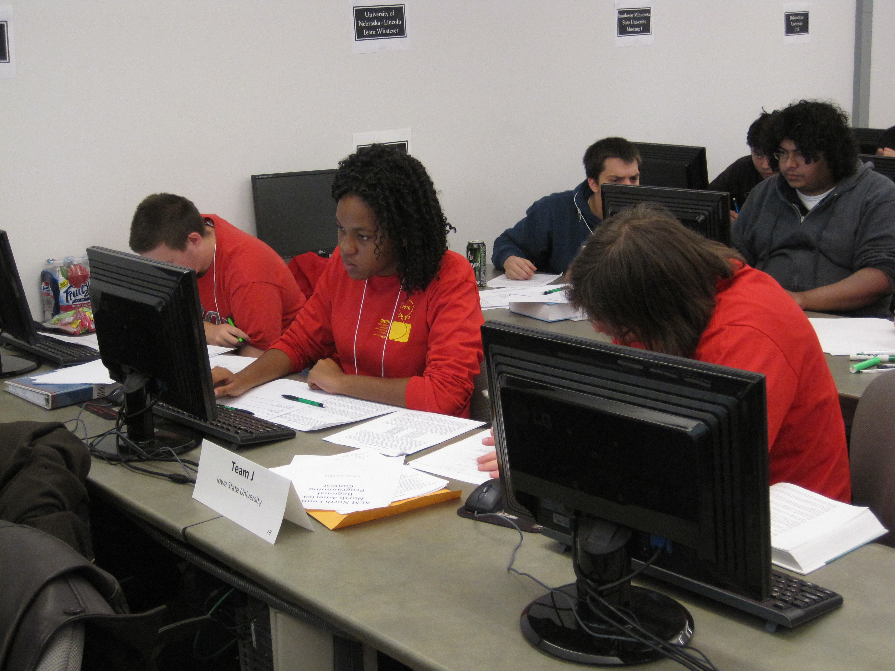
Student Organizations
ACM Student Chapter
Programming Contest
Visit local companies
Bowling tournament (students vs. faculty)
NDev (Nebraska Game Development Club)
Game Development & Competitions
Connection to Electronic Arts
http://ndev.webs.com/

Slide 7
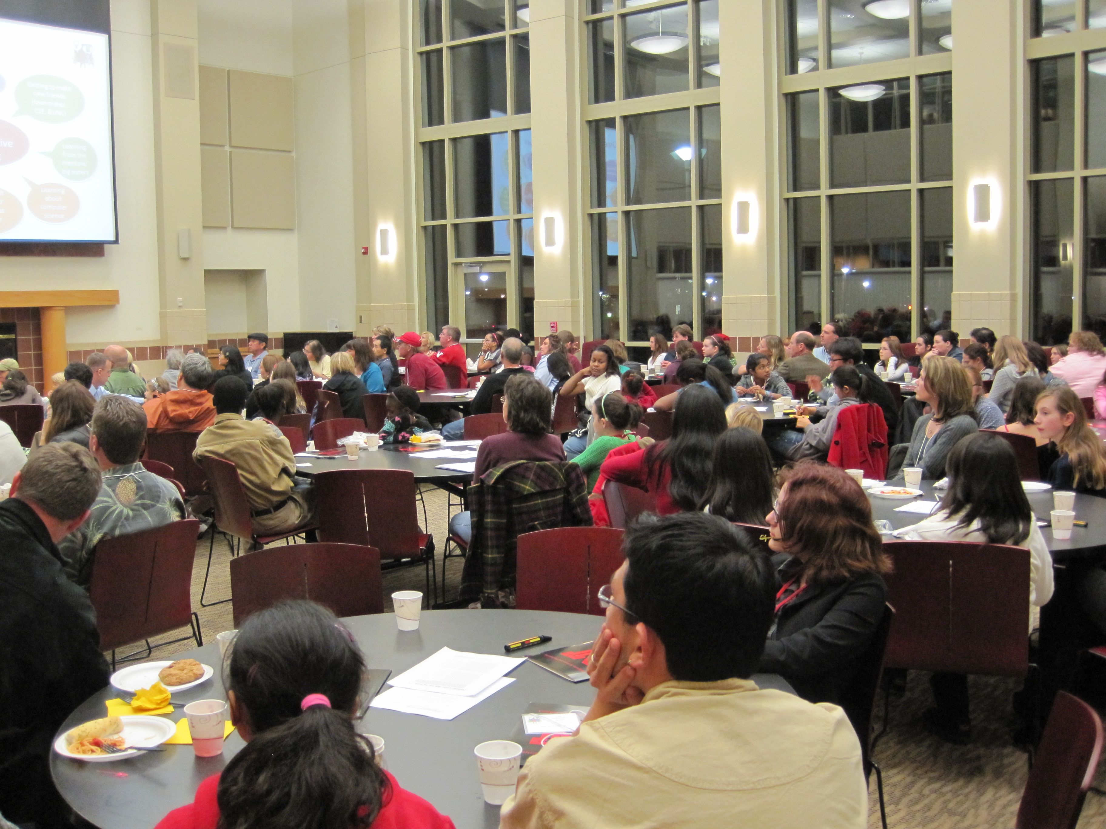
Student Organizations
Association for Women in Computing
Institute of Electrical and Electronics Engineers (IEEE)
Society of Women Engineers

Slide 8
Beyond Graduation
100 % placement in the workforce
68% complete internships
Competitive starting salaries
$56,000 for CE
$53,708 for CS
International, national, regional & local companies interested in UNL graduates

Slide 9
Beyond Graduation
National Instruments
IBM
General Electric
Cerner
Garmin
Microsoft
Sprint/Nextel

Slide 10
www.engineering.unl.edu

