Slide 1


RadioShift: A Framework Measuring the Robustness of Lightweight Neural Networks over RF Signals
Anagh Mishra¹, Phu Le¹, Ryan Evans¹,
Nirnimesh Ghose², Boyang Wang¹
¹University of Cincinnati ²University of Nebraska-Lincoln
2026 IEEE National Aerospace and Electronics Conference
August 9 - 12, 2026

Slide 2
Outline
Motivation
Our Contributions
Our Design
Dataset & Evaluation
Discussion & Conclusion

Slide 3
Motivation
Modification Classification identifies specific modulation(e.g., BPSK, QAM) used by a transmitter over Radio Frequency signals (before decoding)
Applications: military, spectrum management, cognitive radio, signal decoding (non-cooperative scenarios)
Deep neural networks have been introduced to perform modulation classification and offer high accuracy (e.g., >90%)

Slide 4
Motivation
However, neural networks for modulation classification are computationally intensive and require GPUs, → difficult to deploy on wireless devices for real-time RF processing.
Tiny models on FPGAs are available, however, lack of comprehensive evaluations on robustness given domain shifts on RF signals (fading, noise, offset, Doppler shift, etc.)
Our Goal: (1) generating RF signals with domain shifts and (2) understanding robustness of ML on FPGAs

Slide 5
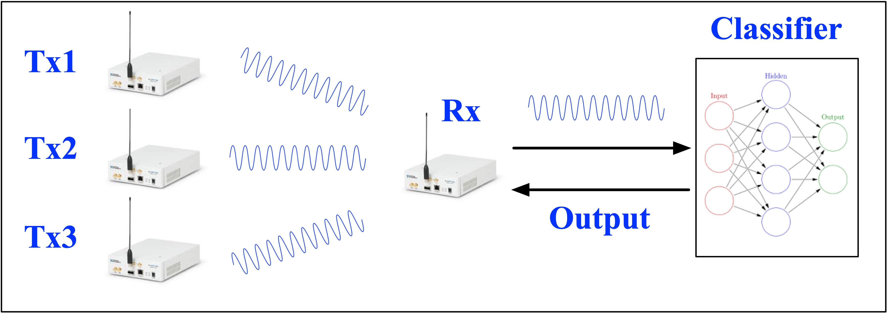
Modification Classification
A receiver performs modulation classification over RF signals
I/Q samples are used as inputs to a classifier (neural network)
Classifier should be not on a remote cloud but on the receiver for real-time classification

Slide 6
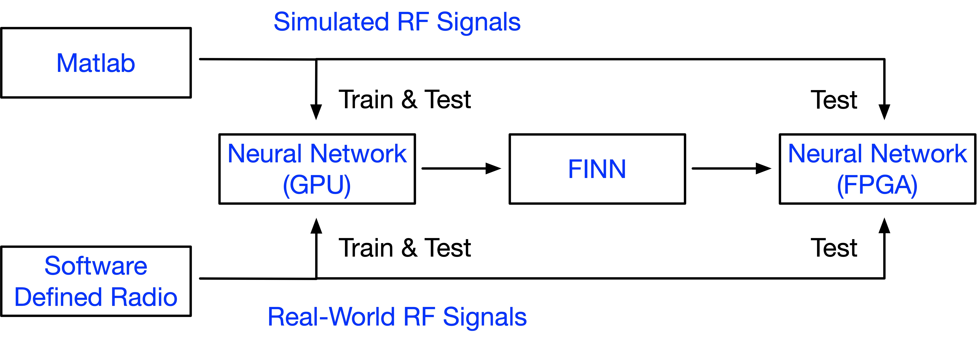
Our Contributions
RadioShift: an end-to-end framework (1) generating simulated RF signals with domain shifts; (2) collecting real-world RF signals from USRPs; (3) training ML on GPUs; (3) transforming, deploying, and testing ML on FPGAs

Slide 7
Our Contributions
RQ1: To what extent do domain shifts in RF signals cause accuracy degradation on lightweight neural networks for modulation classification?
RQ2: Which factor in wireless communication can cause more severe accuracy degradation?
Investigate 2 factors: channel fading (Rician vs Rayleigh) and hardware imperfections (minor vs severe in parts-per-million)
Examine a tiny quantized ML (160,079 parameters) on Xilinx ZCU104 FPGA Board

Slide 8
Our Contributions
RadioShift Dataset: 3.9 million simulated I/Q frames (15 modulations, 0dB – 30dB SNRs); 16K real-world I/Q frames (4 modulations)
F1: Domain shift indeed causes severe accuracy degradation (e.g., 82% to 29%)
F2: Hardware imperfections lead to significant accuracy drop while the impacts of channel fading are minor
F3: Accuracy degradation is not even across all classes
F4: Accuracy in FPGAs is not consistent with the one from GPUs

Slide 9
Problem Formulation
An I/Q frame consists of k (e.g., 1024) I/Q samples
Each I/Q sample has 2 numbers (I for in-phase, Q for quadrature)
A total of m modulation types
n*m I/Q frames in total (training + testing)
Classifier F: trained and then test
Accuracy: given x I/Q test frames, y are predicted correctly, accuracy is y/x

Slide 10
Our Simulated RF Signals
We use/expand Matlab [1] to generated simulated RF signals
  15 modulations: 12 digital (BPSK, QPSK, 8PSK, 16/32/64/128/ 256 QAM, 16/32/64/128 APSK) and 3 analog (FM, AM-DSB-SC, AM-SSB-SC)
  Digital source: random integers -> complex symbols -> up-sampled -> pulse shaping (root-raised-cosine filter)
  Analog source: audio sequences
  Rician: line-of-sight; Rayleigh: non-line-of-sight
  Hardware imperfections: parts-per-million (PPM, up to 20)
[1] https://www.mathworks.com/help/comm/ug/modulation-classification-with-deep-learning.html

Slide 11
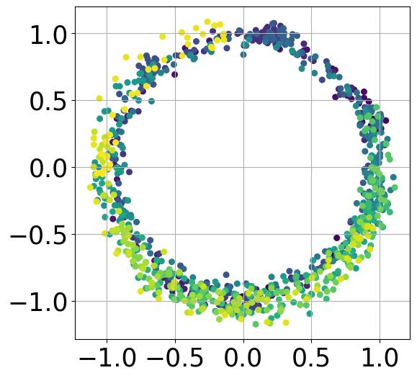
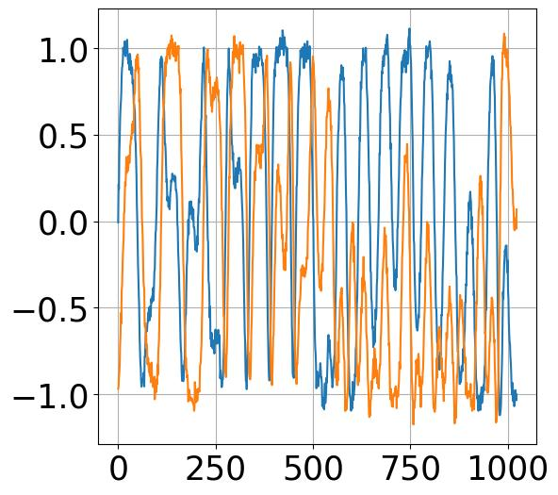
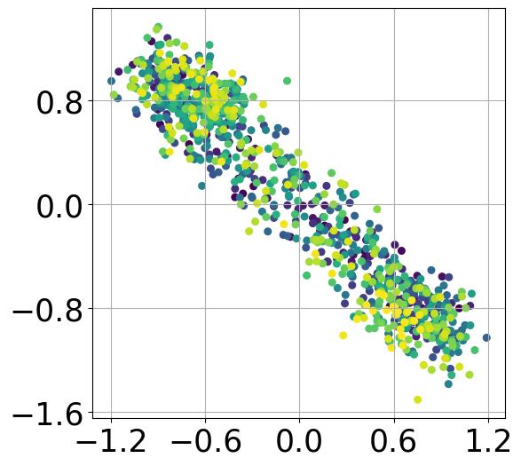
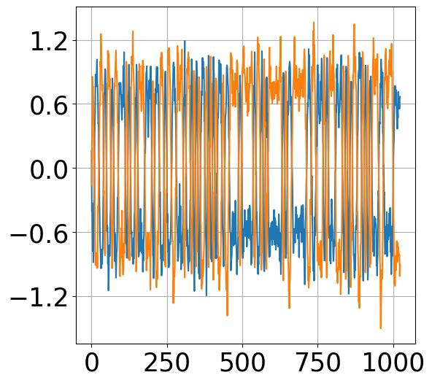
Our Simulated RF Signals
Additive white Gaussian noise -> 0db -30db SNRs
Samples per frame: 1024
Sampling rate: 200kHz
Center frequency: 902MHz (Digital), 100MHz (Analog)
Example I/Q Samples and Frames (Rayleigh, 1ppm, 30dB)
FM I/Q Samples
FM I/Q Frame
BPSK I/Q Samples
BPSK I/Q Frame

Slide 12
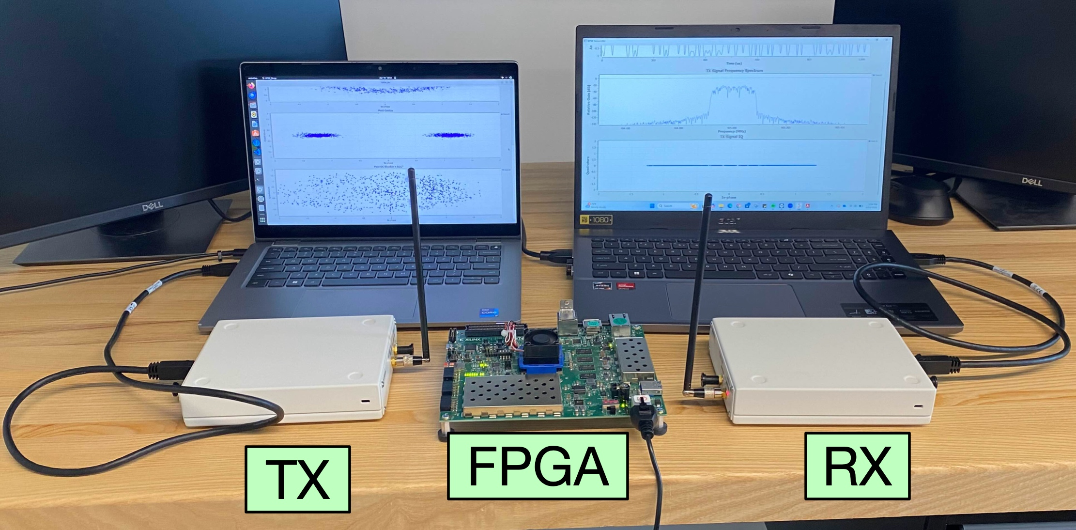
Our Real-World RF Signals
We USRPs to generated real-world RF signals
  4 modulations: 4 digital (BPSK, QPSK, 8PSK) and 1 analog (FM)
  FM: signal from radio station
  B/Q/8PSK: Tx: root raised cosine for pulse shaping; Rx: digital DC blocker, automatic gain control block

Slide 13
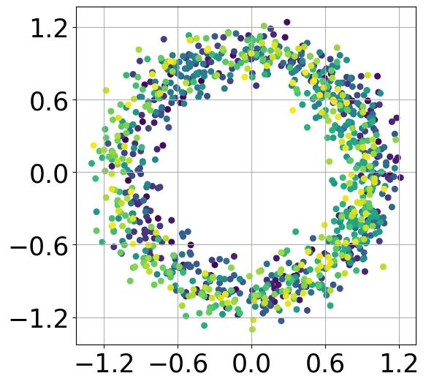
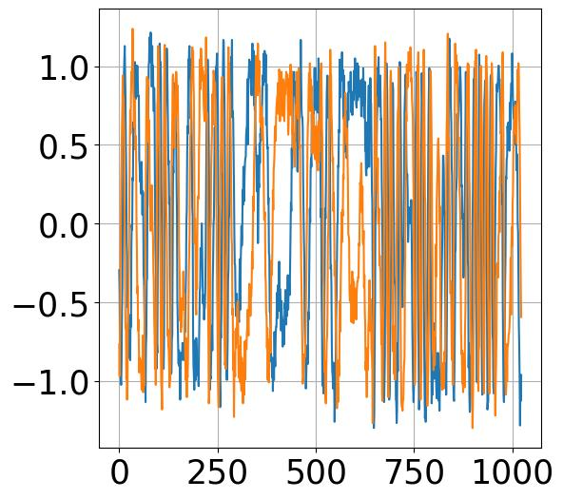
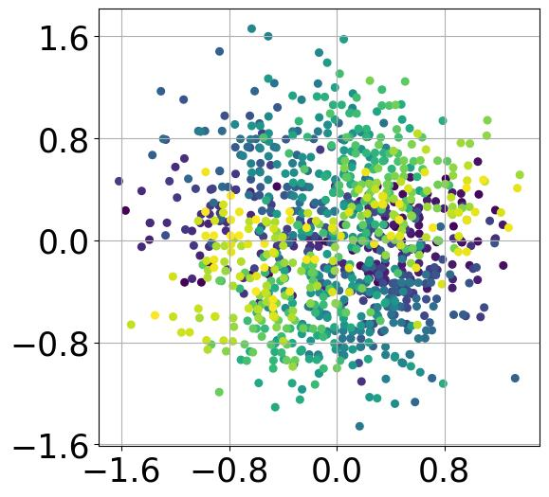
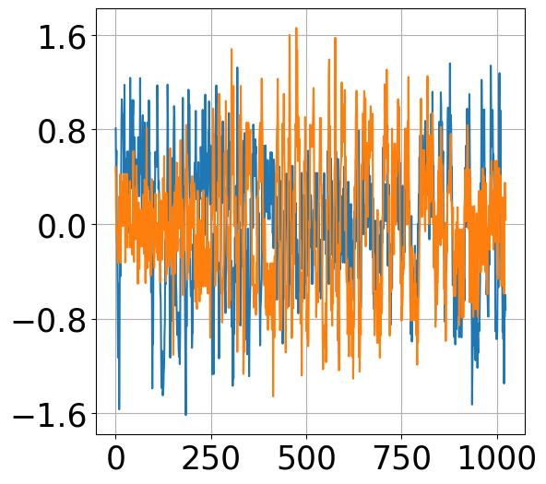
Our Real-World RF Signals
  915 MHz band
  1MHz sampling rate
  I/Q samples collected after automatic gain control on Rx
  Samples per frame: 1024
Example I/Q Samples and Frames (USRP, lab environment)
FM I/Q Samples
FM I/Q Frame
BPSK I/Q Samples
BPSK I/Q Frame

Slide 14
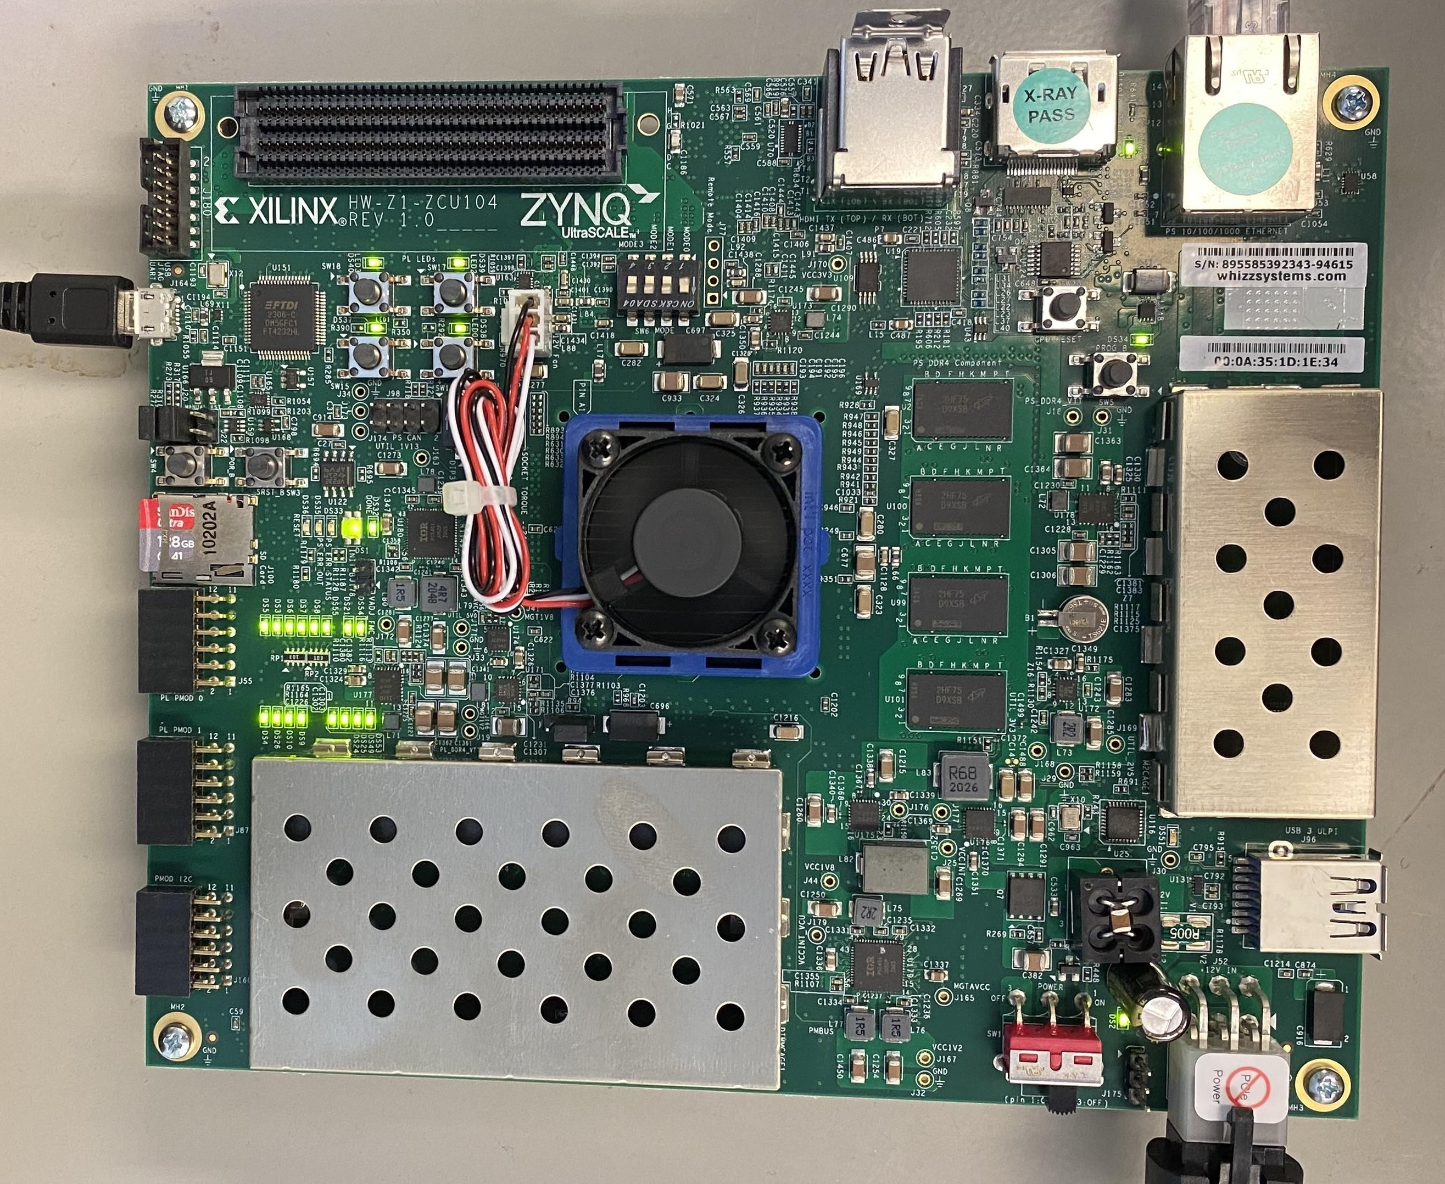
ML Transformation (GPU → FPGA)
We leverage FINN (Fast, Scalable, Quantized Neural Network Inference on FPGAs) from AMD
A High-Level Synthesis framework
  A neural network (in PyTorch) is first trained on GPU
  Apply multiple transformations in format and layer replacement
  Pass it to FINN
  A neural network (in Verilog/VHDL)
  Compile and load to a FPGA
AMD ZCU104
FPGA Board
[1] https://github.com/Xilinx/FINN

Slide 15
Dataset
RadioShift: includes 4 subsets Rician-PPM1, Rician-PPM20, Rayleigh-PPM1, Rayleigh-PPM20
Each subset: 4096 I/Q frames per modulation per SNR level
1,024 I/Q samples per frame
15 modulations
16 SNR levels (0dB – 30dB, 2dB increment)
3,932,160 I/Q frames in total
RadioShift-USRP: 4096 I/Q frames per modulation
1,024 I/Q samples per frame
4 modulations
16,384 I/Q frames in total
Our framework can easily
generate more I/Q frames
when needed

Slide 16
Evaluation
I/Q samples in int8
80% for training, 10% for validation, 10% for testing
Baseline NN: a lightweight VGG10 --- 7 Convolutional Blocks, one linear blocks, and 1 final linear layer
Conv block: 1 conv layer, 1 batch normal, 1 ReLu, 1 max pooling
Linear block: 1 linear layer, 1 batch normal, 1 ReLU
160,079 parameters in total
NNs are trained with a server with Nvidia RTX Titan GPU
Each NN is trained with 150 epochs (early stop of 10 epochs)
Quantize-aware training

Slide 17
Evaluation 1: Train & Test with Same Dataset
Accuracy decreases when we further quantize weights from 8bits to 2bits (expected tradeoff)
4-bit models offer good balance between accuracy and power/utilization on FPGAs
Dataset | Baseline (GPU, 8bit) | FPGA (8bit) | FPGA (4bit) | FPGA (2bit)
Rician-PPM1 (30dB) | 81.0% | 84.0% | 82.2% | 70.5%
Rican-PPM20 (30dB) | 75.1% | 77.9% | 81.0% | 69.4%
Rayleigh-PPM1 (30dB) | 84.1% | 86.5% | 82.3% | 63.0%
Rayleigh-PPM20 (30dB) | 81.0% | 85.1% | 79.5% | 71.7%

Slide 18
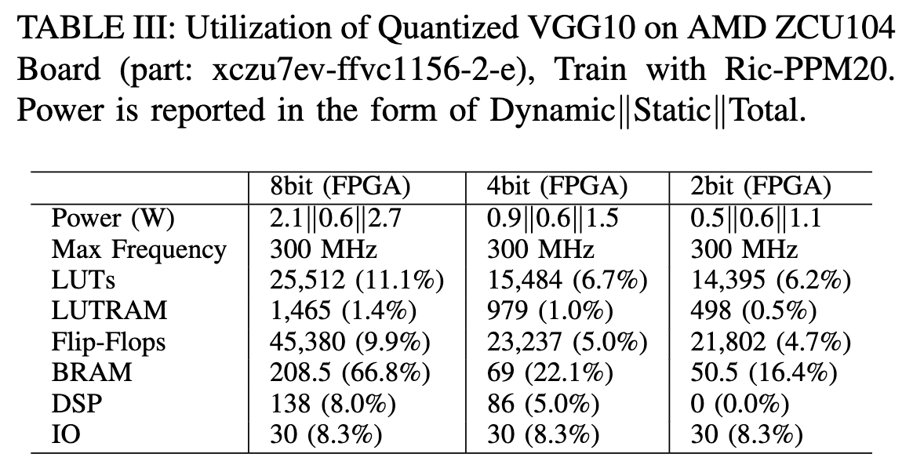
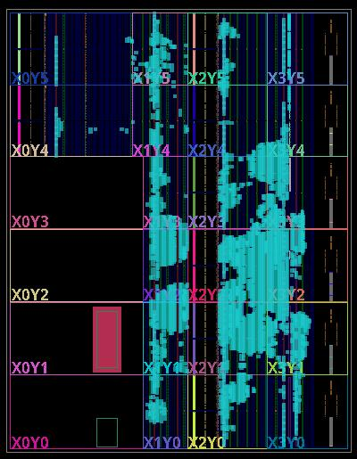
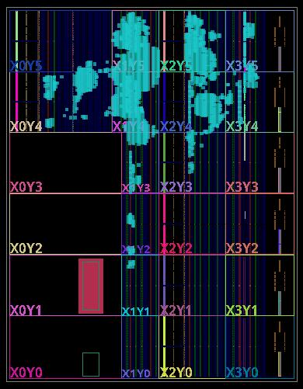
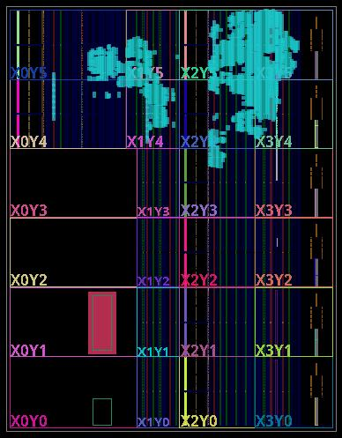
Evaluation 1:
8bit -> 4bit saves significant resources on FPGA
4bit -> 2bit does not save significant resources
8-bit
4-bit
2-bit

Slide 19
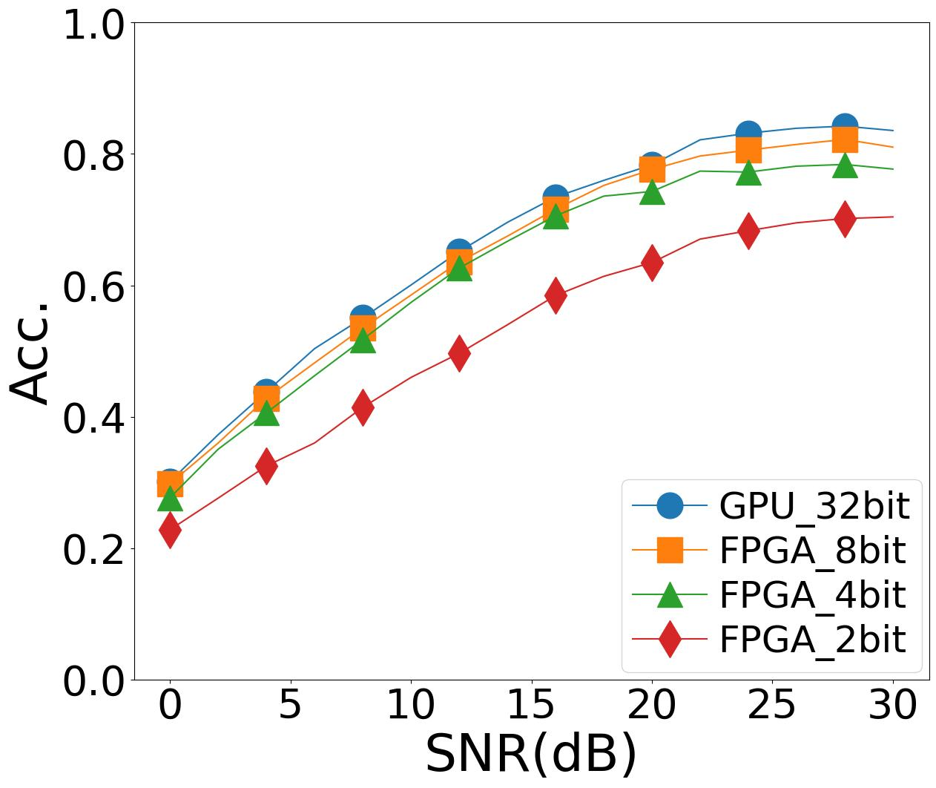
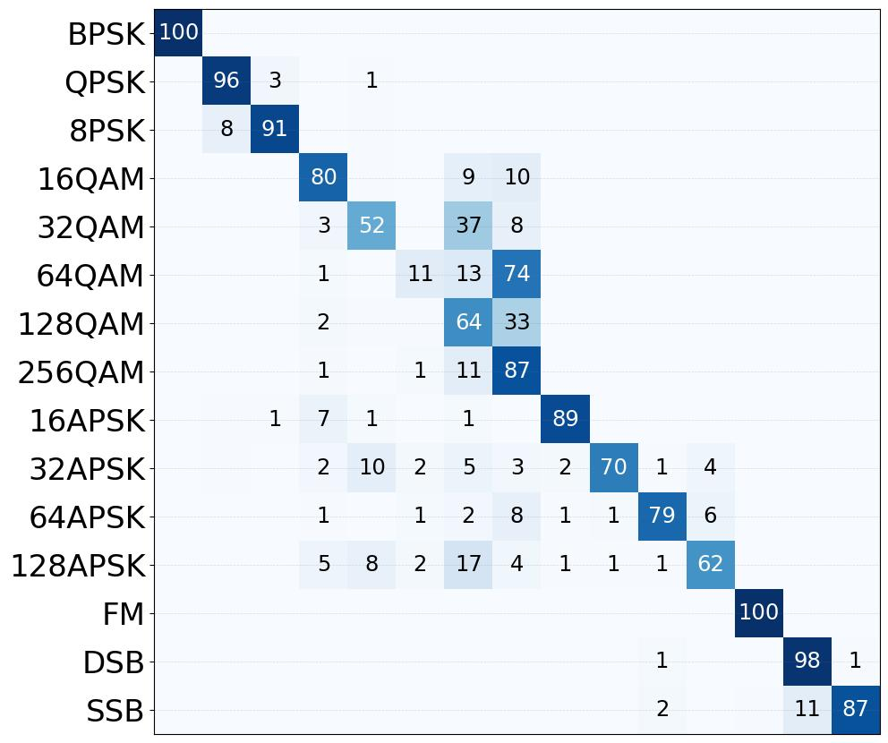
Evaluation 1: Train & Test with Same Dataset
Higher SNR -> higher accuracy
Higher-order comp modulation -> lower accuracy
Train and Test on Rayleigh-PPM20 (confusion matrix 30dB only)

Slide 20
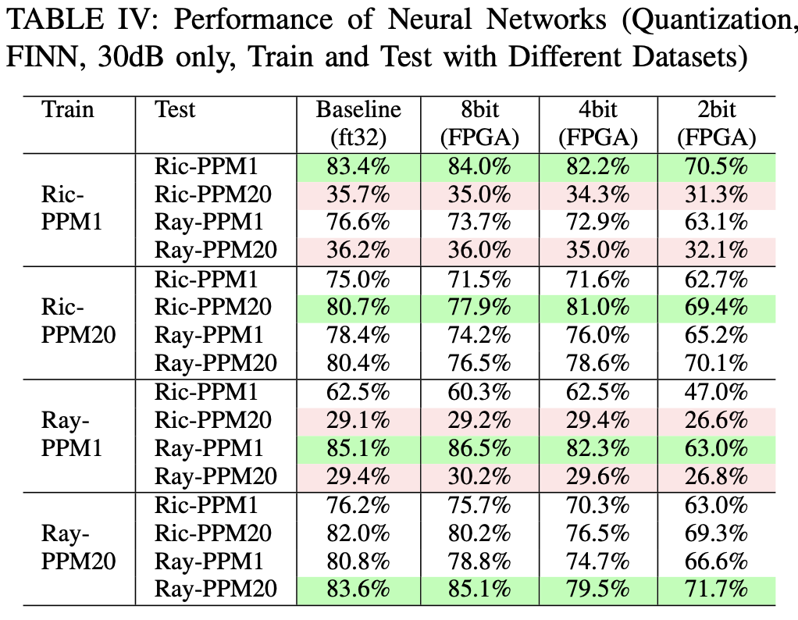
Evaluation 2: Train & Test with Different Datasets
Accuracy decreases given domain shifts between training and test RF data

Slide 21
Evaluation 2: Train & Test with Different Datasets
Accuracy decreases given domain shifts between training and test RF data
Discrepancy in channel fading → minor accuracy drop

Slide 22
Evaluation 2: Train & Test with Different Datasets
Accuracy decreases given domain shifts between training and test RF data
Discrepancy in channel fading → minor accuracy drop
Discrepancy in PPM (or hardware imperfections) → severe accuracy drop

Slide 23
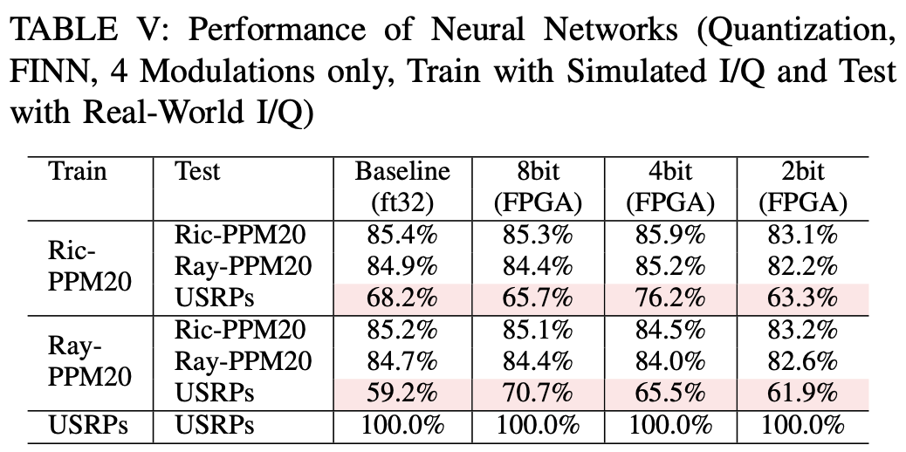
Evaluation 3: Train & Test with Real-World RF
Accuracy decreases further given domain shifts between simulated and real-world RF data
c

Slide 24
Evaluation 3: Train & Test with Real-World RF
Accuracy decreases further given domain shifts between simulated and real-world RF data
Accuracy 100% train and test with real-world RF (as USRP data is small with less noise/shifts)

Slide 25
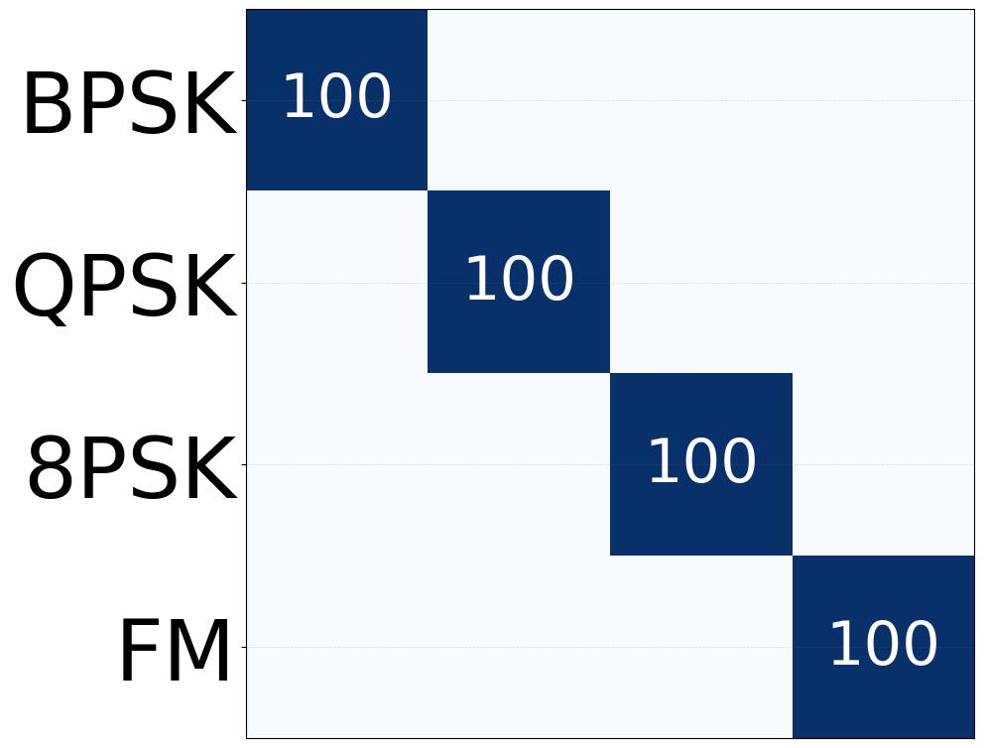
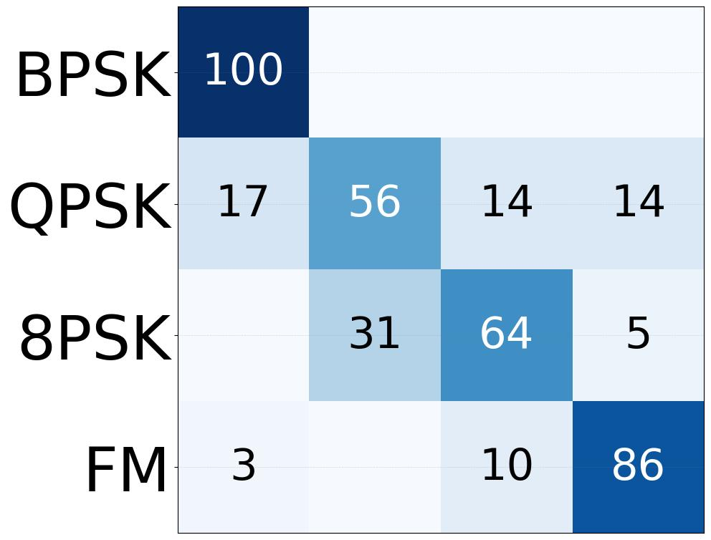
Evaluation 3: Train & Test with Real-World RF
Accuracy drop not even across modulations
FM and BPSK still achieve high accuracy given domain shifts
Train: USRP, Test: USRP
Train: Rician-PPM20, Test: USRP

Slide 26
Conclusion and Future Work
Conclusion: An end-to-end framework measuring robustness of ML on FPGAs for RF classifications
Challenges: significant (but enjoyable) efforts on the integration of wireless, machine learning, and FPGAs
On-Going and Future Work: (1) add more real-world modulation types on USRP; (2) extend to other RF classifications (device fingerprinting); (3) robustness under adversary scenario (jamming)

Slide 27




Thank You! Q&A
Data and System Security Lab (DaSec) at UC https://github.com/UCdasec
CHEST: Center in Hardware and Embedded Systems Security and Trust: https://www.nsfchest.org/
IEEE NAECON 2026, “RadioShift: A Framework Measuring the Robustness of Lightweight Neural Networks over RF Signals” https://github.com/UCdasec/RadioShift
Tutorial videos and documents are available on our GitHub repo for reproducing results and expanding datasets

