Slide 1
SARP: Spatial Agnostic Radio Fingerprinting with Pseudo-Labeling
Fahmida Afrin⃰, Haipeng Li⸶, Boyang Wang⸶, and Nirnimesh Ghose ⃰
⃰ School of Computing, University of Nebraska – Lincoln
⸶Department of Electrical and Computer Engineering, University of Cincinnati
IEEE Consumer Communications & Networking Conference
January 10–13, 2025

Slide 2
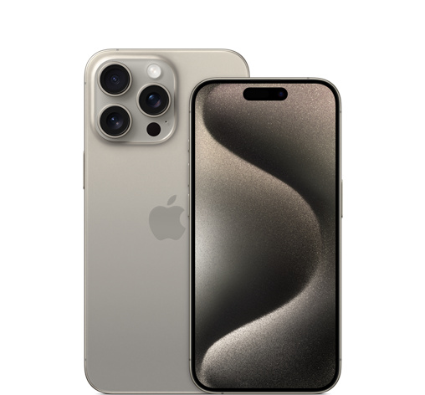
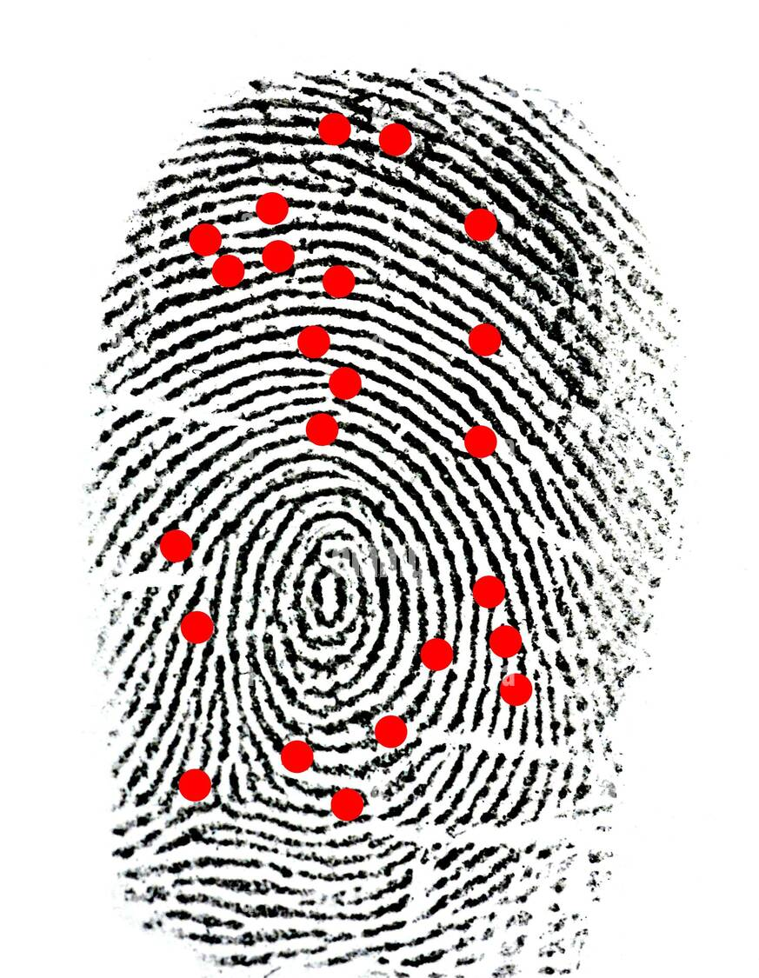
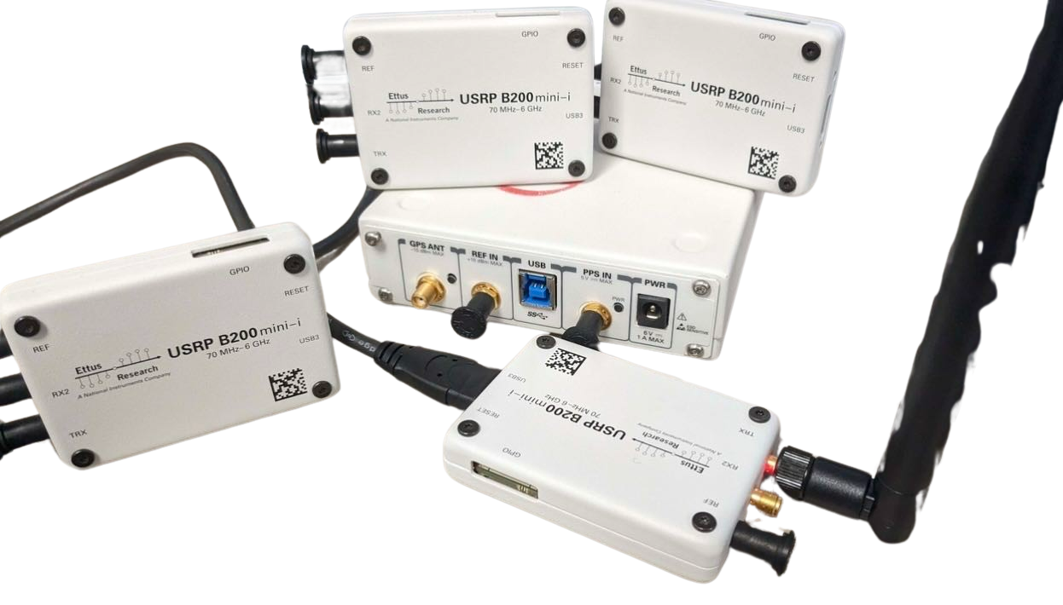
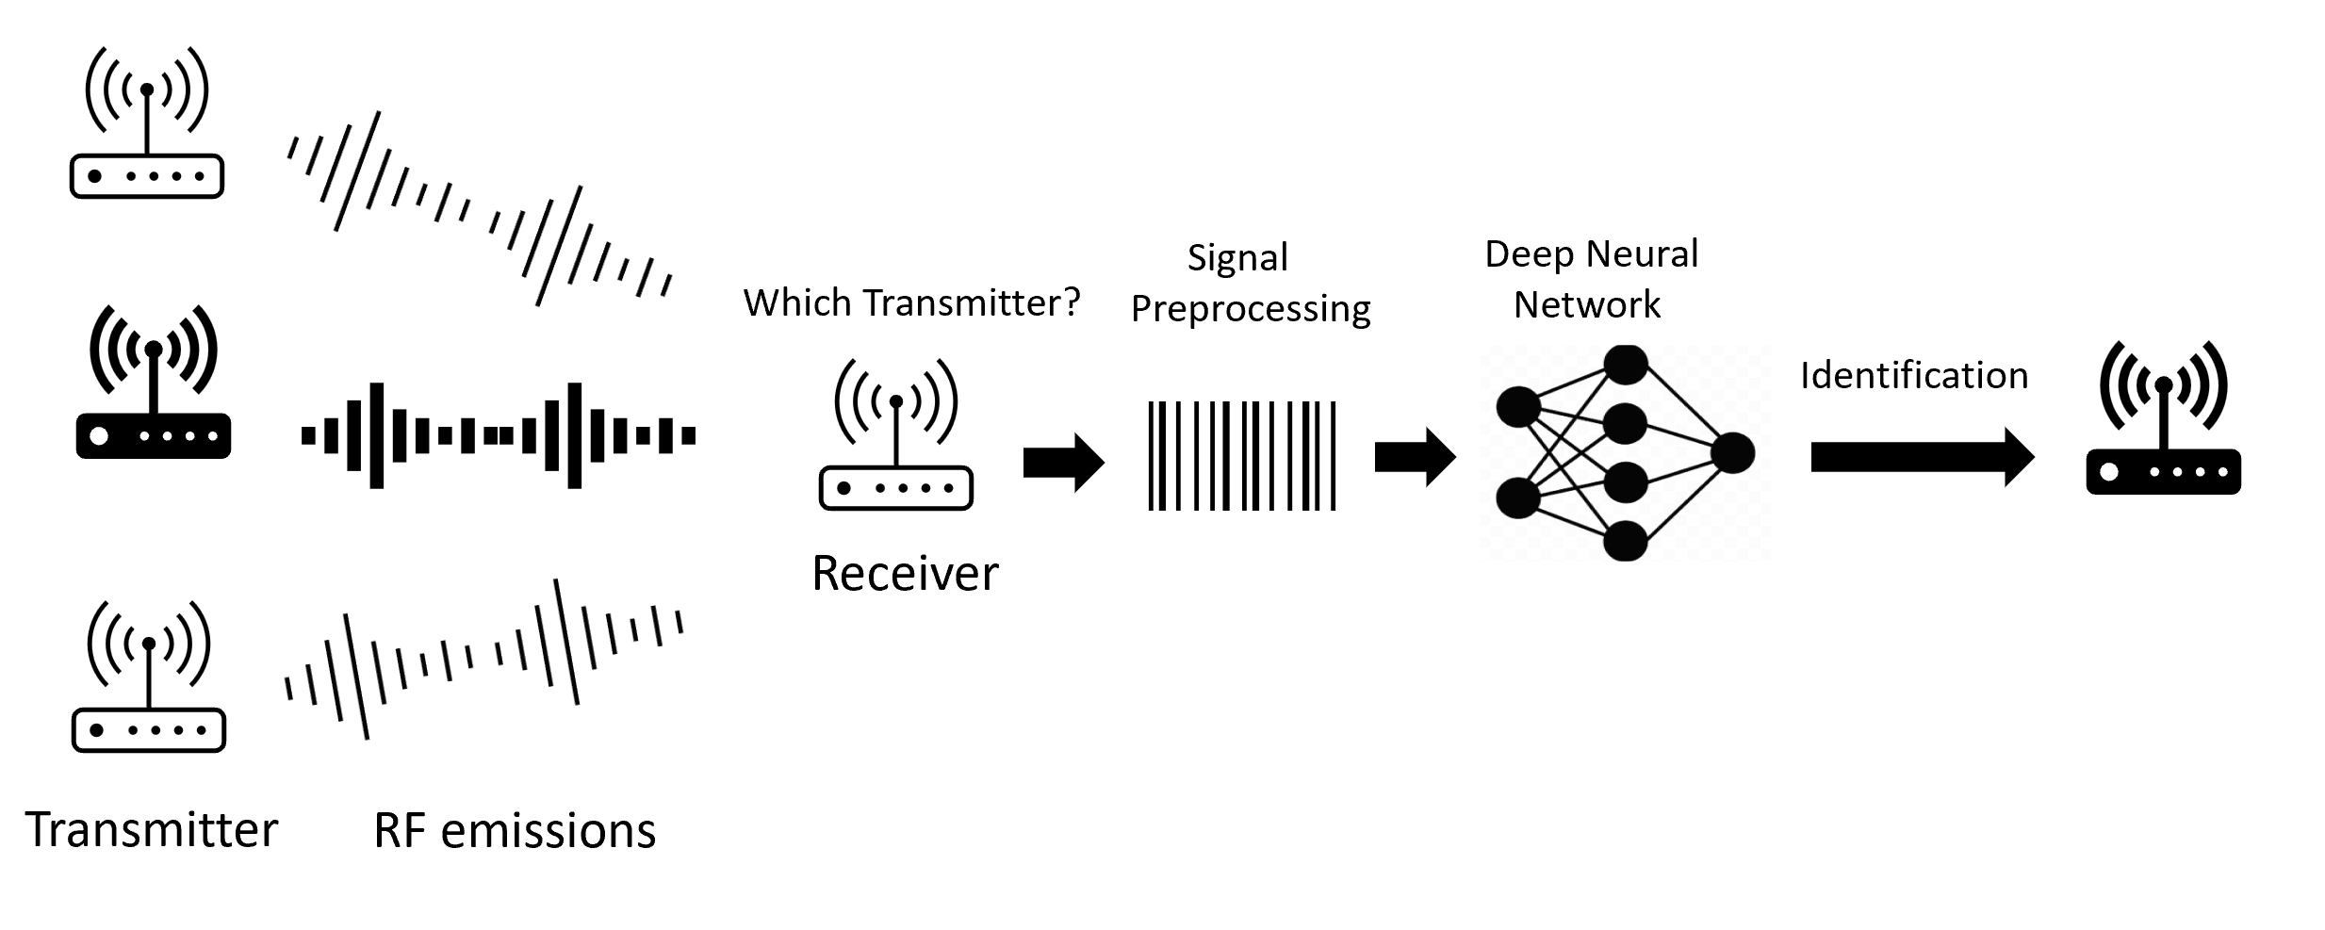
Introduction
No two devices share an identical fingerprint.
Uses:
Device Identification
Device Authentication
RF fingerprinting

Slide 3
Radio Frequency (RF) Fingerprinting
Uniqueness Causes:
Hardware impairment caused by manufacturing process variation.
Serves as discriminative features
Examples: Phase Noise, Nonlinear Distortion, IQ imbalance, DC offset, Non-linear power amplifier gain, among others.

Slide 4
Motivation
Poor performance of traditional deep-learning models in radio fingerprinting under spatial variations.
Mitigate the loss of critical interdependencies caused by separating real and imaginary components in real-valued CNNs.
Bridge the gap in applying Complex-Valued Neural Networks (CVNNs) to real-world RF signals with spatial variations.
Reduce dependency on labeled data from new locations.

Slide 5
Objectives
Develop a CVNN-based method with pseudo-labeling for spatially robust fingerprinting.
Fine-tune models with unlabeled data while retaining I/Q component correlations.
Validate real-world datasets and optimize activation functions for accuracy.

Slide 6
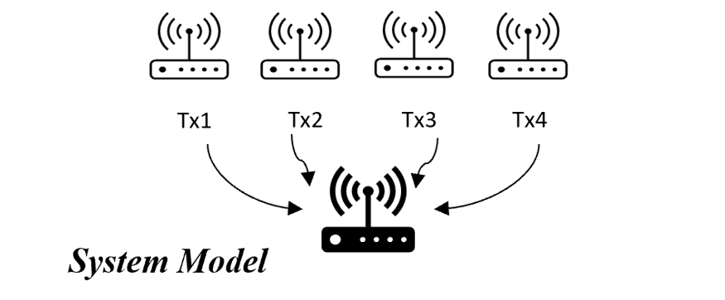
System Model
Setup:
Multiple transmitters, one receiver.
Training Phase:
Receiver collects RF signals
Server trains a classifier.
Authentication Phase:
Classifier identifies transmitters from new RF signals.

Slide 7
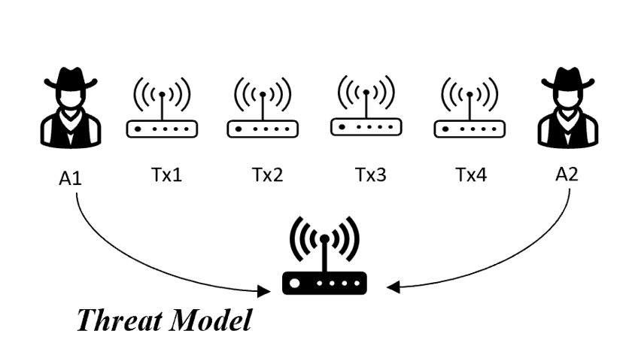
Threat Model
Training Phase:
Trusted participants.
Authentication Phase:
Trained Attackers: e.g., Tx3 impersonating Tx1/Tx2.
Untrained Attackers: e.g., A1/A2 impersonating Tx1/Tx2/Tx3

Slide 8
SARP: Proposed Method
Combine Complex-Valued Neural Networks (CVNNs) and pseudo-labeling to address spatial variations.

Slide 9
Architecture & Settings
Hardware: Tesla V100 GPU, cuDNN 8.6.0.
Model: CVNN, 100 epochs, 0.1 learning rate, early stopping (patience 10).
Dataset: 10,000 I/Q traces, 72% train, 8% val, 20% test.

Slide 10
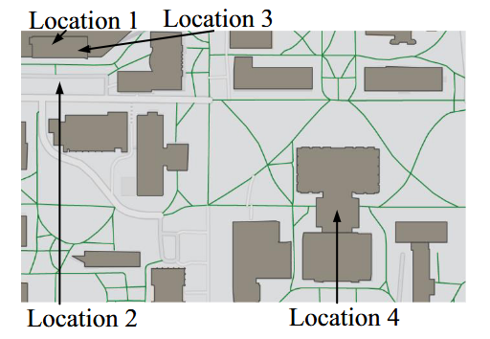
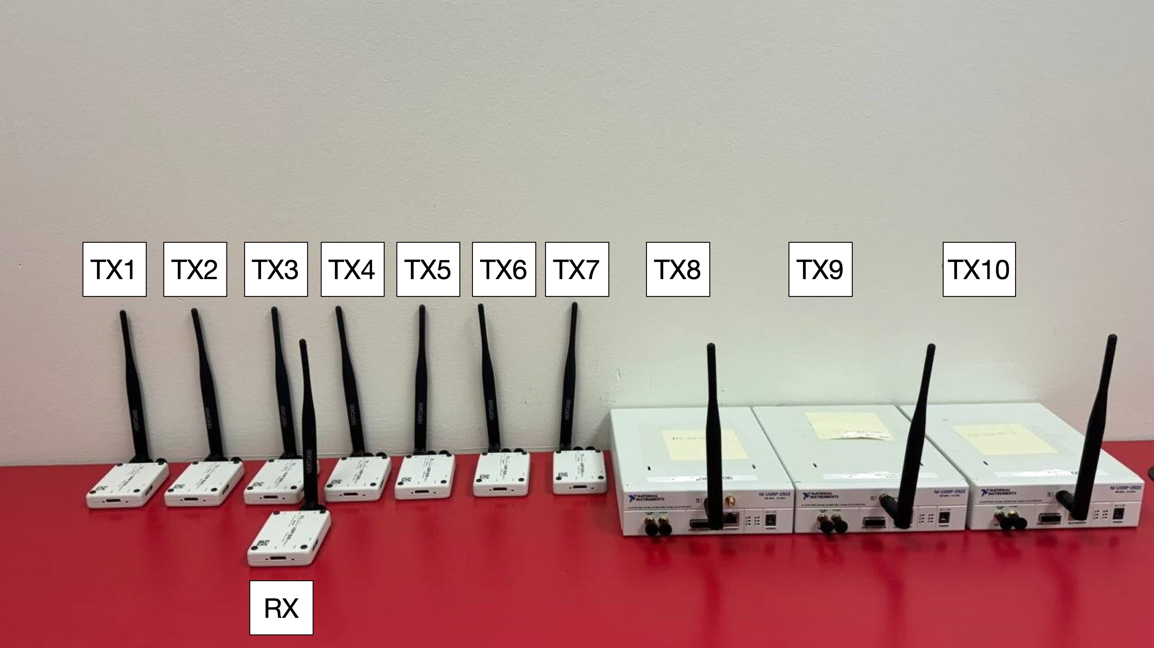
Experimental Setup
Transmitters: 3 USRP 2922 and 7 USRP B200-mini-i.
Receiver: 1 USRP B205-mini-i device.
Modulation: Wi-Fi transmissions using BPSK ½
Parameters:
Center frequency: 2.45 GHz.
Bandwidth: 2.5 MHz
Sampling rate: 5 MHz
Locations: I/Q_Loc1–I/Q_Loc4, devices stationary, 3 ft apart.
Sessions: 3 sessions/location, 30 sec each, 30-sec gaps.

Slide 11
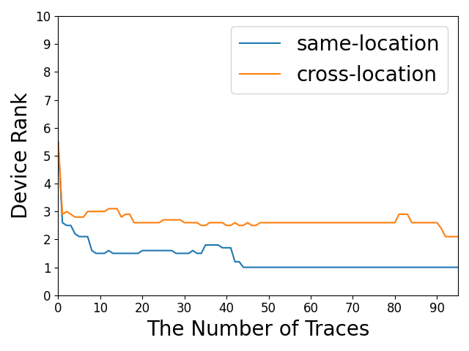
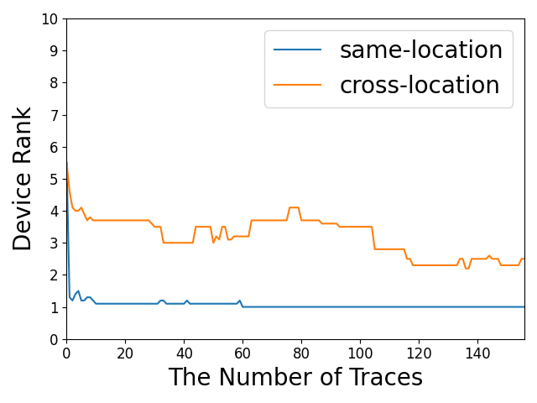
Experiment A: Baseline Performance of CVNN
Test from the same location, Higher accuracy, better distinction.
Test from different locations, Lower accuracy, poor distinction.
Activation Functions: CReLU, Complex Cardioid, Cart Leaky ReLU.
(a) Train: I/Q_Loc1, test: I/Q_Loc2
(a) Train: I/Q_Loc3, test: I/Q_Loc4

Slide 12
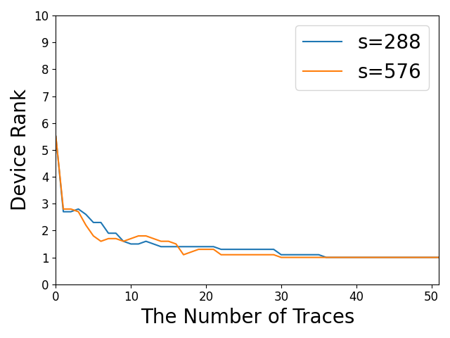
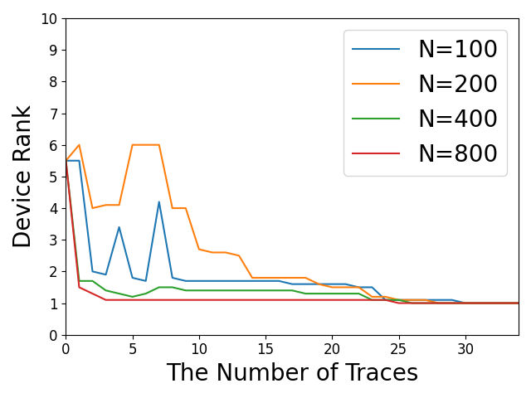
Experiment B: CVNN with Pseudo-Labeling
Accuracy improved to 62.8% with pseudo-labeling
Higher N boosted accuracy.
θ = 0.7 gave best accuracy
(a) Train: I/Q_Loc1, test: I/Q_Loc2
(a) Train: I/Q_Loc3, test: I/Q_Loc4

Slide 13
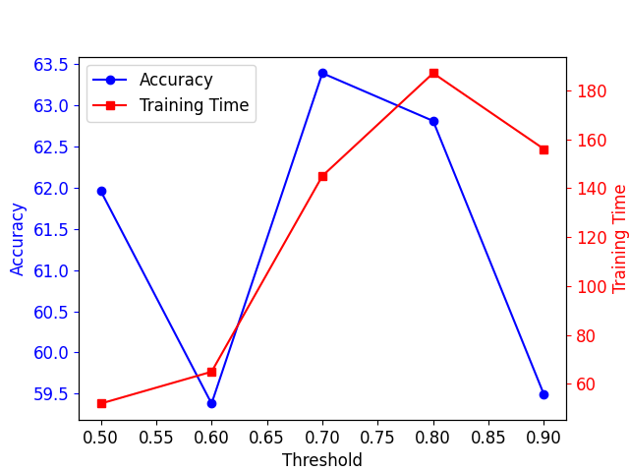
Experiment C: Timing information
Training: 7,200 I/Q traces (1.4 ms).
Fine-Tuning: 200–800 I/Q traces (20–160μs).
Finding: Pseudo-labeling improved cross-location performance.

Slide 14
Conclusion and Future Work
Improved model accuracy by using I/Q data as a single input to a CVNN.
Addressed domain shifts with pseudo-labeling for varying wireless environments.
Demonstrated CVNN outperforms CNN in radio fingerprinting.
Thank you for listening!!!
Questions???

