Slide 1
Unified Learning Model in multiagent system
Vlad Chiriacescu, Derrick Lam, Ziyang Lin

Slide 2
Background
Multiagent systems are environments in which multiple intelligent, autonomous agents may compete against one another to further their own interests or cooperate to solve problems that are too difficult for a single agent
The Unified Learning Model (ULM) developed by Shell et al. (2010) is a recent model that presents the learning process in a new light, combining various educational, psychological, and neurobiological studies and theories into a comprehensive view of human learning
The goal of the project is to design and implement an adaptation of the ULM for multiagent systems

Slide 3
Overview
ULM Adaptation
Simulation Scenario
Agent Design Strategy
Experiments and Results
Conclusions and Future Work

Slide 4
ULM Adaptation
Primary Components
Knowledge – the “crystallized form” of information in long-term memory
Motivation – reflects the agent’s interest or attention.
Working memory – receives and processes sensory information
Other Components
Knowledge Decay

Slide 5
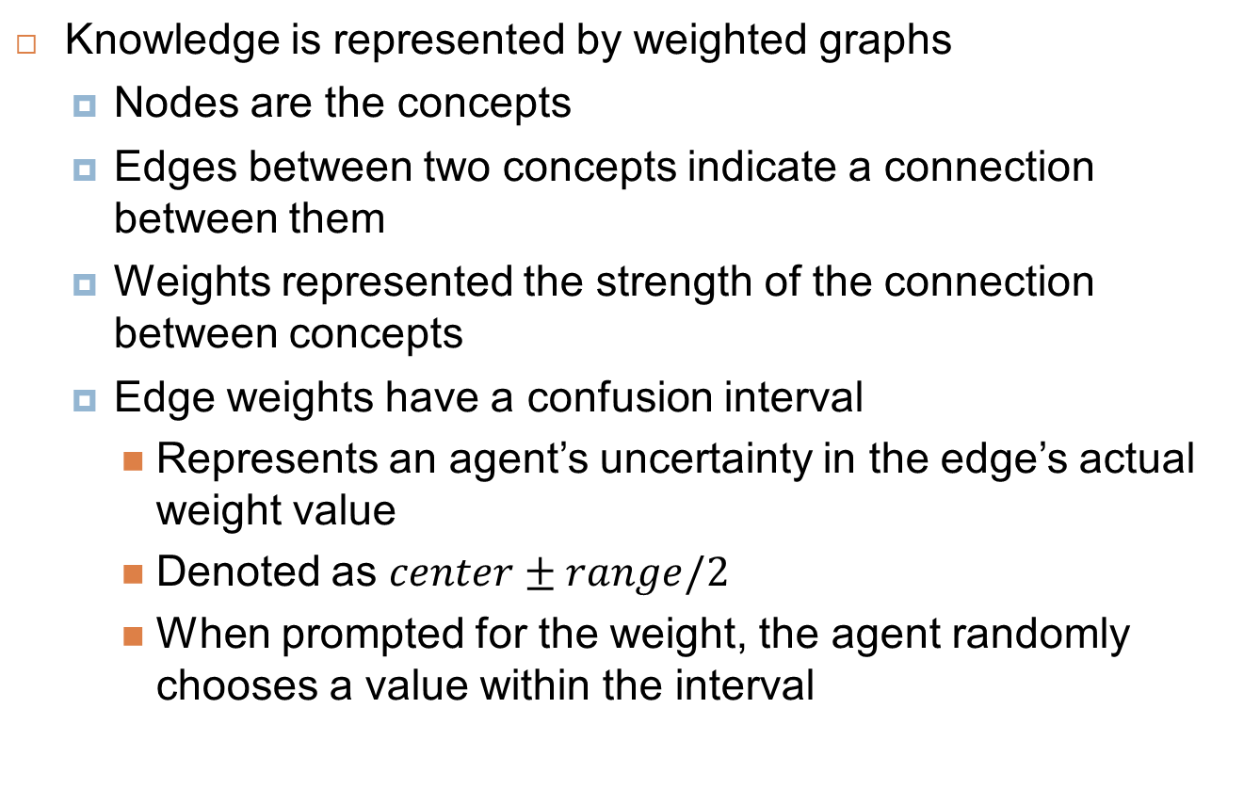
Knowledge
Knowledge is represented by weighted graphs
Nodes are the concepts
Edges between two concepts indicate a connection between them
Weights represented the strength of the connection between concepts
Edge weights have a confusion interval
Represents an agent’s uncertainty in the edge’s actual weight value
Denoted as $center±range/2$
When prompted for the weight, the agent randomly chooses a value within the interval

Slide 6
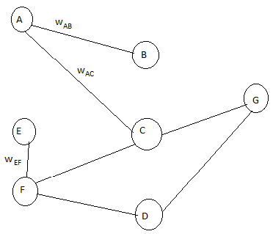
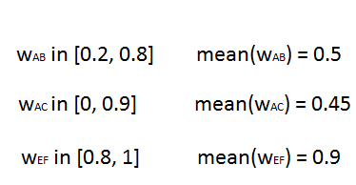
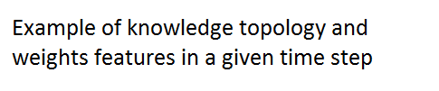
Knowledge

Slide 7
Motivation
Employs the notion of motivational score to model the motivation towards learning about each concept
A function of:
The underlying confusion intervals for the connections related to the concept
The rewards for the tasks that use the concept
Used to determine which concepts can enter the working memory

Slide 8
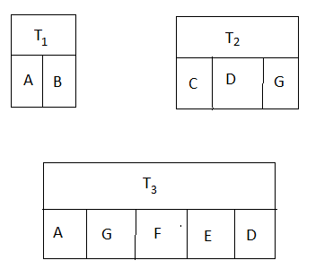

Motivation
Consider $w_{ab}$ , $w_{ac}$ , $T_{1}$ and $T_{3}$ when computing motivational score of concept A

Slide 9
Working Memory
Also a weighted graph but with a limit to the number of concepts
Concepts with motivational scores above a preset threshold may enter working memory
The threshold is called awareness threshold (AT)
Randomly selected from a uniform distribution
Different agents have different AT
AT for each concept is the same
The learning process occurs when an agent receives taught knowledge (represented as a sub-graph)
Agents do not copy information from a sub-graph – they adjust their own knowledge based on it!

Slide 10
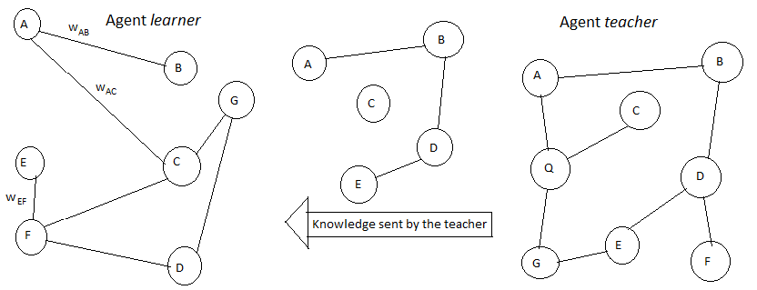
Working Memory
Agent can learn new connections or update connections between existing concepts by learning from another agent

Slide 11
Knowledge Decay
An agent’s unused knowledge on a concept diminishes over time
This is represented by increasing the confusion interval range of edges related to the unused concept
If a concept experiencing weight decay enters working memory, the knowledge decay is stopped

Slide 12
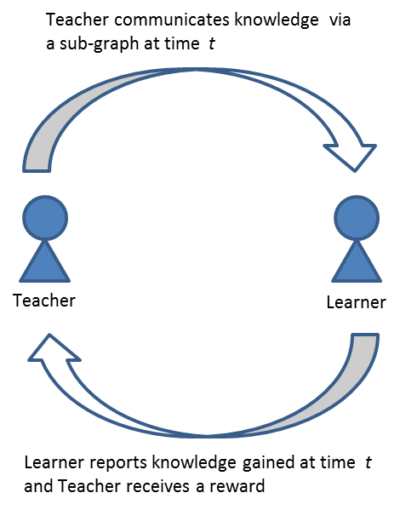
Teacher-Learner Interaction
Teacher teaches (i.e. communicates a subgraph to) the Learner
Learner informs the Teacher of the amount of knowledge learned during the same time step
Teacher receives an immediate reward based on amount learned (i.e. change in confusion interval) and the Learner’s current task

Slide 13
Overview
ULM Adaptation
Simulation Scenario
Agent Design Strategy
Experiments and Results
Conclusions and Future Work

Slide 14
Simulation Scenario
Environment consists of a set of agents with different initial knowledge topologies
The goal of each agent is to maximize rewards earned
Agents can learn or teach during each time step
At the end of each time step, each agent checks to see whether it can solve its current task
If it succeeds, it obtains a reward
If it fails some number of times, it abandons the task
All tasks are available to all agents at all times, except tasks that are already solved or abandoned (no repeats)

Slide 15
Task Representation
Task are represented with weighted graph
Nodes represent knowledge concepts
Edges represent the connections between concepts
Edge weights specify the target weight values
No “confusion interval” for edge weights
Reward
Reward is computed using a base reward, # of concepts used in the task, and # of edges required by the task
All or nothing – the agent either gets the full reward or nothing (no partial reward)

Slide 16
Task Pool
Fixed number of tasks
Randomly generated at the start of the simulation
Task generation process
Randomly decide on # of edges to use for the task
Randomly select edges between any pair of concepts until the # of edges from the previous step has been reached
Generate a random number in the interval [0, 1] (uniform distribution) for each edge to use as the edge weight
Calculate the reward based on the weighted graph formed from the previous steps

Slide 17
Overview
ULM Adaptation
Simulation Scenario
Agent Design Strategy
Experiments and Results
Conclusions and Future Work

Slide 18
Agent Design Strategy
Learning and Teaching
Task Selection and Performance
Determining an Action
Desired Emergent Behavior

Slide 19
Learning and Teaching
An agent must choose between teaching and learning during a tick
One teacher is paired with one learner
Learners
Adjust confusion interval center and range from learning
Gets no immediate rewards from learning but knowledge is refined
Extra learners lose the opportunity to learn
Teachers
Receive rewards from teaching and confusion interval range is updated (but not center)
Extra teachers lose the opportunity to teach and do not get a reward

Slide 20
Task Selection and Performance
Agents choose a current task via random selection from tasks not yet solved or abandoned
Completing a task
Agent instantiates weight values for each of the edges in the task description
Values taken from the edge’s confusion interval
Uniform distribution
Compute distance between the weights in task description and instantiated weights
If the distance for every edge is below a fixed upper bound, then the task is solved

Slide 21
Determining an Action
During each time step, the agent probabilistically determines whether to teach or learn
Probabilities of teaching or learning are determined randomly at the start
Probability of learning = random number in [0, 1]
Probability of teaching = 1 – probability of learning
If the agent learned in the previous step, increase the probability of teaching
If the agent taught in the previous step, increase the probability of teaching

Slide 22
Desired Emergent Behavior
The desired emergent behavior is for the agents to maximize the cumulative reward of the community at the end of the simulation through teaching and learning, with overall confusion interval sizes for all task-related concepts being minimized

Slide 23
Overview
ULM Adaptation
Simulation Scenario
Agent Design Strategy
Experiments and Results
Conclusions and Future Work

Slide 24
Hypothesis #1
Reducing working memory size for all agents will result in reduced cumulative community reward. On the other hand, increasing working memory size will result in increased cumulative community reward.
Learning about a variety of concepts, e.g. forming, shifting, and tightening confusion intervals, will be inhibited with a reduced working memory since fewer simultaneous connections can be made in one tick
With a reduced WM, more ticks must be spent to acquire the connections that a larger WM can create within a smaller time frame.

Slide 25
Hypothesis #2
When the number of concepts in the simulation increases, the average confusion interval ranges across all edges for all agents will be larger compared to interval ranges when it is smaller, regardless of the number of tasks generated and their requirements.
Due to probabilistic decision making, randomness in teacher-learner matching, and limited WM size, an agent is unlikely to repeatedly refine a given edge’s confusion interval
Learning cannot be targeted towards concepts relevant to tasks, so task number and requirements are irrelevant.

Slide 26
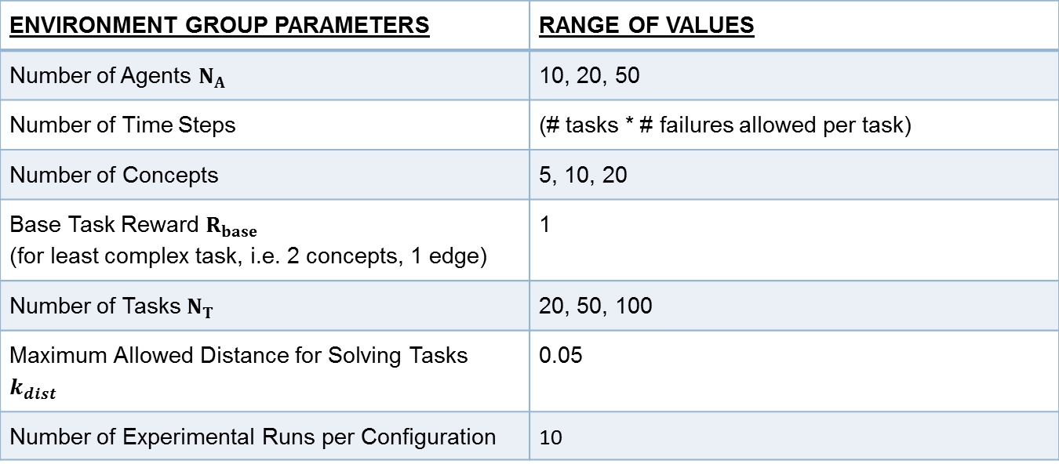
Experiments
ENVIRONMENT GROUP PARAMETERS | RANGE OF VALUES
Number of Agents $N_{A}$ | 10, 20, 50
Number of Time Steps | (# tasks * # failures allowed per task)
Number of Concepts | 5, 10, 20
Base Task Reward $R_{base}$ (for least complex task, i.e. 2 concepts, 1 edge) | 1
Number of Tasks $N_{T}$ | 20, 50, 100
Maximum Allowed Distance for Solving Tasks $k_{dist}$ | 0.05
Number of Experimental Runs per Configuration | 10

Slide 27
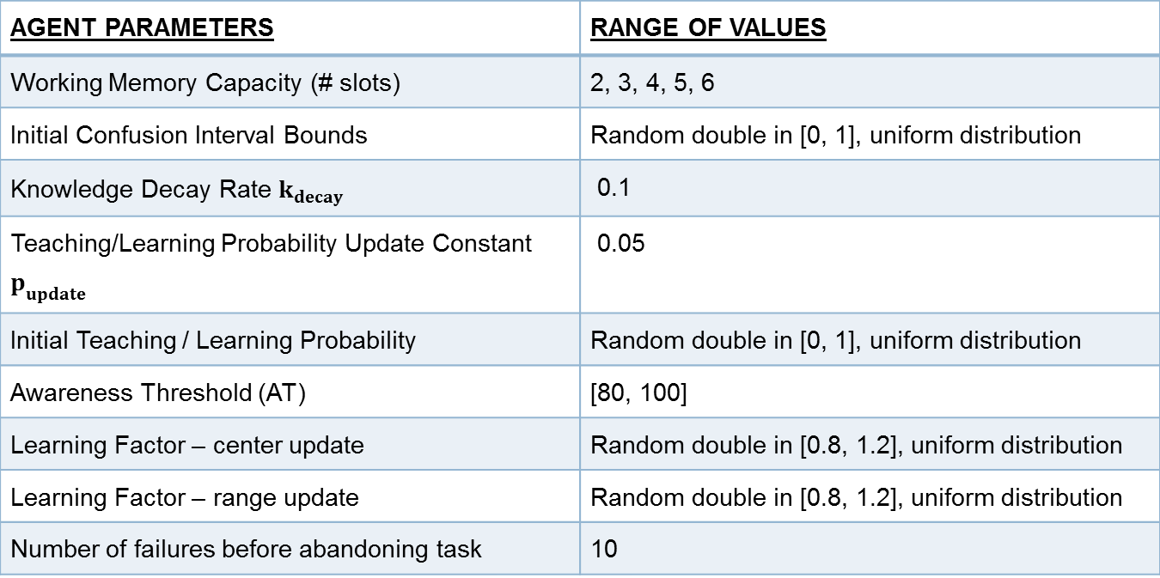
Experiments
AGENT PARAMETERS | RANGE OF VALUES
Working Memory Capacity (# slots) | 2, 3, 4, 5, 6
Initial Confusion Interval Bounds | Random double in [0, 1], uniform distribution
Knowledge Decay Rate $k_{decay}$ | 0.1
Teaching/Learning Probability Update Constant $p_{update}$ | 0.05
Initial Teaching / Learning Probability | Random double in [0, 1], uniform distribution
Awareness Threshold (AT) | [80, 100]
Learning Factor – center update | Random double in [0.8, 1.2], uniform distribution
Learning Factor – range update | Random double in [0.8, 1.2], uniform distribution
Number of failures before abandoning task | 10

Slide 28
Results – General Observations
Low overall task completion rate – average of 9.9% across all configurations and trials
Knowledge updates are dominated by the motivation score term
Biggest problem arising from this: confusion interval ranges shrink too fast
mscore can grow infinitely large with more tasks and concepts whereas other terms are bounded in [0, 1]
Current attempts to curb the value of the term have been unsuccessful

Slide 29
Results – Hypothesis #1
WM Capacity vs. Community Reward: # Concepts = 5, # Agents = 10

Slide 30
Results – Hypothesis #1
WM Capacity vs. Community Reward: # Concepts = 10, # Agents = 10

Slide 31
Results – Hypothesis #1
WM Capacity vs. Community Reward: # Concepts = 20, # Agents = 10

Slide 32
Results – Hypothesis #1
Cumulative community reward generally appears to increase with WM capacity
Greatest increase between 3-4 and 4-5 WM slots
Hypothesis tentatively supported – more experiments needed

Slide 33
Results – Hypothesis #2
# Concepts vs. Average Confusion Interval Range: # Agents = 10, WM Capacity = 4

Slide 34
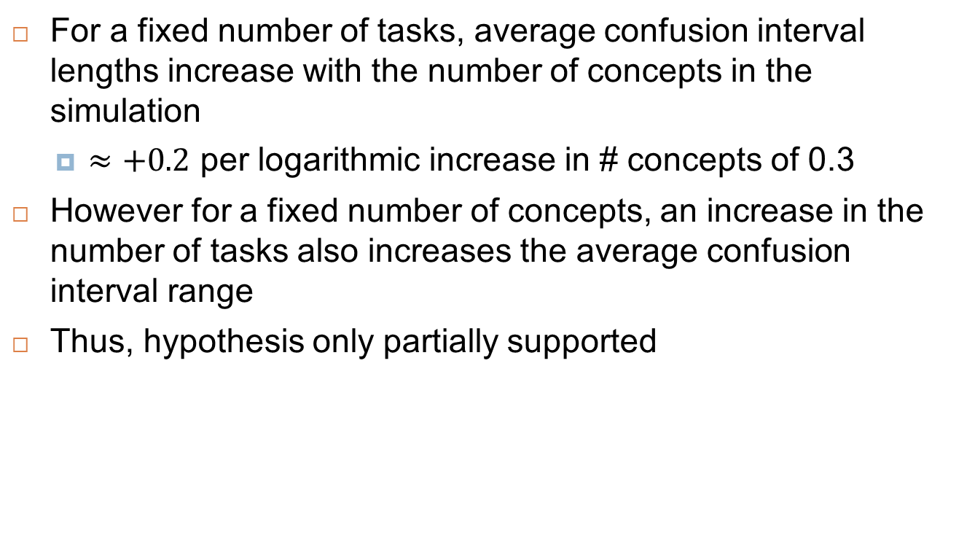
Results – Hypothesis #2
For a fixed number of tasks, average confusion interval lengths increase with the number of concepts in the simulation
$≈+0.2$ per logarithmic increase in # concepts of 0.3
However for a fixed number of concepts, an increase in the number of tasks also increases the average confusion interval range
Thus, hypothesis only partially supported

Slide 35
Overview
ULM Adaptation
Simulation Scenario
Agent Design Strategy
Experiments and Results
Conclusions and Future Work

Slide 36
Future Work
Knowledge Chunking
Improved Action Selection
Improved Task Selection and Agent Matching
Additional Knowledge Update Factors
Teacher motivation
Confusion from learning unexpected values
Knowledge momentum
Task Solution Quality
Learner Performance-based Teaching Reward

Slide 37
Conclusions
Promising start for ULM agents
Minimal benchmark agents behave (mostly) as anticipated
The primary issue to resolve is the unbounded motivation-based component of knowledge updates
Plenty of opportunities for future improvements

Slide 38

Question

Slide 39
References
Shell D. F. et al. (2010) – The Unified Learning Model: How Motivational, Cognitive, and Neurobiological Sciences Inform Best Teaching Practices, Springer

