Slide 1
Poker Agents
LD Miller & Adam Eck May 3, 2011

Slide 2
Motivation
Classic environment properties of MAS
Stochastic behavior (agents and environment)
Incomplete information
Uncertainty
Application Examples
Robotics
Intelligent user interfaces
Decision support systems

Slide 3
Overview
Background
Methodology (Updated)
Results (Updated)
Conclusions (Updated)

Slide 4







Background| Texas Hold’em Poker
Games consist of 4 different steps
Actions: bet (check, raise, call) and fold
Bets can be limited or unlimited
private cards
community cards
(1) pre-flop
(2) flop
(3) turn
(4) river
Background
Methodology
Results
Conclusions

Slide 5
Background| Texas Hold’em Poker
Significant worldwide popularity and revenue
World Series of Poker (WSOP) attracted 63,706 players in 2010 (WSOP, 2010)
Online sites generated estimated $20 billion in 2007 (Economist, 2007)
Has fortuitous mix of strategy and luck
Community cards allow for more accurate modeling
Still many “outs” or remaining community cards which defeat strong hands
Background
Methodology
Results
Conclusions

Slide 6



Background| Texas Hold’em Poker
Strategy depends on hand strength which changes from step to step!
Hands which were strong early in the game may get weaker (and vice-versa) as cards are dealt
private cards
community cards
raise!
raise!
check?
fold?
Background
Methodology
Results
Conclusions

Slide 7
Background| Texas Hold’em Poker
Strategy also depends on betting behavior
Three different types (Smith, 2009):
Aggressive players who often bet/raise to force folds
Optimistic players who often call to stay in hands
Conservative or “tight” players who often fold unless they have really strong hands
Background
Methodology
Results
Conclusions

Slide 8
Methodology| Strategies
Solution 2: Probability distributions
Hand strength measured using Poker Prophesier (http://www.javaflair.com/pp/)
Behavior | Weak | Medium | Strong
Aggressive | [0…0.2) | [0.2…0.6) | [0.6…1)
Optimistic | [0…0.5) | [0.5…0.9) | [0.9…1)
Conservative | [0…0.3) | [0.3…0.8) | [0.8…1)
(1) Check hand strength for tactic
Tactic | Fold | Call | Raise
Weak | [0…0.7) | [0.7…0.95) | [0.95…1)
Medium | [0…0.3) | [0.3…0.7) | [0.7…1)
Strong | [0…0.05) | [0.05…0.3) | [0.3…1)
(2) “Roll” on tactic for action
Background
Methodology
Results
Conclusions

Slide 9
Methodology| Deceptive Agent
Problem 1: Agents don’t explicitly deceive
Reveal strategy every action
Easy to model
Solution: alternate strategies periodically
Conservative to aggressive and vice-versa
Break opponent modeling (concept shift)
Background
Methodology
Results
Conclusions

Slide 10
Methodology| Explore/Exploit
Problem 2: Basic agents don’t adapt
Ignore opponent behavior
Static strategies
Solution: use reinforcement learning (RL)
Implicitly model opponents
Revise action probabilities
Explore space of strategies, then exploit success
Background
Methodology
Results
Conclusions

Slide 11
Methodology| Active Sensing
Opponent model = knowledge
Refined through observations
Betting history, opponent’s cards
Actions produce observations
Information is not free
Tradeoff in action selection
Current vs. future hand winnings/losses
Sacrifice vs. gain
Background
Methodology
Results
Conclusions

Slide 12

Methodology| Active Sensing
Knowledge representation
Set of Dirichlet probability distributions
Frequency counting approach
Opponent state sº = their estimated hand strength
Observed opponent action aº
Opponent state
Calculated at end of hand (if cards revealed)
Otherwise 1 – s
Considers all possible opponent hands
Background
Methodology
Results
Conclusions

Slide 13
Methodology| BoU
Problem: Different strategies may only be effective against certain opponents
Example: Doyle Brunson has won 2 WSOP with 7-2 off suit―worst possible starting hand
Example: An aggressive strategy is detrimental when opponent knows you are aggressive
Solution: Choose the “correct” strategy based on the previous sessions
Background
Methodology
Results
Conclusions

Slide 14
Methodology| BoU
Approach: Find the Boundary of Use (BoU) for the strategies based on previously collected sessions
BoU partitions sessions into three types of regions (successful, unsuccessful, mixed) based on the session outcome
Session outcome―complex and independent of strategy
Choose the correct strategy for new hands based on region membership
Background
Methodology
Results
Conclusions

Slide 15
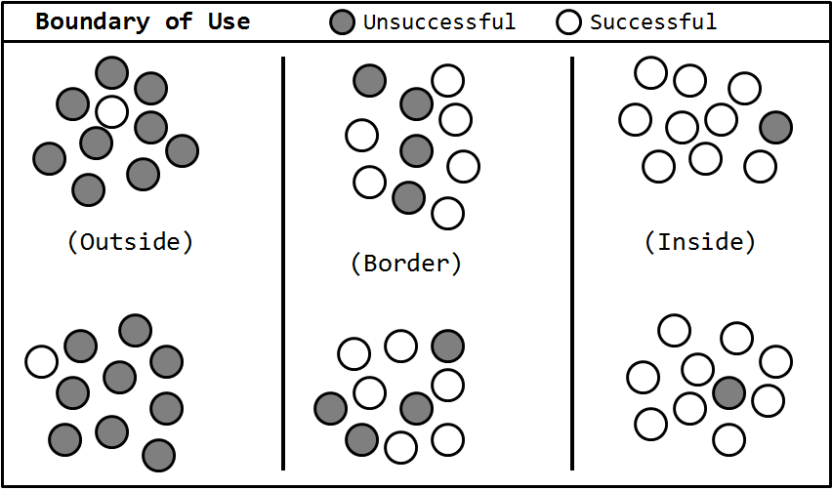
Methodology| BoU
BoU Example
Ideal: All sessions inside the BoU
Strategy
Correct
Strategy
Incorrect
Strategy
?????
Background
Methodology
Results
Conclusions

Slide 16
Methodology| BoU
BoU Implementation
k-Mediods clustering semi-supervised clustering
Similarity metric needs to be modified to incorporate action sequences AND missing values
Number of clusters found automatically balancing cluster purity and coverage
Session outcome
Uses hand strength to compute the correct decision
Model updates
Adjust intervals for tactics based on sessions found in mixed regions
Background
Methodology
Results
Conclusions

Slide 17
Results| Overview
Validation (presented previously)
Basic agent vs. other basic
RL agent vs. basic agents
Deceptive agent vs. RL agent
Investigation
AS agent vs. RL /Deceptive agents
BoU agent vs. RL/Deceptive agents
AS agent vs. BoU agent
Ultimate showdown
Background
Methodology
Results
Conclusions

Slide 18
Results| Overview
Hypotheses (research and operational)
Hypo. | Summary | Validated? | Section
R1 | AS agents will outperform non-AS... | ??? | 5.2.1
R2 | Changing the rate of exploration in AS will... | ??? | 5.2.1
R3 | Using the BoU to choose the correct strategy... | ??? | 5.2.3
O1 | None of the basic strategies dominates | ??? | 5.1.1
O2 | RL approach will outperform basic...and Deceptive will be somewhere in the middle... | ??? | 5.1.2-3
O3 | AS and BoU will outperform RL | ??? | 5.2.1-2
O4 | Deceptive will lead for the first part of games... | ??? | 5.2.1-2
O5 | AS will outperform BoU when BoU does not have any data on AS | ??? | 5.2.3
Background
Methodology
Results
Conclusions

Slide 19
Results| RL Validation
Matchup 1: RL vs. Aggressive
HS | Fold | Call | Raise
1 | 0.1013 | 0.8607 | 0.0380
2 | 0.3005 | 0.6568 | 0.0427
3 | 0.2841 | 0.6815 | 0.0344
4 | 0.3542 | 0.5064 | 0.1393
5 | 0.1827 | 0.6828 | 0.1345
6 | 0.1727 | 0.6857 | 0.1417
7 | 0.0530 | 0.8848 | 0.0622
8 | 0.0084 | 0.9784 | 0.0133
9 | 0.0012 | 0.1130 | 0.8858
10 | 0.0003 | 0.0715 | 0.9281
Background
Methodology
Results
Conclusions

Slide 20
Results| RL Validation
Matchup 2: RL vs. Optimistic
HS | Fold | Call | Raise
1 | 0.1749 | 0.7913 | 0.0338
2 | 0.1565 | 0.8051 | 0.0384
3 | 0.3565 | 0.5729 | 0.0706
4 | 0.3270 | 0.4298 | 0.2432
5 | 0.2252 | 0.5288 | 0.2460
6 | 0.1460 | 0.4698 | 0.3841
7 | 0.0502 | 0.6198 | 0.3300
8 | 0.0185 | 0.9632 | 0.0183
9 | 0.0187 | 0.8862 | 0.0951
10 | 0.0025 | 0.2616 | 0.7359
Background
Methodology
Results
Conclusions

Slide 21
Results| RL Validation
Matchup 3: RL vs. Conservative
HS | Fold | Call | Raise
1 | 0.2460 | 0.6115 | 0.1425
2 | 0.1944 | 0.6824 | 0.1231
3 | 0.1797 | 0.6426 | 0.1778
4 | 0.1355 | 0.3479 | 0.5166
5 | 0.1616 | 0.4245 | 0.4139
6 | 0.1236 | 0.2571 | 0.6193
7 | 0.1290 | 0.6279 | 0.2431
8 | 0.0652 | 0.7893 | 0.1455
9 | 0.0429 | 0.5842 | 0.3729
10 | 0.0090 | 0.4973 | 0.4937
Background
Methodology
Results
Conclusions

Slide 22
Results| RL Validation
Matchup 4: RL vs. Deceptive
HS | Fold | Call | Raise
1 | 0.4108 | 0.5734 | 0.0158
2 | 0.1835 | 0.7104 | 0.1062
3 | 0.0849 | 0.8385 | 0.0766
4 | 0.2641 | 0.5450 | 0.1909
5 | 0.1207 | 0.5989 | 0.2804
6 | 0.0799 | 0.5297 | 0.3903
7 | 0.0846 | 0.8401 | 0.0752
8 | 0.0266 | 0.9419 | 0.0315
9 | 0.0413 | 0.8782 | 0.0805
10 | 0.0167 | 0.4684 | 0.5149
Background
Methodology
Results
Conclusions

Slide 23
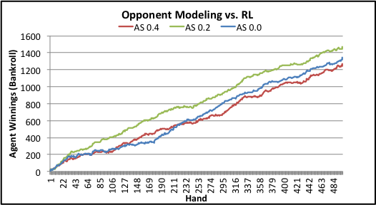
Results| AS Results
All opponent modeling approaches defeat
Explicit modeling better than implicit
AS with ε= 0.2 improves over non-AS due to additional sensing
AS with ε= 0.4 senses too much, resulting in too many lost hands
Background
Methodology
Results
Conclusions

Slide 24
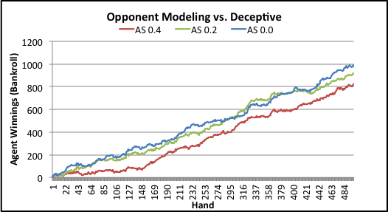
Results| AS Results
All opponent modeling approaches defeat Deceptive
Can handle concept shift AS
AS with ε= 0.2 similar to non-AS
Little benefit from extra sensing
Again AS with ε= 0.4 senses too much
Background
Methodology
Results
Conclusions

Slide 25
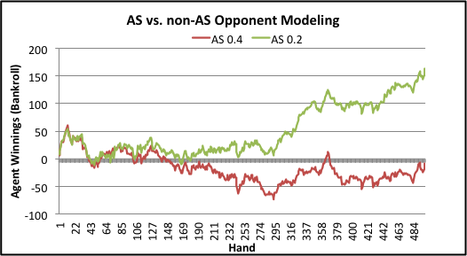
Results| AS Results
AS with ε= 0.2 defeats non-AS
Active sensing provides better opponent model
Overcomes additional costs
Again AS with ε= 0.4 senses too much
Background
Methodology
Results
Conclusions

Slide 26
Results| AS Results
Conclusions
Mixed results for Hypothesis R1
AS with ε= 0.2 better than non-AS against RL and heads-up
AS with ε= 0.4 always worse than non-AS
Confirm Hypothesis R2
ε= 0.4 results in too much sensing which results in more losses when the agent should have folded
Not enough extra sensing benefit to offset costs
Background
Methodology
Results
Conclusions

Slide 27
Results| BoU Results
BoU is crushed by RL ☹
BoU constantly lowers interval for Aggressive
RL learns to be super-tight
Background
Methodology
Results
Conclusions

Slide 28
Results| BoU Results
BoU very close to deceptive
Both use aggressive strategies
BoU’s aggressive is much more reckless after model updates
Background
Methodology
Results
Conclusions

Slide 29
Results| BoU Results
Conclusions
Hypothesis R3 and O3 do not hold
BoU does not outperform deceptive/RL
Model update method
Updates Aggressive strategy to “fix” mixed regions
Results in emergent behavior—reckless bluffing
Bluffing is very bad against a super-tight player
HS | Fold | Call | Raise
1 | 0.202033 | 0.464872 | 0.333095
2 | 0.03513 | 0.929741 | 0.03513
3 | 0.082822 | 0.857834 | 0.059344
4 | 0.290178 | 0.547892 | 0.16193
5 | 0.032236 | 0.14959 | 0.818175
6 | 0.025462 | 0.463111 | 0.511426
7 | 0.026112 | 0.300444 | 0.673444
8 | 0.009666 | 0.913204 | 0.07713
9 | 0.003593 | 0.924241 | 0.072166
10 | 0.148027 | 0.851838 | 0.000135
Background
Methodology
Results
Conclusions

Slide 30
Results| Ultimate Showdown
And the winner is…active sensing (booo)
HS | Fold | Call | Raise
1 | 0.0278 | 0.8611 | 0.1111
2 | 0.2261 | 0.5304 | 0.2435
3 | 0.0145 | 0.8261 | 0.1594
4 | 0.0106 | 0.7660 | 0.2234
5 | 0.0086 | 0.6552 | 0.3362
6 | 0.0103 | 0.6804 | 0.3093
7 | 0.1930 | 0.4891 | 0.3179
8 | 0.0286 | 0.6571 | 0.3143
9 | 0.0233 | 0.5116 | 0.4651
10 | 0.0213 | 0.5106 | 0.4681
Background
Methodology
Results
Conclusions

Slide 31
Conclusion| Summary
AS > RL > Aggressive > Deceptive >= BoU > Optimistic > Conservative
Hypo. | Summary | Validated? | Section
R1 | AS agents will outperform non-AS... | Yes | 5.2.1
R2 | Changing the rate of exploration in AS will... | Yes | 5.2.1
R3 | Using the BoU to choose the correct strategy... | No | 5.2.3
O1 | None of the basic strategies dominates | No | 5.1.1
O2 | RL approach will outperform basic...and Deceptive will be somewhere in the middle... | Yes | 5.1.2-3
O3 | AS and BoU will outperform RL | Yes | 5.2.1-2
O4 | Deceptive will lead for the first part of games... | No | 5.2.1-2
O5 | AS will outperform BoU when BoU does not have any data on AS | Yes | 5.2.3
Background
Methodology
Results
Conclusions

Slide 32

Questions?

Slide 33
References
(Daw et al., 2006) N.D. Daw et. al, 2006. Cortical substrates for exploratory decisions in humans, Nature, 441:876-879.
(Economist, 2007) Poker: A big deal, Economist, Retrieved January 11, 2011, from http://www.economist.com/node/10281315?story_id=10281315, 2007.
(Smith, 2009) Smith, G., Levere, M., and Kurtzman, R. Poker player behavior after big wins and big losses, Management Science, pp. 1547-1555, 2009.
(WSOP, 2010) 2010 World series of poker shatters attendance records, Retrieved January 11, 2011, from http://www.wsop.com/news/2010/Jul/2962/2010-WORLD-SERIES-OF-POKER-SHATTERS-ATTENDANCE-RECORD.html

