Slide 1
Multi-robot systems Maria Gini (work with Elizabeth Jensen, Julio Godoy, Ernesto Nunes, abd James Parker,) Department of Computer Science and Engineering University of Minnesota
March 17, 2015

Slide 2
Main topic for today
Multi-robot systems
Can we use for robots the same methods and algorithms we use for multi-agent systems?
If yes, how? If not, why not?
Are robots the same as agents?
If yes, why? If not, why not?

Slide 3
Robots have a physical body, which requires them to move from location to location subject to the laws of physics.
Have sensors and actuators might not be precise. and are subject to errors and uncertainties.
Have limited power supply.
Might have limited communications, also subject to errors.

Slide 4
Key ideas we will use
Autonomy
Ability to make autonomous decisions in complex environments
[See http://www.nytimes.com/2014/12/16/science/century-long-study-will-examine-effects-of-artificial-intelligence.html?_r=0]
Distributed decision making
Each agent or robot decides, not a central system.
What are the alternatives?
Why do we want distributed decision making?
[See Kiva at Amazon and Symbotic for centralized solutions to warehousing]
Collaboration
We assume Agents have common objectives
Why? What are the alternatives?

Slide 5
Task allocation
Task allocation is ubiquitous in computing and in the real world. For robots it requires solving a Traveling Salesman Problem (TSP).
The objective is to allocate tasks to agents optimize some function (minimize completion time, path costs, etc) in a distributed way.
Many types of task allocation problems:
Number of tasks vs number of robots
Constraints on tasks: spatial, temporal, single agent vs multi-agent, decomposability of tasks, etc
Constraints on agents: single task vs multitask, homogeneous vs heterogeneous, etc.

Slide 6
Allocation of tasks with time constraints
Temporal constraints (time windows) affect the choice of path and the allocation to robots to tasks.
Example of minimization of task completion time. Tasks are done as soon as their time windows allow, path is not minimized.
Task windows
Schedule of tasks allocated
E. Nunes and M.Gini, Multi-robot auctions for allocation of tasks with temporal constraints, AAAI 2015

Slide 7
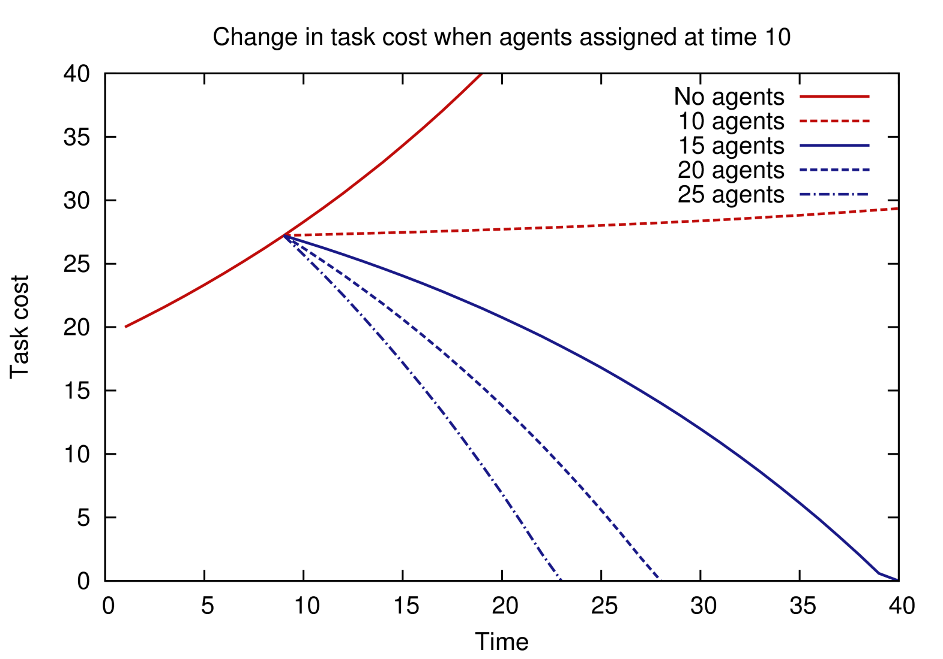


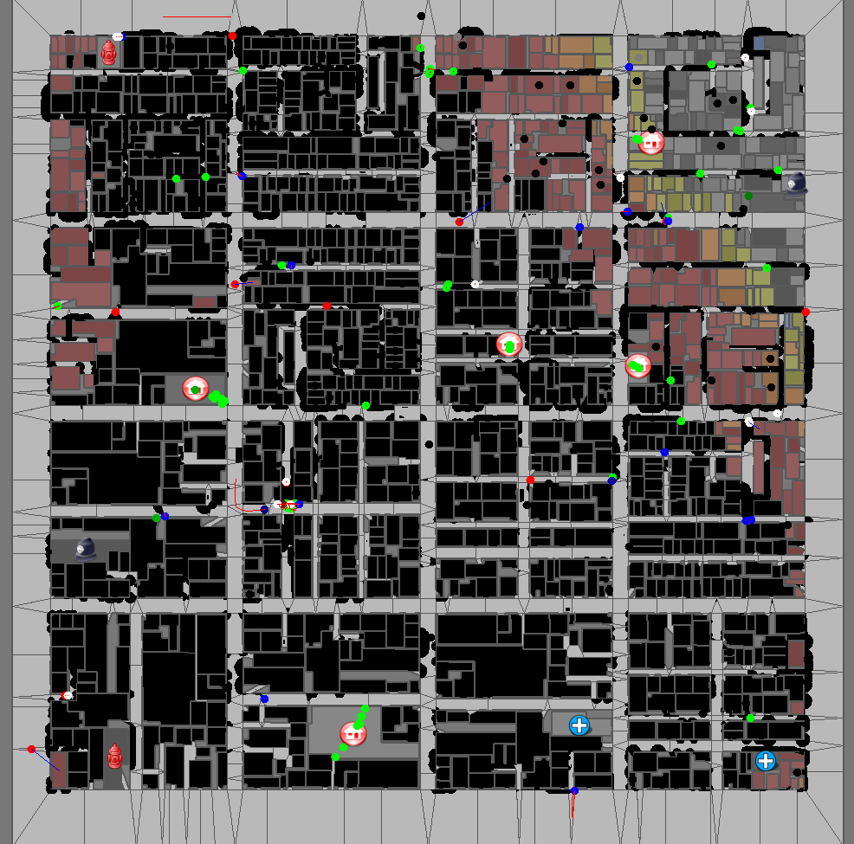
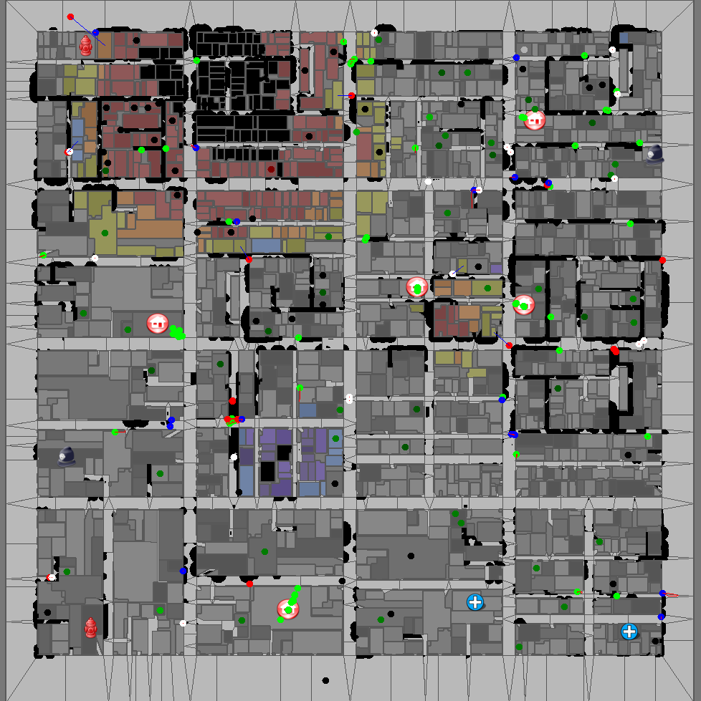
Allocation of tasks with growing costs
Task allocation algorithms assume tasks have a fixed cost. Many tasks have costs that change with time. We model task costs over time as a recurrence relation.
If • agents have fixed work rate •growth function is positive definite convex • travel time is constant • there are more robots than tasks. Theorem: the optimal allocation is to assign agents to tasks with the largest growth (Latest Finishing First).
In practice • growth function is an estimate, • travel time is not constant • new tasks might appear at any time, robots need to be reassigned. A good heuristic is to start from tasks closest to the new ones.
Example in RoboCup Rescue with and without RTLFF
J. Parker and M. Gini, Tasks with Cost Growing over Time and Agent Reallocation Delays, AAMAS 2014

Slide 8
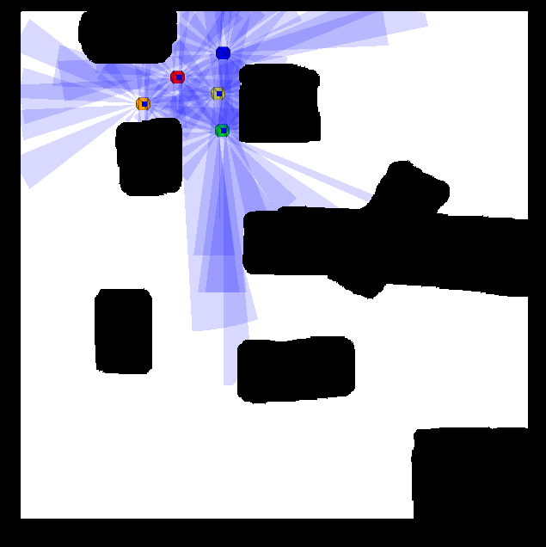

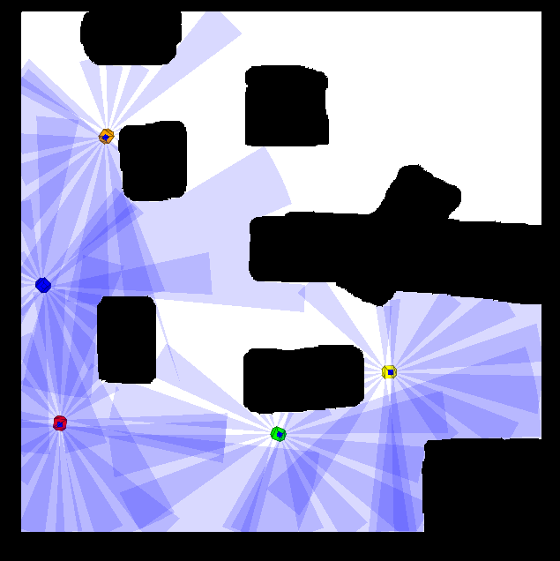

Rolling dispersion of robot teams
The robots have to explore in a systematic way a building looking for survivors. They do not have a map of the building. They disperse as much as possible while maintaining communication, and advance as a group, leaving behind beacons to mark explored areas and provide a path back to the entrance. They continue exploring until the entire environment has been explored, after which they go back to the entrance.
Robot positions at start.
Coverage map at start.
Robots at full coverage
Coverage at full coverage.
E. Jensen and M. Gini ,Rolling Dispersion for Robot Teams,. IJCAI 2013

Slide 9
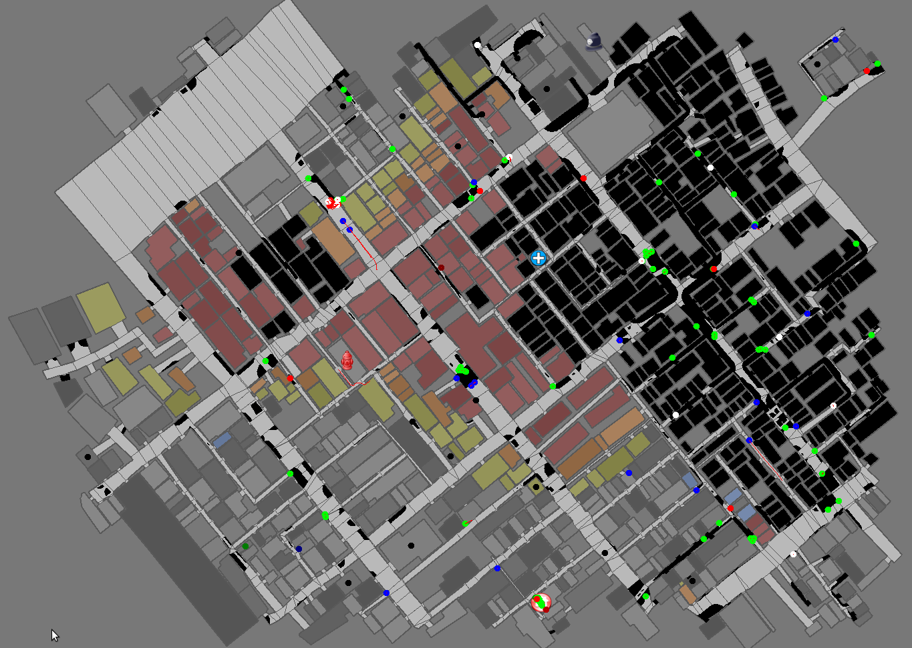
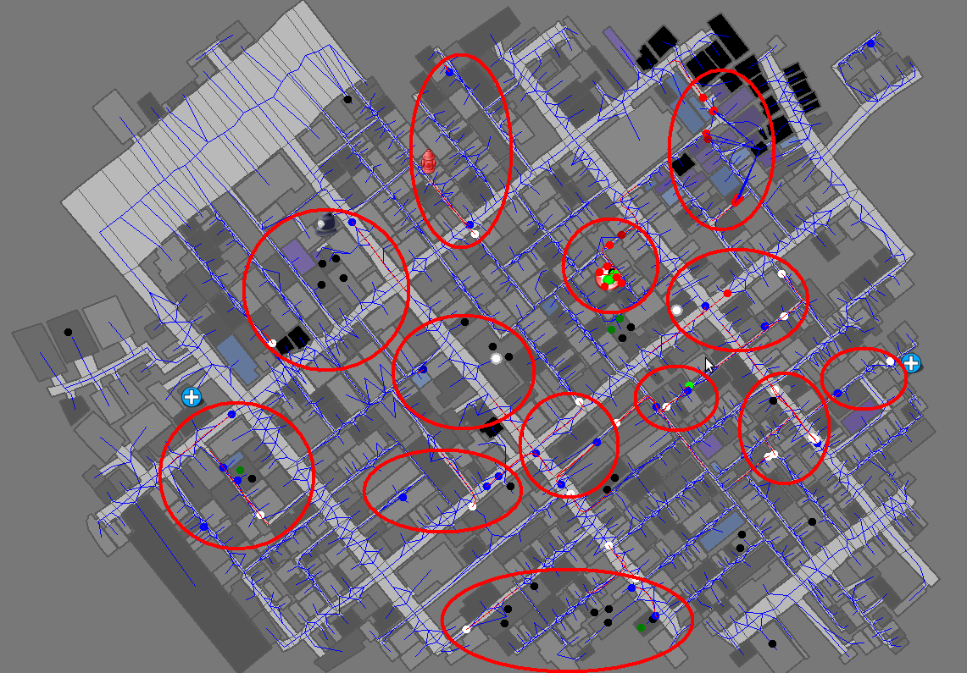
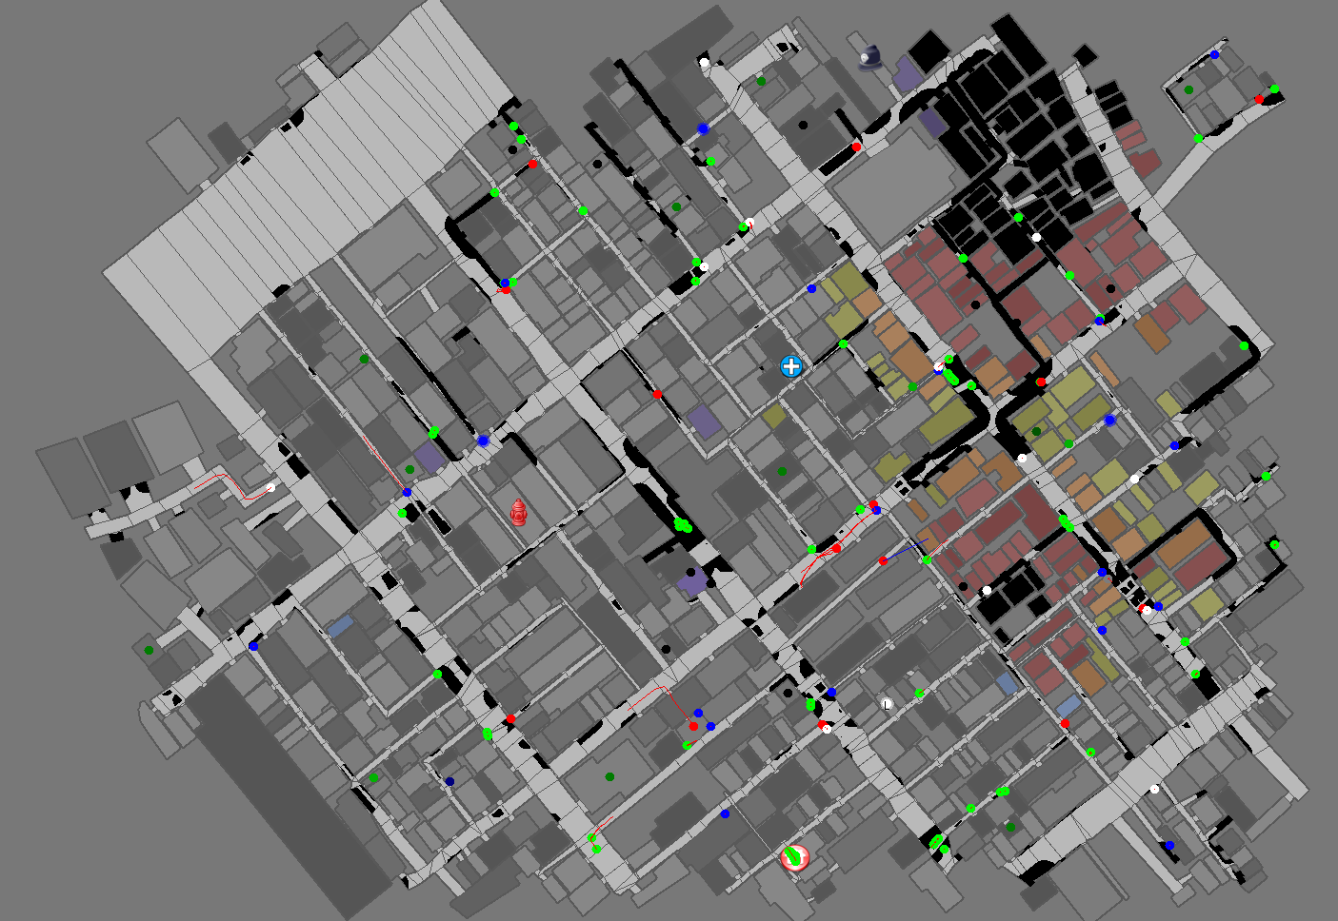
Team work improves performance
Team work improves agents performance and prevents fire spread. Different ways of creating teams have different success rates.
J. Parker, E. Nunes, J. Godoy, M. Gini, Forming Long Term Teams to Exploit Synergies Among Heterogeneous Agents, Tech Report 12-016

Slide 10
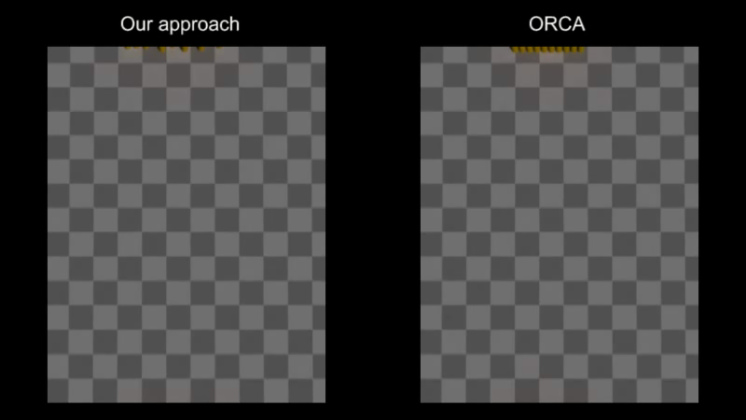
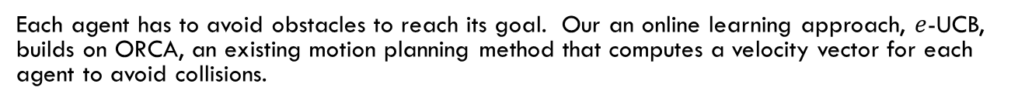
Motion of robots or agents in crowds
Each agent has to avoid obstacles to reach its goal. Our an online learning approach, $e$-UCB, builds on ORCA, an existing motion planning method that computes a velocity vector for each agent to avoid collisions.
J. Godoy, I. Karamouzas, S.J. Guy, and M. Gini, Adaptive Learning for Multi Agent Navigation, AAAI 2015

Slide 11
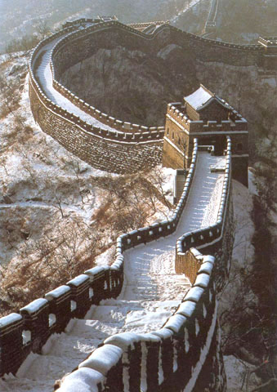
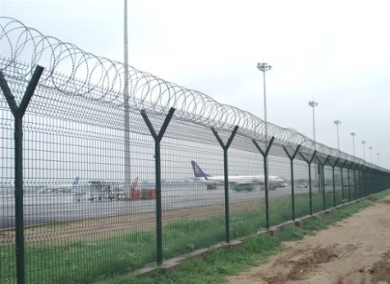
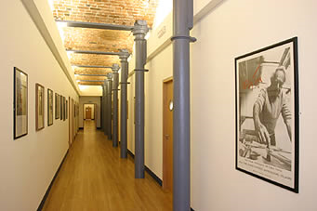
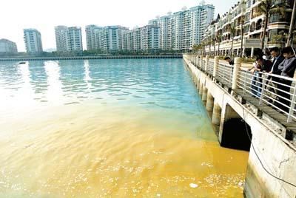

Patrolling a fence with a robot team
Repeated coverage along an open polyline
Guarantee uniformity of coverage
Maximize the frequency with which a point is visited.
How do we maintain a multi-robot patrol of the open polyline, given that the robots will need to be recharged or occasionally replaced?
E. Jensen, M. Franklin, S. Lahr, and M. Gini, Sustainable Multi-Robot Patrol of an Open Polyline, ICRA 2011

Slide 12
Conclusions
Presented a broad overview of problems and open issues in multi-robot systems.
Outlined various research projects that use multiple robots for different tasks.
Tried to show the commonality among approaches and how they build on fundamental computer science algorithms.
Thank you !
For more information go to www.cs.umn.edu/~gini or
email gini@cs.umn.edu

